Slide 1


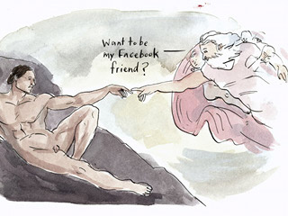
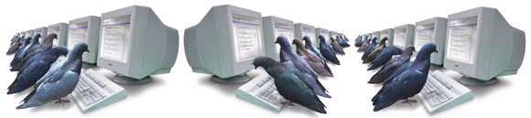

CSE 494/598
Information Retrieval, Mining and Integration on the Internet

Slide 2
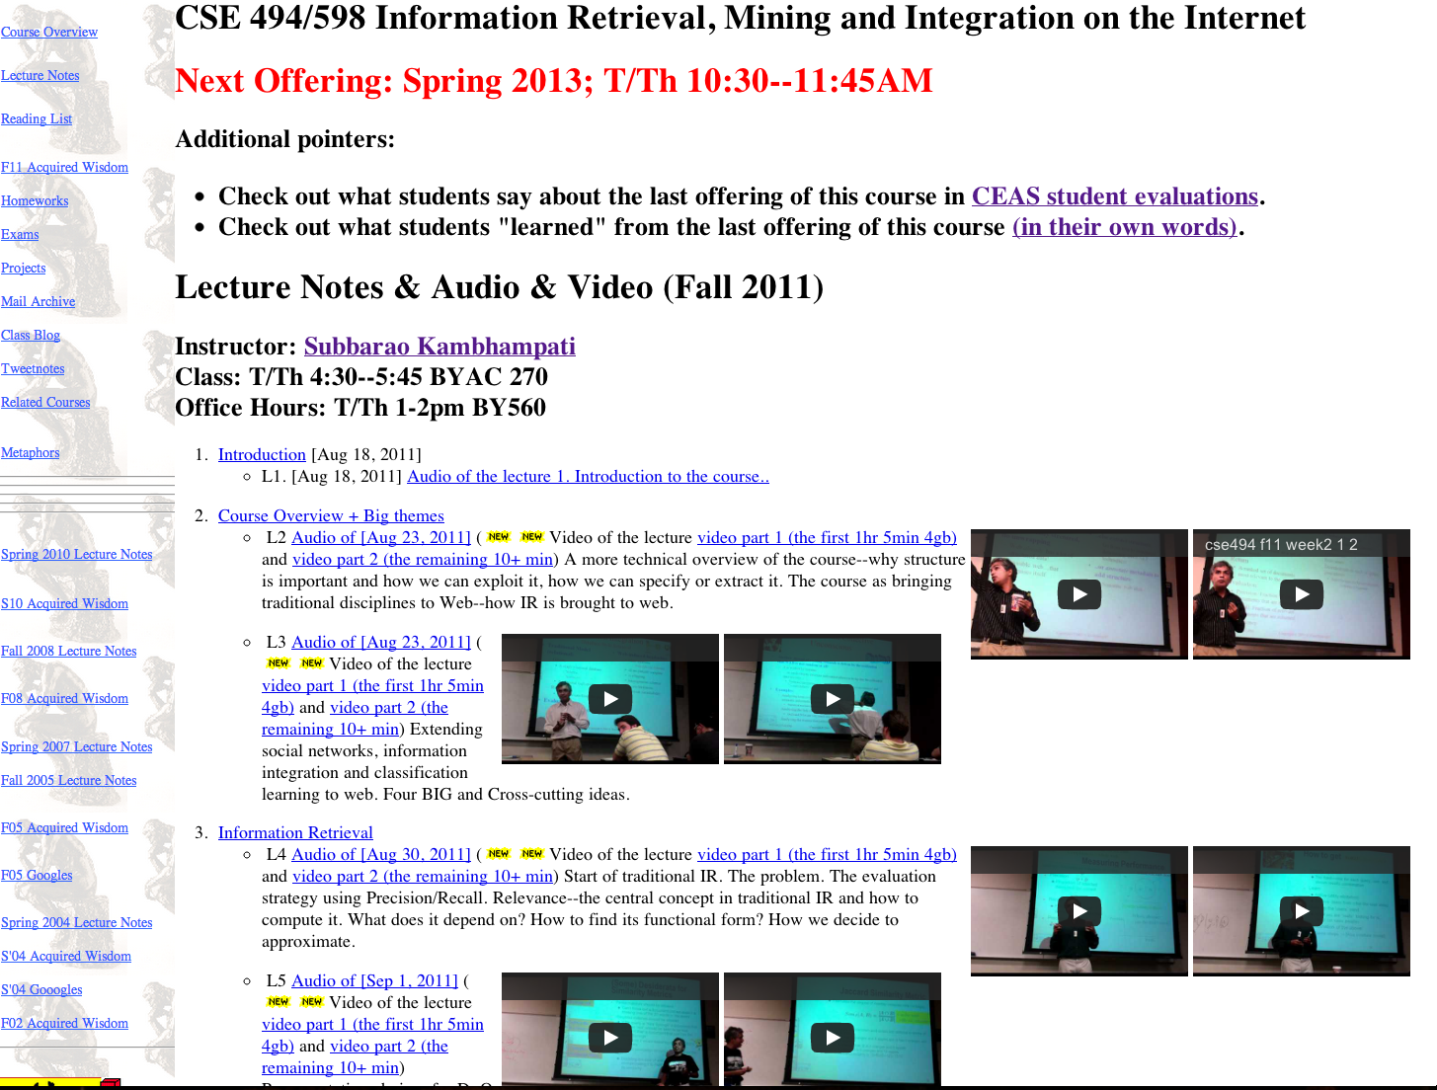
Contact Info
Instructor: Subbarao Kambhampati (Rao)
  Email: rao@asu.edu
  URL: rakaposhi.eas.asu.edu/rao.html
  Course URL: rakaposhi.eas.asu.edu/cse494
  Class: Friday 9-11:45AM SCOB 210
  Office hours: TBD
  Class Forum on PIAZZA
    Most of you received invitations..
TA(s):
  Tejas Mallapura
  Vamsi Meduri
  Office hours: TBD
Webpage *NOT* on Blackboard
Just google “asu 494” or “cse 494”
or “asu ir” or “rao 494” ...

Slide 3
What are your web dreams?
Some people see things as they are
and say why?
I dream things that never were
and say why not?
(mis)attributed to Robert F. Kennedy
who paraphrased Bernard Shaw

Slide 4
  Read all the web & remember what information is where
  Be able to reason about connections between information
  Read my mind and answer questions (or better yet) satisfy my needs, even before I articulate them
How close is this dream to reality?
Are we being too easy on our search
engines?

Slide 5
Web as a collection of information
Web viewed as a large collection of__________
  Text, Structured Data, Semi-structured data
  (connected) (dynamically changing) (user generated) content
  (multi-media/Updates/Transactions etc. ignored for now)
So what do we want to do with it?
  Search, directed browsing, aggregation, integration, pattern finding
How do we do it?
  Depends on your model (text/Structured/semi-structured)

Slide 6
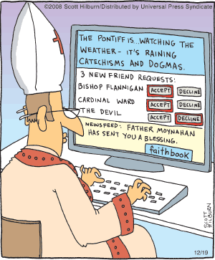
Course Outcomes
After this course, you should be able to answer:
  How search engines work and why are some better than others
  Can web be seen as a collection of (semi)structured data/knoweldge bases?
  Can useful patterns be mined from the pages/data of the web?
  Can we exploit the connectedness of the web pages?

Slide 7
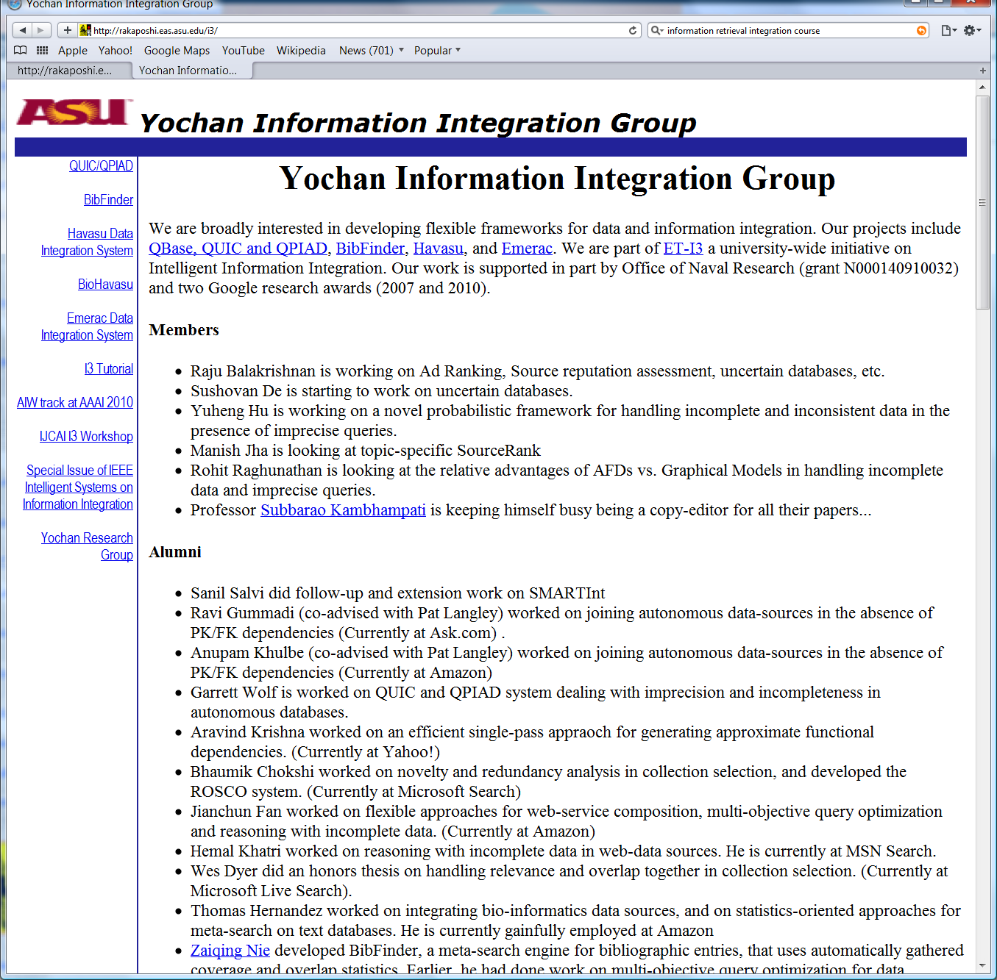
About the Instructor
Mid-life Schizophrenia
  Plan-yochan: Planning, Scheduling, CSP, a bit of learning etc.
  Db-yochan: Information integration, retrieval, mining etc. rakaposhi.eas.asu.edu/i3
    Did a fair amount of publications, tutorials and workshop organization. Had students who did even better ☺
      Nie→Microsoft Research; Nambiar→IBM Research Labs
        Khatri,Chokshi→Bing..; Kalavagattu→Yahoo!
        Hernandez, Fan, Khulbe, Jha, Gummadi →Amazon

Slide 8
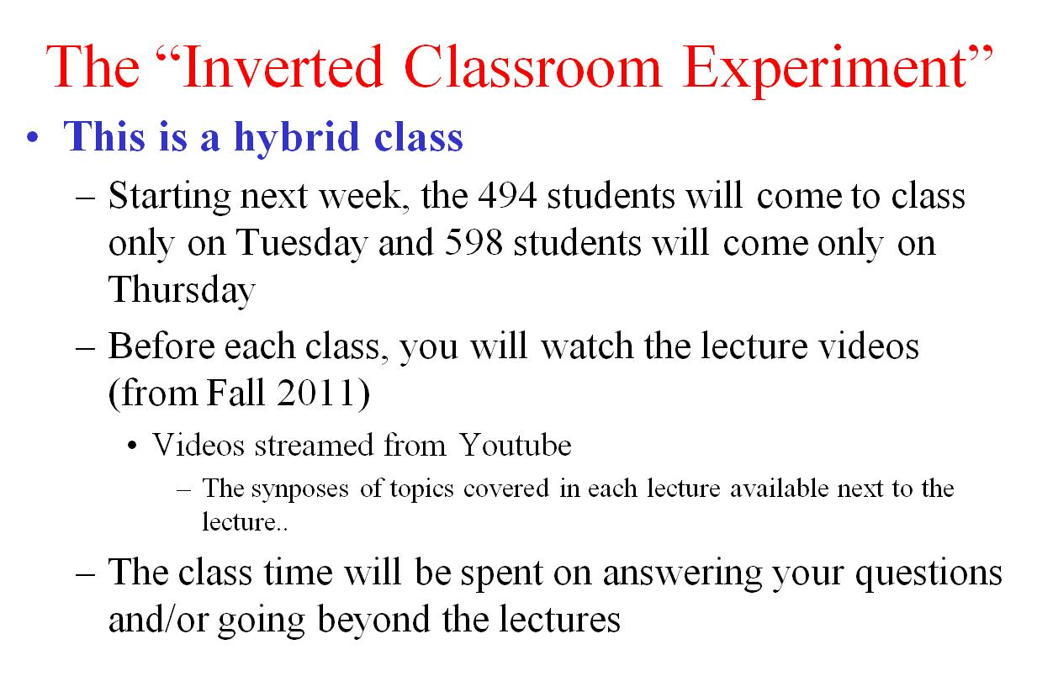

Slide 9
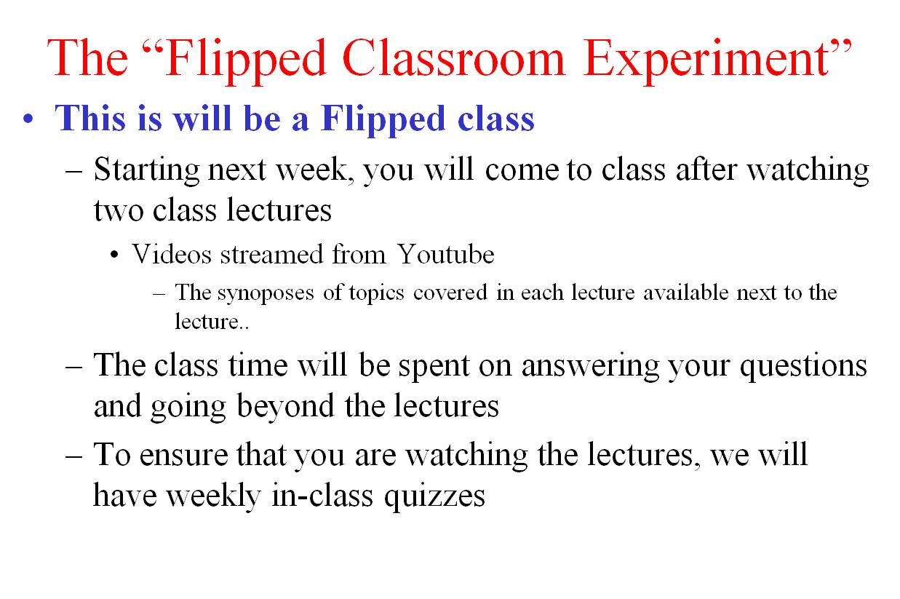

Slide 10
The “Flipped Classroom Experiment”
This will be a Flipped class
  Starting next week, you will come to class after watching two class lectures
    Videos streamed from Youtube
      The synoposes of topics covered in each lecture available next to the lecture..
  The class time will be spent on
    An in-class clicker-based quiz
      With quiz questions interspersed with discussion; answering your questions, redoing portions of the lectures as needed
    In-class exercises,
    (Maybe) and going beyond the lectures
      Short presentations on state-of-the-art techniques from WWW 2013-4/SIGIR 2013-14 etc.
5$

Slide 11
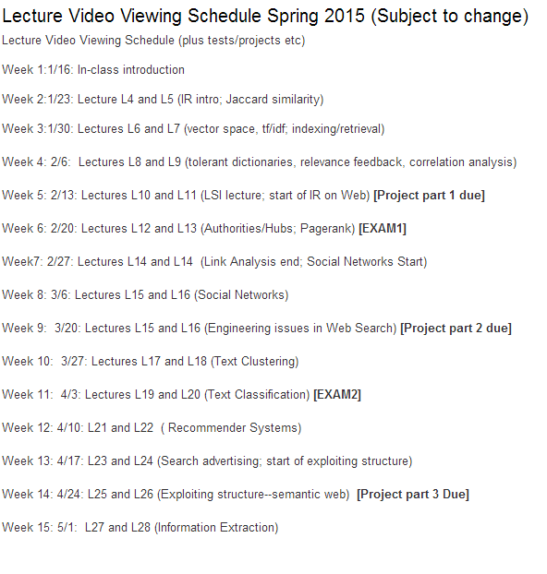

Slide 12
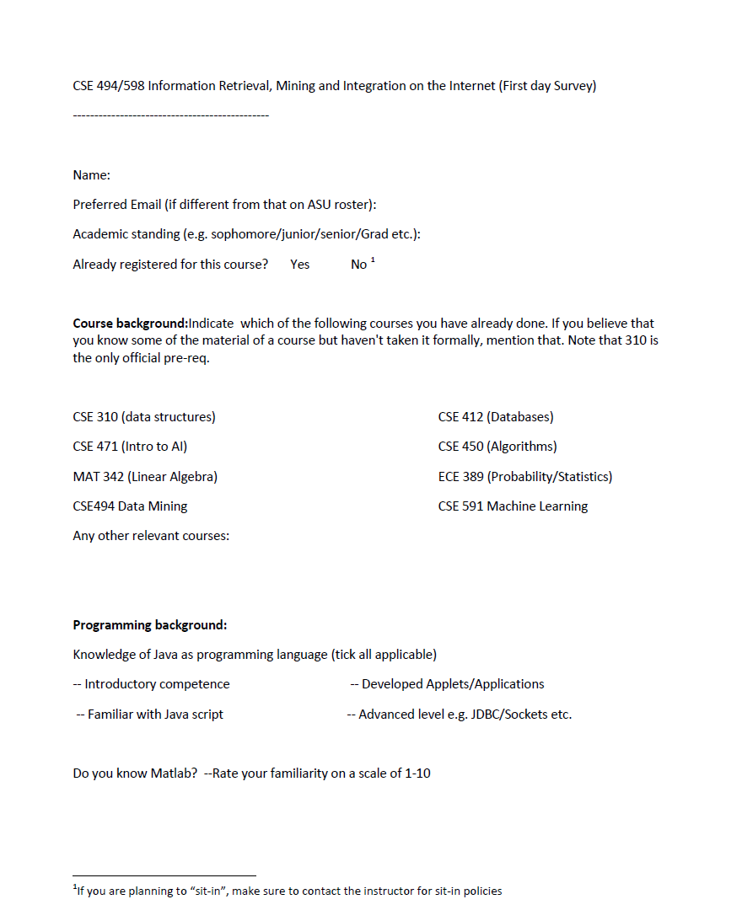
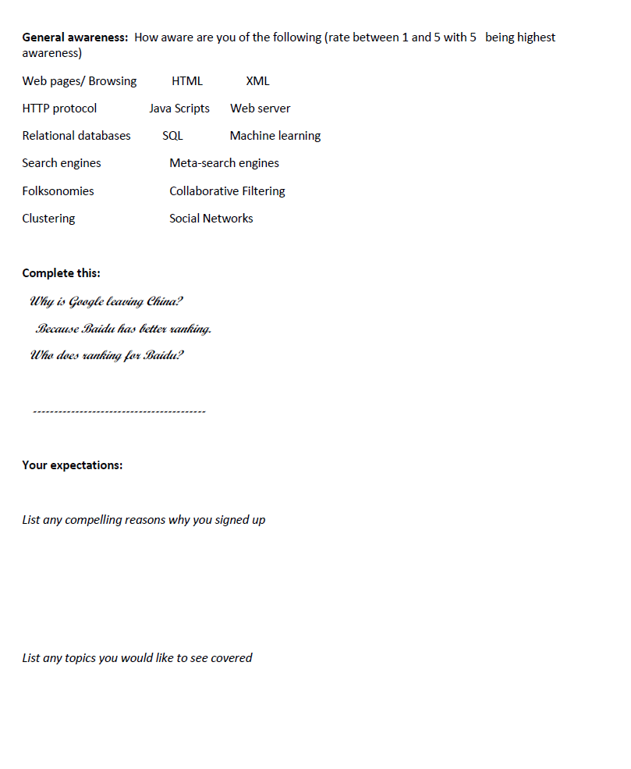

About You
Hu does! ☺
Fill and Return by the end of the class

Slide 13
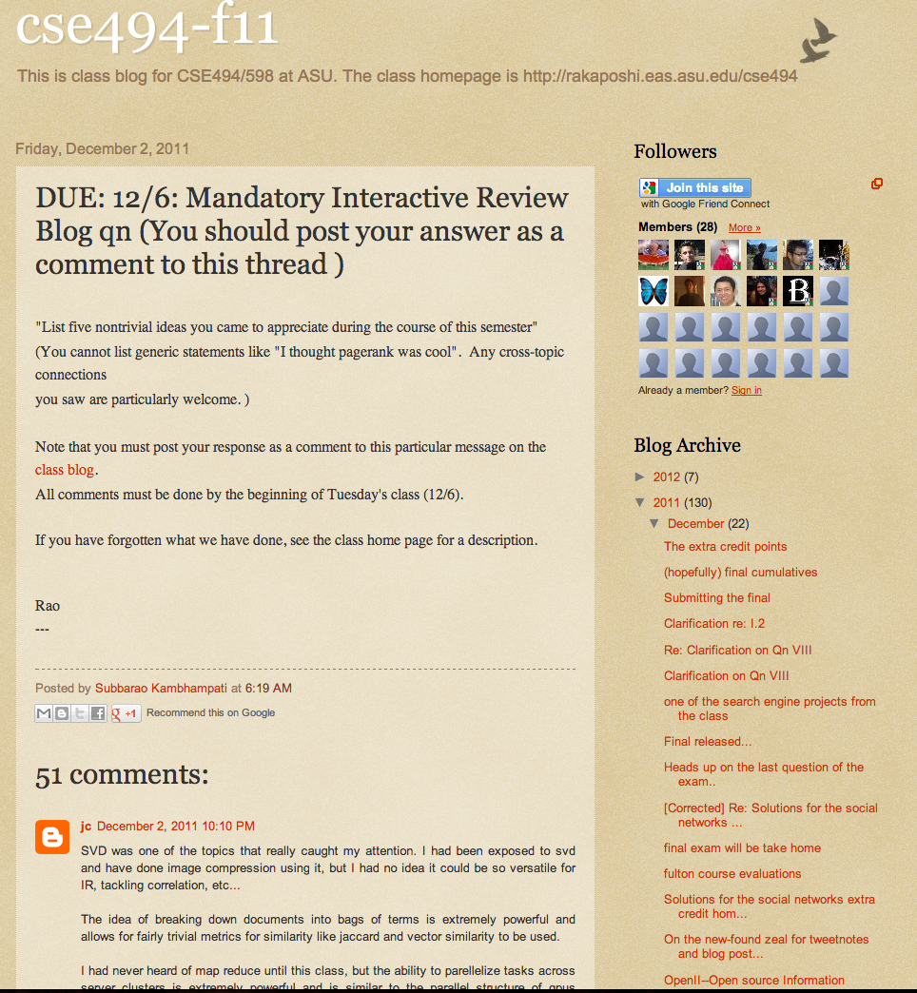
Main Topics
Approximately three halves plus a bit:
  Information retrieval
  Social Networks
  Information integration/Aggregation
  Information mining
  other topics as permitted by time

Slide 14
Topics Covered
Introduction & themes (1+)
Information Retrieval (3)
Indexing & Tolerant Dictionaries (2)
Correlation analysis and latent semantic indexing (3)
Link analysis & IR on web (3)
Social Network Analysis (3)
Crawling & Map Reduce (2)
Clustering (2)
Text Classification (1)
Filtering/Recommender Systems (1)
Specifying and Exploiting Structure (4)
Information Extraction (1)
Information/data Integration (1)

Slide 16
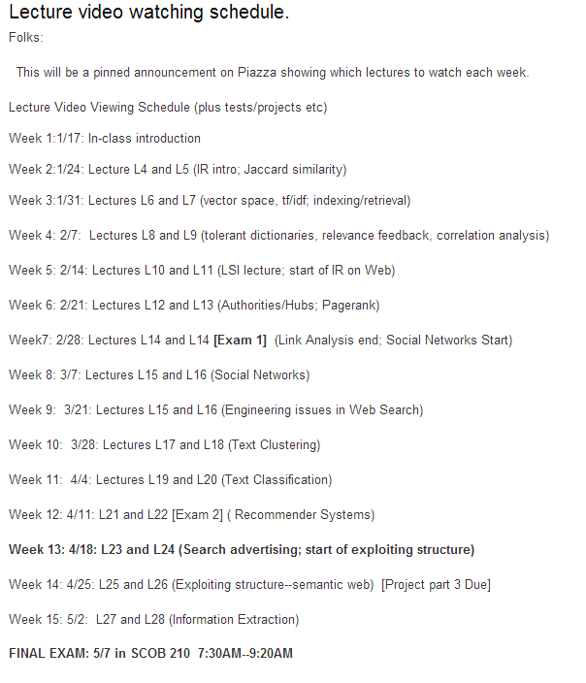
Last year’s schedule

Slide 17
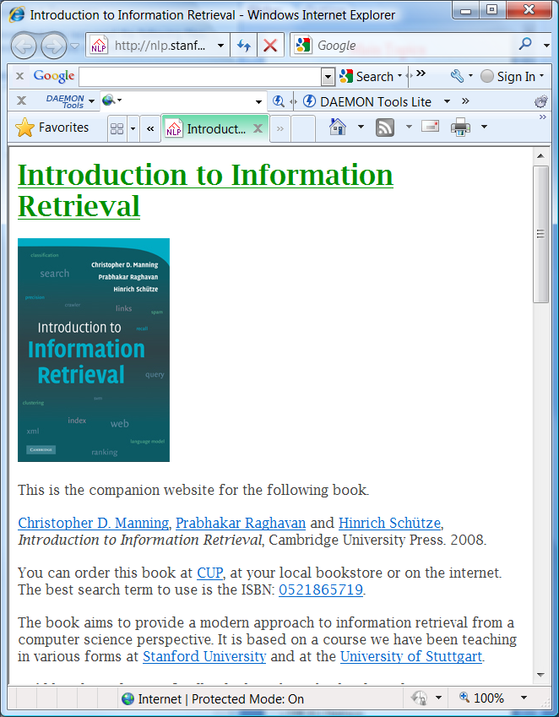
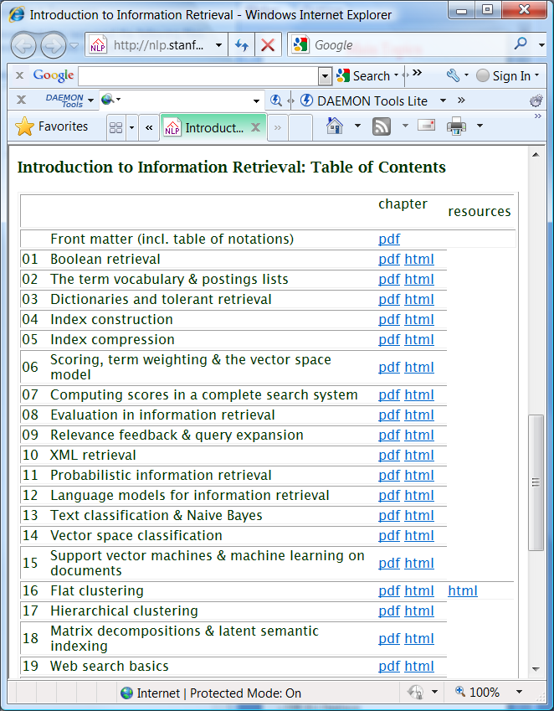
Books (or lack there of)
There are no required text books
  Primary source is a set of readings that I will provide (see “readings” button in the homepage)
    Relative importance of readings is signified by their level of indentation
A good companion book for the IR topics
  Intro to Information Retrieval by Manning/Raghavan/Schutze (available online)
    Modern Information Retrieval (Baeza-Yates et. Al)
Other references
  Modeling the Internet and the Web by Baldi, Frasconi and Smyth
  Mining the web (Soumen Chakrabarti)
  Data on the web (Abiteboul et al).
  A Semantic Web Primer (Antonieu & van Haarmalen)

Slide 18
Pre-reqs
Useful course background
  CSE 310 Data structures
    (Also 4xx course on Algorithms)
  CSE 412 Databases
  CSE 471 Intro to AI
+ some of that math you thought you would never use..
  MAT 342 Linear Algebra
    Matrices; Eigen values; Eigen Vectors; Singular value decomp
      Useful for information retrieval and link analysis (pagerank/Authorities-hubs)
  ECE 389 Probability and Statistics for Engg. Prob solving
    Discrete probabilities; Bayes rule, long tail, power laws etc.
      Useful for datamining stuff (e.g. naïve bayes classifier)
Homework
Ready…
You are primarily
responsible for
refreshing your
memory...

Slide 19
What this course is not (intended tobe)
[] there is a difference between training and education.
If computer science is a fundamental discipline, then university
education in this field should emphasize enduring fundamental
principles rather than transient current technology.
-Peter Wegner, Three Computing Cultures. 1970.
This course is not intended to
  Teach you how to be a web master
  Expose you to all the latest x-buzzwords in technology
    XML/XSL/XPOINTER/XPATH/AJAX
      (okay, may be a little).
  Teach you web/javascript/java/jdbc etc. programming

Slide 20

Grading etc.
Subject to (minor)
Changes
  Projects/Homeworks (~45%)
  Midterm / final (~40%)
  Participation (~15%)
    Reading (papers, web - no single text)
    Class interaction (***VERY VERY IMPORTANT***)
      will be evaluated by attendance, attentiveness, and occasional quizzes
494 and 598 students are treated as separate clusters while awarding final letter grades
(no other differentiation)

Slide 21
Grading etc.
Subject to (minor)
Changes
CSE 494 Section
CSE 598 Section
Weekly quizzes; participation 15%
Exams 40%
  3-4 exams
Project 40%
  3 parts
Homework ~10% (extra)
Weekly quizzes/participation 10%
Exams 50%
  3-4 exams
Project 3 parts 40%
494 and 598 students are treated as separate clusters while awarding final letter grades

Slide 22
Projects (tentative)
One project with 3 parts
  Extending and experimenting with a mini-search engine
    Project description available online (tentative)
        (if you did search engine implementations already and would rather do something else, talk to me)
Expected background
  Competence in JAVA programming
    (Gosling level is fine; Fledgling level probably not..).
    We will not be teaching you JAVA
      We don’t have TA resources to help with debugging your code.

Slide 23
Honor Code/Trawling the Web
Almost any question I can ask you is probably answered somewhere on the web!
  May even be on my own website
    Even if I disable access, Google caches!
…You are still required to do all course related work (homework, exams, projects etc) yourself
  Trawling the web in search of exact answers considered academic plagiarism
  If in doubt, please check with the instructor
All project submissions will be checked “Turnitin” style

Slide 24
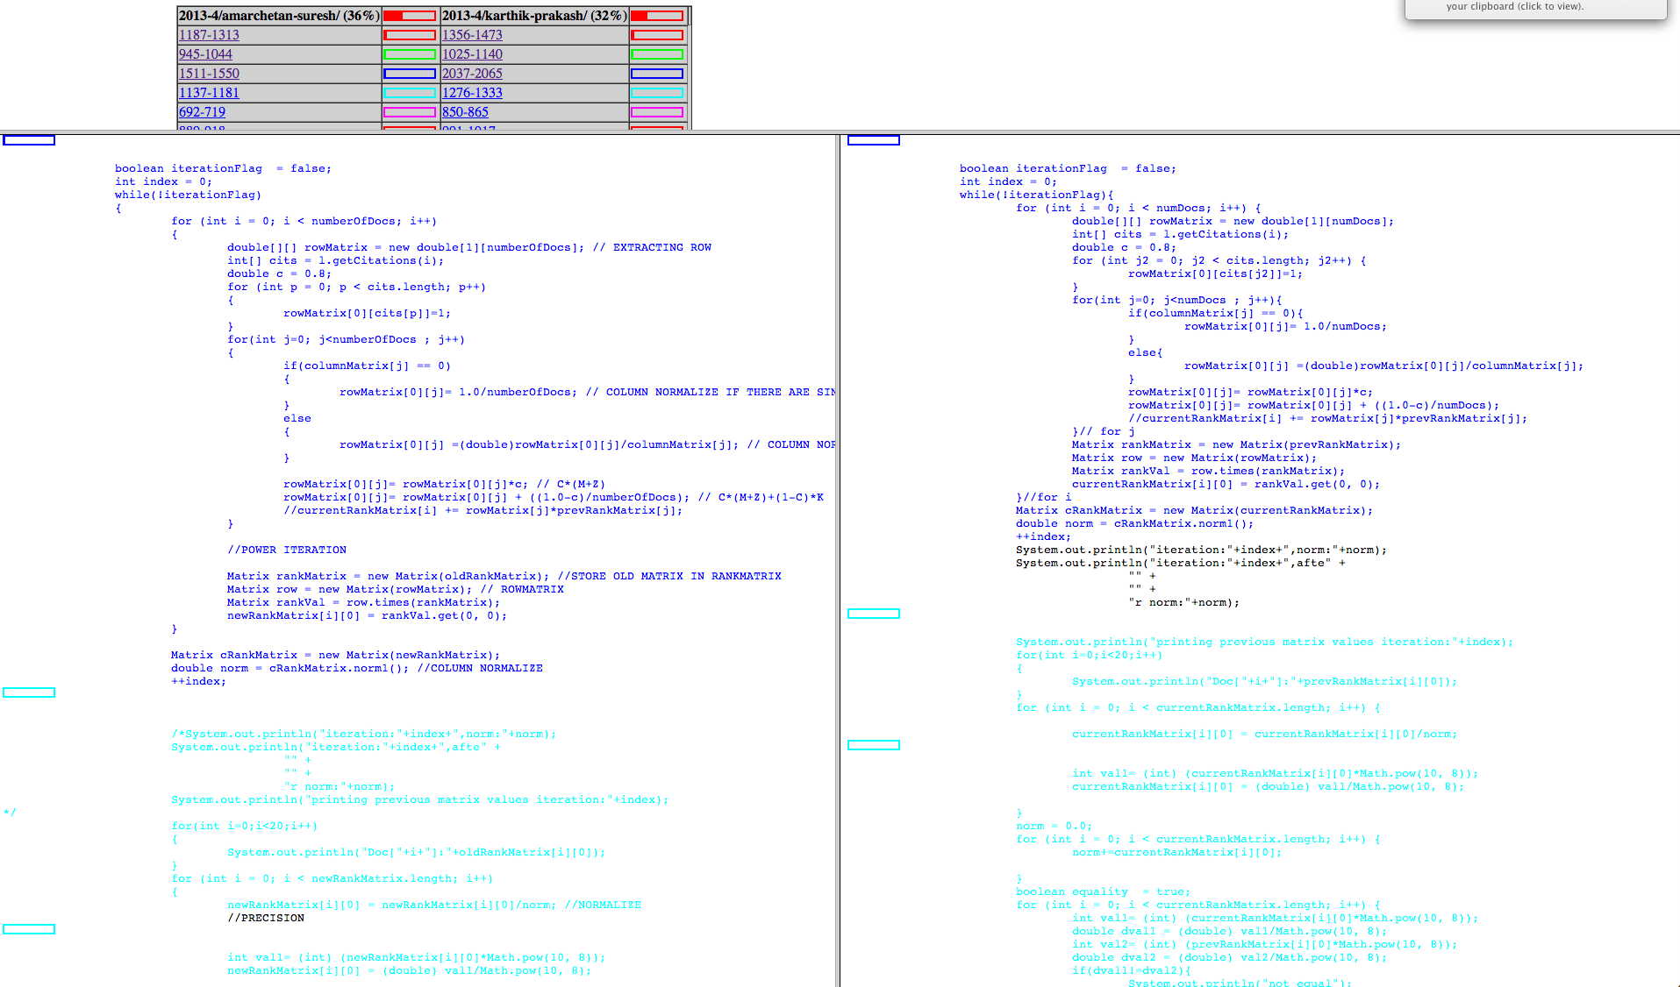
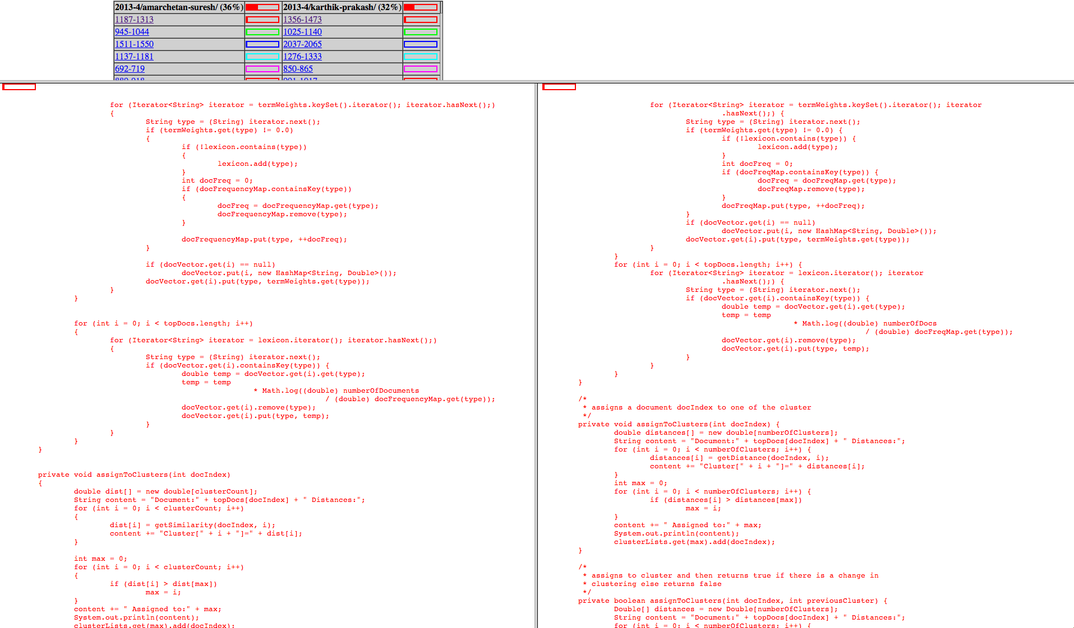
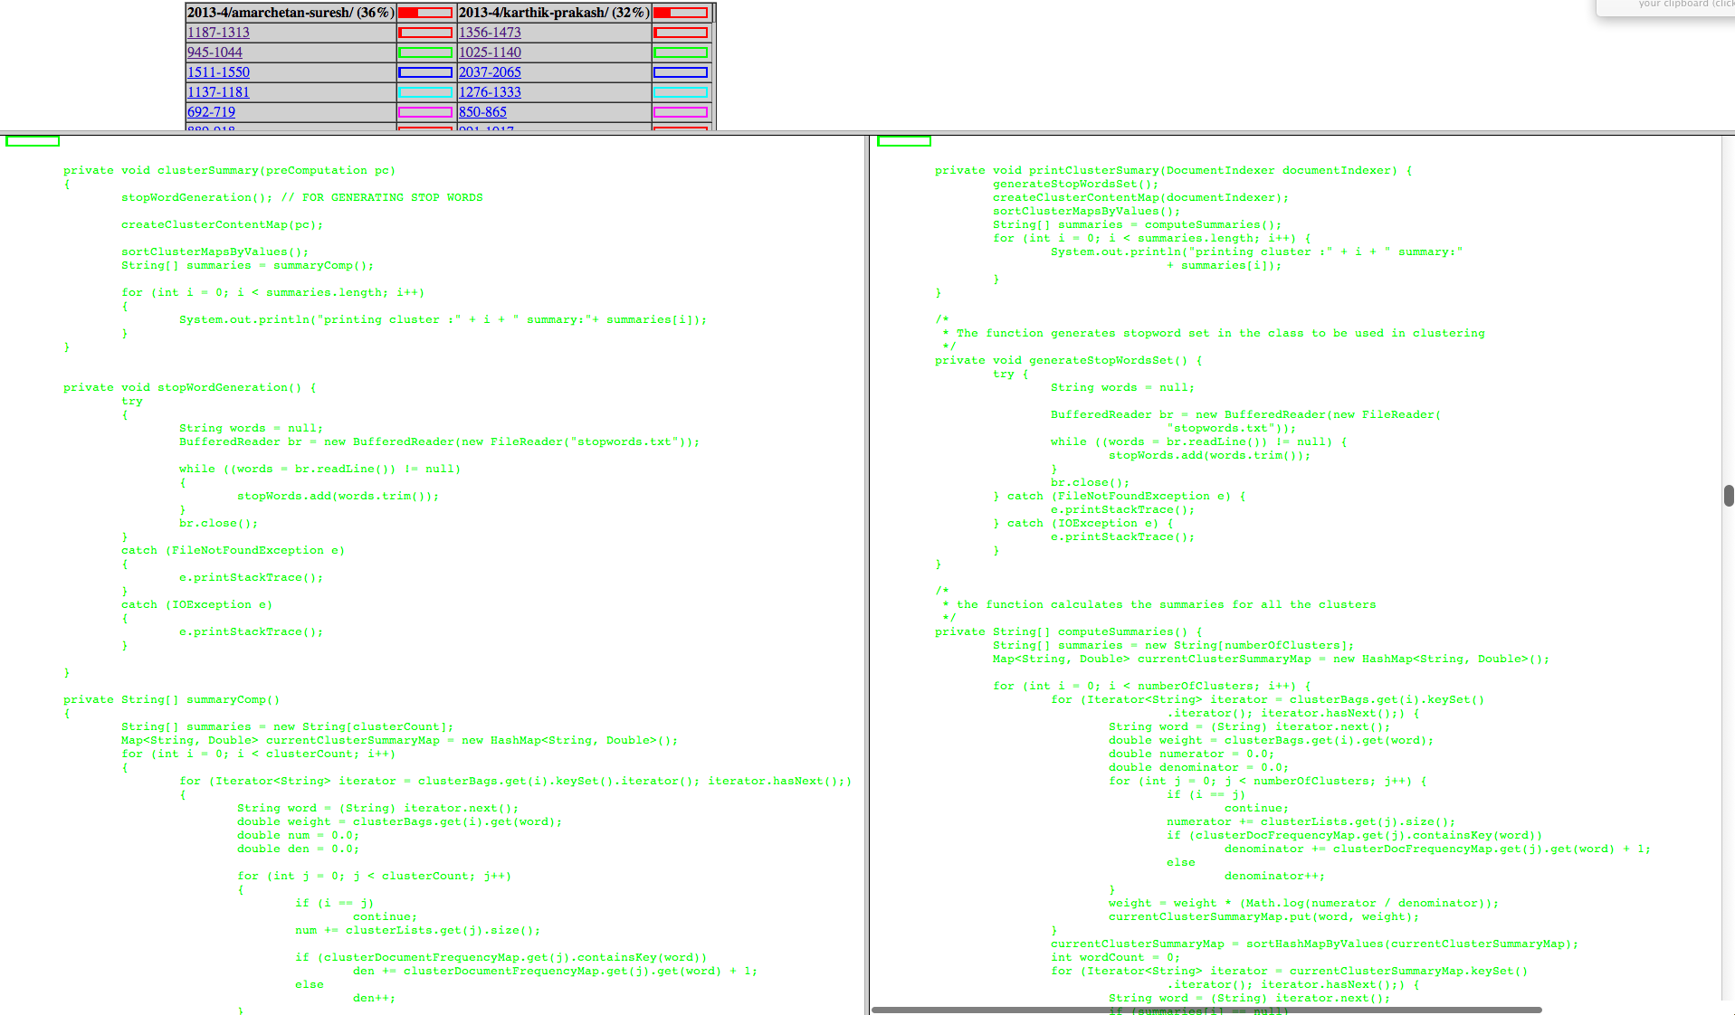
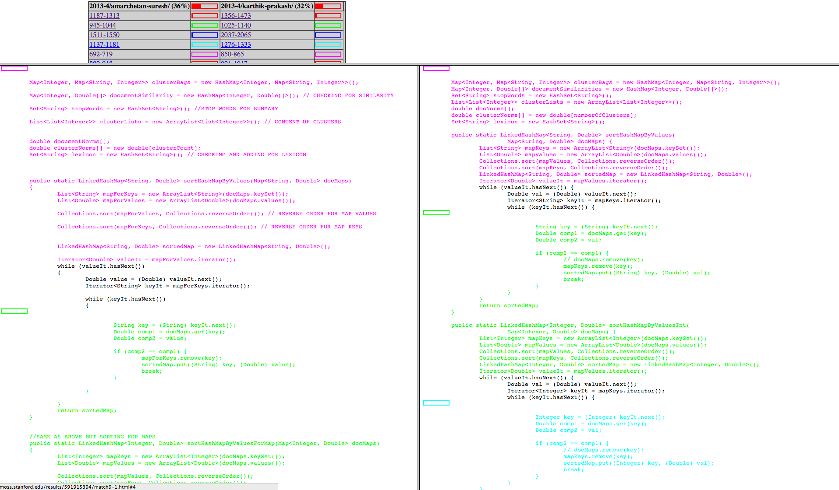

Slide 25
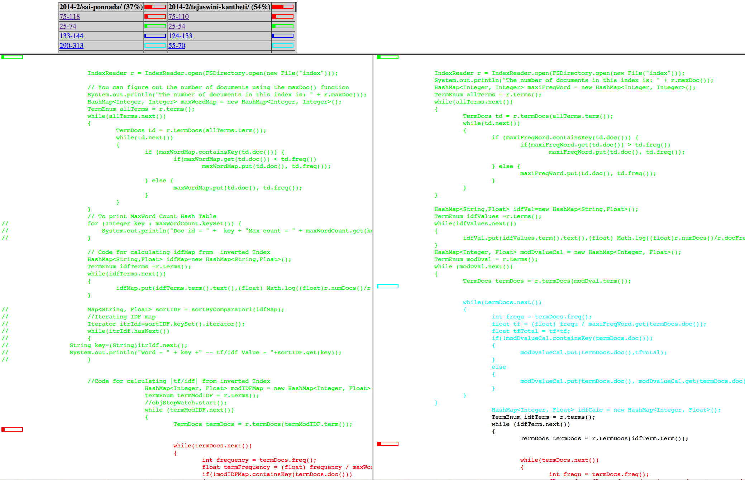

Slide 26
Sociological issues
Attendance in the class is *very* important
  I take unexplained absences seriously
Active concentration in the class is *very* important
  Not the place for catching up on Sleep/State-press reading
Interaction/interactiveness is highly encouraged both in and outside the class
  Use Piazza

Slide 27

Occupational Hazards..
Caveat: Life on the bleeding edge
  494 midway between 4xx class & 591 seminars
    It is a “SEMI-STRUCTURED” class.
  No required text book (recommended books, papers)
  Need a sense of adventure
    ..and you are assumed to have it, considering that you signed up voluntarily
Being offered for the seventh time..and it seems to change every time..
  I modify slides until the last minute…
    To avoid falling asleep during lecture…
Silver Lining?
--Audio & Video Recordings
online

Slide 28
Life with a homepage..
I will not be giving any handouts
  All class related material will be accessible from the web-page
    Home works may be specified incrementally
      (one problem at a time)
  The slides used in the lecture will be available on the class page
    The slides will be “loosely” based on the ones I used in Spring 2010 (these are available on the homepage)
      However I reserve the right to modify them until the last minute (and sometimes beyond it).
    When printing slides avoid printing the hidden slides
Google "asu cse494"

Slide 29
Next Week
Video Lectures: Lectures L4 and L5
Readings: The chapter on Text Retrieval, available in the readings list
  (alternate/optional reading)
    Chapters 1,8,6,7 in Manning et al’s book

Slide 30
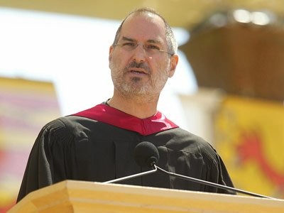

"You can't connect the dots looking forward;
you can only connect them looking backwards.
So you have to trust that the dots will somehow
connect in your future,"

Slide 31

Today’s Agenda
Sing praises of STRUCTURE
Explain how this course brings traditional disciplines of IR, Social Networks, Databases and Machine Learning to the Web
Discuss some BIG IDEAS that permeate the course..

Slide 32
Structure
A generic
web page
containing text
An employee
record
[SQL]
[English]
A movie
review
[XML]
How will search and querying on these three types of data differ?
Semi-Structured

Slide 33
Structure helps querying
Expressive queries
    Give me all pages that have key words “Get Rich Quick”
    Give me the social security numbers of all the employees who have stayed with the company for more than 5 years, and whose yearly salaries are three standard deviations away from the average salary
    Give me all mails from people from ASU written this year, which are relevant to “get rich quick”
keyword
SQL
XML

Slide 34
Structure helps querying
Expressive queries
    Give me all pages that have key words “Get Rich Quick”
    Give me the social security numbers of all the employees who have stayed with the company for more than 5 years, and whose yearly salaries are three standard deviations away from the average salary
    Give me all mails from people from ASU written this year, which are relevant to “get rich quick”
    The Explorer Magellan sailed around the world three times. On one of those trips he died. On which trip did he die?
keyword
SQL
XML
Semantic
Web

Slide 35
Does Web have Structured data?
Isn’t web all text?
  The invisible web
    Most web servers have back end database servers
    They dynamically convert (wrap) the structured data into readable english
      <India, New Delhi> => The capital of India is New Delhi.
      So, if we can “unwrap” the text, we have structured data!
        (un)wrappers, learning wrappers etc…
      Note also that such dynamic pages cannot be crawled...
  The Semi-structured web
    Most pages are at least “semi”-structured
    XML standard is expected to ease the presenatation/on-the-wire transfer of such pages. (BUT…..)

Slide 36
How to get Structure?
When the underlying data is already structured, do unwrapping
  Web already has a lot of structured data!
  Invisible web…that disguises itself
..else extract structure
  Go from text to structured data (using quasi NLP techniques)
..or annotate metadata to add structure
  Semantic web idea..
    Pandora employees adding features to music..
Structure is so important that
we are willing to pay people to
add structure or hope that people
will be disciplined enough to annotate
their pages with structure.
Magellan went around the world three times.
On one of those trips he died.
On which trip did he die?
Notes:
Pandora’s employees make the features…

Slide 37
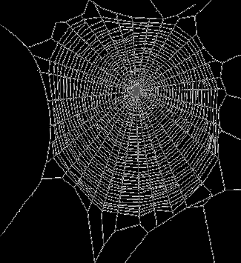
Adapting old disciplines for Web-age
Information (text) retrieval
  Scale of the web
  Hyper text/ Link structure
  Authority/hub computations
Social Network Analysis
  Ease of tracking/centrally representing social networks
Databases
  Multiple databases
    Heterogeneous, access limited, partially overlapping
  Network (un)reliability
Datamining
  [Machine Learning/Statistics/Databases]
  Learning patterns from large scale data
IR
Social
Networks
Web
Databases
Datamining

Slide 38
Information Retrieval
Traditional Model
  Given
    a set of documents
    A query expressed as a set of keywords
  Return
    A ranked set of documents most relevant to the query
  Evaluation:
    Precision: Fraction of returned documents that are relevant
    Recall: Fraction of relevant documents that are returned
    Efficiency
Web-induced headaches
  Scale (billions of documents)
  Hypertext (inter-document connections)
  Bozo users
  Decentralization (lack of quality guarantees)
    Hard for users to figure out quality
      Godfather & Eggplants
& simplifications
  Easier to please “lay” users
Consequently
  Emphasis of precision over recall
  Focus on “trustworthiness” in addition to “relevance”
  Indexing and Retrieval algorithms that are ultra fast
Notes:
Relevance is like correctness—a local property; while quality is like optimality—a global property

Slide 39
Social Networks
Friends vs. Soulmates
Web-induced headaches
  Scale (billions of entities)
  Implicit vs. Explicit links
    Hypertext (inter-entity connections easier to track)
    Interest-based links
& Simplifications
  Global view of social network possible…
Consequently
  Ranking that takes link structure into account
    Authority/Hub
  Recommendations (collaborative filtering; trust propagation)
Traditional Model
  Given
    a set of entities (humans)
    And their relations (network)
  Return
    Measures of centrality and importance
    Propagation of trust (Paths through networks)
  Many uses
    Spread of diseases
    Spread of rumours
    Popularity of people
    Friends circle of people

Slide 40
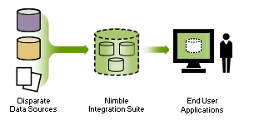
Information Integration
Database Style Retrieval
Traditional Model (relational)
  Given:
    A single relational database
      Schema
      Instances
    A relational (sql) query
  Return:
    All tuples satisfying the query
Evaluation
  Soundness/Completeness
  efficiency
Web-induced headaches
    Many databases
      With differing Schemas
    all are partially complete
    overlapping
    heterogeneous schemas
    access limitations
    Network (un)reliability
Consequently
    Newer models of DB
    Newer notions of completeness
    Newer approaches for query planning

Slide 41
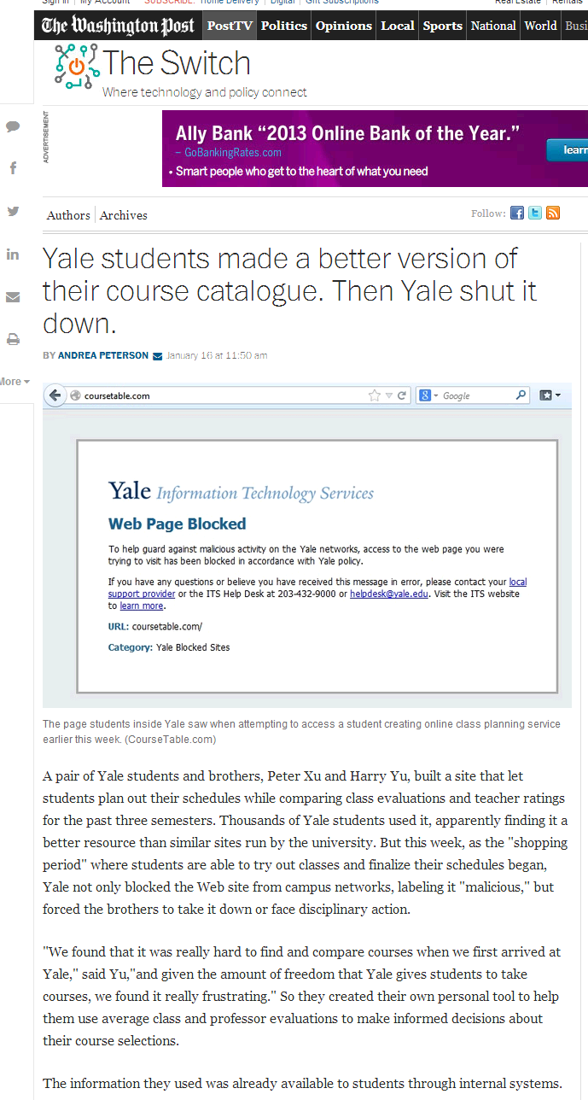

Slide 42
Further headaches brought on by
Semi-structured retrieval
If everyone puts their pages in XML
  Introducing similarity based retrieval into traditional databases
  Standardizing on shared ontologies...

Slide 43
Learning Patterns (from web and users)
Traditional classification learning (supervised)
  Given
    a set of structured instances of a pattern (concept)
  Induce the description of the pattern
Evaluation:
  Accuracy of classification on the test data
  (efficiency of learning)
Mining headaches
  Training data is not obvious
    (relevance)
  Training data is massive
    But much of it unlabeled
  Training instances are noisy and incomplete
Consequently
  Primary emphasis on fast classification
    Even at the expense of accuracy
  Also on getting by with a little labeled data + a lot more unlabeled data [Dantzig Story]

Slide 44

Finding“Sweet Spots” in computer-mediated cooperative work
Big Idea 1
It is possible to get by with techniques blythely ignorant of semantics, when you have humans in the loop
  All you need is to find the right sweet spot, where the computer plays a pre-processing role and presents “potential solutions”
  …and the human very gratefully does the in-depth analysis on those few potential solutions
Examples:
  The incredible success of “Bag of Words” model!
    Bag of letters would be a disaster ;-)
    Bag of sentences and/or NLP would be good
      ..but only to your discriminating and irascible searchers ;-)
Notes:
Don’t overthink the solution…. The surprising thing is not why they don’t work better, but why they work at all?

Slide 45
Big Ideas and Cross Cutting Themes

Slide 46
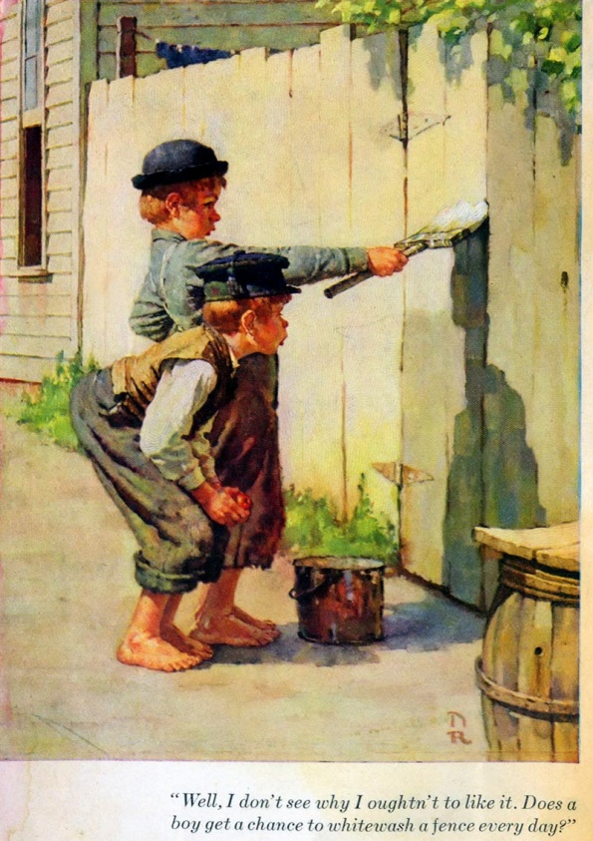
Collaborative Computing
AKA Brain Cycle Stealing
AKA Computizing Eyeballs
Big Idea 2
A lot of exciting research related to web currently involves “co-opting” the masses to help with large-scale tasks
  It is like “cycle stealing”—except we are stealing “human brain cycles” (the most idle of the computers if there is ever one ;-)
    Remember the mice in the Hitch Hikers Guide to the Galaxy? (..who were running a mass-scale experiment on the humans to figure out the question..)
  Collaborative knowledge compilation (wikipedia!)
  Collaborative Curation
  Collaborative tagging
  Paid collaboration/contracting
Many big open issues
  How do you pose the problem such that it can be solved using collaborative computing?
  How do you “incentivize” people into letting you steal their brain cycles?
    Pay them! (Amazon mturk.com )
    Make it fun (ESP game)

Slide 47

Tapping into the Collective Unconscious
Big Idea 3
Another thread of exciting research is driven by the realization that WEB is not random at all!
  It is written by humans
  …so analyzing its structure and content allows us to tap into the collective unconscious ..
    Meaning can emerge from syntactic notions such as “co-occurrences” and “connectedness”
Examples:
  Analyzing term co-occurrences in the web-scale corpora to capture semantic information (gmail)
    Statistical machine translation with massive corpora
  Analyzing the link-structure of the web graph to discover communities
    DoD and NSA are very much into this as a way of breaking terrorist cells
  Analyzing the transaction patterns of customers (collaborative filtering)

Slide 48
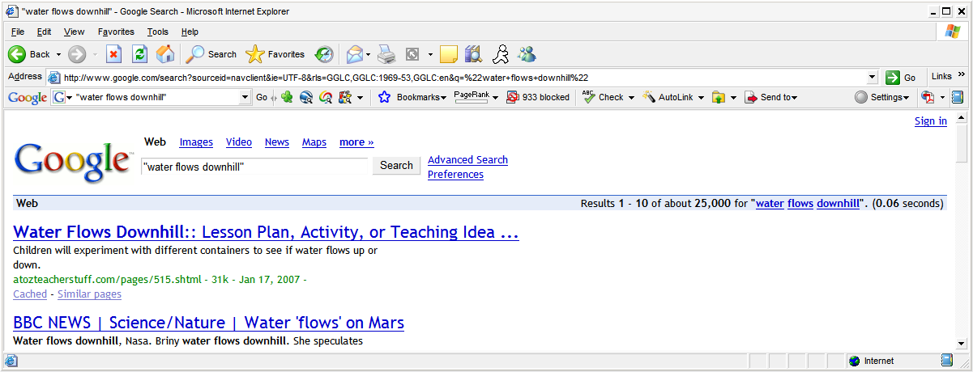
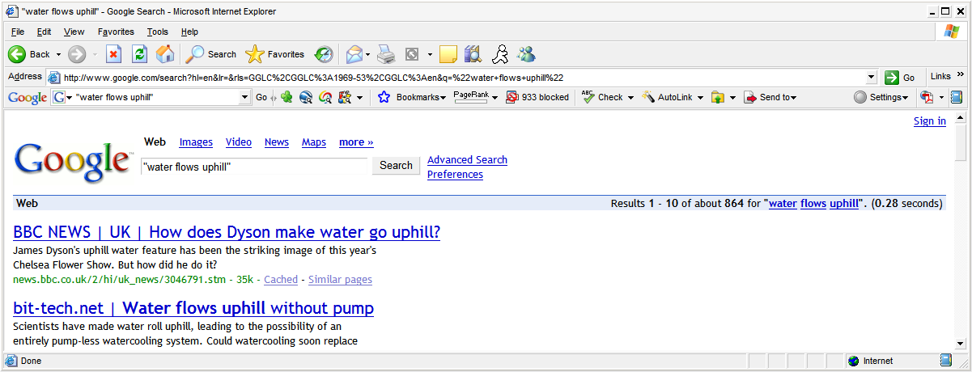
2007

Slide 49
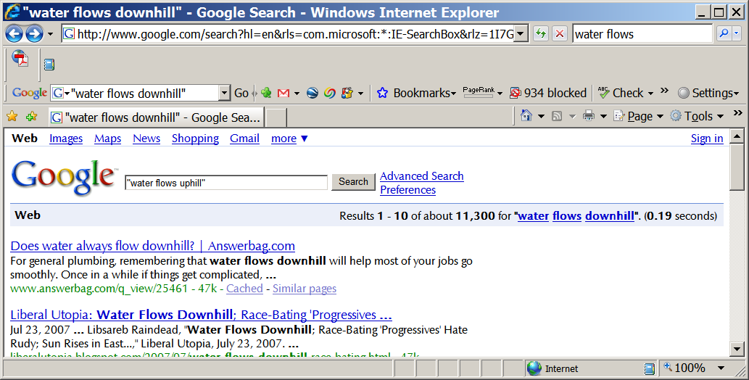
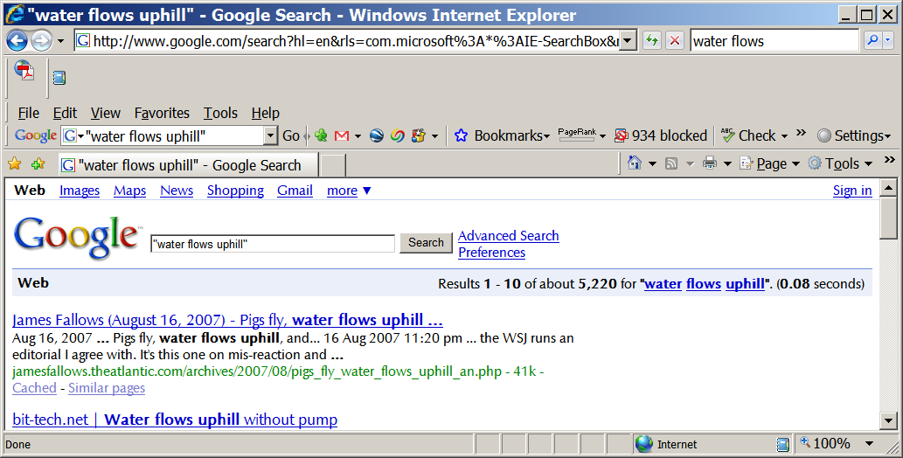
2008
Water’s getting
aggressive

Slide 50
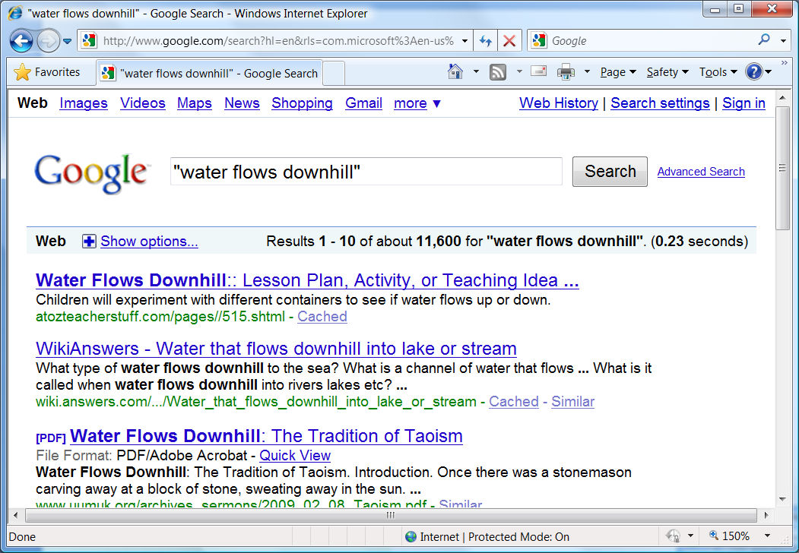
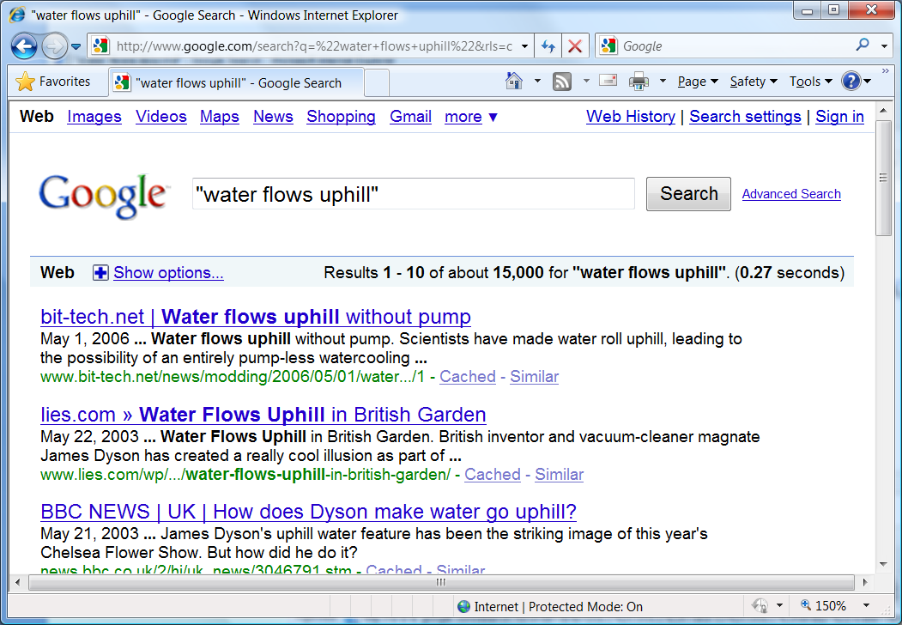
2010

Slide 51
It’s a Jungle out there
(adversarial Web & Arms Race)
Big Idea 4
  Web is authority-free zone!
    Anyone can put up any information and get indexed..
    Everyone is trying to trip you up… (snopes.com)
  Need to keep “adversarial” aspect constantly in view
    Adversarial IR (focus on Trust in addition to Relevance)
    Adversarial mining (the class is being changed even as you are learning)
      Classic example: Spam mail
Notes:
Mother may be making those sites too..

Slide 52
Next Week
Video Lectures: Lectures L4 and L5
Readings: The chapter on Text Retrieval, available in the readings list
  (alternate/optional reading)
    Chapters 1,8,6,7 in Manning et al’s book

Slide 53
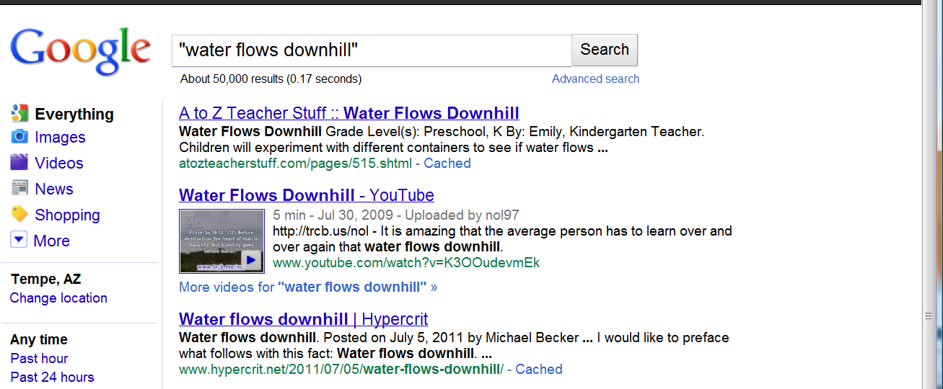
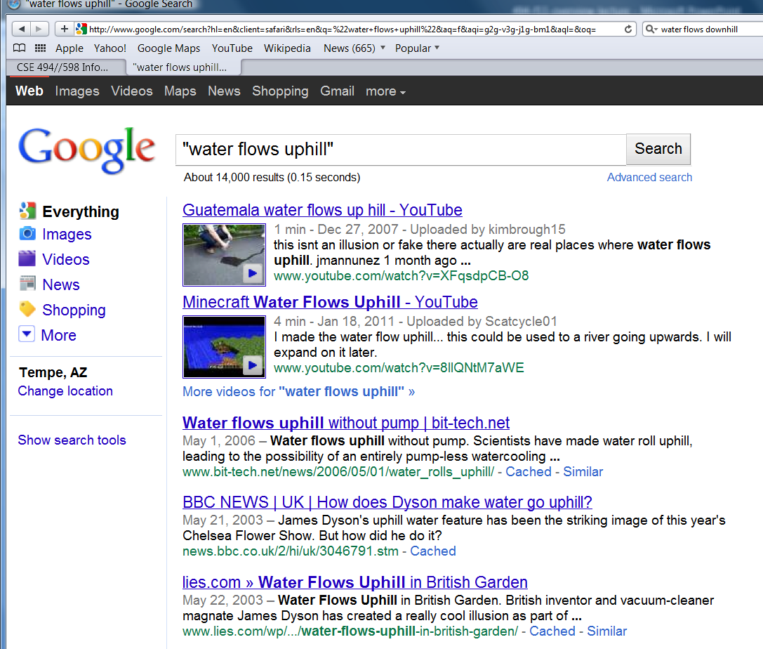
2011

Slide 54
Linear Algebra

Slide 55
vectors and matrices
A vector is a bunch of numbers
A matrix is a bunch of vectors

Slide 56
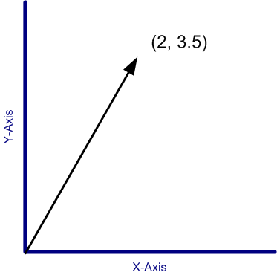
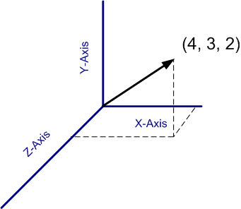
A vector in space
In space, a vector can be shown as an arrow
  starting point is the origin
  ending point are the values of the vector
Notes:
In addition to being a bunch of numbers, we can also represent vectors as arrows from the origin to a point represented by those bunch of numbers. For eg – 2d case, 3d case

Slide 57
Properties of vectors
Its “size” |v|
  the 2-norm of the vector
  |(1, 2, 3)| = √(1² + 2² + 3²)
A unit vector is a vector of size 1.
Notes:
Among the many properties of a vector – one of the more important ones is its ‘size’ – which is the sqrt of sum of squares. unit

Slide 58
Operations on vectors
Addition, Subtraction – easy.
  (a, b, c)+(u, v, w) = (a+u, b+v, c+w)
Dot product
  (a, b, c)•(u, v, w) = au+bv+cw
Multiplication – with other matrices.
Division – not defined.
[There is also cross-product; but we don’t have much use for it..]
Notes:
So let us quickly define the basic math operators. you can add em, subtract em, multiplication is of two sorts – the dot product and the cross product – we don’t deal with the cross product in this course. You can also do matrix multiplication with other matrices. Division is not defined – because multiplication results in stuff outside the domain of vectors.

Slide 59
Dot Product & Orthogonality
Dot product
  (a, b, c)•(u, v, w) = au+bv+cw
Dot product of v1 and v2 is just the magnitude of v1 times the magnitude of projection of v2 on v1
  v1•v2 = |v1| |v2| cos(v1-v2)
  The dot product of orthogonal vectors is zero
    (1, 0 , 0) • (0 1 0) = 0
  Dot product of a vector with itself is square of its magnitude
    (a, b, c) •(a,b,c) = a² + b² + c²
Notes:
So let us quickly define the basic math operators. you can add em, subtract em, multiplication is of two sorts – the dot product and the cross product – we don’t deal with the cross product in this course. You can also do matrix multiplication with other matrices. Division is not defined – because multiplication results in stuff outside the domain of vectors.

Slide 60
Matrices
No intuitive representation in space.
Addition / Subtraction – easy
Multiplication – matrix multiplication
  Not commutative
Division – not defined
  If the matrix is
    a square matrix
    invertible
  then take inverse and multiply

Slide 61
Matrix Multiplication can be seen as computing vector dot products..
Given a matrix R, you can consider each row of M as a vector.
Thus R = [r1
r2
..
rk]
Now Given another matrix S whose column vectors are s1… sk, the ijth element in R*S is ri.sj
  . Is the dot product
As a corollary, if a matrix M is orthogonal—i.e., its row vectors are all orthogonal to each other, then M*M’ or M’*M will both be diagonal matrices..

Slide 62
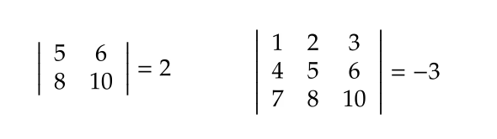
Some identities / properties
transpose of a matrix
determinant of a matrix
A A⁻¹ = I

Slide 63
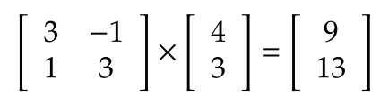
What happens when you multiply a matrix by a vector?
The vector scales and rotates.

Slide 64

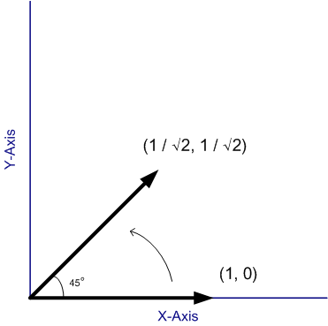
Example 1 – only rotation
Notes:
Here is an example of a matrix that causes a vector to get rotated… only. Here’s the vector, and here it is after the multiplication. Cos(45) is 1/1.414 and you see that the resultant vector has the same size – its just rotated by 45 degrees. I’ve shown this for one vector only, but this is true in general. No matter what vector you start with, this matrix will always rotate it by 45 degrees, and have no other effect.

Slide 65
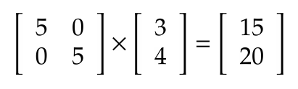
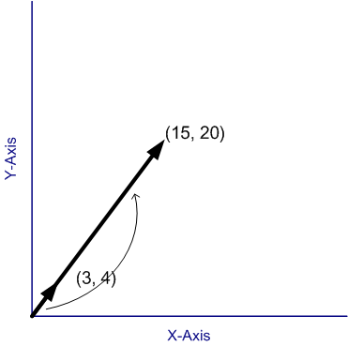
Example 2 – only scaling
Notes:
Here is a matrix that only changes the size of a vector, and leaves its direction alone. Once again, no matter what vector I start with, this matrix will always only scale it, and do nothing else. You should note that the form of the matrix is familiar – it is the unit matrix multiplied by a constant.

Slide 66

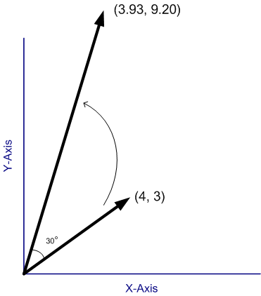
Example 3 - both
Notes:
Here is a matrix that does both – it operates on the vector (4, 3) and gives you this new vector. This new vector is rotated by 30 degrees and increased in size by 2 – now I can say that here because I have constructed this matrix very carefully – in fact, this is the scale-by-2 matrix multiplied by the rotate-by-30-degrees matrix. So it has the effect of increasing the size twofold and rotating by 30 degrees. Note that your general matrix wont have such a nice property that you can simply read off the effects from the numbers in the matrix itself – how to do that is a subject I will come to shortly.

Slide 67
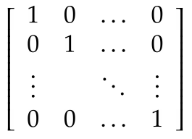
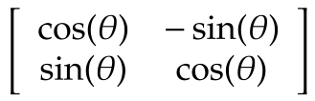
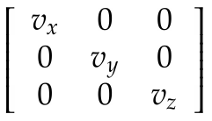
So a matrix is a bunch of numbers that tells us how to rotate and scale vectors
Special matrices: Unit matrix
Special matrices: Rotation matrix
Special matrices: Scaling matrix
Notes:
So to recap – a matrix is a bunch of numbers that affects a vector in a particular way – it rotates it by a bit and scales it by a bit. There are some well known matrices that you should know about –
Unit matrix – it does nothing – whatever you multiply it with stays as is.
Rotation matrix – shown here for the two dimension case – rotates a matrix by \theta degrees and has no other effect.
And the scaling matrix – which you can use to increase the size of the vector in the x, y, and z directions by vx, vy and vz. Note that if vx, vy and vz are different, it also will end up rotating the matrix, the matrix I showed you earlier had the same values of vx and vy, so it had the effect of purely scaling the vector up.

Slide 68
Can we make some general statements about a matrix?
Given any matrix M, can we make some statements about how it affects vectors?
Start with any vector. Multiply it over and over and over with a matrix. What happens?
Notes:
So now that we know a matrix rotates and scales, and we’ve seen some typical matrices, we have the problem that not every matrix fits in those patterns. So given any general matrix, can we make some statements about the way it will scale and rotate vectors?
SO lets think of it this way – we have a matrix. We take some vector – any vector – and multiply a matrix again and again with it. What happens? So lets say it is not one of those special rotation matrices – that rotate only. Your intuition says that it will both scale the vector and rotate it a bit. SO think about it - it rotates but also increases the size. Let’s see how it looks

Slide 69
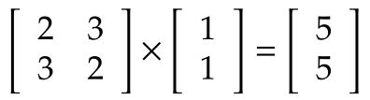
Eigen vectors
There are some vectors which don’t change direction on multiplication with a matrix.
They are called Eigen vectors.
However, the matrix does manage to scale them. The factor it scales them by, are called the ‘Eigen values’.
Notes:
Think of all the possible vectors you could multiply by a matrix – that’s all the vectors in the world, an infinite number of them. Among them, only a few have this very strange property that they don’t change the direction when they get multiplied by the matrix. Those vectors are called the eigen vectors of the matrix. Given a matrix, you can find its eigen vectors. after you’ve found them, try multiplying them with the matrix. What you will observe is that those matrix don’t change direction – they point at exactly the same direction in space. the factor by which they grow is called the eigen value for that particular eigen vector.
Now you should be worried at this point. A little while ago, I showed you a matrix that completely contradicts what I am saying here. It was the rotation matrix. The rotation matrix rotates a vector no matter what. But here I am claiming that every matrix would have some vector that does not get rotated – something is wrong. Well it turns out – that it is possible that some matrices have eigen vectors and eigen values that are complex numbers. When I say that a vector is made up of complex numbers, I mean that the co-ordinates that make the vector up, are imaginary. So if the eigen vector is complex – you wont find a real vector that doesn’t get rotated – hence there is no contradiction here. The vectors you are likely to encounter in this course, and the one that was on your hw – they have real eigen vectors and eigen values, so you don’t need to worry about that.

Slide 70
How to find Eigen values
Let’s assume one of the eigen vectors is v
Then Av = λv, where λ is the eigenvalue.
Transpose it (A - λI)v = 0
Theorem: if v is not zero, then the above equation can only be true if the determinant of (A – λI) is zero. [proof: see Characteristic polynomial in Wikipedia]
Use this fact to find values of λ
Notes:
So

Slide 71
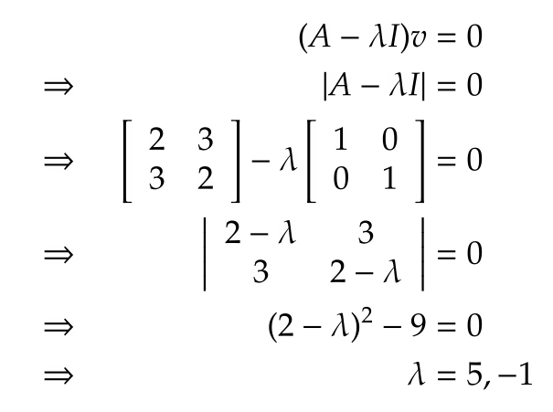

Slide 72
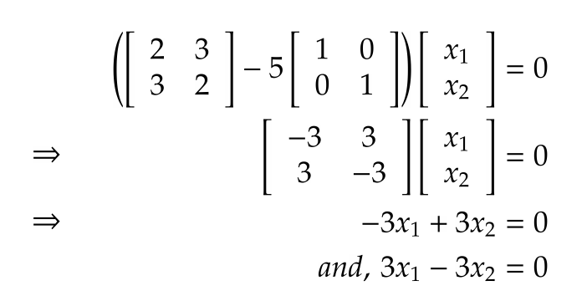
How to find Eigen Vectors
Substitute λ back into the equation (A - λI)v=0
Try to find v
You will get two equations in two variables – but: there is a problem, the two equations are identical

Slide 73
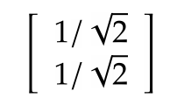
Eigen vectors – the missing eqn
One equation, two variables
Use the additional constraint that the Eigen vector is a unit vector (length 1)
x₁²+x₂² = 1
Using the x₁ = x₂ we found from the previous slide, we have the Eigen vector

Slide 74
So what do these values tell us
If you repeatedly multiply a vector by a matrix, (and then normalize), then you will eventually get the primary Eigen vector.
The primary Eigen vector is, sort of, the general direction in which the matrix turns the vector

Slide 75
How is this all relevant to the class?
Instead of thinking of 2-dimension or 3-dimension vectors, imagine vectors in T dimensions
T = number of different terms.
Each doc will be a vector in this space.
Similarity between the docs = normalized dot product
Store the link structure of the web in a matrix
Eigen values / vectors – PageRank

