Slide 1


Human-in-the-Loop/Human-Aware Planning and Decision Support
What’s Hot: ICAPS
“Challenges in Planning”
A brief talk on the core & (one) fringe of ICAPS
Subbarao Kambhampati
Arizona State University
Talk given at AAAI 2014

Slide 2

Notes:
Monty-Python Italian lesson

Slide 3
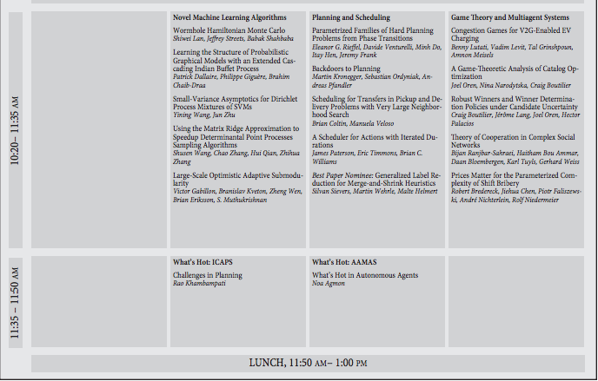
Notes:
Monty-Python Italian lesson

Slide 4


Notes:
Monty-Python Italian lesson

Slide 5
Human-in-the-Loop/Human-Aware Planning and Decision Support
What’s Hot: ICAPS
“Challenges in Planning”
A brief talk on the core & (one) fringe of ICAPS
Subbarao Kambhampati
Arizona State University
Talk given at AAAI 2014

Slide 6
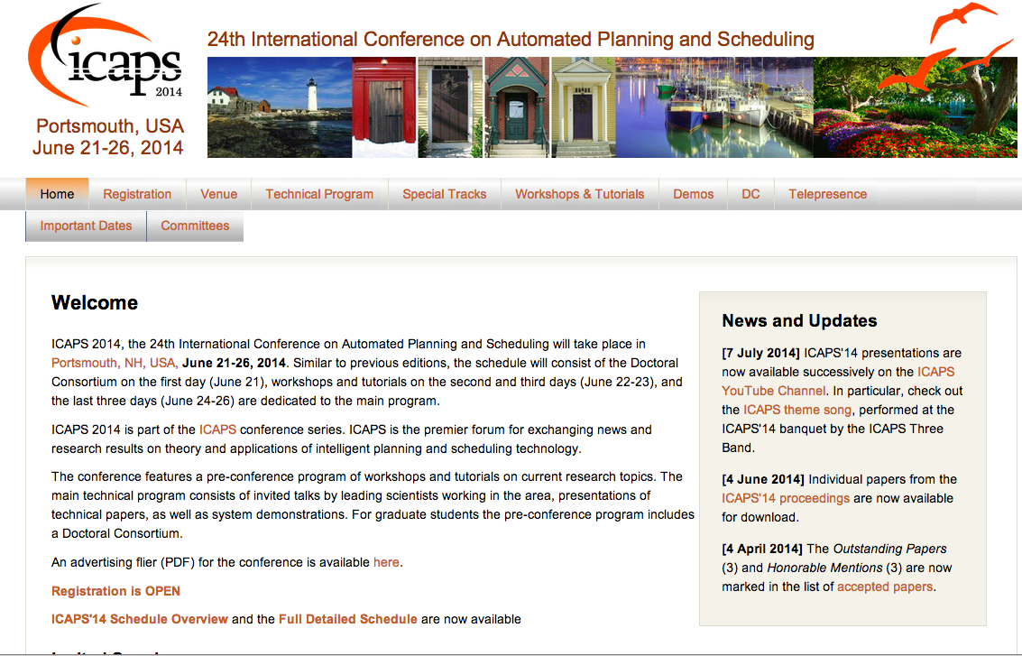

Slide 7

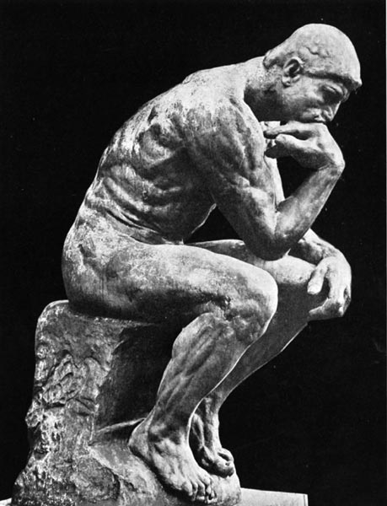
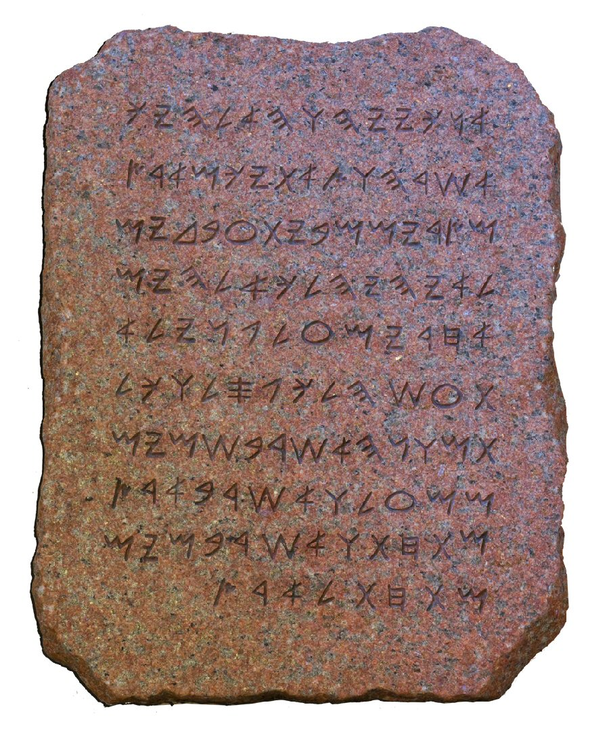
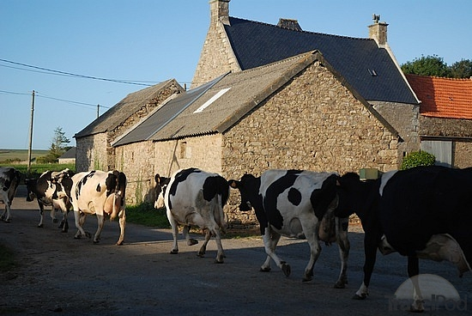
Planning: The Canonical View
A fully specified
problem
--Initial state
--Goals
(each non-negotiable)
--Complete Action Model
The Plan
Notes:
There is nothing wrong with this view—it has a lot of applications, and in fact the majority of planning is

Slide 8
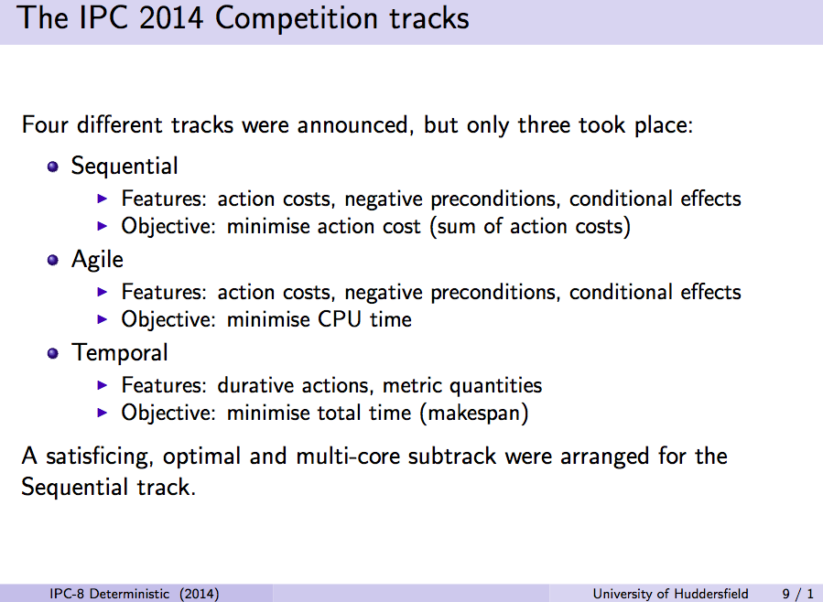
[IPC 2014 slides from Chrpa, Vallati & McCluskey]

Slide 9
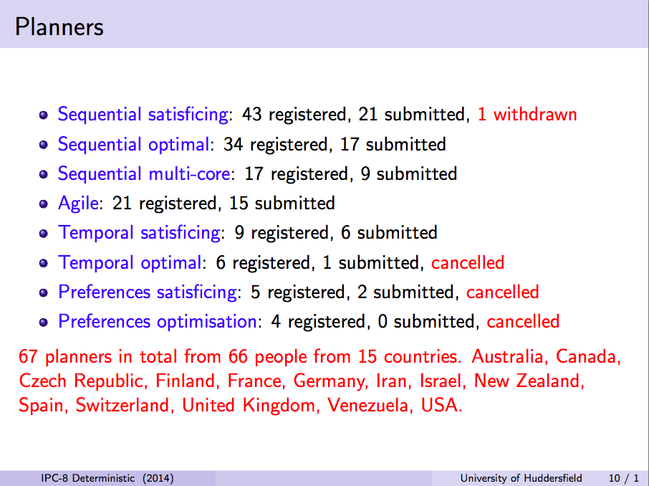
[IPC 2014 slides from Chrpa, Vallati & McCluskey]

Slide 10
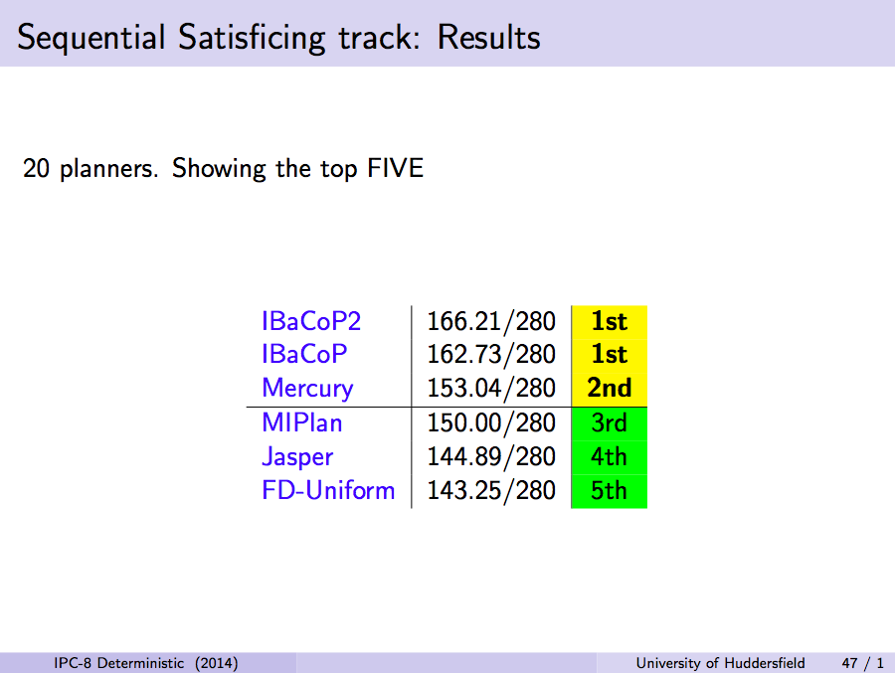

[IPC 2014 slides from Chrpa, Vallati & McCluskey]

Slide 11
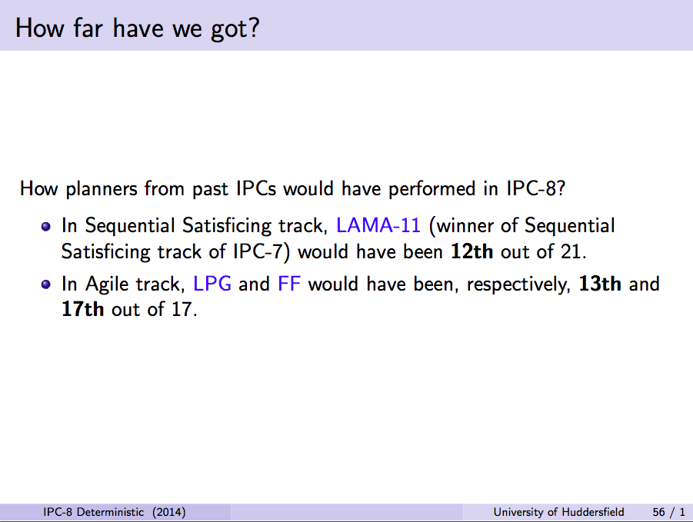
[IPC 2014 slides from Chrpa, Vallati & McCluskey]

Slide 12
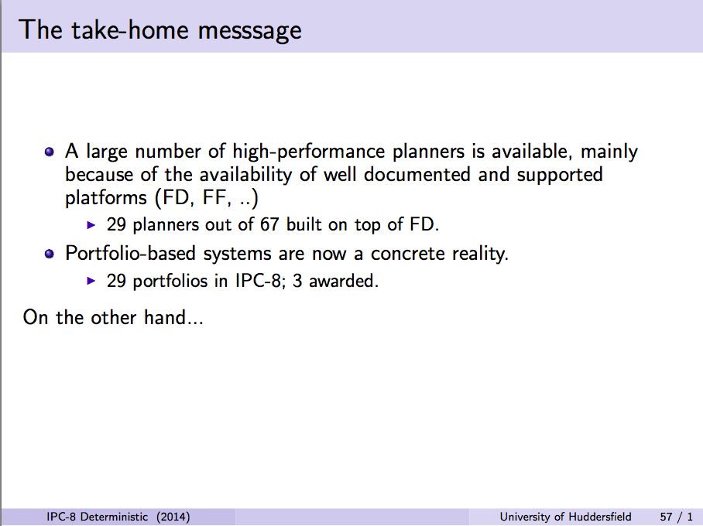
Portfolio planners use a
set of base planners and
select the planner to use
based on the problem
features
→ Typically the selection
policy learned in terms
of problem features
[IPC 2014 slides from Chrpa, Vallati & McCluskey]

Slide 13
So why the continued fascination with classical planning?
..of course, the myriad applications for classical STRIPS planning ☺
But more seriously, because classical planners have become a customized substrate for “compiling down” other more expressive planning problems
  Effective approaches exist for leveraging classical planners to do partial satisfaction planning, conformant planning, conditional planning, stochastic planning etc.

Slide 14
Compilation Substrates for Planning
SAT
IP/LP
(Classical) Planning
First of the substrates
  Kautz&Selman got the classic paper award honorable mention
Continued work on fast SAT solvers
Limited to bounded length planning
(Not great for metric constraints)
Followed closely on the heels of SAT
Can go beyond bounded length planning
  Allows LP Relaxation
  (Has become the basis for powerful admissible heuristics)
IP solvers evolve much slower..
Tremendous progress on heuristic search approaches to classical planning
A currently popular approach is to compile expressive planning problems to classical planning
  Conformant planning, conditional planning
  (even plan recognition)

Slide 15
Planning: The Canonical View
A fully specified
problem
--Initial state
--Goals
(each non-negotiable)
--Complete Action Model
The Plan
Notes:
There is nothing wrong with this view—it has a lot of applications, and in fact the majority of planning is

Slide 16
Assumption: Complete Models
→Complete Action Descriptions
→Fully Specified Preferences
→All objects in the world known up front
→One-shot planning
Allows planning to be a pure inference problem
Violated Assumptions:
→Complete Action Descriptions (fallible domain writers)
→Fully Specified Preferences (uncertain users)
→Packaged planning problem (Plan Recognition)
→One-shot planning (continual revision)
Planning is no longer a pure inference problem ☹
☹ But humans in the loop can ruin a really a perfect day ☹
Traditional Planning
Pref
Metric
Metric-
Temporal
PO
Model Incompleteness
Classical
Temporal
Non-det
Stochastic
Dynamics
Underlying System Dynamics
World
Model-lite Planning
Model-Lite Planning
[AAAI 2010; IJCAI 2009; IJCAI 2007,AAAI 2007]
Effective ways to handle the more expressive planning problems by
exploiting the deterministic planning technology

Slide 17
Need for Human-in-the-Loop/Human-Aware Planning &Decision Support
Planners are increasingly embedded in systems that include both humans and machines
  Human Robot Teaming
    Petrick et al, Veloso et al, Williams et al, Shah et al, Kambhampati et al
  Decision support systems; Crowd-planning systems; Tutorial planning systems
    Allen et al, Kambhampati et al; L
Necessitates Human-in-the-Loop Planning
  But, isn’t it just “Mixed-Initiative Planning”?
    ..a lot of old MIP systems had the “Humans in the land of Planners” paradigm (the humans help planners)
    In effective human-aware planning, planners realize they inhabit the land of humans..
Notes:
From Watson to Crowd planning, there is significantly more interest in planners as decision support systems for humans rather than planners as fully autonomous entities

Slide 18

Human-Robot Teaming
Search and report (rescue)
Goals incoming on the go
World is evolving
Model is changing
Infer instructions from Natural Language
Determine goal formulation through clarifications and questions

Slide 19
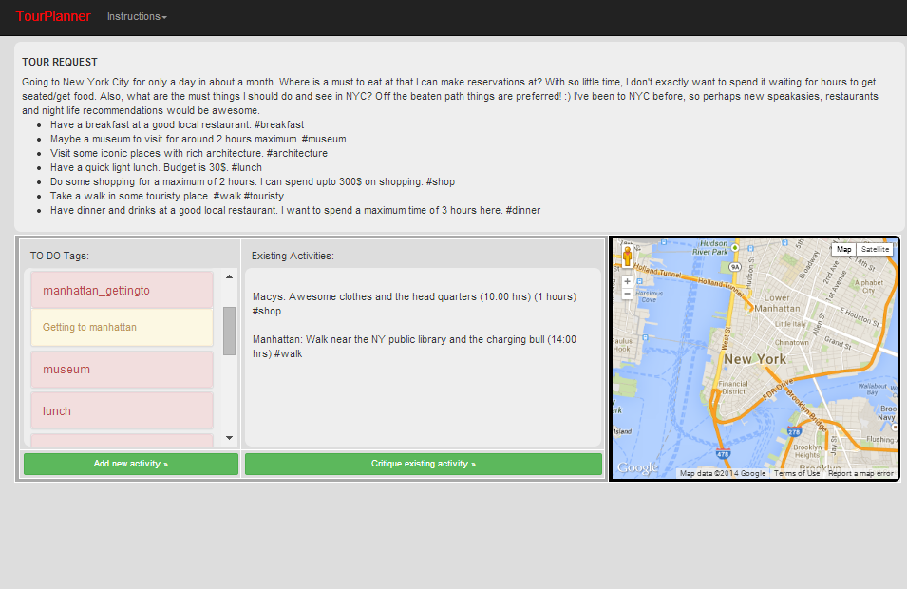
Crowd-Sourced Planning
manhattan_gettingto

Slide 20

Planning: The Canonical View
A fully specified
problem
--Initial state
--Goals
(each non-negotiable)
--Complete Action Model
The Plan
Notes:
There is nothing wrong with this view—it has a lot of applications, and in fact the majority of planning is

Slide 21
Challenges in Human-in-the-Loop/Human-Aware Planning & Decision Support
Interpret what humans are doing
  Plan/goal/intent recognition
Plan with incomplete domain models
  Robust planning with “lite” models
  (Learn to improve domain models)
Continual planning/Replanning
  Commitment sensitive to ensure coherent interaction
Explanations/Excuses
  Excuse generation can be modeled as the (conjugate of) planning problem
Asking for help/elaboration
  Reason about the information value
Eigen Slide

Slide 22

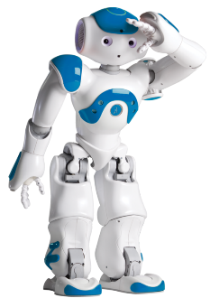
Planning for
Human-Robot Teaming
Full
Problem
Specification
Open World Goals
[IROS09, AAAI10, TIST10]
Problem Updates
[TIST10]
Action Model Information
[HRI12]
PLANNER
Sapa Replan
Assimilate Sensor Information
Handle Human Instructions
[ACS13, IROS14]
Fully Specified
Action Model
Communicate with Human in the Loop
Fully Specified
Goals
Completely Known (Initial) World State
Planning for
Human-Robot Teaming
Replan for the Robot
[AAAI10, DMAP13]
Coordinate with Humans
[IROS14]
Notes:
Make a reference to WATSON here – you can replace the robot with Watson and a lot of the same challenges remain. Can also make a reference to the healthcare (human -> doctor, robot -> Watson) and network security domains.

Slide 23

AI-MIX: System Schematic
COLLABORATIVE
BLACKBOARD
REQUESTER
(Human)
INTERPRETATION
Task specification
Requester goals
Preferences
FORM/MENU
SCHEDULES
PLANNER
Analyze the extracted plan in light of M, and provide critiques
M: Planner’s Model
(Partial)
Human-Computer
Interface
UNSTRUCTURED
STRUCTURED
Crowd’s plan
Sub-goals
New actions
Suggestions
ALERTS
STEERING
CROWD
(Turkers)

Slide 24
Human-in-the-Loop Planning is making inroads at ICAPS..
Several papers that handle these challenges of Human-Aware Planning have been presented at the recent ICAPS (and AAAI and IJCAI)
  Significant help from applications track, robotics track and demonstration track
  Several planning-related papers in non-ICAPS venues (e.g. AAMAS and even CHI) have more in common with the challenges of Human-aware planning
..so consider it for your embedded planning applications

Slide 25
AI-MIX: System Schematic
COLLABORATIVE
BLACKBOARD
REQUESTER
(Human)
INTERPRETATION
Task specification
Requester goals
Preferences
FORM/MENU
SCHEDULES
PLANNER
Analyze the extracted plan in light of M, and provide critiques
M: Planner’s Model
(Partial)
Human-Computer
Interface
UNSTRUCTURED
STRUCTURED
Crowd’s plan
Sub-goals
New actions
Suggestions
ALERTS
STEERING
CROWD
(Turkers)

