Slide 1
Improving Retrieval Accuracy in Web Databases Using Attribute Dependencies
Ravi Gummadi & Anupam Khulbe
gummadi@asu.edu – akhulbe@asu.edu
Computer Science Department
Arizona State University

Slide 2
Agenda
Introduction [Ravi]
SmartINT System [Anupam]
Query Processing [Anupam]
  Source Selection
  Tuple Expansion
Learning [Anupam]
Experiments [Ravi]
Conclusion & Future Work [Ravi]

Slide 3
introduction

Slide 4

Introduction
This describes the imaginary schema containing all the attributes of a vehicle
Consider a table with Universal Relation from vehicle domain
VIN | Make | Vehicle-type | MID | Model | Price | Engine | Miles | Cylinders | Dealer | Address
V001 | Honda | Fullsize | HACC96 | Accord | 19000 | K24A4 | 45k | 6 | Frank | 1011 E Lemon St, Scottsdale, AZ
V002 | Toyota | Midsize | TYCRA08 | Corolla | 14000 | F23A1 | 80k | 4 | Frank | 1011 E Lemon St, Scottsdale, AZ
V003 | Toyota | Midsize | TYCRA09 | Corolla | 16000 | 155 HP | 50k | 4 | John | 900 10th Street, Tucson, AZ
V004 | Toyota | Fullsize | TYCRY09 | Camry | 12000 | 2AZ-FE I4 | 109k | 6 | Steven | 601 Apache Blvd, Glendale, AZ
V005 | Honda | Midsize | HACV08 | Civic | 11500 | F23A1 | 120k | 4 | Frank | 1011 E Lemon St, Scottsdale, AZ
Database Administrator
Introduction
Notes:
This slide breifly introduces the universal table with the tuple set, this setsup the stage for the future discussion on how the normalization is done

Slide 5
Normalized Tables
Lossless Normalization
Dealer-Info
Name | Address
Frank | 1011 E Lemon St, Scottsdale, AZ
Steven | 601 Apache Blvd, Glendale, AZ
John | 900 10th Street, Tucson, AZ
Database Administrator
Car-Reviews
MID | Make | Model | Review | Vehicle-type | Engine | Cylinders
HACC96 | Honda | Accord | Excellent | Midsize | K24A4 | 6
TYCRA08 | Toyota | Corolla | Good | Fullsize | F23A1 | 4
TYCRA09 | Toyota | Corolla | Average | SUV | 155 HP | 4
TYCRY09 | Toyota | Camry | Excellent | Fullsize | 2AZ-FE I4 | 6
HACV08 | Honda | Civic | Very Good | Midsize | F23A1 | 4
Primary Key
VIN | MID | Miles | Dealer | Price
V001 | HACC96 | 45k | Frank | 19000
V002 | TYCRA08 | 80k | Frank | 14000
V003 | TYCRA09 | 50k | John | 16000
V004 | TYCRY09 | 109k | Steven | 12000
V005 | HACV08 | 120k | Frank | 11500
Foreign Key
Introduction
Cars-for-Sale
Notes:
The universal table is normalized in traditional database persay and given a glimpse of how DB query processing is done.

Slide 6
Query Processing
SELECT make, mid, model FROM cars-for-sale c, car-reviews r
WHERE cylinders = 4 AND price < $15k
MID | Make | Model
TYCRA08 | Toyota | Corolla
HACV08 | Honda | Civic
Complete Data
Certain Query
Lossless Normalization
Accurate Results
Introduction
Notes:
Shows how a sample query is processed by illustrating a simple join

Slide 7



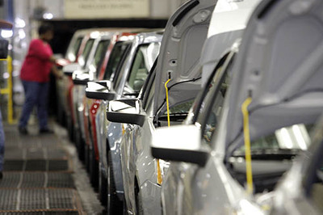
Advent of Web
(in context of Vehicle Domain)
Used Car Dealers
Car Reviewers
Database Administrator
Customers Selling Cars
Engine Makers
Introduction
Notes:
Advent of Web – Its implications

Slide 8
A Sample Data Model
Name | Address
Frank | 1011 E Lemon St, Scottsdale, AZ
Steven | 601 Apache Blvd, Glendale, AZ
John | 900 10th Street, Tucson, AZ
Car Reviewers
Used Car Dealers
Model_name | Review | Vehicle-type | Dealer
Corolla | Excellent | Midsize | Frank
Accord | Good | Fullsize | Frank
Highlander | Average | SUV | John
Camry | Excellent | Fullsize | Steven
Civic | Very Good | Midsize | Frank
MID | Mdl | Engine | Cylinders
HACC96 | Accord | K24A4 | 6
TYCRA08 | Corolla | F23A1 | 4
TYCRA09 | Corolla | 155 HP | 4
TYCRY09 | Camry | 2AZ-FE I4 | 6
HACV08 | Civic | F23A1 | 4
HACV07 | Civic | J27B1 | 4
MID | Make | Model | Price
HACC96 | Honda | Accord | 19000
HACV08 | Honda | Civic | 12000
TYCRY08 | Toyota | Camry | 14500
TYCRA09 | Toyota | Corolla | 14500
Customers Selling Cars
Engine Makers
Introduction

Slide 9
A Sample Data Model
VIN field masked
Hidden Sensitive Information
Name | Address
Frank | 1011 E Lemon St, Scottsdale, AZ
Steven | 601 Apache Blvd, Glendale, AZ
John | 900 10th Street, Tucson, AZ
Key might not be the shared attribute
Used Car Dealers – t_dealer_info
Model_name | Review | Vehicle-type | Dealer
Corolla | Excellent | Midsize | Frank
Accord | Good | Fullsize | Frank
Highlander | Average | SUV | John
Camry | Excellent | Fullsize | Steven
Civic | Very Good | Midsize | Frank
Schema Heterogeneity
Unavailability of Information
Car Reviewers – t_car_reviews
MID | Mdl | Engine | Cylinders
HACC96 | Accord | K24A4 | 6
TYCRA08 | Corolla | F23A1 | 4
TYCRA09 | Corolla | 155 HP | 4
TYCRY09 | Camry | 2AZ-FE I4 | 6
HACV08 | Civic | F23A1 | 4
HACV07 | Civic | J27B1 | 4
MID | Make | Model | Price
HACC96 | Honda | Accord | 19000
HACV08 | Honda | Civic | 12000
TYCRY08 | Toyota | Camry | 14500
TYCRA09 | Toyota | Corolla | 14500
Customers Selling Cars – t_car_sales
Engine Makers – t_eng_makers
Introduction

Slide 10

Vehicles Revisited
Engine Makers
Table 2
Car Reviewers
Table 1
Table 3
Ad-hoc Normalization
Customers Selling Cars
Table 4
User Query
Used Car Dealers
Introduction
Notes:
Modified Data Model

Slide 11
Query is Partial….
SELECT
make, model
FROM
cars
-
for
-
sale c, car
-
reviews r
WHERE
cylinders = 4
AND
price < $15k
The attributes from one source are not visible in other source in WebDBs; the query is not complete
The tables are not visible to the users
Introduction

Slide 12
Approaches – Single Table
Answering queries from a single table
Unable to propagate constraints; Inaccurate results
SELECT make, model WHERE cylinders = 4 AND price < $15k
MID | Make | Model | Price
HACV08 | Honda | Civic | 12000
TYCRY08 | Toyota | Camry | 14500
TYCRA09 | Toyota | Corolla | 14500
Inaccurate Result – Camry has 6 cylinders
Customers Selling Cars
MID | Make | Model | Price
HACC96 | Honda | Accord | 19000
HACV08 | Honda | Civic | 12000
TYCRY08 | Toyota | Camry | 14500
TYCRA09 | Toyota | Corolla | 14500
Introduction

Slide 13
Approaches – Direct Join
Join the tables based on shared attribute
Leads to spurious tuples which do not exist
SELECT make, model WHERE cylinders = 4 AND price < $15k
Make | Price | Mdl | Engine | Cylinders
Honda | 12000 | Civic | F23A1 | 4
Honda | 12000 | Civic | J27B1 | 4
Toyota | 14500 | Corolla | F23A1 | 4
Toyota | 14500 | Corolla | 155 HP | 4
Join the following two tables
Spurious results -
Generates extra tuples
Mdl | Engine | Cylinders
Accord | K24A4 | 6
Corolla | F23A1 | 4
Corolla | 155 HP | 4
Camry | 2AZ-FE I4 | 6
Civic | F23A1 | 4
Civic | J27B1 | 4
Make | Model | Price
Honda | Accord | 19000
Honda | Civic | 12000
Toyota | Camry | 14500
Toyota | Corolla | 14500
Introduction
Customers Selling Cars
Engine Makers

Slide 14
Why is JOIN not working?
The Rules of Normalization
Eliminate Repeating Groups
Eliminate Redundant Data
Eliminate Columns Not Dependent
On Key
Cannot ensure in Autonomous Web Databases
All Columns are dependent on Key in Normalization which is NOT necessarily true in Ad hoc Normalization!!
Introduction
http://www.datamodel.org/NormalizationRules.html

Slide 15
Dependencies….
Shared attribute(s) is not the ‘Key’!
The shared attribute’s relation with other columns is unknown!!
LEARN the dependencies between them
Mine Functional Dependencies (FD) among the columns..
  Neat…works quite well ‘IF ONLY’ the data is clean
  Lot of noisy data in Web Databases
Instead consider
  APPROXIMATE FUNCTIONAL DEPENDENCIES
Introduction

Slide 16
Approximate Functional Dependencies
Approximate Functional Dependencies are rules denoting approximate determinations at attribute level.
  AFDs are of the form (X ~~> Y), where X and Y are sets of attributes
  X is the “determining set” and Y is called “dependent set”
  Rules with singleton dependent sets are of high interest
Examples of AFDs
  (Nationality ~~> Language)
  Make ~~> Model
  (Job Title, Experience) ~~> Salary
Introduction

Slide 17
Using AFDs for Query Processing
These AFDs make up for the missing dependency information between columns.
They help in propagating constraints distributed across tables.
They help in predicting the attributes distribute across tables
They assist in completing the entity information by predicting the related attributes
MID | Make | Model | Price
HACV08 | Honda | Civic | 12000
TYCRA09 | Toyota | Corolla | 14500
Introduction

Slide 18
Summary
Traditional query processing does not hold for Autonomous Web Databases.
Problems like incomplete/Noisy data, imprecise query and ad hoc normalization exist.
Schema Heterogeneity can be countered by existing works.
(Still) Missing PK-FK information lead to inaccurate joins.
Mine Approximate Functional Dependencies and use them to make up for missing PK-FK information.
Introduction

Slide 19
Problem Statement
Given a collection of ad hoc normalized tables, the attribute mappings between the tables and a partial query – return the user an accurate result set covering the majority of attributes described in the universal relation.
Introduction

Slide 20
Agenda
Introduction [Ravi]
SmartINT System [Anupam]
Query Processing [Anupam]
  Source Selection
  Tuple Expansion
Learning [Anupam]
Experiments [Ravi]
Conclusion & Future Work [Ravi]

Slide 21
Smart-int(egrator) &
RElATED WORK

Slide 22
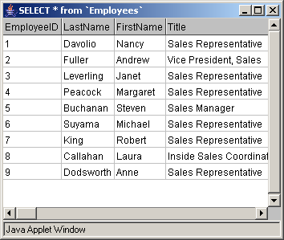

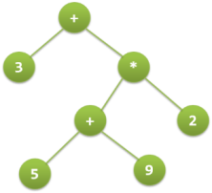
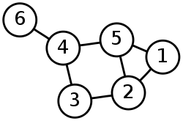
SmartINT Framework
LEARNING
QUERY PROCESSING
QUERY INTERFACE
AFDMiner
Result Set
Tuple
Expansion
Statistics
Learner
Query
Source Selection
Tree of Tables
Graph
of Tables
Web
Database
Attribute Mapping
SmartINT

Slide 23
Related Work – Attribute Mapping
Large body of research over the past few years
Automatic and Manual Approaches
  LSD (Doan et al, SIGMOD 2001)
  Simiflood (Melnik et al, ICDE 2002)
  Cupid (J. Madhavan et al, VLDB 2001)
  SEMINT (Clifton et al, TKDE 2000)
  Clio (Hernandez et al, SIGMOD 2001)
Schema Mapping(Translation Rules) is More Difficult!!
1-1 Attribute mapping is comparatively easier and can be automated
LEARNING
QUERY PROCESSING
QUERY INTERFACE
AFDMiner
Result Set
Tuple
Expansion
Statistics
Learner
Query
Source Selection
Tree of Tables
Graph
of Tables
Web
Database
Attribute Mapping
SmartINT

Slide 24
Related Work – Query Interface
LEARNING
QUERY PROCESSING
QUERY INTERFACE
Imprecise Queries
  Vague (A. Motro, ACM TOIS 1998)
  AIMQ (U. Nambiar et al, ICDE 2006)
  QUIC (Kambhampati et al, CIDR 2007)
Keyword Search
  BANKS (Bhalotia et al, ICDE 2002)
  DISCOVER (Hristdis et al, VLDB 2003)
  KITE (Mayassam et al, ICDE 2007)
PK-FK Assumption does not hold!!
AFDMiner
Result Set
Tuple
Expansion
Statistics
Learner
Query
Source Selection
Tree of Tables
Graph
of Tables
Web
Database
Attribute Mapping
SmartINT

Slide 25
Related Work – Web Database
LEARNING
Query Processing on Web Databases is an important research problem
  Ives at al, SIGMOD 2004
  Lembo et al, KRDB 2002
QPIAD (G. Wolf et al, VLDB 2007) from DB-Yochan, close to ours in spirit, uses AFD based prediction to make up for missing data.
QUERY PROCESSING
QUERY INTERFACE
AFDMiner
Result Set
Tuple
Expansion
Statistics
Learner
Query
Source Selection
Tree of Tables
Graph
of Tables
Web
Database
Attribute Mapping
SmartINT

Slide 26
Related Work – AFD Mining
LEARNING
QUERY PROCESSING
QUERY INTERFACE
AFDMiner
Result Set
FD/AFD Mining is an important problem in DB Community
Mines AFDs as approximation of AFDs with few error tuples
  CORDS
  TANE
Mining them as condensed representation of association rules
  AFDMiner (Kalavagattu, MS Thesis, ASU 2008)
Tuple
Expansion
Statistics
Learner
Query
Source Selection
Tree of Tables
Graph
of Tables
Web
Database
Attribute Mapping
SmartINT

Slide 27
Agenda
Introduction [Ravi]
SmartINT System [Anupam]
Query Processing [Anupam]
  Source Selection
  Tuple Expansion
Learning [Anupam]
Experiments [Ravi]
Conclusion & Future Work [Ravi]

Slide 28
Query processing
LEARNING
QUERY PROCESSING
QUERY INTERFACE
AFDMiner
Result Set
Tuple
Expansion
Statistics
Learner
Query
Source Selection
Tree of Tables
Graph
of Tables
Web
Database
Attribute Mapping

Slide 29
Query Answering Task
SELECT Make, Vehicle-type WHERE cylinders = 4 AND price < $15k
Result set should adhere to all the constraints distributed across tables
Distributed constraints
Make | Model | Price
Honda | Accord | 19000
Honda | Civic | 12000
Toyota | Camry | 14500
Toyota | Corolla | 14500
Make | Model | Price
Honda | Accord | 19000
Honda | Civic | 12000
Toyota | Camry | 14500
Toyota | Corolla | 14500
Make | Model | Price
Honda | Accord | 19000
Honda | Civic | 12000
Toyota | Camry | 14500
Toyota | Corolla | 14500
Distributed attributes
Attribute Match
Model_name | Review | Vehicle-type | Dealer
Corolla | Excellent | Midsize | Frank
Accord | Good | Fullsize | Frank
Highlander | Average | SUV | John
Camry | Excellent | Fullsize | Steven
Civic | Very Good | Midsize | Frank
Model_name | Review | Vehicle-type | Dealer
Corolla | Excellent | Midsize | Frank
Accord | Good | Fullsize | Frank
Highlander | Average | SUV | John
Camry | Excellent | Fullsize | Steven
Civic | Very Good | Midsize | Frank
Mdl | Engine | Cylinders
Accord | K24A4 | 6
Corolla | F23A1 | 4
Corolla | 155 HP | 4
Camry | 2AZ-FE I4 | 6
Civic | F23A1 | 4
Civic | J27B1 | 4
Mdl | Engine | Cylinders
Accord | K24A4 | 6
Corolla | F23A1 | 4
Corolla | 155 HP | 4
Camry | 2AZ-FE I4 | 6
Civic | F23A1 | 4
Civic | J27B1 | 4
Attributes need to
be integrated
Name | Address
Frank | 1011 E Lemon St, Scottsdale, AZ
Steven | 601 Apache Blvd, Glendale, AZ
John | 900 10th Street, Tucson, AZ
Query Processing

Slide 30
Query Answering Approach
Select a tree
Process root table constraints to generate “seed” tuples
Make | Model | Price
Honda | Accord | 19000
Honda | Civic | 12000
Toyota | Camry | 14500
Toyota | Corolla | 14500
Make | Model | Price
Honda | Accord | 19000
Honda | Civic | 12000
Toyota | Camry | 14500
Toyota | Corolla | 14500
Propagate constraints to the root table
Direction of constraint propagation and attribute prediction matters!
Model_name | Review | Vehicle-type | Dealer
Corolla | Excellent | Midsize | Frank
Accord | Good | Fullsize | Frank
Highlander | Average | SUV | John
Camry | Excellent | Fullsize | Steven
Civic | Very Good | Midsize | Frank
Mdl | Engine | Cylinders
Accord | K24A4 | 6
Corolla | F23A1 | 4
Corolla | 155 HP | 4
Camry | 2AZ-FE I4 | 6
Civic | F23A1 | 4
Civic | J27B1 | 4
Predict attributes using AFDs to expand seed tuples
Role of AFDs
Accuracy of constraint propagation and
attribute prediction depends on AFD confidence
Name | Address
Frank | 1011 E Lemon St, Scottsdale, AZ
Steven | 601 Apache Blvd, Glendale, AZ
John | 900 10th Street, Tucson, AZ
Query Processing

Slide 31
SourCE selection
QUERY PROCESSING
Tuple
Expansion
Query
Source Selection
Tree of Tables

Slide 32
Selecting the best tree
Objective: Given a graph of tables and a query,
select the most relevant tree of tables of size up to k
1
2
4
Source Selection
4
2
3
3
5
6
Query
Requirements
Need to estimate relevance of a table, when some of the constraints are not mapped on to its attributes
Need a relevance function for a tree of tables
Source Selection

Slide 33
Constraint Propagation
Table 1
< 15k
Table 1
Make | Model | Price
Honda | Accord | 19000
Honda | Civic | 12000
Toyota | Camry | 14500
Toyota | Corolla | 14500
Make | Model | Price
Honda | Accord | 19000
Honda | Civic | 12000
Toyota | Camry | 14500
Toyota | Corolla | 14500
Model = Corolla or Civic
Table 2
Table 2
Mdl | Engine | Cylinders
Accord | K24A4 | 6
Corolla | F23A1 | 4
Corolla | 155 HP | 4
Camry | 2AZ-FE I4 | 6
Civic | F23A1 | 4
Civic | J27B1 | 4
Mdl | Engine | Cylinders
Accord | K24A4 | 6
Corolla | F23A1 | 4
Corolla | 155 HP | 4
Camry | 2AZ-FE I4 | 6
Civic | F23A1 | 4
Civic | J27B1 | 4
= 4
= 4
Propagate
Cylinders = 4 to Table 1
Distributed constraints
Other information
AFD provides the cond. probability P₂(Cylinders = 4 | Mdl = model_{i})
Source Selection

Slide 34

Relevance of a tree
Factors?
T1
C₁: Price< 15k
Make | Model | Price
Honda | Accord | 19000
Honda | Civic | 12000
Toyota | Camry | 14500
Toyota | Corolla | 14500
1. Root table relevance
Relevance of tree T w.r.t query q
Here,
C₂: Model = ‘Corolla’ or
‘Civic’
T2
Mdl | Engine | Cylinders
Accord | K24A4 | 6
Corolla | F23A1 | 4
Corolla | 155 HP | 4
Camry | 2AZ-FE I4 | 6
Civic | F23A1 | 4
Civic | J27B1 | 4
T3
Model_name | Review | Vehicle-type | Dealer
Corolla | Excellent | Midsize | Frank
Accord | Good | Fullsize | Frank
Highlander | Average | SUV | John
Camry | Excellent | Fullsize | Steven
Civic | Very Good | Midsize | Frank
2. Value overlap:
What fraction of tuples in base-table can be expanded by child table
3. AFD Confidence: How accurately can the value be predicted?
Source Selection

Slide 35


Relevance of a table
Factors?
Make | Model | Price
Honda | Accord | 19000
Honda | Civic | 12000
Toyota | Camry | 14500
Toyota | Corolla | 14500
C₁: Price< 15k
Fraction of query attributes provided
- horizontal relevance
C₂: Model = ‘Corolla’ or
‘Civic’
Mdl | Engine | Cylinders
Accord | K24A4 | 6
Corolla | F23A1 | 4
Corolla | 155 HP | 4
Camry | 2AZ-FE I4 | 6
Civic | F23A1 | 4
Civic | J27B1 | 4
2. Conformance to constraints - vertical relevance
= 4
SELECT Make, Vehicle-type WHERE cylinders = 4 AND price < $15k
Source Selection

Slide 36
Tuple expansion
QUERY PROCESSING
Tuple
Expansion
Query
Source Selection
Tree of Tables

Slide 37
Tuple Expansion
Tuple expansion operates on the tree of tables given by source selection
It has two main steps
  Constructing the Schema
  Populating the tuples

Slide 38
Phase 1: Constructing schema
Tree of tables
Table 1
Make | Model | Price
Honda | Accord | 19000
Honda | Civic | 12000
Toyota | Camry | 14500
Toyota | Corolla | 14500
Make | Model | Price
Table 3
Model_name | Review | Vehicle-type | Dealer
Corolla | Excellent | Midsize | Frank
Accord | Good | Fullsize | Frank
Highlander | Average | SUV | John
Camry | Excellent | Fullsize | Steven
Civic | Very Good | Midsize | Frank
Model_name | Review | Vehicle-type | Dealer
Corolla | Excellent | Midsize | Frank
Accord | Good | Fullsize | Frank
Highlander | Average | SUV | John
Camry | Excellent | Fullsize | Steven
Civic | Very Good | Midsize | Frank
Model_name | Vehicle-type
SELECT Make, Vehicle-type WHERE cylinders = 4 AND price < $15k
Constructed schema
Tuple Expansion

Slide 39
Phase 2: Populating the tuples
Local constraint
Price < 15k
Make | Model | Price
Honda | Accord | 19000
Honda | Civic | 12000
Toyota | Camry | 14500
Toyota | Corolla | 14500
Make | Model | Vehicle-type
Honda | Civic
Toyota | Corolla
Make | Model | Vehicle-type
Honda | Civic | Midsize
Toyota | Corolla | Midsize
Model_name | Vehicle-type
Corolla | Midsize
Accord | Fullsize
Highlander | SUV
Camry | Fullsize
Civic | Midsize
Evaluate constraints
Predict Vehicle-type
Translated constraint
Model = Corolla or Civic
Tuple Expansion

Slide 40
Agenda
Introduction [Ravi]
SmartINT System [Anupam]
Query Processing [Anupam]
  Source Selection
  Tuple Expansion
Learning [Anupam]
Experiments [Ravi]
Conclusion & Future Work [Ravi]

Slide 41
LEARNING
LEARNING
QUERY PROCESSING
QUERY INTERFACE
AFDMiner
Result Set
Tuple
Expansion
Statistics
Learner
Query
Source Selection
Tree of Tables
Graph
of Tables
Web
Database
Attribute Mapping

Slide 42
AFD Mining
The problem of AFD Mining is learn all AFDs that hold over a given relational table
Two costs:
  1. Major cost is the Combinatoric cost of traversing the search space
  2. Cost of visiting data to validate each rule
  (To compute the interestingness measures)
Search process for AFDs is exponential in terms of the number of attributes
Learning

Slide 43
Specificity
Normalized with the worst case Specificity i.e., X is a key
The Specificity measure captures our intuition of different types of AFDs.
It is based on information entropy
  Shares similar motivations with the way SplitInfo is defined in decision trees while computing Information Gain Ratio
Follows Monotonicity
  The Specificity of a subset is equal to or lower than the Specificity of the set. (based on Apriori property)
Learning

Slide 44
Lattice Traversal
Specificity Follows
Monotonicity
ABCD
All these nodes are pruned off
ABC
ABD
ACD
BCD
AFDMiner mines rules with High Confidence and Low Specificity which are apt for works like QPIAD, but SmartINT requires rules with High Specificity. So we change the direction of traversal so that we can use the monotonicity of Specificity to prune more nodes.
AB
AC
AD
BC
BD
CD
A
B
C
D
Upper bound on Specificity – bottom up makes sense
Traversal direction through the lattice depends on the pruning techniques available
Reaches the Specificity threshold
Ǿ
Learning

Slide 45
Lattice Traversal
Specificity Follows
Monotonicity
Lower bound on Specificity – Top down makes sense
ABCD
Reaches the Specificity threshold
ABC
ABD
ACD
BCD
AB
AC
AD
BC
BD
CD
All these nodes are pruned off
A
B
C
D
Traversal direction through the lattice depends on the pruning techniques available
Ǿ
Learning

Slide 46
Pruning Strategies
Pruning off non-shared Attributes
  SmartINT is not interested in non-shared attributes in the determining set. It is only interested in rules with shared attributes in determining set.
Pruning by Specificity
  Specificity(Y) ≥ Specificity(X), where Y is a superset of X
  If Specificity(X) < minSpecificity, we can prune all AFDs with X and its subsets as the determining set
Learning

Slide 47
Agenda
Introduction [Ravi]
SmartINT System [Anupam]
Query Processing [Anupam]
  Source Selection
  Tuple Expansion
Learning [Anupam]
Experiments [Ravi]
Conclusion & Future Work [Ravi]

Slide 48
Experimental evaluation

Slide 49
Experimental Hypothesis
In the context of Autonomous Web Databases, If you Learn Approximate Functional Dependencies (AFDs) and use them in query answering, then it would result in a better retrieval accuracy than using direct-join or single-table approaches.

Slide 50
Experimental Setup
Performed experiments over Vehicle data crawled from Google Base
350,000 Tuples
Generated different partitions of the tables
Posed queries on the data with varying projected attributes and varying constraints
Implemented in Java
  Source code at the following location [In development]
  http://24cross7.svnrepository.com/svn/sorcerer/trunk/code/smartintweb
Data stored in MySQL database
Experiments

Slide 51
Evaluation Methodology
We should have the ‘Oracular Truth’ to compare the approaches
MASTER TABLE - Table containing all the tuples with the universal relation which serves as oracular truth
Splitting MASTER TABLE into different partitions
Issue queries over both partitioned tables and master table – Compare the results and measure precision
Experiments

Slide 52
Correctness & Completeness
Lets consider the following tuple from Master Table (Ground Truth)
Tuple from Master Table (8 Attributes)
Correctness of a tuple = fraction of correct values
Here it is 3/6
Completeness of a tuple =
Total number of values retrieved
Here it is 6/8
Tuple from one of the approaches (6 Attributes)
RIGHT | WRONG | RIGHT | WRONG | RIGHT | WRONG
Need two metrics analogous to Precision and Recall at the tuple level
The following is the tuple from one of the approaches
Experiments

Slide 53
Precision & Recall
Result Set from Master Table (8 Attributes)
Precision
=
Average Correctness of the tuple
Result Set from one of the approaches (6 Attributes)
RIGHT | WRONG | RIGHT | WRONG | RIGHT | WRONG
Recall
=
Cumulative completeness of tuples returned
Experiments

Slide 54
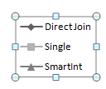
Varying No. of Projected Attributes
Around 0.55
improvement
In F-measure….
Experiments

Slide 55
Varying No. of Constraints
Experiments

Slide 56
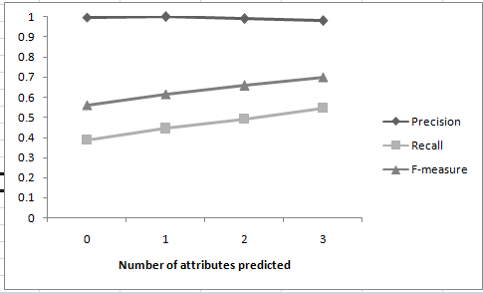
Other Experiments
Comparison with Multiple Join Paths
SmartINT performed better than all possible joins
Variable Width Expansion
The dip in F-measure can be used to stop the expansion
Experiments

Slide 57
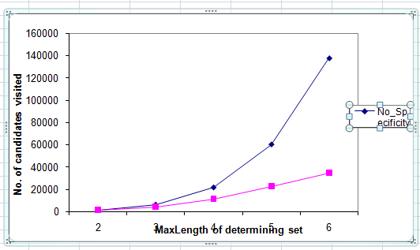
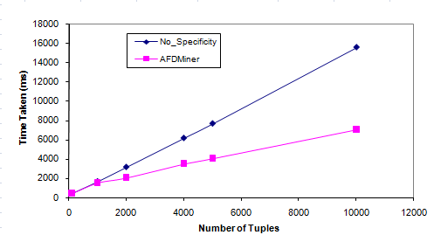
Learning Evaluation
AFDMiner performs better than TANE approach
The execution time and the quality of AFDs are both higher than TANE
Kalavagattu 2008 – M.S Thesis
Experiments

Slide 58
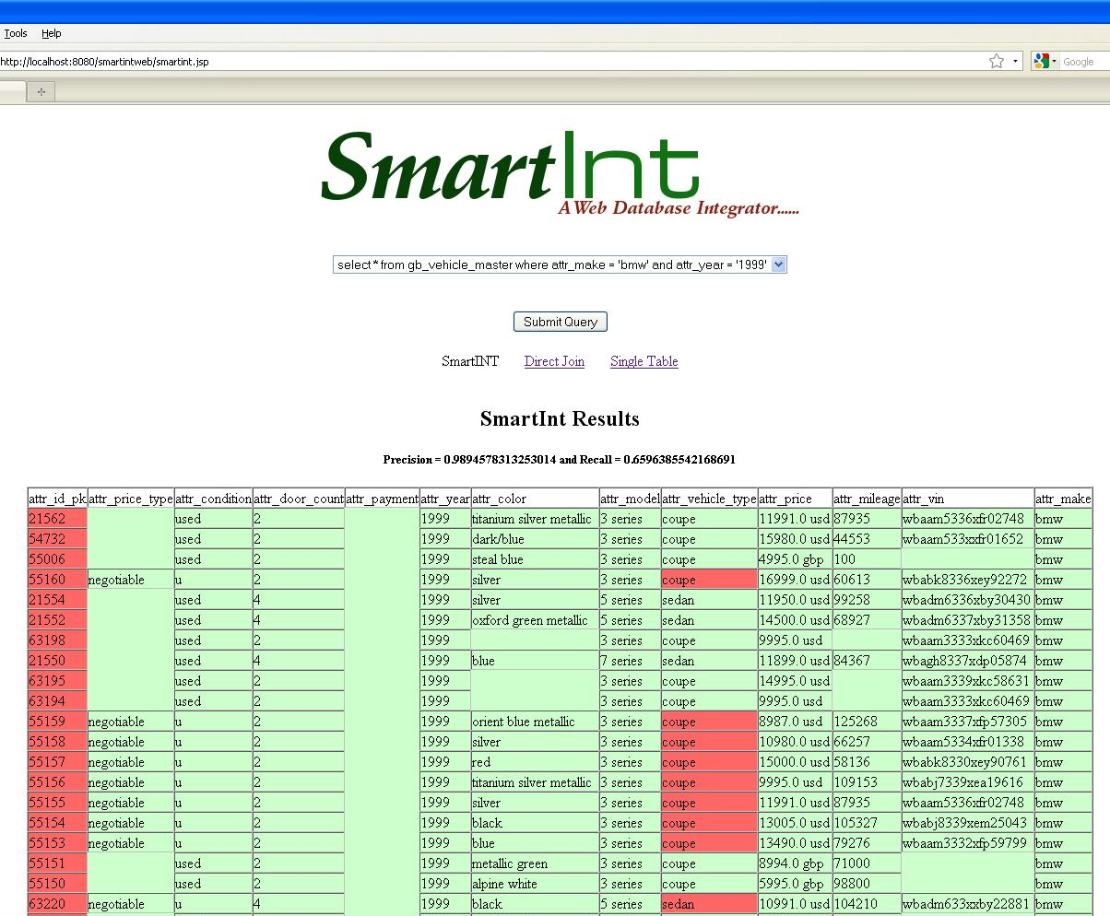
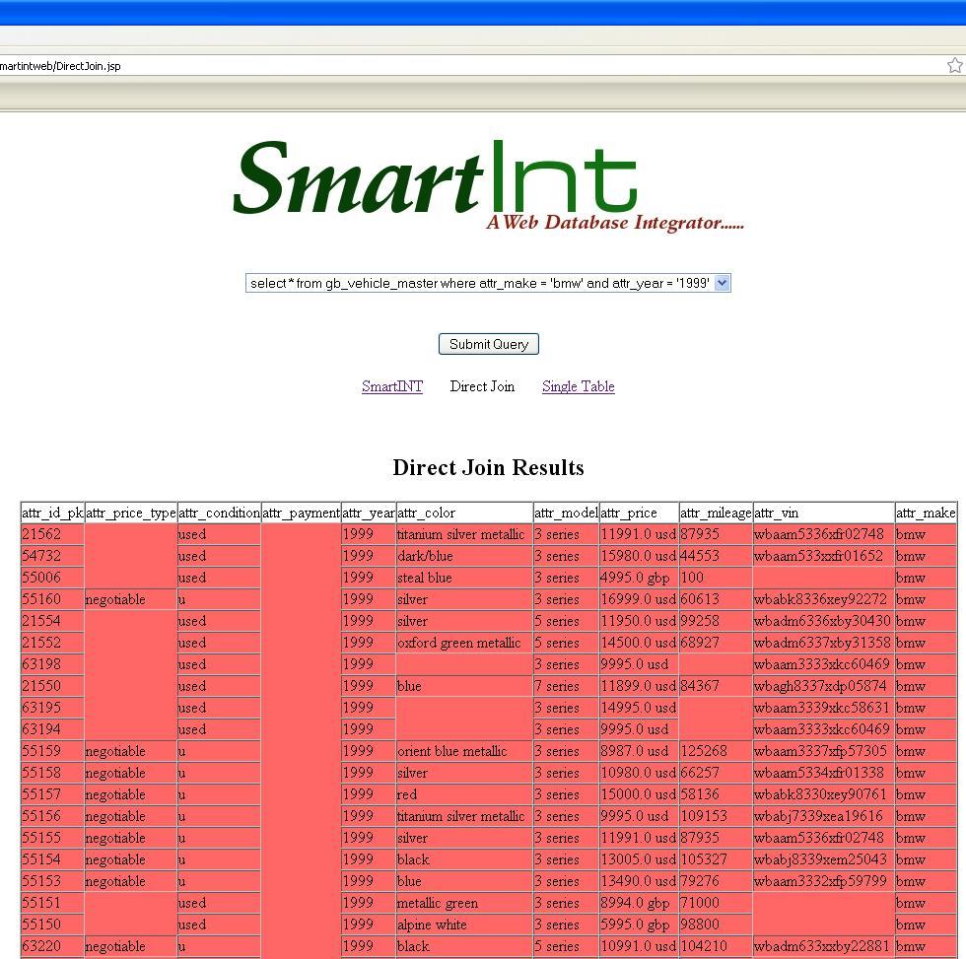
DEMO [work in progress]
http://149.169.227.245:8080/smartintweb/
Experiments

Slide 59
Agenda
Introduction [Ravi]
SmartINT System [Anupam]
Query Processing [Anupam]
  Source Selection
  Tuple Expansion
Learning [Anupam]
Experiments [Ravi]
Conclusion & Future Work [Ravi]

Slide 60
Conclusion &
FUTURE WORK

Slide 61
Conclusion
Autonomous Web Databases call for novel systems to counter the problems due to uncertainty of the Web.
SmartINT makes an effort to answer one such issue – Missing PK-FK
The system gave good improvement in terms of F-measure over approaches like Single Table and Direct Join.
Conclusion and Future Work

Slide 62
Autonomous Web Traditional Database
DB Yochan
QPIAD
(VLDB ‘07, VLDBJ ‘09)
AIMQ(ICDE ‘06)
QUIC(CIDR ‘07)
SmartINT
(Submitted to ICDE ‘09)
Incomplete Complete Data
Imprecise Certain Query
Ad hoc
Lossless Normalization
Probabilistic Accurate Results
Conclusion and Future Work

Slide 63
Future Work
Back-door JOIN
  Can SmartINT be used as back-door approach to join tables?
  SmartINT performs as good as other systems when PK-FK relation is present
  In the absence of such information, other systems fail whereas SmartINT gives good accuracy
Vertical Aggregation
  Taking into account the vertical overlap between the tables
  In the absence of substantial overlap, the strength of AFDs would not help you to retrieve accurate results
Discover Key Info
  Using AFDMiner to discover key information
Conclusion and Future Work

Slide 64
Future Work
Top ‘KW’ search
  Striking a balance between the number of tuples and width of the tuple.
  The more you expand the less precise the results are going to be
Diverse results
  Providing the user with diverse set of results.
Conclusion and Future Work

Slide 65
Thank you…
Prof. Subbarao Kambhampati
Prof. Pat Langley
Prof. Jieping Ye
Special thanks to
  Aravind Kalavagattu
  Raju Balakrishnan

Slide 66

questions

Slide 67
Individual Contribution
Problem Identification and Formulization
  Identifying the problem: Joint work
  Using AFDs for Tuple Expansion: Gummadi
  Source Selection: Khulbe
System Development and Evaluation
  Initial framework setup: Gummadi
  Tuple Expansion, Experiments (Multiple join paths, variable widthe expansion): Gummadi
  Source Selection, Experiments (comparison with direct-join and single table approaches): Khulbe
Writing
  Introduction, Related Work, System Description: Gummadi
  Preliminaries, Source Selection: Khulbe
  Experiments: Joint Work
  Learning: Aravind Kalavagattu

Slide 68
- END –
Extra Slides (DO NOT PRINT)

Slide 69
SmartINT Framework
LEARNING
QUERY PROCESSING
QUERY INTERFACE
AFDMiner
Result Set
Tuple
Expansion
Statistics
Learner
Query
Source Selection
Tree of Tables
Graph
of Tables
Web
Database
Attribute Mapping

Slide 70
Schema Heterogeneity
Schema Heterogeneity is a well studied problem in Databases and many off-the-shelf approaches are available to solve it. [Doan et al]
Full schema mappings are not needed; Just attribute mappings are sufficient to answer the queries. [SimiFlood]

Slide 71
Attribute Mapping
Do we need this work if we have full Schema Mappings?
  No
Do we need this work if we have full Attribute Mappings?
  Yes
Schema Mapping Vs Attribute Mappings
  Interchangeably used – but not the same
  Full schema mapping allow full query processing

Slide 72

Connection to DB Yochan
Traditional DB
Autonomous
DB
Yochan
Web
DB
Complete
Incomplete
QPIAD
Data
Data
(VLDB
‘07)
Certain Query
Imprecise
QUIC
Query
(CIDR
‘07)
Lossless
Ad
-
hoc
SmartINT
(Submitted to ICDE ‘09)
Normalization
Normalization

Slide 73
Connection to DB Yochan
Traditional DB | Autonomous Web DB | DB Yochan
Certain Data | Missing Data | QPIAD (VLDB ‘07)
Certain Query | Imprecise Query | QUIC (CIDR ‘07)
Lossless Normalization | Ad-hoc Normalization | SmartINT

Slide 74
- Aravind DEFENSE SLIDES -
EXTRA REFERENCE

Slide 75
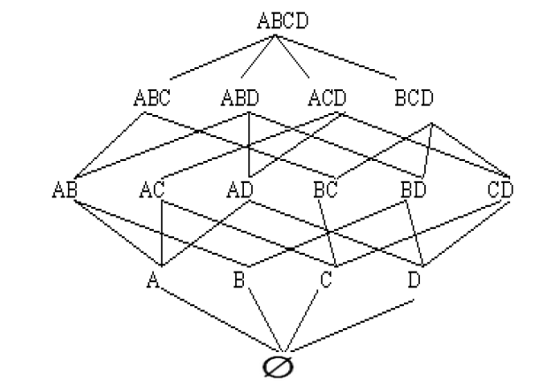
AFDMiner algorithm
Search starts from singleton sets of attributes and works its way to larger attribute sets through the set containment lattice level by level.
When the algorithm is processing a set X, it tests AFDs of the form
(X \{A})~~>A), where
AєX.
Information from previous levels is captured by maintaining RHS+ Candidate Sets for each set.

Slide 76
Traversal in the Search Space
During the bottom-up breadth-first search, the stopping criteria at a node are:
The AFD confidence becomes 1, and thus it is an FD.
The Specificity value of the X is greater than the max value given.
FD based Pruning
Specificity based Pruning
Example:
A→C is an FD
Then, C is removed from RHS+(ABC)
Notes:
Put text boxes (vaalipoinavi) saying pruning is applicable

Slide 77
Computing Confidence and Specificity
Methods are based on representing attribute sets by equivalence class partitions of the set of tuples
And, ∏_{X} is the collection of equivalence classes of tuples for attribute set X
Example:
  ∏_{make} = {{1, 2, 3, 4, 5}, {6, 7, 8}}
  ∏_{model} = {{1, 2, 3}, {4, 5}, {6}, {7, 8}}
  ∏_{{make U model}} = {{1, 2, 3}, {4, 5}, {6}, {7, 8}}
A functional dependency holds if ∏_{X} = ∏_{XUA}
For the AFD (X~~>A),
  Confidence = 1 – g₃(X~~>A)
In this example, Confidence(Model ~~>Make) = 1
Confidence(Make~~>Model) = 5/8

Slide 78
Algorithms
Algorithm AFDMiner:
Computes Confidence
Applies FD-based pruning
Computes Specificity and applies pruning
Computes level L_{l+1}
L_{l+1} contains only those attribute sets of size l+1 which have their subsets of size l in L_{l}

