Slide 1
Temporal Probabilistic Models

Slide 2
Temporal (Sequential) Process
A temporal process is the evolution of system state over time
Often the system state is hidden, and we need to reconstruct the state from the observations
Relation to Planning:
When you are observing a temporal process, you are observing the execution trace of someone else’s plan…

Slide 3
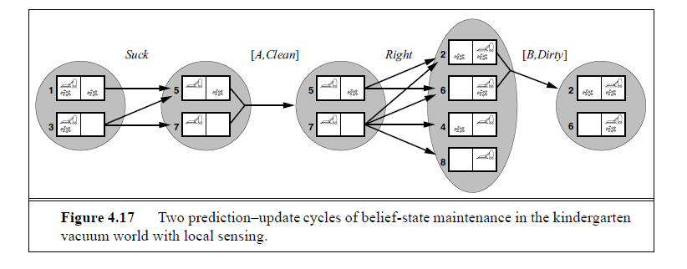
State Estimation…
In non-deterministic scenarios, observation from a state had to be certain
I.e., P(o|s) must be either 0 or 1. Saying “state s may give observation o
doesn’t make sense since there is no way of exploiting that information.
In stochastic scenarios, P(o|s) can be a number between 0 and 1, and this
makes for pretty interesting reasoning opportunities..

Slide 5
Stationarity assumption over time
is akin to “relational” assumption
over objects

Slide 7
Dynamic Bayes Networks are “templates” for specifying the relation between
the values of a random variable across time-slices
→e.g. How is Rain at time t related to Rain at time t+1?
We call them templates because they need to be expanded (unfolded) to the
required number of time steps to reason about the connection between
variables at different time points

Slide 8
Most inference tasks
in DBNs will be about
posterior distributions
over single or multiple
state variables.
While DBNs are special cases of B.N.’s there are a certain inference tasks that are
particularly frequently useful for them (Notice that all of them involve estimating
posterior probability distributions—as is done in any B.N. inference)

Slide 9
Can do much better if we exploit the repetitive structure
Both Exact and Approximate B.N. Inference methods can be made to
take the temporal structure into account.
→Specialized variable-elimination method
→Unfold t+1th level, and roll-up t^{th} level by variable elimination
→Specialized Likelihood-weighting methods that take evidence
into account
→Particle Filtering Techniques

Slide 11
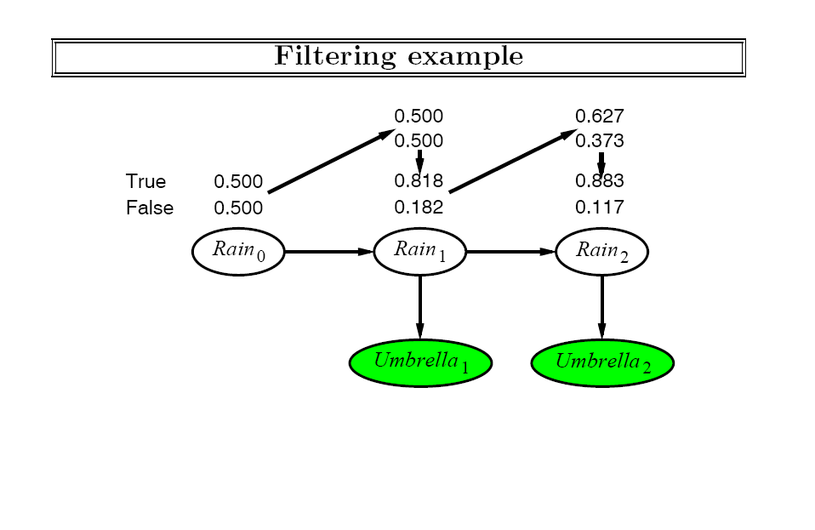

Slide 12
Can do much better if we exploit the repetitive structure
Both Exact and Approximate B.N. Inference methods can be made to
take the temporal structure into account.
→Specialized variable-elimination method
→Unfold t+1th level, and roll-up t^{th} level by variable elimination
→Specialized Likelihood-weighting methods that take evidence
into account
→Particle Filtering Techniques

Slide 13
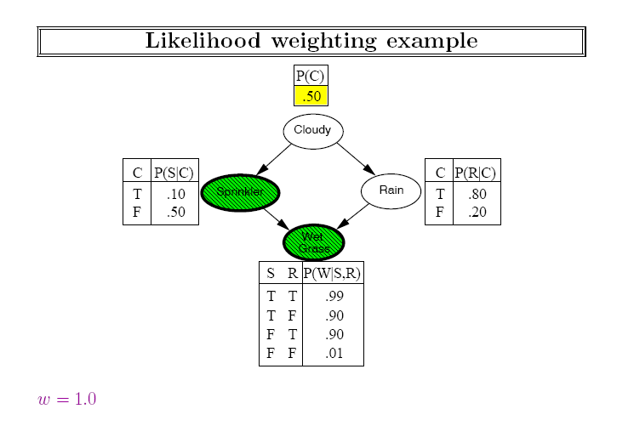

Slide 14
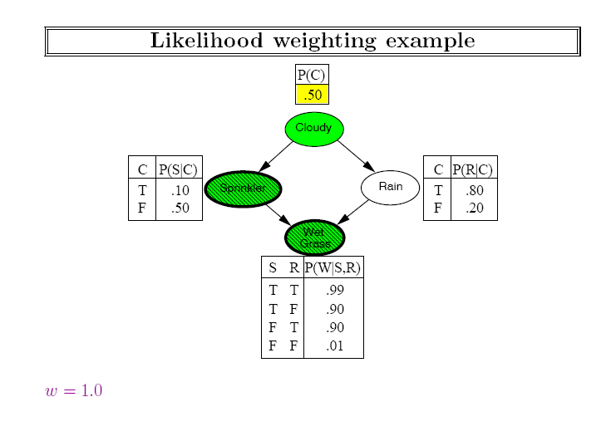

Slide 16
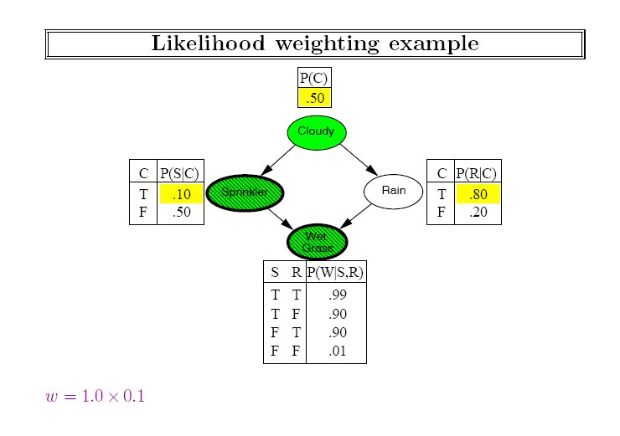

Slide 17
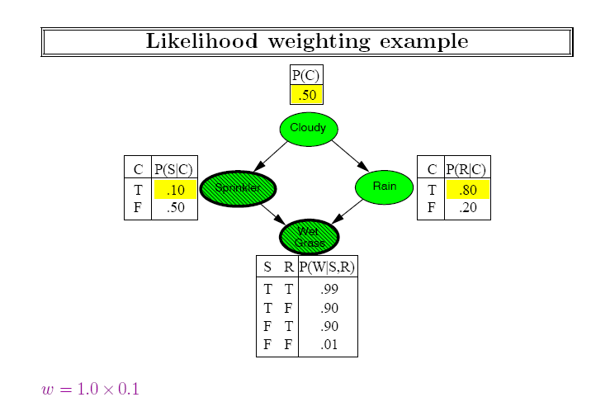

Slide 18
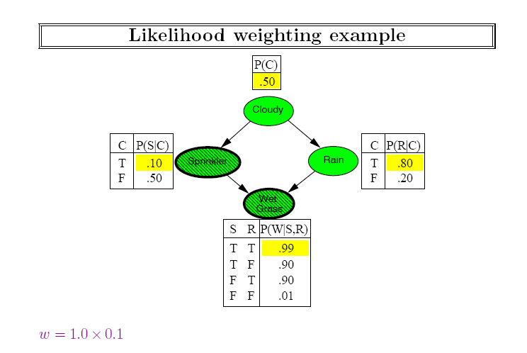

Slide 19
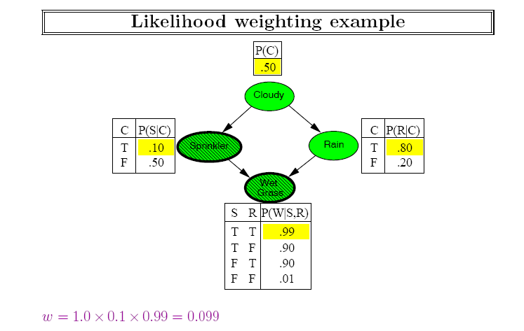
Notice that to attach the likelihood to the evidence, we are using
the CPTs in the bayes net. (Model-free empirical observation,
in contrast, either gives you a sample or not; we can’t get fractional samples)

Slide 21
Normal LW doesn’t do
well when the evidence
is downstream
(the sample weight
will be too small)
In DBN, none of the evidence
is affecting the sampling!
EVEN MORE of an issue
Normal LW takes each
sample through the network
one by one
Idea 1: Take then all from
t to t+1 lock-step
→the samples are the
distribution

Slide 22
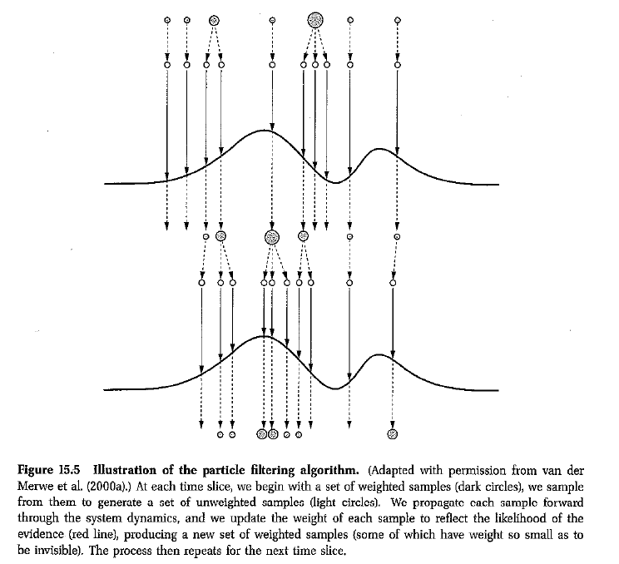
Idea: Put samples back
into high probability
regions
(particle ~ sample)

Slide 23
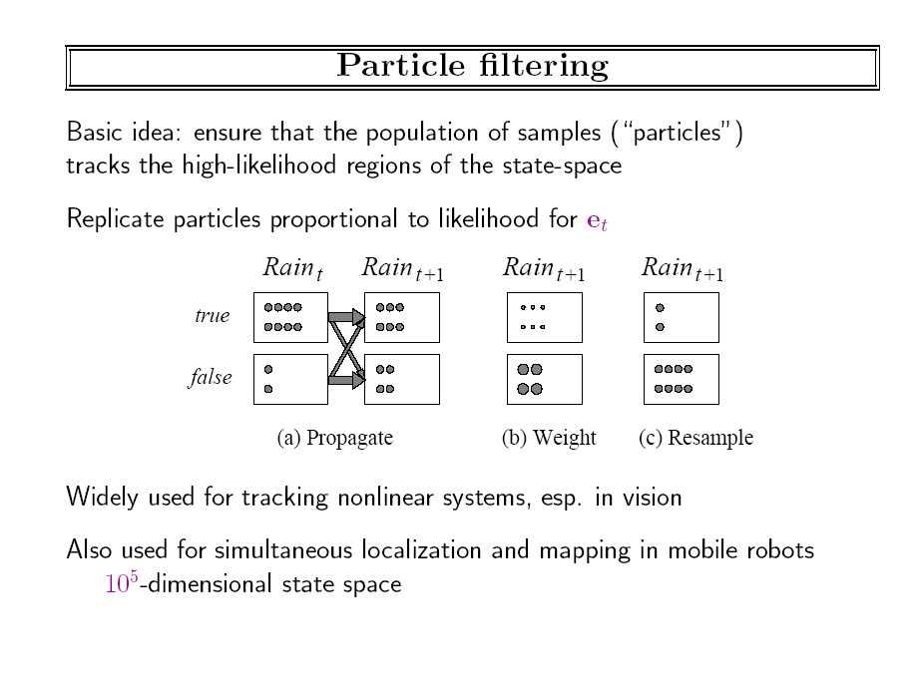

Slide 24
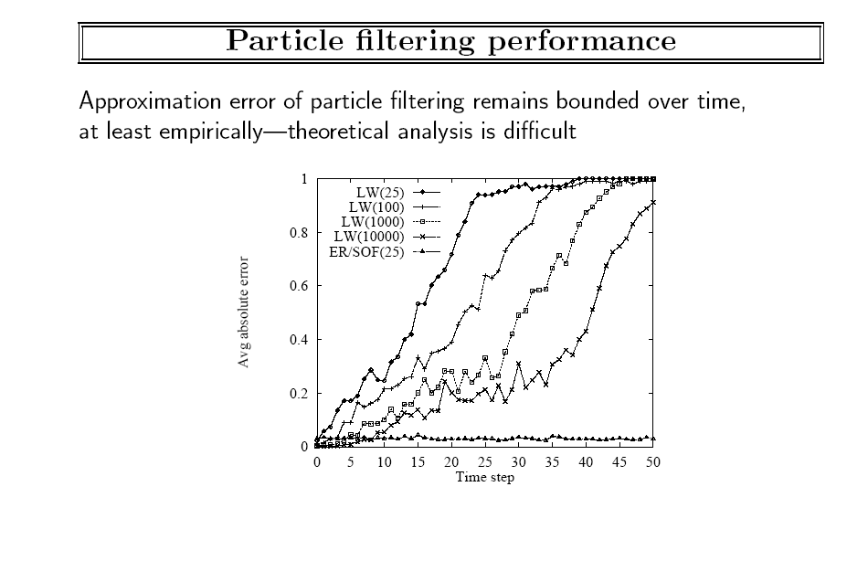

Slide 25
A Robot localizing itself using particle filters

Slide 26
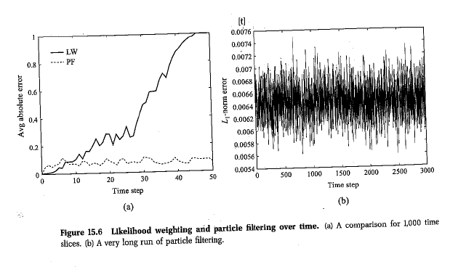

Slide 27
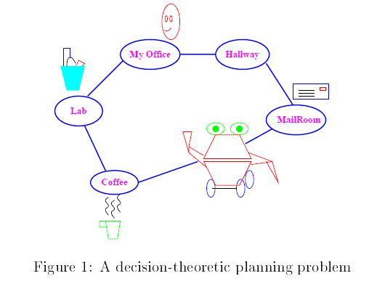
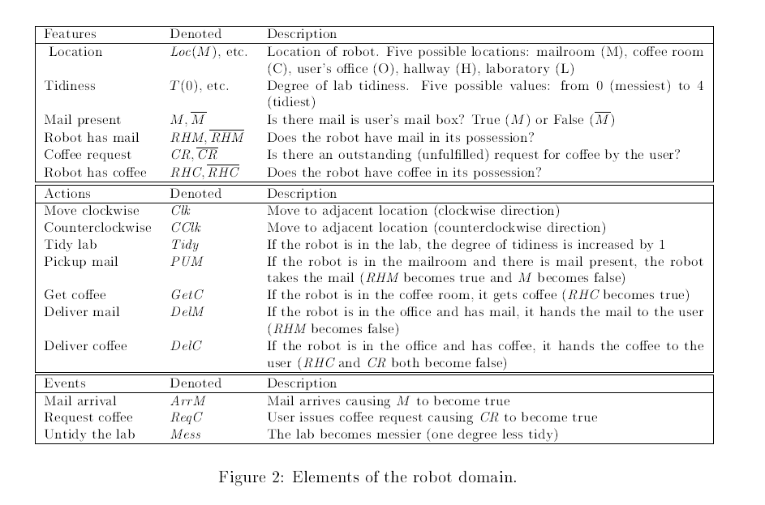
Factored action
representations for MDPs
Based on
Section 4.2
of Boutilier,
Hanks & Dean

Slide 28
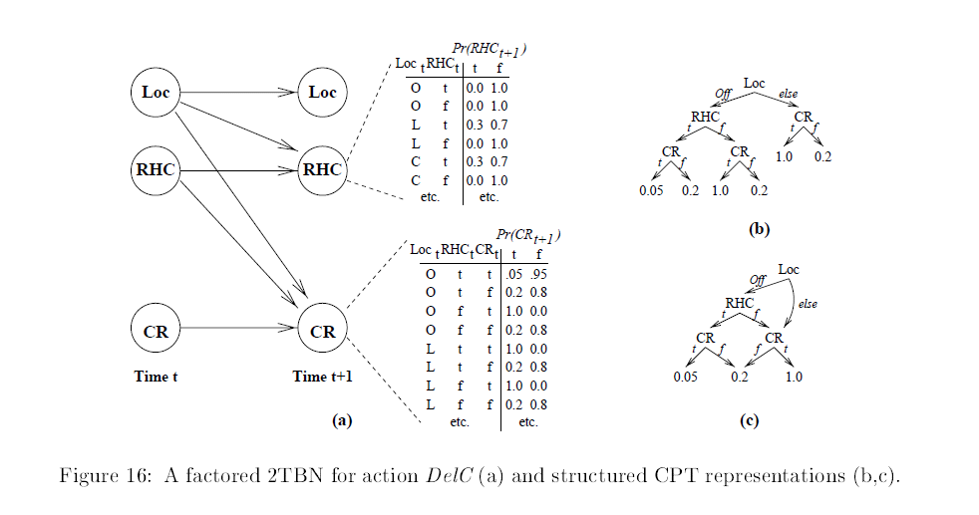

Slide 29
What does IPPC use?

Slide 30
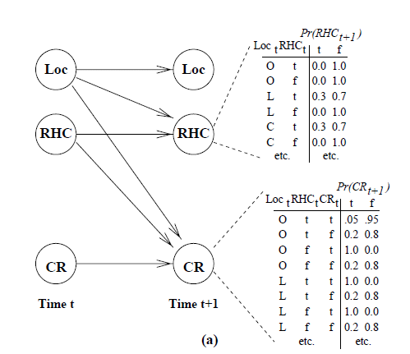
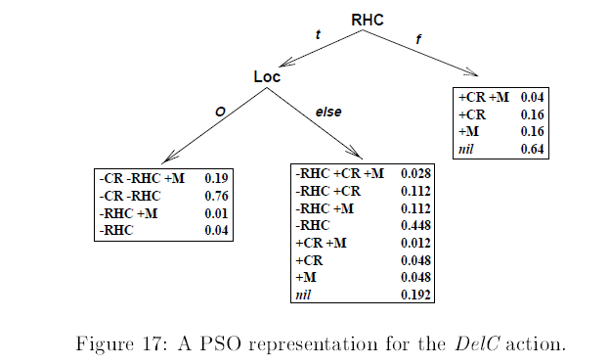
Synchronic vs. diachronic dependencies
Simple 2-TBN have only diachronic dependencies
2-TBNs model effect on each
each variable separately
→Need “persistence” links
over unaffected variables
PSO’s (probabilistic STRIPS operators)
Explicitly represent complete outcomes
→bad when an action has multiple
independent stochastic effects

Slide 32
Special Cases of DBNs are well known in the literature
Restrict number of variables per state
Markov Chain: DBN with one variable that is fully observable
Hidden Markov Model: DBN with only one state variable that is hidden and can be estimated through evidence variable(s)
Restrict the type of CPD
Kalman Filters: DBN where the system transition function as well as the observation variable are linear gaussian
The advantage of Gaussians is that the posterior distribution remains Gaussian

Slide 39
Class Ended here.. Slides beyond this not discussed

Slide 40
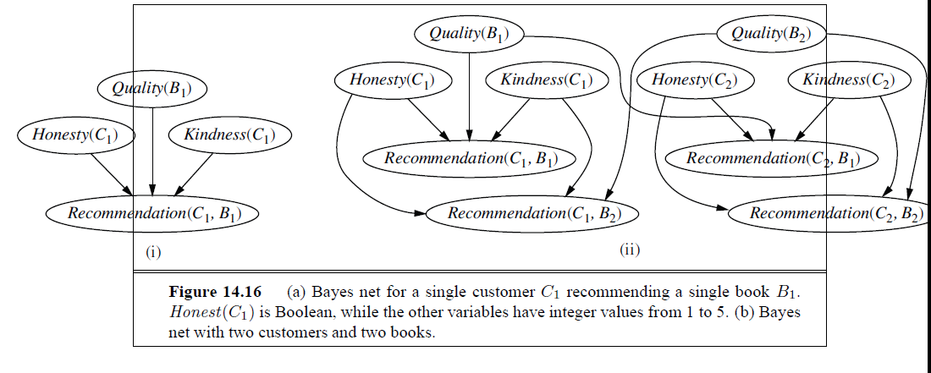

Slide 41
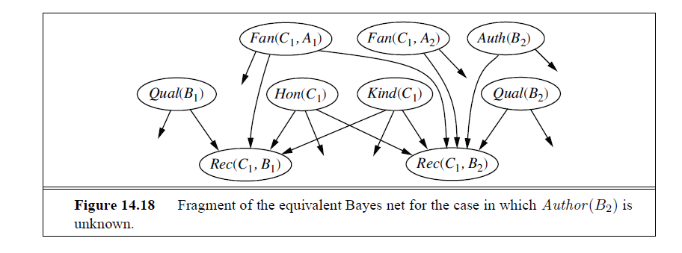

Slide 45
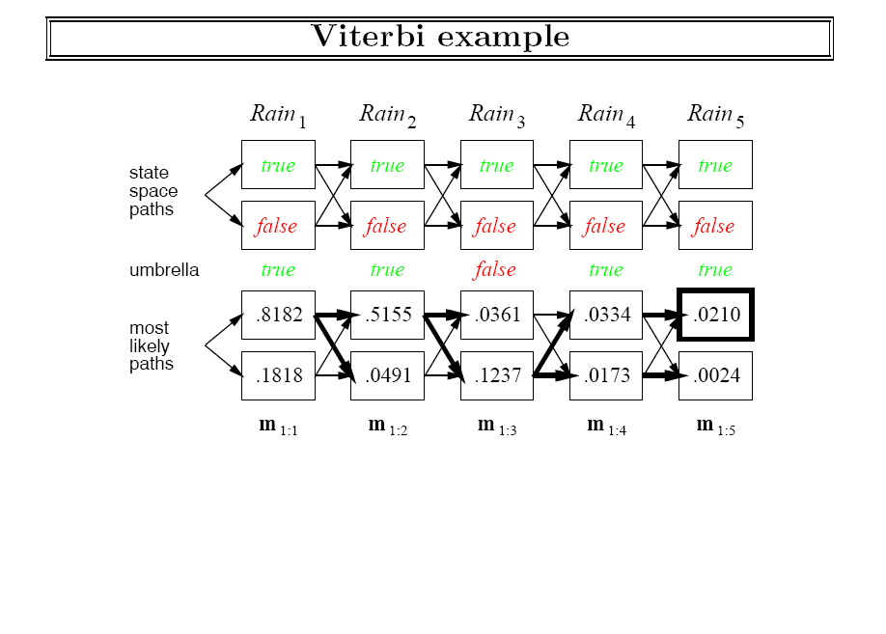

Slide 48
