Slide 1
Statistical Modeling of Text
(Can be seen as an application of probabilistic graphical models)
Best reading supplement for just LDA :
http://rakaposhi.eas.asu.edu/cse571/lda-lsa-reading.pdf
(the original JMLR paper by Blei et al is also good)

Slide 2
Modeling Text Documents
Documents are sequences are words
  D = [p1=w1 p2=w2 p3=w3 … pk=wk]
    Where wi are drawn from some vocabulary V
  So P(D) = P([p1=w1 p2=w2 p3=w3 … pk=wk])
  Needs too many joint probabilities.. How many?
    If the vocabulary size is 10K, and there are 5K words in each novel, then we need 10K^5K joint probabilities
      There are at most 10K novels in English..
Let us make assumptions

Slide 3
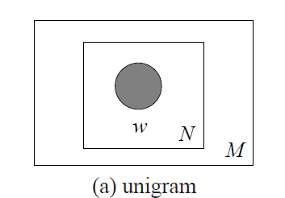
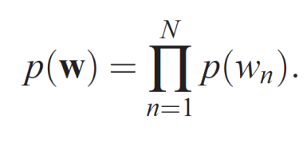
Unigram Model
Assume that all words occur independently (!)
    P(pi=wi pk=wk) = P(pi=wi)*P(pk=wk)
    P(pi=wi pk=wi) = P(pi=wi)*P(pi=wi)
  P ([p1=w1 p2=w2 p3=w3 … pk=wk]) = P(w1)^{#(w1)} P(w2^{)#(w2)} …
Note that this way the probability
of occurrence of a word is the same
in EVERY DOCUMENT…
--A little too overboard..
--words in neighboring positions tend to be correlated
→(bigram models; trigram models)
--Different documents tend to have different topics…
→topic models

Slide 4
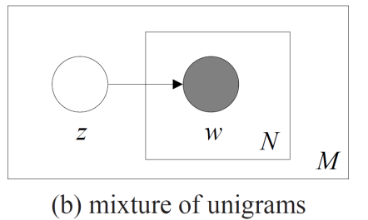
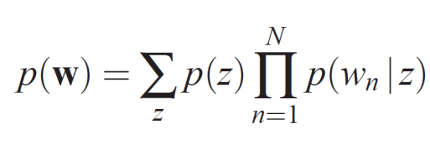
Single Topic Model
Assume each document has a topic z
The topic z determines the probabilities of the word occurrence
  P ([p1=w1 p2=w2 p3=w3 … pk=wk]|z) = P(w1|z)^{#(w1)} P(w2|z)^{#(w2)} …
Connection to candies?
lime and cherry are words
bag types (h1..h5) are topics
you see candies; you guess
bag types..
The “supervised” version of this model
is the Naïve Bayes classifier

Slide 5
Topic is just a distribution over words!
w P(w|Cat = 1)
w P(w|Cat = 2)
HEART 0.2
LOVE 0.2
SOUL 0.2
TEARS 0.2
JOY 0.2
SCIENTIFIC 0.0
KNOWLEDGE 0.0
WORK 0.0
RESEARCH 0.0
MATHEMATICS 0.0
HEART 0.0
LOVE 0.0
SOUL 0.0
TEARS 0.0
JOY 0.0
SCIENTIFIC 0.2
KNOWLEDGE 0.2
WORK 0.2
RESEARCH 0.2
MATHEMATICS 0.2
topic 1
topic 2

Slide 6

Viewing Topic Learning as BN Learning
Note that we are given the topology!
So we only need to learn parameters
Two cases:
  Case 1: We are given a bunch of novels, and their topics
    Naïve Bayes!
  Case 2: We are just given a bunch of novels, but no topics
    Incomplete Data; EM algorithm (if doing MLE)
      What is EM optimizing?
        Consider Harcopy/Softcopy division vs. Westerns/Chick-Lit/SciFi topics
Unsupervised vs.
Supervised
is just
complete data
vs
incomplete data!!

Slide 7
Topic Models and Dimensionality reduction
Suppose I have a document d with me. What information do you need from me so you can reconstruct that document (statistically speaking)?
  In the unigram case, you don’t need any information from me; you can generate your version of the document with the word distribution
  In the single topic case, you need me to tell you the topic
  In the multi-topic case, you need me to tell you the mixture over the k topics (k probabilities)
Notice that this way, we are compressing the document down! (to zero, one or k-bits of information!—The rest are just details)

Slide 8
Text Naïve Bayes Algorithm
(Train)
Let V be the vocabulary of all words in the documents in D
For each category c_{i} ∈ C
Let D_{i} be the subset of documents in D in category c_{i}
P(c_{i}) = |D_{i}| / |D|
Let T_{i} be the concatenation of all the documents in D_{i}
Let n_{i} be the total number of word occurrences in T_{i}
For each word w_{j} ∈ V
Let n_{ij} be the number of occurrences of w_{j} in T_{i}
Let P(w_{j} | c_{i}) = (n_{ij} + 1) / (n_{i} + |V|)

Slide 9
Text Naïve Bayes Algorithm
(Test)
Given a test document X
Let n be the number of word occurrences in X
Return the category:
where a_{i} is the word occurring the ith position in X

Slide 10
Bayesian document categorization
priors
α
Wait—What do you LEARN
here?
Nothing..
But then how are the probabilities
set?
By sampling from the prior
But how does data change anything?
By changing the posterior
So you don’t estimate any parameters?
No
You just do inference?
Yes..
β
θ
P(Cat)
φ
Cat
P(w|Cat)
w₁
n_{D}
D

Slide 11
From Single Topic model to Multi-topic model
Unigram model assumes all documents draw from the same word distribution
The single topic model assumes that word distributions are topic dependent [Good]
  But assume that each document has only one topic [Not So Good]
How about consider documents as having multiple topics?
  A document is a specific “mixture” (distribution) over topics! [sort of like belief states ;-]
  In the single topic case, the “mixture” is a degenerate one—with all probability mass on just one topic
Connection to
Dimensionality
reduction..

Slide 12
Overview of Latent Semantic Indexing
Eigen Slide
factor-factor
(+ve sqrt of eigen values of
d-t*d-t’or d-t’*d-t; both same)
Doc-factor
(eigen vectors of d-t*d-t’)
(term-factor)^{T}
(eigen vectors of d-t’*d-t)
Term
Term
doc
dt
df
ff
tf^{t}
df_{k}
tf_{k}^{t}
dt_{k}
⇒
ff_{k}
doc
dxt
dxf
fxf
fxt
dxk
kxk
kxt
dxt
Singular Value Decomposition
Convert doc-term
matrix into 3matrices
D-F, F-F, T-F
Where DF*FF*TF’ gives the
Original matrix back
Reduce Dimensionality:
Throw out low-order
rows and columns
Recreate Matrix:
Multiply to produce
approximate term-
document matrix.
dt_{k} is a k-rank matrix
That is closest to dt

Slide 13
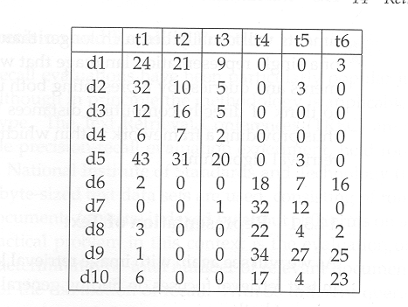
t1= database
t2=SQL
t3=index
t4=regression
t5=likelihood
t6=linear
New document coordinates
d-f*f-f
F-F
D-F
6 singular values
(positive sqrt of
eigen values of
dd or tt)
T-F
Eigen vectors of dd (dt*dt’)
(Principal document
directions)
Eigen vectors of tt (dt’*dt)
(Principal term directions)

Slide 14
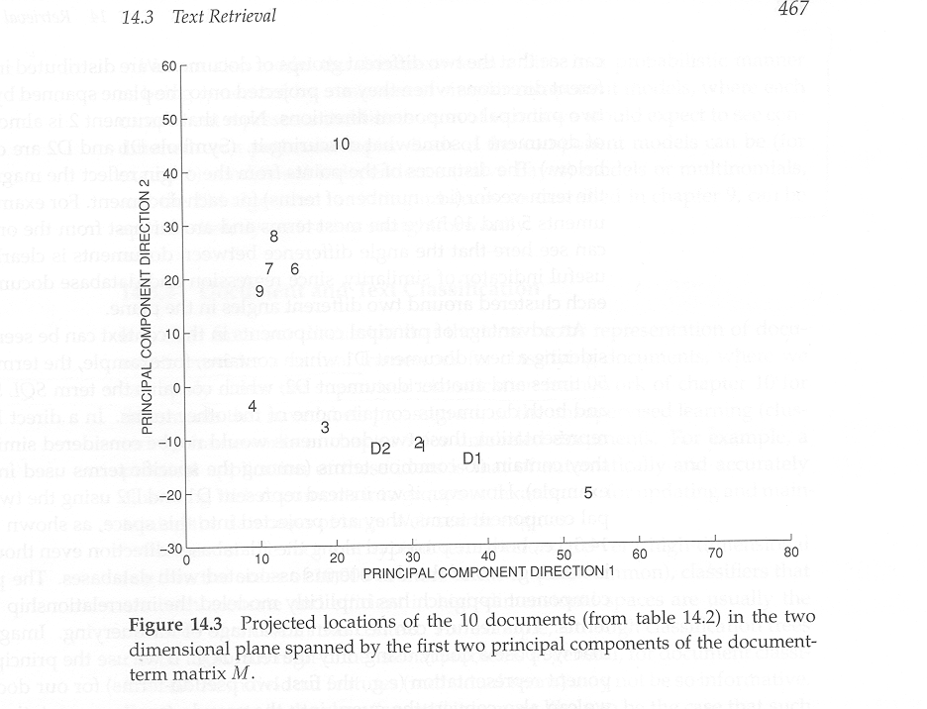
t1= database
t2=SQL
t3=index
t4=regression
t5=likelihood
t6=linear
For the database/regression
example
Suppose D1 is a new
Doc containing “database”
50 times and D2 contains
“SQL” 50 times

Slide 15
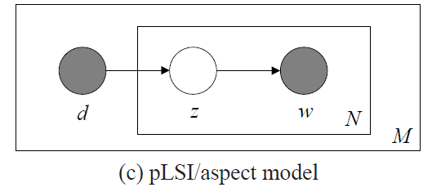
The pLSI Model (attempts to give probabilistic semantics to LSA)
For each word of document d in the training set,
Choose a topic z according to a multinomial conditioned on the index d.
Generate the word by drawing from a multinomial conditioned on z.
LSA factors are linear combinations of terms; LDA topics are multinomial distributions over terms
_{d}
z_{d1}
z_{d2}
z_{d3}
z_{d4}
w_{d1}
w_{d2}
w_{d3}
w_{d4}
Probabilistic Latent Semantic Indexing (pLSI) Model
Can also be written in a symmetric way
P(d)P(z|d)P(w|z) = P(d|z) P(z) P(w|z)
[Slides from Jonathan Huang]
Notes:
between this slide and the previous one, add a motivating example where you have a latent variable in naïve bayse
show an unrolled bn for this model using your running example (text classification)

Slide 16
PLSI to LDA is a small technical step
First order view: LDA is just “bayesian learning” version of PLSI (which typically estimates its parameters with MLE/MAP)
Other differences:
  In pLSI, the observed variable d is an index into some training set. There is no natural way for the model to handle previously unseen documents.
  The number of parameters for pLSI grows linearly with M (the number of documents in the training set).
  We would like to be Bayesian about our topic mixture proportions.

Slide 17
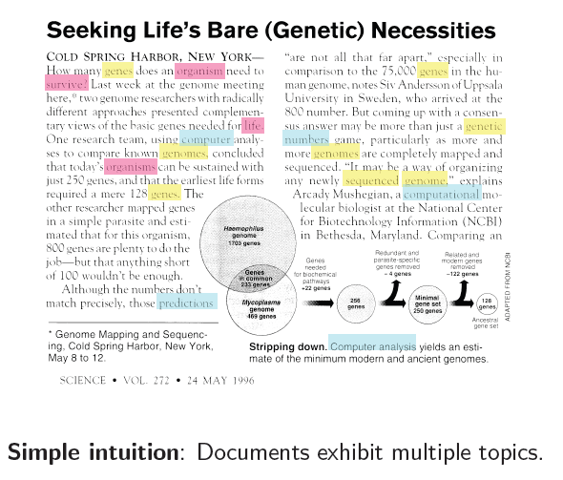
Intuition behind LDA
[LDA slides from Blei’s MLSS 09 lecture]

Slide 18
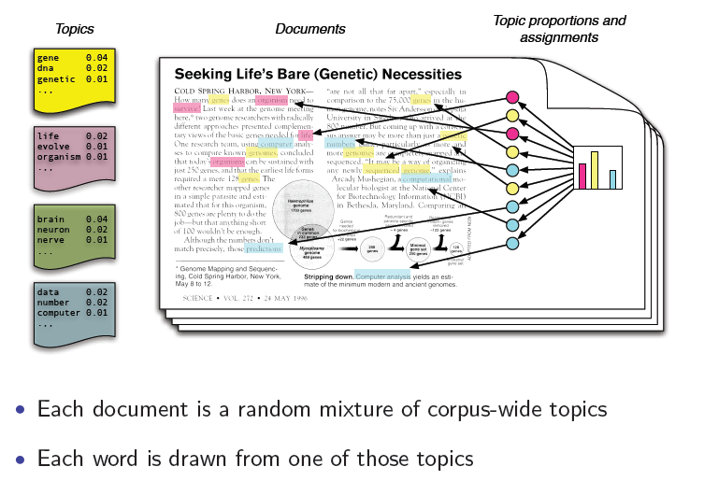
Generative model
See http://cs.stanford.edu/people/karpathy/nipspreview/ for an example
On NIPS papers
Importance of
the “sparsity”
We want a document
to have more than one
topic, but not really
all the topics..
→You can ensure
Sparsity by starting with
a dirichlet prior whose
Hyper parameter sum is
Low..
(you get interesting
colors by combining
primary colors, but
if you combine them
all you always get
white..)
Note that we are assuming that contiguous
words may come from different topics!

Slide 19
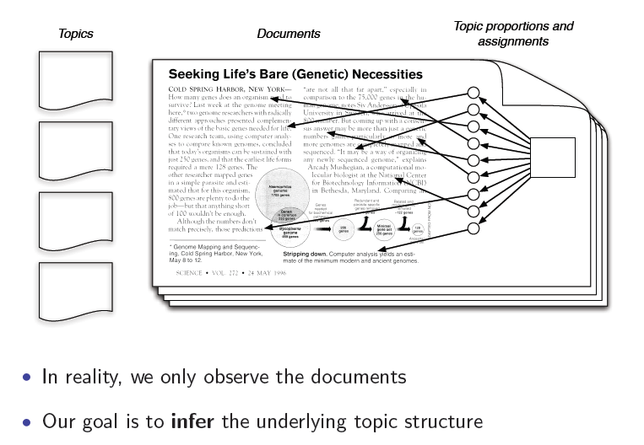
The posterior distribution

Slide 20
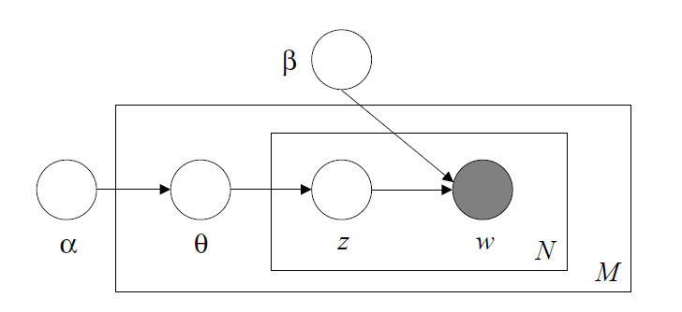
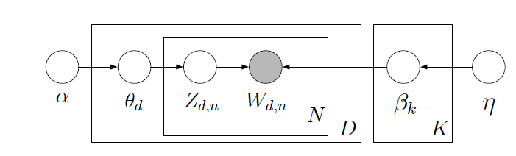
Unrolled LDA Model
α
θ
θ
θ
z₁
z₂
z₃
z₄
z₁
z₂
z₃
z₄
z₁
z₂
z₃
z₄
w₁
w₂
w₃
w₄
w₁
w₂
w₃
w₄
w₁
w₂
w₃
w₄
For each document,
Choose θ~Dirichlet(α)
For each of the N words wn:
  Choose a topic z_{n}» Multinomial(θ)
  Choose a word w_{n} from p(w_{n}|z_{n},β), a multinomial probability conditioned on the topic z_{n}.
β

Slide 21
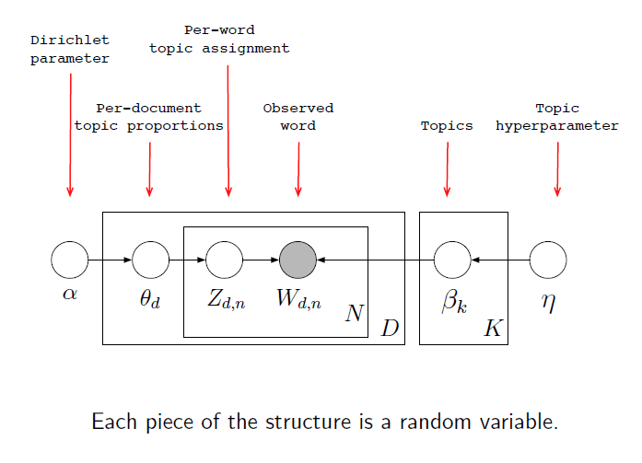
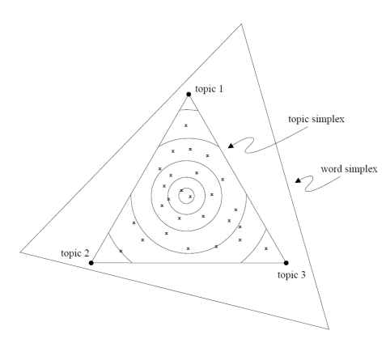
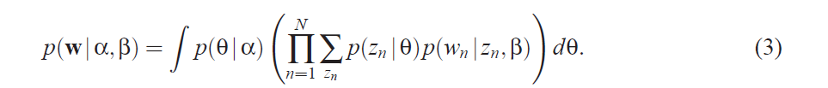
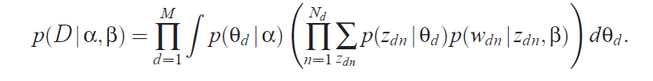
LDA model
LDA as a dimensionality
reduction algorithm
--Documents can be seen
as vectors in k-dimenstional
topic space
--as against V-dimensional
vocabulary space
Why sum over Zn? Because the same word might have come due to different topics…

Slide 22
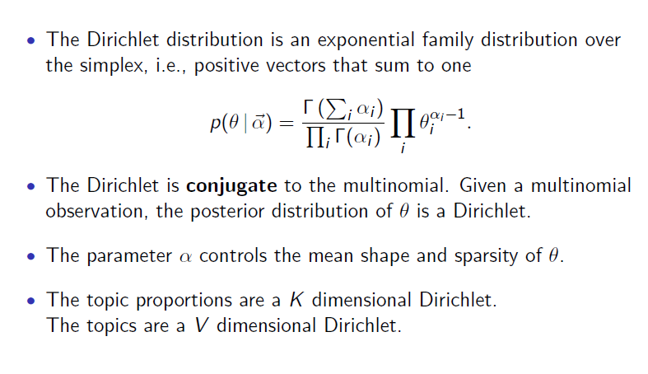
Dirichlet distribution

Slide 23
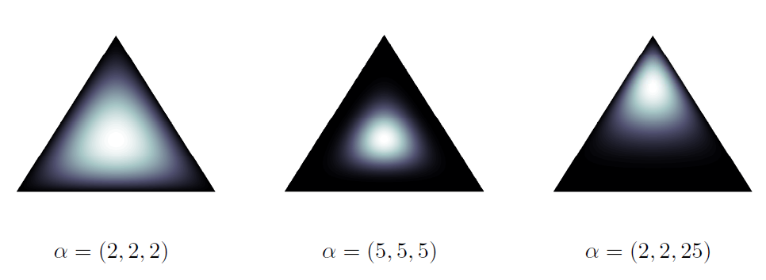
Dirichlet Examples
Darker implies lower magnitude
\alpha < 1 leads to sparser topics

Slide 24
A generative model for documents
w P(w|Cat = 1)
w P(w|Cat = 2)
HEART 0.2
LOVE 0.2
SOUL 0.2
TEARS 0.2
JOY 0.2
SCIENTIFIC 0.0
KNOWLEDGE 0.0
WORK 0.0
RESEARCH 0.0
MATHEMATICS 0.0
HEART 0.0
LOVE 0.0
SOUL 0.0
TEARS 0.0
JOY 0.0
SCIENTIFIC 0.2
KNOWLEDGE 0.2
WORK 0.2
RESEARCH 0.2
MATHEMATICS 0.2
topic 1
topic 2

Slide 25
Choose mixture weights for each document, generate “bag of words”
{P(z = 1), P(z = 2)}
{0, 1}
{0.25, 0.75}
{0.5, 0.5}
{0.75, 0.25}
{1, 0}
MATHEMATICS KNOWLEDGE RESEARCH WORK MATHEMATICS
RESEARCH WORK SCIENTIFIC MATHEMATICS WORK
SCIENTIFIC KNOWLEDGE MATHEMATICS SCIENTIFIC
HEART LOVE TEARS KNOWLEDGE HEART
MATHEMATICS HEART RESEARCH LOVE MATHEMATICS
WORK TEARS SOUL KNOWLEDGE HEART
WORK JOY SOUL TEARS MATHEMATICS
TEARS LOVE LOVE LOVE SOUL
TEARS LOVE JOY SOUL LOVE TEARS SOUL SOUL TEARS JOY

Slide 26
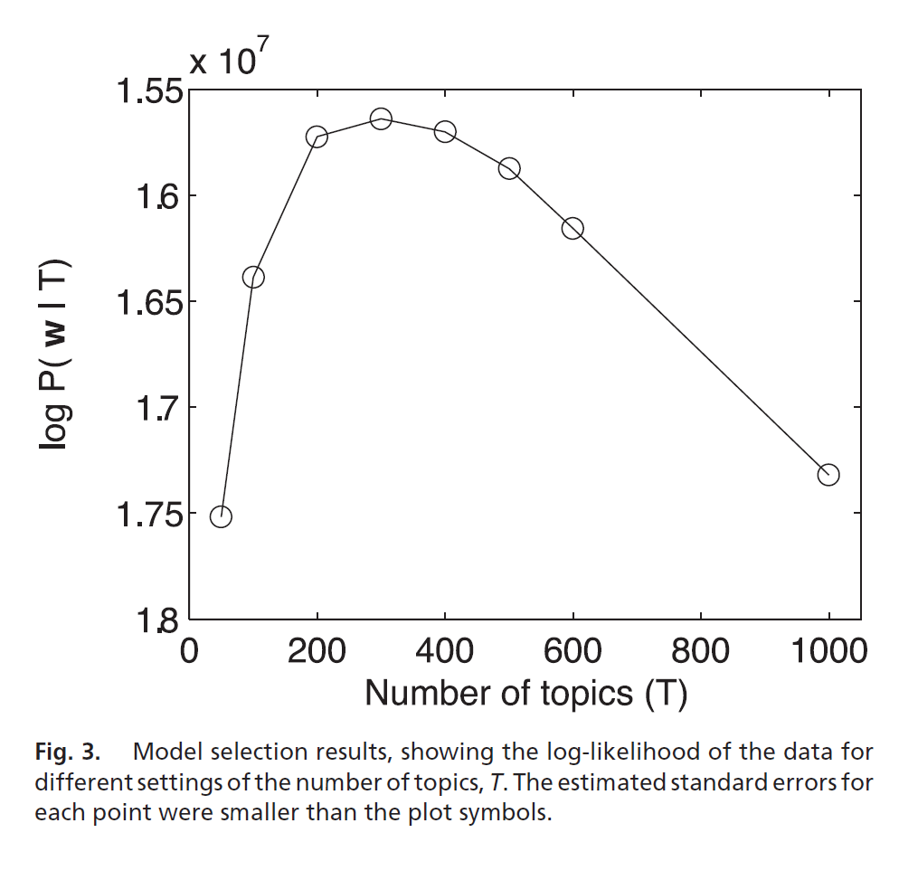

Slide 27
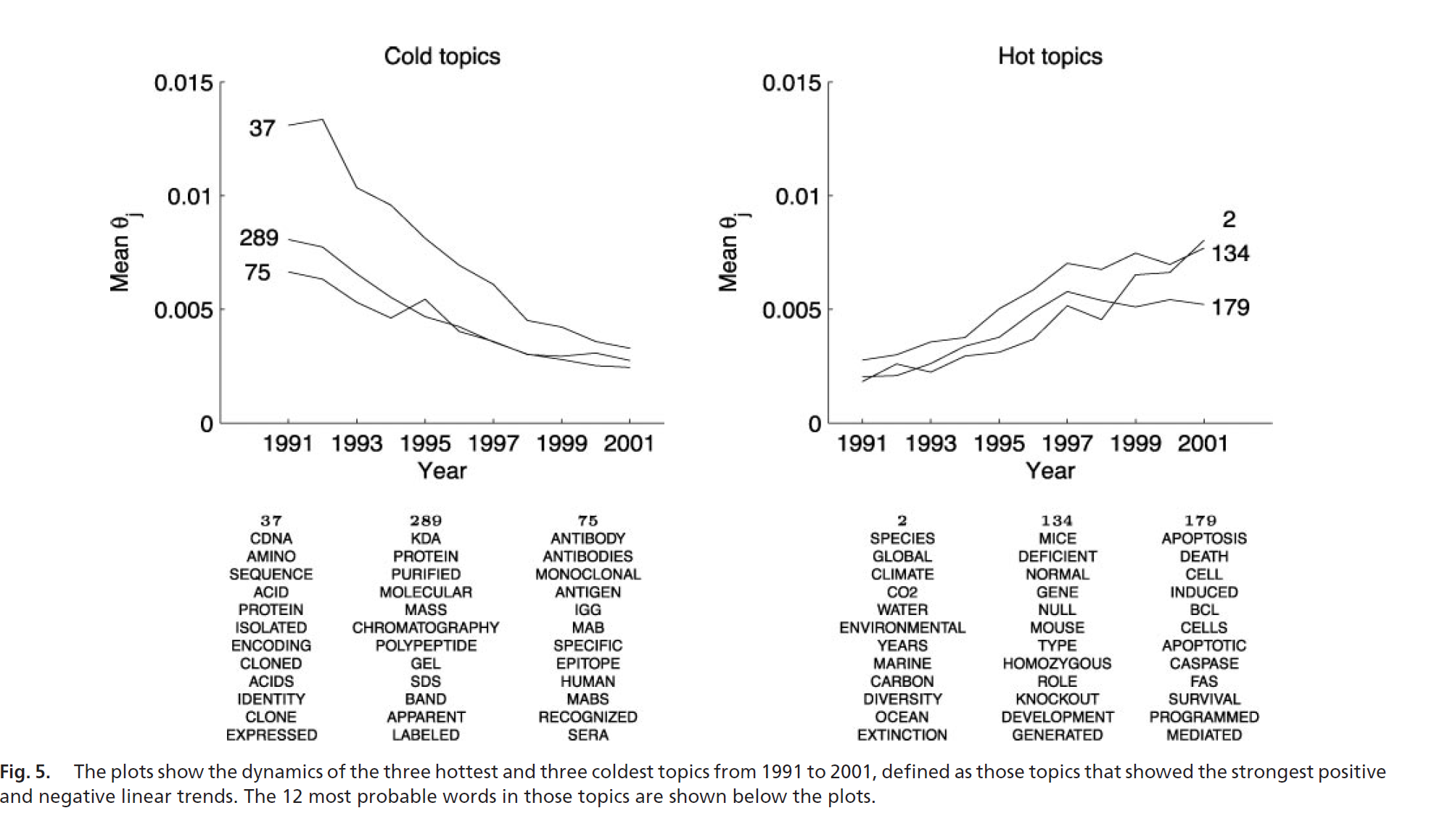

Slide 28
LDA is a mixture-of-topics model for unigram text whose parameters are set through bayesian inference (learning)
Civilization advances by extending the number of important operations that we can do without thinking about them.
--Alfred North Whitehead

Slide 29
Latent Dirichlet allocation
(Blei, Ng, & Jordan, 2001; 2003)
α
distribution over topics
for each document
Dirichlet priors
θ ^{(d)}
θ ^{(d)} ∼ Dirichlet(α)
β
distribution over words
for each topic
topic assignment
for each word
φ ^{(j)} ∼ Dirichlet(β)
φ ^{(j)}
z_{i}
z_{i} ∼ Discrete(θ ^{(d)} )
T
word generated from
assigned topic
w_{i}
w_{i} ∼ Discrete(φ ^{(zi)} )
N_{d}
D

Slide 30
LDA model
LDA as a dimensionality
reduction algorithm
--Documents can be seen
as vectors in k-dimenstional
topic space
--as against V-dimensional
vocabulary space
Why sum over Zn? Because the same word might have come due to different topics…

Slide 31
Inverting the generative model
Maximum likelihood or MAP estimation (EM)
  e.g. Hofmann (1999)
Bayesian Estimation
  Compute the posteriors P(θ|d) P(β| d)
    We know P(θ) and P(β) [They are set by Dirichlet]
    Use bayesian updating to compute P(θ|w,d) P(β|w,d)
  Deterministic approximate algorithms
    variational EM; Blei, Ng & Jordan (2001; 2003)
    expectation propagation; Minka & Lafferty (2002)
  Markov chain Monte Carlo
    Full Gibbs sampler; Pritchard et al. (2000)
      Estimates P(
    collapsed Gibbs sampler; Griffiths & Steyvers (2004)

Slide 32
Unrolled LDA Model
α
θ
θ
θ
z₁
z₂
z₃
z₄
z₁
z₂
z₃
z₄
z₁
z₂
z₃
z₄
w₁
w₂
w₃
w₄
w₁
w₂
w₃
w₄
w₁
w₂
w₃
w₄
For each document,
Choose θ~Dirichlet(α)
For each of the N words wn:
  Choose a topic z_{n}» Multinomial(θ)
  Choose a word w_{n} from p(w_{n}|z_{n},β), a multinomial probability conditioned on the topic z_{n}.
β

Slide 33
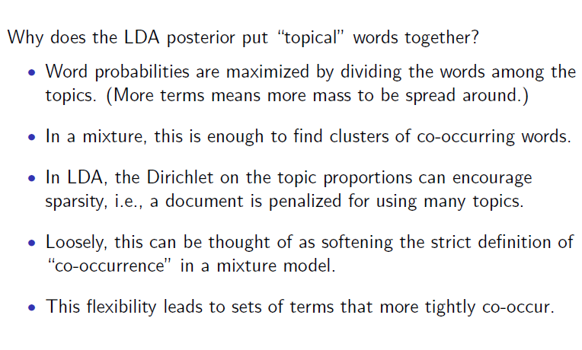
Why does LDA “work” ?

Slide 34
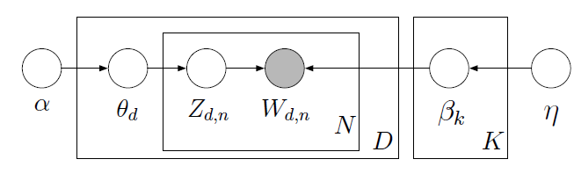
MAP inference
Integrate out z
Treat \theta as random variable
Can use EM algorithm
Updates very similar to that of PLSA (except for additional regularization terms)

Slide 35
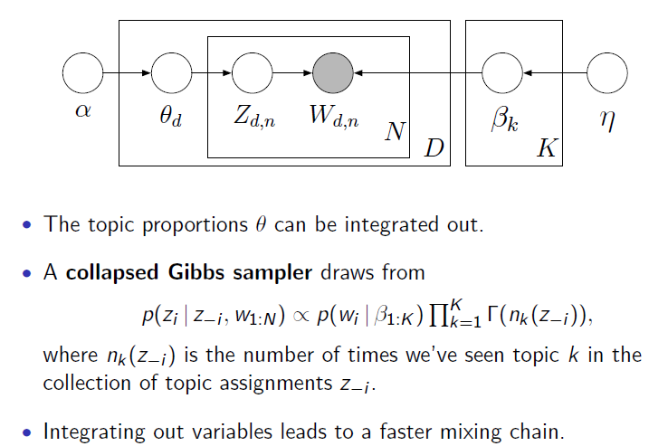
Collapsed Gibbs sampling
Bayesians are the only people who can
feel marginalized after being integrated.

Slide 36
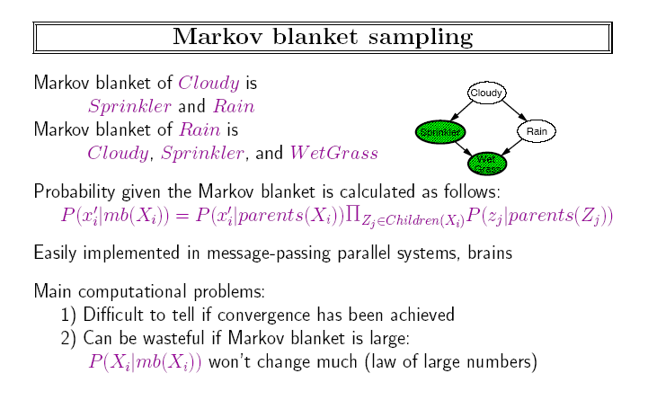
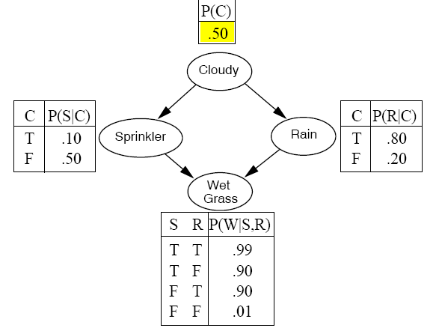
Note that the other parents
of z_{j} are part of the
markov blanket
P(rain|cl,sp,wg) = P(rain|cl) * P(wg|sp,rain)

Slide 37
The collapsed Gibbs sampler
Γ(n+1) = n Γ(n)
Using conjugacy of Dirichlet and multinomial distributions, integrate out continuous parameters
Defines a distribution on discrete ensembles z
We will estimate
This approximately

Slide 38
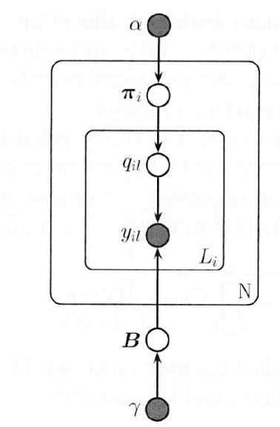
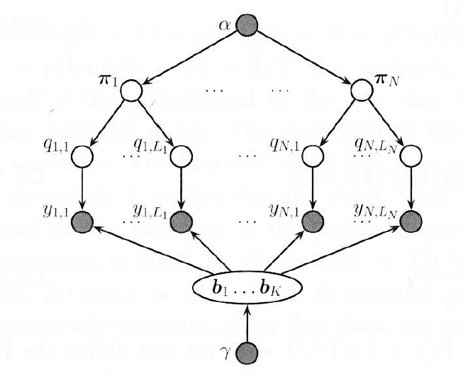
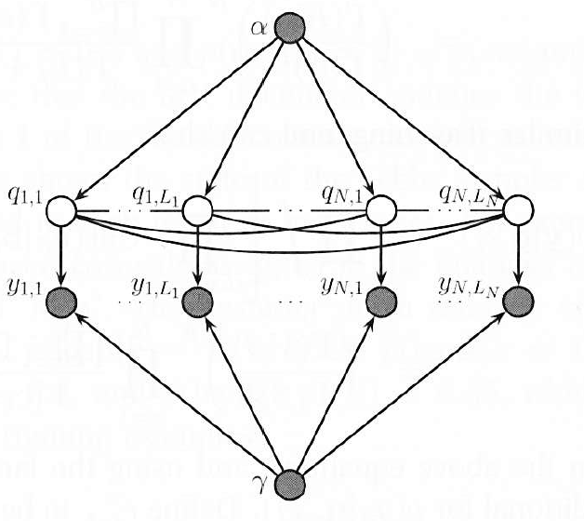
Viewing the “integrating out” Graphically
The LDA model is no longer sparse after
marginalization….!
→But you don’t need to see it ;-)
unroll
Marginalize
We can do Gibbs
sampling without
Integrating.. It will
be inefficient..
Compare markov
blankets for qij
Bayesians are the only people who feel marginalized when integrated..

Slide 39
The collapsed Gibbs sampler
#times w_{i} occurs
in topic z_{i}
Sample each z_{i} conditioned on z_{-i}
This is nicer than your average Gibbs sampler:
  memory: counts can be cached in two sparse matrices
  optimization: no special functions, simple arithmetic
  the distributions on Φ and Θ are analytic given z and w, and can later be found for each sample
#times j^{th} topic occurs
in doc d_{i}

Slide 40
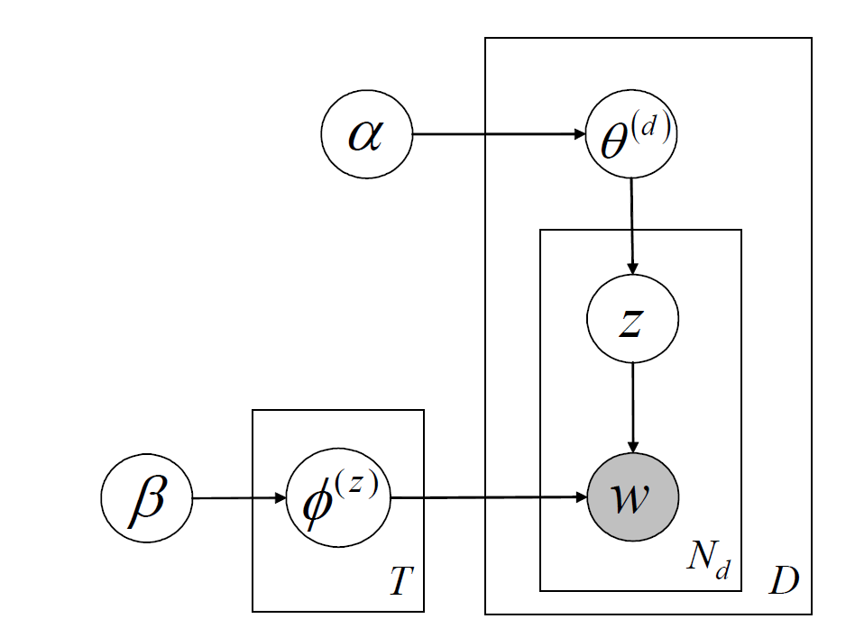
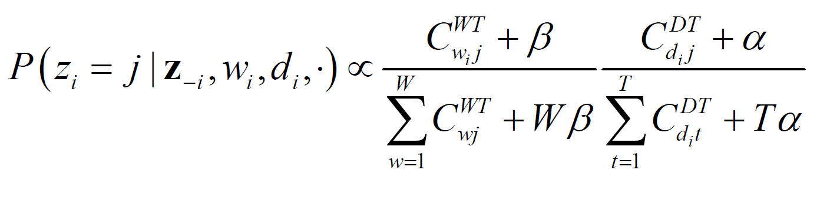
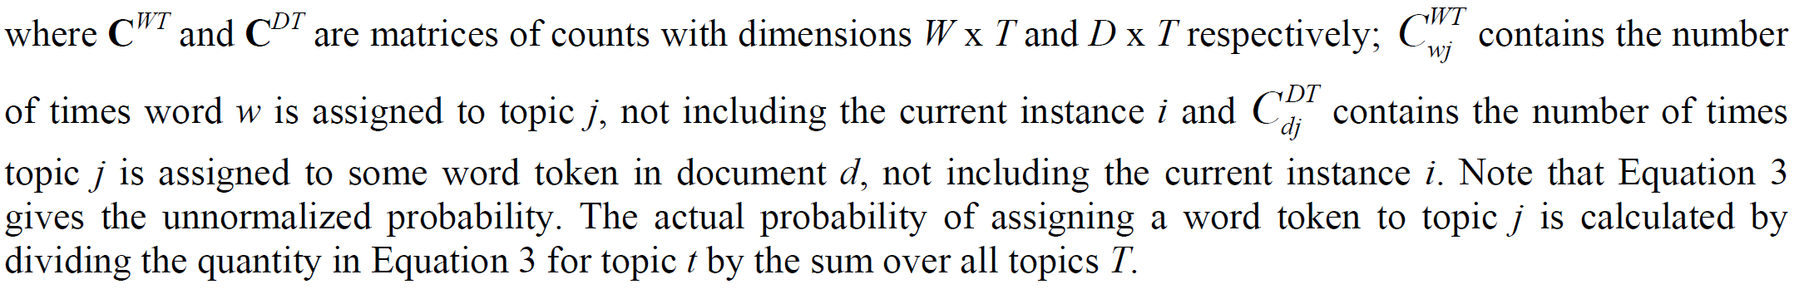
Collapsed Gibbs Sampler
Fraction of times w_{i} occurs in topic J
Fraction of times topic j occurs in doc di
The instance being re-sampled

Slide 41
Gibbs sampling in LDA
5 docs; 10 words/doc; 2 topics
iteration
1

Slide 42
Gibbs sampling in LDA
iteration
1 2

Slide 43
Gibbs sampling in LDA
iteration
1 2

Slide 44
Gibbs sampling in LDA
iteration
1 2

Slide 45
Gibbs sampling in LDA
iteration
1 2

Slide 46
Gibbs sampling in LDA
iteration
1 2

Slide 47
Gibbs sampling in LDA
iteration
1 2

Slide 48
Gibbs sampling in LDA
iteration
1 2

Slide 49
Gibbs sampling in LDA
Can estimate
P(Z|W)
iteration
1 2 … 1000

Slide 50
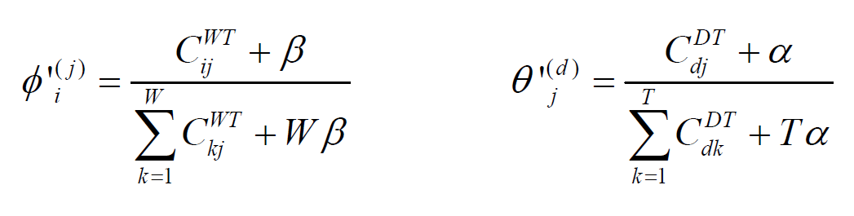
Recovering ϕ and θ
Probability of ith word in jth topic
Probability of jth topic doc d

Slide 51
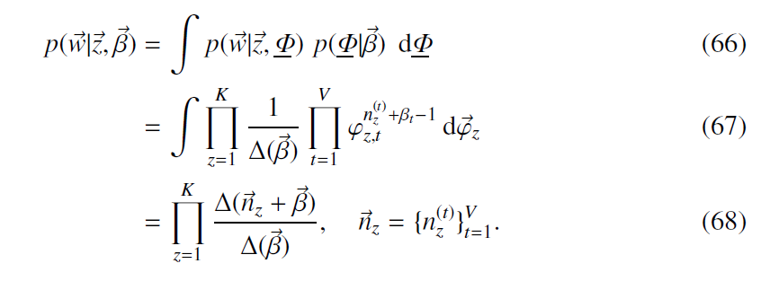
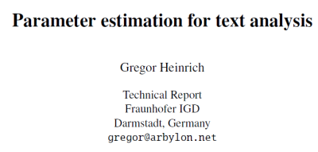
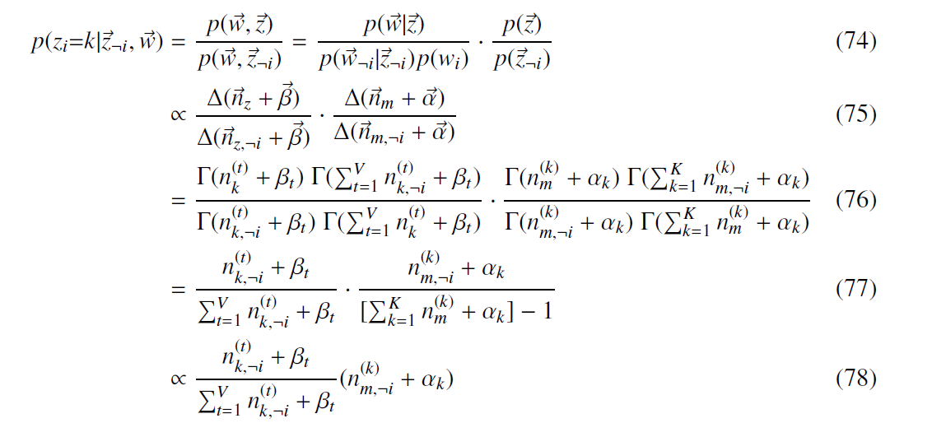
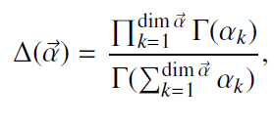
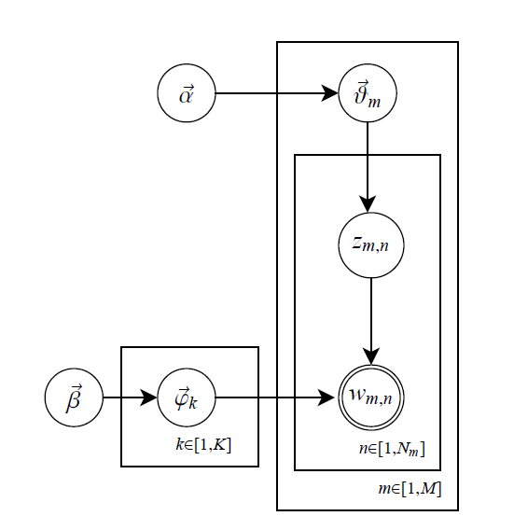
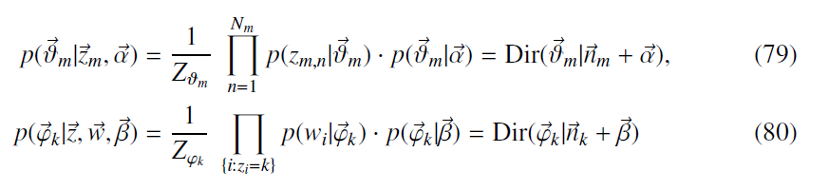
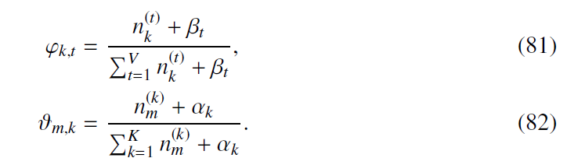
Marginalization
Gibbs Sampling
Recovering ϕ and θ

Slide 52
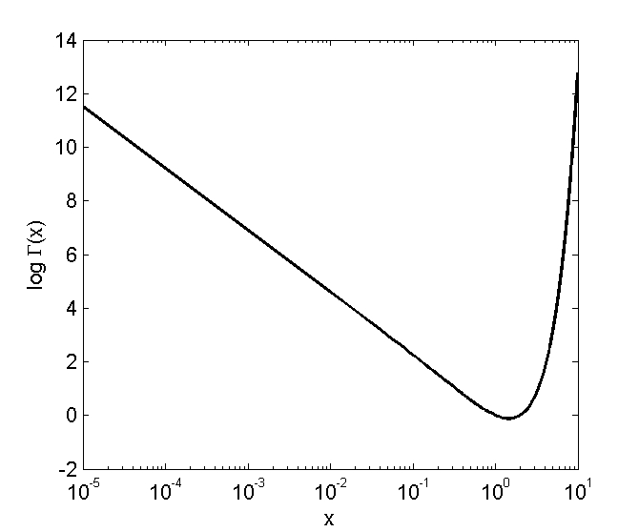
Effects of hyperparameters
α and β control the relative sparsity of Φ and Θ
  smaller α, fewer topics per document
  smaller β, fewer words per topic
Good assignments z compromise in sparsity
log Γ(x)
x

Slide 53
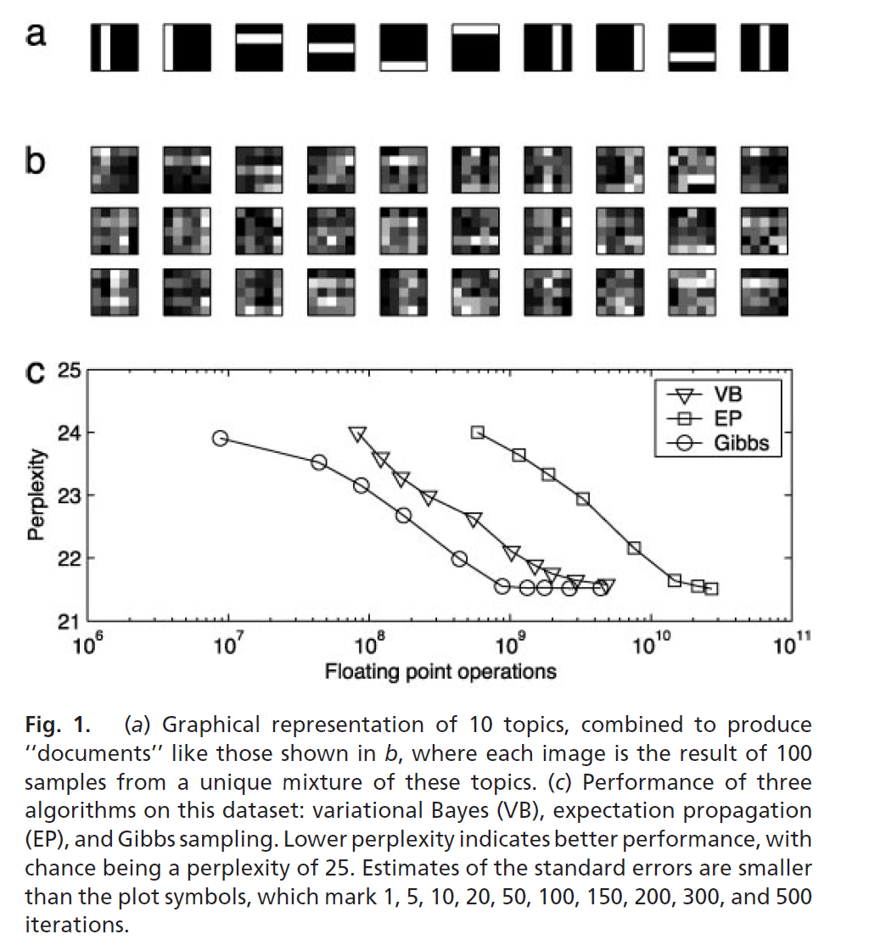

Slide 54
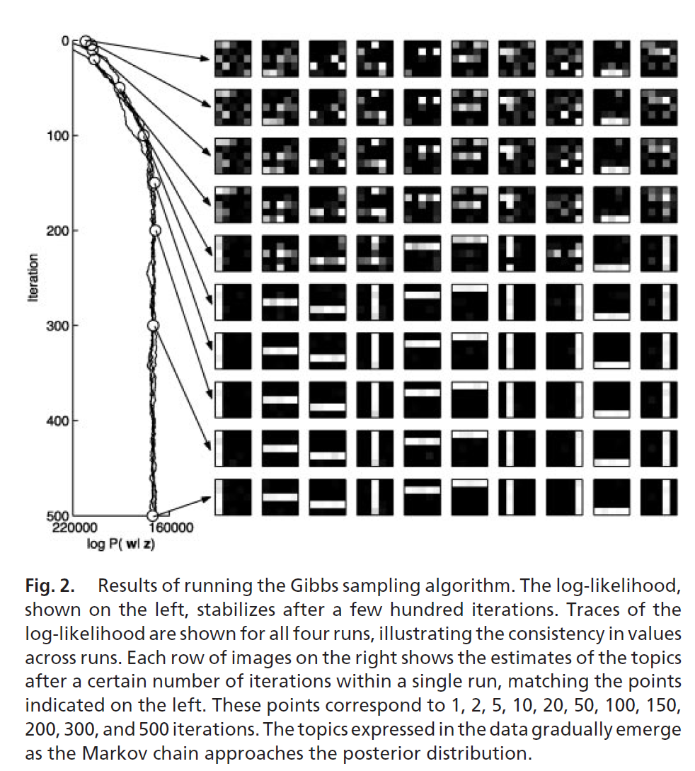

Slide 55
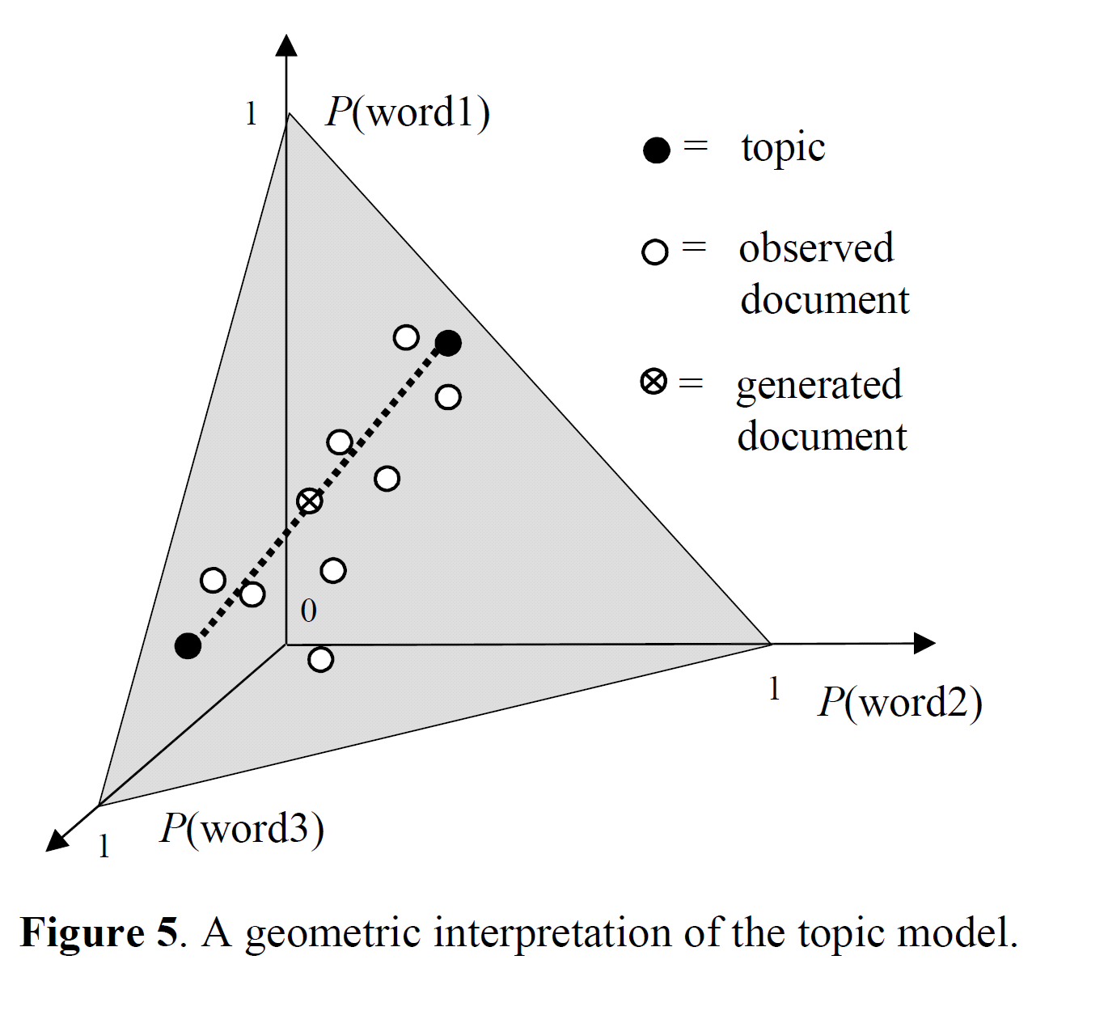
Once you have topics,
not all documents are
generatable!

Slide 56
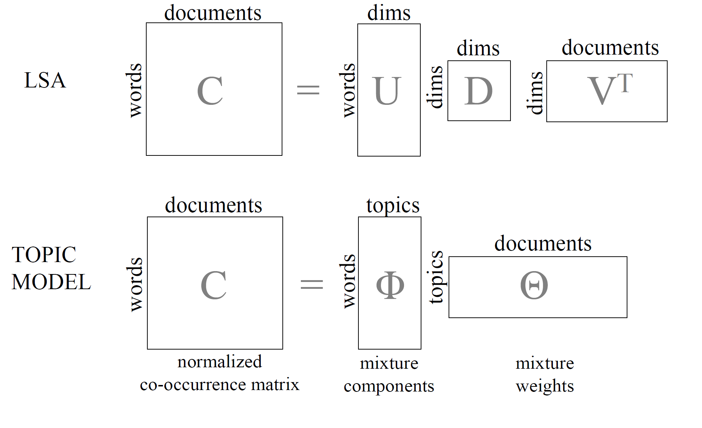

Slide 57

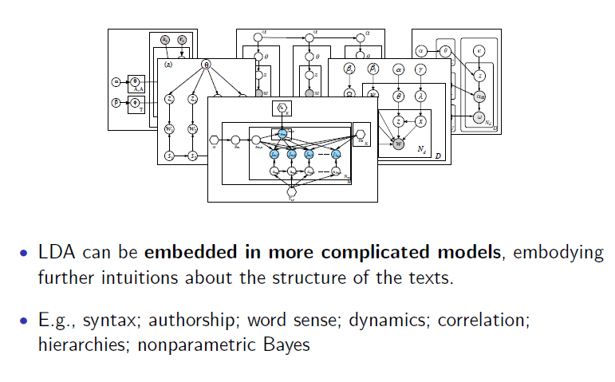
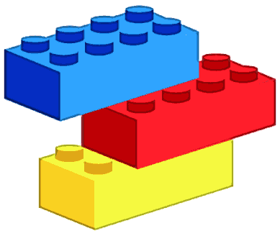
LDA (like any generative model) is modular, general, useful

Slide 58
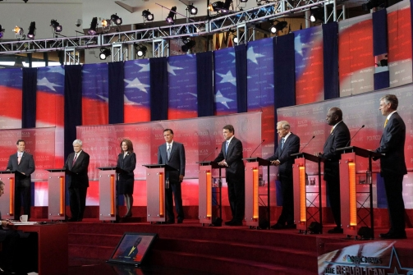
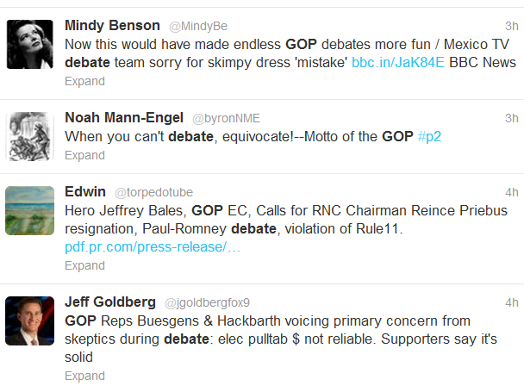
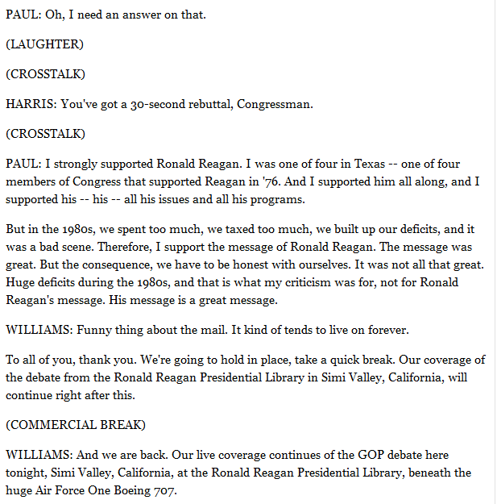
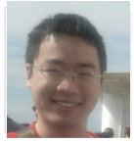
Event Tweet Alignment..
Republican Primary Debate, 09/07/2011
Tweets tagged with #ReaganDebate
?
?
Which part of the event did a tweet refer to?
What were the topics of the event and tweets?
Applications: Event playback/Analysis, Sentiment Analysis, Advertisement, etc
58
Notes:
GOP Primary debate on Sept 07, 2011, talked about various issues such as job creation, healthcare, foreign policy, etc
we crawled tweet using the official hashtag, posted by NBC news
With vast amount of tweets, we want to know two things: 1) which part of the event did a tweet refer to and 2)what were the topics
Answering two questions has great applications, e.g., event analysis, playback, situation awareness etc

Slide 59

Event-Tweet Alignment: The Problem
Given an event’s transcript S and its associated tweets T
  Find the segment s (s ∈ S) which is topically referred by tweet t (t ∈ T) [Could be a general tweet]
Alignment requires:
  Extracting topics in the tweets and event
  Segmenting the event into
  topically coherent chunks
  Classify the tweets
  --General vs. Specific
Idea: represent tweets and
segements in a topic space
59
Notes:
Here's a conceptual model of tweet and event.
event has segment, tweets can be either general or specific, if general, then it can refer to whole event, otherwise, it can refer to centain specific segment, in any case, such reference is based on topics.

Slide 60

Event-Tweet Alignment: A Model

Slide 61
Event-Tweet Alignment: Challenges
  Both topics and Segments are latent
Tweets are topically influenced by the content of the event. A tweet’s words’ topics can be
  general (high-level and constant across the entire event), or
  speciﬁc (concrete and relate to speciﬁc segments of the event)
    General tweet = weakly influenced by the event
    Specific tweet = strongly influenced by the event
An event is formed by discrete sequentially-ordered segments, each of which discusses a particular set of topics

Slide 62
Event-Tweet Alignment: Approaches
Prior work
  Event Segmentation
    HMM-based, etc
  Topics Modeling
    LDA, PLSI
Possible Solution
  Apply LDA to event and Tweets separately
  Measure the closeness by JS-divergence of their topic distributions
  Problem: Event and and its twitter feeds are modeled largely independently
  Our Solution: Joint Modeling
  ET-LDA (event-tweets LDA) considers an event and its Twitter feeds jointly and characterizes the topic influences between them in a fully Bayeisan model
Potential advantages
  Tweets provide a richer context about the topic evolution in the event
  Can measure the influence of the event on the twitterati
Notes:
why not independent? In reality, event and tweets are obviously inter-dependent. For example, in practice, when tweets are generated by the crowds
to express their interests in the event, their content is essentially inﬂuenced by the topics covered in the event in some way.
by joint considering, we have two benefit 1) to be able to measure the influence on tweets 2), from tweets, we can obtain a richer context about the evolution of topics and the topical boundaries in the event which is critical to the event segmentation (i.e., based on tweets response to segment the event). So joint model can do two things together, and these two things are depended on each other.

Slide 63

ET-LDA
Notes:
Show graph model here, learning parameters by gibbs

Slide 64


ET-LDA Model
Event
Tweets
Determine event
segmentation
Determine
which
segment a tweet (word) refers to
Determine tweet type
Determine word’s topic in event
Tweets word’s topic
Notes:
in the event part, we assume that an event is formed by discrete sequentially-ordered segments, each of which discusses a particular set of topics
to do segmentatoin/model the topic evolutions in the event, we apply the Markov assumption on \theta(s),with some probability, it is as same as the distribution of topics of previous paragraph s-1, otherwise, a new distribution of topics \theta(s) is sampled from a dirichlet. This pattern of dependency is produced by associating a binary variable c(s). with each paragraph, indicating whether its topic is the same as that of the previous paragraph or different. If the topic remains the same, these paragraphs are merged to form one segment.
we assume that a tweet consists of
words which can belong to two distinct types of topics: general topics, which are high-level and constant across the entire event, and speciﬁc topics, which are detailed and relate to the segments of the event. As a result, the distribution of general topics is ﬁxed for a tweet. However, the distribution of speciﬁc topics keeps varying with respect to the development of the event.
each word in a tweet is associated with a distribution of topics. It can be either sampled from a mixture of speciﬁc topics \theta(s), or a mixture of general topics \psi(t) over K topics
depending on a binary variable c(t) sampled from a binomial distribution. In the ﬁrst case, \theta(s)
is from a referring segment s of the event, where s is chosen according to a categorical distribution s(t). An important property of the categorical distribution s(t) is to allow choosing any segment in the event. This reﬂects the fact that a person may compose a tweet on topics discussed in a segment that (1) was in the past (2) is currently occurring, or (3) will occur after the tweet is posted (usually when she expects certain topics to be discussed in the event)

Slide 65

ET-LDA Model
For more details of the inference, please refer to our paper: http://bit.ly/MBHjyZ
Notes:
Show graph model here, learning parameters by gibbs

Slide 66


Learning ET-LDA: Gibbs sampling
Coupling between α and β makes the posterior computation of latent variables is intractable
For more details of the inference, please refer to our paper: http://bit.ly/MBHjyZ
Notes:
Show graph model here, learning parameters by gibbs Iteratively update each latent variable given the remaining variables. The update rules are a bit more involved because we have more variables, but it can be done. The paper shows the derivation.

Slide 67

Analysis of the First Obama-Romney Debate

Slide 68



Notes:
He is blaming canada that he is not able to be here to explain it all to you; and you too can blame canada that you are stuck with me.

Slide 69
Generative vs. Discriminative Learning
Often, we are really more interested in predicting only a subset of the attributes given the rest.
  E.g. we have data attributes split into subsets X and Y, and we are interested in predicting Y given the values of X
You can do this by either by
  learning the joint distribution P(X, Y) [Generative learning]
  or learning just the conditional distribution P(Y|X) [Discriminative learning]
Often a given classification problem can be handled either generatively or discriminatively
  E.g. Naïve Bayes and Logistic Regression
Which is better?

Slide 70
Generative vs. Discriminative
P(y)P(x|y) = P(y,x) = P(x)P(y|x)
Generative Learning
Discriminative Learning
More general (after all if you have P(Y, X) you can predict Y given X as well as do other inferences
  You can predict jokes as well as make them up (or predict spam mails as well as generate them)
In trying to learn P(Y,X), we are often forced to make many independence assumptions both in Y and X—and these may be wrong..
  Interestingly, this type of high bias can help generative techniques when there is too little data
More to the point (if what you want is P(Y|X), why bother with P(Y,X) which is after all P(Y|X) *P(X) and thus models the dependencies between X’s also?
Since we don’t need to model dependencies among X, we don’t need to make any independence assumptions among them. So, we can merrily use highly correlated features..
  Interestingly, this freedom can hurt discriminative learners when there is too little data (as over fitting is easy)
Bayes networks are not well suited for discriminative learning; Markov Networks are
--thus Conditional Random Fields are basically MNs doing discriminative learning
--Logistic regression can be seen as a simple CRF

Slide 71
Collapsed Gibbs Sampler
Fraction of times w_{i} occurs in topic J
Fraction of times topic j occurs in doc di
The instance being re-sampled

