Slide 1
Planning

Slide 2
Planning : The big picture
Synthesizing goal-directed behavior
Planning involves
  Action selection; Handling causal dependencies
  Action sequencing and handling resource allocation
    typically called SCHEDULING
  Depending on the problem, plans can be
    action sequences
    or “policies” (action trees, state-action mappings etc.)
Notes:
POINT OUT THAT SCHEDULING HAS LOTS OF APPLICATIONS BUT PLANNING HAS NOT HAD APPLICATIONS BECAUSE OF SCAELE_UP. THINGS ARE CHANGING NOW THOUGH.

Slide 3
Domain-Independent vs. Domain Specific vs. Domain Customized
Domain independent planners only expect as input the description of the actions (in terms of their preconditions and effects), and the description of the goals to be achieved
Domain dependent planners make use of additional knowledge beyond action and goal specification
  Domain dependent planners may either be stand alone programs written specifically for that domain OR domain independent planners customized to a specific domain
  In the case of domain-customized planners, the additional knowledge they exploit can come in many varieties (declarative control rules or procedural directives on which search choices to try and in what order)
  The additional knowledge can either be input manually or in some cases, be learned automatically
Unless noted otherwise, we will be talking about
domain-independent planning

Slide 4
The Many Complexities of Planning
(Discrete vs. Continuous)
(Static vs. Dynamic)
Environment
(Observable vs.
Partially Observable)
(perfect vs.
Imperfect)
perception
(Full vs.
Partial satisfaction)
(Instantaneous vs.
Durative)
Goals
action
(Deterministic vs.
Stochastic)
What action next?
The $$$$$$ Question
Notes:
Intelligent agency involves controlling the evolution of external environments in desirable ways. Planning provides a way in which the agent can maximize its chances of effecting this control. Informally, a plan can be seen as a course of actions that the agent decides upon based on its overall goals, information about the current state of the environment, and the dynamics of its evolution.
The complexity of plan synthesis depends on a variety of properties of the environment and the agent. Perhaps the simplest case of planning occurs when the environment is static, (in that it changes only in response to the agents actions), observable and the agent’s actions have deterministic effects on the state of the environment.
Plan synthesis under these conditions has come to be known as the classical planning problem.
Classical planning problem is thus specified by describing the initial state of the world, the desired goal state, and a set of deterministic actions. The objective is to find a sequence of these actions, which when executed from the initial state leads the agent to the goal state.
Despite its limitations, classical planning problem is still computationally hard, and has received a significant amount of attention. Work on classical planning has historically helped our understanding of planning under non-classical assumptions.

Slide 5
Dynamic
Stochastic
Partially
Observable
Durative
Continuous
Contingent/Conformant Plans, Interleaved execution MDP Policies
Contingent/Conformant Plans, Interleaved execution
Metric-Temporal Planning
Temporal Reasoning
Numeric Constraint reasoning (LP/ILP)
POMDP Policies
Semi-MDP Policies
Replanning/
Situated Plans
Static
Deterministic
Observable
Instantaneous
Propositional
“Classical Planning”
A compilation substrate..

Slide 6
State of the Field
Automated Planning, as a subfield of AI, is as old as AI
The area has become very “active” for the last several years
  Papers appear in AAAI; IJCAI; AIJ; JAIR; as well as AIPS, ECP which have merged to become ICAPS
  Tremendous strides in deterministic plan synthesis
    Bi-annual Intl. Planning Competitions
  Current interest is in exploiting the insights from deterministic planning techniques to other planning scenarios.

Slide 7
Topics to be “covered”
Plan Synthesis under a variety of assumptions
  Classical, Metric Temporal, Non-deterministic, Stochastic, Partially Observable…
Plan Management
  Reasoning with actions and plans (even if you didn’t synthesize them)
  Execution management (Re-planning)
State estimation and Plan Recognition
  Estimating the current state of an agent given a sequence of actions and observations
  Recognize the high-level goals that the agent is attempting to satisfy
Connections to Workflows, Web services, UBICOMP etc

Slide 8

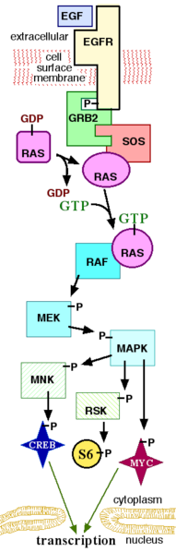

Applications—sublime and mundane
Mission planning (for rovers, telescopes)
Military planning/scheduling
Web-service/Work-flow composition
Paper-routing in copiers
Gene regulatory network intervention

Slide 9
Modeling (Deterministic) Planning Problems:
Actions, States, Correctness

Slide 10
Transition Sytems Perspective
We can think of the agent-environment dynamics in terms of the transition systems
  A transition system is a 2-tuple <S,A> where
    S is a set of states
    A is a set of actions, with each action a being a subset of SXS
  Transition systems can be seen as graphs with states corresponding to nodes, and actions corresponding to edges
    If transitions are not deterministic, then the edges will be “hyper-edges”—i.e. will connect sets of states to sets of states
  The agent may know that its initial state is some subset S’ of S
    If the environment is not fully observable, then |S’|>1 .
  It may consider some subset Sg of S as desirable states
  Finding a plan is equivalent to finding (shortest) paths in the graph corresponding to the transition system
    Search graph is the same as transition graph for deterministic planning
    For non-deterministic actions and/or partially observable environments, the search is in the space of sets of states (called belief states 2^{S})

Slide 11
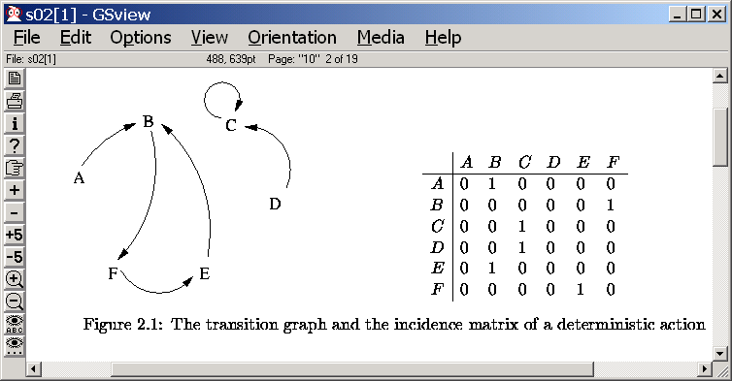
Atomic Model: Transition System Perspective
Each action in this model can be
Represented by incidence matrices
(e.g. below)
The set of all possible transitions
Will then simply be the SUM of the
Individual incidence matrices
Transitions entailed by a sequence of
actions will be given by the (matrix)
multiplication of the incidence matrices
A transition system is a two tuple <S, A>
Where
S is a set of “states”
A is a set of “transitions”
each transition a is a subset of SXS
--If a is a (partial) function then deterministic transition
--otherwise, it is a “non-deterministic” transition
--It is a stochastic transition
If there are probabilities associated with each state a takes s to
--Finding plans becomes is equivalent to finding “paths” in the transition system
Transition system models are called “Explicit state-space” models
In general, we would like to represent the transition systems more compactly
e.g. State variable representation of states.
These latter are called “Factored” models

Slide 12
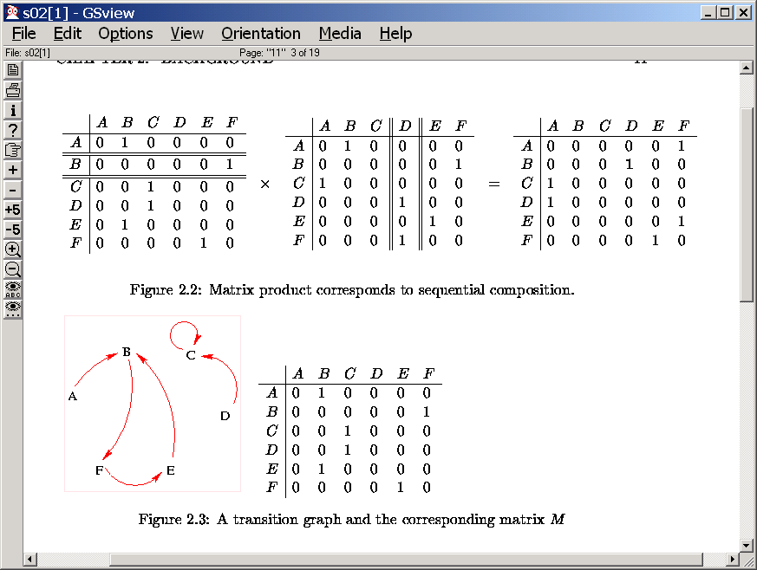
Manipulating Transition Systems
Reachable states can
be computed this way

Slide 13
MDPs as general cases of transition systems
An MDP (Markov Decision Process) is a general (deterministic or non-deterministic) transition system where the states have “Rewards”
  In the special case, only a certain set of “goal states” will have high rewards, and everything else will have no rewards
  In the general case, all states can have varying amount of rewards
Planning, in the context of MDPs, will be to find a “policy” (a mapping from states to actions) that has the maximal expected reward
We will talk about MDPs later in the semester

Slide 14
Problems with transition systems
Transition systems are a great conceptual tool to understand the differences between the various planning problems
…However direct manipulation of transition systems tends to be too cumbersome
  The size of the explicit graph corresponding to a transition system is often very large
  The remedy is to provide “compact” representations for transition systems
    Start by explicating the structure of the “states”
      e.g. states specified in terms of state variables
    Represent actions not as incidence matrices but rather functions specified directly in terms of the state variables
      An action will work in any state where some state variables have certain values. When it works, it will change the values of certain (other) state variables

Slide 15
State Variable Models
World is made up of states which are defined in terms of state variables
  Can be boolean (or multi-ary or continuous)
States are complete assignments over state variables
  So, k boolean state variables can represent how many states?
Actions change the values of the state variables
  Applicability conditions of actions are also specified in terms of partial assignments over state variables

Slide 16
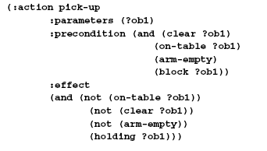
Init:
Ontable(A),Ontable(B),
Clear(A), Clear(B), hand-empty
Goal:
~clear(B), hand-empty
Blocks world
State variables:
Ontable(x) On(x,y) Clear(x) hand-empty holding(x)
Initial state:
Complete specification of T/F values to state variables
--By convention, variables with F values are omitted
STRIPS ASSUMPTION:
If an action changes
a state variable,
this must be explicitly
mentioned in its effects
Goal state:
A partial specification of the desired state variable/value combinations
--desired values can be both positive and negative
Pickup(x)
Prec: hand-empty,clear(x),ontable(x)
eff: holding(x),~ontable(x),~hand-empty,~Clear(x)
Putdown(x)
Prec: holding(x)
eff: Ontable(x), hand-empty,clear(x),~holding(x)
Stack(x,y)
Prec: holding(x), clear(y)
eff: on(x,y), ~cl(y), ~holding(x), hand-empty
Unstack(x,y)
Prec: on(x,y),hand-empty,cl(x)
eff: holding(x),~clear(x),clear(y),~hand-empty
All the actions here have only positive preconditions; but this is not necessary

Slide 17
Blocks world
Init:
Ontable(A),Ontable(B),
Clear(A), Clear(B), hand-empty
Goal:
~clear(B), hand-empty
State variables:
Ontable(x) On(x,y) Clear(x) hand-empty holding(x)
Initial state:
Complete specification of T/F values to state variables
--By convention, variables with F values are omitted
Goal state:
A partial specification of the desired state variable/value combinations
Pickup(x)
Prec: hand-empty,clear(x),ontable(x)
eff: holding(x),~ontable(x),~hand-empty,~Clear(x)
Putdown(x)
Prec: holding(x)
eff: Ontable(x), hand-empty,clear(x),~holding(x)
Stack(x,y)
Prec: holding(x), clear(y)
eff: on(x,y), ~cl(y), ~holding(x), hand-empty
Unstack(x,y)
Prec: on(x,y),hand-empty,cl(x)
eff: holding(x),~clear(x),clear(y),~hand-empty

Slide 18
8/30

Slide 19
Why is this more compact?
(than explicit transition systems)
In explicit transition systems actions are represented as state-to-state transitions where in each action will be represented by an incidence matrix of size |S|x|S|
In state-variable model, actions are represented only in terms of state variables whose values they care about, and whose value they affect.
Consider a state space of 1024 states. It can be represented by log₂1024=10 state variables. If an action needs variable v1 to be true and makes v7 to be false, it can be represented by just 2 bits (instead of a 1024x1024 matrix)
  Of course, if the action has a complicated mapping from states to states, in the worst case the action rep will be just as large
  The assumption being made here is that the actions will have effects on a small number of state variables.

Slide 20
Why is STRIPS representation compact?
(than explicit transition systems)
In explicit transition systems actions are represented as state-to-state transitions where in each action will be represented by an incidence matrix of size |S|x|S|
In state-variable model, actions are represented only in terms of state variables whose values they care about, and whose value they affect.
Consider a state space of 1024 states. It can be represented by log₂1024=10 state variables. If an action needs variable v1 to be true and makes v7 to be false, it can be represented by just 2 bits (instead of a 1024x1024 matrix)
  Of course, if the action has a complicated mapping from states to states, in the worst case the action rep will be just as large
  The assumption being made here is that the actions will have effects on a small number of state variables.
First
order
Sit. Calc
Rel/
Prop
STRIPS rep
Atomic
Transition
rep

Slide 21
State-Variable Models
States are modeled in terms of (binary)
state-variables
-- Complete initial state, partial goal state
Actions are modeled as state
transformation functions
-- Syntax: ADL language (Pednault)
-- Apply(A,S) = (S \ eff(A)) + eff(A)
(If Precond(A) hold in S)
At(A,M),At(B,M)
¬In(A), ¬In(B)
Appolo 13
Earth
Earth
At(A,E), At(B,E),At(R,E)
Effects
At(R,M), ¬At(R,E)
In(o₁)
¬In(o₁)
∀
In
(
x
⇒
)
At
(
x
,
x
M)
Unload(o₁)
& ¬At(x, E)
Load(o₁)
Fly()
Prec.
At(o₁,l₁), At(R,l₁)
In(o₁)
At(R,E)
Notes:
We shall now look at the way the classical planning problem is modeled. Let us use a very simple example scenario -- that of transporting two packets from earth to Moon, using a single (and somewhat out-of-shape) rocket.
States of the world are modeled in terms of a bunch of binary state-variables. Initial state is assumed to be completely specified, so negated conditions need not be seen. Goals involve achieving the specified values for certain state variables.
Actions are modeled as state-transformation functions, with pre-conditions and effects. A widely used action syntax is Pednault’s creatively named Action Description Language, where preconditions and effects are first order quantified formulas (with no disjunction in the effects formula).
We have three actions in our rocket domain -- load which makes a package to be IN the rocket, unload, which gets it out, and Fly, which takes everything in the rocket over to the moon. Notice the quantified and negated effects in the case of FLY. Its second effect says that every box that is inside the rocket-- before the FLY action is executed -- will be at the moon after the action.
An action can be executed in any state where its preconditions hold and upon execution the state is modified such that state-variables named in the effects have the specified values.

Slide 22
Some notes on action representation
STRIPS Assumption: Actions must specify all the state variables whose values they change...
No disjunction allowed in effects
  Conditional effects are NOT disjunctive
    (antecedent refers to the previous state & consequent refers to the next state)
Quantification is over finite universes
  essentially syntactic sugaring
All actions can be compiled down to a canonical representation where preconditions and effects are propositional
  Exponential blow-up may occur (e.g removing conditional effects)
    We will assume the canonical representation

Slide 23
Pros & Cons of Compiling to Canonical Action Representation (Added)
As mentioned, it is possible to compile down ADL actions into STRIPS actions
  Quantification is written as conjunctions/disjunctions over finite universes
  Actions with conditional effects are compiled into multiple (exponentially more) actions without conditional effects
  Actions with disjunctive effects are compiled into multiple actions, each of which take one of the disjuncts as their preconditions
  (Domain axioms can be compiled down into the individual effects of the actions; so all actions satisfy STRIPS assumption)
Compilation is not always a win-win.
  By compiling down to canonical form, we can concentrate on highly efficient planning for canonical actions
    However, often compilation leads to an exponential blowup and makes it harder to exploit the structure of the domain
  By leaving actions in non-canonical form, we can often do more compact encoding of the domains as well as more efficient search
    However, we will have to continually extend planning algorithms to handle these representations
The basic tradeoff here is akin to the RISC vs. SISC tradeoff..
    And we will re-visit it again when we consider compiling planning problems themselves down into other combinatorial substrates such as CSP, ILP, SAT etc..

Slide 24
Boolean vs. Multi-valued fluents
The state variables (“fluents”) in the “factored” representations can be either boolean or multi-valued
  Most planners have conventionally used boolean fluents
Many domains are sometimes more compactly and naturally represented in terms of multi-valued variables.
Given a multi-valued state-variable representation, it is easy to compile it down to a boolean state-variable representation.
  Each D-domain multi-valued fluent gets translated to D boolean variables of the form “fluent-has-the-value-v”
  Complete conversion should also put in a domain axiom to the effect that only one of those D boolean variables can be true in any state
    Unfortunately, since ordinary STRIPS representation doesn’t allow domain axioms, this piece of information is omitted during conversion (forcing planners to figure this out through costly search failures)
Conversion from boolean to multi-valued representation is trickier.
  Need to find “cliques” of boolean variables where no more than one variable in the clique can be true at the same time; and convert that clique into a multi-valued state variable.

Slide 25
Deterministic Planning
Given an initial state I, a goal state G and a set of actions A:{a1…an}
Find a sequence of actions that when applied from the initial state will lead the agent to the goal state.
Qn: Why is this not just a search problem (with actions being operators?)
  Answer: We have “factored” representations of states and actions.
    And we can use this internal structure to our advantage in
      Formulating the search (forward/backward/insideout)
      deriving more powerful heuristics etc.

Slide 26
Problems with transition systems
Transition systems are a great conceptual tool to understand the differences between the various planning problems
…However direct manipulation of transition systems tends to be too cumbersome
  The size of the explicit graph corresponding to a transition system is often very large (see Homework 1 problem 1)
  The remedy is to provide “compact” representations for transition systems
    Start by explicating the structure of the “states”
      e.g. states specified in terms of state variables
    Represent actions not as incidence matrices but rather functions specified directly in terms of the state variables
      An action will work in any state where some state variables have certain values. When it works, it will change the values of certain (other) state variables

Slide 27
What do we lose with STRIPS actions?
Need to write all effects explicitly
  Can’t depend on derived effects
Leads to loss of modularity
  Instead of saying “Clear” holds when nothing is “On” the block, we have to write Clear effects everywhere
  If now the blocks become bigger and can hold two other blocks, you will have to rewrite all the action descriptions
Then again, state-variable (STRIPS) model is a step-up from the even more low-level “State Transition model”
Where actions are just mappings from States to States (and so must be seen as SXS matrices)

Slide 28
An action A can be applied to state S iff the preconditions
are satisfied in the current state
The resulting state S’ is computed as follows:
--every variable that occurs in the actions effects
gets the value that the action said it should have
--every other variable gets the value it had in the
state S where the action is applied
Progression:
STRIPS ASSUMPTION:
If an action changes
a state variable,
this must be explicitly
mentioned in its effects
holding(A)
~Clear(A)
~Ontable(A)
Ontable(B),
Clear(B)
~handempty
Ontable(A)
Ontable(B),
Clear(A)
Clear(B)
hand-empty
Pickup(A)
holding(B)
~Clear(B)
~Ontable(B)
Ontable(A),
Clear(A)
~handempty
Pickup(B)

Slide 29
Generic (progression) planner
Goal test(S,G)—check if every state variable in S, that is mentioned in G, has the value that G gives it.
Child generator(S,A)
  For each action a in A do
    If every variable mentioned in Prec(a) has the same value in it and S
      Then return Progress(S,a) as one of the children of S
        Progress(S,A) is a state S’ where each state variable v has value v[Eff(a)]if it is mentioned in Eff(a) and has the value v[S] otherwise
Search starts from the initial state

Slide 30
A state S can be regressed over an action A
(or A is applied in the backward direction to S)
Iff:
--There is no variable v such that v is given different
values by the effects of A and the state S
--There is at least one variable v’ such that v’ is given
the same value by the effects of A as well as state S
The resulting state S’ is computed as follows:
-- every variable that occurs in S, and does not occur in
the effects of A will be copied over to S’ with its
value as in S
-- every variable that occurs in the precondition list of
A will be copied over to S’ with the value it has in
in the precondition list
Regression:
Termination test:
Stop when the state
s’ is entailed by the
initial state s_{I}
*Same entailment dir
as before..
~clear(B)
holding(A)
Putdown(A)
~clear(B)
hand-empty
Stack(A,B)
holding(A)
clear(B)
Putdown(B)??

Slide 31
Interpreting progression and regression in the transition graph
In the transition graph (corresponding to the atomic model)
  progression search corresponds to finding a single path
  Regression search corresponds to simultaneously starting from multiple states (all of which satisfy the goal conditions), and effectively searching in parallel until one of the paths reaches the initial state
    Alternately, you can see regression as searching in the space of sets of states, with the termination condition being that any of the states is an initial state.

Slide 32
Progression vs. Regression
The never ending war.. Part 1
Progression has higher branching factor
Progression searches in the space of complete (and consistent) states
Regression has lower branching factor
Regression searches in the space of partial states
  There are 3^{n} partial states (as against 2^{n} complete states)
You can also do bidirectional search
stop when a (leaf) state in the progression tree
entails a (leaf) state (formula) in the regression tree

Slide 33
Regression vs. Reversibility
Notice that regression doesn’t require that the actions are reversible in the real world
  We only think of actions in the reverse direction during simulation
  …just as we think of them in terms of their individual effects during partial order planning
Normal blocks world is reversible (if you don’t like the effects of stack(A,B), you can do unstack(A,B)). However, if the blocks world has a “bomb” the table action, then normally, there won’t be a way to reverse the effects of that action.
  But even with that action we can do regression
  For example we can reason that the best way to make table go-away is to add “Bomb” action into the plan as the last action
    ..although it might also make you go away ☺

Slide 34
On the asymmetry of init/goal states
Goal state is partial
  It is a (seemingly) good thing
    if only m of the k state variables are mentioned in a goal specification, then upto 2^{k-m} complete state of the world can satisfy our goals!
    ..I say “seeming” because sometimes a more complete goal state may provide hints to the agent as to what the plan should be
      In the blocks world example, if we also state that On(A,B) as part of the goal (in addition to ~Clear(B)&hand-empty) then it would be quite easy to see what the plan should be..
Initial State is complete
  If initial state is partial, then we have “partial observability” (i.e., the agent doesn’t know where it is!)
    If only m of the k state variables are known, then the agent is in one of 2^{k-m} states!
    In such cases, the agent needs a plan that will take it from any of these states to a goal state
      Either this could be a single sequence of actions that works in all states (e.g. bomb in the toilet problem)
      Or this could be “conditional plan” that does some limited sensing and based on that decides what action to do
    ..More on all this during the third class
Because of the asymmetry between init and goal states, progression is in the space of complete states, while regression is in the space of “partial” states (sets of states). Specifically, for k state variables, there are 2^{k} complete states and 3^{k} “partial” states
  (a state variable may be present positively, present negatively or not present at all in the goal specification!)

Slide 35
Planning vs. Search: What is the difference?
Search assumes that there is a child-generator and goal-test functions which know how to make sense of the states and generate new states
Planning makes the additional assumption that the states can be represented in terms of state variables and their values
  Initial and goal states are specified in terms of assignments over state variables
    Which means goal-test doesn’t have to be a blackbox procedure
  That the actions modify these state variable values
    The preconditions and effects of the actions are in terms of partial assignments over state variables
  Given these assumptions certain generic goal-test and child-generator functions can be written
    Specifically, we discussed one Child-generator called “Progression”, another called “Regression” and a third called “Partial-order”
Notice that the additional assumptions made by planning do not change the search algorithms (A*, IDDFS etc)—they only change the child-generator and goal-test functions
  In particular, search still happens in terms of search nodes that have parent pointers etc.
    The “state” part of the search node will correspond to
      “Complete state variable assignments” in the case of progression
      “Partial state variable assignments” in the case of regression
      “A collection of steps, orderings, causal commitments and open-conditions in the case of partial order planning

Slide 36
Checking correctness of a plan:
The State-based approaches
Progression Proof: Progress the initial state over the action sequence, and see if the goals are present in the result
progress
progress
At(A,E)
At(R,E)
At(B,E)
At(B,E)
At(R,E)
In(A)
In(A)
At(R,E)
In(B)
Load(A)
Load(B)
Regression Proof: Regress the goal state over the action sequence, and see if the initial state subsumes the result
regress
regress
At(A,E)
At(R,E)
At(B,E)
At(B,E)
At(R,E)
In(A)
In(A)
In(B)
Load(A)
Load(B)

Slide 37
Checking correctness of a plan:
The Causal Approach
Contd..
Causal Proof: Check if each of the goals and preconditions of the action are
    “established” : There is a preceding step that gives it
    “unclobbered”: No possibly intervening step deletes it
      Or for every preceding step that deletes it, there exists another step that precedes the conditions and follows the deleter & adds it back.
Causal proof is
  “local” (checks correctness one condition at a time)
  “state-less” (does not need to know the states preceding actions)
    Easy to extend to durative actions
  “incremental” with respect to action insertion
    Great for replanning
~At(A,E)
~At(B,E)
In(A)
In(A)
In(B)
At(A,E)
Load(A)
Load(B)
In(B)
At(B,E)
At(A,E)
At(B,E)
At(R,E)
At(R,E)
At(R,E)
Notes:
Two fundamental operations are described for actions. THe first, progression, defines when an action is executed in a state. Progression is defined only when the precondition formula of the action holds in the current state, and in this case we compute the new state by removing any conditions that appear negated in the effects, and then add the effects of the action. Notice that since we assume full observability, and thus have complete states, we can check whether preconditions hold by simple model checking rather than theorem proving.
The second operation is the regression operation. It tells us what happens if an action is applied in the backward direction. It can be thought of as telling us what subgoals need to be achieved if the chosen action is the last action of the solution. Notice that the state that is computed in the backward direction is partially specified, and thus can have negated goals.

Slide 39
Plan Space Planning: Terminology
Step: a step in the partial plan—which is bound to a specific action
Orderings: s1<s2 s1 must precede s2
Open Conditions: preconditions of the steps (including goal step)
Causal Link (s1—p—s2): a commitment that the condition p, needed at s2 will be made true by s1
  Requires s1 to “cause” p
    Either have an effect p
    Or have a conditional effect p which is FORCED to happen
      By adding a secondary precondition to S1
Unsafe Link: (s1—p—s2; s3) if s3 can come between s1 and s2 and undo p (has an effect that deletes p).
Empty Plan: { S:{I,G}; O:{I<G}, OC:{g1@G;g2@G..}, CL:{}; US:{}}

Slide 40
Partial plan representation
POP background
P = (A,O,L,OC,UL)
A: set of action steps in the plan
S₀ ,S₁ ,S₂ …,S_{inf}
O: set of action ordering S_{i} < S_{j} ,…
L: set of causal links
OC: set of open conditions
(subgoals remain to be satisfied)
UL: set of unsafe links
where p is deleted by some
action S_{k}
I={q₁ ,q₂ }
G={g₁ ,g₂ }
p
q₁
S₁
S₃
g₁
S_{i}
p
S_{j}
g₂
S₀
S_{inf}
oc₁
oc₂
g₂
S_{i}
p
S_{j}
S₂
~p
Flaw: Open condition OR unsafe link
Solution plan: A partial plan with no remaining flaw
Every open condition must be satisfied by some action
No unsafe links should exist (i.e. the plan is consistent)

Slide 41
Algorithm
POP background
1. Initial plan:
g₁
g₂
S₀
S_{inf}
1. Let P be an initial plan
2. Flaw Selection: Choose a flaw f (either
open condition or unsafe link)
3. Flaw resolution:
If f is an open condition,
choose an action S that achieves f
If f is an unsafe link,
choose promotion or demotion
Update P
Return NULL if no resolution exist
4. If there is no flaw left, return P
else go to 2.
2. Plan refinement (flaw selection and resolution):
p
q₁
S₁
S₃
g₁
S₀
g₂
S_{inf}
oc₁
oc₂
g₂
S₂
~p
Choice points
Flaw selection (open condition? unsafe link?)
Flaw resolution (how to select (rank) partial plan?)
    establishment (Action selection) (backtrack point)
    Unsafe link resolution (backtrack point)

Slide 42
Example Problem
Goals: p,q Actions: A1 takes m and gives p and ~n
A2 takes n and gives q
Init: m,n

Slide 46
Handling Conditional Effects
Conditional effects don’t change the progression much at all
  Why? (because the state in which the operator is being applied is known. So you know whether or not the conditional effect actually happens)
Handling conditional effects in regression planning introduces “secondary” preconditions
  Consider regressing goals {P,Q} over an action A with two conditional effects: R=>P; J=>~Q
  What happens if A has two more effects: U=> P; N=>~Q

Slide 50
Handling “lifted” actions
(action schemas)
Progression doesn’t change much!
  You can generate all the applicable groundings of the operator
Regression changes—can be less committed!
  Consider regressing a goal state {P(a),Q(b)} over an action schema A with effects P(x) and ~Q(y)
  What happens if the effects were U(x)=>P(x) and M(y)=>~Q(y)

Slide 51
Handling “lifted” actions
(action schemas)
Progression doesn’t change much!
  You can generate all the applicable groundings of the operator
Regression changes—can be less committed!
  Consider regressing a goal state {P(a),Q(b)} over an action schema A with effects P(x) and ~Q(y)
  What happens if the effects were U(x)=>P(x) and M(y)=>~Q(y)

Slide 53
Mark A. Peot, David E. Smith: Threat-Removal Strategies for Partial-Order Planning. AAAI 1993:
David E. Smith, Mark A. Peot: Postponing Threats in Partial-Order Planning. AAAI 1993: 500-506

Slide 54
Atif M. Memon, Martha E. Pollack, Mary Lou Soffa:
Plan Generation for GUI Testing. AIPS 2000: 226-235

Slide 57
Relevance, Rechabililty & Heuristics
Reachability: Given a problem [I,G], a (partial) state S is called reachable
if there is a sequence [a₁,a₂,…,a_{k}] of actions which when executed
from state I will lead to a state where S holds
Relevance: Given a problem [I,G], a state S is called relevant
if there is a sequence [a1,a2,…,ak] of actions which when executed
from S will lead to a state satisfying
(Relevance is Reachability from goal state)
Regression takes “relevance” of actions into account
  Specifically, it makes sure that every state in its search queue is relevant
.. But has not idea whether the states (more accurately, state sets) in its search queue are reachable
SO, heuristics for regression need to help it estimate the “reachability” of the states in the search queue
Progression takes “applicability” of actions into account
  Specifically, it guarantees that every state in its search queue is reachable
..but has no idea whether the states are relevant (constitute progress towards top-level goals)
SO, heuristics for progression need to help it estimate the “relevance” of the states in the search queue
Since relevance is nothing but reachability from goal state,
reachability analysis can form the basis for good heuristics

Slide 58
Subgoal interactions
Suppose we have a set of subgoals G₁,….G_{n}
Suppose the length of the shortest plan for achieving
the subgoals in isolation is l₁,….l_{n}
We want to know what is the length of the shortest plan for
achieving the n subgoals together, l_{1…n}
If subgoals are independent: l_{1..n} = l₁+l₂+…+l_{n}
If subgoals have +ve interactions alone: l_{1..n} < l₁+l₂+…+l_{n}
If subgoals have -ve interactions alone: l_{1..n} > l₁+l₂+…+l_{n}
If you made “independence” assumption, and added up the individual costs of
subgoals, then your resultant heuristic will be
→perfect if the goals are actually independent
→inadmissible (over-estimating) if the goals have +ve interactions
→ un-informed (hugely under-estimating) if the goals have –ve interactions

Slide 59
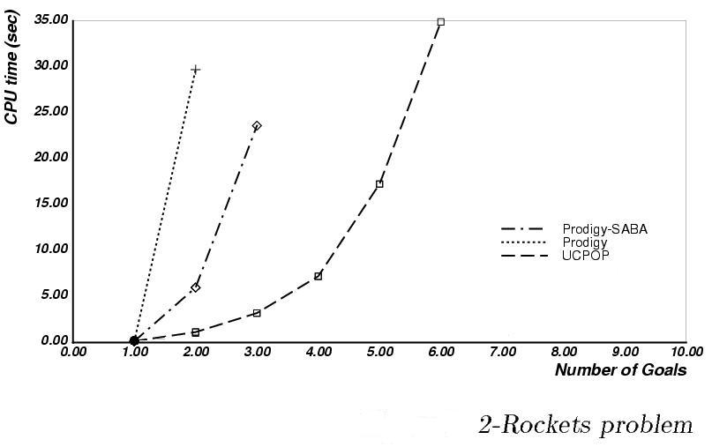
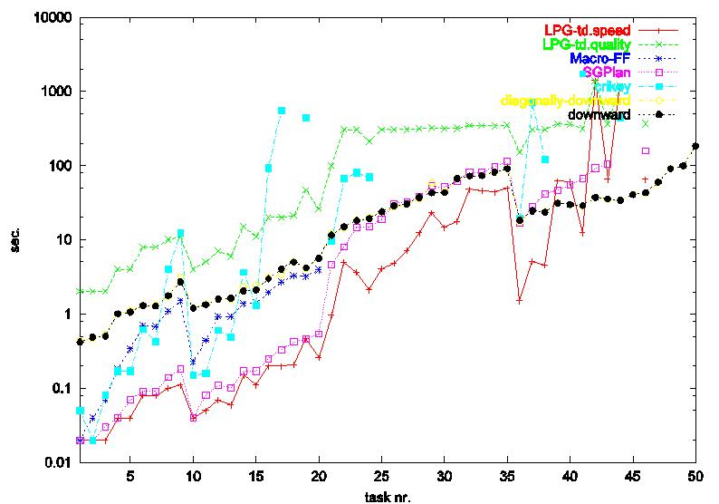

We have figured out how to scale synthesis..
Scalability was the big bottle-neck…
Problem is Search Control!!!
Before, planning algorithms could synthesize about 6 – 10 action plans in minutes
Significant scale-up in the last 6-7 years
  Now, we can synthesize 100 action plans in seconds.
Realistic encodings
of Munich airport!
The primary revolution in planning in the recent years has been methods to scale up plan synthesis

Slide 60
Scalability came from sophisticated
reachability heuristics based on
planning graphs..
..and not from any hand-coded
domain-specific
control knoweldge
Total cost
incurred in search
Cost of computing
the heuristic
Cost of searching
with the heuristic
h₀
h_{set-difference}
h_{C}
h*
h_{P}
Not always clear where the total minimum occurs
Old wisdom was that the global min was closer to cheaper heuristics
Current insights are that it may well be far from the cheaper heuristics for many problems
  E.g. Pattern databases for 8-puzzle
  Plan graph heuristics for planning
“Optimistic projection of achievability”
Notes:
The scalability came from sophisticated reachability heuristics based on planning graphs.. That sounds quite ominous—but it is really AI 101..

Slide 61

Planning Graph and Projection
pqr
A2
A1
pq
pq
Envelope of Progression Tree (Relaxed Progression)
  Proposition lists: Union of states at k^{th} level
  Mutex: Subsets of literals that cannot be part of any legal state
Lowerbound reachability information
A3
A1
pqs
A2
p
pr
A3
A1
psq
A3
ps
ps
A4
pst
p
p
q
r
s
p
q
r
s
t
A1
A1
Planning Graphs can be used as the basis for
heuristics!
A2
A2
A3
A3
A4
[Blum&Furst, 1995] [ECP, 1997][AI Mag, 2007]

Slide 62
Planning Graph Basics
  Envelope of Progression Tree (Relaxed Progression)
    Linear vs. Exponential Growth
  Reachable states correspond to subsets of proposition lists
      BUT not all subsets are states
    Can be used for estimating non-reachability
      If a state S is not a subset of k^{th} level prop list, then it is definitely not reachable in k steps
pqr
A2
A1
pq
pq
A1
A3
pqs
A2
p
pr
A3
A1
psq
A3
ps
ps
A4
pst
p
p
q
r
s
p
q
r
s
t
A1
A1
A2
A2
A3
A3
A4
[ECP, 1997]

Slide 63
Reachability through progression
pqr
A2
A1
pq
pq
A1
A3
pqs
A2
p
pr
A3
A1
psq
A3
ps
ps
A4
pst
[ECP, 1997]

Slide 64
Planning Graph Basics
  Envelope of Progression Tree (Relaxed Progression)
    Linear vs. Exponential Growth
  Reachable states correspond to subsets of proposition lists
      BUT not all subsets are states
    Can be used for estimating non-reachability
      If a state S is not a subset of k^{th} level prop list, then it is definitely not reachable in k steps
pqr
A2
A1
pq
pq
A1
A3
pqs
A2
p
pr
A3
A1
psq
A3
ps
ps
A4
pst
p
p
q
r
s
p
q
r
s
t
A1
A1
A2
A2
A3
A3
A4
[ECP, 1997]

Slide 65
Scalability of Planning
Before, planning algorithms could synthesize about 6 – 10 action plans in minutes
Significant scale-up in the
last 6-7 years
  Now, we can synthesize 100 action plans in seconds.
Realistic encodings
of Munich airport!
Problem is Search Control!!!
The primary revolution in planning in the recent years has been domain-independent heuristics to scale up plan synthesis
…and now for a ring-side retrospective ☺

Slide 66
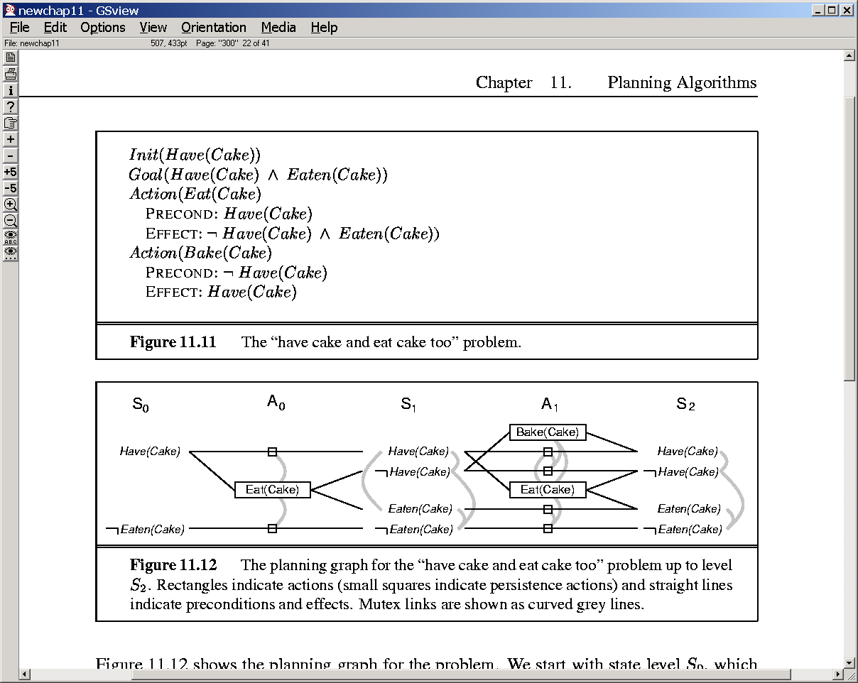
Graph has leveled off, when the prop list has not changed from the previous iteration
~Have(cake)
eaten(cake)
Have(cake)
eaten(cake)
bake
Eat
Have(cake)
~eaten(cake)
Don’t look at curved lines
for now…
No-op
~Have(cake)
eaten(cake)
Have(cake)
~eaten(cake)
Eat
Have(cake)
~eaten(cake)
No-op
No-op
The note that the graph has leveled off now since the last two
Prop lists are the same (we could actually have stopped at the
Previous level since we already have all possible literals by step 2)

Slide 67
Blocks world
Init:
Ontable(A),Ontable(B),
Clear(A), Clear(B), hand-empty
Goal:
~clear(B), hand-empty
State variables:
Ontable(x) On(x,y) Clear(x) hand-empty holding(x)
Initial state:
Complete specification of T/F values to state variables
--By convention, variables with F values are omitted
Goal state:
A partial specification of the desired state variable/value combinations
--desired values can be both positive and negative
Pickup(x)
Prec: hand-empty,clear(x),ontable(x)
eff: holding(x),~ontable(x),~hand-empty,~Clear(x)
Putdown(x)
Prec: holding(x)
eff: Ontable(x), hand-empty,clear(x),~holding(x)
Stack(x,y)
Prec: holding(x), clear(y)
eff: on(x,y), ~cl(y), ~holding(x), hand-empty
Unstack(x,y)
Prec: on(x,y),hand-empty,cl(x)
eff: holding(x),~clear(x),clear(y),~hand-empty
All the actions here have only positive preconditions; but this is not necessary

Slide 68
h-A
h-B
Pick-A
Pick-B
~cl-A
~cl-B
~he
onT-A
onT-A
onT-B
onT-B
cl-A
cl-A
cl-B
cl-B
he
he

Slide 69
Planning : The big picture
Synthesizing goal-directed behavior
Planning involves
  Action selection; Handling causal dependencies
  Action sequencing and handling resource allocation
    typically called SCHEDULING
  Depending on the problem, plans can be
    action sequences
    or “policies” (action trees, state-action mappings etc.)
Notes:
POINT OUT THAT SCHEDULING HAS LOTS OF APPLICATIONS BUT PLANNING HAS NOT HAD APPLICATIONS BECAUSE OF SCAELE_UP. THINGS ARE CHANGING NOW THOUGH.

Slide 70
h-A
St-A-B
on-A-B
on-B-A
h-B
Pick-A
h-A
h-B
Pick-B
~cl-A
~cl-B
~cl-A
St-B-A
~cl-B
~he
onT-A
onT-A
~he
Ptdn-A
onT-A
onT-B
onT-B
onT-B
Ptdn-B
cl-A
cl-A
cl-A
Pick-A
cl-B
cl-B
cl-B
Pick-B
he
he
he

Slide 71
Estimating the cost of achieving individual literals (subgoals)
Idea: Unfold a data structure called “planning graph” as follows:
1. Start with the initial state. This is called the zeroth level proposition list
2. In the next level, called first level action list, put all the actions whose
preconditions are true in the initial state
-- Have links between actions and their preconditions
3. In the next level, called first level propostion list, put:
Note: A literal appears at most once in a proposition list.
3.1. All the effects of all the actions in the previous level.
Links the effects to the respective actions.
(If multiple actions give a particular effect, have multiple
links to that effect from all those actions)
3.2. All the conditions in the previous proposition list (in this case
zeroth proposition list).
Put persistence links between the corresponding literals in the
previous proposition list and the current proposition list.
*4. Repeat steps 2 and 3 until there is no difference between two consecutive
proposition lists. At that point the graph is said to have “leveled off”
The next 2 slides show this expansion upto two levels

Slide 72
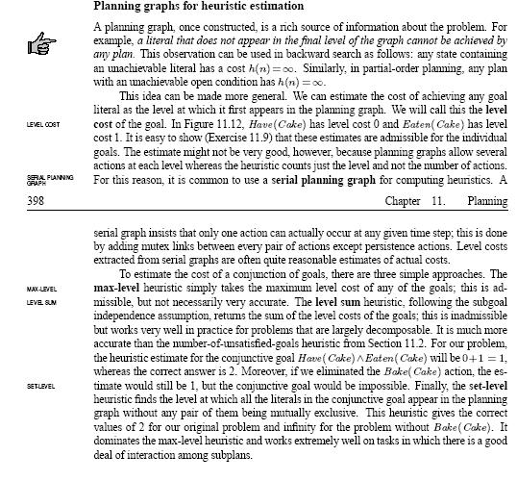


Slide 73
Using the planning graph to estimate the cost of single literals:
1. We can say that the cost of a single literal is the index of the first proposition level
in which it appears.
--If the literal does not appear in any of the levels in the currently expanded
planning graph, then the cost of that literal is:
-- l+1 if the graph has been expanded to l levels, but has not yet leveled off
-- Infinity, if the graph has been expanded
(basically, the literal cannot be achieved from the current initial state)
Examples:
h({~he}) = 1
h ({On(A,B)}) = 2
h({he})= 0
How about sets of literals?
→see next slide

Slide 74
Estimating reachability of sets
We can estimate cost of a set of literals in three ways:
  Make independence assumption
    h_{sum}(p,q,r)= h(p)+h(q)+h(r)
  if we define the cost of a set of literals in terms of the level where they appear together
    h-lev({p,q,r})= The index of the first level of the PG where p,q,r appear together
      so, h({~he,h-A}) = 1
  Compute the length of a “relaxed plan” to supporting all the literals in the set S, and use it as the heuristic (**) h_{relax}

Slide 75
Neither h_{lev} nor h_{sum} work well always
P₀
A₀
P₁
True cost of {p₁…p₁₀₀} is 1
(needs just one action reach)
H_{lev} says the cost is 1
H_{sum} says the cost is 100
H_{lev} better than H_{sum}
q
q
B1
p₁
B2
p₂
B3
p₃
B99
p₉₉
B100
p₁₀₀
P₀
A₀
P₁
True cost of {p₁…p₁₀₀} is 100
(needs 100 actions to reach)
H_{lev} says the cost is 1
H_{sum} says the cost is 100
H_{sum} better than H_{lev}
q
q
p₁
p₂
B*
p₃
p₉₉
H_{relax} will get it correct both times..
p₁₀₀

Slide 76
“Relaxed plan”
Suppose you want to find a relaxed plan for supporting literals g1…gm on a k-length PG. You do it this way:
  Start at kth level. Pick an action for supporting each gi (the actions don’t have to be distinct—one can support more than one goal). Let the actions chosen be {a1…aj}
  Take the union of preconditions of a1…aj. Let these be the set p1…pv.
  Repeat the steps 1 and 2 for p1…pv—continue until you reach init prop list.
The plan is called “relaxed” because you are assuming that sets of actions can be done together without negative interactions.
Optimal relaxed plan is still NP-hard
No backtracking needed!

Slide 77
Relaxed Plan Heuristics
When Level does not reflect distance well, we can find a relaxed plan.
A relaxed plan is subgraph of the planning graph, where:
  Every goal proposition is supported by an action in the previous level
  Every action in the graph introduces its preconditions as goals in the previous level.
    And so they too have a supporting action in the relaxed plan
It is possible to find a “feasible” relaxed plan greedily (without backtracking)
    The greedy heuristic is
      Support goals with no-ops where possible
      Support goals with actions already chosen to support other goals where possible
  Relaxed Plans computed in the greedy way are not admissible, but are generally effective.
Optimal relaxed plans are admissible.
  But alas, finding the optimal relaxed plan is NP-hard

Slide 78
Relaxed plan
for our blocks
example
h-A
St-A-B
on-A-B
on-B-A
h-B
Pick-A
h-A
h-B
Pick-B
~
cl
-A
~
cl
-B
~
cl
-A
St-B-A
~
cl
-B
~he
onT
-A
onT
-A
~he
Ptdn
-A
onT
-A
onT
-B
onT
-B
onT
-B
Ptdn
-B
cl
-A
cl
-A
cl
-A
Pick-A
cl
-B
cl
-B
cl
-B
Pick-B
he
he
he

Slide 79
Sept 13, 2010

Slide 80
Are Relaxed Plan (or Landmark) heuristics really causing planner scale-up?
Modern planners are engineered artifacts and it is hard to pinpoint a single feature of the planner as the main reason for its performance (much like it is hard to pinpoint what exact rivet in the Brooklyn Bridge accounts for its longevity)
To some extent RP (and/or LM) heuristics are the “preferred” explanations for planner success (much as motherhood and apple pie are the preferred explanations for the durability of USA ;-)
The other equally (or sometimes “more”) important reasons for the planner success have to do with the search techniques that
  Allow freedom to recover from early mistakes [idea: Restart]
  Allow hedging bets on the heuristics [idea: Multi-heuristic Search]
  Allow reduction in branching [idea: helpful actions/preferred operators]
  Allow laziness [idea: delayed heuristic evaluation]

Slide 81
Non-heuristic type ideas that have a big impact on performance
Search type: Enforced hill climbing (FF)
  Queue Management: Multi-heuristic search
  Lazy evaluation: Deferred evaluation of heuristics (only compute heuristic when the node is picked for expansion; until then it inherits its parent’s h)
Branching reduction: Helpful actions (FF); preferred operators (LAMA)

Slide 82

How do we use reachability heuristics for regression?
Progression
Regression
Goal
Stalagmites
Stalactites
Initial State

Slide 83
Use of PG in Progression vs Regression
Remember the Altimeter metaphor..
Progression
  Need to compute a PG for each child state
    As many PGs as there are leaf nodes!
    Lot higher cost for heuristic computation
      Can try exploiting overlap between different PGs
  However, the states in progression are consistent..
    So, handling negative interactions is not that important
    Overall, the PG gives a better guidance even without mutexes
Regression
  Need to compute PG only once for the given initial state.
    Much lower cost in computing the heuristic
  However states in regression are “partial states” and can thus be inconsistent
    So, taking negative interactions into account using mutex is important
      Costlier PG construction
    Overall, PG’s guidance is not as good unless higher order mutexes are also taken into account
Historically, the heuristic was first used with progression
planners. Then they used it with regression planners. Then they
found progression planners do better. Then they found that combining
them is even better.

Slide 84

Planning Graphs for heuristics
Construct planning graph(s) at each search node
  Extract relaxed plan to achieve goal for heuristic
1
1
o₁₂
1
o₁₂
1
q
5
q
t
r
5
6
q
t
r
s
p
5
6
7
3
2
o₂₃
2
o_{G}
G
3
o₃₄
o_{qt}
3
o_{qs}
3
4
o₃₄
4
o_{qr}
r
q
p
5
6
o₄₅
r
q
p
s
t
5
6
7
q5
r
5
o_{tp}
5
p
5
p
q
r
5
6
p
q
r
s
t
5
6
7
o_{rs}
o_{G}
o_{rq}
G
o₆₇
G
G
o₅₆
o_{G}
o_{pq}
3
o_{ps}
3
3
o_{G}
3
o_{pr}
o_{pq}
o₃₄
o_{rp}
o₃₄
5
4
o_{qt}
4
p5
r5
o_{pr}
p
6
o_{qt}
p
q
r
6
7
o₄₅
p
q
r
s
t
6
7
8
5
o₅₆
o₅₆
5
o₆₇
5
o₅₆
o₅₆
o₅₆
o₆₇
6
o_{ps}
6
h(
)=5
o_{pq}
o₆₇
p6
o_{pr}
o_{qt}
7
1
1
o₁₂
1
o₁₂
1
o₆₇
2
o₇₈
2
o_{G}
G
5
o₂₃
3
5
o₅₆
5
o₅₆
5
6
o₆₇
6
7
Notes:
1 min

Slide 85
So, is regression a doomed idea?
[or is it all a conspiracy of the benchmarks?]
Regression seems to have a lot going for it
  Low “goal-driven” branching factor
  Ability to get by with a single planning graph
…and yet, seems to be cursed with an inability to do well on the benchmark problems
Is it Regression or is it just the benchmarks?
One possible explanation: The reason relaxed planning graph heuristics seem to help progression is in part because most benchmark domains are ergodic (i.e., you can reach any state from any other state) and thus progression planners will never have to backtrack
  In contrast, even in ergodic domains, regression planners may have to backtrack because the specific set of goals they are trying to achieve are infeasible together.
Qn: What if progression planners were actually made to handle non-ergodic domains? Will regression be competitive then?
An alternate experiment: For every domain D, consider both D+ which is the normal forward version, and D- which is the time-reversed version
  Now, we can use progression or regression both in D+ and D- giving rise to 4 domain-direction/planner-direction combinations
  How will progression and regression do in these scenarios?

Slide 86
Back-Chaining as a meta-idea
Back-chaining involves ‘goal-subgoal’ analysis of the type “to get G, I can use A which gives G, but requires P and Q. So I just subgoal on P and Q
Backchaining—per se– does not tell us how to handle multiple goals together
  Regression implements back-chaining by combining all subgoaling branches into a single regression state
  Partial-order planning implements back-chaining by keeping all the actions in the plan with partial ordering relations, and enough book keeping (causal links) to eventually deconflict (or declare failure)
  Means-ends analysis (e.g. STRIPS) implements back-chaining by working on recursively achieving each subgoal, and concatenating the plans together
    Has to consider all possible orderings over goals
    Even then, it will fail to solve a problem if its goals cannot be serialized
      E.g. Sussman Anomaly, Register Swapping problem

Slide 87
Back-chaining is connected to Land-mark heuristic
One way to exploit ideas that are not provably “sound” is to make them be part of heuristics
Land-mark orderings are basically related to serialization of subgoals.

Slide 88
h-sum; h-lev; h-relax
H-lev is lower than or equal to h-relax
H-ind is larger than or equal to H-lev
H-lev is admissible
H-relax is not admissible unless you find optimal relaxed plan
  Which is NP-Hard..

Slide 89
PGs for reducing actions
If you just use the action instances at the final action level of a leveled PG, then you are guaranteed to preserve completeness
  Reason: Any action that can be done in a state that is even possibly reachable from init state is in that last level
  Cuts down branching factor significantly
  Sometimes, you take more risky gambles:
    If you are considering the goals {p,q,r,s}, just look at the actions that appear in the level preceding the first level where {p,q,r,s} appear for the first time without Mutex.

Slide 90

9/15

Slide 91
Negative Interactions
To better account for -ve interactions, we need to start looking into feasibility of subsets of literals actually being true together in a proposition level.
Specifically,in each proposition level, we want to mark not just which individual literals are feasible,
  but also which pairs, which triples, which quadruples, and which n-tuples are feasible. (It is quite possible that two literals are independently feasible in level k, but not feasible together in that level)
The idea then is to say that the cost of a set of S literals is the index of the first level of the planning graph, where no subset of S is marked infeasible
The full scale mark-up is very costly, and makes the cost of planning graph construction equal the cost of enumerating the full progres sion search tree.
  Since we only want estimates, it is okay if talk of feasibility of upto k-tuples
For the special case of feasibility of k=2 (2-sized subsets), there are some very efficient marking and propagation procedures.
  This is the idea of marking and propagating mutual exclusion relations.

Slide 92
Graph has leveled off, when the prop list has not changed from the previous iteration
~Have(cake)
eaten(cake)
Have(cake)
eaten(cake)
bake
Eat
Have(cake)
~eaten(cake)
Don’t look at curved lines
for now…
No-op
~Have(cake)
eaten(cake)
Have(cake)
~eaten(cake)
Eat
Have(cake)
~eaten(cake)
No-op
No-op
The note that the graph has leveled off now since the last two
Prop lists are the same (we could actually have stopped at the
Previous level since we already have all possible literals by step 2)

Slide 93
Level-off definition? When neither propositions nor mutexes change between levels

Slide 94
Mutex Propagation Rules
This one is
not listed in
the text
Rule 1. Two actions a1 and a2 are mutex if
  both of the actions are non-noop actions or
  a1 is any action supporting P, and a2 either needs ~P, or gives ~P.
  some precondition of a1 is marked mutex with some precondition of a2
Serial graph
interferene
Competing needs
Rule 2. Two propositions P1 and P2 are marked mutex
if all actions supporting P1 are pair-wise mutex
with all actions supporting P2.

Slide 95
h-A
h-B
Pick-A
Pick-B
~cl-A
~cl-B
~he
onT-A
onT-A
onT-B
onT-B
cl-A
cl-A
cl-B
cl-B
he
he

Slide 96
h-A
St-A-B
on-A-B
on-B-A
h-B
Pick-A
h-A
h-B
Pick-B
~cl-A
~cl-B
~cl-A
St-B-A
~cl-B
~he
onT-A
onT-A
~he
Ptdn-A
onT-A
onT-B
onT-B
onT-B
Ptdn-B
cl-A
cl-A
cl-A
Pick-A
cl-B
cl-B
cl-B
Pick-B
he
he
he
Notes:
We want to try and make the level of a set of literals a good indicator of the difficulty of achieving them. One way is to introduce and propagate mutual exclusion (mutex) relations.
Here is how it goes. We know that at every time step we are really only going to do one non-no-op action. So, at the first level either pickup-A, or pickup-B or pickup-C are done. If one of them is done, the others can’t be. So, we put red-arrows to signify that each pair of actions are mutually exclusive.
Now, we can PROPAGATE the mutex relations to the proposition levels.
Rule 1. Two actions a1 and a2 are mutex if
both of the actions are non-noop actions or
a1 is a noop action supporting P, and a2 either needs ~P, or gives ~P.
some precondition of a1 is marked mutex with some precondition of a2
By this rule Pick-A is mutex with Pick-B. Similarly, the noop action he is mutex with pick-A.
Rule 2. Two propositions P1 and P2 are marked mutex if all actions supporting P1 are pair-wise mutex with all actions supporting P2.
By this rule, h-A and h-B are mutex in level 1 since the only action giving h-A is mutex with the only action giving h-B.
~cl(B) and he are mutex in the first level, but are not mutex in the second level (note that
~cl(B) is supported by a noop and stack-a-b (among others) in level 2. he is supported by stack-a-b, noop (among others). At least one action –stack-a-b supporting the first is non-mutex with one action—stack-a-b-- supporting the second.

Slide 97
Level-based heuristics on planning graph with mutex relations
We now modify the h_{lev} heuristic as follows
h_{lev}({p₁, …p_{n}})= The index of the first level of the PG where p₁, …p_{n} appear together
and no pair of them are marked mutex.
(If there is no such level, then h_{lev} is set to l+1 if the PG is expanded
to l levels, and to infinity, if it has been expanded until it leveled off)
This heuristic is admissible.
With this heuristic, we have a much better handle on both +ve
and -ve interactions. In our example, this heuristic gives the
following reasonable costs:
h({~he, cl-A}) = 1
h({~cl-B,he}) = 2
h({he, h-A}) = infinity
(because they will be marked mutex even in the final level of the
leveled PG)
Works very well in practice
H({have(cake),eaten(cake)}) = 2

Slide 98
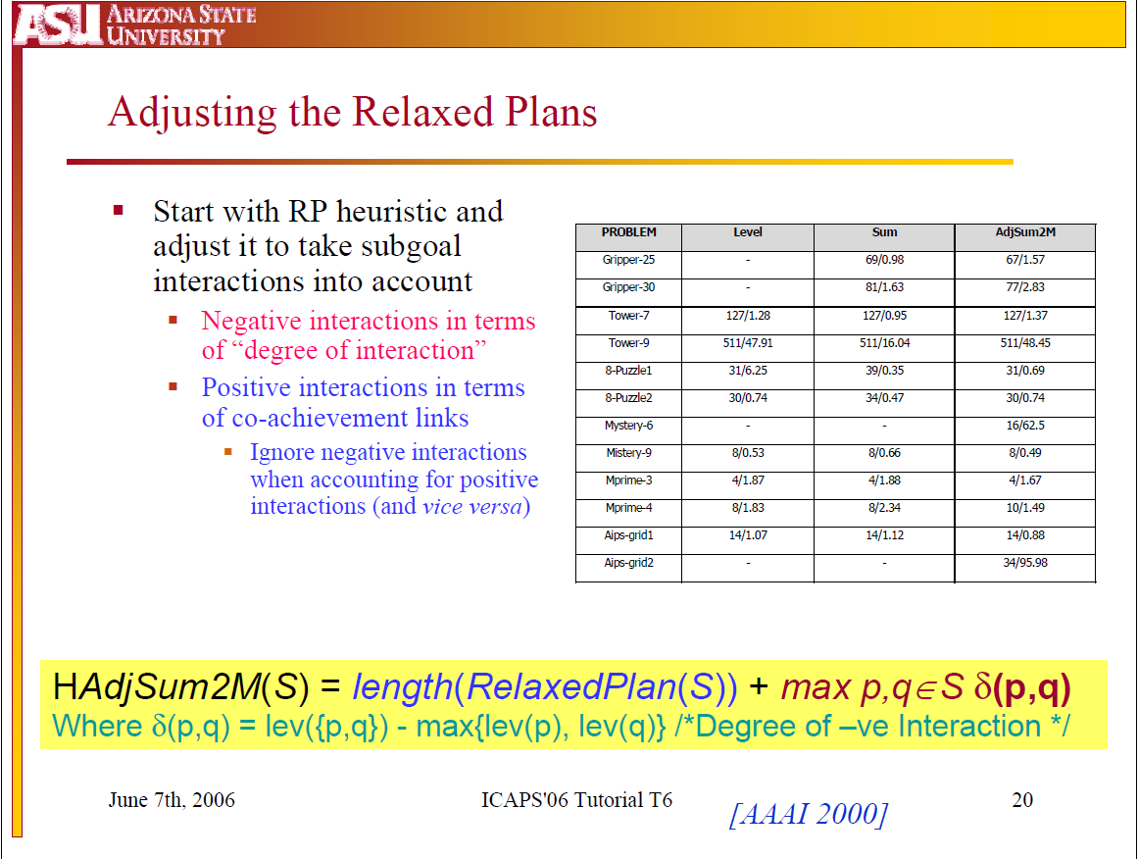

Slide 99
How about having a relaxed plan on PGs with Mutexes?
We had seen that extracting relaxed plans lead to heuristics that are better than “level” heuristics
Now that we have mutexes, we generalized level heuristics to take mutexes into account
But how about a generalization for relaxed plans?
  Unfortunately, once you have mutexes, even finding a feasible plan (subgraph) from the PG is NP-hard
    We will have to backtrack over assignments of actions to propositions to find sets of actions that are not conflicting
  In fact, “plan extraction” on a PG with mutexes basically leads to actual (i.e., non-relaxed) plans.
    This is what Graphplan does (see next)
  (As for Heuristics, the usual idea is to take the relaxed plan ignoring mutexes, and then add a penalty of some sort to take negative interactions into account. See adjusted sum heuristics)
added after class

Slide 100
How lazy can we be in marking mutexes?
We noticed that h_{lev} is already admissible even without taking negative interactions into account
If we mark mutexes, then h_{lev} can only become more informed
  So, being lazy about marking mutexes cannot affect admissibility
    Unless of course we are using the planning graph to extract sound plans directly.
      In this latter case, we must at least mark all statically interfering actions mutex
        Any additional mutexes we mark by propagation only improve the speed of the search (but the improvement is TREMENDOUS)
  However, being over-eager about marking mutexes (i.e., marking non-mutex actions mutex) does lead to loss of admissibility
added after class

Slide 101
PGs can be used as a basis for finding plans directly
If there exists a k-length plan, it will be a subgraph of the
k-length planning graph.
(see the highlighted subgraph of the PG for our example problem)

Slide 102
Finding the subgraphs that correspond to valid solutions..
--Can use specialized graph travesal techniques
--start from the end, put the vertices
corresponding to goals in.
--if they are mutex, no solution
--else, put at least one of the supports of those
goals in
--Make sure that the supports are not
mutex
--If they are mutex, backtrack and
choose other set of supports.
{No backtracking if we have no
mutexes; basis for “relaxed plans”}
--At the next level subgoal on the preconds of
the support actions we chose.
--The recursion ends at init level
--Consider extracting the plan from the PG
directly
-- This search can also be cast as a CSP
Variables: literals in proposition lists
Values: actions supporting them
Constraints: Mutex and Activation
The idea behind Graphplan

Slide 104
Backward search in Graphplan
A5
Animated
P1
P1
P1
A6
A1
G1
I₁
X
X
P2
P2
A7
G2
P3
A2
I₂
P3
A8
G3
P4
P4
I₃
A9
A3
G4
P5
X
P5
A10
P6
P6
P6
A4
A11

Slide 105
The Story Behind Memos…
Memos essentially tell us that a particular set S of conditions cannot be achieved at a particular level k in the PG.
  We may as well remember this information—so in case we wind up subgoaling on any set S’ of conditions, where S’ is a superset of S, at that level, you can immediately declare failure
    “Nogood” learning—Storage/matching cost vs. benefit of reduced search.. Generally in our favor
But, just because a set S={C1….C100} cannot be achieved together doesn’t necessarily mean that the reason for the failure has got to do with ALL those 100 conditions. Some of them may be innocent bystanders.
  Suppose we can “explain” the failure as being caused by the set U which is a subset of S (say U={C45,C97})—then U is more powerful in pruning later failures
  Idea called “Explanation based Learning”
    Improves Graphplan performance significantly….
[Rao, IJCAI-99; JAIR 2000]

Slide 106
Compilation to SAT
[Kautz & Selman]
Goals: In(A),In(B)
Init: At-R-E-0 & At-A-E-0 & At-B-E-0
Goal: In-A-1 & In-B-1
Graph: “cond at k => one of the supporting actions at k-1”
In-A-1 => Load-A-1 In-B-1 => Load-B-1
At-R-M-1 => Fly-R-1 At-R-E-1 => P-At-R-E-1
Load-A-1 => At-R-E-0 & At-A-E-0 “Actions => preconds”
Load-B-1 => At-R-E-0 & At-B-E-0
P-At-R-E-1 => At-R-E-0h
~In-A-1 V ~ At-R-M-1 ~In-B-1 V ~At-R-M-1 “Mutexes”

Slide 108
Compilation to CSP
[Do & Kambhampati, 2000]
Goals: In(A),In(B)
CSP: Given a set of discrete variables,
the domains of the variables, and constraints
on the specific values a set of variables can take
in combination, FIND an assignment of values to
all the variables which respects all constraints
Variables: Propositions (In-A-1, In-B-1, ..At-R-E-0 …)
Domains: Actions supporting that proposition in the plan
In-A-1 : { Load-A-1, #} At-R-E-1: {P-At-R-E-1, #}
Constraints: Mutual exclusion
~[ ( In-A-1 = Load-A-1) & (At-R-M-1 = Fly-R-1)] ; etc..
Activation
In-A-1 != # & In-B-1 != # (Goals must have action assignments)
In-A-1 = Load-A-1 => At-R-E-0 != # , At-A-E-0 != #
(subgoal activation constraints)
[Corresponds to a
regression-based proof]

Slide 109
Conversion to CSP
-- This search can also be cast as a CSP
Variables: literals in proposition lists
Values: actions supporting them
Constraints: Mutex and Activation constraints
Variables/Domains:
~cl-B-2: { #, St-A-B-2, Pick-B-2}
he-2: {#, St-A-B-2, St-B-A-2,Ptdn-A-2,Ptdn-B-2}
h-A-1: {#, Pick-A-1}
h-B-1: {#,Pick-B-1 }
….
Constraints:
he-2 = St-A-B-2 => h-A-1 !=#
{activation}
On-A-B-2 = St-A-B-2 => On-B-A-2 != St-B-A-2
{mutex constraints}
Goals:
~cl-B-2 != # he-2 !=#

Slide 110
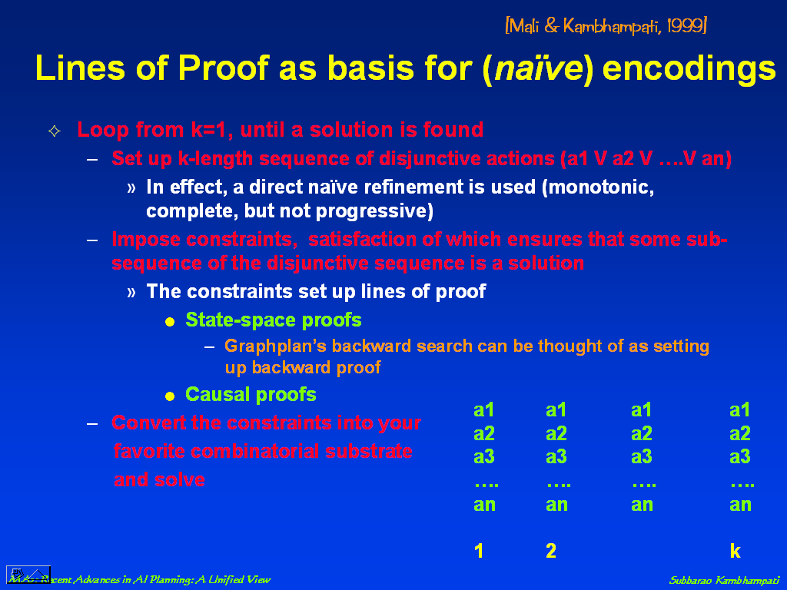

Slide 111
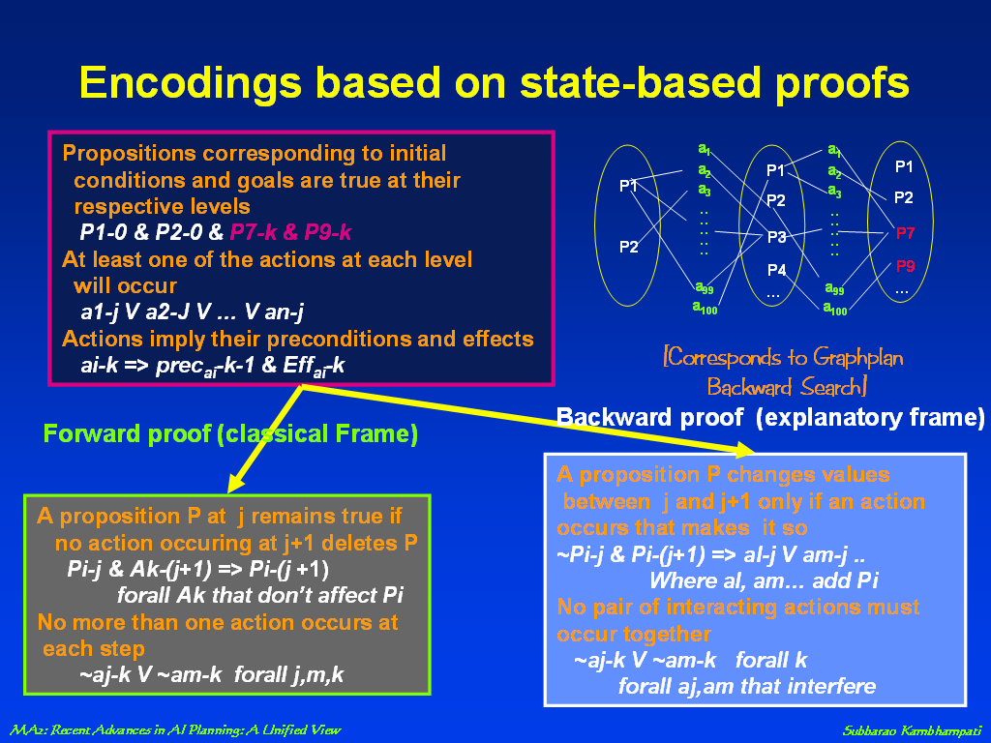
Basically GP minimum
Mutex propagation (which will
add more derived constraints)

Slide 112
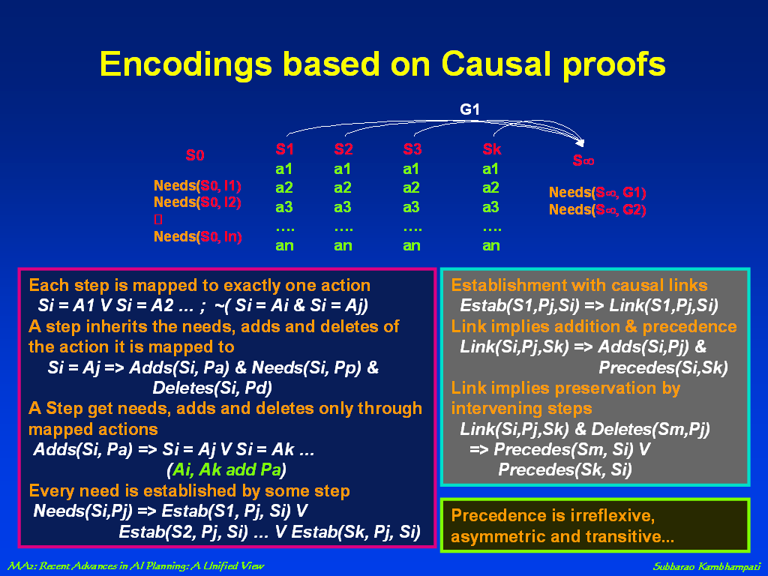

Slide 113
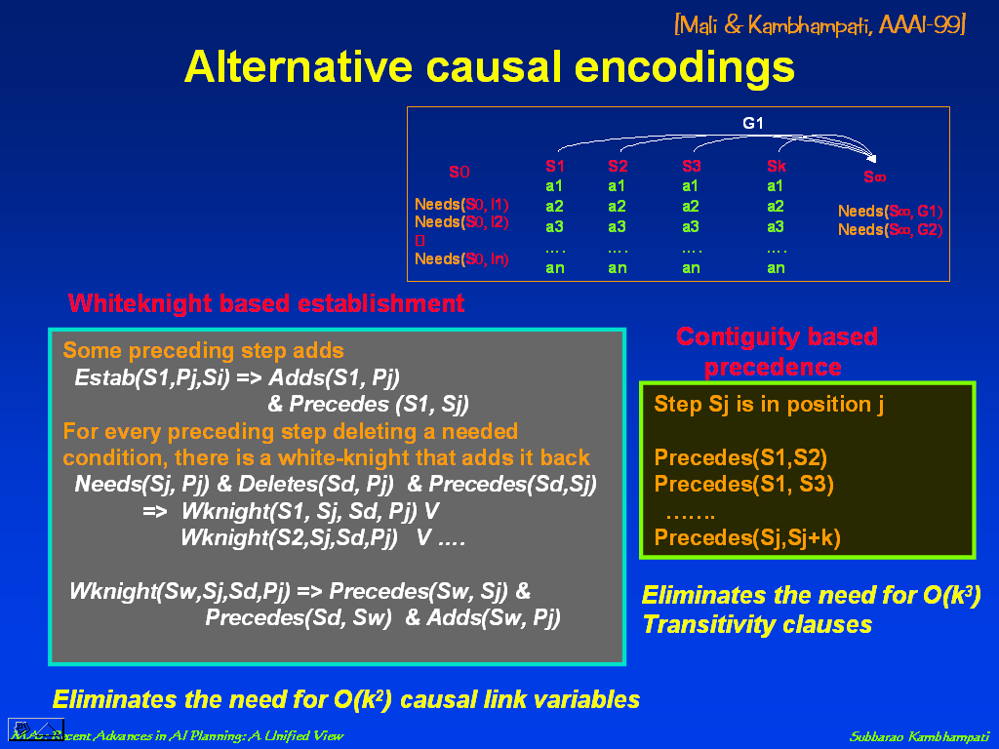

Slide 114
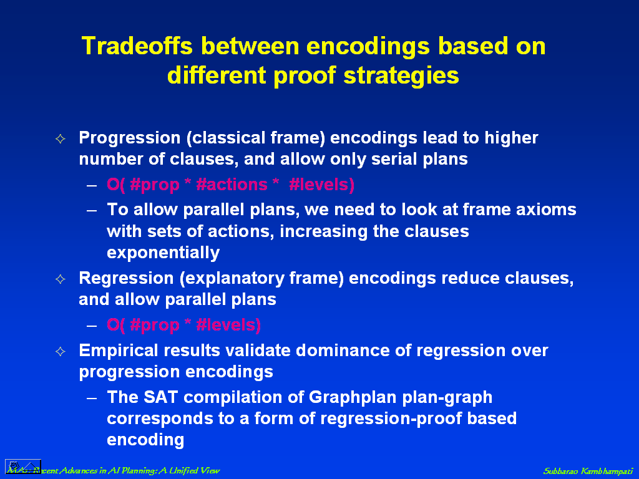

Slide 115
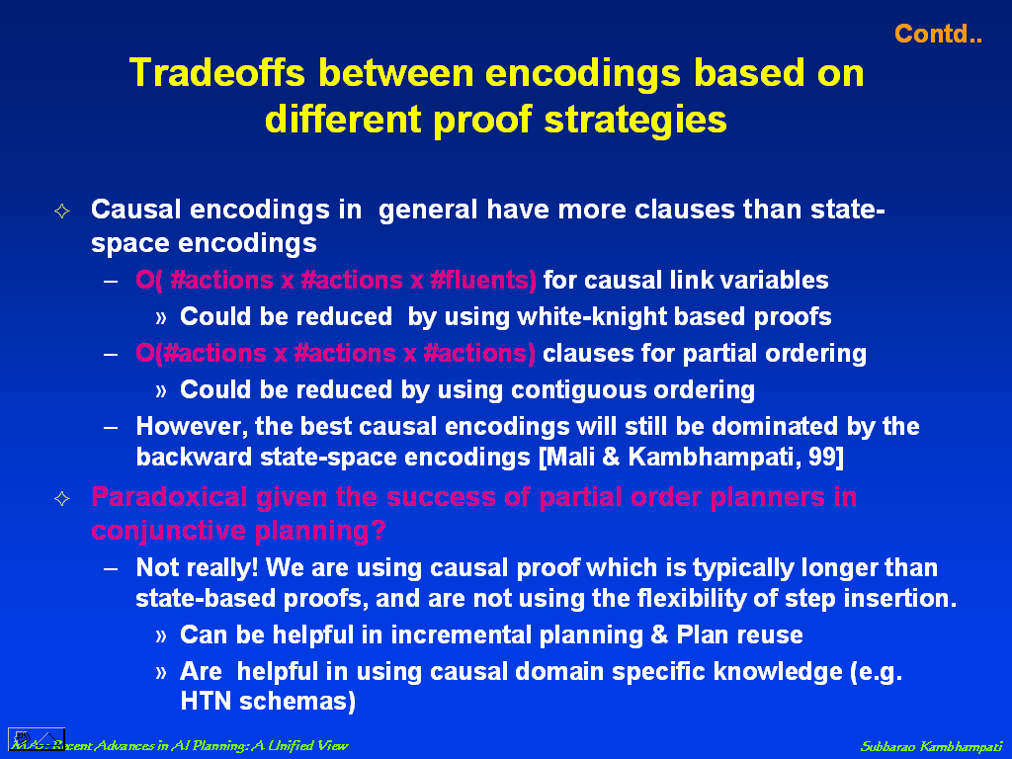

Slide 116
Some observations about the structure of the PG
1. If an action a is present in level l, it will be present in
all subsequent levels.
2. If a literal p is present in level l, it will be present in all
subsequent levels.
3. If two literals p,q are not mutex in level l, they will never
be mutex in subsequent levels
--Mutex relations relax monotonically as we grow PG
1,2,3 imply that a PG can be represented efficiently in a bi-level
structure: One level for propositions and one level for actions.
For each proposition/action, we just track the first time instant
they got into the PG. For mutex relations we track the first time instant
they went away.
PG doesn’t have to be grown to level-off to be useful for computing heuristics
PG can be used to decide which actions are worth considering in the search

Slide 117
Life must be lived forward, but can only be understood backward.--Kierkegaard

Slide 118
Distance of a Set of Literals
Admissible
h(S) = ∑p∈S lev({p})
h(S) = lev(S)
Sum
Set-Level
Set-Level
with memos
Partition-k
Adjusted Sum
Combo
lev(p) : index of the first level at which p comes into the planning graph
lev(S): index of the first level where all props in S appear non-mutexed.
  If there is no such level, then
    If the graph is grown to level off, then ∞
    Else k+1 (k is the current length of the graph)

Slide 120

PG Heuristics for Partial Order Planning
Distance heuristics to estimate cost of partially ordered plans (and to select flaws)
  If we ignore negative interactions, then the set of open conditions can be seen as a regression state
Mutexes used to detect indirect conflicts in partial plans
  A step threatens a link if there is a mutex between the link condition and the steps’ effect or precondition
  Post disjunctive precedences and use propagation to simplify

Slide 122
What if actions have non-uniform costs?

Slide 123
Challenges in Cost Propagation

