Slide 1

Friday:
2-3:15pm BY 510
make-up class
Today:
1. Online search
2. Planning in
Belief-space

Slide 2
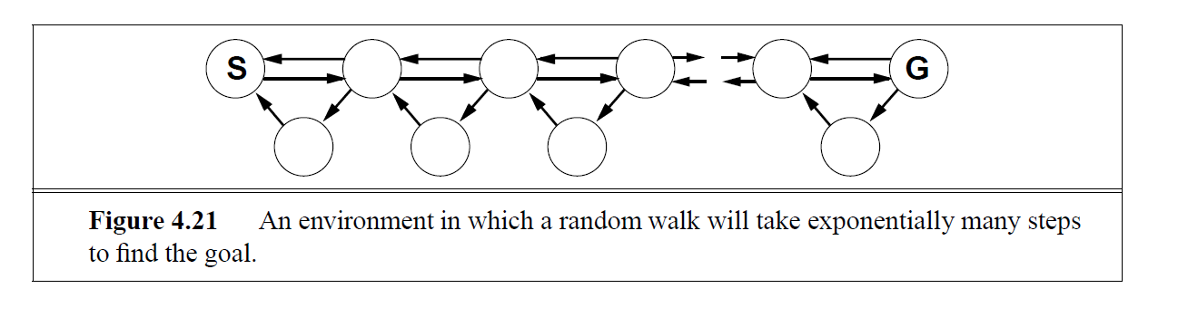
Online Search
--as against “Offline” search. Agent interleaves search
and execution. Necessary when there is no model. May be useful
when the model is complex (non-determinism etc)
Online Search (with the knowledge of transition model)
Online Search (in the absence of transition model)
To avoid planning for all contingencies..
Qn: How worse off are you compared to someone who took the model into account?
  Competitive Ratio
  “Adventure is just Failure to Plan”
All you can do is act, learn the model, use it to act better
Cannot use search methods that require shifting branches
  Depth-First okay
  Hill-Climbing okay—but not random-restart. Random-walk okay
Need to learn the model
  Taboo list; LRTA*, Reinforcement learning
Where did you see online search in 471? Is it full or no model?

Slide 3
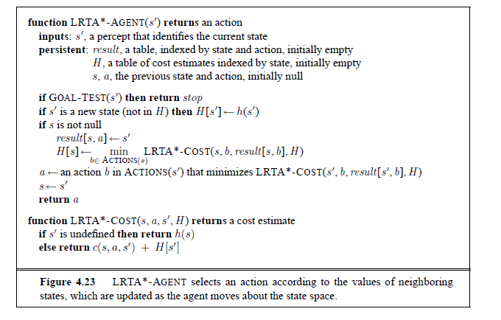

Slide 4
Online Search as a Hammer that can hit many nails..
If you have no model, you will need online search
  Since only by exploring you can figure out the model
    ..and as you learn part of the model, you are stuck with the exploration/exploitation tradeoff
If you have a model, but you are too lazy to use it, you need online search
  Limited contingency planning; planning and replanning; online stochastic planning
If you have no time to reason, you will need to do online search
  E.g. dynamic and semi-dynamic scenarios
Online search doesn’t mean “no need whatsoever to think”
--Trick is to use partial model (either learned or excerpted)

Slide 5
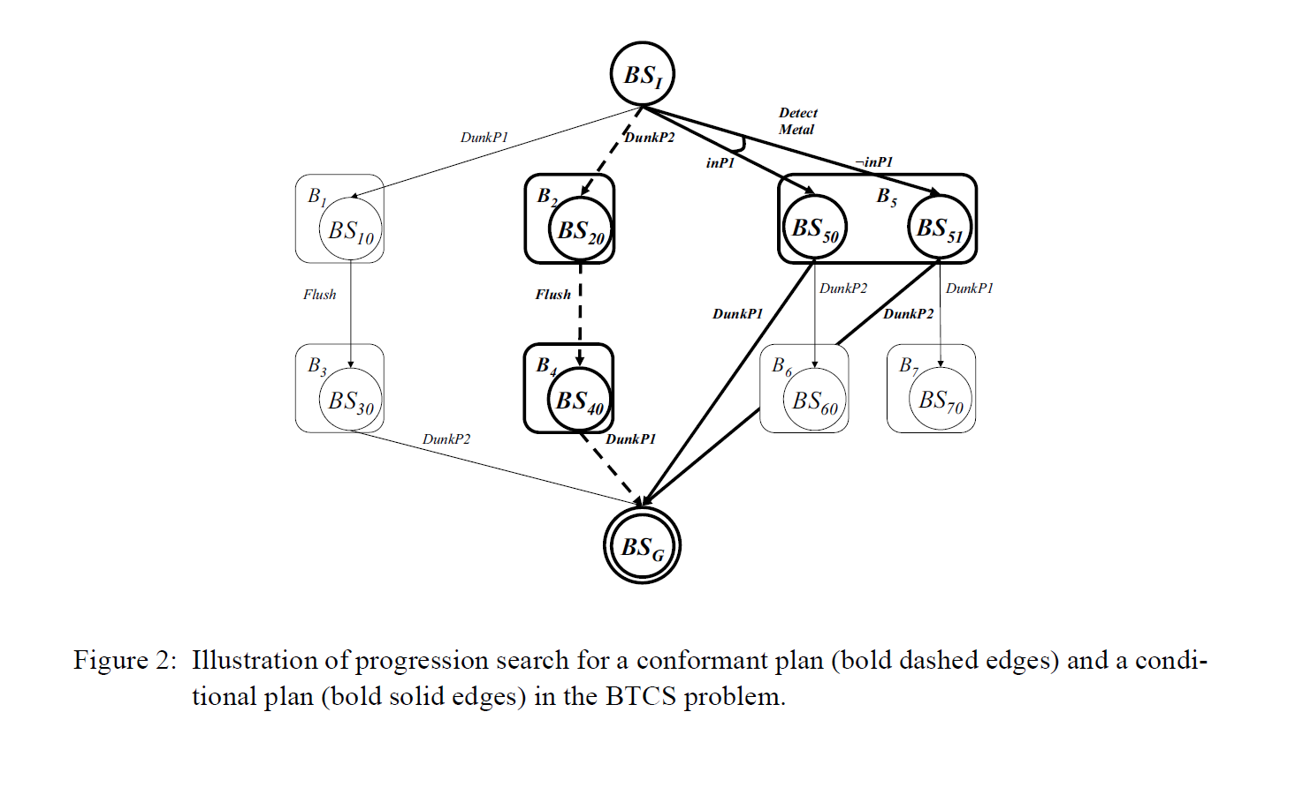

Slide 6
Belief-Space Planning

Slide 7
Representing Belief States

Slide 8
What happens if we restrict uncertainty?
If initial state uncertainty can be restricted to the status of single variables (i.e., some variables are “unknown” the rest are known), then we have “conjunctive uncertainty”
With conjunctive uncertainty, we only have to deal with 3^{n} belief states (as against 2^(2^{n}))
  Notice that this leads to loss of expressiveness (if, for example, you know that in the initial state one of P or Q is true, you cannot express this as a conjunctive uncertainty
  Notice also the relation to “goal states” in classical planning. If you only care about the values of some of the fluents, then you have conjunctive indifference (goal states, and thus regression states, are 3^{n}).
    Not caring about the value of a fluent in the goal state is a boon (since you can declare success if you reach any of the complete goal states consistent with the partial goal state; you have more ways to succeed)
    Not knowing about the value of a fluent in the initial state is a curse (since you now have to succeed from all possible complete initial states consistent with the partial initial state)

Slide 9
Belief State Rep (cont)
Belief space planners have to search in the space of full propositional formulas!!
  In contrast, classical state-space planners search in the space of interpretations (since states for classical planning were interpretations).
Several headaches:
    Progression/Regression will have to be done over all states consistent with the formula (could be exponential number).
    Checking for repeated search states will now involve checking the equivalence of logical formulas (aaugh..!)
      To handle this problem, we have to convert the belief states into some canonical representation. We already know the CNF and DNF representations. There is another one, called Ordered Binary Decision Diagrams that is both canonical and compact
        OBDD can be thought of as a compact representation of the DNF version of the logical formula

Slide 10
Effective representations of logical formulas
  Checking for repeated search states will now involve checking the equivalence of logical formulas (aaugh..!)
    To handle this problem, we have to convert the belief states into some canonical representation.
    We already know the CNF and DNF representations. These are normal forms but are not canonical
      Same formula may have multiple equivalent CNF/DNF representations
    There is another one, called Reduced Ordered Binary Decision Diagrams that is both canonical and compact
      ROBDD can be thought of as a compact representation of the DNF version of the logical formula

Slide 12
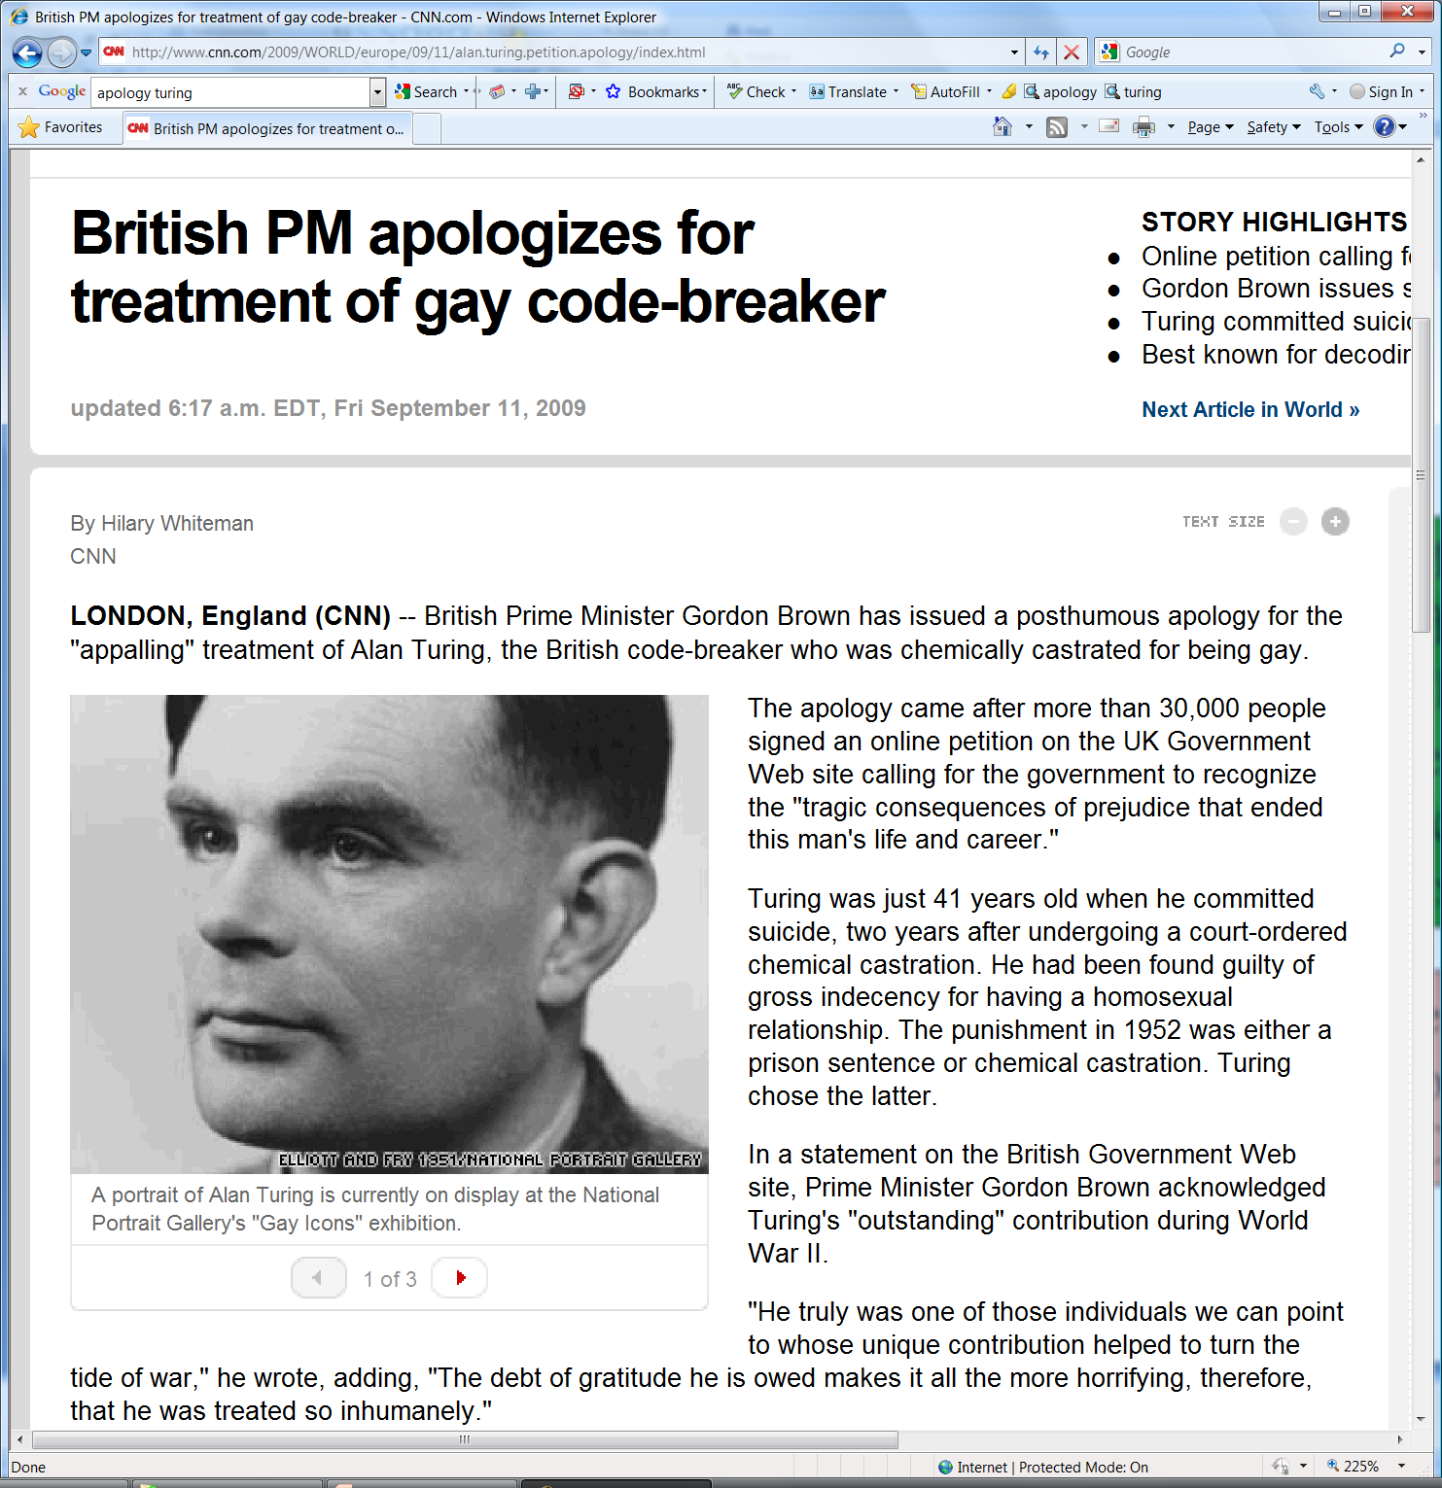

Slide 13
Belief State Search: An Example Problem
Actions:
A1: M
P => K
A2: M
Q => K
A3: M
R => L
A4: K => G
A5: L => G
Plan:
??
Initial state: M is true and exactly one of P,Q,R are true
Goal: Need G
DNF good for progression
(clauses are partial states)
Init State Formula: [(p & ~q & ~r)V(~p&q&~r)V(~p&~q&r)]&M
DNF: [M&p&~q&~r]V[M&~p&~q&~r]V[M&~p&~q&r]
CNF: (P V Q V R) & (~P V ~Q) &(~P V ~R) &(~Q V ~R) & M
CNF good
For regression

Slide 14
Progression & Regression
Progression with DNF
  The “constituents” (DNF clauses) look like partial states already. Think of applying action to each of these constituents and unioning the result
    Action application converts each constituent to a set of new constituents
    Termination when each constituent entails the goal formula
Regression with CNF
  Very little difference from classical planning (since we already had partial states in classical planning).
  THE Main difference is that we cannot split the disjunction into search space
  Termination when each (CNF) clause is entailed by the initial state

Slide 15
Progression Example

Slide 16
Regression Search Example
Actions:
A1: M
P => K
A2: M
Q => K
A3: M
R => L
A4: K => G
A5: L => G
G
A4
G or K must be true before A4
For G to be true after A4
(G V K)
A5
(G V K V L)
A1
(G V K V L V P) &
M
A2
Enabling precondition
Must be true before
A1 was applied
Initially:
(P V Q V R) &
(~P V ~Q) &
(~P V ~R) &
(~Q V ~R) &
M
(G V K V L V P V Q) &
M
Initially:
(P V Q V R) &
(~P V ~Q) &
(~P V ~R) &
(~Q V ~R) &
M
A3
Each Clause is Satisfied by a Clause in the Initial Clausal State -- Done!
(5 actions)
(G V K V L V P V Q V R) &
M
(G V K V L V P V Q V R) &
M
Goal State:
G
Clausal States compactly represent disjunction to sets of uncertain literals – Yet, still need heuristics for the search

Slide 17
Symbolic model checking: The bird’s eye view
Belief states can be represented as logical formulas (and “implemented” as BDDs )
Transition functions can be represented as 2-stage logical formulas (and implemented as BDDs)
The operation of progressing a belief state through a transition function can be done entirely (and efficiently) in terms of operations on BDDs
Read Appendix C before next class
(emphasize C.5; C.6)

Slide 18
Sensing: General observations
Sensing can be thought in terms of
  Speicific state variables whose values can be found
  OR sensing actions that evaluate truth of some boolean formula over the state variables.
    Sense(p) ; Sense(pV(q&r))
A general action may have both causative effects and sensing effects
  Sensing effect changes the agent’s knowledge, and not the world
  Causative effect changes the world (and may give certain knowledge to the agent)
  A pure sensing action only has sensing effects; a pure causative action only has causative effects.

Slide 19
Sensing at Plan Time vs. Run Time
When applied to a belief state, AT RUN TIME the sensing effects of an action wind up reducing the cardinality of that belief state
  basically by removing all states that are not consistent with the sensed effects
AT PLAN TIME, Sensing actions PARTITION belief states
  If you apply Sense-f? to a belief state B, you get a partition of B₁: B&f and B₂: B&~f
  You will have to make a plan that takes both partitions to the goal state
    Introduces branches in the plan
If you regress two belief state B&f and B&~f over a sensing action Sense-f?, you get the belief state B

Slide 20
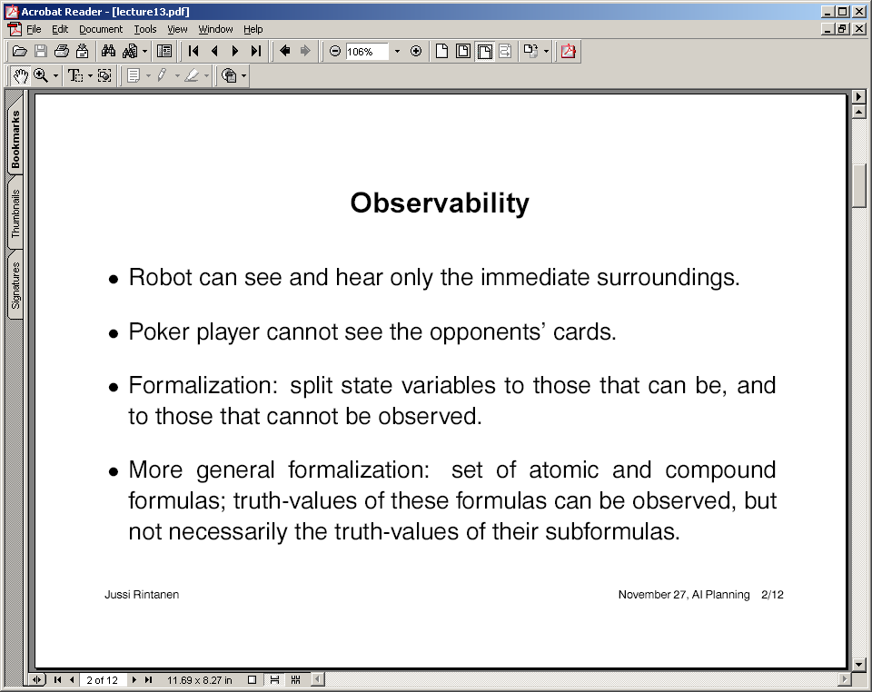

Slide 21
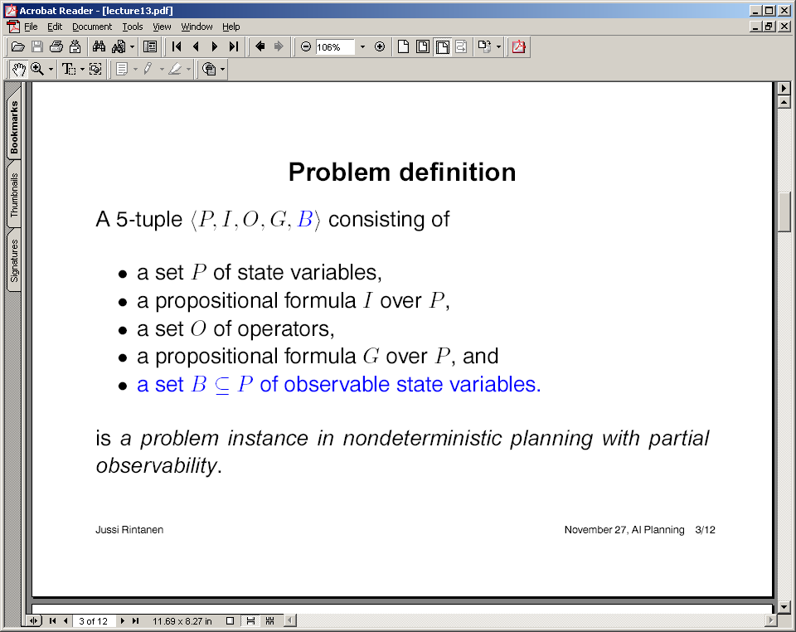
Note: Full vs. Partial observability is independent of sensing individual fluents vs. sensing formulas.
(assuming single literal sensing)
If a state variable p
Is in B, then there is
some action A^{p} that
Can sense whether p
is true or false
If P=B, the problem is fully observable
If B is empty, the problem is non observable
If B is a subset of P, it is partially observable

Slide 22
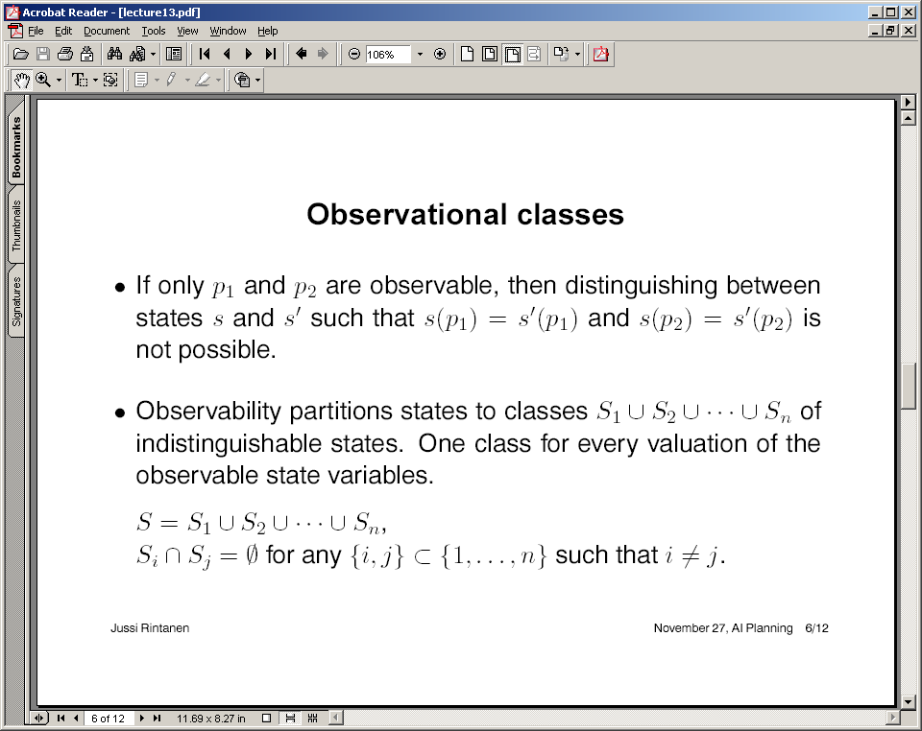
Full Observability: State Space partitioned to singleton Obs. Classes
Non-observability: Entire state space is a single observation class
Partial Observability: Between 1 and |S| observation classes

Slide 23
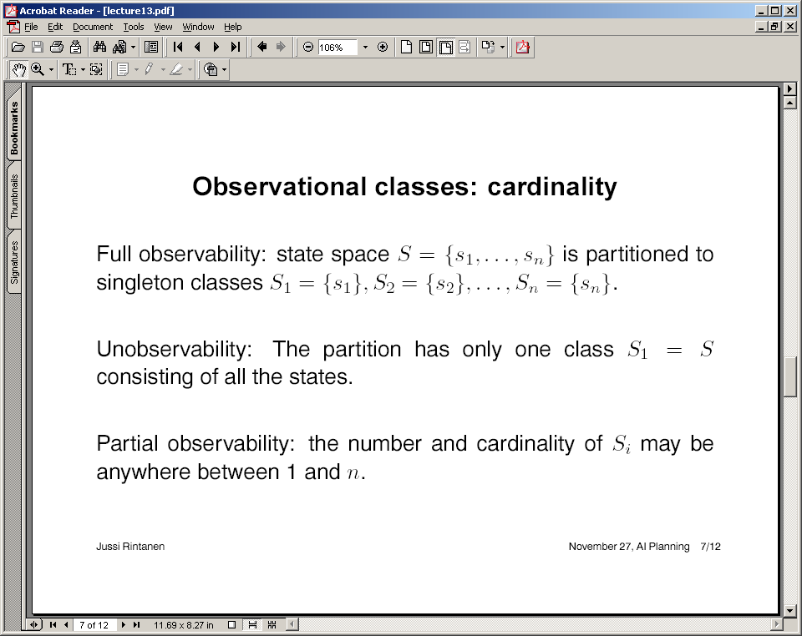

Slide 24
Hardness classes for planning with sensing
Planning with sensing is hard or easy depending on: (easy case listed first)
  Whether the sensory actions give us full or partial observability
  Whether the sensory actions sense individual fluents or formulas on fluents
  Whether the sensing actions are always applicable or have preconditions that need to be achieved before the action can be done

Slide 25
A Simple Progression Algorithm in the presence of pure sensing actions
Call the procedure Plan(B^{I},G,nil) where
Procedure Plan(B,G,P)
  If G is satisfied in all states of B, then return P
  Non-deterministically choose:
    I. Non-deterministically choose a causative action a that is applicable in B.
      Return Plan(a(B),G,P+a)
    II. Non-deterministically choose a sensing action s that senses a formula f (could be a single state variable)
      Let p’ = Plan(B&f,G,nil); p’’=Plan(B&~f,G,nil)
        /*B^{f} is the set of states of B in which f is true */
      Return P+(s?:p’;p’’)
If we always pick I and never do II then we will produce conformant
Plans (if we succeed).

Slide 26
Very simple Example
Problem: Init: don’t know p
Goal: g
A1
p=>r,~p
A2
~p=>r,p
A3
r=>g
O5
observe(p)
Plan: O5:p?[A1→A3][A2→A3]
Notice that in this case we also have a conformant plan:
A1;A2;A3
--Whether or not the conformant plan is cheaper depends
on how costly is sensing action O5 compared to A1 and A2

Slide 27
Very simple Example
A1
p=>r,~p
A2
~p=>r,p
A3
r=>g
O5
observe(p)
Problem: Init: don’t know p
Goal: g
Plan: O5:p?[A1→A3][A2→A3]
O5:p?
Y
N
A2
A1
A3
A3

Slide 28
A more interesting example: Medication
This domain is partially observable because the states
(~D,I,~B) and (~D,~I,~B) cannot be distinguished
The patient is not Dead and may be Ill. The test paper is not Blue.
We want to make the patient be not Dead and not Ill
We have three actions: Medicate which makes the patient not ill if he is ill
Stain—which makes the test paper blue if the patient is ill
Sense-paper—which can tell us if the paper is blue or not.
No conformant plan possible
here. Also, notice that
I cannot be sensed directly but
only through B

Slide 29
“Goal directed” conditional planning
Recall that regression of two belief state B&f and B&~f over a sensing action Sense-f will result in a belief state B
Search with this definition leads to two challenges:
    We have to combine search states into single ones (a sort of reverse AO* operation)
    We may need to explicitly condition a goal formula in partially observable case (especially when certain fluents can only be indirectly sensed)
      Example is the Medicate domain where I has to be found through B
      If you have a goal state B, you can always write it as B&f and B&~f for any arbitrary f! (The goal Happy is achieved by achieving the twin goals Happy&rich as well as Happy&~rich)
        Of course, we need to pick the f such that f/~f can be sensed (i.e. f and ~f defines an observational class feature)
      This step seems to go against the grain of “goal-directedenss”—we may not know what to sense based on what our goal is after all! ☹
Regression for
PO case is
Still not
Well-understood

Slide 30
Regresssion

Slide 31
Handling the “combination” during regression
  We have to combine search states into single ones (a sort of reverse AO* operation)
    Two ideas:
        In addition to the normal regression children, also generate children from any pair of regressed states on the search fringe (has a breadth-first feel. Can be expensive!) [Tuan Le does this]
        Do a contingent regression. Specifically, go ahead and generate B from B&f using Sense-f; but now you have to go “forward” from the “not-f” branch of Sense-f to goal too. [CNLP does this; See the example]

Slide 32
Need for explicit conditioning during regression (not needed for Fully Observable case)
If you have a goal state B, you can always write it as B&f and B&~f for any arbitrary f! (The goal Happy is achieved by achieving the twin goals Happy&rich as well as Happy&~rich)
  Of course, we need to pick the f such that f/~f can be sensed (i.e. f and ~f defines an observational class feature)
This step seems to go against the grain of “goal-directedenss”—we may not know what to sense based on what our goal is after all! ☹
Notice the analogy to
conditioning in evaluating
a probabilistic query
Consider the Medicate problem.
Coming from the goal of
~D&~I, we will never see
the connection to sensing blue!

Slide 33
Sensing: More things under the mat
(which we won’t lift for now ☺)
Review
Sensing extends the notion of goals (and action preconditions).
  Findout goals: Check if Rao is awake vs. Wake up Rao
    Presents some tricky issues in terms of goal satisfaction…!
      You cannot use “causative” effects to support “findout” goals
        But what if the causative effects are supporting another needed goal and wind up affecting the goal as a side-effect? (e.g. Have-gong-go-off & find-out-if-rao-is-awake)
Quantification is no longer syntactic sugaring in effects and preconditions in the presence of sensing actions
  Rm* can satisfy the effect forall files remove(file); without KNOWING what are the files in the directory!
  This is alternative to finding each files name and doing rm <file-name>
Sensing actions can have preconditions (as well as other causative effects); they can have cost
The problem of OVER-SENSING (Sort of like a beginning driver who looks all directions every 3 millimeters of driving; also Sphexishness) [XII/Puccini project]
  Handling over-sensing using local-closedworld assumptions
    Listing a file doesn’t destroy your knowledge about the size of a file; but
    compressing it does. If you don’t recognize it, you will always be checking the size of the file after each and every action

Slide 34
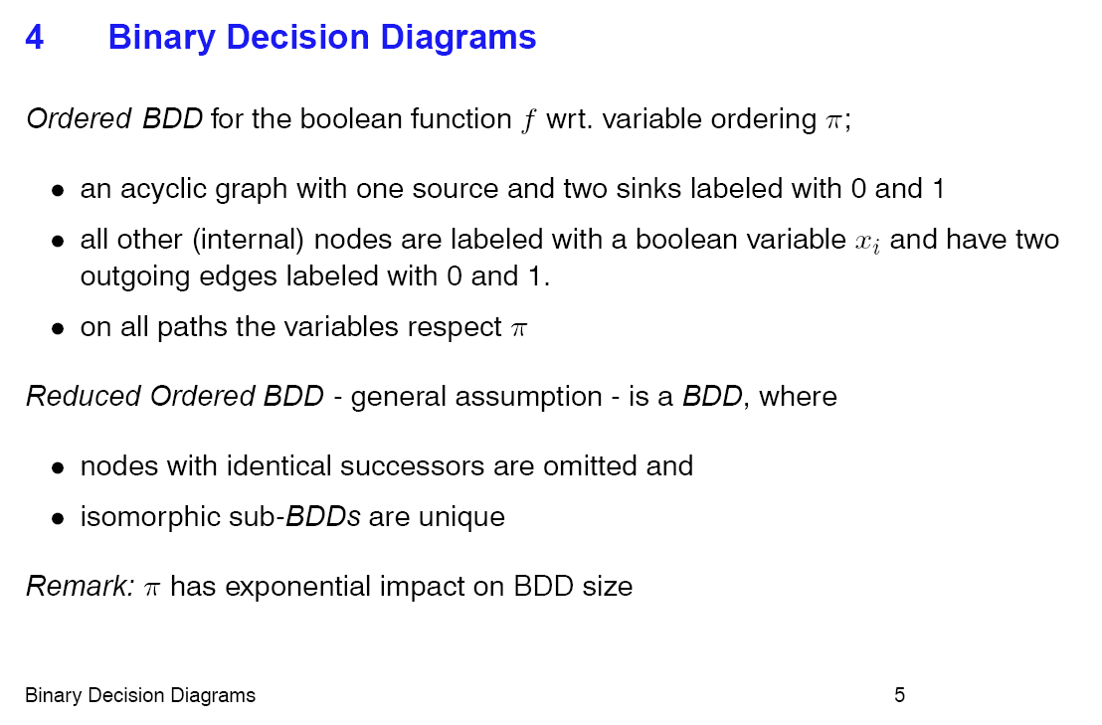
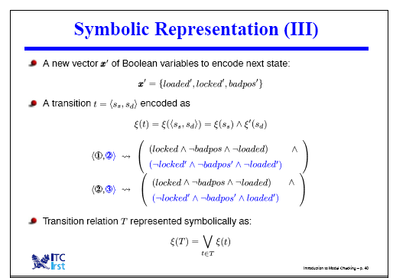
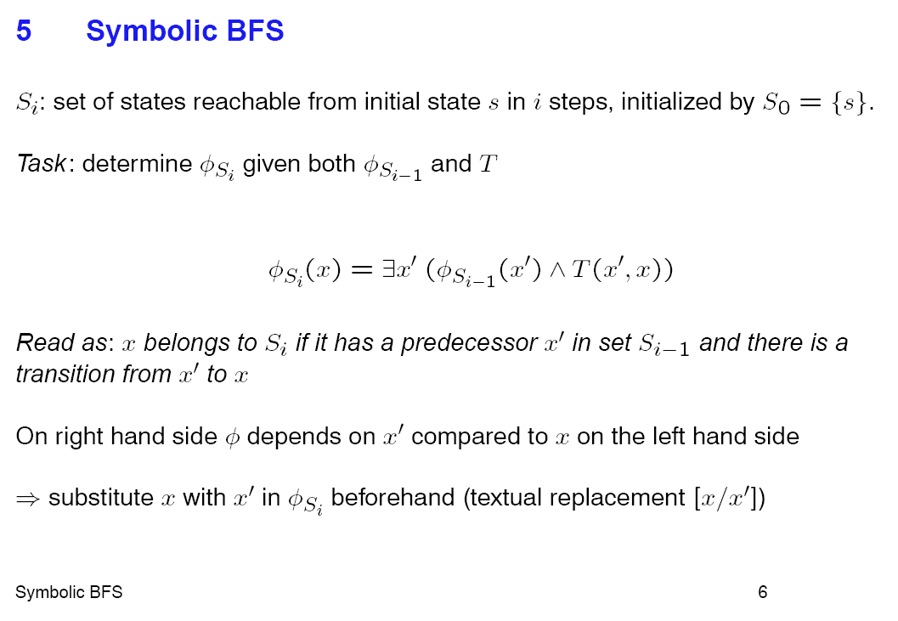

Slide 35
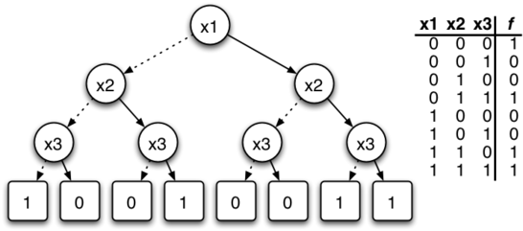
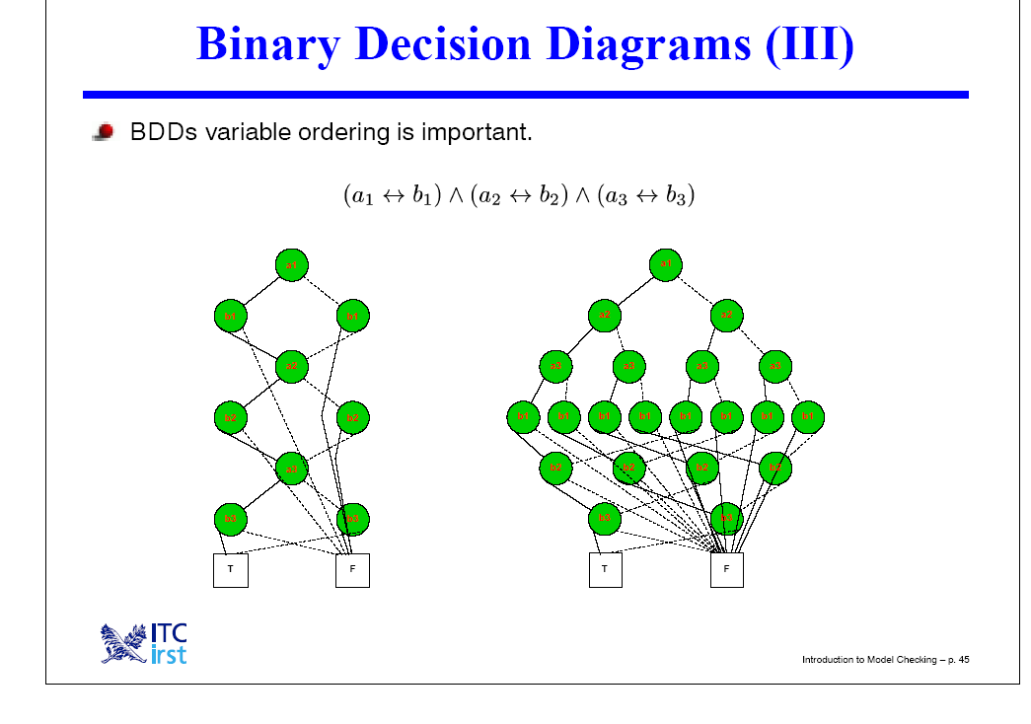
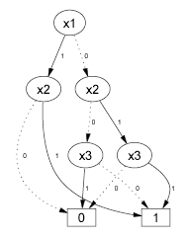
A good presentation just on BDDs
from the inventors:
http://www.cs.cmu.edu/~bryant/presentations/arw00.ppt

Slide 36
Symbolic FSM Analysis Example
  K. McMillan, E. Clarke (CMU) J. Schwalbe (Encore Computer)
Encore Gigamax Cache System
  Distributed memory multiprocessor
  Cache system to improve access time
  Complex hardware and synchronization protocol.
Verification
  Create “simplified” finite state model of system (10⁹ states!)
  Verify properties about set of reachable states
Bug Detected
  Sequence of 13 bus events leading to deadlock
  With random simulations, would require ≈2 years to generate failing case.
  In real system, would yield MTBF < 1 day.

Slide 37
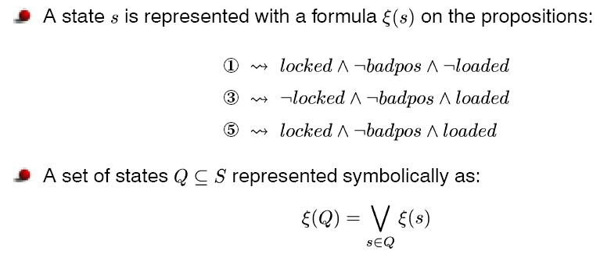
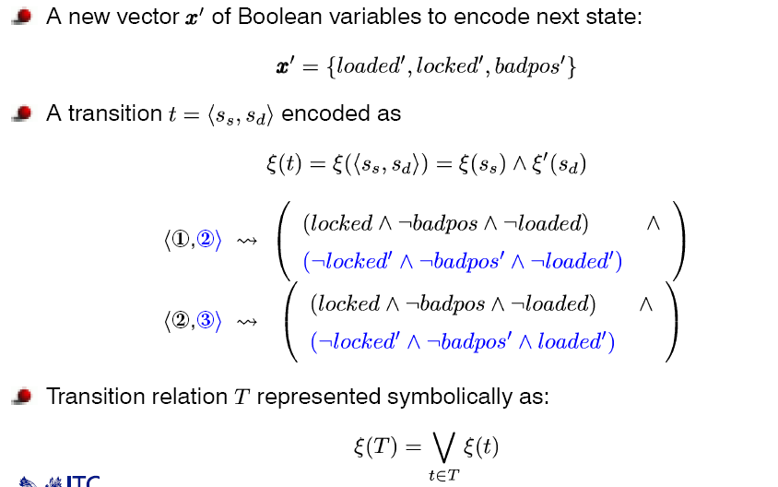
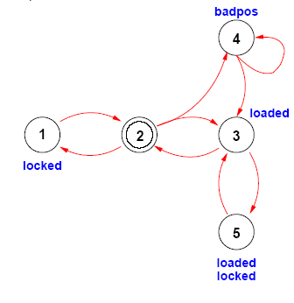
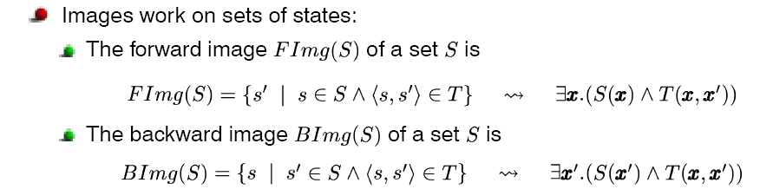
Symbolic Projection
A set of states
is a logical formula
A transition function
is also a logical formula
Projection is a logical
operation

Slide 38
Symbolic Manipulation with OBDDs
Strategy
  Represent data as set of OBDDs
    Identical variable orderings
  Express solution method as sequence of symbolic operations
    Sequence of constructor & query operations
    Similar style to on-line algorithm
  Implement each operation by OBDD manipulation
    Do all the work in the constructor operations
Key Algorithmic Properties
  Arguments are OBDDs with identical variable orderings
  Result is OBDD with same ordering
  Each step polynomial complexity
[From Bryant’s slides]

Slide 39
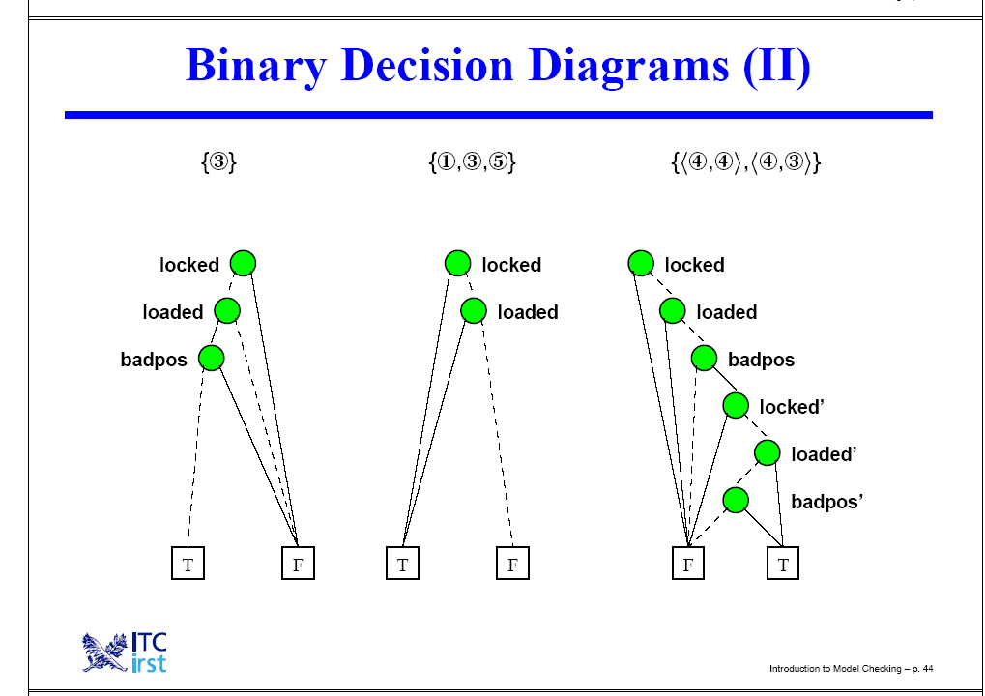
BDDs for representing States & Transition Function
Belief state
as a BDD
Transition function
as a BDD

Slide 40
Restriction Execution Example
Argument F
Restriction F[b=1]
Reduced Result
a
a
b
c
c
c
d
d
d
0
1
0
1
0
1

Slide 41
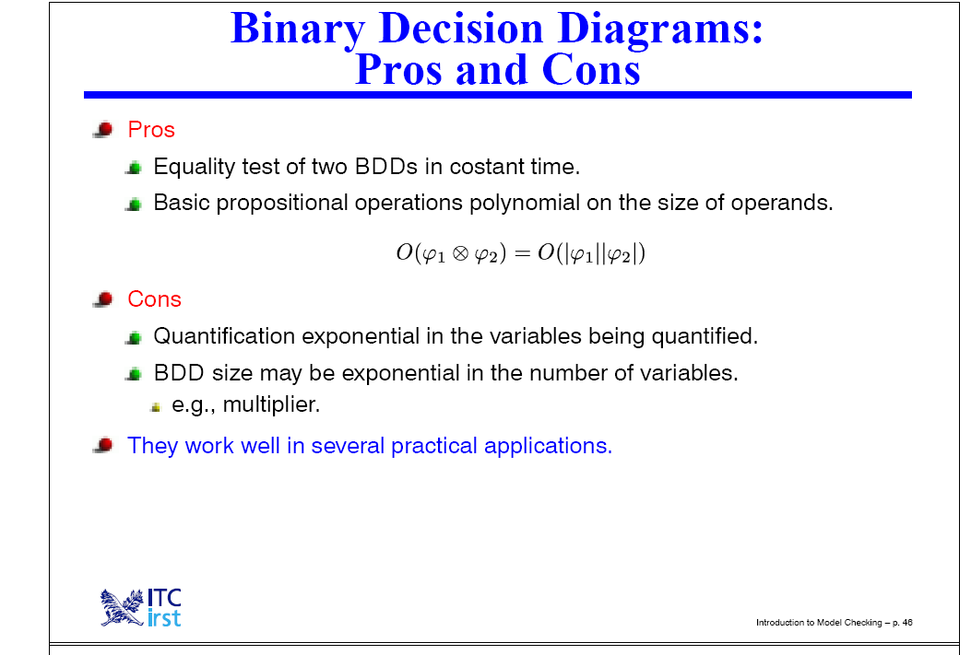

Slide 42
Heuristics for Belief-Space Planning

Slide 43
Conformant Planning: Efficiency Issues
Graphplan (CGP) and SAT-compilation approaches have also been tried for conformant planning
  Idea is to make plan in one world, and try to extend it as needed to make it work in other worlds
Planning graph based heuristics for conformant planning have been investigated.
  Interesting issues involving multiple planning graphs
    Deriving Heuristics? – relaxed plans that work in multiple graphs
    Compact representation? – Label graphs

Slide 44
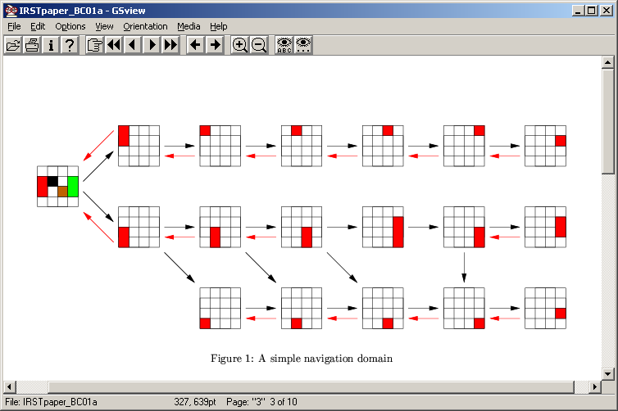
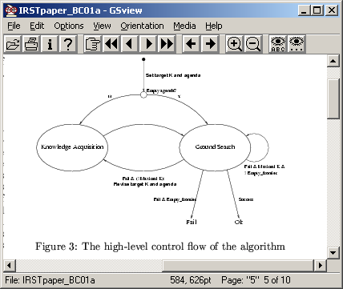
KACMBP and Uncertainty reducing actions

Slide 45
Heuristics for Conformant Planning
First idea: Notice that “Classical planning” (which assumes full observability) is a “relaxation” of conformant planning
  So, the length of the classical planning solution is a lowerbound (admissible heuristic) for conformant planning
  Further, the heuristics for classical planning are also heuristics for conformant planning (albeit not very informed probably)
Next idea: Let us get a feel for how estimating distances between belief states differs from estimating those between states

Slide 46
World’s funniest joke (in USA)
In addition to
interactions between literals
as in classical planning
we also have interactions between states
(belief space planning)
Three issues:
How many states are there?
How far are each of the states from goal?
How much interaction is there between states?
→For example if the length of plan for taking
S1 to goal is 10, S2 to goal is 10, the length of plan for taking
both to goal could be anywhere between 10 and Infinity depending
on the interactions [Notice that we talk about “state” interactions here
just as we talked about “goal interactions” in classical planning]
Need to estimate the length of
“combined plan” for taking
all states to the goal

Slide 47
Belief-state cardinality alone won’t be enough…
Early work on conformant planning concentrated exclusively on heuristics that look at the cardinality of the belief state
  The larger the cardinality of the belief state, the higher its uncertainty, and the worse it is (for progression)
    Notice that in regression, we have the opposite heuristic—the larger the cardinality, the higher the flexibility (we are satisfied with any one of a larger set of states) and so the better it is
From our example in the previous slide, cardinality is only one of the three components that go into actual distance estimation.
  For example, there may be an action that reduces the cardinality (e.g. bomb the place ☹) but the new belief state with low uncertainty will be infinite distance away from the goal.
We will look at planning graph-based heuristics for considering all three components
  (actually, unless we look at cross-world mutexes, we won’t be considering the interaction part…)

Slide 48
Planning Graph Heuristic Computation
Note that in classical planning
progression didn’t quite need
negative interaction analysis
because it was a complete state
already.
In belief-space planning the
negative interaction analysis
is likely to be more important
since the states in belief state
may have interactions.
Heuristics
  BFS
  Cardinality
  Max, Sum, Level, Relaxed Plans
Planning Graph Structures
  Single, unioned planning graph (SG)
  Multiple, independent planning graphs (MG)
  Single, labeled planning graph (LUG)
    [Bryce , et. al, 2004] – AAAI MDP workshop

Slide 49
Regression Search Example
Actions:
A1: M
P => K
A2: M
Q => K
A3: M
R => L
A4: K => G
A5: L => G
G
A4
G or K must be true before A4
For G to be true after A4
(G V K)
A5
(G V K V L)
A1
(G V K V L V P) &
M
A2
Enabling precondition
Must be true before
A1 was applied
Initially:
(P V Q V R) &
(~P V ~Q) &
(~P V ~R) &
(~Q V ~R) &
M
(G V K V L V P V Q) &
M
Initially:
(P V Q V R) &
(~P V ~Q) &
(~P V ~R) &
(~Q V ~R) &
M
A3
Each Clause is Satisfied by a Clause in the Initial Clausal State -- Done!
(5 actions)
(G V K V L V P V Q V R) &
M
(G V K V L V P V Q V R) &
M
Goal State:
G
Clausal States compactly represent disjunction to sets of uncertain literals – Yet, still need heuristics for the search

Slide 50
Using a Single, Unioned Graph
P
P
P
P
P
M
A1
A1
A1
Q
Q
Q
Q
M
A2
A2
R
R
R
R
A3
A3
M
M
M
M
M
K
K
K
Minimal
implementation
Heuristic
Estimate = 2
A4
A4
L
L
Union literals from all initial states into a conjunctive initial graph level
Not effective
Lose world specific support information
A5
G
G

Slide 51
Using Multiple Graphs
P
P
A1
P
P
A1
A1
M
Same-world Mutexes
M
M
M
P
K
K
K
A4
A4
M
G
G
Q
Memory Intensive
Heuristic Computation Can be costly
Q
Q
Q
Q
A2
A2
A2
M
M
M
M
M
R
K
K
K
A4
A4
M
G
G
Unioning these graphs a priori would give much savings …
R
R
R
R
A3
A3
A3
M
M
M
M
L
L
L
A5
A5
G
G

Slide 52


Using a Single, Labeled Graph
(joint work with David E. Smith)
Labels signify possible worlds
under which a literal holds
Action Labels:
Conjunction of Labels
of Supporting Literals
P
P
P
P
P
M
P
Memory Efficient
Cheap Heuristics
Scalable
Extensible
A1
A1
A1
A1
Q
Q
Q
Q
Q
Q
A2
A2
A2
A2
M
R
R
R
R
R
A3
A3
A3
R
A3
M
M
M
M
M
Literal Labels:
Disjunction of Labels
Of Supporting Actions
K
K
K
A4
Benefits from BDD’s
A4
Label Key
L
L
L
True
A5
A5
G
~Q & ~R
(~P & ~R) V (~Q & ~R)
G
~P & ~R
(~P & ~R) V (~Q & ~R) V
(~P & ~Q)
~P & ~Q
Heuristic Value = 5

Slide 53
What about mutexes?
In the previous slide, we considered only relaxed plans (thus ignoring any mutexes)
  We could have considered mutexes in the individual world graphs to get better estimates of the plans in the individual worlds (call these same world mutexes)
  We could also have considered the impact of having an action in one world on the other world.
    Consider a patient who may or may not be suffering from disease D. There is a medicine M, which if given in the world where he has D, will cure the patient. But if it is given in the world where the patient doesn’t have disease D, it will kill him. Since giving the medicine M will have impact in both worlds, we now have a mutex between “being alive” in world 1 and “being cured” in world 2!
    Notice that cross-world mutexes will take into account the state-interactions that we mentioned as one of the three components making up the distance estimate.
We could compute a subset of same world and cross world mutexes to improve the accuracy of the heuristics…
  …but it is not clear whether or not the accuracy comes at too much additional cost to have reasonable impact on efficiency.. [see Bryce et. Al. JAIR submission]

Slide 54
Connection to CGP
CGP—the “conformant Graphplan”—does multiple planning graphs, but also does backward search directly on the graphs to find a solution (as against using these to give heuristic estimates)
  It has to mark sameworld and cross world mutexes to ensure soundness..

Slide 55
Heuristics for sensing
We need to compare the cumulative distance of B1 and B2 to goal with that of B3 to goal
  Notice that Planning cost is related to plan size while plan exec cost is related to the length of the deepest branch (or expected length of a branch)
If we use the conformant belief state distance (as discussed last class), then we will be over estimating the distance (since sensing may allow us to do shorter branch)
Bryce [ICAPS 05—submitted] starts wth the conformant relaxed plan and introduces sensory actions into the plan to estimate the cost more accurately
B1
B2
B3

Slide 56
Slides beyond this not covered..

Slide 57
Sensing Actions
Sensing actions in essence “partition” a belief state
  Sensing a formula f splits a belief state B to B&f; B&~f
  Both partitions need to be taken to the goal state now
  Tree plan
  AO* search
Heuristics will have to compare two generalized AND branches
  In the figure, the lower branch has an expected cost of 11,000
  The upper branch has a fixed sensing cost of 300 + based on the outcome, a cost of 7 or 12,000
    If we consider worst case cost, we assume the cost is 12,300
    If we consider both to be equally likey, we assume 6303.5 units cost
    If we know actual probabilities that the sensing action returns one result as against other, we can use that to get the expected cost…
7
300
12,000
A_{s}
A
11,000

Slide 58
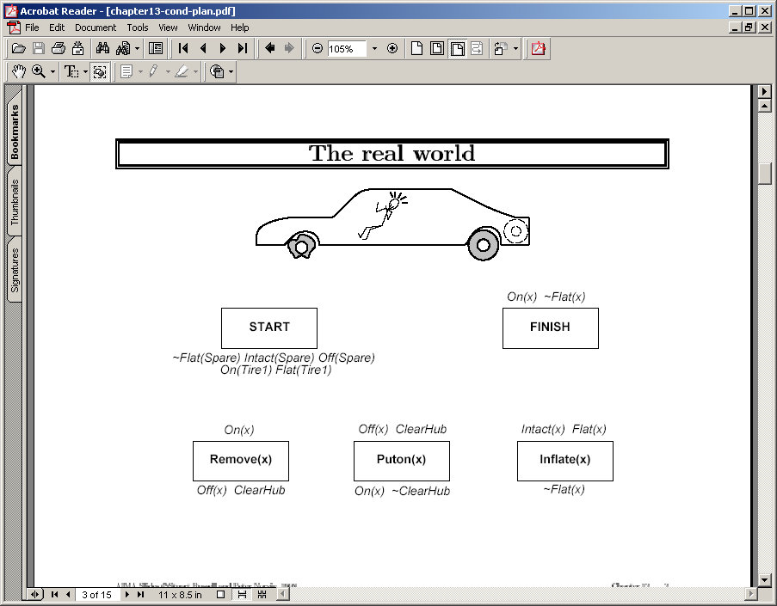

Slide 59
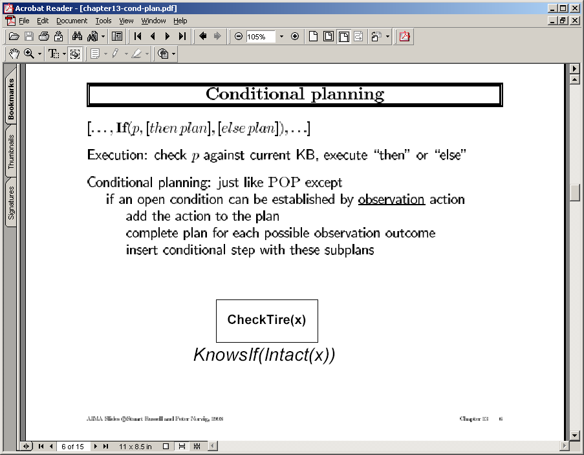

Slide 62
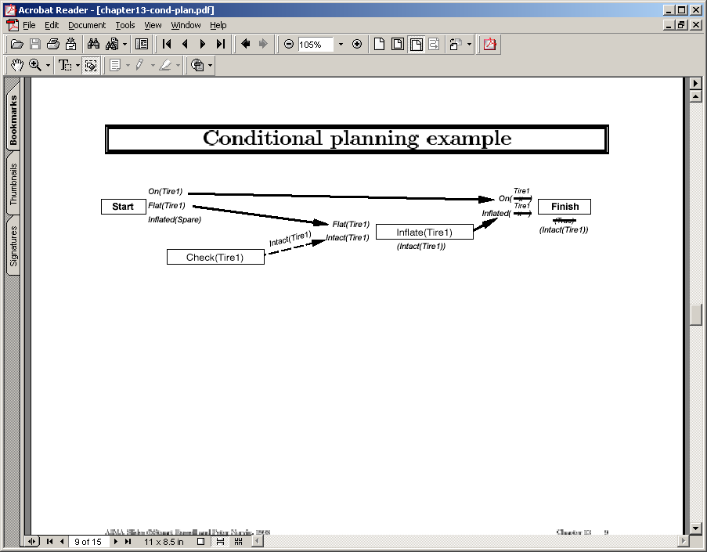

Slide 63
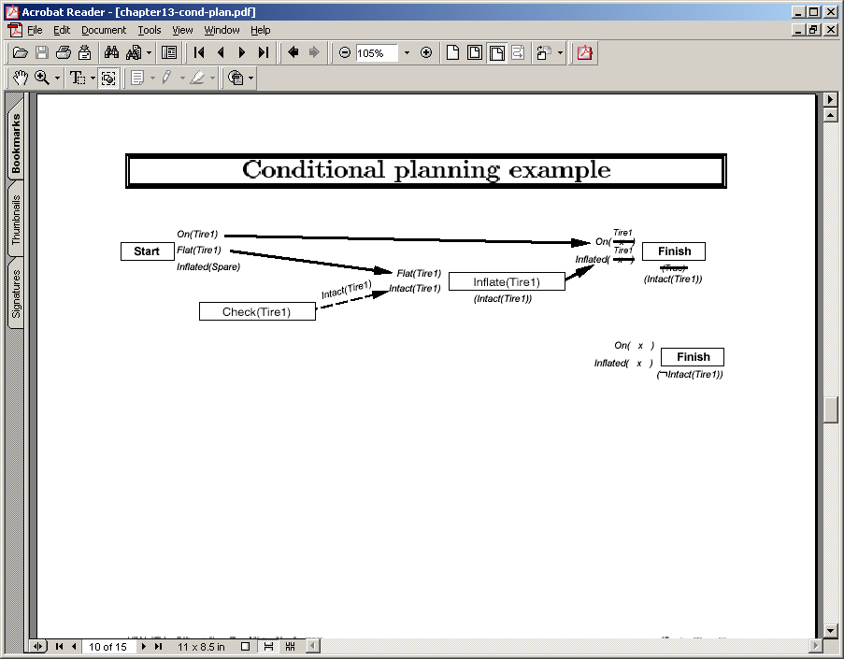

Slide 64
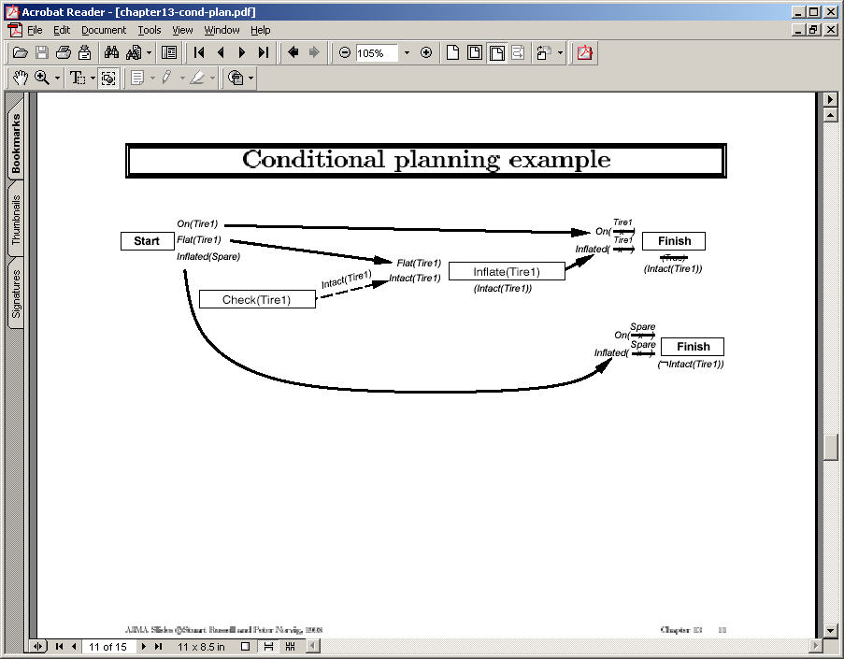

Slide 65
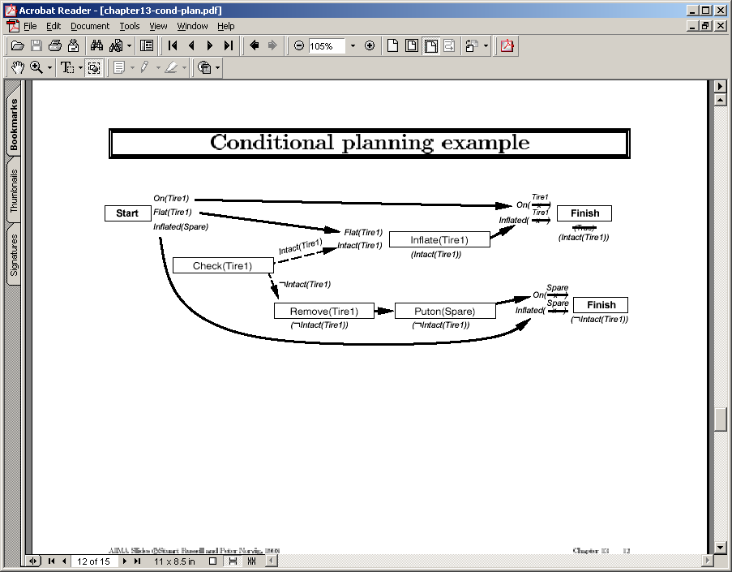
We now have yet another way of handling unsafe links
--Conditioning to put the threatening step in a different world!
Similar processing can be done for
regression (PO planning is nothing
but least-committed regression planning)

Slide 66
Sensing: More things under the mat
Sensing extends the notion of goals too.
  Check if Rao is awake vs. Wake up Rao
    Presents some tricky issues in terms of goal satisfaction…!
Handling quantified effects and preconditions in the presence of sensing actions
  Rm* can satisfy the effect forall files remove(file); without KNOWING what are the files in the directory!
Sensing actions can have preconditions (as well as other causative effects)
The problem of OVER-SENSING (Sort of like the initial driver; also Sphexishness) [XII/Puccini project]
  Handling over-sensing using local-closedworld assumptions
    Listing a file doesn’t destroy your knowledge about the size of a file; but
    compressing it does. If you don’t recognize it, you will always be checking the size of the file after each and every action
A general action may have both causative effects and sensing effects
  Sensing effect changes the agent’s knowledge, and not the world
  Causative effect changes the world (and may give certain knowledge to the agent)
  A pure sensing action only has sensing effects; a pure causative action only has causative effects.
    The recent work on conditional planning has considered mostly simplistic sensing actions that have no preconditions and only have pure sensing effects.
Sensing has cost!

Slide 67
A* vs. AO* Search
A* search finds a path in
in an “or” graph
AO* search finds an “And”
path in an And-Or graph
AO*➔A* if there are no
AND branches
AO* typically used for
problem reduction search

Slide 72
Remarks on Progression with sensing actions
Progression is implicitly finding an AND subtree of an AND/OR Graph
  If we look for AND subgraphs, we can represent DAGS.
The amount of sensing done in the eventual solution plan is controlled by how often we pick step I vs. step II (if we always pick I, we get conformant solutions).
  Progression is as clue-less as to whether to do sensing and which sensing to do, as it is about which causative action to apply
    Need heuristic support

