Slide 1
Markov Decision Processes
* Based in part on slides by Alan Fern, Craig Boutilier and Daniel Weld

Slide 2
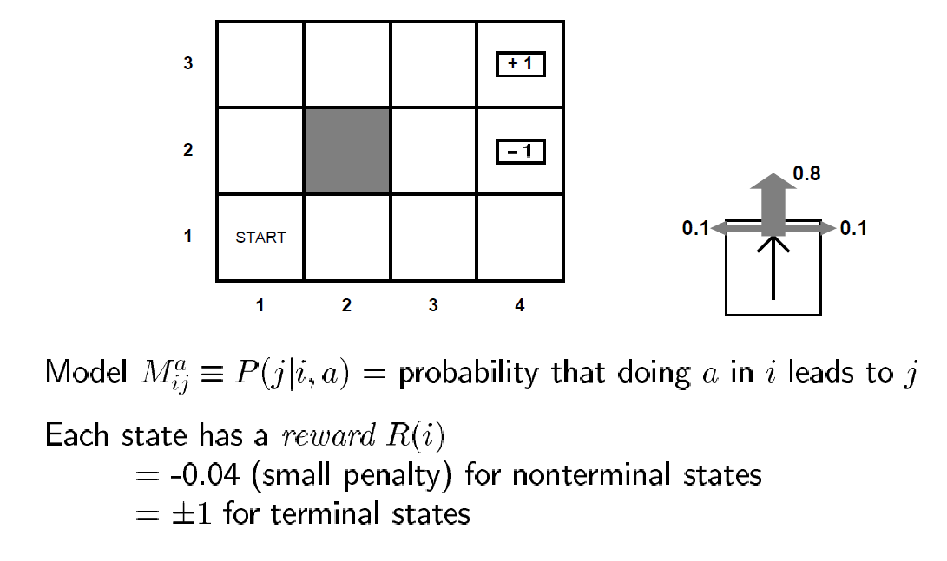
Atomic Model for stochastic environments with generalized rewards
Deterministic worlds + goals of attainment
Stochastic worlds +generalized rewards
Atomic model: Graph search
Propositional models: The PDDL planning that we discussed..
An action can take you to any of a set of states with known probability
You get rewards for visiting each state
Objective is to increase your “cumulative” reward…
What is the solution?

Slide 3
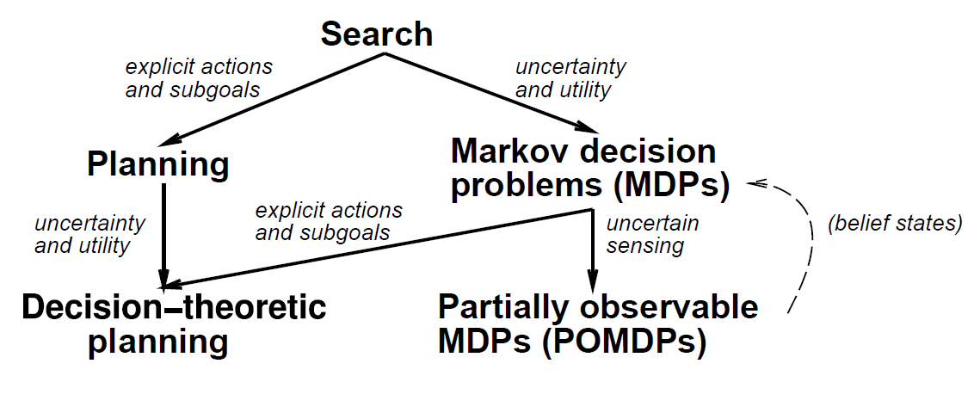

Slide 4
Optimal Policies depend on horizon, rewards..
-
-
-
-

Slide 5
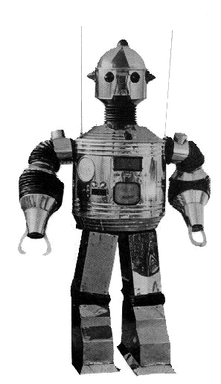
Classical Planning Assumptions
Percepts
Actions
World
sole source
of change
perfect
????
deterministic
fully
observable
instantaneous

Slide 6
Stochastic/Probabilistic Planning: Markov Decision Process (MDP) Model
Percepts
Actions
World
sole source
of change
perfect
????
stochastic
fully
observable
instantaneous

Slide 7
Types of Uncertainty
Disjunctive (used by non-deterministic planning)
Next state could be one of a set of states.
Stochastic/Probabilistic
Next state is drawn from a probability distribution over the set of states.
How are these models related?

Slide 8
Markov Decision Processes
An MDP has four components: S, A, R, T:
  (finite) state set S (|S| = n)
  (finite) action set A (|A| = m)
  (Markov) transition function T(s,a,s’) = Pr(s’ | s,a)
    Probability of going to state s’ after taking action a in state s
    How many parameters does it take to represent?
  bounded, real-valued (Markov) reward function R(s)
    Immediate reward we get for being in state s
    For example in a goal-based domain R(s) may equal 1 for goal states and 0 for all others
    Can be generalized to include action costs: R(s,a)
    Can be generalized to be a stochastic function
Can easily generalize to countable or continuous state and action spaces (but algorithms will be different)

Slide 9
Graphical View of MDP
At
At+1
St
St+1
St+2
Rt
Rt+1
Rt+2

Slide 10
Assumptions
First-Order Markovian dynamics (history independence)
  Pr(S^{t+1}|A^{t},S^{t},A^{t-1},S^{t-1},..., S⁰) = Pr(S^{t+1}|A^{t},S^{t})
  Next state only depends on current state and current action
First-Order Markovian reward process
  Pr(R^{t}|A^{t},S^{t},A^{t-1},S^{t-1},..., S⁰) = Pr(R^{t}|A^{t},S^{t})
  Reward only depends on current state and action
  As described earlier we will assume reward is specified by a deterministic function R(s)
    i.e. Pr(R^{t}=R(S^{t}) | A^{t},S^{t}) = 1
Stationary dynamics and reward
  Pr(S^{t+1}|A^{t},S^{t}) = Pr(S^{k+1}|A^{k},S^{k}) for all t, k
  The world dynamics do not depend on the absolute time
Full observability
  Though we can’t predict exactly which state we will reach when we execute an action, once it is realized, we know what it is

Slide 11
Policies (“plans” for MDPs)
Nonstationary policy [Even though we have stationary dynamics and reward??]
  π:S x T → A, where T is the non-negative integers
  π(s,t) is action to do at state s with t stages-to-go
  What if we want to keep acting indefinitely?
Stationary policy
  π:S → A
  π(s) is action to do at state s (regardless of time)
  specifies a continuously reactive controller
These assume or have these properties:
  full observability
  history-independence
  deterministic action choice
If you are 20 and are not a liberal, you are heartless
If you are 40 and not a conservative, you are mindless
-Churchill
Why not just consider sequences of actions?
Why not just replan?

Slide 12
Value of a Policy
How good is a policy π?
How do we measure “accumulated” reward?
Value function V: S →ℝ associates value with each state (or each state and time for non-stationary π)
V_{π}(s) denotes value of policy at state s
  Depends on immediate reward, but also what you achieve subsequently by following π
  An optimal policy is one that is no worse than any other policy at any state
The goal of MDP planning is to compute an optimal policy (method depends on how we define value)

Slide 13
Finite-Horizon Value Functions
We first consider maximizing total reward over a finite horizon
Assumes the agent has n time steps to live
To act optimally, should the agent use a stationary or non-stationary policy?
Put another way:
  If you had only one week to live would you act the same way as if you had fifty years to live?

Slide 14
Finite Horizon Problems
Value (utility) depends on stage-to-go
  hence so should policy: nonstationary π(s,k)
is k-stage-to-go value function for π
  expected total reward after executing π for k time steps (for k=0?)
Here R^{t} and s^{t} are random variables denoting the reward received and state at stage t respectively

Slide 15
Computing Finite-Horizon Value
Can use dynamic programming to compute
  Markov property is critical for this
(a)
(b)
immediate reward
expected future payoff
with k-1 stages to go
π(s,k)
0.7
What is time complexity?
0.3
V^{k}
V^{k-1}

Slide 16
Bellman Backup
How can we compute optimal V^{t+1}(s) given optimal V^{t} ?
Compute
Expectations
V^{t}
_{s1}
Compute
Max
0.7
a₁
_{s2}
0.3
V^{t+1}(s)
s
0.4
_{s3}
a₂
0.6
_{s4}
_{V}^{t+1}_{(s) = R(s)+max {}
_{0.7 V}^{t} _{(s1) + 0.3 V}^{t} _{(s4)}
_{0.4 V}^{t} _{(s2) + 0.6 V}^{t}_{(s3)}
}

Slide 17
Value Iteration: Finite Horizon Case
Markov property allows exploitation of DP principle for optimal policy construction
  no need to enumerate |A|^{Tn} possible policies
Value Iteration
Bellman backup
V^{k} is optimal k-stage-to-go value function
Π*(s,k) is optimal k-stage-to-go policy

Slide 18
Value Iteration
Optimal value depends on stages-to-go
(independent in the infinite horizon case)
V³
V²
V¹
V⁰
_{s1}
_{s2}
_{0.7}
_{0.7}
_{0.7}
_{0.4}
_{0.4}
_{0.4}
_{s3}
_{0.6}
_{0.6}
_{0.6}
_{0.3}
_{0.3}
_{0.3}
_{s4}
_{V}¹_{(s4) = R(s4)+max {}
_{0.7 V}⁰ _{(s1) + 0.3 V}⁰ _{(s4)}
_{0.4 V}⁰ _{(s2) + 0.6 V}⁰_{(s3)}
}
Notes:
Mention time-dependence of value (independence in infinite horizon)

Slide 19
Value Iteration
V³
V²
V¹
V⁰
_{s1}
_{s2}
_{0.7}
_{0.7}
_{0.7}
_{0.4}
_{0.4}
_{0.4}
_{s3}
_{0.6}
_{0.6}
_{0.6}
_{0.3}
_{0.3}
_{0.3}
_{s4}
_{Π}*_{(s4,t) = max { }}

Slide 20
Value Iteration
Note how DP is used
  optimal soln to k-1 stage problem can be used without modification as part of optimal soln to k-stage problem
Because of finite horizon, policy nonstationary
What is the computational complexity?
  T iterations
  At each iteration, each of n states, computes expectation for |A| actions
  Each expectation takes O(n) time
Total time complexity: O(T|A|n²)
  Polynomial in number of states. Is this good?

Slide 21
Summary: Finite Horizon
Resulting policy is optimal
  convince yourself of this
Note: optimal value function is unique, but optimal policy is not
  Many policies can have same value

Slide 22
Discounted Infinite Horizon MDPs
Defining value as total reward is problematic with infinite horizons
  many or all policies have infinite expected reward
  some MDPs are ok (e.g., zero-cost absorbing states)
“Trick”: introduce discount factor 0 ≤ β < 1
  future rewards discounted by β per time step
Note:
Motivation: economic? failure prob? convenience?

Slide 23
Notes: Discounted Infinite Horizon
Optimal policy maximizes value at each state
Optimal policies guaranteed to exist (Howard60)
Can restrict attention to stationary policies
  I.e. there is always an optimal stationary policy
  Why change action at state s at new time t?
We define for some optimal π

Slide 24
Policy Evaluation
Value equation for fixed policy
How can we compute the value function for a policy?
  we are given R and Pr
  simple linear system with n variables (each variables is value of a state) and n constraints (one value equation for each state)
  Use linear algebra (e.g. matrix inverse)

Slide 25
Computing an Optimal Value Function
Bellman equation for optimal value function
  Bellman proved this is always true
How can we compute the optimal value function?
  The MAX operator makes the system non-linear, so the problem is more difficult than policy evaluation
Notice that the optimal value function is a fixed-point of the Bellman Backup operator B
  B takes a value function as input and returns a new value function

Slide 26
Value Iteration
Can compute optimal policy using value iteration, just like finite-horizon problems (just include discount term)
Will converge to the optimal value function as k gets large. Why?

Slide 27
Convergence
B[V] is a contraction operator on value functions
  For any V and V’ we have || B[V] – B[V’] || ≤ β || V – V’ ||
  Here ||V|| is the max-norm, which returns the maximum element of the vector
  So applying a Bellman backup to any two value functions causes them to get closer together in the max-norm sense.
Convergence is assured
  any V: || V* - B[V] || = || B[V*] – B[V] || ≤ β|| V* - V ||
  so applying Bellman backup to any value function brings us closer to V* by a factor β
  thus, Bellman fixed point theorems ensure convergence in the limit
When to stop value iteration? when ||V^{k} - V^{k-1}||≤ ε
  this ensures ||V^{k} – V*|| ≤ εβ /1-β

Slide 28
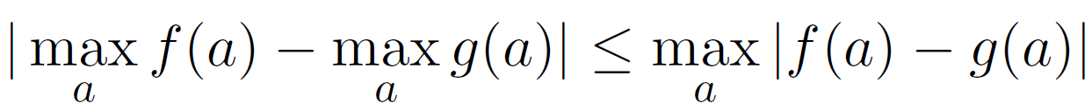
Contraction property proof sketch
Note that for any functions f and g
We can use this to show that
  |B[V]-B[V’]| <= β|V – V’|

Slide 29
How to Act
Given a V^{k} from value iteration that closely approximates V*, what should we use as our policy?
Use greedy policy:
Note that the value of greedy policy may not be equal to V^{k}
Let V^{G} be the value of the greedy policy? How close is V^{G} to V*?

Slide 30
How to Act
Given a V^{k} from value iteration that closely approximates V*, what should we use as our policy?
Use greedy policy:
  We can show that greedy is not too far from optimal if V^{k} is close to V*
In particular, if V^{k} is within ε of V*, then V^{G} within 2εβ /1-β of V* (if ε is 0.001 and β is 0.9, we have 0.018)
Furthermore, there exists a finite ε s.t. greedy policy is optimal
  That is, even if value estimate is off, greedy policy is optimal once it is close enough

Slide 31
Policy Iteration
Given fixed policy, can compute its value exactly:
Policy iteration exploits this: iterates steps of policy evaluation and policy improvement
1. Choose a random policy π
2. Loop:
(a) Evaluate V_{π}
(b) For each s in S, set
(c) Replace π with π’
Until no improving action possible at any state
Policy improvement

Slide 32
Policy Iteration Notes
Each step of policy iteration is guaranteed to strictly improve the policy at some state when improvement is possible
Convergence assured (Howard)
  intuitively: no local maxima in value space, and each policy must improve value; since finite number of policies, will converge to optimal policy
Gives exact value of optimal policy

Slide 33
Value Iteration vs. Policy Iteration
Which is faster? VI or PI
  It depends on the problem
VI takes more iterations than PI, but PI requires more time on each iteration
  PI must perform policy evaluation on each step which involves solving a linear system
  Also, VI can be done with asynchronous and prioritized update fashion..
Complexity:
  There are at most exp(n) policies, so PI is no worse than exponential time in number of states
  Empirically O(n) iterations are required
  Still no polynomial bound on the number of PI iterations (open problem)!

Slide 34
Markov Decision Process (MDP)
S: A set of states
A: A set of actions
Pr(s’|s,a): transition model
    (aka Mª_{s,s’})
C(s,a,s’): cost model
G: set of goals
s₀: start state
γ: discount factor
R(s,a,s’): reward model
Value function: expected
long term reward from
the state
Q values: Expected long
term reward of doing a
in s
V(s) = max Q(s,a)
Greedy Policy w.r.t.
a value function
Value of a policy
Optimal value function
Notes:
34

Slide 35
Examples of MDPs
Goal-directed, Indefinite Horizon, Cost Minimization MDP
  <S, A, Pr, C, G, s₀>
  Most often studied in planning community
Infinite Horizon, Discounted Reward Maximization MDP
  <S, A, Pr, R, γ>
  Most often studied in reinforcement learning
Goal-directed, Finite Horizon, Prob. Maximization MDP
  <S, A, Pr, G, s₀, T>
  Also studied in planning community
Oversubscription Planning: Non absorbing goals, Reward Max. MDP
  <S, A, Pr, G, R, s₀>
  Relatively recent model

Slide 36
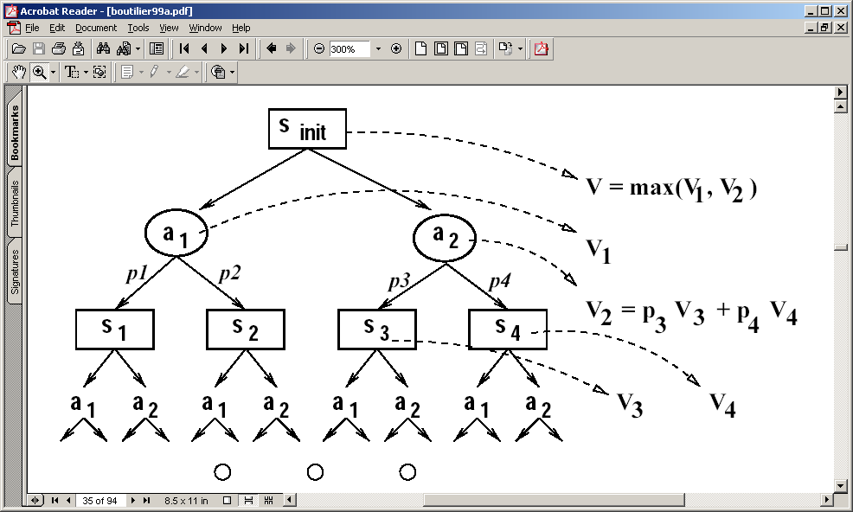
SSPP—Stochastic Shortest Path Problem An MDP with Init and Goal states
MDPs don’t have a notion of an “initial” and “goal” state. (Process orientation instead of “task” orientation)
  Goals are sort of modeled by reward functions
    Allows pretty expressive goals (in theory)
  Normal MDP algorithms don’t use initial state information (since policy is supposed to cover the entire search space anyway).
    Could consider “envelope extension” methods
      Compute a “deterministic” plan (which gives the policy for some of the states; Extend the policy to other states that are likely to happen during execution
      RTDP methods
SSSP are a special case of MDPs where
  (a) initial state is given
  (b) there are absorbing goal states
  (c) Actions have costs. All states have zero rewards
A proper policy for SSSP is a policy which is guaranteed to ultimately put the agent in one of the absorbing states
For SSSP, it would be worth finding a partial policy that only covers the “relevant” states (states that are reachable from init and goal states on any optimal policy)
  Value/Policy Iteration don’t consider the notion of relevance
  Consider “heuristic state search” algorithms
    Heuristic can be seen as the “estimate” of the value of a state.

Slide 37
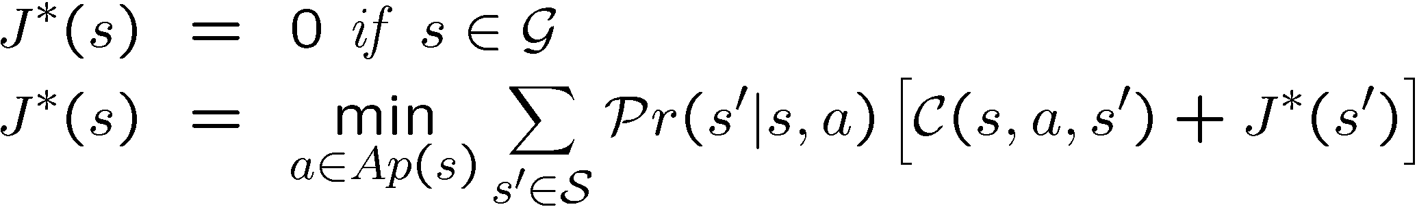
Bellman Equations for Cost Minimization MDP
(absorbing goals)[also called Stochastic Shortest Path]
<S, A, Pr, C, G, s₀>
Define J*(s) {optimal cost} as the minimum expected cost to reach a goal from this state.
J* should satisfy the following equation:
Q*(s,a)

Slide 38
Bellman Equations for infinite horizon discounted reward maximization MDP
<S, A, Pr, R, s_{0,} γ>
Define V*(s) {optimal value} as the maximum expected discounted reward from this state.
V* should satisfy the following equation:

Slide 39
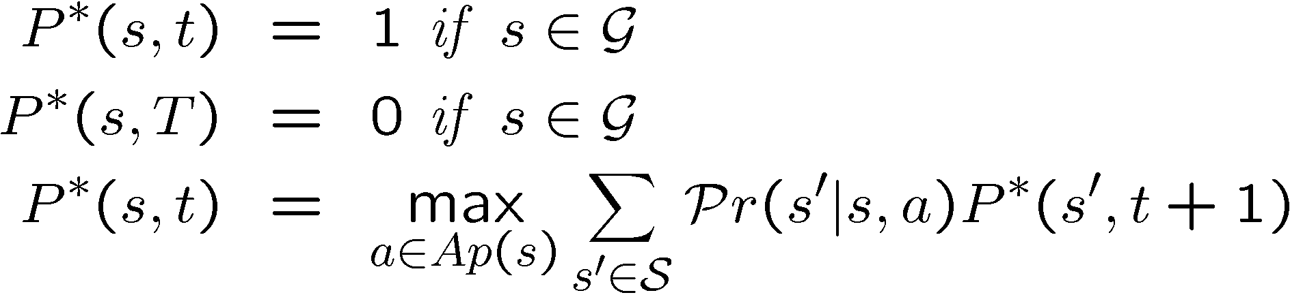

Bellman Equations for probability maximization MDP
<S, A, Pr, G, s₀, T>
Define P*(s,t) {optimal prob.} as the maximum probability of reaching a goal from this state at t^{th} timestep.
P* should satisfy the following equation:

Slide 40
Modeling Softgoal problems as deterministic MDPs
Consider the net-benefit problem, where actions have costs, and goals have utilities, and we want a plan with the highest net benefit
How do we model this as MDP?
  (wrong idea): Make every state in which any subset of goals hold into a sink state with reward equal to the cumulative sum of utilities of the goals.
    Problem—what if achieving g1 g2 will necessarily lead you through a state where g1 is already true?
  (correct version): Make a new fluent called “done” dummy action called Done-Deal. It is applicable in any state and asserts the fluent “done”. All “done” states are sink states. Their reward is equal to sum of rewards of the individual states.

Slide 41
Heuristic Search vs. Dynamic Programming (Value/Policy Iteration)
VI and PI approaches use Dynamic Programming Update
Set the value of a state in terms of the maximum expected value achievable by doing actions from that state.
They do the update for every state in the state space
  Wasteful if we know the initial state(s) that the agent is starting from
Heuristic search (e.g. A*/AO*) explores only the part of the state space that is actually reachable from the initial state
Even within the reachable space, heuristic search can avoid visiting many of the states.
  Depending on the quality of the heuristic used..
But what is the heuristic?
  An admissible heuristic is a lowerbound on the cost to reach goal from any given state
  It is a lowerbound on J*!

