Slide 1
Structure
A generic
web page
containing text
An employee
record
[SQL]
[English]
A movie
review
[XML]
How will search and querying on these three types of data differ?
Semi-Structured

Slide 2
Structure helps querying
Expressive queries
    Give me all pages that have key words “Get Rich Quick”
    Give me the social security numbers of all the employees who have stayed with the company for more than 5 years, and whose yearly salaries are three standard deviations away from the average salary
    Give me all mails from people from ASU written this year, which are relevant to “get rich quick”
Challenges in Exploiting Structure
  Languages for specifying “Semi-structured” data
    Standards for supporting/exploiting semantic tagging
  Techniques for extracting information (NLP-lite)
keyword
SQL
XML

Slide 3
Topic 3: Finding, Representing & Exploiting Structure
Getting Structure:
  Allow structure specification languages
  → XML? [More structured than text and less structured than databases]
  If structure is not explicitly specified (or is obfuscated), can we extract it?
  →Wrapper generation/Information Extraction
Using Structure:
  For retrieval:
  →Extend IR techniques to use the additional structure
  For query processing: (Joins/Aggregations etc)
  →Extend database techniques to use the partial structure
  For reasoning with structured knowledge
  →Semantic web ideas..
Structure in the context of multiple sources:
  How to align structure
  How to support integrated querying on pages/sources (after alignment)

Slide 4
असंबाधम बध्यतो मानवानाम यस्य उद्वातः परावतः समं बहु
नानावीर्या ओशाधीर्या बिभर्ति पृथिवी नह प्रथाताम राध्यताम नह
Asambaadham badhyato maanavaanam yasya udvatah pravatah samam bahu
Naanaaveeryaa oshadheeryaa bibharti pruthivee nah prathataam raadhyataam nah
Earth which has many heights, and slopes and
the unconfined plain that bind men together,
Earth that bears plants of various healing powers,
may she spread wide for us and thrive
-Bhoomi Sooktam
Atharva Veda XII.I
(4/22, 12th Century B.C.; Iron Age)

Slide 5

Adapting old disciplines for Web-age
Information (text) retrieval
  Scale of the web
  Hyper text/ Link structure
  Authority/hub computations
Databases
  Multiple databases
    Heterogeneous, access limited, partially overlapping
  Network (un)reliability
Datamining [Machine Learning/Statistics/Databases]
  Learning patterns from large scale data

Slide 6
Why do we care about databases?
Three reasons
  Deep web is all databases…
  We can do better with structured data…
  Exposing databases on web changes their clientele..

Slide 7
Deep Web is databases..
The crawlable web pages are just the tip of a huge ice berg that is deep web
  Many web sites have huge backend databases that generate pages dynamically in response to queries
    Airline fare databases; News paper classifieds etc.
  By some estimates, deep web is 2 orders of magnitude bigger than the shallow (“html page”) web
We need to exploit deep web
  Crawl/index deep web
  Select databases relevant to a query
  Provide information aggregation/integration services over deep web databases
    ..and all the big kids are trying to gobble up anyone who is even going through the motions of doing these..
…which leads to several DB challenges not addressed in traditional DBs
  Wrapper generation
  Schema mapping [Structure alignment]
  (automated) form filling
  Query optimization
    Learning source profiles

Slide 8
Databases offer lessons on exploiting structure
We argued that structure (and semantics) help querying
  If there is structure (as in databases) we can exploit it
    Databases is an existing technology for exploiting some forms of structure
      SQL may not look like much, but it is more expressive than keyword queries!
  If not, we can extract structure and then exploit it
Challenges
  Techniques for extracting information (NLP-lite)
  Languages for representing/handling “Semi-structured” data
  Standards for supporting/exploiting semantic tagging

Slide 9
Specifying Structured Text/Data: XML
XML is the confluence of several factors:
  The Web needed a more declarative format for data, trying to describe the meaning of the data
  Documents needed a mechanism for extended tags to mark structure
  Database people needed a more flexible interchange format
Original expectation:
  The whole web would go to XML instead of HTML
Today’s reality:
  Not so… But XML is used all over “under the covers”
TEXT
More
Structure
XML
Less
Structure
Structured
(relational)
Data
Differing
Expectations
Based on which
Side you came from

Slide 10
An XML Document Example
Start Tag
<imdb>
<show year=“1993”>
<title>Fugitive, The</title>
<review>
<suntimes>
<reviewer>Roger Ebert</reviewer> gives <rating>two thumbs
up</rating>! A fun action movie, Harrison Ford at his best.
</suntimes>
</review>
<review>
<nyt>The standard &hollywood; summer movie strikes back.</nyt>
</review>
<box_office>183,752,965</box_office>
</show>
<show year=“1994”>
<title>X Files,The</title>
<seasons>4</seasons>
</show>
</imdb>
Mixed Content
Element
--can be nested
End Tag
Attribute

Slide 11
XML Terminology
tags: book, title, author, …
start tag: <book>, end tag: </book>
elements: <book>…<book>,<author>…</author>
elements are nested
empty element: <red></red> abbrv. <red/>
an XML document: single root element
Attributes
Name spaces
well formed XML document: if it has matching tags

Slide 12
More XML: Attributes
<book price = “55” currency = “USD”>
<title> Foundations of Databases </title>
<author> Abiteboul </author>
…
<year> 1995 </year>
</book>
Attributes are single-valued
--No guidance on when to use them

Slide 13
More XML: Oids and References
Object identifiers
<person id=“o555”> <name> Jane </name> </person>
<person id=“o456”> <name> Mary </name>
<children idref=“o123 o555”/>
</person>
<person id=“o123” mother=“o456”><name>John</name>
</person>
oids and references in XML are just syntax

Slide 14
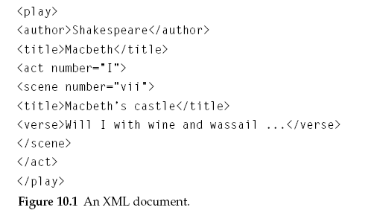
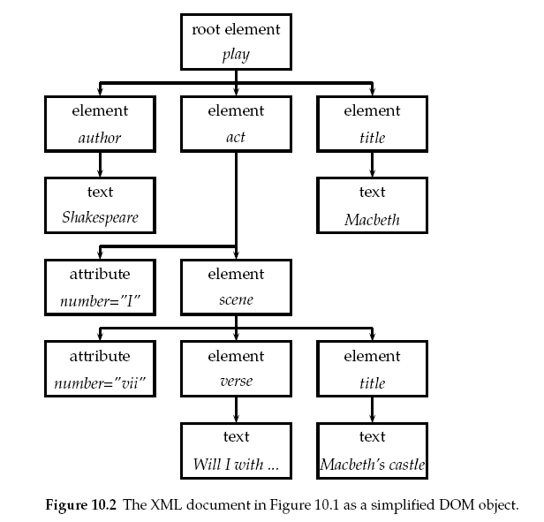
An XML document can be seen as a hierarchical tree
(…but oids can introduce loops..)
Path Expressions
play/act/scene/verse=“Will I with”
Query: Find “Shakespere” occurring in an author element
../author/../”Shakespeare”
Normal keyword queries: adam apple
../adam & ../apple
Qn: What if shakespeare occurs under “Writer” or “Poet”?
(Schema standardization is not a given)

Slide 15
XML & Order
If you see an XML file as a text file with tags, then order should matter
If you see an XML file as a self-describing version of (relational) data, then order shouldn’t matter
Which should be the default?

Slide 16
HTML vs. XML
<h1> Bibliography </h1>
<p> <i> Foundations of Databases </i>
Abiteboul, Hull, Vianu
<br> Addison Wesley, 1995
<p> <i> Data on the Web </i>
Abiteoul, Buneman, Suciu
<br> Morgan Kaufmann, 1999
<bibliography>
  <book> <title> Foundations… </title>
  <author> Abiteboul </author>
  <author> Hull </author>
  <author> Vianu </author>
  <publisher> Addison Wesley </publisher>
  <year> 1995 </year>
  </book>
  …
</bibliography>
“Self-describing”
-Schema info part of the data
-Good for data exchange
(albeit baroque for storage)

Slide 17
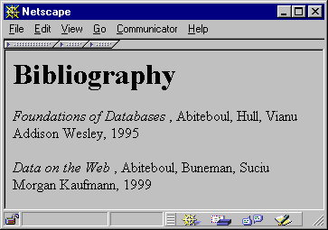
<h1> Bibliography </h1>
<p> <i> Foundations of Databases </i>
Abiteboul, Hull, Vianu
<br> Addison Wesley, 1995
<p> <i> Data on the Web </i>
Abiteoul, Buneman, Suciu
<br> Morgan Kaufmann, 1999
<bibliography>
  <book> <title> Foundations… </title>
  <author> Abiteboul </author>
  <author> Hull </author>
  <author> Vianu </author>
  <publisher> Addison Wesley </publisher>
  <year> 1995 </year>
  </book>
  …
</bibliography>
HTML describes presentation
XSL (stylesheets)
can be used to
specify the conversion
XML describes content

Slide 18
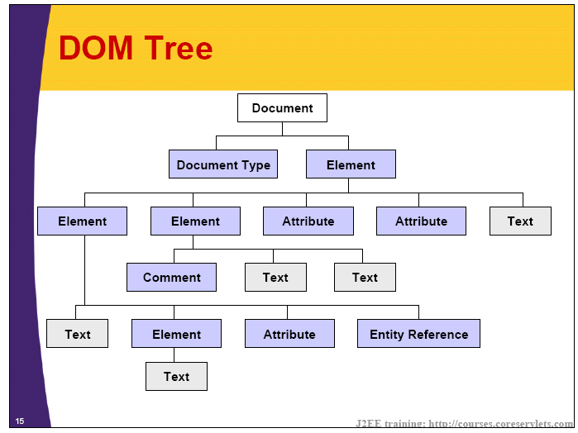
DOM Tree (Document-Object Model)
An XML document can be seen as a hierarchical tree

Slide 19
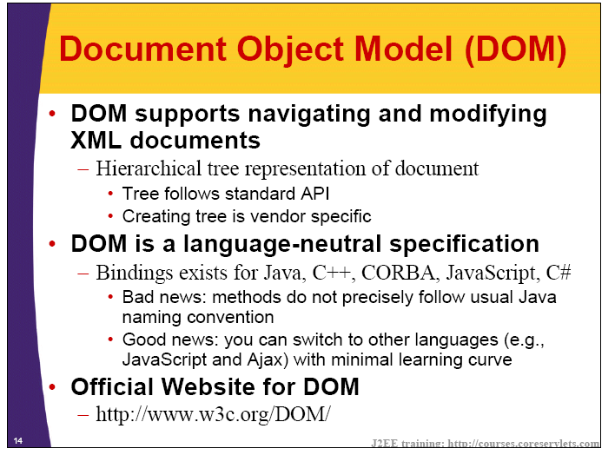

Slide 20
Who puts everything into XML?
To a certain extent, this a vaccuous question, once we realize that XML is just a syntactic standard
  You can put things into XML by just putting <body> tag (or any tag) at the beginning and end of the file
XML is not meant to be an imposition but rather a facilitator
  XML facilitates marking up structure if someone wants to do this. That someone can be:
    creator of the page
    secondary user who wants to tag the page
    An extraction program that wants to remember the structure it extracted by tagging the page
  The markup tags may or may not have any specific meaning based on prior agreements/standardization

Slide 21
XML Dialect “pot pourri”
Extensible Financial Reporting Markup Language (XFRML),
eXtensible Business Reporting Language (XBRL),
MusicXML,
Spacecraft Markup Language (SML),
Bank Internet Payment System (BIPS),
Bioinformatic Sequence Markup Language (BSML),
Biopolymer Markup Language (BIOML),
Open Catalog Format (OCF),
Chemical Markup Language (CML),
Electronic Business XML Initiative (ebXML),
Open Trading Protocol (OTP),
FinXML, Financial Information eXchange protocol (FIX),
RecipeML, CVML,
XML Bookmark Exchange Language (XBEL),
Scalable Vector Graphics (SVG),
NewsML,
DocBook,
Real Estate Listing Markup Language (RELML), . . .
Examples of communities that
Standardized their tags…

Slide 22
Why are IR folks excited about XML?
XML files are text files with structure
  Structure easily identifiable (the DOM structure)
We can improve Precision/Recall by taking structure into account..
  We already did a bit—e.g. higher weight to words occuring in the header tags..

Slide 23
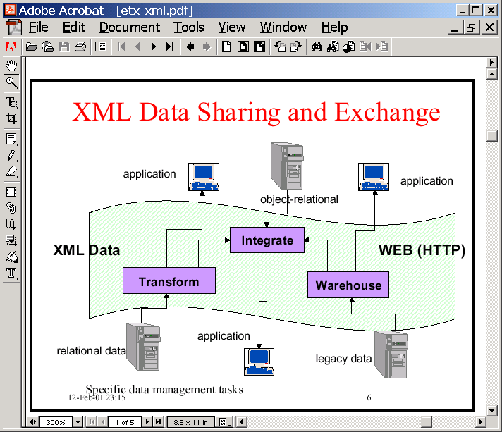
Why are Database folks excited about XML?
XML is just a syntax for (self-describing) data
This is still exciting because
  No standard syntax for relational data
  With XML, we can
    Translate any legacy data to XML
    Can exchange data in XML format
      Ship over the web, input to any application
    Talk about querying on semi-structured data

Slide 24
XML viewed from an IR Point of View

Slide 25
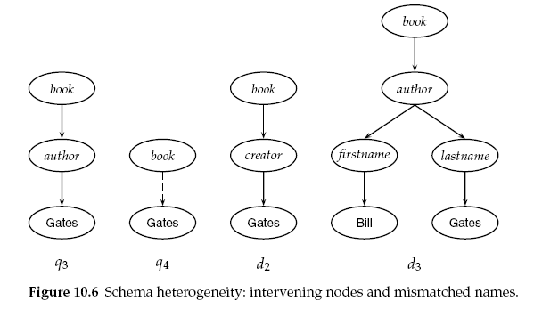
Vector-space Retrieval for XML
What are queries?
  Keywords? Path expressions?
What are results?
  The entire XML file?
  Just the smallest element of the XML that matches the query?
    What if we the query is keywords?
Does normal indexing work?
  Simple term indexing?
  Lexical tree indexing?
How are term weights computed?
  For the entire document?
  W.r.t. individual elements (Context specific)

Slide 26
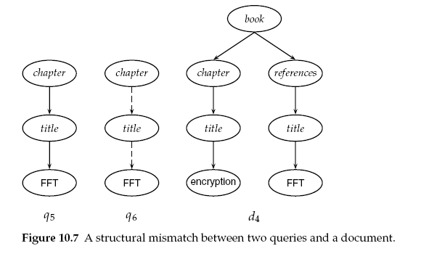
IR Style Querying of XML
Documents

Slide 27
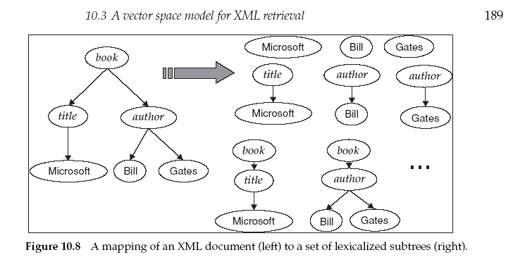
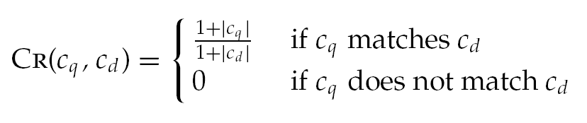
From Manning et al
IR Text
An XML document is
represented as a
vector in the space of
Lexical Trees
Query is an extended
lexical tree
Similarity between
Query & Lexical tree
defined as follows:
Within the document, you return the snippet that is closest..
Note that we are increasing the size of the index (lexical trees rather than just words), to exploit
Structure. This is normal (i.e., index becomes larger when structure is present)

Slide 28
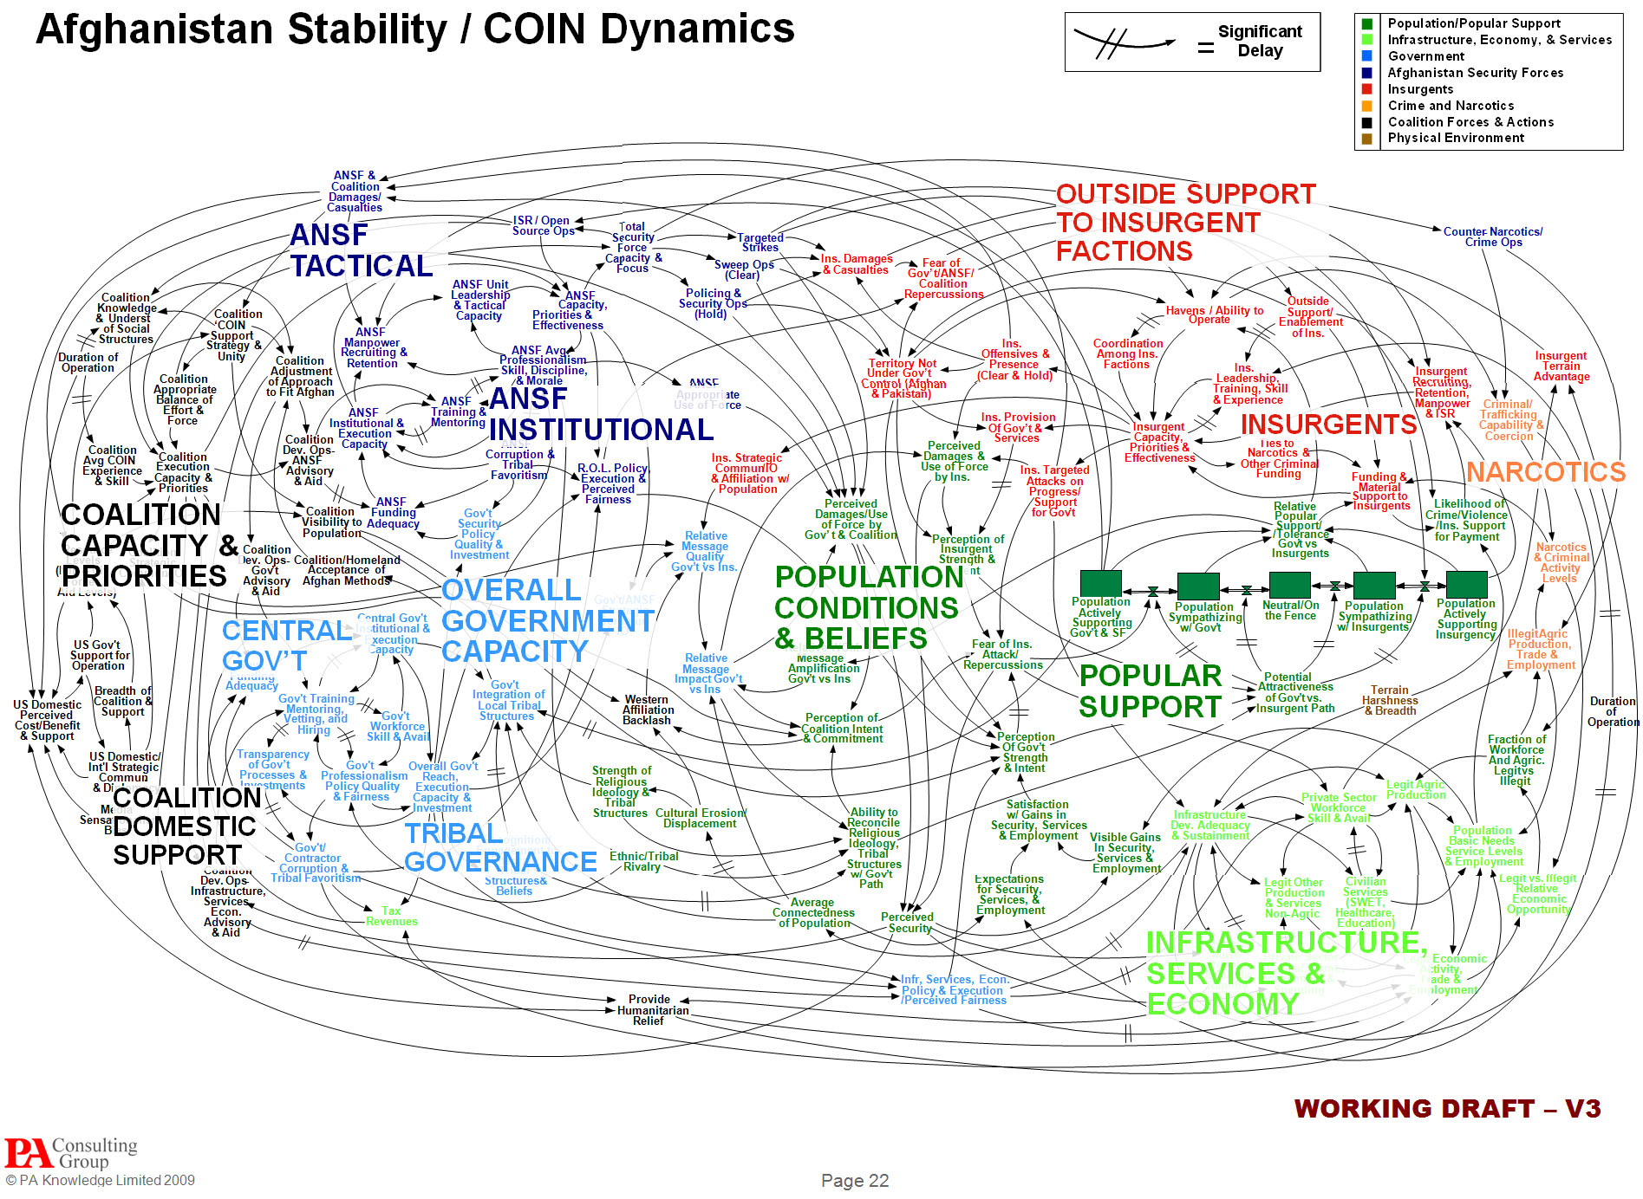
Those types of PowerPoint presentations, Dr. Hammes said, are known as “hypnotizing chickens.”

Slide 29
Gettysburg Cemetery Dedication
Abraham Lincoln
From Peter Norvig

Slide 30
Agenda
Met on battlefield (great)
Dedicate portion of field - fitting!
Unfinished work (great tasks)

Slide 31
Not on Agenda!
Dedicate
Consecrate
Hallow
(in narrow sense)
Add or detract
Note or remember what we say

Slide 32
Review of Key Objectives
& Critical Success Factors
What makes nation unique
  Conceived in Liberty
  Men are equal
Shared vision
  New birth of freedom
  Gov’t of/for/by the people

Slide 33
Organizational Overview

Slide 34
Summary
New nation
Civil war
Dedicate field
Dedicated to unfinished work
New birth of freedom
Government not perish

Slide 35
XML viewed from a Database Point of View

Slide 36
XML vs. Relational Data
XML is meant as a language that supports both Text and Structured Data
  Conflicting demands...
XML supports semi-structured data
  In essence, the schema can be union of multiple schemas
    Easy to represent books with or without prices, books with any number of authors etc.
XML supports free mixing of text and data
  using the #PCDATA type
XML is ordered (while relational data is unordered)
TEXT
More
Structure
XML
Less
Structure
Structured
(relational)
Data

Slide 37
XML Data Model (DOM)
imdb
show
@year
title
review
review
“Fugitive, The”
“1993”
suntimes
nyt
… …
reviewer
rating
“two...”
“Roger Ebert”
“gives”
Check http://www.w3.org/XML/ for more details

Slide 38
DTDs
Notice that DTD is not
In XML syntax… ☹
<!DOCTYPE paper [
<!ELEMENT paper (section*)>
<!ELEMENT section ((title,section*) | text)>
<!ELEMENT title (#PCDATA)>
<!ELEMENT text (#PCDATA)>
]>
Semi-
structured
<paper> <section> <text> </text> </section>
<section> <title> </title> <section> … </section>
<section> … </section>
</section>
</paper>

Slide 39
XML Schema
Supersedes DTD (and has XML syntax)
unifies previous schema proposals
generalizes DTDs
uses XML syntax
two documents: structure and datatypes
  http://www.w3.org/TR/xmlschema-1
  http://www.w3.org/TR/xmlschema-2

Slide 40
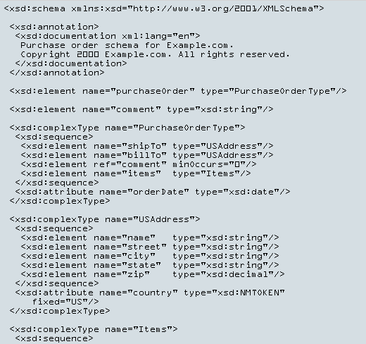
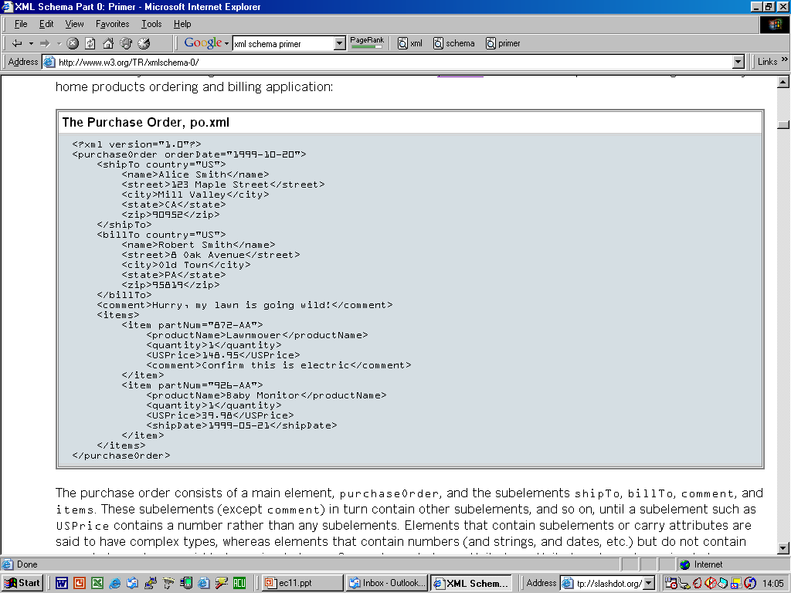
XML Schema

Slide 41
RDF: Meta-data Standard for Web
<rdf:Description about=“www.mypage.com”>
<about> birds, butterflies, snakes </about>
<author> <rdf:Description>
<firstname> John </firstname>
<lastname> Smith </lastname>
</rdf:Description>
</author>
</rdf:Description>
Good’ol semantic networks..?

Slide 42
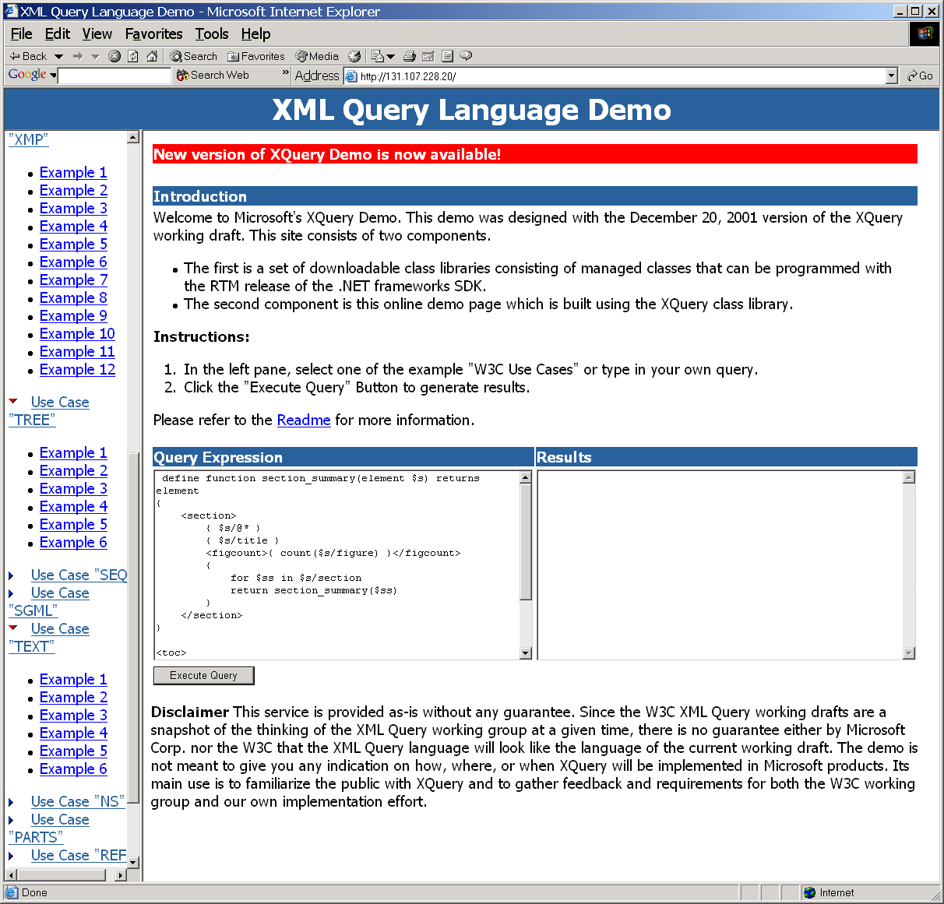
Xquery Resources
XQuery 1.0: An XML Query Language
  W3C Working Draft 20 December 2001
XML Query Use Cases
  W3C Working Draft 20 December 2001
Microsoft .Net Xquery Language Demo
  http://131.107.228.20/
  http://support.x-hive.com/xquery/index.html
  Supports querying on the documents described in the W3C Use Cases
Xquery Tutorial by Fankhauser & Wadler
  www.research.avayalabs.com/user/wadler/papers/xquery-tutorial/ xquery-tutorial.pdf

Slide 43
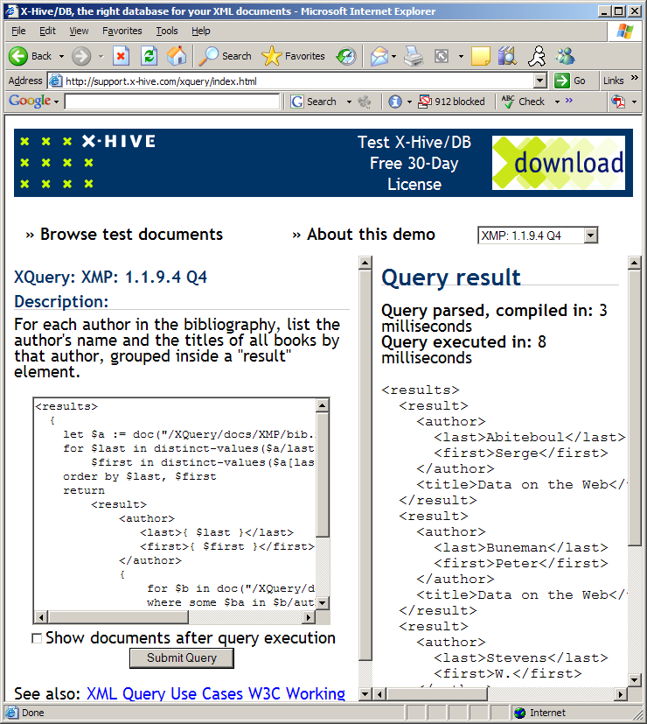
http://support.x-hive.com/xquery/index.html

Slide 44
FLoWeR Expressions
Xquery queries are made up of FLWR expressions that work on “paths”
For binds variables to nodes
Let computes aggregates
Where applies a formula to find matching elements
Return constructs the output elements
Path expressions are of the form:
element//element/element[attrib=value]

Slide 45
Comparison to SQL
Look at the use case description on Xquery manual
Supports all (?) SQL style queries (with different syntax of course) [default queries in the demo]
Has support for
  “construction”—outputting the answers in arbitrary XML formats (use case “XMP” )
  “path expressions” --- navigating the XML tree (use case “seq”)
  Simple text queries [use case “text”]
  Allows queries on “Tag” elements
    Removes the “data/meta-data” barrier in queries
      For each book that has at least one author, list the title and first two authors, and an empty "et-al" element if the book has additional authors. [XMP use case 6]

Slide 46
XQuery; IR-style search on XML; Semantic Web standards

Slide 47
DTD for http://www.bn.com/bib.xml
<!ELEMENT bib (book* )>
<!ELEMENT book (title, (author+ | editor+ ), publisher, price )>
<!ATTLIST book year CDATA #REQUIRED >
<!ELEMENT author (last, first )>
<!ELEMENT editor (last, first, affiliation )>
<!ELEMENT title (#PCDATA )>
<!ELEMENT last (#PCDATA )>
<!ELEMENT first (#PCDATA )>
<!ELEMENT affiliation (#PCDATA )>
<!ELEMENT publisher (#PCDATA )>
<!ELEMENT price (#PCDATA )>

Slide 48
Example Query
Query
Result
<bib>
{ for $b in /bib/book
where $b/publisher = "Addison-Wesley"
and $b/@year > 1991
return <book year={ $b/@year }>
{ $b/title }
</book> }
</bib>
“For all books after 1991,
return with Year changed from
a tag to an attribute”
<bib>
<book year="1994">
<title>TCP/IP Illustrated</title>
</book>
<book year="1992">
<title>Advanced Programming in the Unix environment</title>
</book>
</bib>

Slide 49
Example Query (2)
Return the books that cost more at amazon than fatbrain
Let $amazon := document(http://www.amazon.com/books.xml),
Let $fatbrain := document(http://www.fatbrain.com/books.xml)
For $am in $amazon/books/book,
$fat in $fatbrain/books/book
Where $am/isbn = $fat/isbn
and $am/price > $fat/price
Return <book>{ $am/title, $am/price, $fat/price }<book>
Join

Slide 50
XML frenzy in the DB Community
Now that XML is there, what can we do with it?
  Convert all databases from Relational to XML?
    Or provide XML views of relational databases?
  Develop theory of native XML databases?
    Or assume that XML data will be stored in relational databases..
      Issues: What sort of storage mechanisms? What sort of indices?

Slide 51
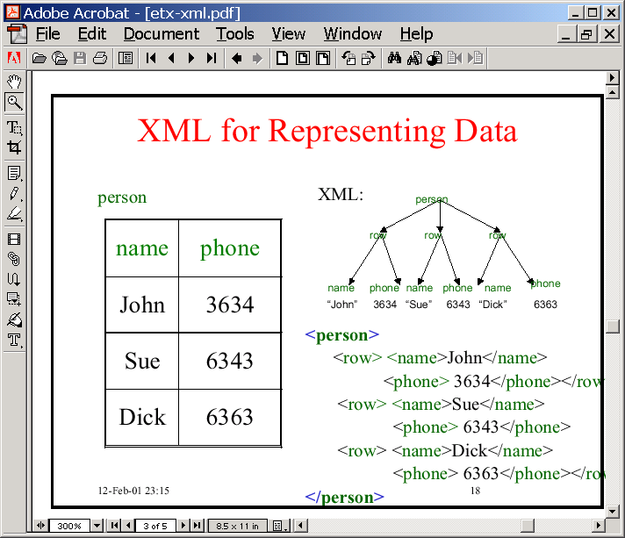
XML middleware for Databases
RDBMS
On the internet, nobody needs to know that you are a dog
XML adapters (middle-ware) received significant attention in DB community
  SilkRoute (AT&T)
  Xperanto (IBM)
Issues:
  Need to convert relational data into XML
    Tagging (easy)
  Need to convert Xquery queries into equivalent SQL queries
    Trickier as Xquery supports schema querying

Slide 52
XML & Meaning
“Colorless Green Ideas Sleep Furiously.”

Slide 53
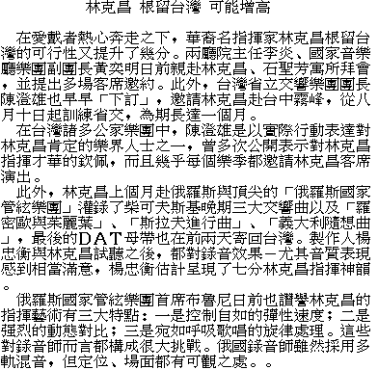
XML ≠ machine accessible meaning
Jim Hendler
This is what a web-page in natural language
looks like for a machine (Unless it is in Beijing.. ☺ )

Slide 54
XML ≠ machine accessible meaning
Jim Hendler
XML allows “meaningful tags” to be added to
parts of the text
< >
name
< >
education
< >
CV
< >
work
< >
private

Slide 55
XML ≠ machine accessible meaning
Jim Hendler
But to your machine,
the tags look like this….(assuming it is not in Athens)
< ναμε >
< >
name
<εδυχατιον>
< >
education
< Χς >
< >
CV
<ωορκ>
< >
work
<πριϖατε>
< >
private

Slide 56
XML ≠ machine accessible meaning
Jim Hendler
Schemas help….
< Χς >
…by relating
common terms
between documents
πριϖατε

Slide 57
But other people use other schemas
Jim Hendler
Someone else has one like this….
name>
< >
name
<educ>
< >
education
< CV >
< >
CV
<>
< >
work
<⇐⇑©∨>
< >
private

Slide 58
But other people use other schemas
Jim Hendler
< Χς >
πριϖατε
…which don’t fit in
Moral: There is still
need for ontology
mapping..
→either by fiat
→or by learning

Slide 59
XML & Meaning: Summary
XML is a purely syntactic standard
  Saying that something is in XML format is like saying something is in List or Table format
    It is NOT like saying that something in English/C++ etc (all of which have specific semantics)
Tags in XML do not up front have any “meaning”
  Tags can be overloaded with specific meaning through prior agreement or standardization
    Such agreements/standardization are possible for specific sub-tasks (e.g. HTML for rendering) or specific sub-communities (e.g. ebXML etc—see next slide)
  Tags’ meaning can be expressed by relating them to other tags
    This is the usual knowledge representation way (meaning comes from inter-predicate relations). Semantic Web pushes this view.
      You can also learn the relations through context/practice/usage etc. This is the sort of view taken by (semi-automated) schema-mapping techniques

Slide 60
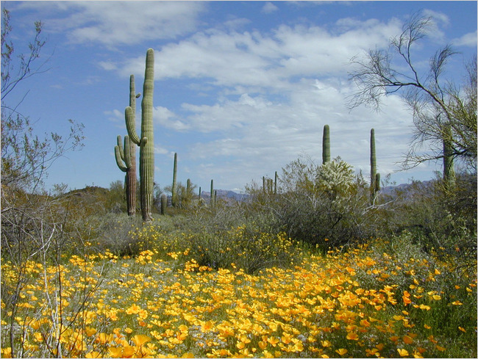
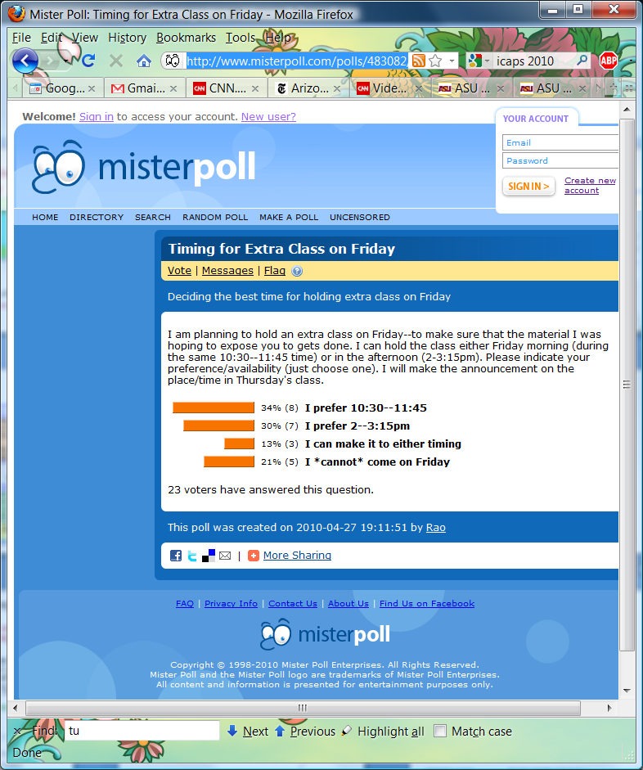
Arizona is the most unpredictable political patch of earth I’ve ever seen,” said Chip Scutari,
a former political reporter who now runs a Phoenix public relations firm. “It’s the land
of Sheriff Joe Arpaio’s tough-as-nails Tent City, and super-liberal Congressman Raul Grijalva calling for a boycott of his own state. That’s Arizona.” --NY Times, 4/29/10

Slide 61
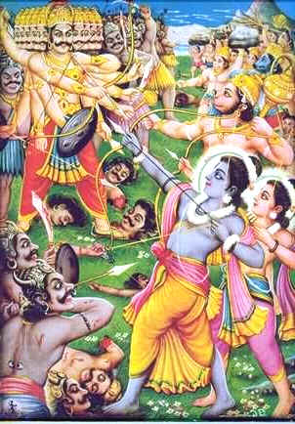
OWL/RDF-Schema are standards
for writing domain knowledge
in XML syntax
Son-of(x,y) ➔ Parent-of(y,x)
Married(x,y) ➔ Spouse-of(x,y) & Spouse-of(y,x)
Query: Spouse-of(Rama,x)
Father-of(Rama,x)
Married(Rama, Sita)
Son-of(Dasaratha, Rama)
Abducts(Ravana, Sita)
Rescues(Rama, Sita)
RDF is a standard
for writing base facts
in XML syntax
Query: Married(rama,x)
Rama was the son of King Dasaratha. He had three brothers.
He married Sita. Ramayana tells the story of Rama’s quest to
rescue Sita when she is abducted by Ravana.
Query: rama sita
రామాయణమంతా విని రాముడికి సీత ఏమవుతుంది అన్నట్టు!

Slide 62
Semantic Web Standards
RDF/RDF-Schema/OWL

Slide 63
Syntax vs. Semantics
Syntax provides the grammar for a language (all you can do is to see whether a sentence is grammatically correct and do “parts of speech” tagging
  XML
Semantics provides the set of worlds where a particular sentence (or a set of sentences) hold
  Many formal languages have well-defined semantics (Propositional logic; first order logic etc.)
  Semantic Web involves providing an XML syntax for representing “description logics”—a fragment of First order logic
    Has two parts: Base facts are represented by RDF standard
    Background Knowledge (axioms etc.)are represented by RDF-Schema (which is superseded now by OWL)

Slide 64
XML isn’t enough for Knowledge Exchange..
XML is a universal metalanguage for defining markup
It provides a uniform framework for interchange of data and metadata between applications
However, XML does not provide any means of talking about the semantics (meaning) of data
E.g., there is no intended meaning associated with the nesting of tags
  It is up to each application to interpret the nesting.

Slide 65
Nesting of Tags in XML
David Billington is a lecturer of Discrete Maths
<course name="Discrete Maths">
<lecturer>David Billington</lecturer>
</course>
<lecturer name="David Billington">
<teaches>Discrete Maths</teaches>
</lecturer>
Opposite nesting, same information!

Slide 66
What we want is a standard for representing knowledge on the web..
A standard technique for KR is Logic
So how about we find a way of encoding Logical statements in XML?
A logical theory consists of
  Base facts
  Background theory
RDF is a standard for writing (binary predicate) base-facts
  E.g. parent(Tom,Mary)
RDF-Schema is a standard for writing background theory..
  E.g. Forallx,y Parent(x,y)=>Loves(x,y)
    Recall that the complexity of inference depends on the form of background theory (e.g. semi-decidable for general FOPC and polynomial for Horn clause. It is also tractable for “description logics” where all the background knowledge is of the form class, sub-class, instance. This is what RDF-Schema tries to capture)
RQL is (an emerging?) standard for querying RDF/RDF-S databases

Slide 67
Basic Ideas of RDF
Basic building block: object-attribute-value triple
  It is called a statement
  Sentence about Billington is such a statement
RDF has been given a syntax in XML
  This syntax inherits the benefits of XML
  Other syntactic representations of RDF possible

Slide 68
Web “Schema” Languages
Existing Web languages extended to facilitate content description
  XML → XML Schema (XMLS)
  RDF → RDF Schema (RDFS)
XMLS not an ontology language
  Changes format of DTDs (document schemas) to be XML
  Adds an extensible type hierarchy
    Integers, Strings, etc.
    Can define sub-types, e.g., positive integers
RDFS is recognisable as an ontology language
  Classes and properties
  Sub/super-classes (and properties)
  Range and domain (of properties)

Slide 69
RDF and RDFS
RDF stands for Resource Description Framework
It is a W3C candidate recommendation (http://www.w3.org/RDF)
RDF is graphical formalism ( + XML syntax + semantics)
  for representing metadata
  for describing the semantics of information in a machine- accessible way
RDFS extends RDF with “schema vocabulary”, e.g.:
  Class, Property
  type, subClassOf, subPropertyOf
  range, domain

Slide 70
The RDF Data Model
Statements are <subject, predicate, object> triples:
hasColleague
Ian
Uli
Can be represented using XML serialisation, e.g.:
  <Ian,hasColleague,Uli>
Statements describe properties of resources
A resource is a URI representing a (class of) object(s):
  a document, a picture, a paragraph on the Web;
  http://www.cs.man.ac.uk/index.html
  a book in the library, a real person (?)
  isbn://5031-4444-3333
  …
Properties themselves are also resources (URIs)

Slide 71
URIs
URI = Uniform Resource Identifier
"The generic set of all names/addresses that are short strings that refer to resources“
URIs may or may not be dereferencable
  URLs (Uniform Resource Locators) are a particular type of URI, used for resources that can be accessed on the WWW (e.g., web pages)
In RDF, URIs typically look like “normal” URLs, often with fragment identifiers to point at specific parts of a document:
  http://www.somedomain.com/some/path/to/file#fragmentID

Slide 72
RDF Syntax
RDF has an XML syntax that has a specific meaning:
Every Description element describes a resource
Every attribute or nested element inside a Description is a property of that Resource with an associated object resource
Resources are referred to using URIs
<Description about="some.uri/person/ian_horrocks">
<hasColleague resource="some.uri/person/uli_sattler"/>
</Description>
<Description about="some.uri/person/uli_sattler">
<hasHomePage>http://www.cs.mam.ac.uk/~sattler</hasHomePage>
</Description>
<Description about="some.uri/person/carole_goble">
<hasColleague resource="some.uri/person/uli_sattler"/>
</Description>

Slide 73
Linking Statements
The subject of one statement can be the object of another
Such collections of statements form a directed, labeled graph
Note that the object of a triple can also be a “literal” (a string)
Note also that RDF triples don’t by themselves give meaning
  You know that (1) Ian and Carol are most likely colleagues (barring multiple jobs for Uli (2) (Uli hasCollegue Ian) holds (“colleagueness” –unlike “love” is symmetric). But DOES YOUR PROGRAM KNOW THIS?

Slide 74
A Critical View of RDF:
Binary Predicates
RDF uses only binary properties
  This is a restriction because often we use predicates with more than 2 arguments
  But binary predicates can simulate these
Example: referee(X,Y,Z)
  X is the referee in a chess game between players Y and Z

Slide 75
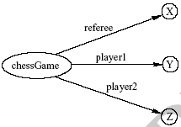
A Critical View of RDF:
Binary Predicates (2)
We introduce:
  a new auxiliary resource chessGame
  the binary predicates ref, player1, and player2
We can represent referee(X,Y,Z) as:

Slide 76
A Critical View of RDF: Properties
Properties are special kinds of resources
  Properties can be used as the object in an object-attribute-value triple (statement)
  They are defined independent of resources
This possibility offers flexibility
But it is unusual for modelling languages and OO programming languages
It can be confusing for modellers

Slide 77
A Critical View of RDF: Reification
The reification mechanism is quite powerful
It appears misplaced in a simple language like RDF
Making statements about statements introduces a level of complexity that is not necessary for a basic layer of the Semantic Web
Instead, it would have appeared more natural to include it in more powerful layers, which provide richer representational capabilities

Slide 78
A Critical View of RDF: Summary
RDF has its idiosyncrasies and is not an optimal modeling language but
It is already a de facto standard
It has sufficient expressive power
  At least as for more layers to build on top
Using RDF offers the benefit that information maps unambiguously to a model

Slide 79
RDF Schema (RDFS)
RDF gives a formalism for meta data annotation, and a way to write it down in XML, but it does not give any special meaning to vocabulary such as subClassOf or type
  Interpretation is an arbitrary binary relation
  I.e., <Person,subClassOf,Animal> has no special meaning
RDF Schema defines “schema vocabulary” that supports definition of ontologies
  gives “extra meaning” to particular RDF predicates and resources (such as subClasOf)
  this “extra meaning”, or semantics, specifies how a term should be interpreted
NOTICE THAT RDF-SCHEMA is NOT to RDF
WHAT XML-Schema is to XML

Slide 80
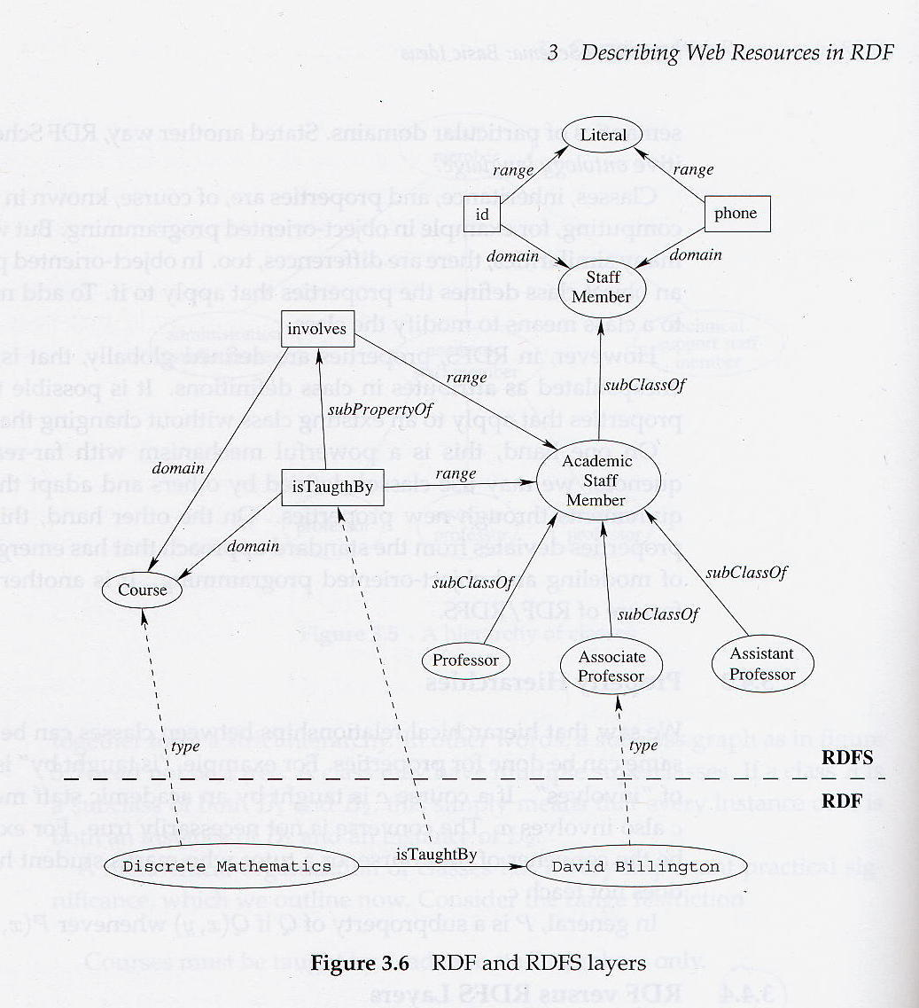
“Instances”

Slide 81
“Background Theory”
RDF Schema
is really RDF
background
knowledge!
“Instances”

Slide 82
RDF/RDFS vs. General Knowledge Rep & Reasoning
We noted that RDF can be seen as “base level facts” and RDFS can be seen as “background theory/facts/rules
At this level, inference with RDF/RDFS seems to be just a special case of Knowledge Representation Reasoning
This is good (CSE471 Ahoy!) and bad (reasoning over most non-trivial logics is NP-hard or much much worse).
RDF/RDFS can be seen as an attempt to limit the complexity of reasoning by limiting the expressiveness of what can be expressed
  RDF/RDFS together can be seen as capturing a certain tractable subset of First Order Logic
  ..already there is trouble in paradise with people complaining that the expressiveness is not enough
    Enter OWL, which attempts to provide expressiveness equivalent to “description logics” (a sort of inheritance reasoning in First-order logic)
But what about uncertain knowledge? (e.g. first order bayes nets?)…

Slide 83
Expressiveness issues in RDF-Schema
Added based on the discussion in the class
It is clear that the complexity of query answering in logical theories depends on the nature of the theory.
Since RDF is just base facts, we are particularly interested in what is expressible in RDF-Schema
  RDF-Schema turns out to be closest to a fragment/variant of First order logic called “description logic”
    Where most of the knowledge is in terms of class/sub-class relationships
  Turns out that RDF-Schema is not even as expressive as description logic; so now there is a “more expressive” standard called OWL
But, does it make sense to limit expressiveness of what can be said a priori?
An alternative is to let everything be expressed (e.g. at First order logic level), but only support some of the queries (e.g. go with sound but incomplete inference procedures)
An argument can be made that this alternative is more closer to the WEB philosophy—where we already let people write anything they want in full natural language, but support limited forms of retrieval..

Slide 84
Problems with RDFS
RDFS too weak to describe resources in sufficient detail
  No localised range and domain constraints
    Can’t say that the range of hasChild is person when applied to persons and elephant when applied to elephants
  No existence/cardinality constraints
    Can’t say that all instances of person have a mother that is also a person, or that persons have exactly 2 parents
  No transitive, inverse or symmetrical properties
    Can’t say that isPartOf is a transitive property, that hasPart is the inverse of isPartOf or that touches is symmetrical
  …
Difficult to provide reasoning support
  No “native” reasoners for non-standard semantics
  May be possible to reason via FO axiomatisation

Slide 85
RDFS Examples
RDF Schema terms (just a few examples):
  Class
  Property
  type
  subClassOf
  range
  domain
These terms are the RDF Schema building blocks (constructors) used to create vocabularies:
  <Person,type,Class>
  <hasColleague,type,Property>
  <Professor,subClassOf,Person>
  <Carole,type,Professor>
  <hasColleague,range,Person>
  <hasColleague,domain,Person>

Slide 86
RDF/RDFS “Liberality”
No distinction between classes and instances (individuals)
  <Species,type,Class>
  <Lion,type,Species>
  <Leo,type,Lion>
Properties can themselves have properties
  <hasDaughter,subPropertyOf,hasChild>
  <hasDaughter,type,familyProperty>
No distinction between language constructors and ontology vocabulary, so constructors can be applied to themselves/each other
  <type,range,Class>
  <Property,type,Class>
  <type,subPropertyOf,subClassOf>

Slide 87
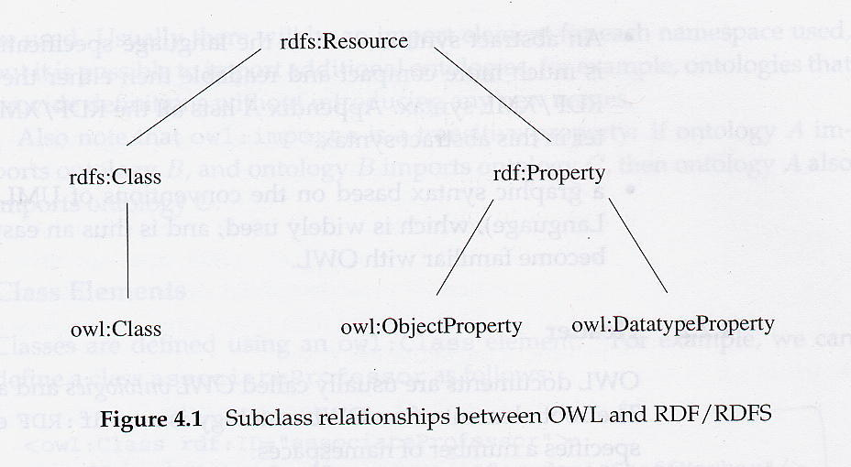
RDF Schema is now being superseded by OWL

Slide 88
Web Ontology Language Requirements
Desirable features identified for Web Ontology Language:
Extends existing Web standards
  Such as XML, RDF, RDFS
Easy to understand and use
  Should be based on familiar KR idioms
Formally specified
Of “adequate” expressive power
Possible to provide automated reasoning support

Slide 89
From RDF to OWL
Two languages developed to satisfy above requirements
  OIL: developed by group of (largely) European researchers (several from EU OntoKnowledge project)
  DAML-ONT: developed by group of (largely) US researchers (in DARPA DAML programme)
Efforts merged to produce DAML+OIL
  Development was carried out by “Joint EU/US Committee on Agent Markup Languages”
  Extends (“DL subset” of) RDF
DAML+OIL submitted to W3C as basis for standardisation
  Web-Ontology (WebOnt) Working Group formed
  WebOnt group developed OWL language based on DAML+OIL
  OWL language now a W3C Recommendation (i.e., a standard like HTML and XML)

Slide 90
OWL Language
Three species of OWL
  OWL full is union of OWL syntax and RDF
  OWL DL restricted to FOL fragment (¼ DAML+OIL)
  OWL Lite is “easier to implement” subset of OWL DL
Semantic layering
  OWL DL ¼ OWL full within DL fragment
  DL semantics officially definitive
OWL DL based on SHIQ Description Logic
  In fact it is equivalent to SHOIN(D_{n}) DL
OWL DL Benefits from many years of DL research
  Well defined semantics
  Formal properties well understood (complexity, decidability)
  Known reasoning algorithms
  Implemented systems (highly optimised)

Slide 91
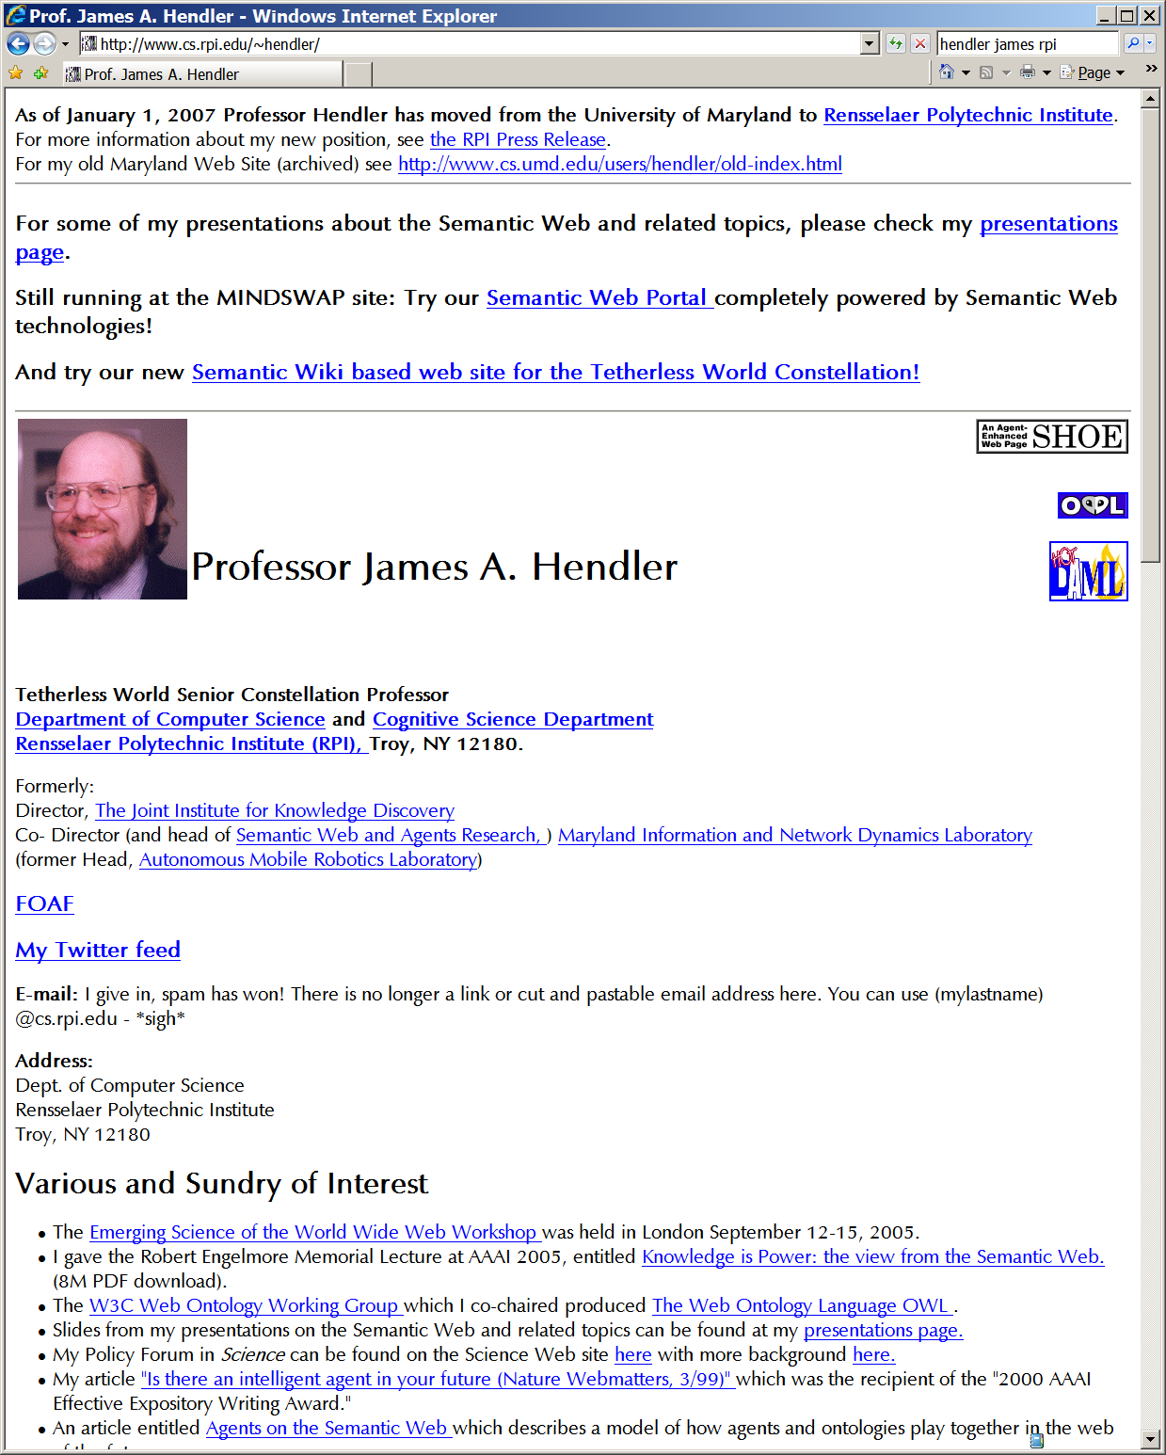
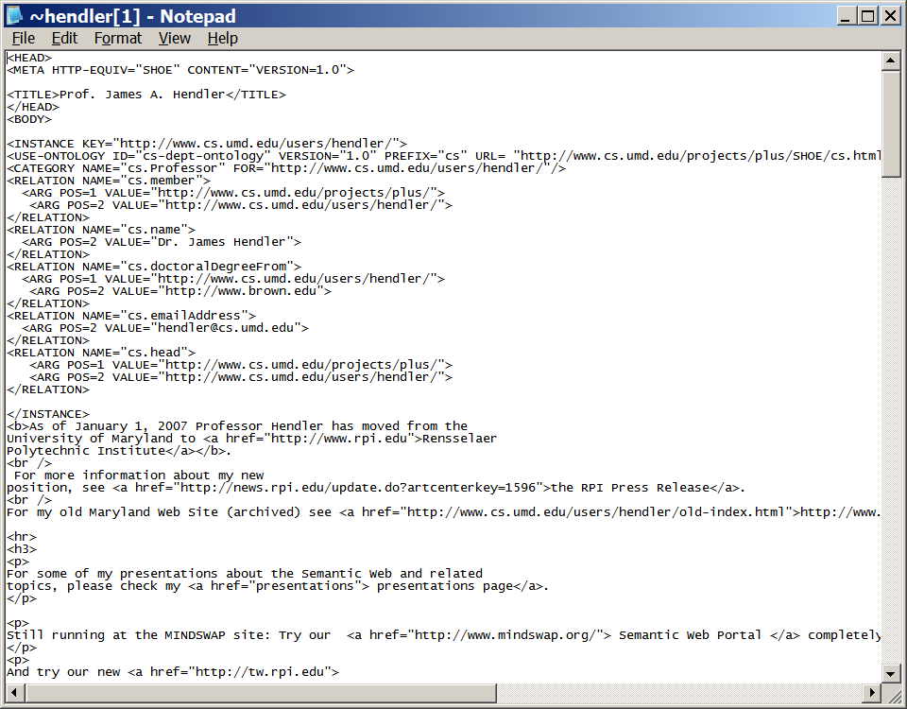
Intended Use of Semantic Web?
Pages should be annotated with RDF triples, with links to RDF-S (our OWL) background ontology.

Slide 92
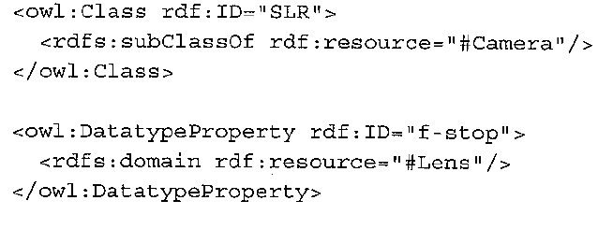
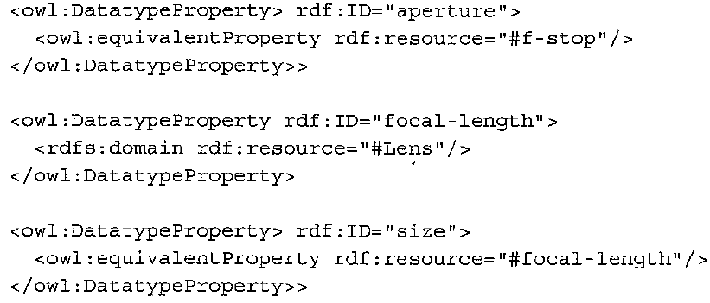
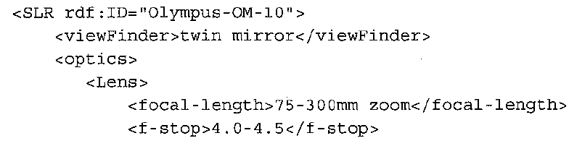
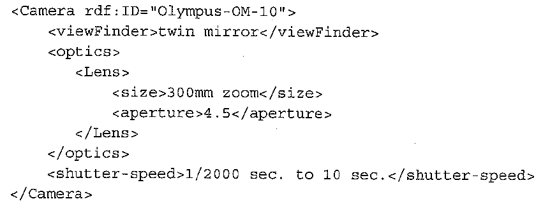
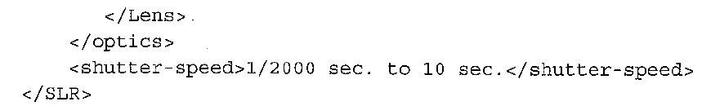
Semantic Web Solution for
source integration:
→Let the sources use whichever schema
(written in rdf)
→Let there be a global ontology
(mediator schema) onto which the the
individual ontologies are mapped
(using OWL)
→Who does the mapping?
Integrator
(needs a way to map schemas)

Slide 93
The annotation problem
Semantic web works if the users annotate their pages using some existing ontology (or their own ontology, but with mapping to other ontologies)
  But users typically do not conform to standards..
    and are not patient enough for delayed gratification…
Solutions
  1. Intercede in the way pages are created (act as if you are helping them write web-pages)
    What if we change the MS Frontpage/Claris Homepage so that they (slyly) add annotations?
    E.g. The Mangrove project at U. Wash.
      Help user in tagging their data (allow graphical editing)
      Provide instant gratification by running services that use the tags.
  2. Collaborative tagging!
    “Folksonomies” (look at Wikipedia article)
      FLICKR, Technorati, deli.cio.us etc
    CBIOC, ESP game etc.
      Need to incentivize users to do the annotations..
  3. Automated information extraction (next topic)
    “Structure Servers” (e.g. Semtag/Seeker)

Slide 94
Folksonomies—The good
Bottom-up approach to taxonomies/ontologies
  [In systems like] Furl, Flickr and Del.icio.us... people classify their pictures/bookmarks/web pages with tags (e.g. wedding), and then the most popular tags float to the top (e.g. Flickr's tags or Del.icio.us on the right)....
  [F]olksonomies can work well for certain kinds of information because they offer a small reward for using one of the popular categories (such as your photo appearing on a popular page). People who enjoy the social aspects of the system will gravitate to popular categories while still having the freedom to keep their own lists of tags.

Slide 95
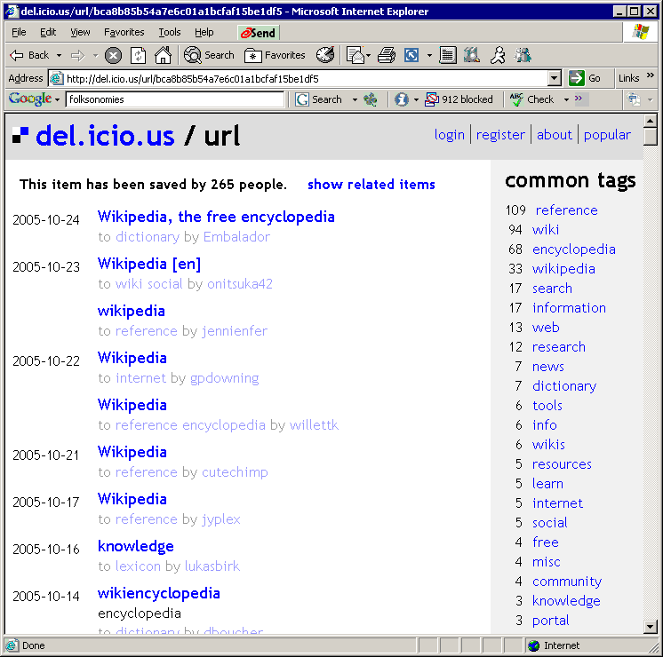
Works best when
Many people
Tag the same
Info…

Slide 96
Folksonomies… the bad
On the other hand, not hard to see a few reasons why a folksonomy would be less than ideal in a lot of cases:
  None of the current implementations have synonym control (e.g. "selfportrait" and "me" are distinct Flickr tags, as are "mac" and "macintosh" on Del.icio.us).
  Also, there's a certain lack of precision involved in using simple one-word tags--like which Lance are we talking about?
  And, of course, there's no heirarchy and the content types (bookmarks, photos) are fairly simple.
For indexing and library people, folksonomies are about as appealing as Wikipedia is to encyclopedia editors.
  But.. there's some interesting stuff happening around them.

Slide 97
Mass Collaboration
(& Mice running the Earth)
The quality of the tags generated through folksonomies is notoriously hard to control
  So, design mechanisms that ensure correctness of tags..
    ESP game makes it fun to
    CBIOC and Google Co-op restrict annotation previleges to trusted users..
It is hard to get people to tag things in which they don’t have personal interest..
  Find incentive structures..
    ESP makes it a “game” with points
    CBIOC and Google Co-op try to promise delayed gratification in terms of improved search later..

