Slide 1
Linear Algebra

Slide 2
vectors and matrices
A vector is a bunch of numbers
A matrix is a bunch of vectors

Slide 3
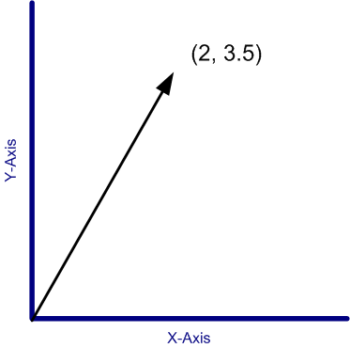
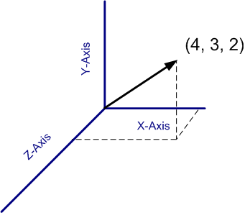
A vector in space
In space, a vector can be shown as an arrow
starting point is the origin
ending point are the values of the vector
Notes:
In addition to being a bunch of numbers, we can also represent vectors as arrows from the origin to a point represented by those bunch of numbers. For eg – 2d case, 3d case

Slide 4
Properties of vectors
Its “size” |v|
the 2-norm of the vector
|(1, 2, 3)| = √(1² + 2² + 3²)
A unit vector is a vector of size 1.
Notes:
Among the many properties of a vector – one of the more important ones is its ‘size’ – which is the sqrt of sum of squares. unit

Slide 5
Operations on vectors
Addition, Subtraction – easy.
(1, 2, 3) + (100, 200, 300) = (101, 202, 303)
Dot product
(1, 2, 3)•(100, 200, 300) = (100, 400, 900)
Multiplication – with other matrices.
Division – not defined.
Notes:
So let us quickly define the basic math operators. you can add em, subtract em, multiplication is of two sorts – the dot product and the cross product – we don’t deal with the cross product in this course. You can also do matrix multiplication with other matrices. Division is not defined – because multiplication results in stuff outside the domain of vectors.

Slide 6
Matrices
No intuitive representation in space.
Addition / Subtraction – easy
Multiplication – matrix multiplication
Not commutative
Division – not defined
If the matrix is
a square matrix
invertible
then take inverse and multiply

Slide 7
Matrix Multiplication can be seen as computing vector dot products..
Given a matrix R, you can consider each row of M as a vector.
Thus R = [r1
r2
..
rk]
Now Given another matrix S whose column vectors are s1… sk, the ijth element in R*S is ri.sj
. Is the dot product
As a corollary, if a matrix M is orthogonal—i.e., its row vectors are all orthogonal to each other, then M*M’ or M’*M will both be diagonal matrices..

Slide 8
Some identities / properties
transpose of a matrix
determinant of a matrix
A A⁻¹ = I

Slide 9
What happens when you multiply a matrix by a vector?
The vector scales and rotates.

Slide 10
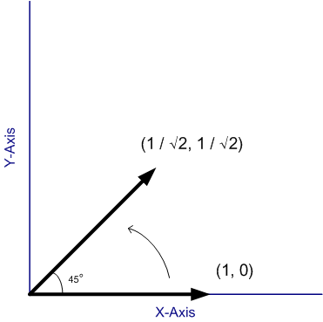
Example 1 – only rotation
Notes:
Here is an example of a matrix that causes a vector to get rotated… only. Here’s the vector, and here it is after the multiplication. Cos(45) is 1/1.414 and you see that the resultant vector has the same size – its just rotated by 45 degrees. I’ve shown this for one vector only, but this is true in general. No matter what vector you start with, this matrix will always rotate it by 45 degrees, and have no other effect.

Slide 11
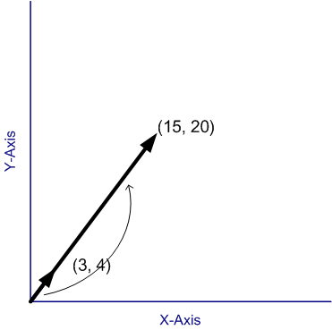
Example 2 – only scaling
Notes:
Here is a matrix that only changes the size of a vector, and leaves its direction alone. Once again, no matter what vector I start with, this matrix will always only scale it, and do nothing else. You should note that the form of the matrix is familiar – it is the unit matrix multiplied by a constant.

Slide 12
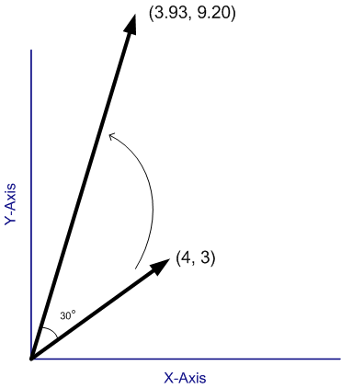
Example 3 - both
Notes:
Here is a matrix that does both – it operates on the vector (4, 3) and gives you this new vector. This new vector is rotated by 30 degrees and increased in size by 2 – now I can say that here because I have constructed this matrix very carefully – in fact, this is the scale-by-2 matrix multiplied by the rotate-by-30-degrees matrix. So it has the effect of increasing the size twofold and rotating by 30 degrees. Note that your general matrix wont have such a nice property that you can simply read off the effects from the numbers in the matrix itself – how to do that is a subject I will come to shortly.

Slide 13
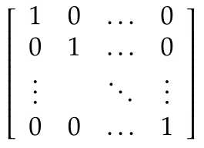
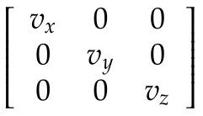
So a matrix is a bunch of numbers that tells us how to rotate and scale vectors
Special matrices: Unit matrix
Special matrices: Rotation matrix
Special matrices: Scaling matrix
Notes:
So to recap – a matrix is a bunch of numbers that affects a vector in a particular way – it rotates it by a bit and scales it by a bit. There are some well known matrices that you should know about –
Unit matrix – it does nothing – whatever you multiply it with stays as is.
Rotation matrix – shown here for the two dimension case – rotates a matrix by \theta degrees and has no other effect.
And the scaling matrix – which you can use to increase the size of the vector in the x, y, and z directions by vx, vy and vz. Note that if vx, vy and vz are different, it also will end up rotating the matrix, the matrix I showed you earlier had the same values of vx and vy, so it had the effect of purely scaling the vector up.

Slide 14
Can we make some general statements about a matrix?
Given any matrix M, can we make some statements about how it affects vectors?
Start with any vector. Multiply it over and over and over with a matrix. What happens?
Notes:
So now that we know a matrix rotates and scales, and we’ve seen some typical matrices, we have the problem that not every matrix fits in those patterns. So given any general matrix, can we make some statements about the way it will scale and rotate vectors?
SO lets think of it this way – we have a matrix. We take some vector – any vector – and multiply a matrix again and again with it. What happens? So lets say it is not one of those special rotation matrices – that rotate only. Your intuition says that it will both scale the vector and rotate it a bit. SO think about it - it rotates but also increases the size. Let’s see how it looks

Slide 15
Eigen vectors
There are some vectors which don’t change direction on multiplication with a matrix.
They are called Eigen vectors.
However, the matrix does manage to scale them. The factor it scales them by, are called the ‘Eigen values’.
Notes:
Think of all the possible vectors you could multiply by a matrix – that’s all the vectors in the world, an infinite number of them. Among them, only a few have this very strange property that they don’t change the direction when they get multiplied by the matrix. Those vectors are called the eigen vectors of the matrix. Given a matrix, you can find its eigen vectors. after you’ve found them, try multiplying them with the matrix. What you will observe is that those matrix don’t change direction – they point at exactly the same direction in space. the factor by which they grow is called the eigen value for that particular eigen vector.
Now you should be worried at this point. A little while ago, I showed you a matrix that completely contradicts what I am saying here. It was the rotation matrix. The rotation matrix rotates a vector no matter what. But here I am claiming that every matrix would have some vector that does not get rotated – something is wrong. Well it turns out – that it is possible that some matrices have eigen vectors and eigen values that are complex numbers. When I say that a vector is made up of complex numbers, I mean that the co-ordinates that make the vector up, are imaginary. So if the eigen vector is complex – you wont find a real vector that doesn’t get rotated – hence there is no contradiction here. The vectors you are likely to encounter in this course, and the one that was on your hw – they have real eigen vectors and eigen values, so you don’t need to worry about that.

Slide 16
How to find Eigen values
Let’s assume one of the eigen vectors is v
Then Av = λv, where λ is the eigenvalue.
Transpose it (A - λI)v = 0
Theorem: if v is not zero, then the above equation can only be true if the determinant of (A – λI) is zero. [proof: see Characteristic polynomial in Wikipedia]
Use this fact to find values of λ
Notes:
So

Slide 17
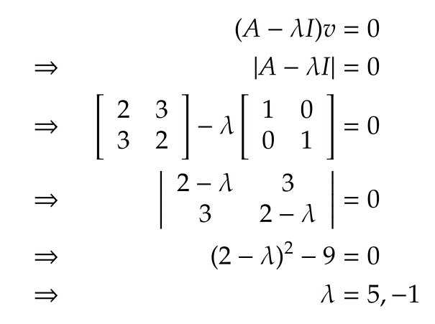

Slide 18
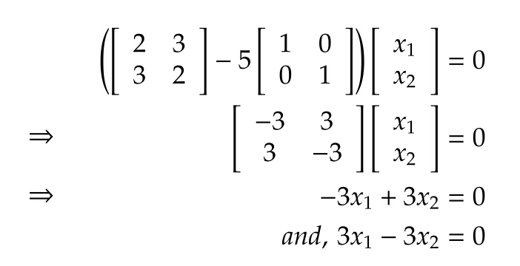
How to find Eigen Vectors
Substitute λ back into the equation (A - λI)v=0
Try to find v
You will get two equations in two variables – but: there is a problem, the two equations are identical

Slide 19
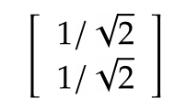
Eigen vectors – the missing eqn
One equation, two variables
Use the additional constraint that the Eigen vector is a unit vector (length 1)
x₁²+x₂² = 1
Using the x₁ = x₂ we found from the previous slide, we have the Eigen vector

Slide 20
So what do these values tell us
If you repeatedly multiply a vector by a matrix, (and then normalize), then you will eventually get the primary Eigen vector.
The primary Eigen vector is, sort of, the general direction in which the matrix turns the vector

Slide 21
How is this all relevant to the class?
Instead of thinking of 2-dimension or 3-dimension vectors, imagine vectors in T dimensions
T = number of different terms.
Each doc will be a vector in this space.
Similarity between the docs = normalized dot product
Store the link structure of the web in a matrix
Eigen values / vectors – PageRank

