Slide 1
Start of IR
Each student must send
at least one tweetnote
for at least 2/3rd of the classes

Slide 2
Information Retrieval
Traditional Model
  Given
    a set of documents
    A query expressed as a set of keywords
  Return
    A ranked set of documents most relevant to the query
  Evaluation:
    Precision: Fraction of returned documents that are relevant
    Recall: Fraction of relevant documents that are returned
    Efficiency
Web-induced headaches
  Scale (billions of documents)
  Hypertext (inter-document connections)
Consequently
  Ranking that takes link structure into account
    Authority/Hub
  Indexing and Retrieval algorithms that are ultra fast

Slide 3
What is Information Retrieval
Given a large repository of documents, and a text query from the user, return the documents that are relevant to the user
  Examples: Lexis/Nexis, Medical reports, AltaVista
Different from databases
  Unstructured (or semi-structured) data
  Information is (typically) text
  Requests are (typically) word-based & imprecise
    Either because the system can’t understand the Natural Language fully
    Or because the users realized that the system doesn’t understand anyway and started talking in keywords
    Or because the users don’t precisely what they want
Even if the user queries are precise,
Answering them requires NLP!
--NLP too hard as yet
--IR tries to get by
with syntactic methods
Catch22: Since IR doesn’t
do NLP, users tend to
write cryptic keyword
queries

Slide 4
Information vs. Data
Data retrieval
    which docs contain a set of keywords?
    Well defined semantics
      The retrieval system can tell if a record is an answer or not
    a single erroneous object implies failure!
      A single missed object implies failure too..
Information retrieval
    information about a subject or topic
    semantics is frequently loose
      The retrieval system can only guess; the final arbiter is the user
    small errors are tolerated
    generate a ranking which reflects relevance
    notion of relevance is most important

Slide 5
Measuring Performance
1.0 precision ~ Soundness ~ nothing but the truth
1.0 recall ~ Completeness ~ whole truth
Analogy: Swearing-in witnesses in courts
Actual relevant docs
tn
Precision
  Proportion of selected items that are correct
Recall
  Proportion of target items that were selected
Precision-Recall curve
  Shows tradeoff
fp
tp
fn
System returned these
Whose absence
can the users sense?
Precision
Why don’t we use precision/recall
measurements for databases?
Recall

Slide 6
Evaluation: TREC
How do you evaluate information retrieval algorithms?
Need prior relevance judgements
TREC:Text Retrieval Competion
  Given
    documents;
    a set of queries;
      and for each query, prior relevance judgements
        Documents are judged in isolation from other possibly relevant documents that have been shown
          Mostly because the potential subsets of documents already shown can be exponential; too many relevance judgements..
  Rank systems based on their precision recall on the corpus of queries
There are variants of TREC
  TREC for bio-informatics; TREC for collection selection etc
    Very benchmark driven….

Slide 7
Why can’t search engines have 100% precision and 100% recall?
Because relevance is in the eye of the beholder…
  I think that a page pointing to culture of Kalahari Bushmen is highly relevant to my query “bush”
  The campus republicans might find that it is a lousy answer..

Slide 8
Measuring performance of retrieval system
Why do courts ask witnesses to swear that
“..I will tell the whole truth and nothing but the truth..”
Why not just ask them to swear
“I will tell the truth”

Slide 9
Measuring Performance
Precision/recall studies involving real users…

Slide 10
Precision/Recall Curves
11-point recall-precision curve plots precision at recalls 0,.1,.2,.3….1.0
Example: Suppose for a given query, 10 documents are relevant. Suppose when all documents are ranked in descending similarities, we have
d₁ d₂ d₃ d₄ d₅ d₆ d₇ d₈ d₉ d₁₀ d₁₁ d₁₂ d₁₃ d₁₄ d₁₅ d₁₆ d₁₇ d₁₈ d₁₉ d₂₀ d₂₁ d₂₂ d₂₃ d₂₄ d₂₅ d₂₆ d₂₇ d₂₈ d₂₉ d₃₀ d_{31 …}
.2 recall happens at the third doc
Here the precision is 2/3= .66
.3 recall happens at 6th doc. Here the
Precision is 3/6=0.5
precision
.1
.3
1.0
recall

Slide 11
Precision Recall Curves…
Note: We assume that all
Methods are using the same
Document corpus
When evaluating the retrieval effectiveness of a text retrieval system or method, a large number of queries are used and their average 11-point recall-precision curve is plotted.
Methods 1 and 2 are better than method 3.
Method 1 is better than method 2 for high recalls.
precision
Method 1
Method 2
Method 3
recall

Slide 12
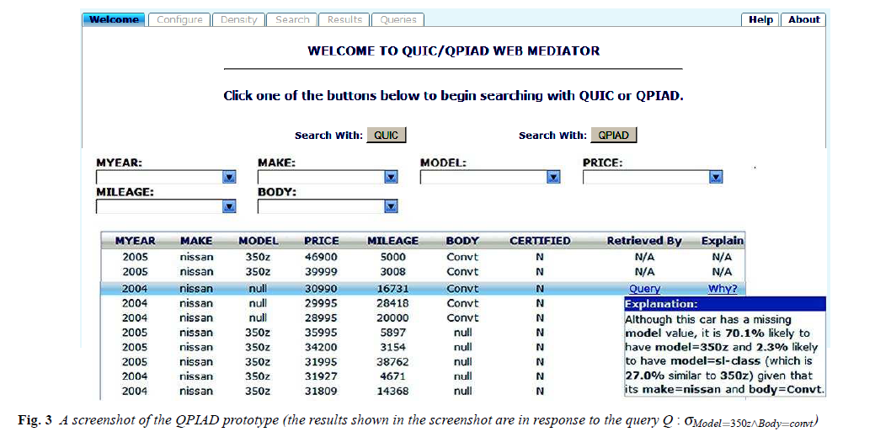
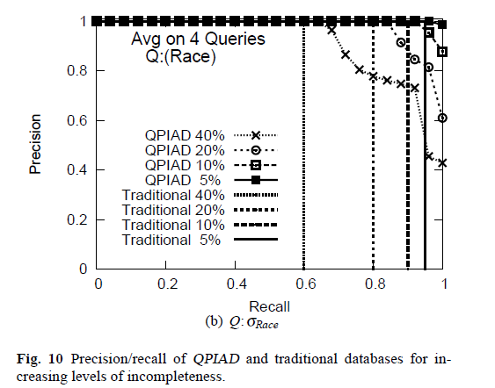
Database Example (discussed in class)
From QPIAD paper
http://rakaposhi.eas.asu.edu/vldbj-qpiad.pdf

Slide 13
Combining precision and recall into a single measure
We can consider a weighted summation of precision and recall into a single quantity
  What is the best way to combine?
    Arithmetic mean?
    Geometric mean?
    Harmonic mean?
f=0 if p=0 or r=0
f=0.5 if p=r=0.5
Good because it is
Exceedingly easy to
Get 100% of one thing
If we don’t care about the other
F-measure (aka F₁-measure)
(harmonic mean
of precision and recall)
If you travel at 40mph on
the way out and 60mph
on the return, what is
your average speed?
Alterantive: Area under the precision/recall curve

Slide 14
Mean Average Precision
Average of the precision scores after each relevant document retrieved

Slide 15
Sophie’s choice: Web version
If you can either have precision or recall but not both, which would you rather keep?
  If you are a medical doctor trying to find the right paper on a disease
  If you are Joe Schmoe surfing on the web?

Slide 16
Relevance: The most over-loaded word in IR
We want to rank and return documents that are “relevant” to the user’s query
  Easy if each document has a relevance number R(.); just sort the documents in R(.).
What does relevance R(.) depend on?
  The document d
  The query Q
  The user U

Slide 17
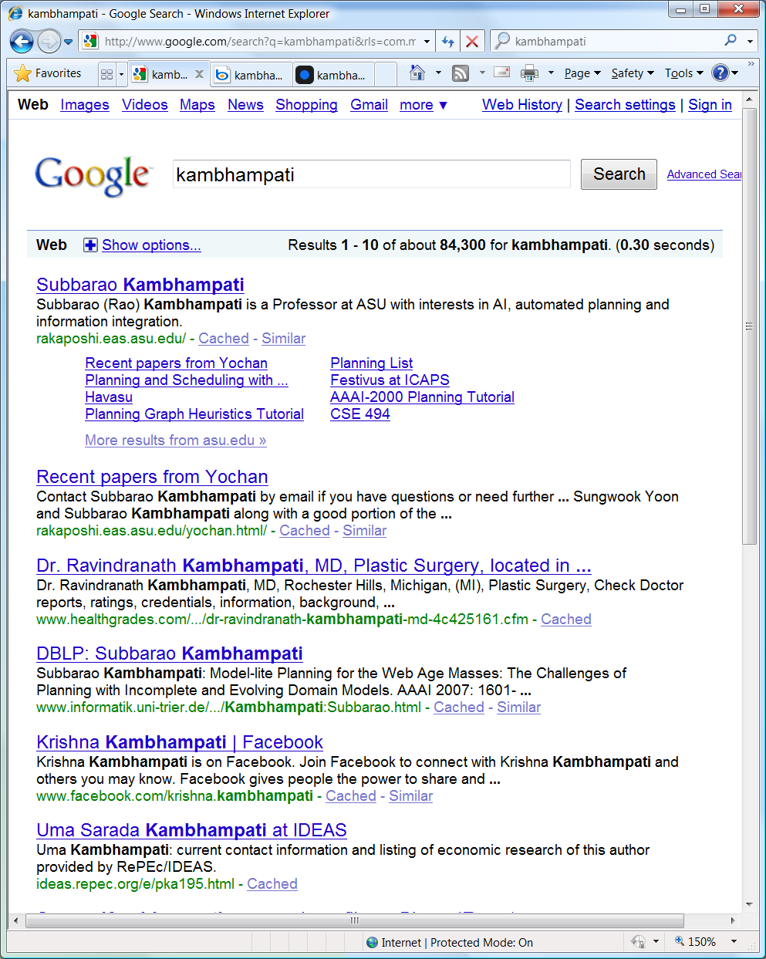

Slide 18
Relevance: The most over-loaded word in IR
We want to rank and return documents that are “relevant” to the user’s query
  Easy if each document has a relevance number R(.); just sort the documents in R(.).
What does relevance R(.) depend on?
  The document d
  The query Q
  The user U
  The other documents already shown {d₁ d₂ … d_{k} }
R(d|Q,U, {d₁ d₂ … d_{k} })

Slide 19
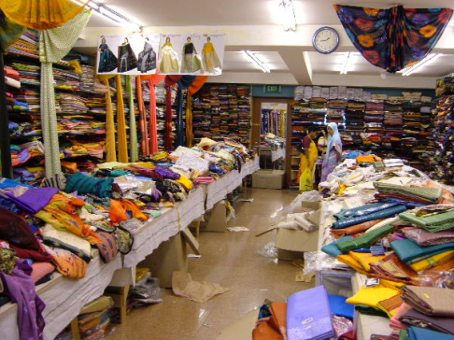

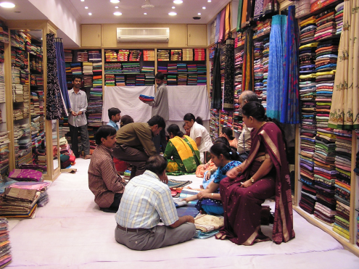
How to get
R(d|Q,U, {d₁ d₂ … d_{k} })
Specify up front
  Too hard—one for each query, user and shown results combination
Learn
  Active (utility elicitation)
  Passive (learn from what the user does)
Make up the users’ mind
  What you are “really” looking for is.. (used car sales people)
Combination of the above
  Saree shops ;-) [Also overture model]
Assume (impose) a relevance model
  Based on “default” models of d and U.
..But do remember the better ideas!

Slide 20
Types of Web Queries…
Web queries can be classified into three categories
Informational Queries
  Want to know about some topic
Navigational Queries
  Want to find a particular site
Transactional Queries
  Want to find a site so as to do some transaction on it..
IR work focuses
implicitly on
informational
queries

Slide 21
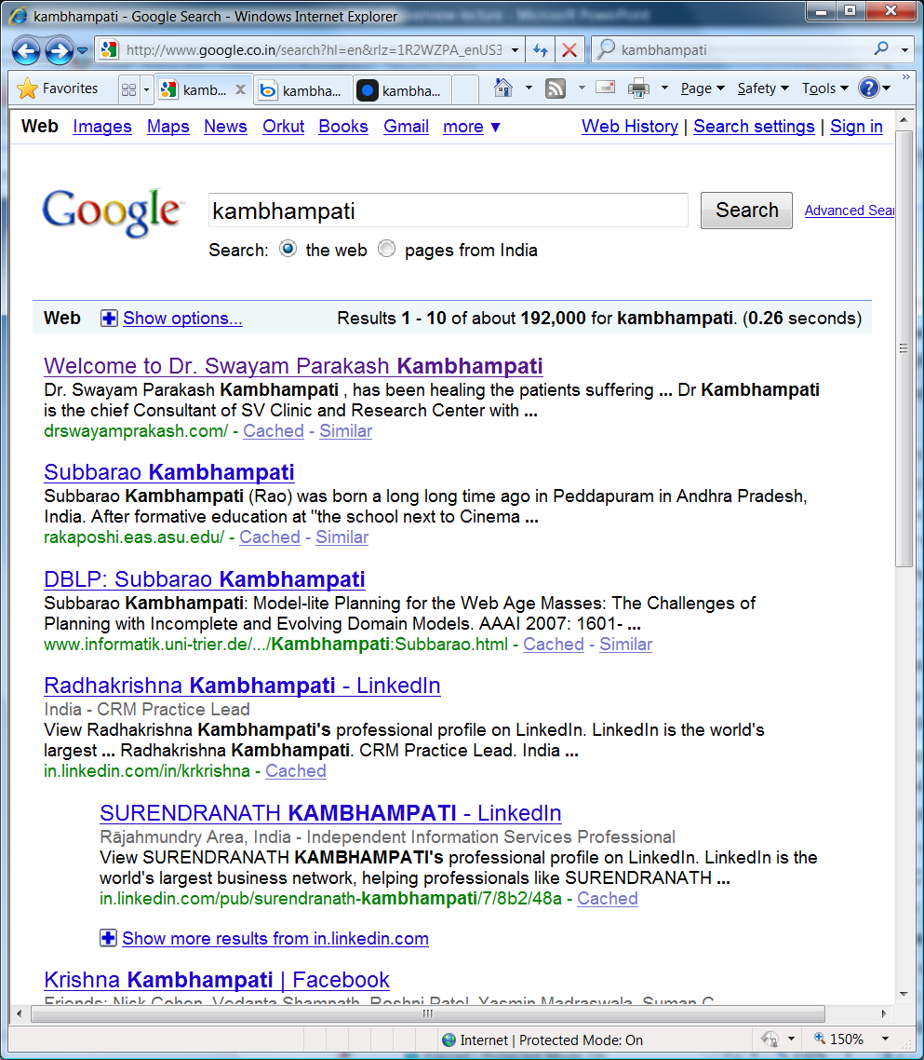
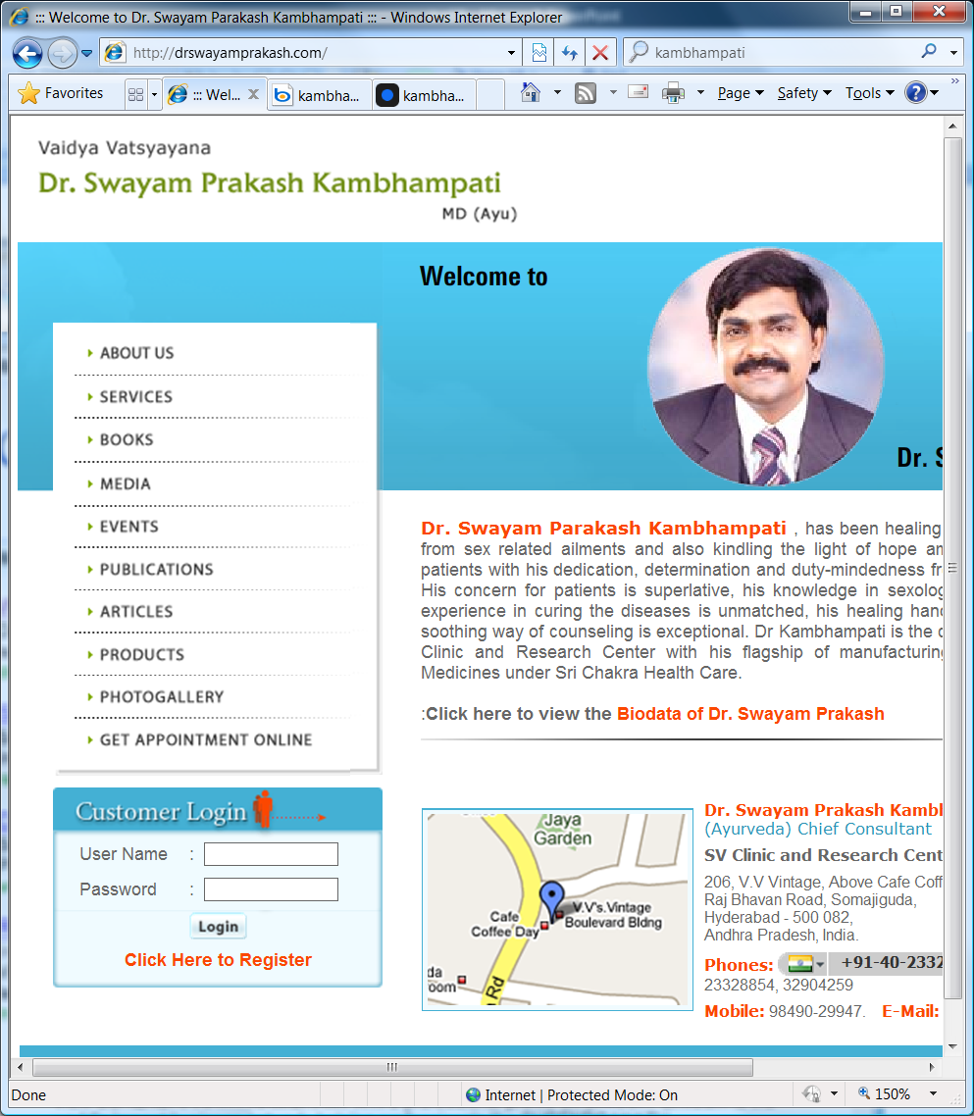
Notes:
While I could beat a plastic surgeon in US, I couldn’t quite beat a sexologist in India.. Alas even my page-rank has limits…

Slide 22
9/1
“We dance around the ring and suppose,
but the secret sits in the middle and knows”
- Robert Frost

Slide 23
Representing constituents of Relevance Function
→meaning?
→keywords?
→all words?
→shingles? sentences?
→Parsetrees?
R(.) depends on the specific
representations used..
R(d|Q,U, {d₁ d₂ … d_{k} })
→Sets?
→Bags?
→Vectors?
→Distributions?
→meaning & context
→keywords?
→User profile
→Interests, domicile etc

Slide 24
Precision/Recall comparison of Bag of Letters/Words/Shingles
 | Precision | Recall
Bag of Letters | low | high
Bag of Words | med | med
Bag of k-Shingles k>>1 | high | low
Also, if you want to do “plagiarism” detection,
then you want to go with k-shingles, with
k higher than 1 but not too high (say about 10)

Slide 25
Default models of D and U & the Relevance they lead to
R(d|Q,U, {d₁ d₂ … d_{k} })
We shall assume that the document is represented in terms of its “key words”
  Set/Bag/Vector of keywords
We shall ignore the user initially
Relevance assessed as:
  “Similarity” between doc D and query Q
    User profile?
Residual relevance assessed in terms of dissimilarity to the documents already shown
  Typically ignored in traditional IR
Ergo, IR is just
Text Similarity
Metrics!!

Slide 26

Drunk searching for his keys…
Ergo, IR is just
Text Similarity
Metrics!!
What we really want:
  Relevance of doc D to user U, given query Q
  Marginal/residual relevance of doc D’ to user U given query Q, and the fact that U has already seen docs {d1…dk}
What we hope to get by:
  Similarity between doc D and query Q (to heck with the user and her relevance)
  Document D’ that is most similar to Q while being most distant from docs {d1…dk} already shown

Slide 27
Marginal (Residual) Relevance
It is clear that the first document returned should be the one most similar to the query
How about the second…and top-10 documents?
  If we have near-duplicate documents, you would think the user wouldn’t want to see all copies!
  If there seem to be different clusters of documents that are all close to the query, it is best to hedge your bets by returning one document from each cluster (e.g. given a query “bush”, you may want to return one page on republican bush, one on Kalahari bushmen and one on rose bush etc..)
Insight: If you are returning top-K documents, they should simultaneously satisfy two constraints:
  They are as similar as possible to the query
  They are as dissimilar as possible from each other
Most search engines do care about this “result diversity”
  They don’t necessarily do it by directly solving the optimization problem. One idea is to take top-100 documents that are similar to they query and then cluster them. You can then give one representative document from each cluster
    Example: Vivisimo.com
So we need R(d|Q,U,{d1…di-1}) where d1..di-1 are documents
already shown to the user.

Slide 28
Difficulties in designing ranking methods
We want a ranking algorithm that captures the user’s relevance metric
  Only the user’s relevance metric is not fully captured by the short keyword query
    Worse when the query has 10 words limit (as in most search engines)
So, we hypothesize what might be underlying the user’s relevance judgment
  Similarity of words
  Similarity of co-citation
  Popularity of the document
..and hope that our hypotheses are good
We dance round in a ring
and suppose,
But the Secret sits in
the middle and knows.
-- Robert Frost.

Slide 29
Default models of D and U & the Relevance they lead to
R(d|Q,U, {d₁ d₂ … d_{k} })
We shall assume that the document is represented in terms of its “key words”
  Set/Bag/Vector of keywords
We shall ignore the user initially
Relevance assessed as:
  “Similarity” between doc D and query Q (to heck with the user and her relevance)
Residual relevance assessed in terms of dissimilarity to the documents already shown
  Typically ignored in traditional IR
Notes:
“Trust” is a separate aspect—it really is not about relevance…

Slide 30
Ranking
A ranking is an ordering of the documents retrieved that (hopefully) reflects the relevance of the documents to the user query
A ranking is based on fundamental premisses regarding the notion of relevance, such as:
  common sets of index terms
  sharing of weighted terms
  likelihood of relevance
Each set of premisses leads to a distinct IR model
The biggie

Slide 31
IR Models
Set Theoretic
Fuzzy
Extended Boolean
Classic Models
boolean
vector
probabilistic
Algebraic
U
s
e
r
T
a
s
k
Generalized Vector
Lat. Semantic Index
Neural Networks
Retrieval:
Adhoc
Filtering
Structured Models
Probabilistic
Non-Overlapping Lists
Proximal Nodes
Inference Network
Belief Network
Browsing
Browsing
Flat
Structure Guided
Hypertext

Slide 32

(Some) Desiderata for Similarity Metrics
Partial matches should be allowed
  Can’t throw out a document just because it is missing one of the 20 words in the query..
Weighted matches should be allowed
  If the query is “Red Sponge” a document that just has “red” should be seen to be less relevant than a document that just has the word “Sponge”
    But not if we are searching in Sponge Bob’s library…
Relevance (similarity) should not depend on the size!
  Doubling the size of a document by concatenating it to itself should not increase its similarity
Boolean out.
Reduce the importance
Of common words
Normalize the
Document Sizes

Slide 33
Similairty Models/ Metrics we will look at
Models
  Set
  Bag
  Vector
Metrics
  Boolean
  Jaccard
  Vector
Adjustments
  Normalization
  Tf/idf

Slide 34
The Boolean Model
(set representation for documents and queries)
Simple model based on set theory
  Documents as sets of keywords
Queries specified as boolean expressions
  q = ka ∧ (kb ∨ ¬kc)
    precise semantics
Terms are either present or absent. Thus, wij ε {0,1}
Consider
  q = ka ∧ (kb ∨ ¬kc)
  vec(qdnf) = (1,1,1) ∨ (1,1,0) ∨ (1,0,0)
  vec(qcc) = (1,1,0) is a conjunctive component
AI Folks: This is DNF as against CNF which you used in 471

Slide 35
The Boolean Model
Ka
Kb
(1,1,0)
q = ka ∧ (kb ∨ ¬kc)
sim(q,dj) = 1 if ∃ vec(qcc) | (vec(qcc) ε vec(qdnf)) ∧ (∀ki, gi(vec(dj)) = gi(vec(qcc))) 0 otherwise
(1,0,0)
(1,1,1)
A document dj is a long conjunction
of keywords
Kc

Slide 36
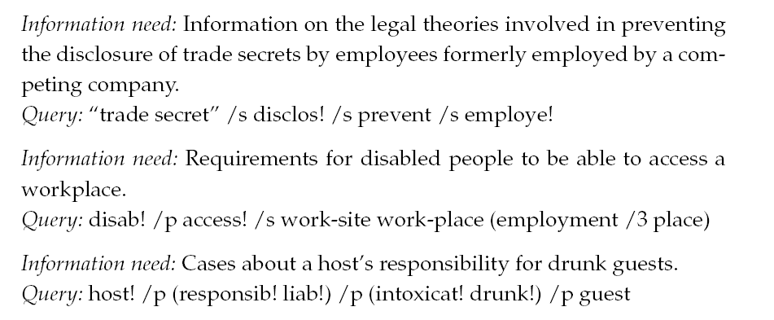
Boolean model is popular in legal search engines..
Notice long
Queries,
proximity ops
WestLaw
/s →same sentence /p →same para /k →within k words

Slide 37
Drawbacks of the Boolean Model
Retrieval based on binary decision criteria with no notion of partial matching
No ranking of the documents is provided (absence of a grading scale)
Information need has to be translated into a Boolean expression which most users find awkward
  The Boolean queries formulated by the users are most often too simplistic
    As a consequence, the Boolean model frequently returns either too few or too many documents in response to a user query
      Keyword (vector model) is not necessarily better—it just annoys the users somewhat less ☺

Slide 38
Boolean Search in Web Search Engines
Most web search engines do provide boolean operators in the query as part of advanced search features
However, if you don’t pick advanced search, your query is not viewed as a boolean query
  Makes sense because a “keyword query” can only be interpreted as a fully conjunctive or fully disjunctive one
  Both interpretations are typically wrong
    Conjunction is wrong because it won’t allow partial matches
    Disjunction is wrong because it makes the query too weak
..instead they typically use bag/vector semantics for the query (to be discussed)

Slide 39
Documents as bags of words
a: System and human system engineering testing of EPS
b: A survey of user opinion of computer system response time
c: The EPS user interface management system
d: Human machine interface for ABC computer applications
e: Relation of user perceived response time to error measurement
f: The generation of random, binary, ordered trees
g: The intersection graph of paths in trees
h: Graph minors IV: Widths of trees and well-quasi-ordering
i: Graph minors: A survey

Slide 40
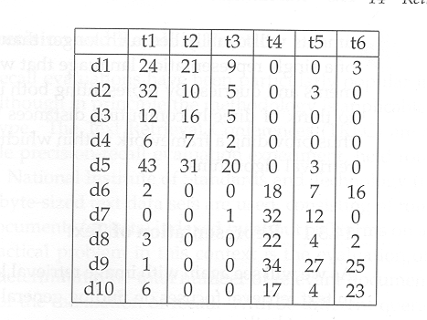
Documents as bags of keywords (another eg)
t1= database
t2=SQL
t3=index
t4=regression
t5=likelihood
t6=linear

Slide 41

Jaccard Similarity Metric
  Estimates the degree of overlap between sets (or bags)
  For bags, intersection and union are defined in terms of max & min
    If A has 5 oranges and 8 apples and B has 3 oranges and 12 apples
    A .intersection. B is 3 oranges and 8 apples
    A .union. B is 5 oranges and 12 apples
    Jaccard similarity is (3+8)/(5 +12)= 11/17
Can be used
with set semantics

Slide 42
Documents as bags of keywords (another eg)
t1= database
t2=SQL
t3=index
t4=regression
t5=likelihood
t6=linear
Similarity(d1,d2)
= (24+10+5)/32+21+9+3+3
=0.57
What about d1 and d1d1 (which is a twice concatenated version of d1)?
--need to normalize the bags (e.g. divide coeffs by bag size)
      --Also can better differentiate the ceffs (tf/idf metrics)

Slide 43
The Effect of Bag Size
If you have 2 bags. Bag1: 5 apples, 8 oranges
Bag2: 9 apples, 4 oranges
Jaccard: (5+4)/(9+8)=9/17
If you triple the size of bag1: 15 apples, 24 oranges
Jaccard: (9+4)/(15+24)= 13/29 –Similarity changed…
How do we stop this?
Normalize all bags to the same size..
Bag of 5 apples and 8 oranges could be normalized as
5/(5+8), 8/(5+8)
This way, doubling the bag size doesn’t change its representation..

Slide 44
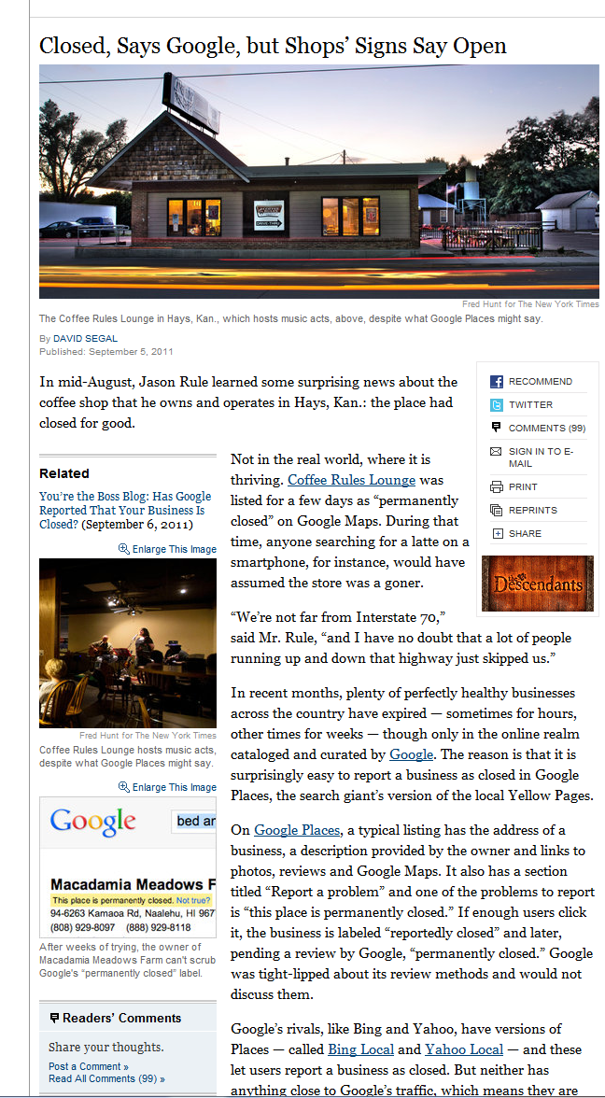
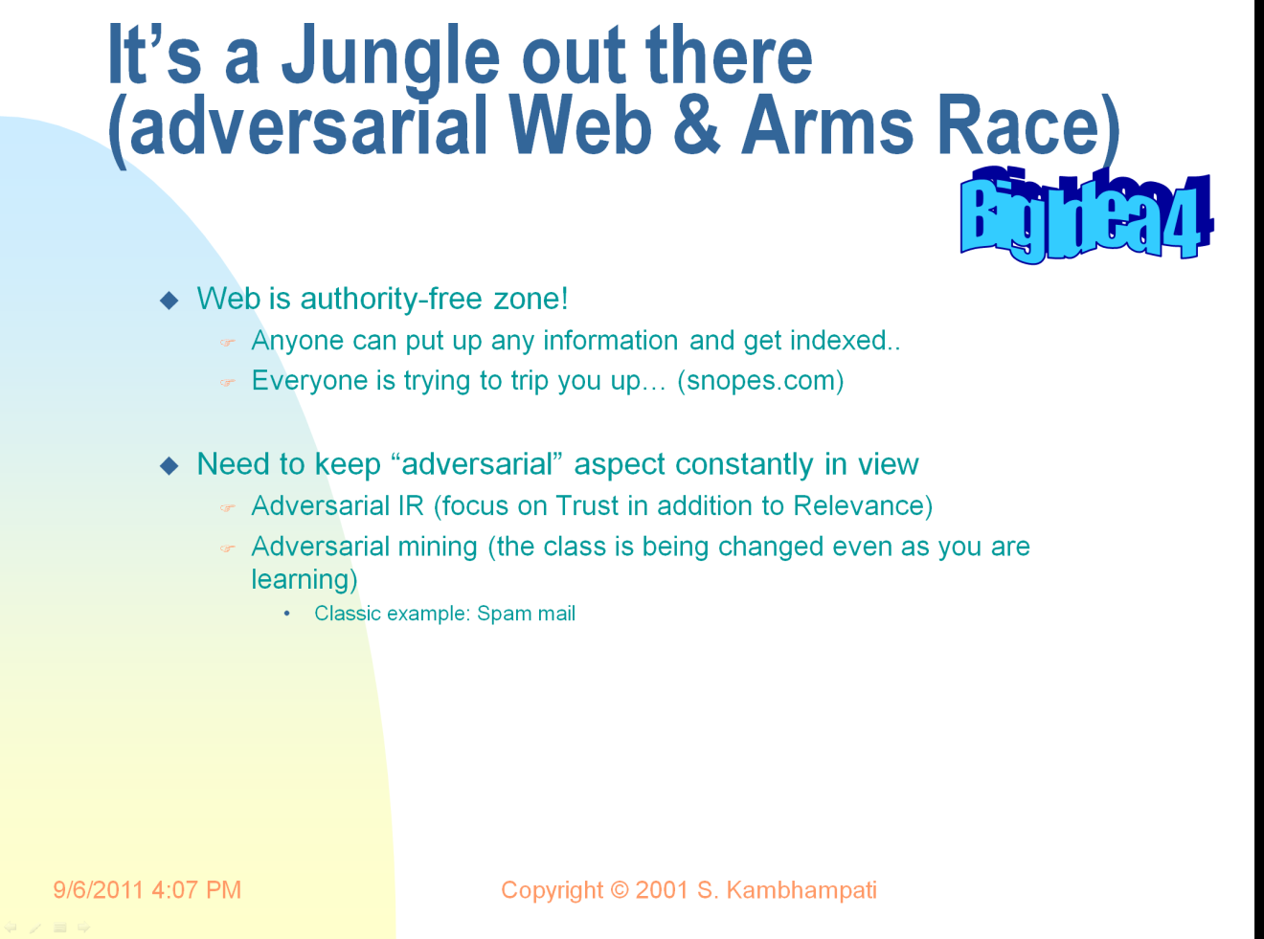
9/6

Slide 45
Marginal (Residual) Relevance
It is clear that the first document returned should be the one most similar to the query
How about the second…and top-10 documents?
  If we have near-duplicate documents, you would think the user wouldn’t want to see all copies!
  If there seem to be different clusters of documents that are all close to the query, it is best to hedge your bets by returning one document from each cluster (e.g. given a query “bush”, you may want to return one page on republican bush, one on Kalahari bushmen and one on rose bush etc..)
Insight: If you are returning top-K documents, they should simultaneously satisfy two constraints:
  They are as similar as possible to the query
  They are as dissimilar as possible from each other
Most search engines do care about this “result diversity”
  They don’t necessarily do it by directly solving the optimization problem. One idea is to take top-100 documents that are similar to they query and then cluster them. You can then give one representative document from each cluster
    Example: Vivisimo.com

Slide 46
The Vector Model
Use of binary weights is too limiting
  Non-binary weights provide consideration for partial matches
These term weights are used to compute a degree of similarity between a query and each document
Ranked set of documents provides for better matching

Slide 47
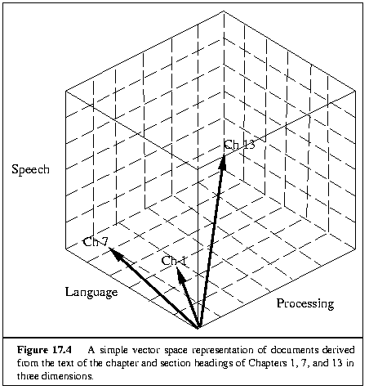
The Vector Model
Documents/Queries bags are seen as Vectors over keyword space
  vec(dj) = (w1j, w2j, ..., wtj) vec(q) = (w1q, w2q, ..., wtq)
      wiq >= 0 associated with the pair (ki,q)
        wij > 0 whenever ki ∈ dj
  To each term ki is associated a unitary vector vec(i)
    The unitary vectors vec(i) and vec(j) are assumed to be orthonormal (i.e., index terms are assumed to occur independently within the documents)
        Is this Reasonable??????
The t unitary vectors vec(i) form an orthonormal basis for a t-dimensional space
  Each vector holds a place for every term in the collection
  Therefore, most vectors are sparse

Slide 48
Vector Space Example
t1= database
t2=SQL
t3=index
t4=regression
t5=likelihood
t6=linear

Slide 49
Vector Space Example
a: System and human system engineering testing of EPS
b: A survey of user opinion of computer system response time
c: The EPS user interface management system
d: Human machine interface for ABC computer applications
e: Relation of user perceived response time to error measurement
f: The generation of random, binary, ordered trees
g: The intersection graph of paths in trees
h: Graph minors IV: Widths of trees and well-quasi-ordering
i: Graph minors: A survey

Slide 50
Similarity Function
The similarity or closeness of a document
    d = ( w₁, …, w_{i}, …, w_{n} )
with respect to a query (or another document)
    q = ( q₁, …, q_{i}, …, q_{n} )
is computed using a similarity (distance) function.
Many similarity functions exist
Eucledian distance, dot product, normalized dot product (cosine-theta)

Slide 51
Eucledian distance
Given two document vectors d1 and d2

Slide 52
Dot Product distance
sim(q, d) = dot(q, d) = q₁ ∗ w₁ + … + q_{n} ∗ w_{n}
Example: Suppose d = (0.2, 0, 0.3, 1) and
q = (0.75, 0.75, 0, 1), then
sim(q, d) = 0.15 + 0 + 0 + 1 = 1.15
Observations of the dot product function.
Documents having more terms in common with a query tend to have higher similarities with the query.
For terms that appear in both q and d, those with higher weights contribute more to sim(q, d) than those with lower weights.
It favors long documents over short documents.
The computed similarities have no clear upper bound.

Slide 53
A normalized similarity metric
j
dj
Θ
q
i
Sim(q,dj) = cos(Θ)
= [vec(dj) • vec(q)] / |dj| * |q|
= [Σ wij * wiq] / |dj| * |q|
Since wij > 0 and wiq > 0,
    0 <= sim(q,dj) <=1
A document is retrieved even if it matches the query terms only partially

Slide 54
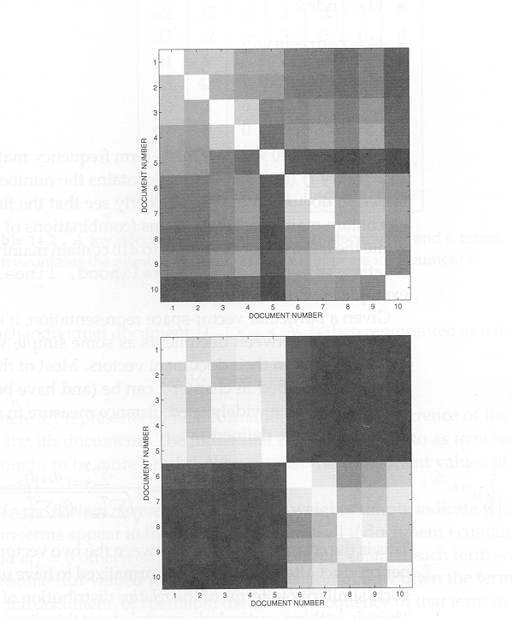
Whiter => more similar
Eucledian
t1= database
t2=SQL
t3=index
t4=regression
t5=likelihood
t6=linear
Cosine
Comparison of Eucledian
and Cosine distance metrics

Slide 55
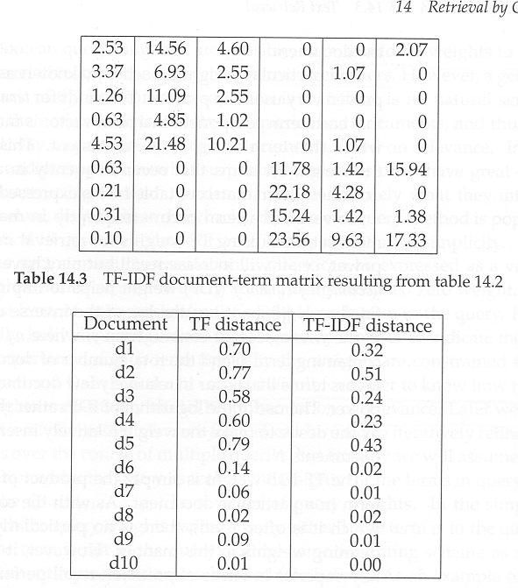
Answering Queries
Represent query as vector
Compute distances to all documents
Rank according to distance
Example
  “database index”
t1= database
t2=SQL
t3=index
t4=regression
t5=likelihood
t6=linear
Given Q={database, index}
= {1,0,1,0,0,0}

Slide 56
Term Weights in the Vector Model
Sim(q,dj) = [Σ wij * wiq] / |dj| * |q|
How to compute the weights wij and wiq ?
  Simple keyword frequencies tend to favor common words
    E.g. Query: The Computer Tomography
Ideally, a term weighting should solve “Feature Selection Problem” (viewing retrieval as a “classification of documents” into those relevant/irrelevant to the query)
  For now, we shall focus on a “one size fits all” solution.
A good weight must take into account two effects:
  quantification of intra-document contents (similarity)
    tf factor, the term frequency within a document
  quantification of inter-documents separation (dissi-milarity)
    idf factor, the inverse document frequency
  wij = tf(i,j) * idf(i)

Slide 57
Tf-IDF
Let,
  N be the total number of docs in the collection
  ni be the number of docs which contain ki
  freq(i,j) raw frequency of ki within dj
A normalized tf factor is given by
  f(i,j) = freq(i,j) / max(freq(i,j))
    where the maximum is computed over all terms which occur within the document dj
The idf factor is computed as
  idf(i) = log (N/ni)
    the log is used to make the values of tf and idf comparable. It can also be interpreted as the amount of information associated with the term ki.
Note that we
normalize the
vector again
after this..

Slide 58
Document/Query Representation using TF-IDF
The best term-weighting schemes use weights which are given by
  wij = f(i,j) * log(N/ni)
  the strategy is called a tf-idf weighting scheme
For the query term weights, several possibilities:
  wiq = (0.5 + 0.5 * [freq(i,q) / max(freq(i,q)]) * log(N/ni)
    Alternatively, just use the IDF weights (to give preference to rare words)
  Let the user give the weights to the keywords to reflect her *real* preferences
    Easier said than done... Users are often dunderheads..☹
      Help them with “relevance feedback” techniques.

Slide 59
t1= database
t2=SQL
t3=index
t4=regression
t5=likelihood
t6=linear
Note: In this case,
the weights used in
query were 1 for t1 and t3,
and 0 for the rest.
Given Q={database, index}
= {1,0,1,0,0,0}

Slide 60
The Vector Model:Summary
The vector model with tf-idf weights is a good ranking strategy with general collections
  The vector model is usually as good as the known ranking alternatives. It is also simple and fast to compute.
Advantages:
  term-weighting improves quality of the answer set
  partial matching allows retrieval of docs that approximate the query conditions
  cosine ranking formula sorts documents according to degree of similarity to the query
Disadvantages:
  assumes independence of index terms
  Does not handle synonymy/polysemy
  Query weighting may not reflect user relevance criteria.

Slide 61
Next: Indexing/Retrieval

Slide 62
The Vector Model:Summary
The vector model with tf-idf weights is a good ranking strategy with general collections
  The vector model is usually as good as the known ranking alternatives. It is also simple and fast to compute.
Advantages:
  term-weighting improves quality of the answer set
  partial matching allows retrieval of docs that approximate the query conditions
  cosine ranking formula sorts documents according to degree of similarity to the query
Disadvantages:
  assumes independence of index terms
  Does not handle synonymy/polysemy
  Query weighting may not reflect user relevance criteria.

Slide 63
So many ways things can go wrong…
Reasons that ideal effectiveness hard to achieve:
Document representation loses information.
Users’ inability to describe queries precisely.
Similarity function used not be good enough.
Importance/weight of a term in representing a document and query may be inaccurate
Same term may have multiple meanings and different terms may have similar meanings.
Query expansion
Relevance feedback
LSI
Co-occurrence analysis

Slide 64
Making the document representation less lossy..
Considering documents as bag of words is probably too coarse
  Hey—it is less coarse than thinking of them as bag of letters ☺
  One idea is to consider documents as strings..
    Strings of letters?
      But then you get stuck too closely with the low-level details/distinctions
    Strings of words?
      Less stuck with low-level details, but still too costly..
  A middle ground is to consider documents as bags of shingles
    A k-shingle is set of k contiguous words extracted by sliding a k-size window over the document.
  ..a cheaper version of this idea is do “adaptive” detection of frequently appearing shingles
    E.g. Noun-phrase detection (computer-science will be considered a new word distinct from “computer” and “science”)

Slide 65
Digression:Plagiarism detection using similarity metrcs
Will bag similarity be sufficient for plagiarism detection..?
  No. Students will be accused of plagiarism just because they have similar (impoverished) vocabulary as the other students
How about string similarity/identicality
  No. Teachers will miss plagiarised essays just because a couple of padding sentences are thrown in…
A middle ground:
  Similarity over bag of shingles..
    A k-shingle is set of k contiguous words extracted by sliding a k-size window over the document.
      A plagiarized document may have many of the shingles of the original document but re-arranged
      See http://www-db.stanford.edu/~shiva/Pubs/DlMag/dlmag.html
    Too costly for normal retrieval since there are many more shingles than there are words!
Second order Digression:
This whole discussion
Can also be done in
Terms of strings (rather
Than documents)
--In the context of strings,
shingles are called
“grams”. So a q-gram
is a contiguous sequence
of q letters from a string
--Relevant for looking at similar
strings (potentially misspelled)
→also relevant for comparing
genes… (since genes
are but enormous
strings over a small
set of letters)

Slide 66
Drunk searching for his keys…
What we hope to get by:
  Similarity between doc D and query Q (to heck with the user and her relevance)
  Document D’ that is most similar to Q while being most distant from docs {d1…dk} already shown
What we really want:
  Relevance of doc D to user U, given query Q
  Marginal/residual relevance of doc D’ to user U given query Q, and the fact that U has already seen docs {d1…dk}

Slide 67
Some improvements
Query expansion techniques (for 1)
  relevance feedback
  co-occurrence analysis (local and global thesauri)
Improving the quality of terms [(2), (3) and (5).]
  Latent Semantic Indexing
  Phrase-detection

Slide 68
Relevance Feedback
Main Idea:
  Modify existing query based on relevance judgements
    Extract terms from relevant documents and add them to the query
    and/or re-weight the terms already in the query
  Two main approaches:
    Users select relevant documents
      Directly or indirectly (by pawing/clicking/staring etc)
    Automatic (psuedo-relevance feedback)
      Assume that the top-k documents are the most relevant documents..
  Users/system select terms from an automatically-generated list
Digression: Do the users really know relevance?

Slide 69
Relevance Feedback
Usually do both:
  expand query with new terms
  re-weight terms in query
There are many variations
  usually positive weights for terms from relevant docs
  sometimes negative weights for terms from non-relevant docs
  Remove terms ONLY in non-relevant documents

Slide 70
Relevance Feedback for Vector Model
In the “ideal” case where we know the relevant
Documents a priori
Cr = Set of documents that are truly relevant to Q
N = Total number of documents

Slide 71
Rocchio Method
Qo is initial query. Q₁ is the query after one iteration
Dr are the set of relevant docs
Dn are the set of irrelevant docs
Alpha =1; Beta=.75, Gamma=.25 typically.
Other variations possible,
but performance similar

Slide 72
Rocchio/Vector Illustration
Information
1.0
Q₀ = retrieval of information = (0.7,0.3)
D₁ = information science = (0.2,0.8)
D₂ = retrieval systems = (0.9,0.1)
Q’ = ½*Q₀+ ½ * D₁ = (0.45,0.55)
Q” = ½*Q₀+ ½ * D₂ = (0.80,0.20)
D₁
Q’
0.5
Q₀
Q”
D₂
0
0.5
1.0
Retrieval

Slide 73
Example Rocchio Calculation
Relevant
docs
Non-rel doc
Original Query
Constants
Rocchio Calculation
Resulting feedback query

Slide 74
Rocchio Method
Rocchio automatically
  re-weights terms
  adds in new terms (from relevant docs)
    have to be careful when using negative terms
    Rocchio is not a machine learning algorithm
Most methods perform similarly
  results heavily dependent on test collection
Machine learning methods are proving to work better than standard IR approaches like Rocchio

Slide 75
Using Relevance Feedback
Known to improve results
  in TREC-like conditions (no user involved)
What about with a user in the loop?
  How might you measure this?
    Precision/Recall figures for the unseen documents need to be computed

Slide 76
Classic IR Models - Basic Concepts
Each document represented by a set of representative keywords or index terms
  Query is seen as a “mini”document
An index term is a document word useful for remembering the document main themes
  Usually, index terms are nouns because nouns have meaning by themselves
    [However, search engines assume that all words are index terms (full text representation)]

Slide 77
The Retrieval Process
User
Interface
Text
user need
4, 10
Text
Text Operations (stemming, noun phrase detection etc..)
6, 7
logical view
logical view
Query
Operations
(elaboration,
relevance feedback
DB Manager
Module
Indexing
user feedback
5
8
query
inverted file
Searching
(hash tables etc.)
Index
8
retrieved docs
Text
Database
Ranking
(vector models ..)
ranked docs
2

Slide 78
A quick glimpse at inverted files
Dictionary Postings

Slide 79
Generating keywords (index terms) in traditional IR
Accents
spacing
Noun
groups
Manual
indexing
Docs
stopwords
stemming
structure
structure
Full text
Index terms
Stop-word elimination
Noun phrase detection
  “data structure” “computer architecture”
Stemming (Porter Stemmer for English)
  If suffix of a word is “IZATION” and prefix contains at least one vowel followed by a consonant, then replace suffix with “IZE” (e.g. Binarization→Binarize)
Generating index terms
Improving quality of terms.
        (e.g. Synonyms, co-occurence
        detection, latent semantic indexing..

Slide 80
Example of Stemming and Stopword Elimination
The number of Web pages on the World Wide Web was
estimated to be over 800 million in 1999.
Stop word elimination
Stemming
  So does Google use stemming?
    All kinds of stemming?
  Stopword elimination?
    Any non-obvious stop-words?

Slide 81
Why don’t search engines do much text-ops?
User population is too large and is easily impressed with reasonably relevant answers
  We are not talking of medical doctors looking for the most relevant paper describing the cure for the symptoms of their patient
  A search engine can do well even if all the doctors give it low marks ☺
    Corollary: All of these text-ops may well be relevant for “Vertical” (topic-specific) search engines
Some of the text-ops were put in place as a way of dealing with the computational limitations
  E.g. indexing in terms of only few keywords
  These are not as relevant in the era of current day computers…

