Slide 1


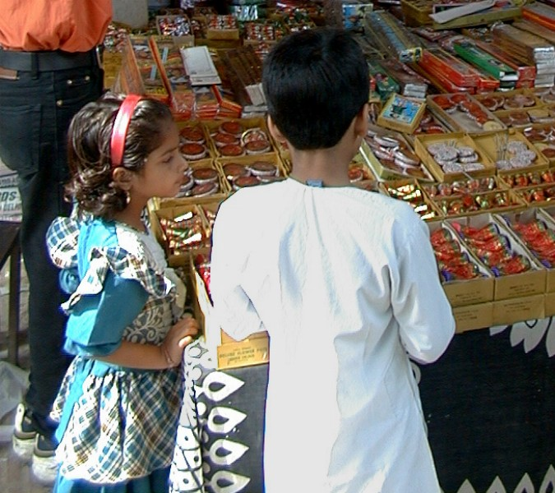

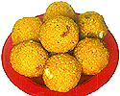

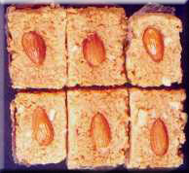
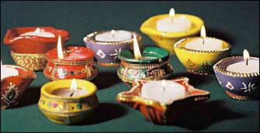

Happy
Deepavali!
10/25
4th Nov, 2002.

Slide 2
Text Classification

Slide 3
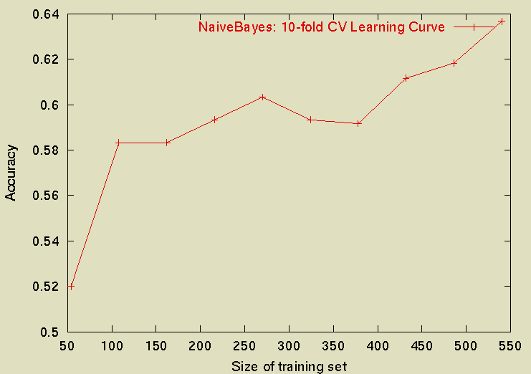
Classification Learning (aka supervised learning)
Given labelled examples of a concept (called training examples)
Learn to predict the class label of new (unseen) examples
  E.g. Given examples of fradulent and non-fradulent credit card transactions, learn to predict whether or not a new transaction is fradulent
How does it differ from Clustering?
Evaluating Classification
techniques:
Accuracy on test data
(for various sizes of
training data)
(if you want to separate
omission/commission errors
use precision/recall or F-measure)

Slide 4
Many uses of Text Classification
Text classification is the task of classifying text documents to multiple classes
  Is this mail spam?
  Is this article from comp.ai or misc.piano?
  Is this article likely to be relevant to user X?
  Is this page likely to lead me to pages relevant to my topic? (as in topic-specific crawling)
  Is this book possibly of interest to the user?

Slide 5
Classification vs. Clustering
Coming from Clustering, classification seems significantly simple…
You are already given the clusters and names (over the training data)
All you need to do is to decide, for the test data, which cluster it should belong to.
Seems like a simple distance computation
  Assign test data to the cluster whose centroid it is closest to
    Rocchio text classification
    Can also be used for “online learning”—relevance feedback
  Assign test data to the cluster whose members seem to make the majority of its neighbors

Slide 6
Rochchio Categorization
Represent each document as a vector (using tf-idf weighting)
Training: For each class C, compute the centroid of the class
Classification: Given a new vector D, classify it into the class whose centroid it is closest to

Slide 7
Rocchio for Relevance Feedback
Given a set of relevant and irrelevant documents,
rather than classify a given document as relevant/irrelevant,
we want to retrieve more relevant documents
Main Idea:
  Modify existing query based on relevance judgements
    Extract terms from relevant documents and add them to the query
    and/or re-weight the terms already in the query
  Two main approaches:
    Users select relevant documents
      Directly or indirectly (by pawing/clicking/staring etc)
    Automatic (psuedo-relevance feedback)
      Assume that the top-k documents are the most relevant documents..
  Users/system select terms from an automatically-generated list

Slide 8
Relevance Feedback
Usually do both:
  expand query with new terms
  re-weight terms in query
There are many variations
  usually positive weights for terms from relevant docs
  sometimes negative weights for terms from non-relevant docs
  Remove terms ONLY in non-relevant documents

Slide 9
Using Relevance Feedback (Rocchio)
Relevance feedback methods can be adapted for text categorization.
Use standard TF/IDF weighted vectors to represent text documents (normalized by maximum term frequency).
For each category, compute a prototype vector by summing the vectors of the training documents in the category.
Assign test documents to the category with the closest prototype vector based on cosine similarity.

Slide 10
Relevance Feedback for Vector Model
In the “ideal” case where we know the relevant
Documents a priori
Cr = Set of documents that are truly relevant to Q
N = Total number of documents

Slide 11
Rocchio Method
Qo is initial query. Q₁ is the query after one iteration
Dr are the set of relevant docs
Dn are the set of irrelevant docs
Alpha =1; Beta=.75, Gamma=.25 typically.
Other variations possible,
but performance similar
How do beta and gamma affect precision and recall?

Slide 12
Rocchio/Vector Illustration
Information
1.0
Q₀ = retrieval of information = (0.7,0.3)
D₁ = information science = (0.2,0.8)
D₂ = retrieval systems = (0.9,0.1)
Q’ = ½*Q₀+ ½ * D₁ = (0.45,0.55)
Q” = ½*Q₀+ ½ * D₂ = (0.80,0.20)
D₁
Q’
0.5
Q₀
Q”
D₂
0
0.5
1.0
Retrieval

Slide 13
Example Rocchio Calculation
Relevant
docs
Non-rel doc
Original Query
Constants
Rocchio Calculation
Resulting feedback query

Slide 14
Rocchio Method
Rocchio automatically
  re-weights terms
  adds in new terms (from relevant docs)
    have to be careful when using negative terms
    Rocchio is not a machine learning algorithm
Most methods perform similarly
  results heavily dependent on test collection
Machine learning methods are proving to work better than standard IR approaches like Rocchio

Slide 15
Using Relevance Feedback
Known to improve results
  in TREC-like conditions (no user involved)
What about with a user in the loop?
  How might you measure this?
    Precision/Recall figures for the unseen documents need to be computed

Slide 16
K Nearest Neighbor for Text
Training:
For each each training example <x, c(x)> ∈ D
Compute the corresponding TF-IDF vector, d_{x}, for document x
Test instance y:
Compute TF-IDF vector d for document y
For each <x, c(x)> ∈ D
Let s_{x} = cosSim(d, d_{x})
Sort examples, x, in D by decreasing value of s_{x}
Let N be the first k examples in D. (get most similar neighbors)
Return the majority class of examples in N
Find k nearest neighbors is just retrieving k closest docs!

Slide 17
Why aren’t the “clustering” based methods enough?
The class labels may be describing “non-spherical” (non-isotropic) clusters
  The coastal cities class of USA
The class labels may be effectively combining non-overlapping clusters into a single class
  Hawaii & Alaska are in USA class?
These problems exist in clustering too—but since it is posed as an unsupervised problem, any clustering with good internal quality is seen as okay.
  In the case of classification, we are forced to find the clustering that actually agrees with class labels
    (if the teacher doesn’t know the answer for a test question, all they can see is whether you wrote cleanly and argued persuasively… similarly, in the case of clustering, since no external validation exists in general, you can only hope to see how “tight” the clusters are)

Slide 18
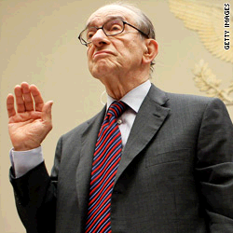
Alan Greenspan: 'I was right
70 percent of the time'

Slide 19
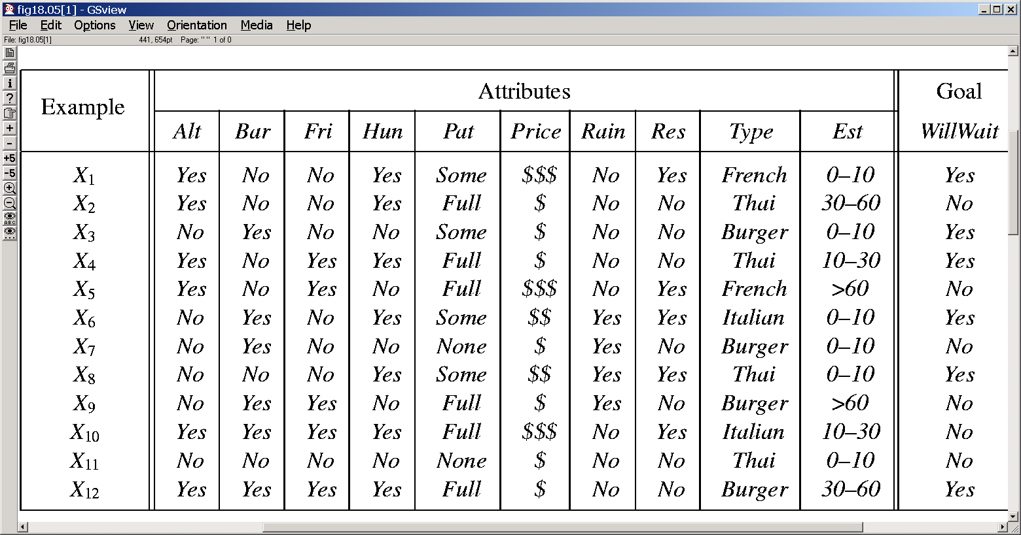
A classification learning example
Predicting when Rusell will wait for a table
--similar to book preferences, predicting credit card fraud,
predicting when people are likely to respond to junk mail

Slide 20
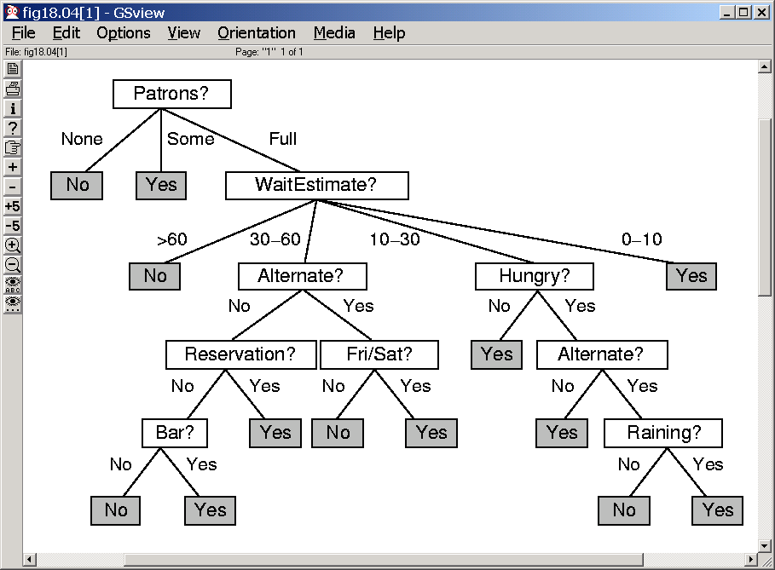
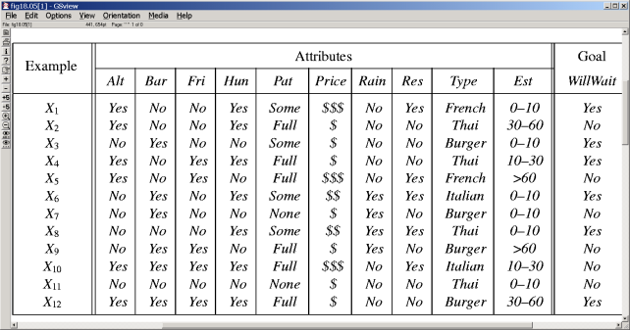
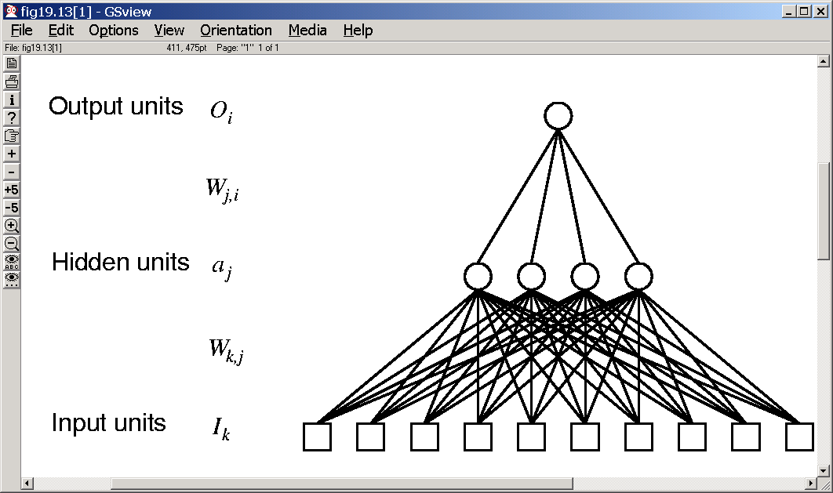
Uses different biases in predicting Russel’s waiting habbits
Decision Trees
--Examples are used to
--Learn topology
--Order of questions
K-nearest
neighbors
If patrons=full and day=Friday
then wait (0.3/0.7)
If wait>60 and Reservation=no
then wait (0.4/0.9)
Association rules
--Examples are used to
--Learn support and
confidence of association
rules
SVMs
Neural Nets
--Examples are used to
--Learn topology
--Learn edge weights
Naïve bayes
(bayesnet learning)
--Examples are used to
--Learn topology
--Learn CPTs

Slide 21
Parametric vs. Non-Parametric
Learners
K-NN is an example of non-parametric method.
  The size of the “learned structure” is proportional to the size of training set
More traditional learners are “parametric”
  They summarize the training set with a fixed set of parameters
    E.g. Linear classifiers

Slide 22
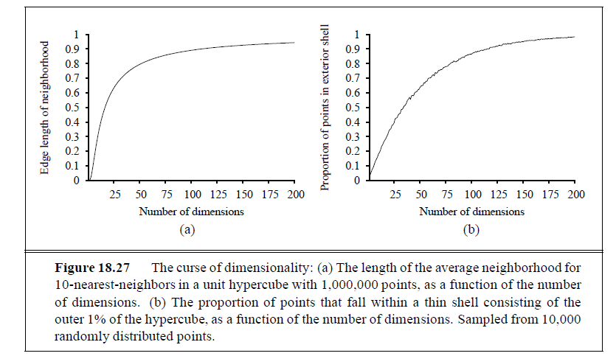
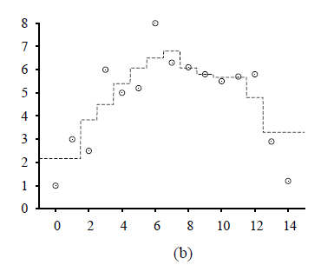
Nearest Neighbors and High-Dimensions..
Nearest neighbors in high-dimensions are not very near
  Remember the n-dimensional apple—it is all peel and no core.
  So, if you consider an n-D sphere centered on a data point, all its neighbors are going to be at the shell!
    K-NN doesn’t do well in high-dimensions

Slide 23
Mirror, Mirror, on the wall
Which learning bias is the best of all?
Well, there is no such thing, silly!
--Each bias makes it easier to learn some patterns and harder (or impossible) to learn others:
-A line-fitter can fit the best line to the data very fast but won’t know what to do if the data doesn’t fall on a line
--A curve fitter can fit lines as well as curves… but takes longer time to fit lines than a line fitter.
-- Different types of bias classes (Decision trees, NNs etc) provide different ways of naturally carving up the space of all possible hypotheses
So a more reasonable question is:
-- What is the bias class that has a specialization corresponding to the type of patterns that underlie my data?
-- In this bias class, what is the most restrictive bias that still can capture the true pattern in the data?
--Decision trees can capture all boolean functions
--but are faster at capturing conjunctive boolean functions
--Neural nets can capture all boolean or real-valued functions
--but are faster at capturing linearly seperable functions
--Bayesian learning can capture all probabilistic dependencies
But are faster at capturing single level dependencies (naïve bayes classifier)

Slide 24
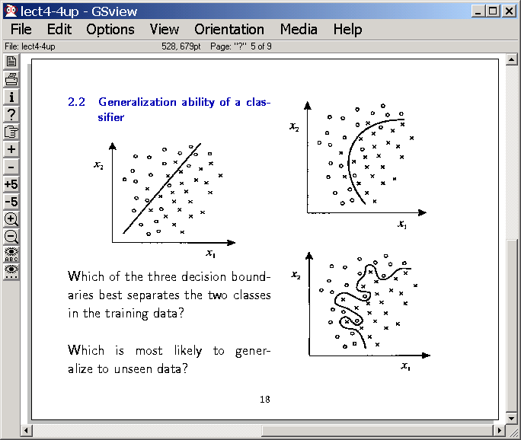
Fitting test cases vs. predicting future cases
The BIG TENSION….
2
1
Why Simple is Better?
3
Why not the 3rd?

Slide 25
To add..
K-nn and over-fitting.. Squiggly boundaries
The example of NBC with unlabeled examples.

Slide 26
Text Categorization
Representations of text are very high dimensional (one feature for each word).
  High-bias algorithms that prevent overfitting in high-dimensional space are best.
For most text categorization tasks, there are many irrelevant and many relevant features.
  Methods that sum evidence from many or all features (e.g. naïve Bayes, KNN, neural-net) tend to work better than ones that try to isolate just a few relevant features (decision-tree or rule induction).

Slide 27

Uses different biases in predicting Russel’s waiting habbits
Decision Trees
--Examples are used to
--Learn topology
--Order of questions
K-nearest
neighbors
If patrons=full and day=Friday
then wait (0.3/0.7)
If wait>60 and Reservation=no
then wait (0.4/0.9)
Association rules
--Examples are used to
--Learn support and
confidence of association
rules
SVMs
Neural Nets
--Examples are used to
--Learn topology
--Learn edge weights
Naïve bayes
(bayesnet learning)
--Examples are used to
--Learn topology
--Learn CPTs

Slide 28
Naïve Bayesian Classification
Problem: Classify a given example E into one of the classes among [C₁, C₂ ,…, C_{n}]
  E has k attributes A₁, A₂ ,…, A_{k} and each A_{i} can take d different values
Bayes Classification: Assign E to class C_{i} that maximizes P(C_{i} | E)
  P(C_{i}| E) = P(E| C_{i}) P(C_{i}) / P(E)
    P(C_{i}) and P(E) are a priori knowledge (or can be easily extracted from the set of data)
Estimating P(E|C_{i}) is harder
  Requires P(A₁=v₁ A₂=v₂….A_{k}=v_{k}|C_{i})
    Assuming d values per attribute, we will need nd^{k} probabilities
Naïve Bayes Assumption: Assume all attributes are independent P(E| C_{i}) = Π P(A_{i}=v_{j} | C_{i} )
  The assumption is BOGUS, but it seems to WORK (and needs only n*d*k probabilities

Slide 29
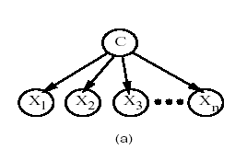
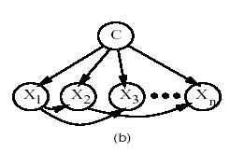
NBC in terms of BAYES networks..
NBC assumption
More realistic assumption

Slide 30
Estimating the probabilities for NBC
Given an example E described as A₁=v₁ A₂=v₂….A_{k}=v_{k} we want to compute the class of E
  Calculate P(C_{i} | A₁=v₁ A₂=v₂….A_{k}=v_{k}) for all classes C_{i} and say that the class of E is the one for which P(.) is maximum
  P(C_{i} | A₁=v₁ A₂=v₂….A_{k}=v_{k})
  = Π P(v_{j} | C_{i} ) P(C_{i}) / P(A₁=v₁ A₂=v₂….A_{k}=v_{k})
Given a set of training N examples that have already been classified into n classes C_{i}
Let #(C_{i}) be the number of examples that are labeled as C_{i}
Let #(C_{i}, A_{i}=v_{i}) be the number of examples labeled as C_{i}
that have attribute A_{i} set to value v_{j}
P(C_{i}) = #(C_{i})/N
P(A_{i}=v_{j} | C_{i}) = #(C_{i}, A_{i}=v_{i}) / #(C_{i})
Common factor
USER PROFILE

Slide 31
Example
P(willwait=yes) = 6/12 = .5
P(Patrons=“full”|willwait=yes) = 2/6=0.333
P(Patrons=“some”|willwait=yes)= 4/6=0.666
Similarly we can show that
P(Patrons=“full”|willwait=no)
=0.6666
P(willwait=yes|Patrons=full) = P(patrons=full|willwait=yes) * P(willwait=yes)
-----------------------------------------------------------
P(Patrons=full)
= k* .333*.5
P(willwait=no|Patrons=full) = k* 0.666*.5

Slide 32
The Many Splendors of Bias
Digression
The Space of
Hypotheses
Training Examples
(labelled)
“Bias” filter
Pick the best hypothesis
that fits the examples
Bias is any knowledge other than the
training examples that is used to
restrict the space of hypotheses considered
Can be domain independent or
domain-specific
Use the hypothesis to
predict new instances

Slide 33
Biases
Digression
Domain-indepdendent bias
  Syntactic bias
    Look for “lines”
    Look for naïve bayes nets
    “Whole object” bias
      Gavagai problem
  Preference bias
    Look for “small” decision trees
Domain-specific bias
  ALL domain knowledge is bias!
    Background theories & Explanations
      The relevant features of the data point are those that take part in explaining why the data point has that label
    Weak domain theories/Determinations
      Nationality determines language
      Color of the skin determines degree of sunburn
    Relevant features
      I know that certain phrases are relevant for spam/non-spam classification

Slide 34
Bias & Learning cost
Digression
Strong Bias ➔ smaller filtered hypothesis space
  Lower learning cost! (because you need fewer examples to rank the hypotheses!)
    Suppose I have decided that hair length determines pass/fail grade in the class, then I can “learn” the concept with a _single_ example!
  Cuts down the concepts you can learn accurately
Strong Bias➔ fewer parameters for describing the hypthesis
  Lower learning cost!!

Slide 35
Tastes Great/Less Filling
Digression
Biases are essential for survival of an agent!
  You must need biases to just make learning tractable
    “Whole object bias” used by kids in language acquisition
Biases put blinders on the learner—filtering away (possibly more accurate) hypotheses
  “God doesn’t play dice with the universe” (Einstein)
  “Color of Skin relevant to predicting crime” (Billy Bennett—Former Education Secretary)

Slide 36
Domain-knowledge & Learning
Those who ignore easily available domain knowledge are
doomed to re-learn it…
Santayana’s brother
Digression
Classification learning is a problem addressed by both people from AI (machine learning) and Statistics
Statistics folks tend to “distrust” domain-specific bias.
  Let the data speak for itself…
  ..but this is often futile. The very act of “describing” the data points introduces bias (in terms of the features you decided to use to describe them..)
…but much human learning occurs because of strong domain-specific bias..
Machine learning is torn by these competing influences..
  In most current state of the art algorithms, domain knowledge is allowed to influence learning only through relatively narrow avenues/formats (E.g. through “kernels”)
    Okay in domains where there is very little (if any) prior knowledge (e.g. what part of proteins are doing what cellular function)
    ..restrictive in domains where there already exists human expertise..

Slide 37
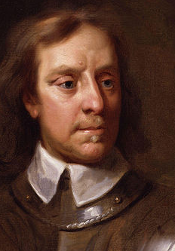
Need for Smoothing..
I beseech you, in the bowels of Christ, think it possible you may be mistaken.
--Cromwell to synod of the Church of Scotland; 1650
(aka Cromwell's Rule)
Suppose I toss a coin twice, and it comes up heads both times
  What is the empirical probability of Rao’s coin coming tails?
Suppose I continue to toss the coin another 3000 times, and it comes heads all these times
  What is the empirical probability of Rao’s coin coming tails?
What is happening?
→ We have a “prior”
on the coin tosses
We slowly modify that prior
in light of evidence
How do we get NBC
to do it?

Slide 38
Using M-estimates to improve probablity estimates
Zero is
FOREVER
The simple frequency based estimation of P(A_{i}=v_{j}|C_{k}) can be inaccurate, especially when the true value is close to zero, and the number of training examples is small (so the probability that your examples don’t contain rare cases is quite high)
Solution: Use M-estimate
P(A_{i}=v_{j} | C_{i}) = [#(C_{i}, A_{i}=v_{i}) + mp ] / [#(C_{i}) + m]
  p is the prior probability of A_{i} taking the value v_{i}
    If we don’t have any background information, assume uniform probability (that is 1/d if A_{i} can take d values)
  m is a constant—called “equivalent sample size”
    If we believe that our sample set is large enough, we can keep m small. Otherwise, keep it large.
    Essentially we are augmenting the #(C_{i}) normal samples with m more virtual samples drawn according to the prior probability on how A_{i} takes values
      Popular values p=1/|V| and m=|V| where V is the size of the vocabulary
Also, to avoid overflow errors do addition of logarithms of probabilities
(instead of multiplication of probabilities)

Slide 39
Applying NBC for Text Classification
Text classification is the task of classifying text documents to multiple classes
  Is this mail spam?
  Is this article from comp.ai or misc.piano?
  Is this article likely to be relevant to user X?
  Is this page likely to lead me to pages relevant to my topic? (as in topic-specific crawling)
NBC has been applied a lot to text classification tasks.
The big question: How to represent text documents as feature vectors?
  Vector space variants (e.g. a binary version of the vector space rep)
    Used by Sahami et.al. in SPAM filtering
    A problem is that the vectors are likely to be as large as the size of the vocabulary
      Use “feature selection” techniques to select only a subset of words as features (see Sahami et al paper)
  Unigram model [Mitchell paper]
    Used by Joachims for newspaper article categorization
    Document as a vector of positions with values being the words

Slide 40
NBC with Unigram Model
Assume that words from a fixed vocabulary V appear in the document D at different positions (assume D has L words)
    P(D|C) is P(p1=w1,p2=w2…pL=wl | C)
      Assume that words appearance probabilities are independent of each other
    P(D|C) is P(p1=w1|C)*P(p2=w2|C) …*P(pL=wl | C) ←Unigram assumption
      Assume that word occurrence probability is INDEPENDENT of its position in the document
      P(p1=w1|C)=P(p2=w1|C)=…P(pL=w1|C)
    Use m-estimates; set p to 1/V and m to V (where V is the size of the vocabulary)
    P(w_{k}|C_{i}) = [#(wk,Ci) + 1]/#w(Ci) + V
      #(wk,Ci) is the number of times wk appears in the documents classified into class Ci
      #w(Ci) is the total number of words in all documents of class C_{i}
Used to classify usenet articles from 20 different groups
--achieved an accuracy of 89%!! (random guessing will get you 5%)s

Slide 41
Multinomial vs. Bernouli Model
The model we discussed is “multi-nomial” model. You consider the total number of occurrences of the word
In contrast, Bernouli model looks at the binary presence of a word in a document (and ignores how many times it is present in the document)

Slide 42
11/1

Slide 43
Text Naïve Bayes Algorithm
(Train)
Let V be the vocabulary of all words in the documents in D
For each category c_{i} ∈ C
Let D_{i} be the subset of documents in D in category c_{i}
P(c_{i}) = |D_{i}| / |D|
Let T_{i} be the concatenation of all the documents in D_{i}
Let n_{i} be the total number of word occurrences in T_{i}
For each word w_{j} ∈ V
Let n_{ij} be the number of occurrences of w_{j} in T_{i}
Let P(w_{j} | c_{i}) = (n_{ij} + 1) / (n_{i} + |V|)

Slide 44
Text Naïve Bayes Algorithm
(Test)
Given a test document X
Let n be the number of word occurrences in X
Return the category:
where a_{i} is the word occurring the ith position in X

Slide 45
Feature Selection
A problem -- too many features -- each vector x
contains “several thousand” features.
  Most come from “word” features -- include a word if any e-mail contains it (eg, every x contains an “opossum” feature even though this word occurs in only one message).
  Slows down learning and predictoins
  May cause lower performance
    The Naïve Bayes Classifier makes a huge assumption -- the “independence” assumption.
    A good strategy is to have few features, to minimize the chance that the assumption is violated.
    Ideally, discard all features that violate the assumption. (But if we knew these features, we wouldn’t need to make the naive independence assumption!)
Feature selection: “a few thousand”  500 features

Slide 46

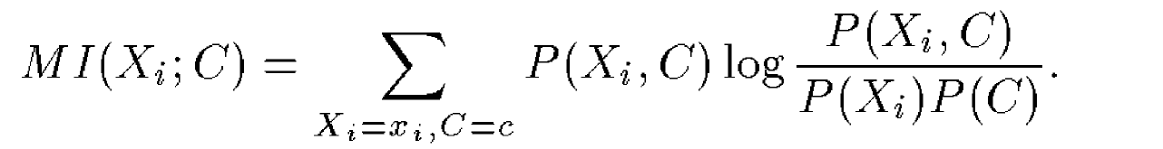
Feature-Selection approach
Lots of ways to perform feature selection
  FEATURE SELECTION ~ DIMENSIONALITY REDUCTION
One simple strategy: mutual information (equivalent to “information gain” heuristic)
If I tell you that feature f is present in the data, how much information have I given you about the class of the data?
Mutual information is low (zero) if the distribution of the feature and class over the data are independent..
Note that MI can be calculated from the training data..
Extensions include handling features that are redundant w.r.t. each other (i.e., MI(f1,f2) and MI(f2,f1) are 1 )

Slide 47
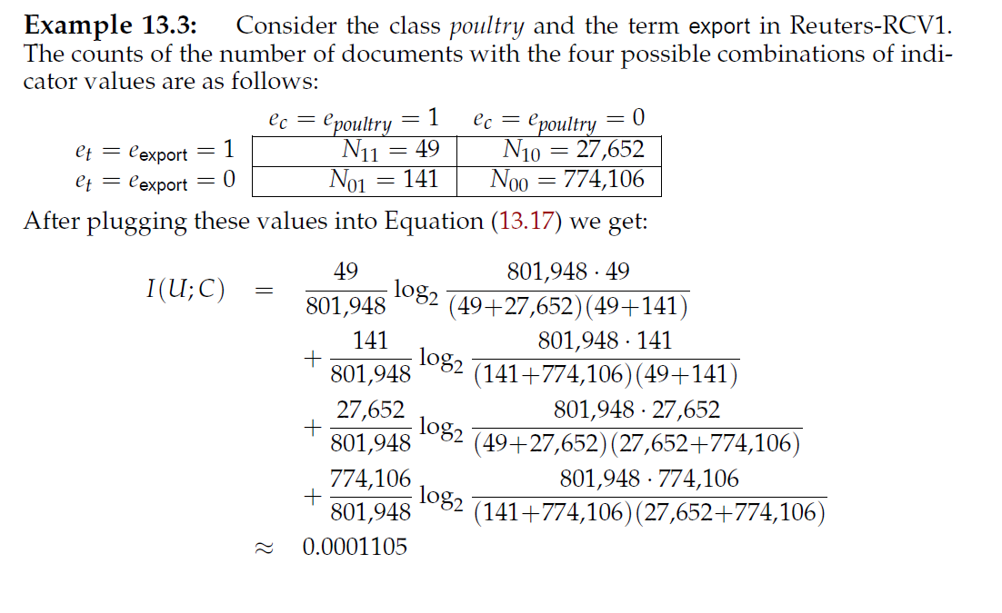
Example of Mutual Information
Note: 801,948 is in the
denominator of all
probabilities, and so
one instance of it comes
up to the numerator
Accuracy can be improved further by taking inter-feature dependencies

Slide 48
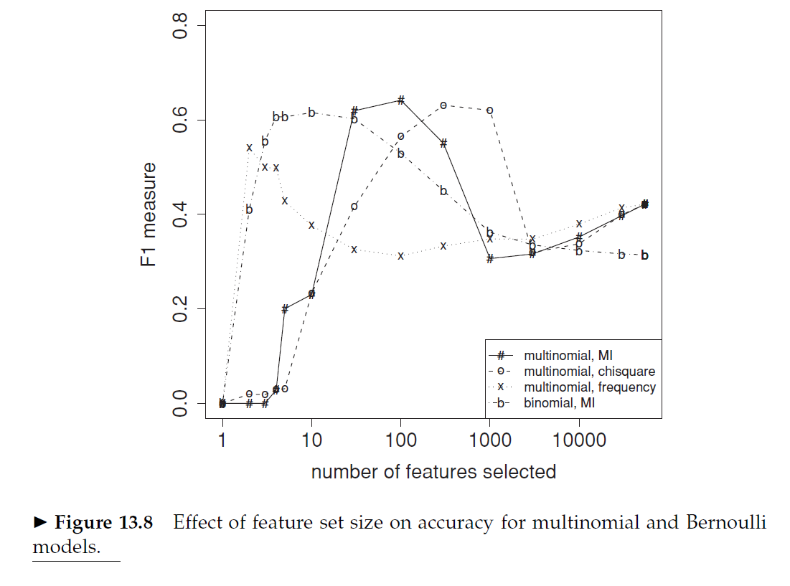
NBC with feature selection is better
F-measure (w.r.t. a class C)
= harmonic mean
of precision, recall
Precision=fraction of
classifications w.r.t C that
are correct
Recall = fraction of real instances
of C that were identified

Slide 49
The Information Gain
Computation
# expected comparisons
needed to tell whether a
given example is +ve or -ve
P₊ : N₊ /(N₊+N₋)
P₋ : N₋ /(N₊+N₋)
I(P_{+ ,}, P₋) = -P₊ log(P₊) - P₋ log(P₋ )
N+
N-
Splitting on
feature f_{k}
The difference
is the information
gain
So, pick the feature
with the largest Info Gain
I.e. smallest residual info
N₁+
N₁-
N₂+
N₂-
N_{k}+
N_{k}-
I(P1_{+ ,}, P1₋)
I(P2_{+ ,}, P2₋)
I(Pk_{+ ,}, Pk₋)
k
Given k mutually exclusive and exhaustive
events E₁….E_{k} whose probabilities are
p₁….p_{k}
The “information” content (entropy) is defined as
Σ _{i} -p_{i} log₂ p_{i}
A split is good if it reduces the entropy..
Σ
[N_{i+} + N_{i-} ]/[N₊ + N₋] I(Pi_{+ ,}, Pi₋)
i=1

Slide 50

Feature selection & LSI
Both MI and LSI are dimensionality reduction techniques
MI is looking to reduce dimensions by looking at a subset of the original dimensions
  LSI looks instead at a linear combination of the subset of the original dimensions (Good: Can automatically capture sets of dimensions that are more predictive. Bad: the new features may not have any significance to the user)
MI does feature selection w.r.t. a classification task (MI is being computed between a feature and a class)
  LSI does dimensionality reduction independent of the classes (just looks at data variance)
  ..where as MI needs to increase variance across classes and reduce variance within class
    Doing this is called LDA (linear discriminant analysis)
    LSI is a special case of LDA where each point defines its own class
Digression

Slide 51
MI based feature selection vs. LSI
Both MI and LSI are dimensionality reduction techniques
MI is looking to reduce dimensions by looking at a subset of the original dimensions
  LSI looks instead at a linear combination of the subset of the original dimensions (Good: Can automatically capture sets of dimensions that are more predictive. Bad: the new features may not have any significance to the user)
MI does feature selection w.r.t. a classification task (MI is being computed between a feature and a class)
  LSI does dimensionality reduction independent of the classes (just looks at data variance)

Slide 52
Experiments
1789 hand-tagged e-mail messages
  1578 junk
  211 legit
Split into…
  1528 training messages (86%)
  251 testing messages (14%)
  Similar to experiment described in AdEater lecture, except messages are not randomly split. This is unfortunate -- maybe performance is just a fluke.
Training phase: Compute Pr[X=x|C=junk], Pr[X=x], and P[C=junk] from training messages
Testing phase: Compute Pr[C=junk|X=x] for each training message x. Predict “junk” if Pr[C=junk|X=x]>0.999. Record mistake/correct answer in confusion matrix.

Slide 53
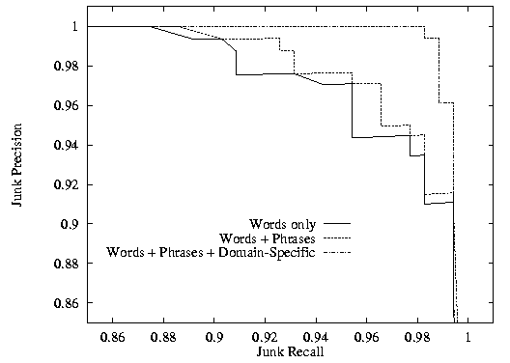
Precision/Recall Curves
better performance
Points from Table on Slide 14

Slide 54
Sahami et. Al. spam filtering
Note that all features—whether words, phrases or domain names etc are
Treated the same way—we estimate P(feature|class) probabilities and use them
The above framework is completely general. We just need to encode each e-mail as a fixed-width vector X = ⟨X₁, X₂, X₃, ..., X_{N}⟩ of features.
So... What features are used in Sahami’s system
  words
  suggestive phrases (“free money”, “must be over 21”, ...)
  sender’s domain (.com, .edu, .gov, ...)
  peculiar punctuation (“!!!Get Rich Quick!!!”)
  did email contain an attachment?
  was message sent during evening or daytime?
  ?
  ?
(We’ll see a similar list for AdEater and other learning systems)
generated
automatically
hand
crafted!

Slide 55
How Well (and WHY) DOES NBC WORK?
Naïve bayes classifier is darned easy to implement
    Good learning speed, classification speed
    Modest space storage
    Supports incrementality
      Recommendations re-done as more attribute values of the new item become known.
It seems to work very well in many scenarios
  Peter Norvig, the director of Machine Learning at GOOGLE said, when asked about what sort of technology they use “Naïve bayes”
But WHY?
  [Domingos/Pazzani; 1996] showed that NBC has much wider ranges of applicability than previously thought (despite using the independence assumption)
  classification accuracy is different from probability estimate accuracy
    Notice that normal classification application application don’t quite care about the actual probability; only which probability is the highest
      Exception is Cost-based learning—suppose false positives and false negatives have different costs…
        E.g. Sahami et al consider a message to be spam only if Spam class probability is >.9 (so they are using incorrect NBC estimates here)

Slide 56
Extensions to Naïve Bayes idea
Vector of Bags model
  E.g. Books have several different fields that are all text
    Authors, description, …
    A word appearing in one field is different from the same word appearing in another
  Want to keep each bag different—vector of m Bags

Slide 57

Current State of the Art in Spam Filtering
SpamAssassin (http://www.spamassassin.org ) is pretty much the best spam filter out there (it is FREE!)
Based on a variety of tests. Each test gives a numerical score (spam points) to the message (the more positive it is, the more spammy it is). When the cumulative scores is above a threshold, it puts the message in spam box. Tests used are at http://www.spamassassin.org/tests.html.
Tests are 1 of three types:
  Domain Specific: Has a set of hand-written rules (sort of like the Sahami et. Al. domain specific features). If the rule matches then the message is given a score (+ve or –ve). If the cumulative score is more than a threshold, then the message is classified as SPAM..
  Bayesian Filter: Uses NBC to train on messages that the user classified (requires that SA be integrated with a mail client; ASU IMAP version does it)
    An interesting point is that it is hard to “explain” to the user why the bayesian filter found a message to be spam (while domain specific filter can say that specific phrases were found).
  Collaborative Filter: E.g. Vipul’s razor, etc. If this type of message has been reported as SPAM by other users (to a central spam server), then the message is given additional spam points.
    Messages are reported in terms of their “signatures”
      Simple “checksum” signatures don’t quite work (since the Spammers put minor variations in the body)
      So, these techniques use “fuzzy” signatures, and “similarity” rather than “equality” of signatures. (see the connection with Crawling and Duplicate Detection).

Slide 58
A message caught by Spamassassin
Message 346:
From aetbones@ccinet.ab.ca Thu Mar 25 16:51:23 2004
From: Geraldine Montgomery <aetbones@ccinet.ab.ca>
To: randy.mullen@asu.edu
Cc: ranga@asu.edu, rangers@asu.edu, rao@asu.edu, raphael@asu.edu,
rapture@asu.edu, rashmi@asu.edu
Subject: V1AGKRA 80% DISCOUNT !! sg g pz kf
Date: Fri, 26 Mar 2004 02:49:21 +0000 (GMT)
X-Spam-Flag: YES
X-Spam-Checker-Version: SpamAssassin 2.63 (2004-01-11) on
parichaalak.eas.asu.edu
X-Spam-Level: ******************************************
X-Spam-Status: Yes, hits=42.2 required=5.0 tests=BIZ_TLD,DCC_CHECK,
FORGED_MUA_OUTLOOK,FORGED_OUTLOOK_TAGS,HTML_30_40,HTML_FONT_BIG,
HTML_MESSAGE,HTML_MIME_NO_HTML_TAG,MIME_HTML_NO_CHARSET,
MIME_HTML_ONLY,MIME_HTML_ONLY_MULTI,MISSING_MIMEOLE,
OBFUSCATING_COMMENT,RCVD_IN_BL_SPAMCOP_NET,RCVD_IN_DSBL,RCVD_IN_NJABL,
RCVD_IN_NJABL_PROXY,RCVD_IN_OPM,RCVD_IN_OPM_HTTP,
RCVD_IN_OPM_HTTP_POST,RCVD_IN_SORBS,RCVD_IN_SORBS_HTTP,SORTED_RECIPS,
SUSPICIOUS_RECIPS,X_MSMAIL_PRIORITY_HIGH,X_PRIORITY_HIGH autolearn=no
version=2.63
MIME-Version: 1.0
This is a multi-part message in MIME format.
------------=_40637084.02AF45D4
Content-Type: text/plain
Content-Disposition: inline
--More--

Slide 59
Example of SpamAssassin explanation
Domain specific
X-Spam-Status: Yes, hits=42.2 required=5.0 tests=BIZ_TLD,DCC_CHECK,
FORGED_MUA_OUTLOOK,FORGED_OUTLOOK_TAGS,HTML_30_40,HTML_FONT_BIG,
HTML_MESSAGE,HTML_MIME_NO_HTML_TAG,MIME_HTML_NO_CHARSET,
MIME_HTML_ONLY,MIME_HTML_ONLY_MULTI,MISSING_MIMEOLE,
OBFUSCATING_COMMENT,RCVD_IN_BL_SPAMCOP_NET,RCVD_IN_DSBL,RCVD_IN_NJABL,
RCVD_IN_NJABL_PROXY,RCVD_IN_OPM,RCVD_IN_OPM_HTTP,
RCVD_IN_OPM_HTTP_POST,RCVD_IN_SORBS,RCVD_IN_SORBS_HTTP,SORTED_RECIPS,
SUSPICIOUS_RECIPS,X_MSMAIL_PRIORITY_HIGH,X_PRIORITY_HIGH autolearn=no
version=2.63
collaborative
In this case, autolearn is set to no; so bayesian filter is not active.

Slide 60
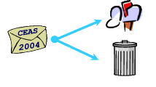
General comments on Spam
Spam is a technical problem (we created it)
It has the “arms-race” character to it
  We can’t quite legislate against SPAM
    Most spam comes from outside national boundaries…
Need “technical” solutions
  To detect Spam (we mostly have a handle on it)
  To STOP spam generation (detecting spam after its gets sent still is taxing mail servers—by some estimates more than 66% of the mail relayed by AOL/Yahoo mailservers is SPAM
    Brother Gates suggest “monetary” cost
      Make every mailer pay for the mail they send
        Not necessarily in “stamps” but perhaps by agreeing to give some CPU cycles to work on some problem (e.g. finding primes; computing PI etc)
        The cost will be minuscule for normal users, but will multiply for spam mailers who send millions of mails.
    Other innovative ideas needed—we now have a conferences on Spam mail
      http://www.ceas.cc/

