Slide 1

IR for Web Pages
“I’m not sure Google is a rational business trying to maximize its own profits,”
--Eric Schmidt 9/22

Slide 2
Search Engine
A search engine is essentially a text retrieval system for web pages plus a Web interface.
So what’s new???

Slide 3
Some Characteristics of the Web
Web pages are
  very voluminous and diversified
  widely distributed on many servers.
  extremely dynamic/volatile.
Web pages have
  more structure (extensively tagged).
  are extensively linked.
  may often have other associated metadata
Web search is
  Noisy (pages with high similarity to query may still differ in relevance)
  Uncurated; Adversarial!
    A page can advertise itself falsely just so it will be retrieved
Web users are
  ordinary folks (“dolts”?) without special training
    they tend to submit short queries.
  There is a very large user community.
Need to crawl and maintain index
Use the links and tags and
Meta-data!
Use the social structure
of the web
Easily impressed ☺

Slide 4
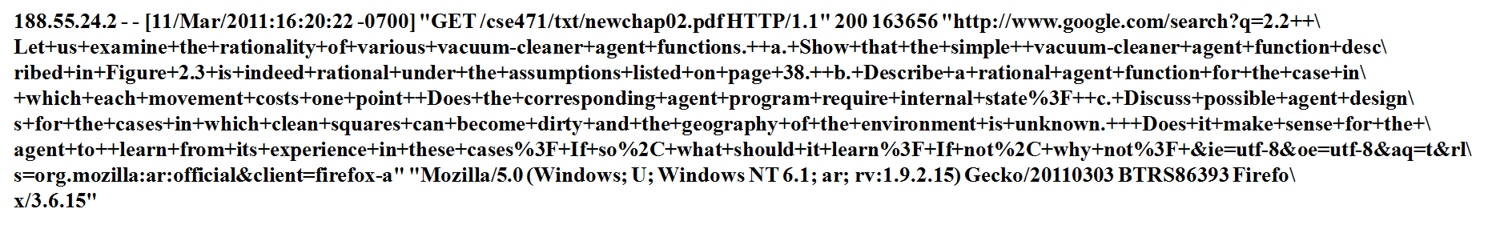
Short queries?
Okay--except when the student is desparately trying to use the web
to cheat on his/her homework ☺

Slide 5
Use of Tag Information (1)
Web pages are mostly HTML documents (for now).
HTML tags allow the author of a web page to
  Control the display of page contents on the Web.
  Express their emphases on different parts of the page.
HTML tags provide additional information about the contents of a web page.
Can we make use of the tag information to improve the effectiveness of a search engine?

Slide 6

Use of Tag Information (2)
Document is indexed not just with its contents;
But with the contents of others descriptions of it
Two main ideas of using tags:
Associate different importance to term occurrences in different tags.
  Title > header 1 > header 2 > body > footnote > invisible
Use anchor text to index referenced documents. (What should be its importance?)
. . . . . .
“worst teacher I ever had”
. . . . . .
Your page
Page 2: Rao’s page

Slide 7
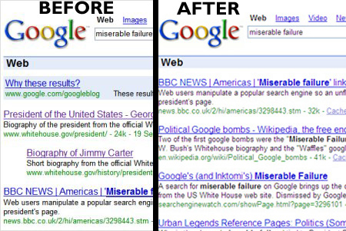
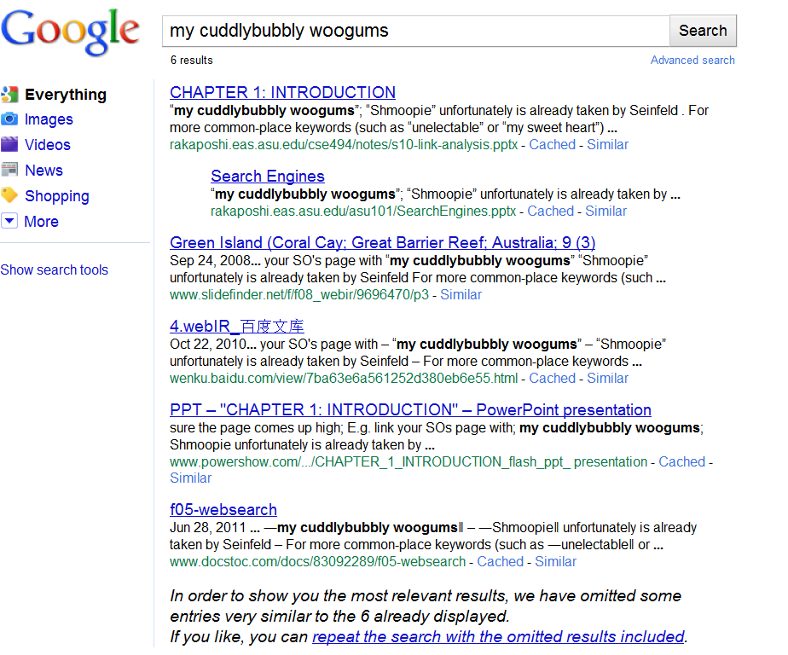
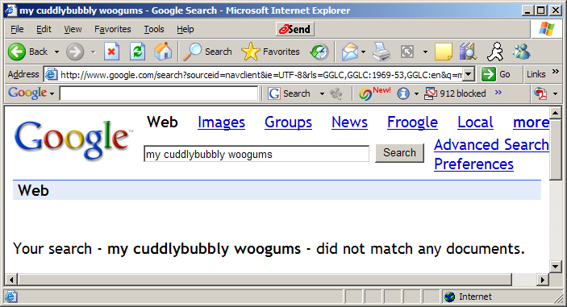
Google Bombs:
The other side of Anchor Text
Anchor text is a way of “changing” a page!
(and it is given higher importance than the page contents)
You can “tar” someone’s page just by linking to them with some damning anchor text
  If the anchor text is unique enough, then even a few pages linking with that keyword will make sure the page comes up high
    E.g. link your SO’s page with
      “my cuddlybubbly woogums”
      “Shmoopie” unfortunately is already taken by Seinfeld
  For more common-place keywords (such as “unelectable” or “my sweet heart”) you need a lot more links
    Which, in the case of the later, may defeat the purpose

Slide 8
Use of Tag Information
Associating different importance to term occurrences.
  Eg: Consider occurrences in six classes title, header, list, strong, anchor, plain
    Think of term frequency vector rather than just term frequency
  Consider a 6-ary weight vector <w1….w6> for relative weights
  To get the effective term weight, consider the dot product of term frequency vector and the weight vector
  Weights can be either pre-set or “learned”

Slide 9
Use of Tag Information (4)
The Webor Method (Cutler 97, Cutler 99)
Partition HTML tags into six ordered classes:
  title, header, list, strong, anchor, plain
Extend the term frequency value of a term in a document into a term frequency vector (TFV).
Suppose term t appears in the i^{th} class tf_{i} times, i = 1..6. Then TFV = (tf₁, tf₂, tf₃, tf₄, tf₅, tf₆).
Example: If for page p, term “binghamton” appears 1 time in the title, 2 times in the headers and 8 times in the anchors of hyperlinks pointing to p, then for this term in p:
TFV = (1, 2, 0, 0, 8, 0).

Slide 10
Use of Tag Information (6)
The Webor Method (Continued)
Challenge: How to find the (optimal) CIV = (civ₁, civ₂, civ₃, civ₄, civ₅, civ₆) such that the retrieval performance can be improved the most?
One Solution: Find the optimal CIV experimentally using a hill-climbing search in the space of CIV
Details
Skipped

Slide 11
Handling Uncurated/Adversarial Nature of Web
Pure query similarity will be unable to pinpoint right pages because of the sheer volume of pages
  There may be too many pages that have same keyword similarity with the query
    The “even if you are one in a million, there are still 300 more like you” phenomenon
  Web content creators are autonomous/uncontrolled
    No one stops me from making a page and writing on it “this is the homepage of President Bush”
  and… adversarial
    I may intentionally create pages with keywords just to drive traffic to my page
    I might even use spoofing techniques to show one face to the search engine and another to the user
So we need some metrics about the trustworthiness/importance of the page
  These topics have been investigated in the context of human social networks
    Who should I ask for advice on Grad School? Marriage?
  The hyper-link structure of pages defines an implicit social network..
  Can we exploit that?

Slide 12
Important points on Trust vs. Relevance
Relevance vs. Trustworthiness
  User will know whether something is relevant when shown
    Woody Allen “I finally had an orgasm and my doctor says it is the wrong kind”
  Won’t know whether it is trustworthy/popular etc
Relevance can be learned from user models
Trust can’t be learned from the user—but the quality of the data.
Relevance has the notion of “marginal relevance” –No notion of Marginal trustworthiness.
Pagerank is best seen as a trust measure.

Slide 13
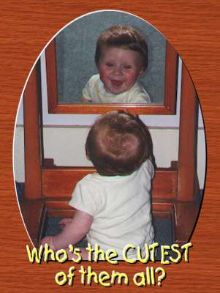
Connection to Citation Analysis
Mirror mirror on the wall, who is the biggest Computer Scientist of them all?
  The guy who wrote the most papers
    That are considered important by most people
      By citing them in their own papers
        “Science Citation Index”
  Should I write survey papers or original papers?
Infometrics;
Bibliometrics

Slide 14
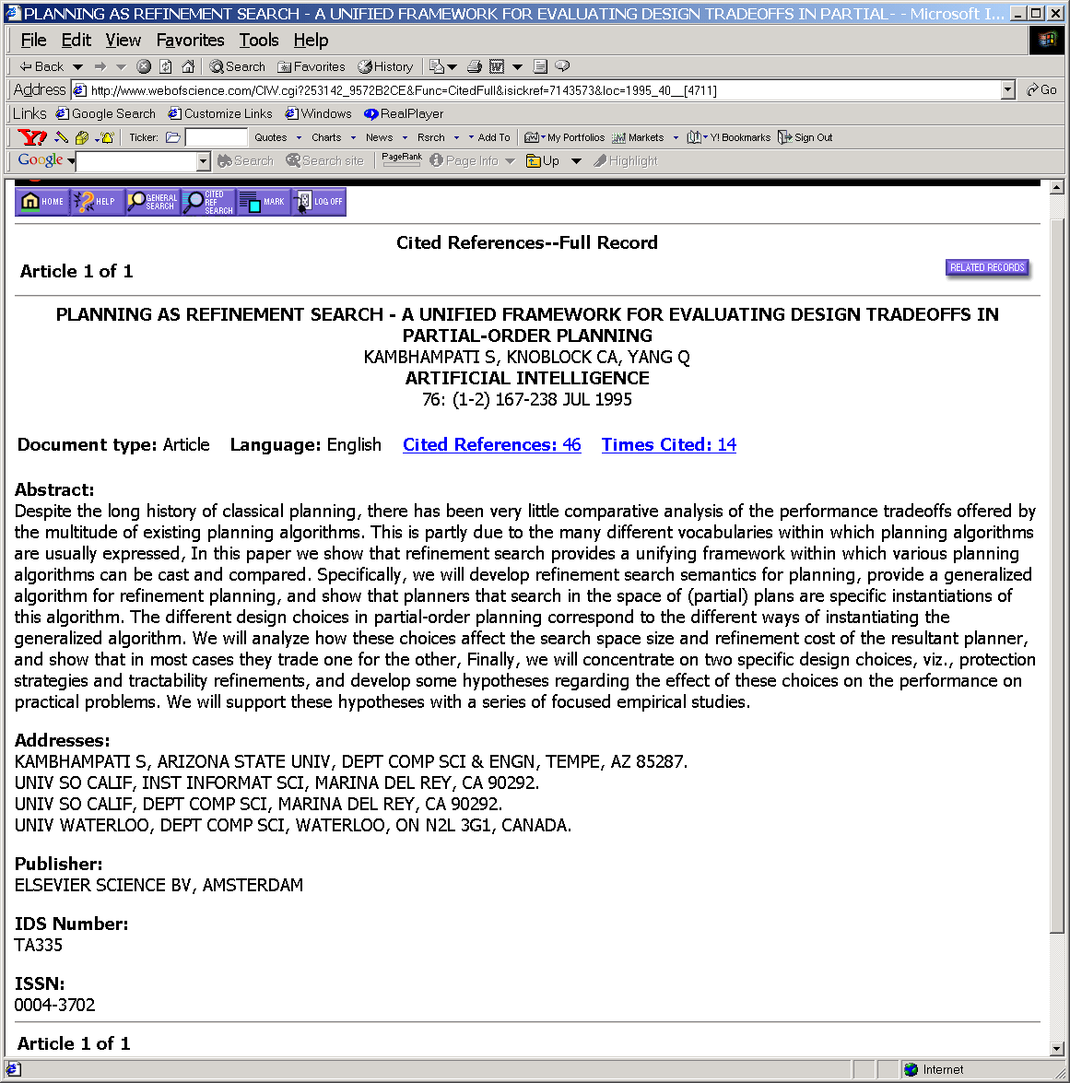
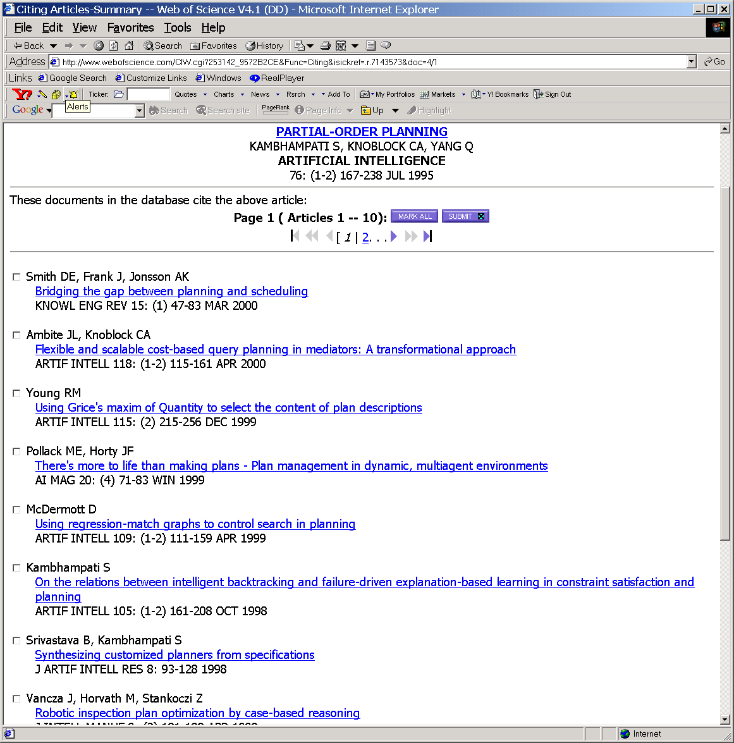
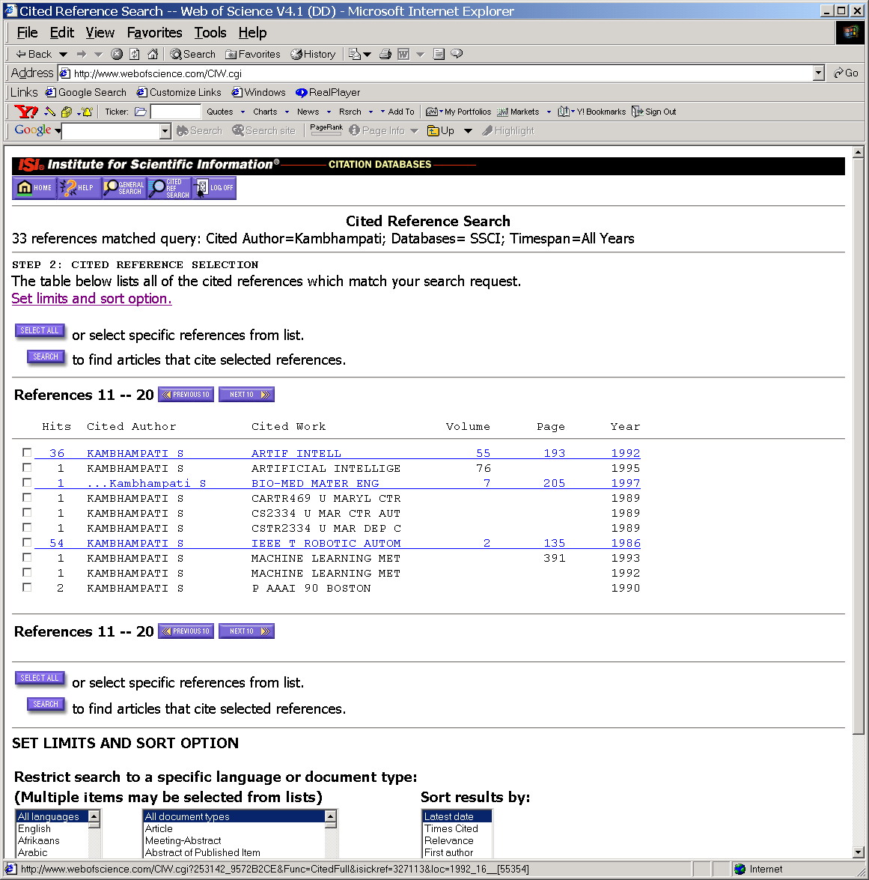
What
Citation Index says
About Rao’s papers

Slide 15
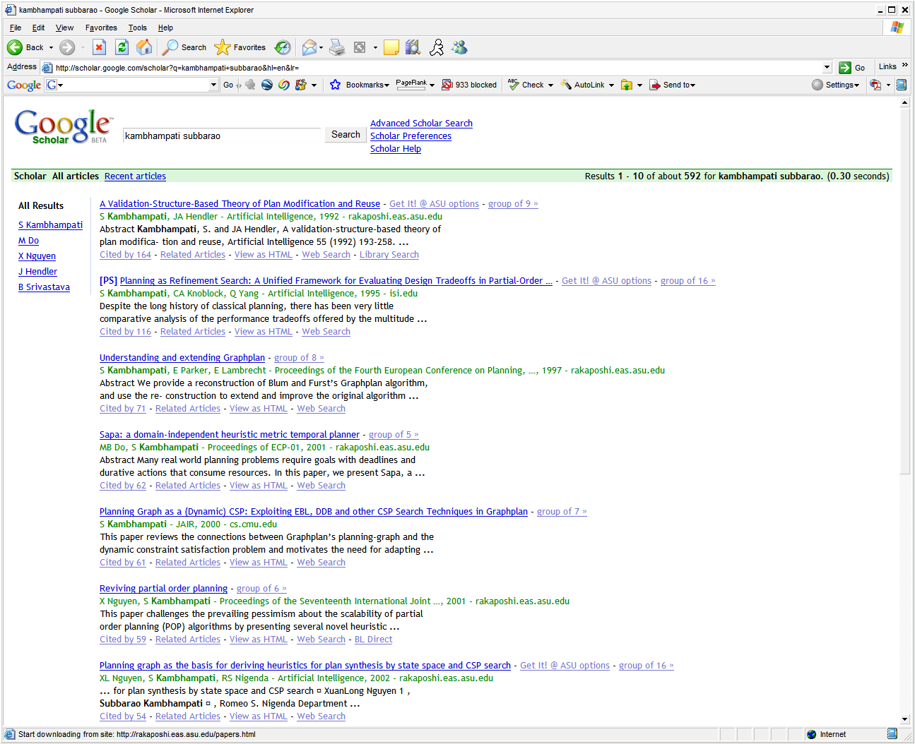
Scholar.google

Slide 16
Desiderata for Defining Page Importance Measures..
Page importance is hard to define unilaterally such that it satisfies everyone. There are however some desiderata:
  It should be sensitive to
    The link structure of the web
      Who points to it; who does it point to (~ Authorities/Hubs computation)
      How likely are people going to spend time on this page (~ Page Rank computation)
        E.g. Casa Grande is an ideal advertisement place..
    The amount of accesses the page gets
      Third-party sites have to maintain these statistics which tend to charge for the data.. (see nielson-netratings.com)
      To the extent most accesses to a site are through a search engine—such as google—the stats kept by the search engine should do fine
    The query
      Or at least the topic of the query..
    The user
      Or at least the user population
  It should be stable w.r.t. small random changes in the network link structure
  It shouldn’t be easy to subvert with intentional changes to link structure
How about:
“Eloquence”
“informativeness”
“Trust-worthiness”
“Novelty”

Slide 17
Dependencies between different importance measures..
The “number of page accesses” measure is not fully subsumed by link-based importance
  Mostly because some page accesses may be due to topical news
    (e.g. aliens landing in the Kalahari Desert would suddenly make a page about Kalahari Bushmen more important than White House for the query “Bush”)
  But, notice that if the topicality continues for a long period, then the link-structure of the web might wind up reflecting it (so topicality will thus be a “leading” measure)
Generally, eloquence/informativeness etc of a page get reflected indirectly in the link-based importance measures
You would think that trust-worthiness will be related to link-based importance anyway (since after all, who will link to untrustworthy sites)?
  But the fact that web is decentralized and often adversarial means that trustworthiness is not directly subsumed by link structure (think “page farms” where a bunch of untrustworthy pages point to each other increasing their link-based importance)
Novelty wouldn’t be much of an issue if web is not evolving; but since it is, an important page will not be discovered by purely link-based criteria
  # of page accesses might sometimes catch novel pages (if they become topically sensitive). Otherwise, you may want to add an “exploration” factor to the link-based ranking (i.e., with some small probability p also show low page-rank pages of high query similarity)

Slide 18
Two (very similar) ideas for assessing page importance
Authorities/Hubs (HITS)
Pagerank
View hyper-linked pages as authorities and hubs.
  Authorities are pointed to by Hubs (and derive their importance from who are pointing to them)
  Hubs point to authorities (and derive their importance from who they point to)
Return good Hub and Authority pages…
View hyper-linked pages as a markov chain
  A page is important if the probability of a random surfer landing on that page is high
Return pages with “high probability of landing”

Slide 19
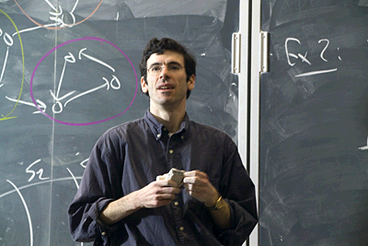

Moral: Publish or Perish!
A/H algorithm was published in SODA as well as JACM
  Kleinberg got TENURE at Cornell; became famous
  ..and rich…Got a McArthur Genius award (250K) & ACM Infosys Award (150K) & and several Google grants
Pagerank algorithm was rejected from SIGIR and was never officially published
  Page & Brin never even got a PhD (let alone any cash awards)
    and had to be content with starting some sort of a company..

Slide 20
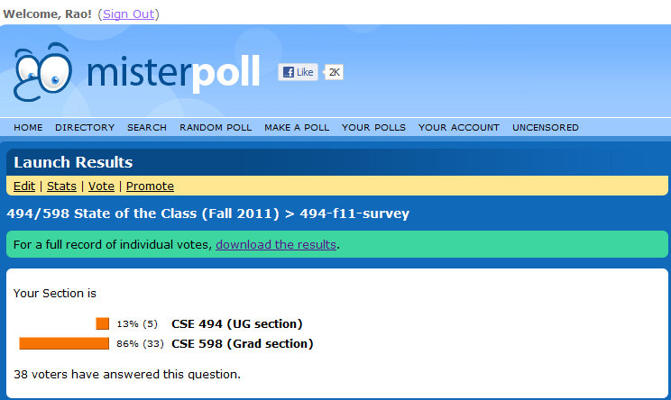
9/27

Slide 21


What would be most useful for me
would be subbed videos.
--Survey feedback from a student ☹
Notes:
I guess the international students are having trouble keeping up with my native arizona accent..
While I can use a more accessible accent, I am unfortunately duty bound to use AZ accent—as this NYT article says,my career might be hindered otherwise..
am thinking it is one of these Indian students who are unable to follow my perfected Arizonan accent.
I heard about this whole backlash thing about teacher accent, but I didn’t realize it is getting close..
can speak in perfect Mide-west accent.. I just decided I need to help you prepare for the real-world Computing workplace ;-)

Slide 22
Two (very similar) ideas for assessing page importance
Authorities/Hubs (HITS)
Pagerank
View hyper-linked pages as authorities and hubs.
  Authorities are pointed to by Hubs (and derive their importance from who are pointing to them)
  Hubs point to authorities (and derive their importance from who they point to)
Return good Hub and Authority pages…
View hyper-linked pages as a markov chain
  A page is important if the probability of a random surfer landing on that page is high
Return pages with “high probability of landing”

Slide 23
Link-based Importance using “who cites and who is citing” idea
A page that is referenced by lot of important pages (has more back links) is more important (Authority)
  A page referenced by a single important page may be more important than that referenced by five unimportant pages
A page that references a lot of important pages is also important (Hub)
“Importance” can be propagated
  Your importance is the weighted sum of the importance conferred on you by the pages that refer to you
  The importance you confer on a page may be proportional to how many other pages you refer to (cite)
    (Also what you say about them when you cite them!)
Different
Notions of
Importance
Eg. Publicity
Agent; star
Text book;
Original paper
“Popov”
Qn: Can we assign consistent authority/hub values
to pages?

Slide 24
Authorities and Hubs as mutually reinforcing properties
Authorities and hubs related to the same query tend to form a bipartite subgraph of the web graph.
Suppose each page has an authority score a(p) and a hub score h(p)
hubs
authorities

Slide 25
Authority and Hub Pages
I: Authority Computation: for each page p:
a(p) = Σ h(q)
q: (q, p)∈E
O: Hub Computation: for each page p:
h(p) = Σ a(q)
q: (p, q)∈E
q₁
q₂
p
q₃
q₁
p
q₂
q₃
A set of simultaneous equations… Can we solve these?

Slide 26
Authority and Hub Pages (8)
Matrix representation of operations I and O.
Let A be the adjacency matrix of SG: entry (p, q) is 1 if p has a link to q, else the entry is 0.
Let A^{T} be the transpose of A.
Let h_{i} be vector of hub scores after i iterations.
Let a_{i} be the vector of authority scores after i iterations.
Operation I: a_{i} = A^{T} h_{i-1}
Operation O: h_{i} = A a_{i}
Normalize after every multiplication

Slide 27
Authority and Hub Pages (9)
After each iteration of applying Operations I and O, normalize all authority and hub scores.
Repeat until the scores for each page converge (the convergence is guaranteed).
5. Sort pages in descending authority scores.
6. Display the top authority pages.

Slide 28
Authority and Hub Pages (11)
Example: Initialize all scores to 1.
1st Iteration:
I operation:
a(q₁) = 1, a(q₂) = a(q₃) = 0,
a(p₁) = 3, a(p₂) = 2
O operation: h(q₁) = 5,
h(q₂) = 3, h(q₃) = 5, h(p₁) = 1, h(p₂) = 0
Normalization: a(q₁) = 0.267, a(q₂) = a(q₃) = 0,
a(p₁) = 0.802, a(p₂) = 0.535, h(q₁) = 0.645,
h(q₂) = 0.387, h(q₃) = 0.645, h(p₁) = 0.129, h(p₂) = 0
q₁
p₁
q₂
p₂
q₃

Slide 29
Authority and Hub Pages (12)
After 2 Iterations:
a(q₁) = 0.061, a(q₂) = a(q₃) = 0, a(p₁) = 0.791,
a(p₂) = 0.609, h(q₁) = 0.656, h(q₂) = 0.371,
h(q₃) = 0.656, h(p₁) = 0.029, h(p₂) = 0
After 5 Iterations:
a(q₁) = a(q₂) = a(q₃) = 0,
a(p₁) = 0.788, a(p₂) = 0.615
h(q₁) = 0.657, h(q₂) = 0.369,
h(q₃) = 0.657, h(p₁) = h(p₂) = 0
q₁
p₁
q₂
p₂
q₃

Slide 30
auth =
0 0 0 1.0000 0 q1
1.0000 0 0 0 0 q2
0 1.0000 0 0 0 q3
0 0 0.6154 0 -0.7882 p1
0 0 -0.7882 0 -0.6154 p2
v =
0 0 0 0 0
0 0 0 0 0
0 0 0.4384 0 0
0 0 0 1.0000 0
0 0 0 0 4.5616
hub =
0.7071 0 0.2610 0 0.6572
0.0000 0 -0.9294 0 0.3690
-0.7071 0 0.2610 0 0.6572
0 0 0 1.0000 0
0 1.0000 0 0 0
q₁
p₁
q₂
p₂
q₃

Slide 31
What happens if you multiply a vector by a matrix?
In general, when you multiply a vector by a matrix, the vector gets “scaled” as well as “rotated”
  ..except when the vector happens to be in the direction of one of the eigen vectors of the matrix
  .. in which case it only gets scaled (stretched)
A (symmetric square) matrix has all real eigen values, and the values give an indication of the amount of stretching that is done for vectors in that direction
The eigen vectors of the matrix define a new ortho-normal space
  You can model the multiplication of a general vector by the matrix in terms of
    First decompose the general vector into its projections in the eigen vector directions
      ..which means just take the dot product of the vector with the (unit) eigen vector
    Then multiply the projections by the corresponding eigen values—to get the new vector.
  This explains why power method converges to principal eigen vector..
    ..since if a vector has a non-zero projection in the principal eigen vector direction, then repeated multiplication will keep stretching the vector in that direction, so that eventually all other directions vanish by comparison..
Optional

Slide 32
(why) Does the procedure converge?
x
x₂
x_{k}
As we multiply repeatedly with
M, the component of x in the direction of principal eigen vector gets stretched wrt to other directions.. So we converge finally to the direction of principal eigenvector
Necessary condition: x must have a component in the direction of principal eigen vector (c₁must be non-zero)
The rate of convergence depends on the “eigen gap”

Slide 33
Can we power iterate to get other (secondary) eigen vectors?
Yes—just find a matrix M₂ such that M₂ has the same eigen vectors as M, but the eigen value corresponding to the first eigen vector e₁ is zeroed out..
Now do power iteration on M₂
Alternately start with a random vector v, and find a new vector v’ = v – (v.e₁)e₁ and do power iteration on M with v’
Why? 1. M₂e₁ = 0
2. If e₂ is the second eigen vector of M,
then it is also an eigen vector of M₂

Slide 34
Tyranny of Majority
Which do you think are
Authoritative pages?
Which are good hubs?
1
6
2
4
8
7
3
5
-intutively, we would say
that 4,8,5 will be authoritative
pages and 1,2,3,6,7 will be
hub pages.
BUT The power iteration will show that
Only 4 and 5 have non-zero authorities
[.923 .382]
And only 1, 2 and 3 have non-zero hubs
[.5 .7 .5]
The authority and hub mass
Will concentrate completely
Among the first component, as
The iterations increase. (See next slide)

Slide 35
Tyranny of Majority (explained)
Suppose h0 and a0 are all initialized to 1
m
p1
q1
n
q
p2
p
qn
pm
m>n

Slide 36
Two (very similar) ideas for assessing page importance
Authorities/Hubs (HITS)
Pagerank
View hyper-linked pages as authorities and hubs.
  Authorities are pointed to by Hubs (and derive their importance from who are pointing to them)
  Hubs point to authorities (and derive their importance from who they point to)
Return good Hub and Authority pages…
View hyper-linked pages as a markov chain
  A page is important if the probability of a random surfer landing on that page is high
Return pages with “high probability of landing”

Slide 37
PageRank
(Importance as Stationary Visit Probability on a Markov Chain)
Basic Idea:
  Think of Web as a big graph. A random surfer keeps randomly clicking on the links.
  The importance of a page is the probability that the surfer finds herself on that page
  --Talk of transition matrix instead of adjacency matrix
  Transition matrix M derived from adjacency matrix A
  --If there are F(u) forward links from a page u,
  then the probability that the surfer clicks
  on any of those is 1/F(u) (Columns sum to 1. Stochastic matrix)
  [M is the column-normalized version of A^{t}]
  --But even a dumb user may once in a while do something other than
  follow URLs on the current page..
  --Idea: Put a small probability that the user goes off to a page not pointed to by the current page.
  --Question: When you are bored, *where* do you go?
  --Reset distribution—can be different for different people
Principal eigenvector
Gives the stationary
distribution!

Slide 38
Example: Suppose the Web graph is:
M =
D
C
A
B
A B C D
A B C D
A
B
C
D
0 0 0 ½
0 0 0 ½
1 0 0
0 0 1 0
A
B
C
D
0 0 1 0
0 0 1 0
0 0 0 1
1 1 0 0
A=

Slide 39
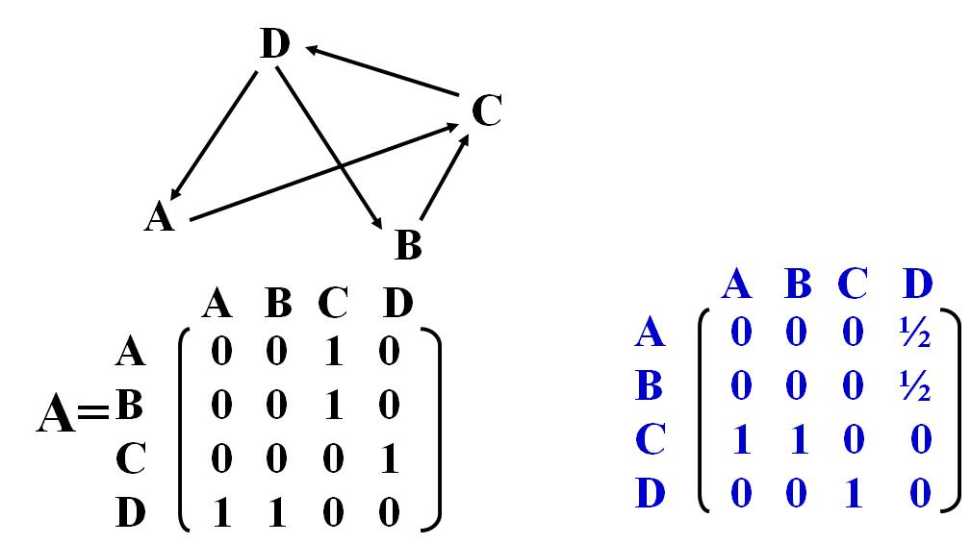
Let R be the vector of occupation probabilities of the pages at the steady state
By definition of steady state,
R = M × R,
Suppose we start with the initial vector R₀ and “power iterate”
R_{i+1} ← M x R_{i}
If this procedure converges, then we get R
(So R is the eigenvector of matrix M with eigenvalue being 1).
But are we sure this will always happen?
Do all markov chains have a unique steady state
occupation probability distribution?
Principal eigen value for
A stochastic matrix is 1

Slide 40
Computing PageRank
Matrix representation
Let M be an N×N matrix and m_{uv} be the entry at the u-th row and v-th column.
m_{uv} = 1/N_{v} if page v has a link to page u
m_{uv} = 0 if there is no link from v to u
Let R_{i} be the N×1 rank vector for I-th iteration
and R₀ be the initial rank vector.
Then R_{i} = M × R_{i-1}

Slide 41
Computing PageRank
If the ranks converge, i.e., there is a rank vector R such that
R = M × R,
R is the eigenvector of matrix M with eigenvalue being 1.
Convergence is guaranteed only if
M is aperiodic (the Web graph is not a big cycle). This is practically guaranteed for Web.
M is irreducible (the Web graph is strongly connected). This is usually not true.
Principal eigen value for
A stochastic matrix is 1

Slide 42
Computing PageRank (7)
A solution to the non-irreducibility and rank sink problem.
Conceptually add a link from each page v to every page (include self).
If v has no forward links originally, make all entries in the corresponding column in M be 1/N.
If v has forward links originally, replace 1/N_{v} in the corresponding column by c∗1/N_{v} and then add (1-c) ∗1/N to all entries, 0 < c < 1.
Motivation comes also from random-surfer model

Slide 43
Project B – Report (Auth/Hub)
Authorities/Hubs
  Motivation for approach
  Algorithm
  Experiment by varying the size of root set (start with k=10)
  Compare/analyze results of A/H with those given by Vector Space
  Which results are more relevant: Authorities or Hubs? Comments?

Slide 44
Project B – Report (PageRank)
PageRank (score = w*PR + (1-w)*VS)
  Motivation for approach
  Algorithm
  Compare/analyze results of PageRank+VS with those given by A/H
  What are the effects of varying “w” from 0 to 1?
  What are the effects of varying “c” in the PageRank calculations?
  Does the PageRank computation converge?

Slide 45
Project B – Coding Tips
Download new link manipulation classes
  LinkExtract.java – extracts links from HashedLinks file
  LinkGen.java – generates the HashedLinks file
Only need to consider terms where
  term.field() == “contents”
Increase JVM Heap Size
  “java –Xmx512m programName”

Slide 46
Markov Chains & Random Surfer Model
Markov Chains & Stationary distribution
  Necessary conditions for existence of unique steady state distribution: Aperiodicity and Irreducibility
  Aperiodicity→it is not a big cycle
  Irreducibility: Each node can be reached from every other node with non-zero probability
    Must not have sink nodes (which have no out links)
        Because we can have several different steady state distributions based on which sink we get stuck in
      If there are sink nodes, change them so that you can transition from them to every other node with low probability
    Must not have disconnected components
        Because we can have several different steady state distributions depending on which disconnected component we get stuck in
      Sufficient to put a low probability link from every node to every other node (in addition to the normal weight links corresponding to actual hyperlinks)
      This can be used as the “reset” distribution—the probability that the surfer gives up navigation and jumps to a new page
The parameters of random surfer model
  c the probability that surfer follows a link on the page
    The larger it is, the more the surfer sticks to what the page says
  M the way link matrix is converted to markov chain
    Can make the links have differing transition probability
      E.g. query specific links have higher prob. Links in bold have higher prop etc
  Z sink node elimination matrix
    If M has an all zero column, put an all 1/n column in Z
  K the reset distribution of the surfer (great thing to tweak)
    It is quite feasible to have m different reset distributions corresponding to m different populations of users (or m possible topic-oriented searches)
    It is also possible to make the reset distribution depend on other things such as
      trust of the page [TrustRank]
      Recency of the page [Recency-sensitive rank]
M*= c(M+Z) + (1-c)K

Slide 47
Computing PageRank (8)
Z will have 1/N
For sink pages
And 0 otherwise
(RESET Matrix)
K can have1/N
For all entries (default)
M*= c (M + Z) + (1 – c) x K
M* is irreducible.
M* is stochastic, the sum of all entries of each column is 1 and there are no negative entries.
Therefore, if M is replaced by M* as in
R_{i} = M* × R_{i-1}
then the convergence is guaranteed
Can be made sensitive to “topic”, “trust”
etc

Slide 48
The Reset Distribution Matrix..
The reset distribution matrix K is an nxn matrix, where the i-th column tells us the probability that the user will go off to a random page when he wants to “get-out”
  All we need thus is that the columns all add up to 1.
  No requirement that the columns define a uniform distribution
    They can capture the user’s special interests (e.g. more probability mass concentrated on CS pages, and less on news sites..)
  No requirement that the columns must all be the same distribution
    They can capture the fact that the user might to very different things when they are getting out of different pages
      E.g., a user who wants to get out of a CS page may decide to go to a non-CS (e.g. news ) page with more probability; while the same user who has done enough news surfing for the day might want to get out with higher preference to CS pages.

Slide 49
Computing PageRank (9)
Interpretation of M* based on the random walk model.
If page v has no forward links originally, a web surfer at v can jump to any page in the Web with probability 1/N.
If page v has forward links originally, a surfer at v can either follow a link to another page with probability c ∗ 1/N_{v}, or jumps to any page with probability (1-c) ∗1/N.

Slide 50
9/29
→Pagerank continuation
→When to do link-analysis?
→how to combine link-based importance with similarity?
→Analyzing stability and robustness of link-analysis

Slide 51
Computing PageRank (10)
Example: Suppose the Web graph is:
M =
D
C
A
B
A B C D
A
B
C
D
0 0 0 ½
0 0 0 ½
1 0 0
0 0 1 0

Slide 52
Computing PageRank (11)
Example (continued): Suppose c = 0.8. All entries in Z are 0 and all entries in K are ¼.
M* = 0.8 (M+Z) + 0.2 K =
Compute rank by iterating
R := M*xR
0.05 0.05 0.05 0.45
0.05 0.05 0.05 0.45
0.85 0.85 0.05 0.05
0.05 0.05 0.85 0.05
MATLAB says:
R(A)=.338 (.176)
R(B)=.338 (.176)
R(C)=.6367 (.332)
R(D)=.6052 (.315)
Eigen decomposition gives the *unit* vector.. To get the “probabilites” just normalize by dividing every number by the sum of the entries..

Slide 53
Comparing PR & A/H on the same graph
Actually, this one has eigen gap zero
Which means both the right most and
The one next to it can be seen as primary
Eigen vectors—both of them provide
Stable A/H scores..
A
B
C
D
A
B
C
D
pagerank
A/H?

Slide 54
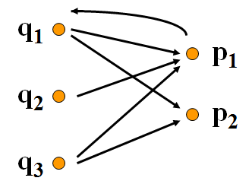
auth =
0 0 0 1.0000 0 q1
1.0000 0 0 0 0 q2
0 1.0000 0 0 0 q3
0 0 0.6154 0 -0.7882 p1
0 0 -0.7882 0 -0.6154 p2
v =
0 0 0 0 0
0 0 0 0 0
0 0 0.4384 0 0
0 0 0 1.0000 0
0 0 0 0 4.5616
hub =
0.7071 0 0.2610 0 0.6572
0.0000 0 -0.9294 0 0.3690
-0.7071 0 0.2610 0 0.6572
0 0 0 1.0000 0
0 1.0000 0 0 0
A
M*
q1 q2 q3 p1 p2
q1 0 0 0 1 1
q2 0 0 0 1 0
q3 0 0 0 1 1
p1 1 0 0 0 0
p2 0 0 0 0 0
0.0400 0.0400 0.0400 0.8400 0.2000
0.0400 0.0400 0.0400 0.0400 0.2000
0.0400 0.0400 0.0400 0.0400 0.2000
0.4400 0.8400 0.4400 0.0400 0.2000
0.4400 0.0400 0.4400 0.0400 0.2000
-0.6245 -0.7347 0.6768 0.6768 -0.7071
-0.1539 -0.0984 -0.2822 + 0.0766i -0.2822 - 0.0766i -0.0000
-0.1539 -0.0984 -0.2822 + 0.0766i -0.2822 - 0.0766i 0.7071
-0.5883 0.5253 0.0389 + 0.3325i 0.0389 - 0.3325i -0.0000
-0.4652 0.4061 -0.1513 - 0.4858i -0.1513 + 0.4858i 0.0000
1.0000 0 0 0 0
0 -0.6605 0 0 0
0 0 0.0102 + 0.2782i 0 0
0 0 0 0.0102 - 0.2782i 0
0 0 0 0 0.0000
q1
q2
q3
p1
p2
Big Authorities
➔ Big Page Rank
Pure Hub
→ low page rank

Slide 55
When to do Importance Computation?
Global
Query-Specific
Do A/H (or Pagerank) Computation once for the whole corpus
  Advantage: Importance computation done before the query time
  Disadvantage: Importance is not sensitive to the individual queries
Do A/H (or Pagerank) computation with respect to the query results (and their backward/forward neighbors)
  Advantage: Importance computation sensitive to queries
  Disadvantage: Importance computation is done at query time! (slows down querying)
Compromise:
Do Importance computation w.r.t. topics
At query time, map query to
topics and use the appropriate
importance values

Slide 56
How to Combine Importance and Relevance (Similarity) Metrics?
If you do query specific importance computation, then you first do similarity and then importance…
If you do global importance computation, then you need to combine apples and oranges…

Slide 57
Authority and Hub Pages
Algorithm (summary)
submit q to a search engine to obtain the root set S;
expand S into the base set T;
obtain the induced subgraph SG(V, E) using T;
initialize a(p) = h(p) = 1 for all p in V;
for each p in V until the scores converge
{ apply Operation I;
apply Operation O;
normalize a(p) and h(p); }
return pages with top authority & hub scores;

Slide 58
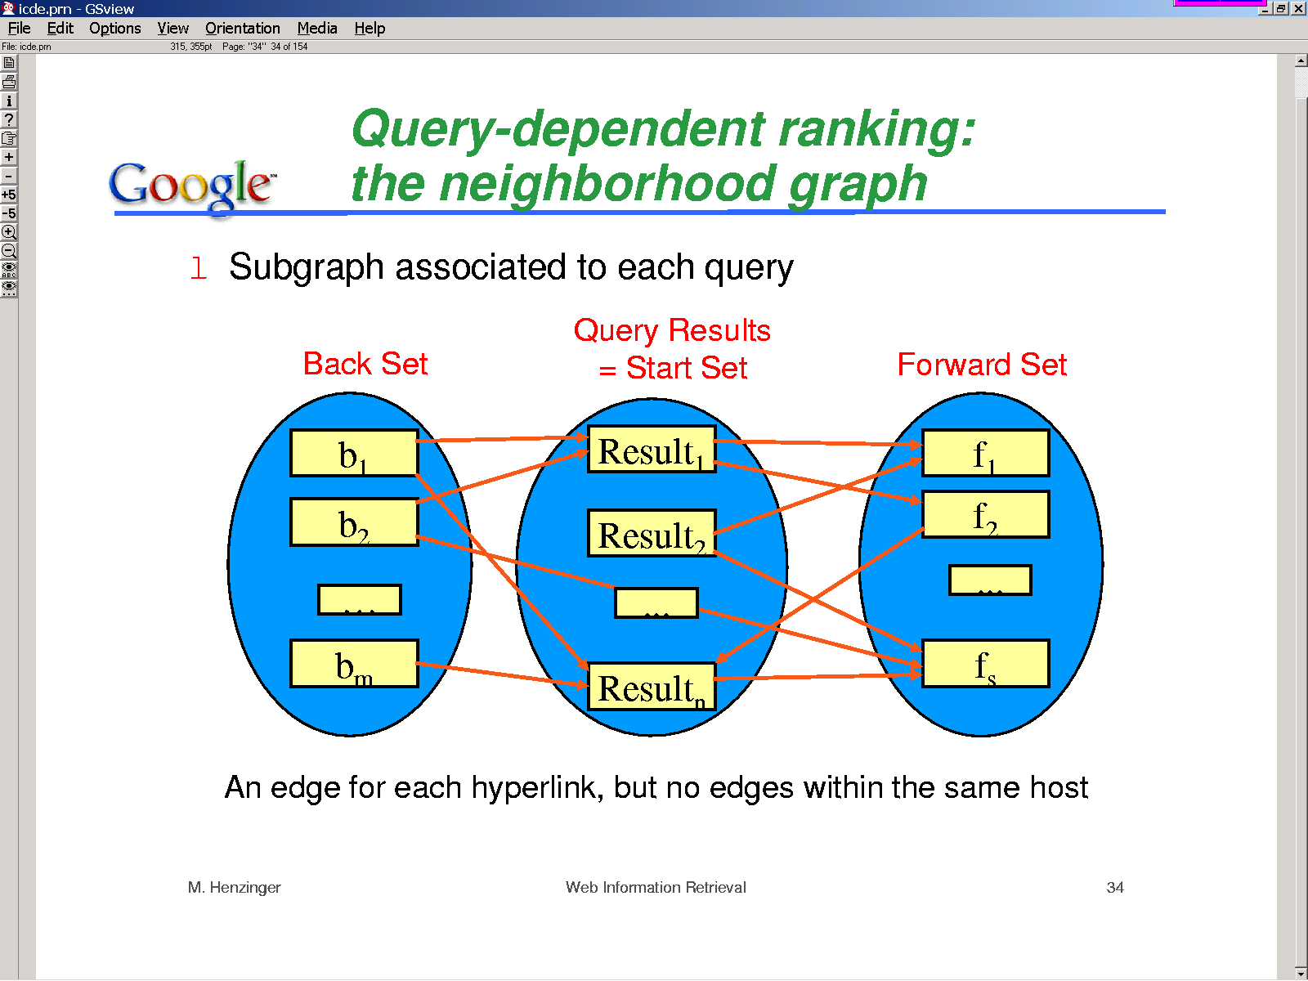

Slide 59
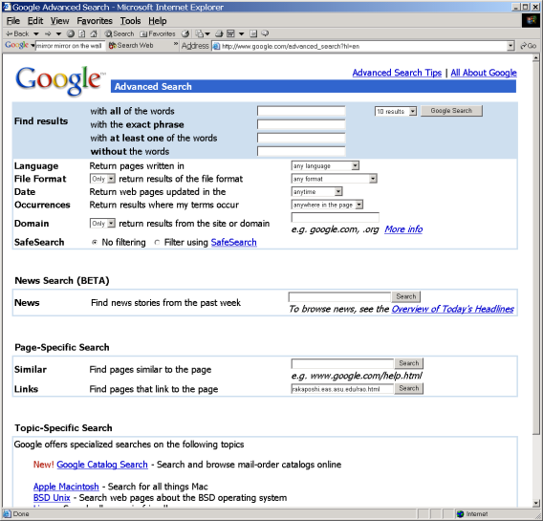
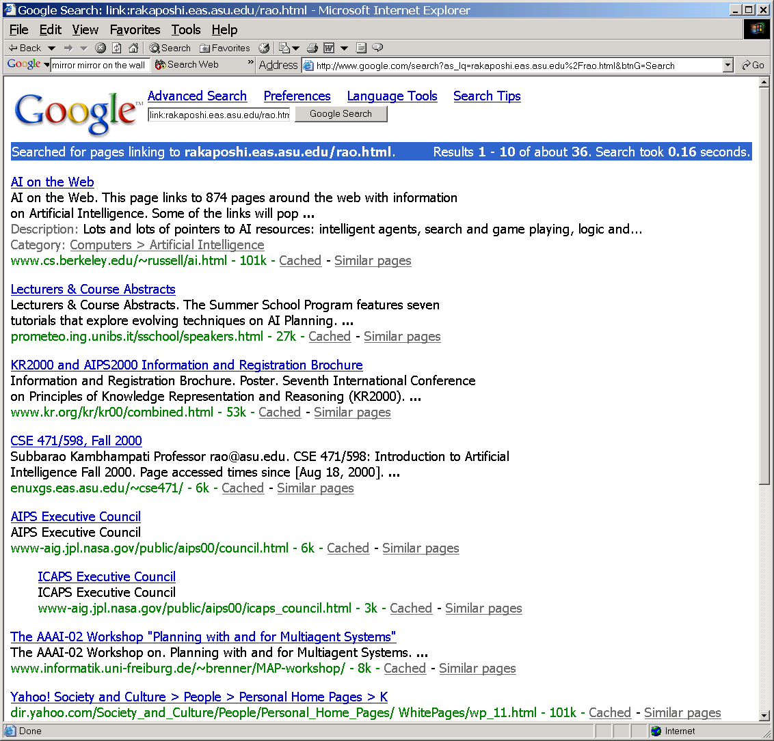
Base set computation
can be made easy by storing the link structure of the Web in advance Link structure table (during crawling)
--Most search engines serve this information now. (e.g. Google’s link: search)
parent_url child_url
url1 url2
url1 url3

Slide 60
Combining PR & Content similarity
Incorporate the ranks of pages into the ranking function of a search engine.
The ranking score of a web page can be a weighted sum of its regular similarity with a query and its importance.
ranking_score(q, d)
= w∗sim(q, d) + (1-w) ∗ R(d), if sim(q, d) > 0
= 0, otherwise
where 0 < w < 1.
  Both sim(q, d) and R(d) need to be normalized to between [0, 1].
Who sets w?

Slide 61
PageRank Variants
Topic-specific page rank
  Think of this as a middle-ground between one-size-fits-all page rank and query-specific page rank
Trust rank
  Think of this as a middle-ground between one-size-fits-all page rank and user-specific page rank
Recency Rank
  Allow recently generated (but probably high-quality) pages to break-through..
User-specific page rank..
  Google social search…
ALL of these play with the reset distribution (i.e., the distribution that tells what the random surfer does when she gets bored following links)

Slide 62
We can pick and choose
Two alternate ways of computing page importance
  I1. As authorities/hubs
  I2. As stationary distribution over the underlying markov chain
Two alternate ways of combining importance with similarity
  C1. Compute importance over a set derived from the top-100 similar pages
  C2. Combine apples & organges
    a*importance + b*similarity
We can pick any pair of alternatives
  (even though I1 was originally proposed with C1 and I2 with C2)

Slide 63
Making Link Analysis even more query specific…
Should all links be equally treated?
Two considerations:
Some links may be more meaningful/important than other links.
Web site creators may trick the system to make their pages more authoritative by adding dummy pages pointing to their cover pages (spamming).

Slide 64
Handling Spam Links (contd)
Transverse link: links between pages with different domain names.
        Domain name: the first level of the URL of a page.
Intrinsic link: links between pages with the same domain name.
Transverse links are more important than intrinsic links.
Two ways to incorporate this:
Use only transverse links and discard intrinsic links.
Give lower weights to intrinsic links.

Slide 65
Handling Spam Links (contd)
How to give lower weights to intrinsic links?
In adjacency matrix A, entry (p, q) should be assigned as follows:
If p has a transverse link to q, the entry is 1.
If p has an intrinsic link to q, the entry is c, where 0 < c < 1.
If p has no link to q, the entry is 0.

Slide 66
Considering link “context”
For a given link (p, q), let V(p, q) be the vicinity (e.g., ± 50 characters) of the link.
If V(p, q) contains terms in the user query (topic), then the link should be more useful for identifying authoritative pages.
To incorporate this: In adjacency matrix A, make the weight associated with link (p, q) to be 1+n(p, q),
    where n(p, q) is the number of terms in V(p, q) that appear in the query.
    Alternately, consider the “vector similarity” between V(p,q) and the query Q

Slide 67
Computing PageRank (6)
Rank sink: A page or a group of pages is a rank sink if they can receive rank propagation from its parents but cannot propagate rank to other pages.
Rank sink causes the loss of total ranks.
Example:
A
B
(C, D) is a rank sink
C
D

Slide 68
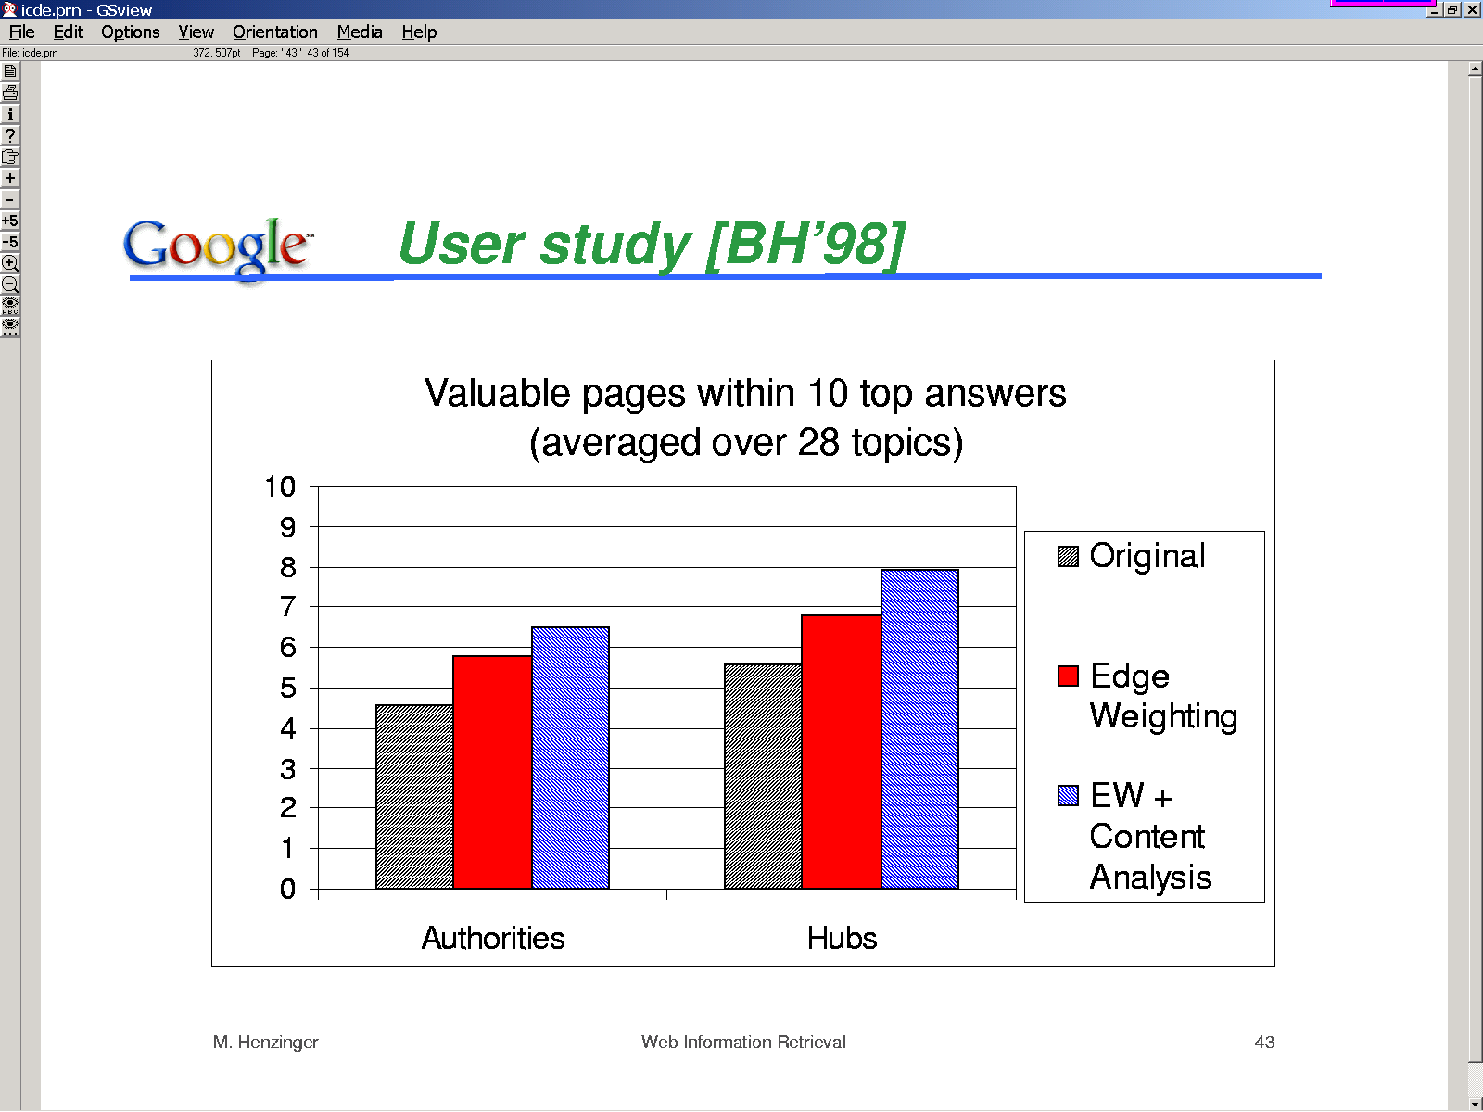

Slide 69
Evaluation
Sample experiments:
Rank based on large in-degree (or backlinks)
query: game
Rank in-degree URL
1 13 http://www.gotm.org
2 12 http://www.gamezero.com/team-0/
3 12 http://ngp.ngpc.state.ne.us/gp.html
4 12 http://www.ben2.ucla.edu/~permadi/
gamelink/gamelink.html
5 11 http://igolfto.net/
6 11 http://www.eduplace.com/geo/indexhi.html
Only pages 1, 2 and 4 are authoritative game pages.

Slide 70
Evaluation
Sample experiments (continued)
Rank based on large authority score.
query: game
Rank Authority URL
1 0.613 http://www.gotm.org
2 0.390 http://ad/doubleclick/net/jump/
gamefan-network.com/
3 0.342 http://www.d2realm.com/
4 0.324 http://www.counter-strike.net
5 0.324 http://tech-base.com/
6 0.306 http://www.e3zone.com
All pages are authoritative game pages.

Slide 71
Authority and Hub Pages (19)
Sample experiments (continued)
Rank based on large authority score.
query: free email
Rank Authority URL
1 0.525 http://mail.chek.com/
2 0.345 http://www.hotmail/com/
3 0.309 http://www.naplesnews.net/
4 0.261 http://www.11mail.com/
5 0.254 http://www.dwp.net/
6 0.246 http://www.wptamail.com/
All pages are authoritative free email pages.

Slide 72
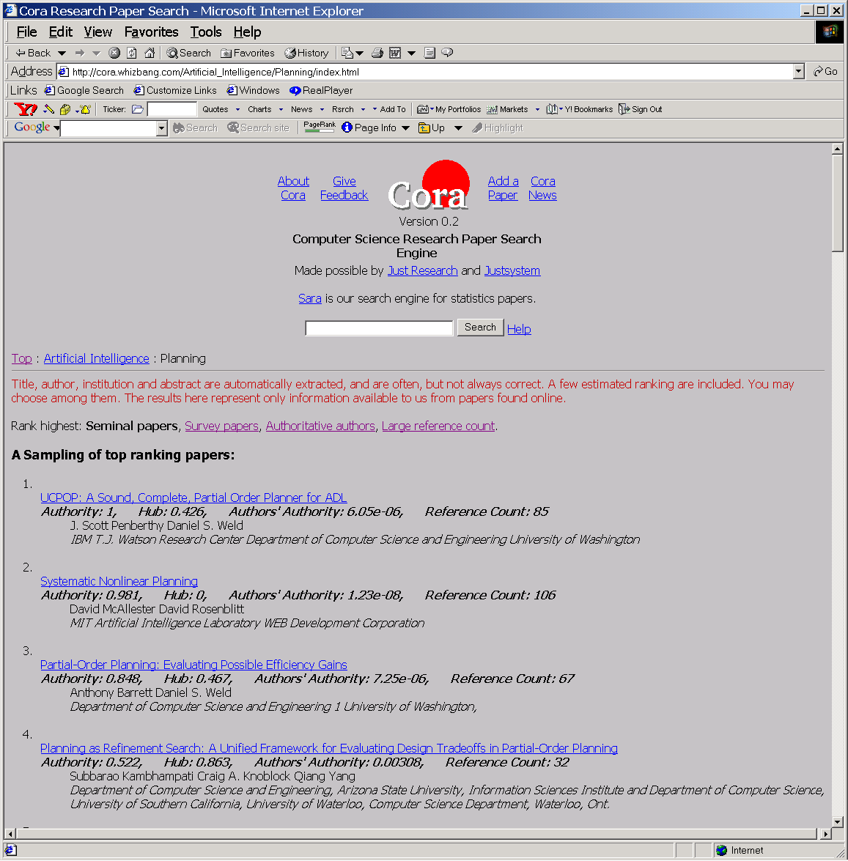
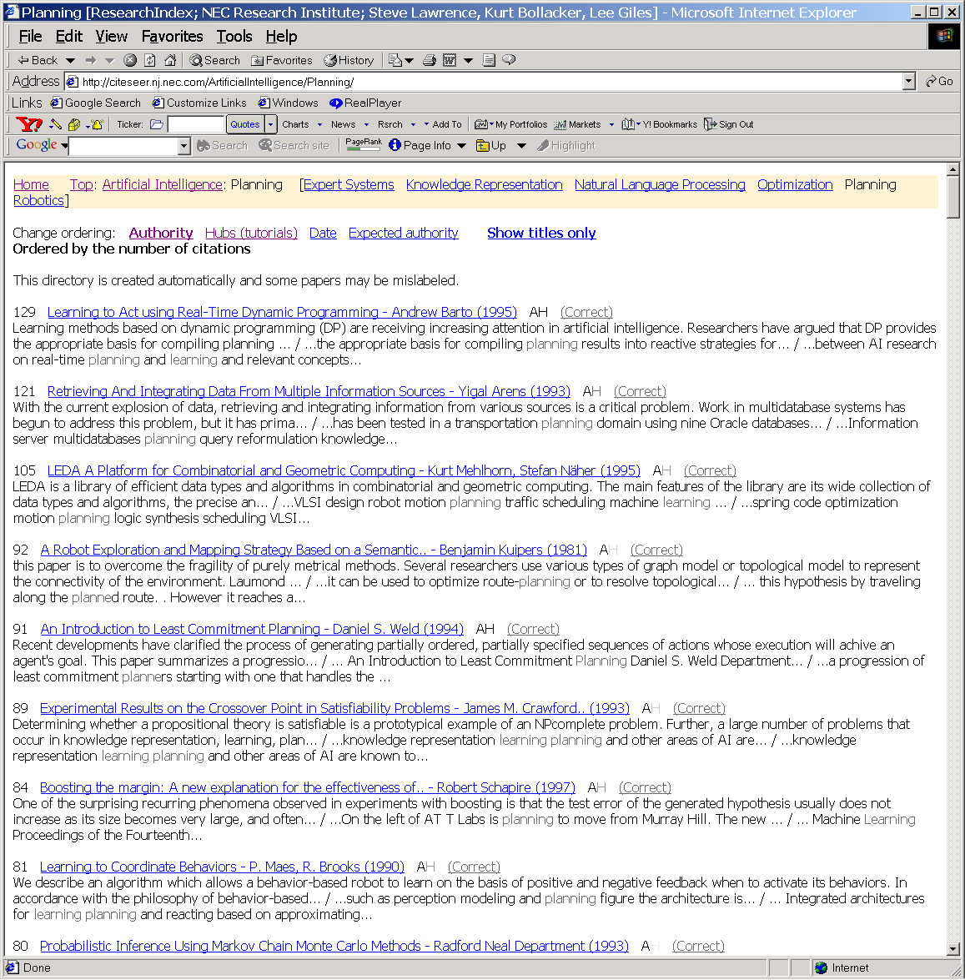
Cora thinks Rao is Authoritative on Planning
Citeseer has him down at 90th position… ☹
How come???
--Planning has two clusters
--Planning & reinforcement learning
--Deterministic planning
--The first is a bigger cluster
--Rao is big in the second cluster☹

Slide 73
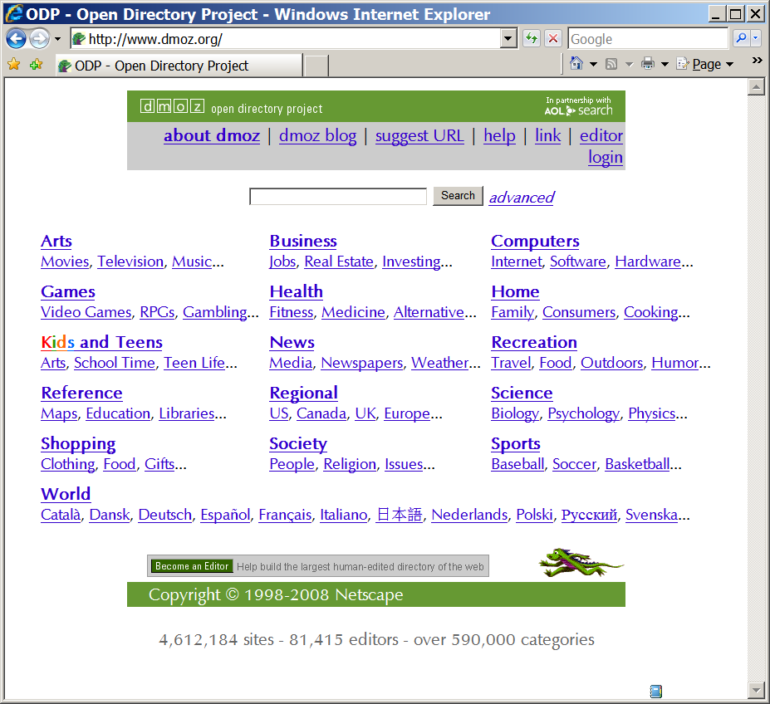
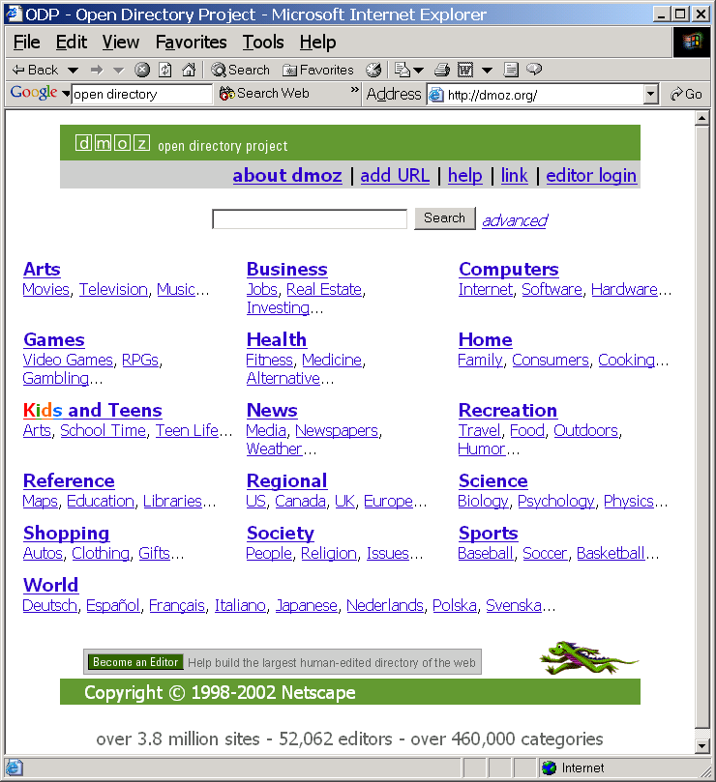
Topic Specific Pagerank
Haveliwala,
WWW 2002
For each page compute k different page ranks
  K= number of top level hierarchies in the Open Directory Project
  When computing PageRank w.r.t. to a topic, say that with ε probability we transition to one of the pages of the topic_{k}
    Could also consider link relevance to the topic
When a query q is issued,
  Compute similarity between q (+ its context) to each of the topics
  Take the weighted combination of the topic specific page ranks of q, weighted by the similarity to different topics

Slide 74
Topic Specific Pagerank
Haveliwala,
WWW 2002
For each page compute k different page ranks
  K= number of top level hierarchies in the Open Directory Project
  When computing PageRank w.r.t. to a topic, say that with ε probability we transition to one of the pages of the topic_{k}
When a query q is issued,
  Compute similarity between q (+ its context) to each of the topics
  Take the weighted combination of the topic specific page ranks of q, weighted by the similarity to different topics

Slide 75
10/4/2011
→Homework 2 due today
→Project part 2 released
→Midterm will be either 10/13 or 10/18

Slide 76
PageRank Variants that play with Reset Distribution..
Topic-specific page rank
  User goes to topic-relevant pages with higher probability
  Think of this as a middle-ground between one-size-fits-all page rank and query-specific page rank
Trust rank
  User goes to more trustworthy pages with higher probability
  Think of this as a middle-ground between one-size-fits-all page rank and user-specific page rank
Recency Rank
  Uses goes to more recently created pages with higher probability
  Allow recently generated (but probably high-quality) pages to break-through..
User-specific page rank..
  User goes to pages in his social circle with higher probability

Slide 77
Project Part 2
LinkAnalysis.java
  depends on two files IntCitations.txt and IntLinks.txt
  To get every document that points to document number 1234, call
    link_analysis.getCitations(1234)
  To get every document that document 1234 points to, call
    link_analysis.getLinks(1234)
  Using this, you can create the adjacency graph

Slide 78
Project 2: Authorities/Hubs
Lucene Index
Root Set
Base Set
use your phase 1 code
TF-IDF
use LinkAnalysis to grow
links, citations
perform Auth/Hub computation
rank
Final Results

Slide 79
Project 2: PageRank
Precomputed PageRank
Vector Similarity
Final Results
w
(1-w)
R_{i}=M* × R_{i-1}
M* = c(M + Z) + (1-c) K
R_{i}: The current PageRank of the pages.
M*: The adjusted link matrix
M: The original adjacency matrix
Z: Adjustment for sink pages (1/N for sink pages, 0 otherwise)
K: Reset Matrix (1/N for all entries)
c: A parameter that you control

Slide 80
Stability w.r.t disruptions and attacks
Is the importance measure robust w.r.t. small random changes?
Is the importance measure robust w.r.t. directed changes (“attacks”)?
  Specifically, how easy is it to game the ranking?

Slide 81
Stability
We saw that PageRank computation introduces “weak links” between all pages
The default A/H method, on the other hand, doesn’t modify the link matrix
What is the impact of this?

Slide 82
Tyranny of Majority
Which do you think are
Authoritative pages?
Which are good hubs?
1
6
2
4
8
7
3
5
-intutively, we would say
that 4,8,5 will be authoritative
pages and 1,2,3,6,7 will be
hub pages.
BUT The power iteration will show that
Only 4 and 5 have non-zero authorities
[.923 .382]
And only 1, 2 and 3 have non-zero hubs
[.5 .7 .5]
The authority and hub mass
Will concentrate completely
Among the first component, as
The iterations increase. (See next slide)

Slide 83
Tyranny of Majority (explained)
Suppose h0 and a0 are all initialized to 1
m
p1
q1
n
q
p2
p
qn
pm
m>n

Slide 84
Impact of Bridges..
9
1
6
When the graph is disconnected,
only 4 and 5 have non-zero authorities
[.923 .382]
And only 1, 2 and 3 have non-zero hubs
[.5 .7 .5]CV
2
4
8
7
3
5
Bad news from
stability point of view
→Can be fixed by putting
a weak link between any
two pages.. (saying in
essence that you expect
every page to be reached
from every other page)
(analogy to “vaccination”)
When the components are bridged by
adding one page (9)
the authorities change
only 4, 5 and 8 have non-zero authorities
[.853 .224 .47]
And o1, 2, 3, 6,7 and 9 will have non-zero hubs
[.39 .49 .39 .21 .21 .6]

Slide 85
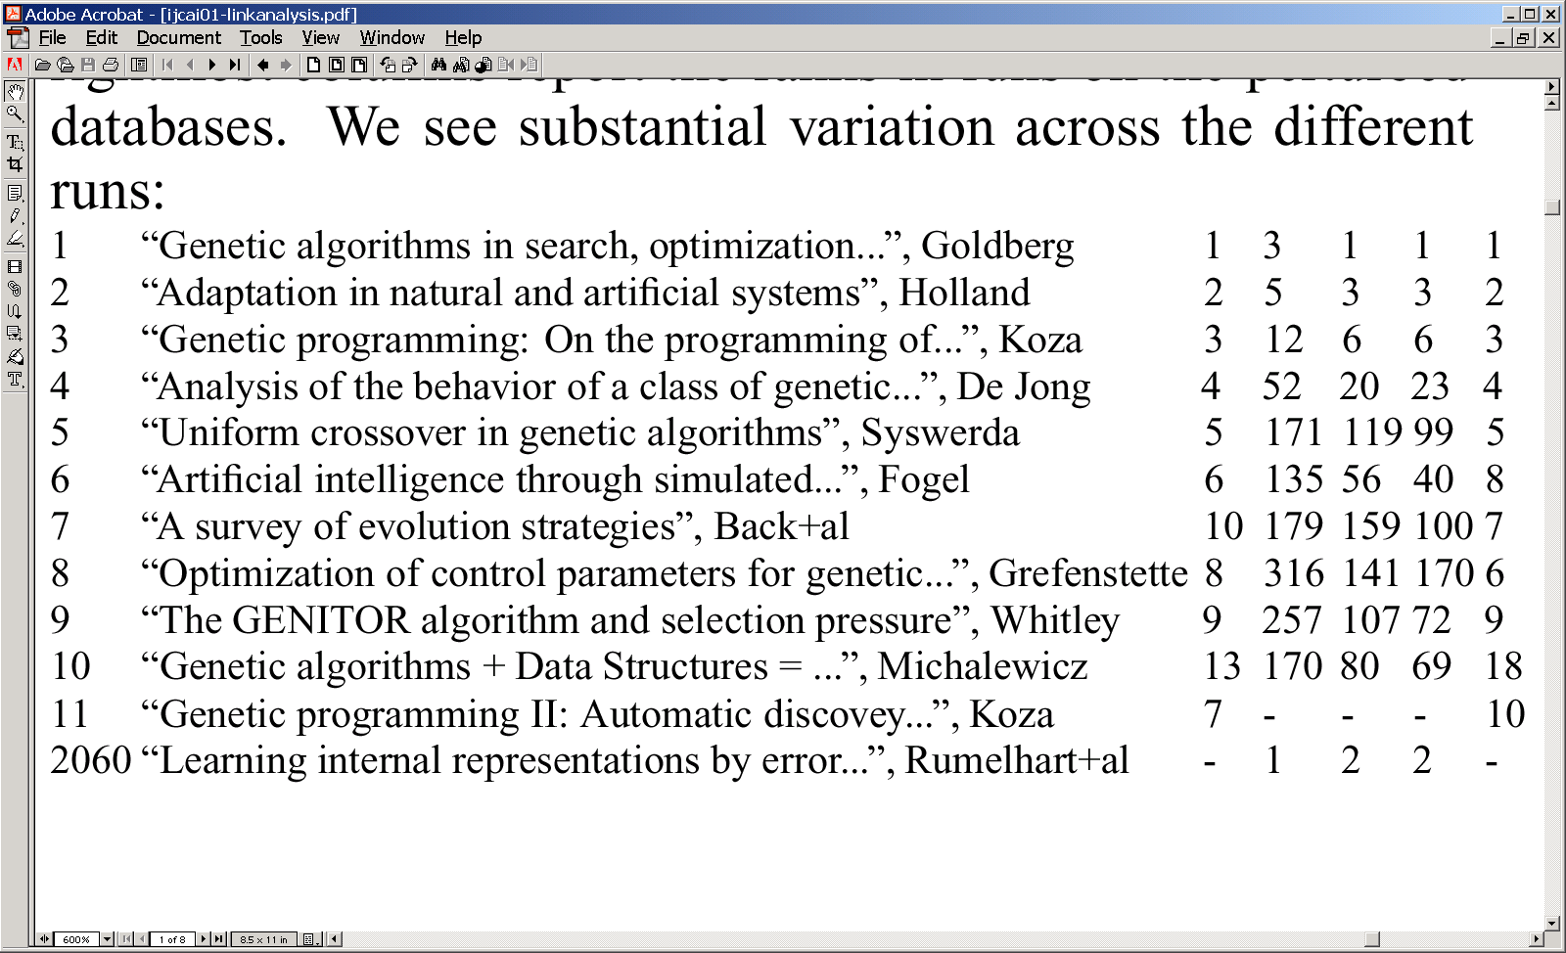
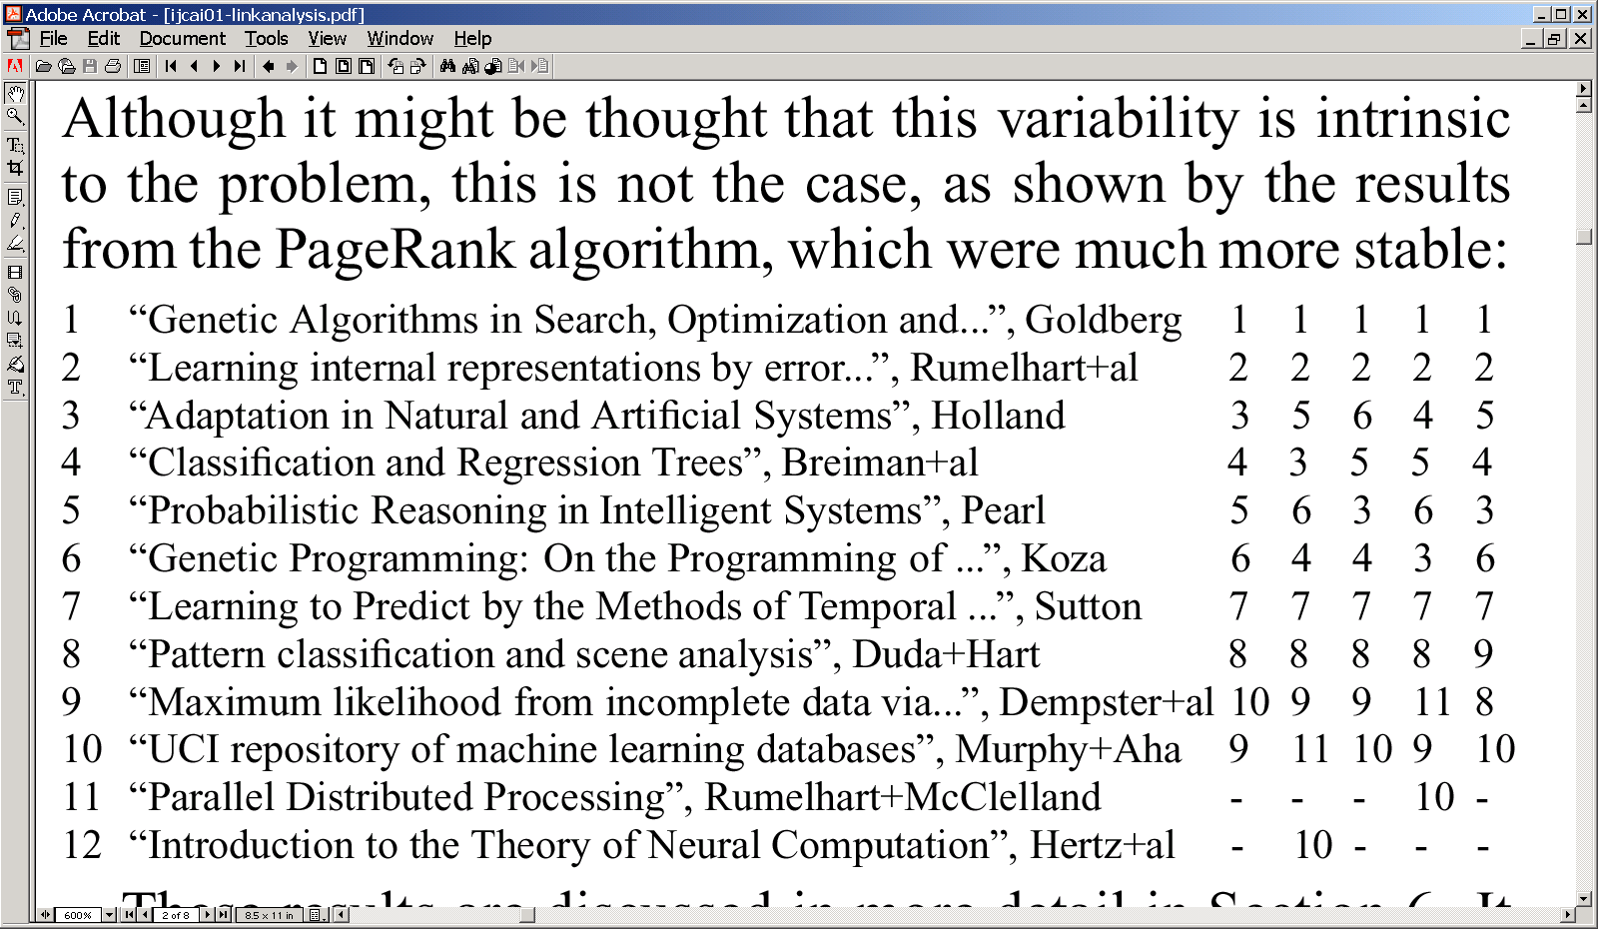
Stability of Rank
Calculations
(after random
Perturbation)
(From Ng et. al. )
The left most column
Shows the original rank
Calculation
-the columns on the right
are result of rank
calculations
when 30% of pages are
randomly removed

Slide 86
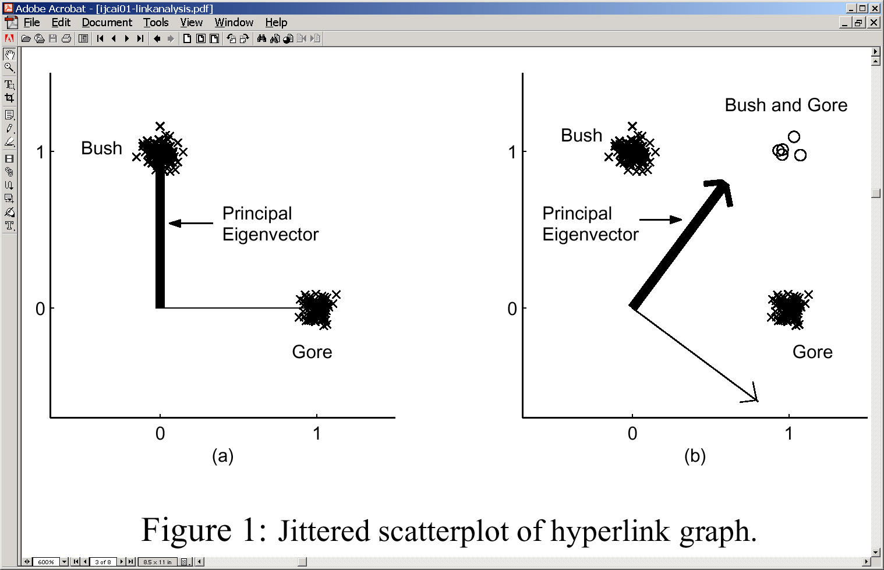
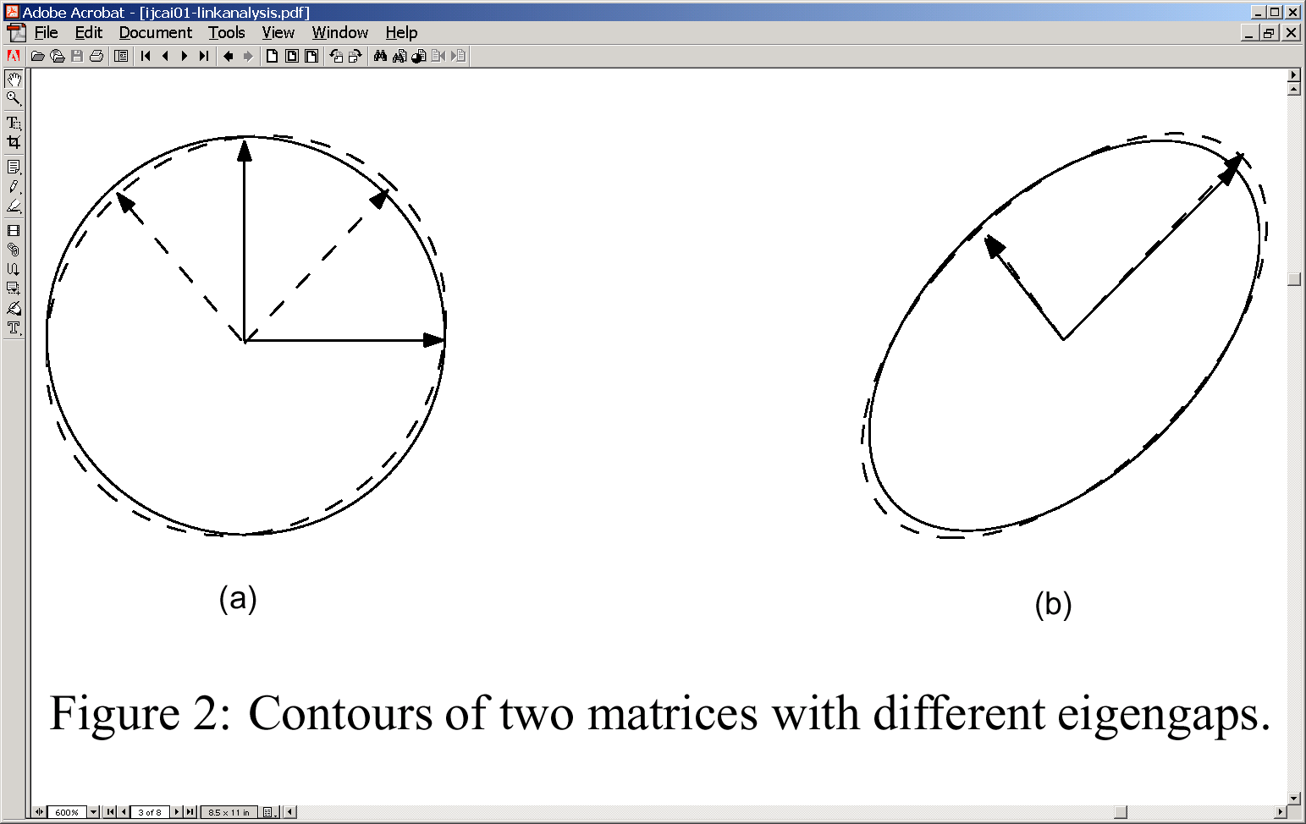
Two ways you can make
A/H just as stable
1. Put weak links for
the adjacency matrix
too
2. Consider the cross-product
of primary & secondary
eigen vectors
To improve stability,
focus on the plane defined by
the primary and secondary
eigen vectors (e.g. take the
cross product of the two…)

Slide 87
If you have lemons, make lemonade…
Or Finding Communities using Link Analysis
How to retrieve pages from smaller communities?
A method for finding pages in nth largest community:
  Identify the next largest community using the existing algorithm.
  Destroy this community by removing links associated with pages having large authorities.
  Reset all authority and hub values back to 1 and calculate all authority and hub values again.
  Repeat the above n − 1 times and the next largest community will be the nth largest community.

Slide 88
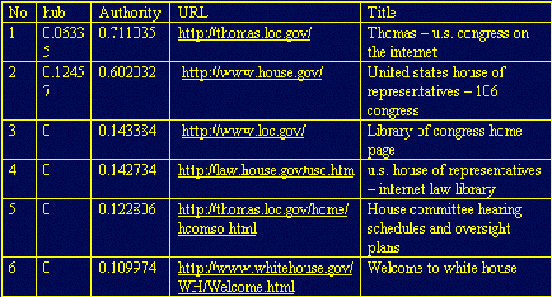
Multiple Clusters on “House”
Query: House (first community)
Notes:
Some queries may have several aspects, e.g., in the query "house" there will be web sites for White House and others for buying a house. From my basic algorithm, I can only retrieve those web sites for White House. It is certain that the House of Representatives and White House are the most famous "house" in the world, but people usually give more attention to buying a house.

Slide 89

Authority and Hub Pages (26)
Query: House (second community)
Notes:
In the second communities, we get a good site for buying a house. Because this community is not big, I can only retrieve two links.

Slide 90
Robustness against adversarial attacks…
Stability talks about “random” addition of links.
  Stability can be improved by introducing weak links
Robustness talks about the extent to which the importance measure can be co-opted by the adversaries..
Robustness is a bigger problem for “global” importance measures (as against query-dependent ones)
  Search King
  JC Penny/ Overstock in Spring 2011
    Mails asking you to put ads on your page…

Slide 91
Effect of collusion on PageRank
C
C
A
A
B
B
Assuming α=0.8 and K=[1/3]
Rank(A)=Rank(B)=Rank(C)=
0.5774
Rank(A)=0.37
Rank(B)=0.6672
Rank(C)=0.6461
Moral: By referring to each other, a cluster of pages can artificially boost
their rank (although the cluster has to be big enough to make an
appreciable difference.
Solution: Put a threshold on the number of intra-domain links that will count
Counter: Buy two domains, and generate a cluster among those..
Solution: Google dance→manually change the page rank once in a while…
Counter: Sue Google!

Slide 92
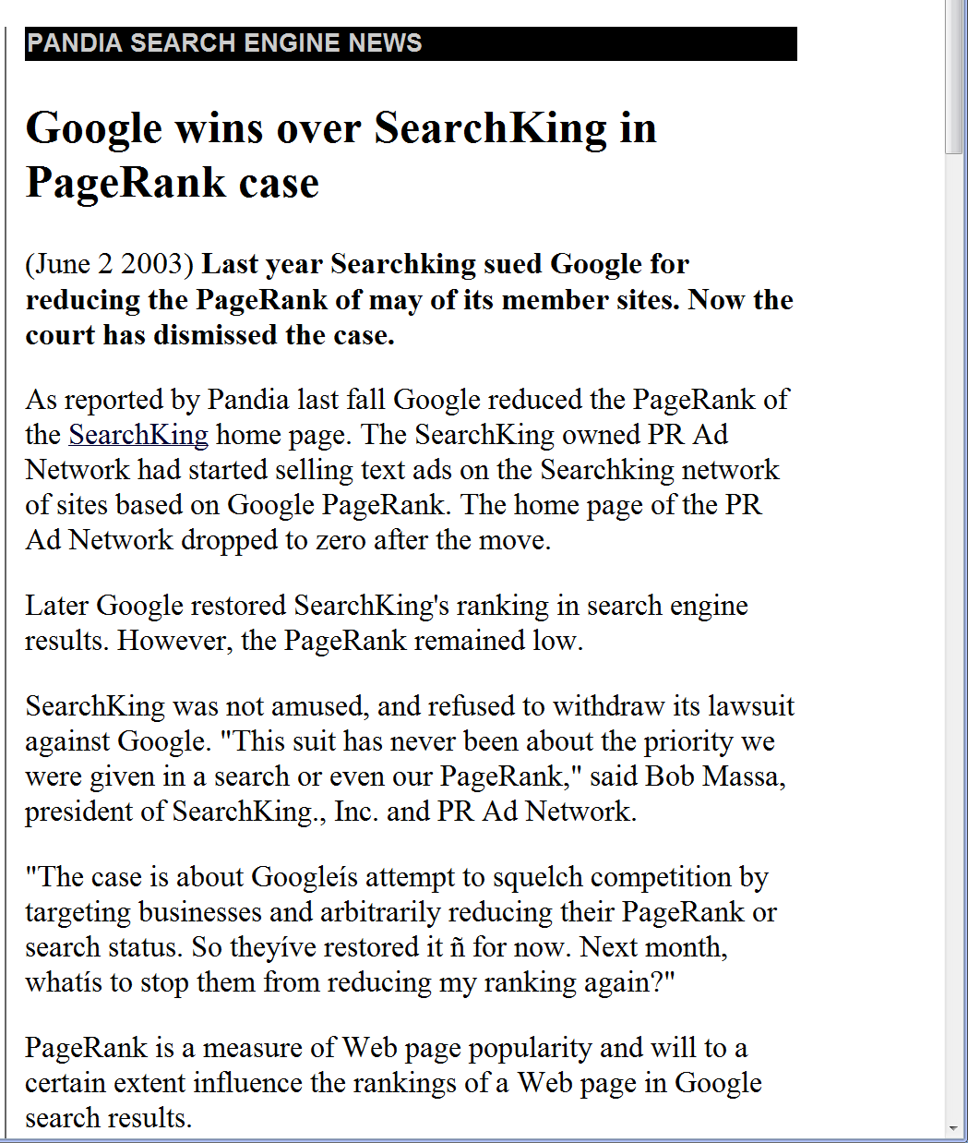

Slide 93
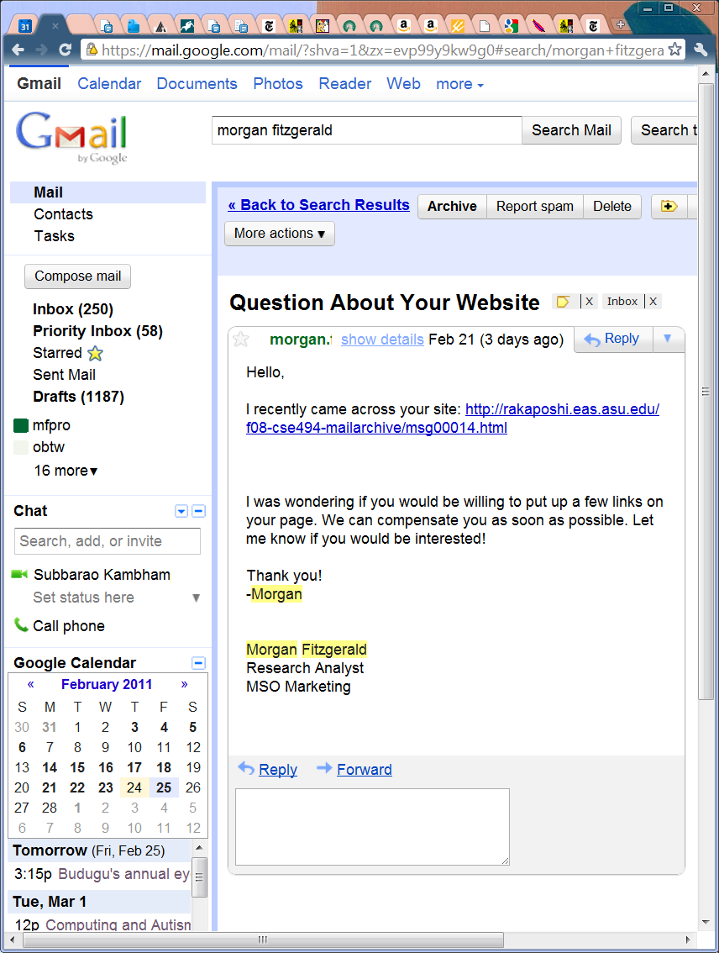
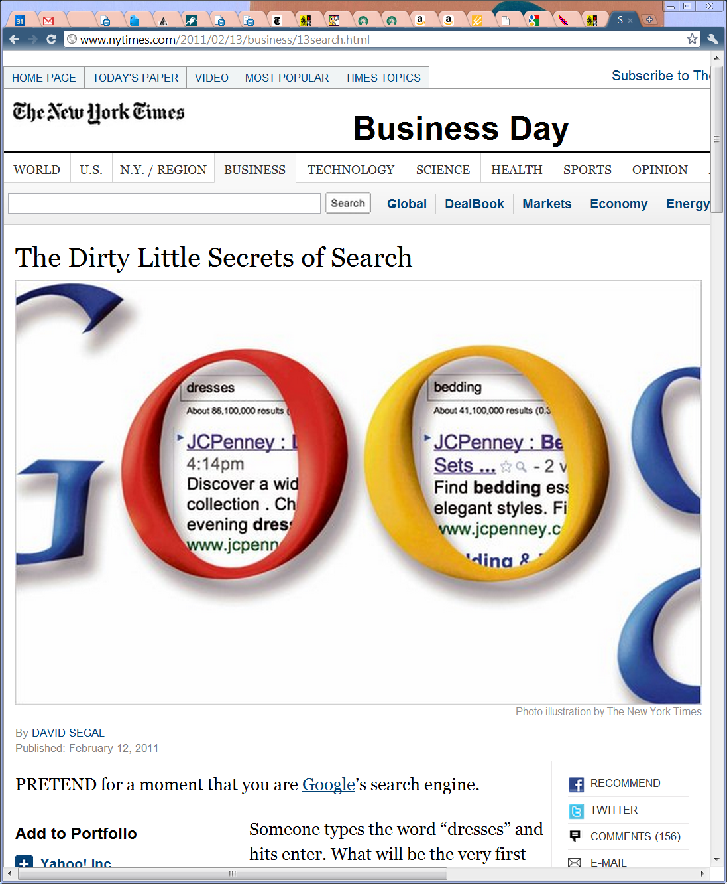

Page Farms & Content Farms

Slide 94
Content Farms
eHOW, Associated content etc
  Track what people are searching for
  Make up pages with those words, and have free lancers write shoddy articles
  Demand Media—which owned eHow—went public in Spring 2011 and became worth 1.6 billion dollars…
http://www.wired.com/magazine/2010/02/ff_google_algorithm/

Slide 95


Slide 96
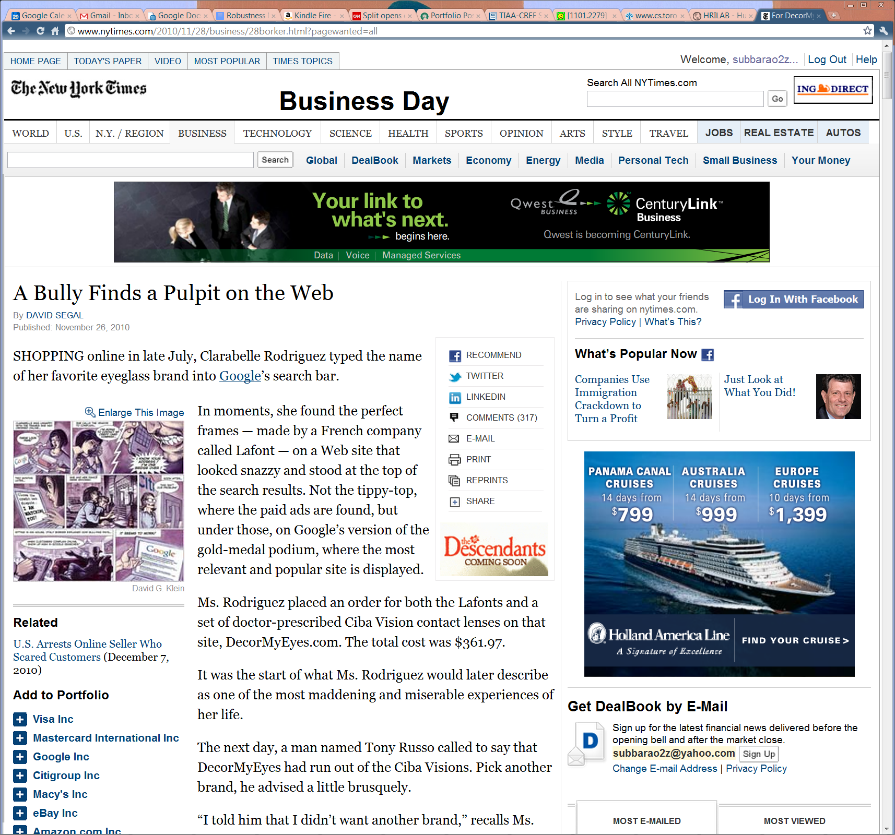
Why pay
when you
can induce
people to
put links
freely?
But how?
→ Be a good
business
(nyah—takes
too long)
→Be a bad
Business and
And people to
Put links to
Your page with
Their complaints

Slide 97
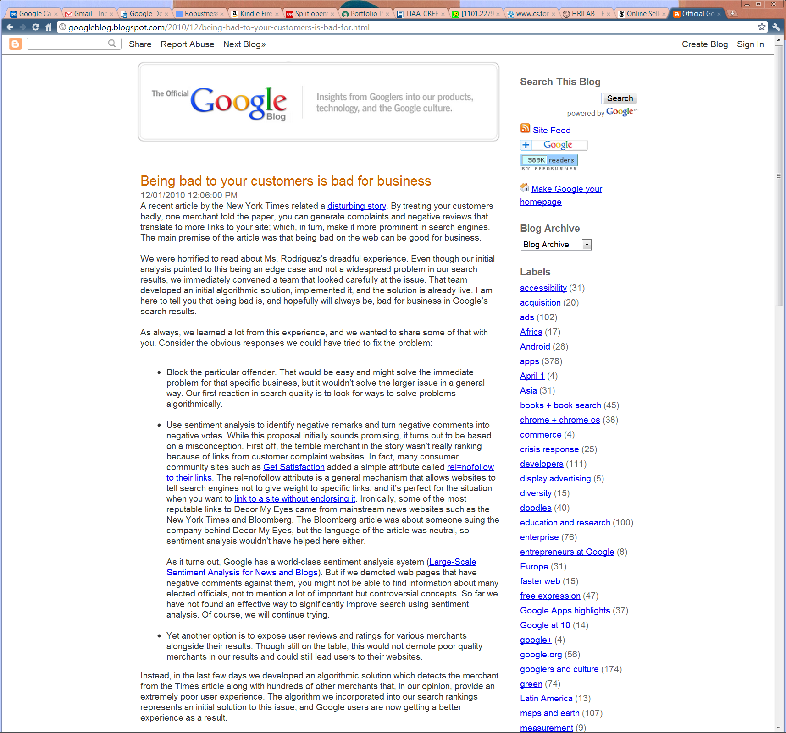

Slide 98
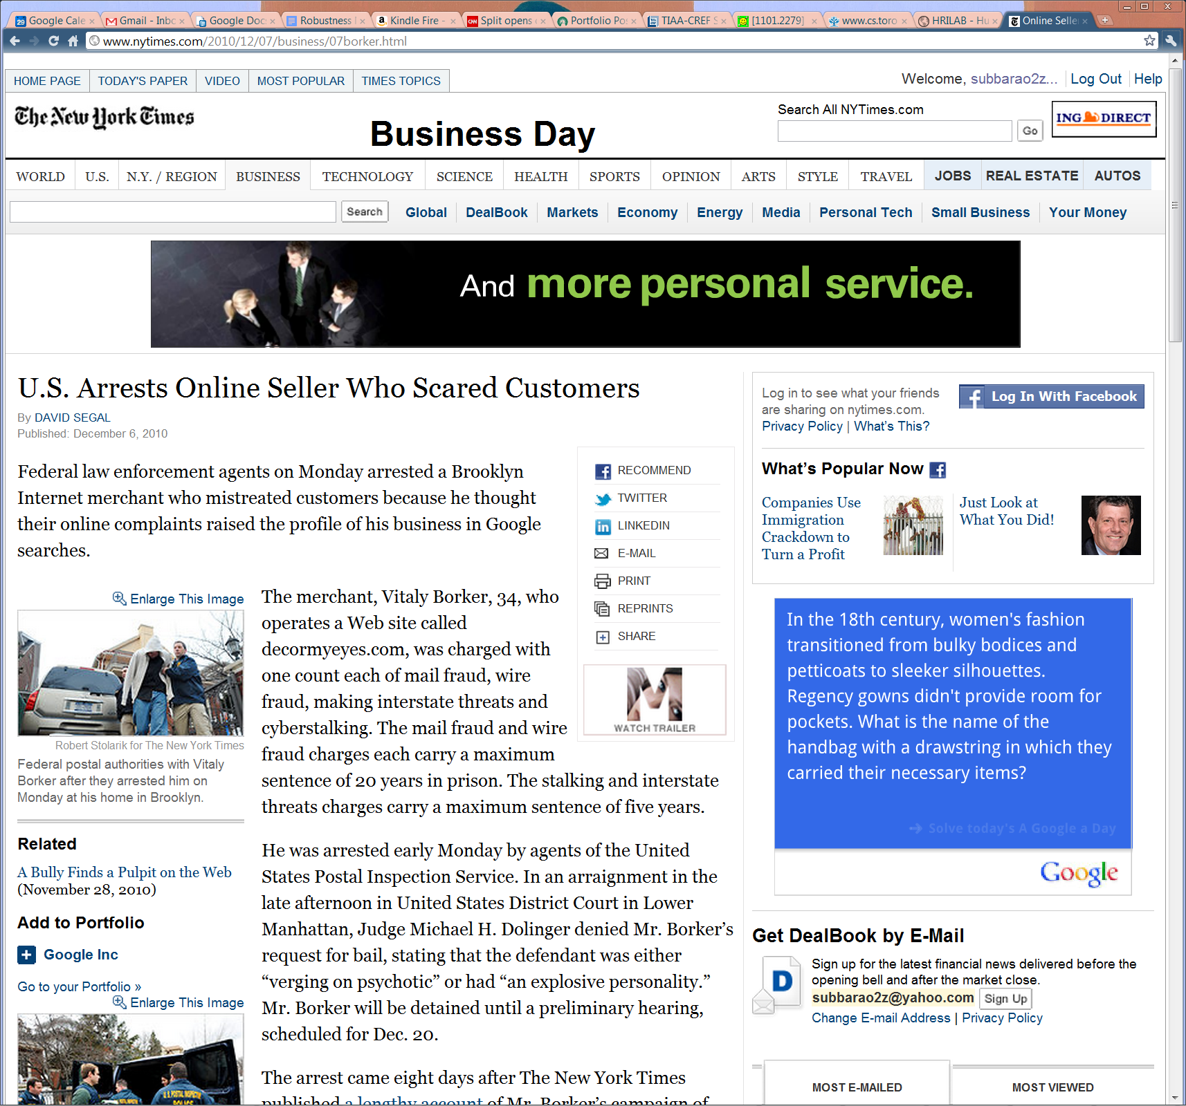
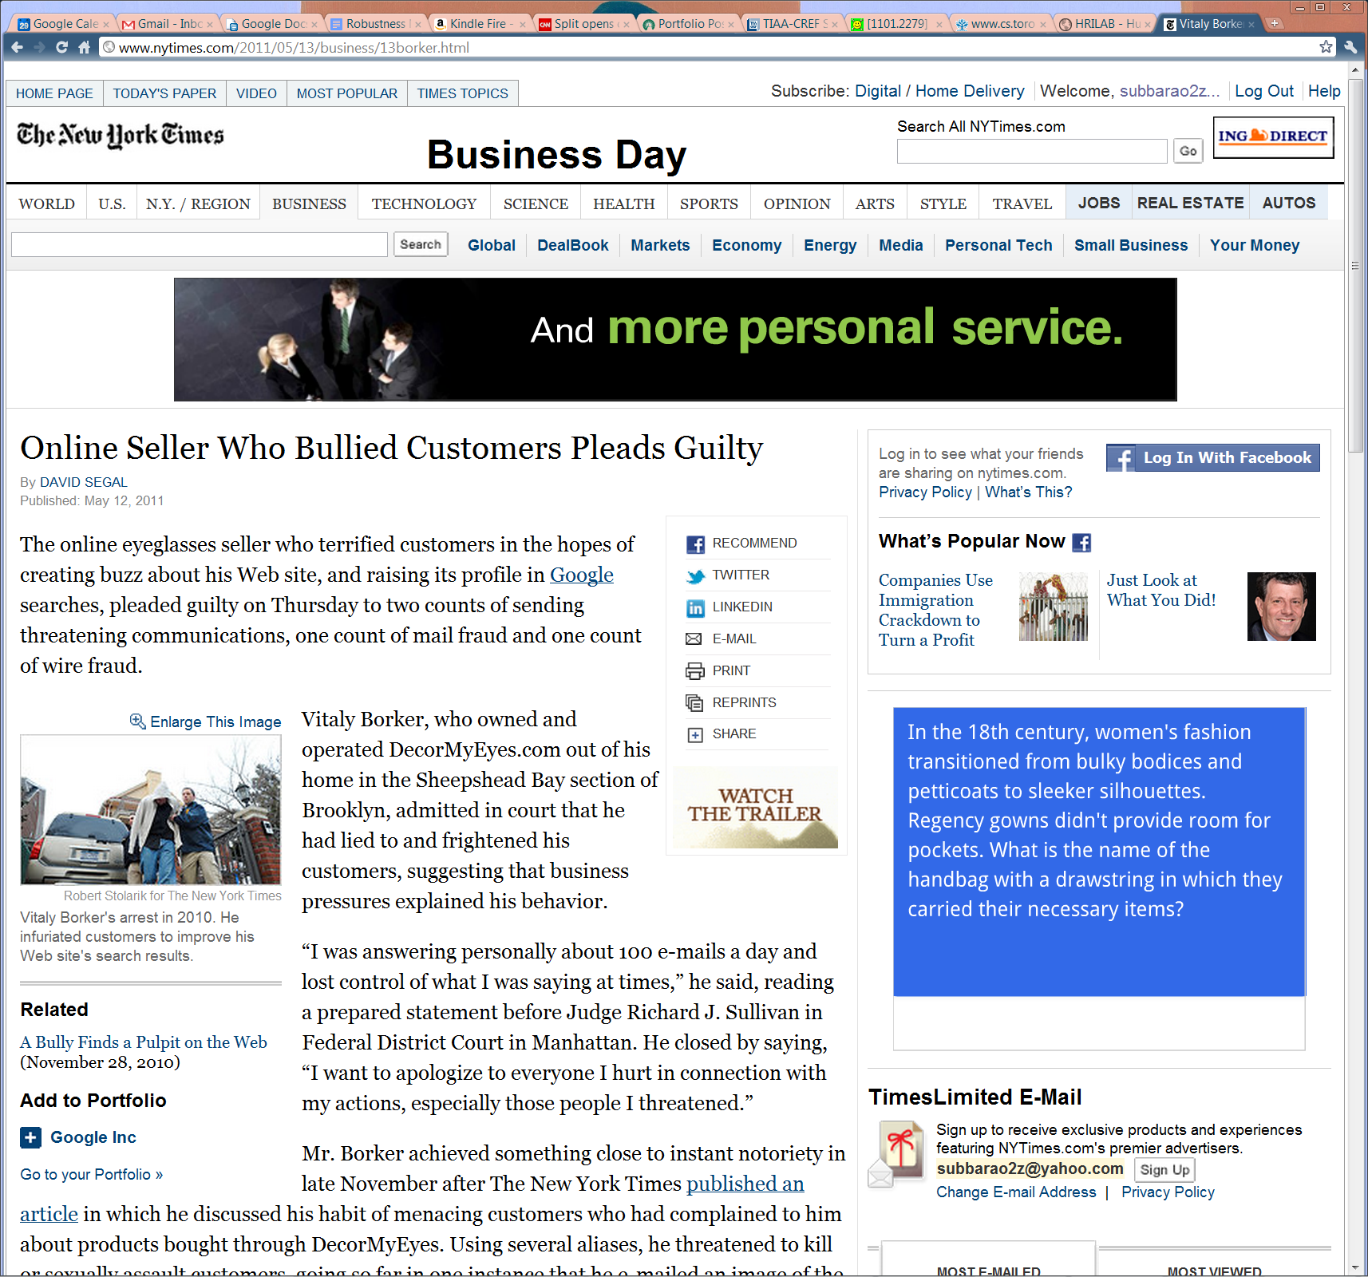
And another honest merchant who
Understood pagerank/link analysis
Is put behind bars ☹
Notes:
And another honest merchant who understood pagerank/link analysis is put behind bars ☹

Slide 99
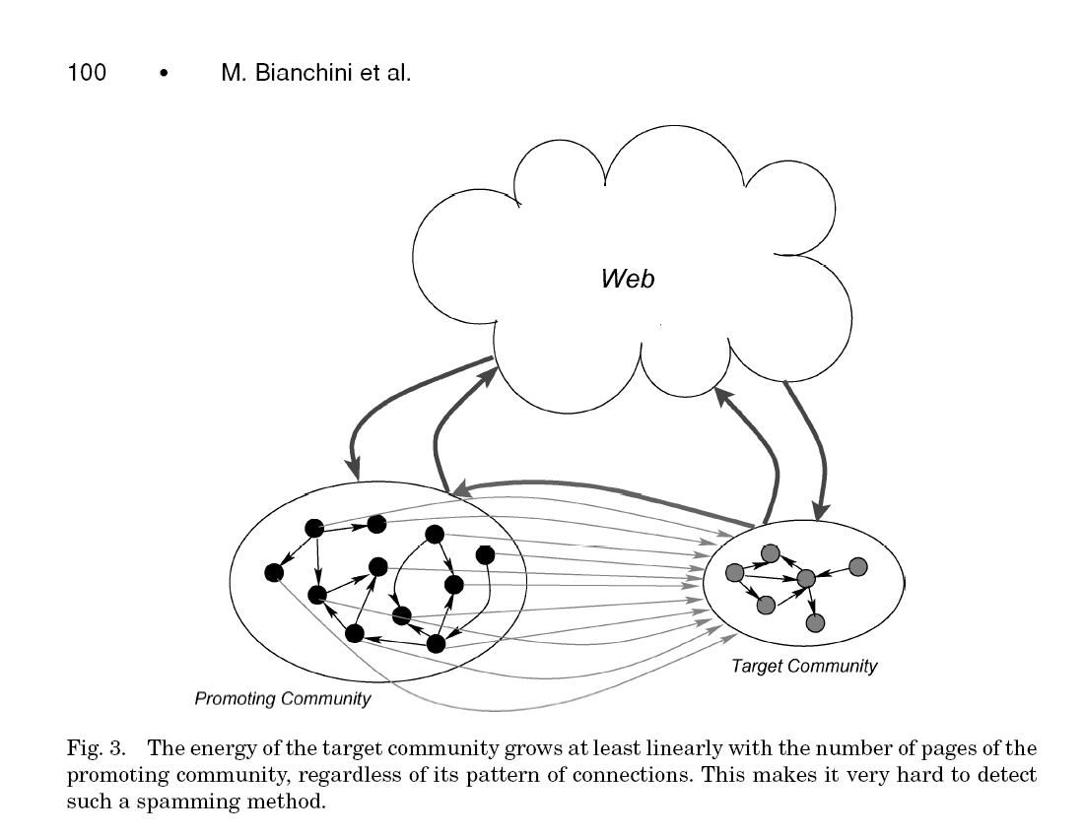

Slide 100
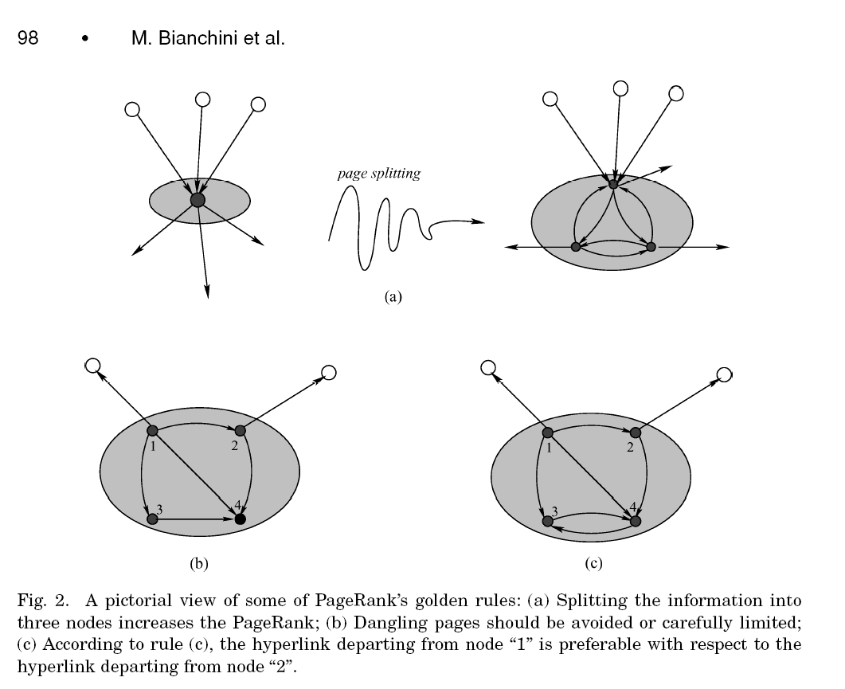

Slide 101
Stability (w.r.t. random change) and Robustness (w.r.t. Adversarial Change) of Link Importance measures
For random changes (e.g. a randomly added link etc.), we know that stability depends on ensuring that there are no disconnected components in the graph to begin with (e.g. the “standard” A/H computation is unstable w.r.t. bridges if there are disconnected componets—but become more stable if we add low-weight links from every page to every other page). We can always make up a story about these capturing transitions by impatient user ☺
For adversarial changes (where someone with an adversarial intent makes changes to link structure of the web, to artificially boost the importance of certain pages),
  It is clear that query specific importance measures (e.g. computed w.r.t. a base set) will be harder to sabotage.
  In contrast query (and user-) independent similarity measures are easier (since they provide a more stationary target).

Slide 102
Use of Link Information
PageRank defines the global importance of web pages but the importance is domain/topic independent.
We often need to find important/authoritative pages which are relevant to a given query.
  What are important web browser pages?
  Which pages are important game pages?
    Idea: Use a notion of topic-specific page rank
      Involves using a non-uniform probability

Slide 103
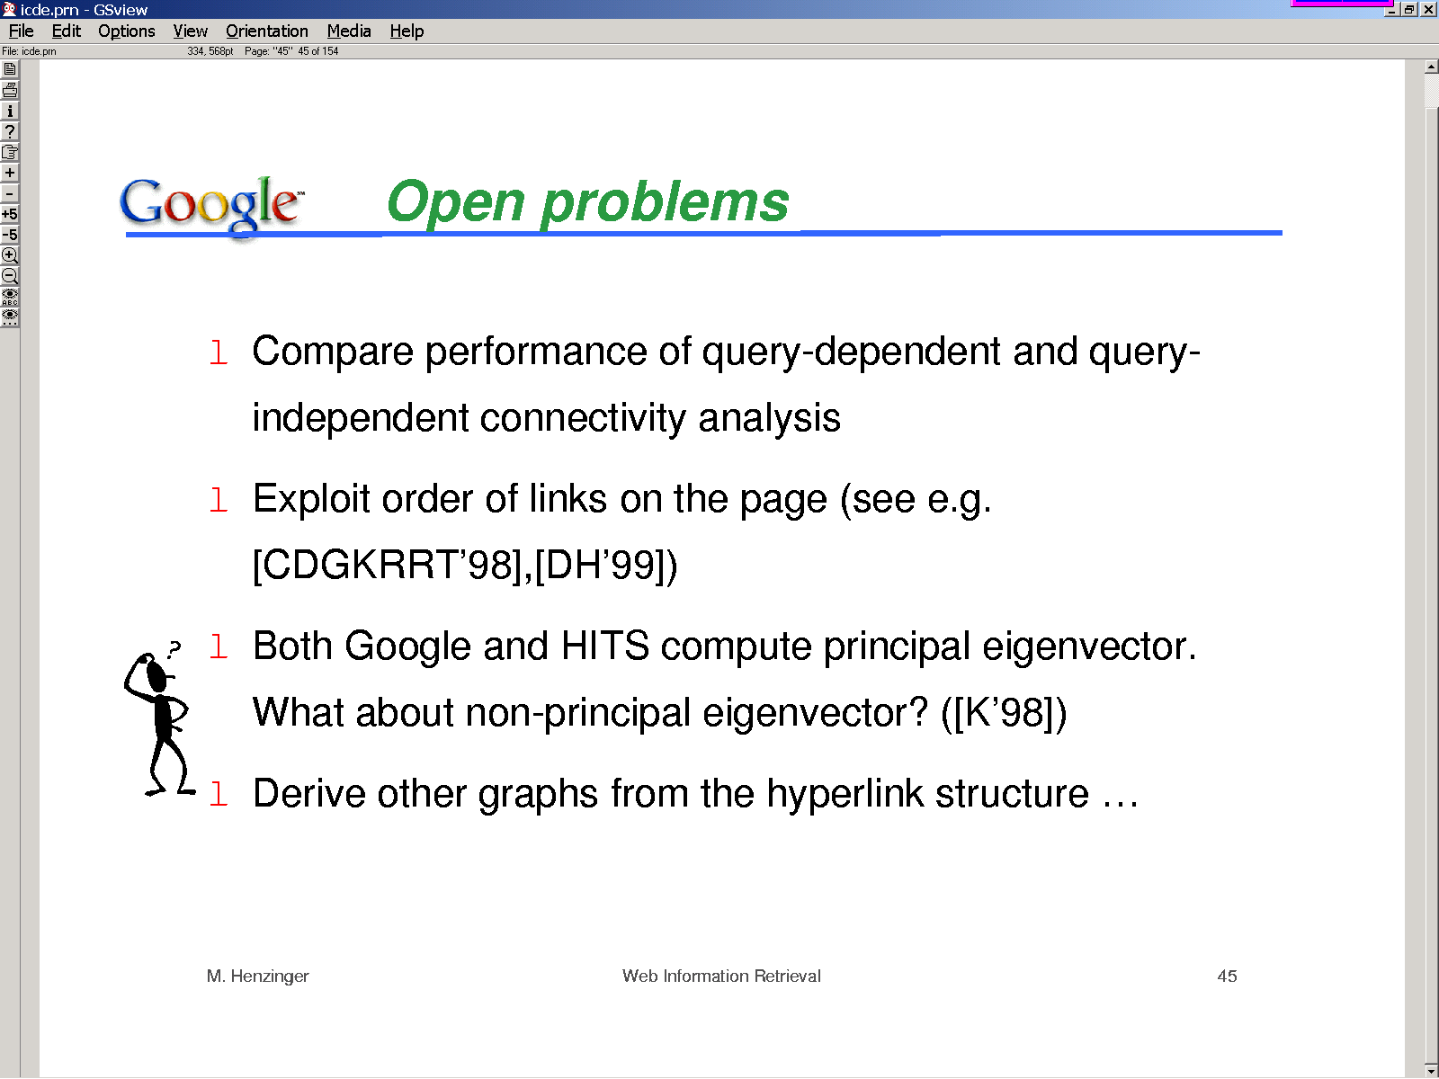

Slide 104
Query complexity
Complex queries (966 trials)
  Average words 7.03
  Average operators (+*–") 4.34
Typical Alta Vista queries are much simpler [Silverstein, Henzinger, Marais and Moricz]
  Average query words 2.35
  Average operators (+*–") 0.41
Forcibly adding a hub or authority node helped in 86% of the queries
Notes:
Picked 966 nodes from Yahoo!
Constructed simple Alta Vista queries by trial and error until topic
distillation produced resources that were indistinguishable in quality
from Yahoo! As judged by a blind tester.
Queries got quite tricky and non-trivial to frame. You saw an example
a moment earlier. We had to use ...
In some cases, the best bet was to do feature selection manually.
Upon somehow finding that Lufthansa and KLM are examples of
the topic “european airlines,” we added these names to the query.

Slide 105
What about non-principal eigen vectors?
Principal eigen vector gives the authorities (and hubs)
What do the other ones do?
  They may be able to show the clustering in the documents (see page 23 in Kleinberg paper)
    The clusters are found by looking at the positive and negative ends of the secondary eigen vectors (ppl vector has only +ve end…)

Slide 106
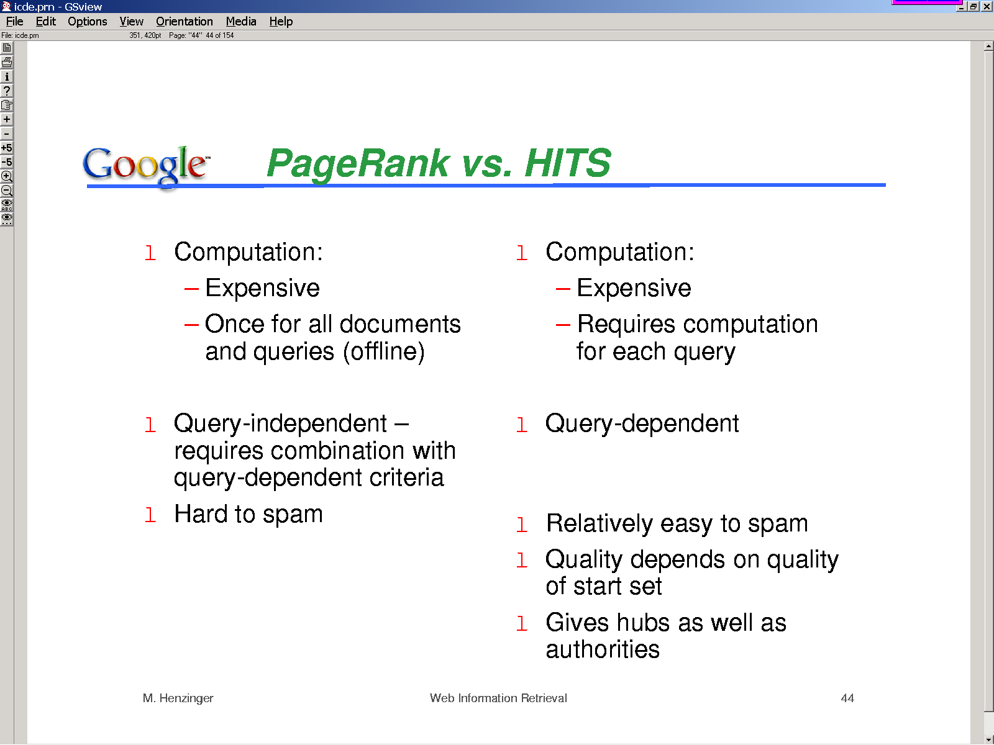
Can be done
For base set too
Can be done
For full web too
Query relevance vs. query time computation tradeoff
See topic-specific
Page-rank idea..
More stable because
random surfer model
allows low prob edges
to every place.CV
Can be made stable with subspace-based
A/H values [see Ng. et al.; 2001]

Slide 107
Beyond Google (and Pagerank)
Are backlinks reliable metric of importance?
  It is a “one-size-fits-all” measure of importance…
    Not user specific
    Not topic specific
  There may be discrepancy between back links and actual popularity (as measured in hits)
        The “sense” of the link is ignored (this is okay if you think that all publicity is good publicity)
    Mark Twain on Classics
      “A classic is something everyone wishes they had already read and no one actually had..” (paraphrase)
    Google may be its own undoing…(why would I need back links when I know I can get to it through Google?)
Customization, customization, customization…
  Yahoo sez about their magic bullet.. (NYT 2/22/04)
      "If you type in flowers, do you want to buy flowers, plant flowers or see pictures of flowers?"

Slide 108
Challenges in Web Search Engines
Spam
  Text Spam
  Link Spam
  Cloaking
Content Quality
  Anchor text quality
Quality Evaluation
  Indirect feedback
Web Conventions
  Articulate and develop validation
Duplicate Hosts
  Mirror detection
Vaguely Structured Data
  Page layout
  The advantage of making rendering/content language be same

