Slide 1
Indexing & Tolerant Dictionaries
The pdf image slides are from Hinrich Schütze’s slides,

Slide 2
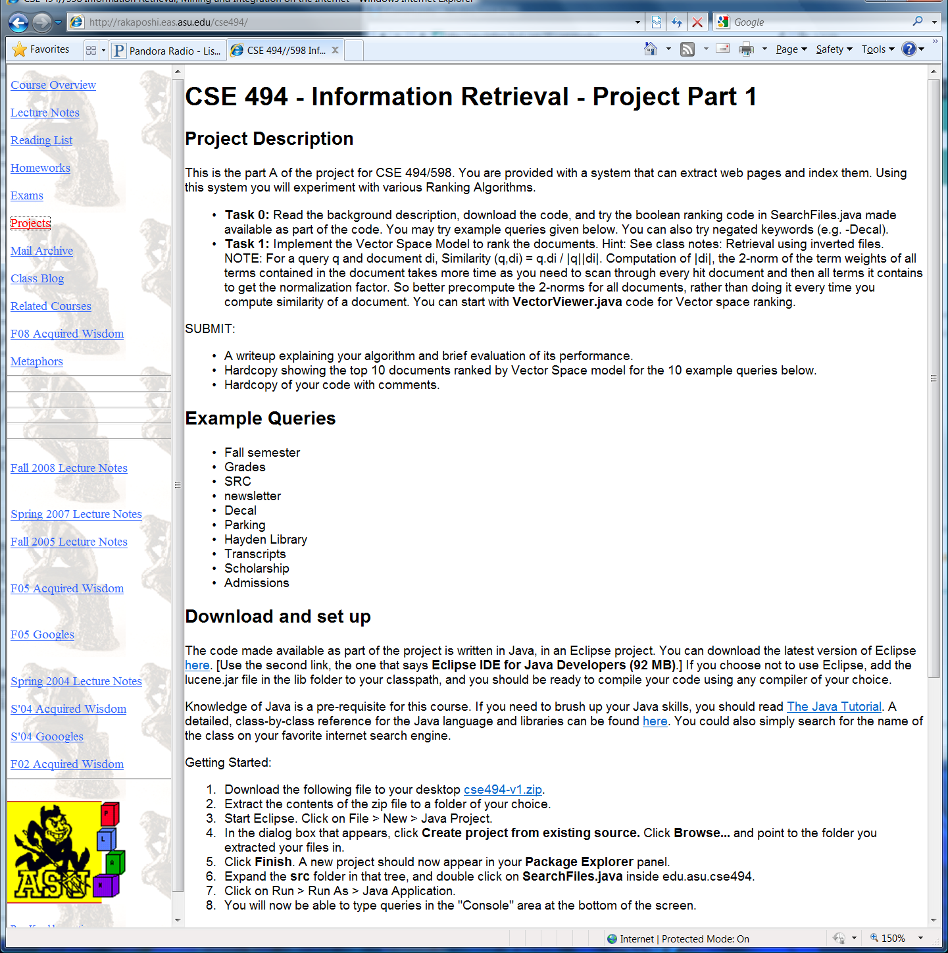

Slide 3
Efficient Retrieval
Document-term matrix
t₁ t₂ . . . t_{j} . . . t_{m} nf
d₁ w₁₁ w₁₂ . . . w_{1j} . . . w_{1m} 1/|d₁|
d₂ w₂₁ w₂₂ . . . w_{2j} . . . w_{2m} 1/|d₂|
. . . . . . . . . . . . . .
d_{i} w_{i1} w_{i2} . . . w_{ij} . . . w_{im} 1/|d_{i}|
. . . . . . . . . . . . . .
d_{n} w_{n1} w_{n2} . . . w_{nj} . . . w_{nm} 1/|d_{n}|
w_{ij} is the weight of term t_{j} in document d_{i}
Most w_{ij}’s will be zero.

Slide 4
Naïve retrieval
Consider query q = (q₁, q₂, …, q_{j}, …, q_{n}), nf = 1/|q|.
How to evaluate q (i.e., compute the similarity between q and every document)?
Method 1: Compare q with every document directly.
document data structure:
d_{i} : ((t₁, w_{i1}), (t₂, w_{i2}), . . ., (t_{j}, w_{ij}), . . ., (t_{m}, w_{im} ), 1/|d_{i}|)
Only terms with positive weights are kept.
Terms are in alphabetic order.
query data structure:
q : ((t₁, q₁), (t₂, q₂), . . ., (t_{j}, q_{j}), . . ., (t_{m}, q_{m} ), 1/|q|)

Slide 5
Naïve retrieval
Method 1: Compare q with documents directly (cont.)
Algorithm
initialize all sim(q, d_{i}) = 0;
for each document di (i = 1, …, n)
{ for each term t_{j} (j = 1, …, m)
if t_{j} appears in both q and d_{i}
sim(q, d_{i}) += q_{j} ∗w_{ij};
sim(q, d_{i}) = sim(q, d_{i}) ∗(1/|q|) ∗(1/|d_{i}|); }
sort documents in descending similarities and
display the top k to the user;

Slide 6
Observation
Method 1 is not efficient
Needs to access most non-zero entries in doc-term matrix.
Solution: Inverted Index
Data structure to permit fast searching.
Like an Index in the back of a text book.
Key words --- page numbers.
E.g, precision, 40, 55, 60-63, 89, 220
Lexicon
Occurrences

Slide 7
Search Processing (Overview)
Lexicon search
E.g. looking in index to find entry
Retrieval of occurrences
Seeing where term occurs
Manipulation of occurrences
Going to the right page

Slide 8
Inverted Files
POS
1
10
20
30
36
FILE
A file is a list of words by position
First entry is the word in position 1 (first word)
Entry 4562 is the word in position 4562 (4562nd word)
Last entry is the last word
An inverted file is a list of positions by word!
a (1, 4, 40)
entry (11, 20, 31)
file (2, 38)
list (5, 41)
position (9, 16, 26)
positions (44)
word (14, 19, 24, 29, 35, 45)
words (7)
4562 (21, 27)
INVERTED FILE

Slide 9
Inverted Files for Multiple Documents
Can also store
precomputed “tf”
LEXICON
“jezebel” occurs
6 times in document 34,
3 times in document 44,
4 times in document 56 . . .
DOCID OCCUR POS 1 POS 2 . . .
…
OCCURENCE INDEX
. . .
Positional information is useful for (a) proximity queries and
(b) snippet construction

Slide 10
Many Variations Possible
Address space (flat, hierarchical)
Position
TF /IDF info precalculated
Header, font, tag info stored
Compression strategies

Slide 11
Using Inverted Files
Several data structures:
For each term t_{j}, create a list (inverted file list) that contains all document ids that have t_{j}.
I(t_{j}) = { (d₁, w_{1j}), (d₂, w_{2j}), …, (d_{i}, w_{ij}), …, (d_{n}, w_{nj}) }
d_{i} is the document id number of the ith document.
Weights come from freq of term in doc
Only entries with non-zero weights should be kept.

Slide 12
Inverted files continued
More data structures:
Normalization factors of documents are pre-computed and stored in an array: nf[i] stores 1/|d_{i}|.
Lexicon: a hash table for all terms in the collection.
. . . . . .
t_{j} pointer to I(t_{j})
. . . . . .
Inverted file lists are typically stored on disk.
The number of distinct terms is usually very large.

Slide 13
Retrieval using Inverted files
Algorithm
initialize all sim(q, d_{i}) = 0;
for each term t_{j} in q
{ find I(t) using the hash table;
for each (d_{i}, w_{ij}) in I(t)
sim(q, d_{i}) += q_{j} ∗w_{ij}; }
for each document di
sim(q, d_{i}) = sim(q, d_{i}) ∗ nf[i];
sort documents in descending similarities and
display the top k to the user;
Term centered rather than
document centered…
Use something like this
as part of your
Project..

Slide 14
Observations about Method 2
If a document d does not contain any term of a given query q, then d will not be involved in the evaluation of q.
Only non-zero entries in the columns in the document-term matrix corresponding to the query terms are used to evaluate the query.
Computes the similarities of multiple documents simultaneously (w.r.t. each query word)

Slide 15
Efficient Retrieval
Example (Method 2): Suppose
q = { (t1, 1), (t3, 1) }, 1/|q| = 0.7071
d1 = { (t1, 2), (t2, 1), (t3, 1) }, nf[1] = 0.4082
d2 = { (t2, 2), (t3, 1), (t4, 1) }, nf[2] = 0.4082
d3 = { (t1, 1), (t3, 1), (t4, 1) }, nf[3] = 0.5774
d4 = { (t1, 2), (t2, 1), (t3, 2), (t4, 2) }, nf[4] = 0.2774
d5 = { (t2, 2), (t4, 1), (t5, 2) }, nf[5] = 0.3333
I(t1) = { (d1, 2), (d3, 1), (d4, 2) }
I(t2) = { (d1, 1), (d2, 2), (d4, 1), (d5, 2) }
I(t3) = { (d1, 1), (d2, 1), (d3, 1), (d4, 2) }
I(t4) = { (d2, 1), (d3, 1), (d4, 1), (d5, 1) }
I(t5) = { (d5, 2) }

Slide 16
Efficient Retrieval
q = { (t1, 1), (t3, 1) }, 1/|q| = 0.7071
d1 = { (t1, 2), (t2, 1), (t3, 1) }, nf[1] = 0.4082
d2 = { (t2, 2), (t3, 1), (t4, 1) }, nf[2] = 0.4082
d3 = { (t1, 1), (t3, 1), (t4, 1) }, nf[3] = 0.5774
d4 = { (t1, 2), (t2, 1), (t3, 2), (t4, 2) }, nf[4] = 0.2774
d5 = { (t2, 2), (t4, 1), (t5, 2) }, nf[5] = 0.3333
I(t1) = { (d1, 2), (d3, 1), (d4, 2) }
I(t2) = { (d1, 1), (d2, 2), (d4, 1), (d5, 2) }
I(t3) = { (d1, 1), (d2, 1), (d3, 1), (d4, 2) }
I(t4) = { (d2, 1), (d3, 1), (d4, 1), (d5, 1) }
I(t5) = { (d5, 2) }
After t1 is processed:
sim(q, d1) = 2, sim(q, d2) = 0, sim(q, d3) = 1
sim(q, d4) = 2, sim(q, d5) = 0
After t3 is processed:
sim(q, d1) = 3, sim(q, d2) = 1, sim(q, d3) = 2
sim(q, d4) = 4, sim(q, d5) = 0
After normalization:
sim(q, d1) = .87, sim(q, d2) = .29, sim(q, d3) = .82
sim(q, d4) = .78, sim(q, d5) = 0

Slide 17
Approximate ranking
Motivation: We want to further reduce the documents for which we compute the
query distance, without affecting the top-10 results too much (even at the expense
of ranking a 2014th document as 2019th!)
→We are willing to do this because (a) most users want high precisions
at low recalls (except of course the guy who wrote the 2014th ranked doc ☺)
(b) the ranking process—based as it is on vector similarity is not all that
sacrosanct anyway…
Query based ideas
Idea 1: Don’t consider documents that have less than k of the query words
Idea 2: Don’t consider documents that don’t have query words with IDF above a threshold
Idea 2 generalizes Idea 1
Document corpus-based ideas
Split documents into different (at least two) barrels of decreasing importance but increasing size (e.g 20% top docs in the short barrel and 80% remaining docs in the long barrel). Focus on the short barrel first in looking for top 10 matches
How to split into barrels?
Based on some intrinsic measure of importance of the document
E.g. short barrel contains articles published in prestigious journals
E.g. short barrel contains pages with high page rank
Can combine both

Slide 18
What is indexed?
Traditional IR only indexed “keywords”
Which are either manually given
Or automatically generated through text operations
Stemming, stopword elimination etc.
Modern search engines index the full text.

Slide 19
Generating keywords (index terms) in traditional IR
Accents
spacing
Noun
groups
Manual
indexing
Docs
stopwords
stemming
structure
structure
Full text
Index terms
Stop-word elimination
Noun phrase detection
“data structure” “computer architecture”
Stemming (Porter Stemmer for English)
If suffix of a word is “IZATION” and prefix contains at least one vowel followed by a consonant, then replace suffix with “IZE” (e.g. Binarization→Binarize)
Generating index terms
Improving quality of terms.
(e.g. Synonyms, co-occurence
detection, latent semantic indexing..

Slide 20
Example of Stemming and Stopword Elimination
The number of Web pages on the World Wide Web was
estimated to be over 800 million in 1999.
Stop word elimination
Stemming
So does Google use stemming?
All kinds of stemming?
Stopword elimination?
Any non-obvious stop-words?

Slide 21
Why do stop word
elimination?
Reduces the index size
Improves answer relevance
“the rose” is converted to
“rose”
Modern search engines don’t
care about size of the index
But how about the relevance
part?
Idf weight takes care of it
to a certain extent

Slide 22
Barrels vs. Collections
We talked about distributing a central index onto multiple machines by splitting it into barrels
A related scenario is one where instead of a single central document base, we have a set of separate document collections, each with their own index. You can think of each collection as a “barrel”
Examples include querying multiple news source (NYT, LA Times etc), or “meta search engines” like dogpile and metacrawler that outsource the query to other search engines.
And we need to again do result retrieval from each collection followed by result merging
One additional issue in such cases is the “collection selection”— If you can call only k collections, which k collections would you choose?
A simple idea is to get a sample of documents from each collection, consider the sample as a super document representing the collection. We now have n super-documents. We can do tf/idf weights and vector similarity ranking on top of the n super docs to pick the top k superdocs nearest to the query, and then call those collections.

Slide 23
Efficiency versus Flexibility
Storing computed document weights is good for efficiency but bad for flexibility.
Recomputation needed if tf and idf formulas change and/or tf and df information change.
Flexibility is improved by storing raw tf and df information but efficiency suffers.
A compromise
Store pre-computed tf weights of documents.
Use idf weights with query term tf weights instead of document term tf weights.

Slide 24
Tolerant Dictionaries
Ability to retrieve vocabulary terms with misspellings and mistypings
Ideally, the correction depends on our model of how errors/mistypings are made
If we think errors are made because no one can quite remember the spelling
Use k-gram methods
K-grams are to words what k-shingles are to documents—a contiguous sequence of k letters in the word
Or Use phonetic correction methods
If we think errors are made because of the specific way words are input
Consider edit distances between words
Need a way to compute distances between words
One idea is to use “k-gram” distance
K-grams are to words what k-shingles are to documents—a contiguous sequence of k letters in the word
Another idea is to use “edit distances”—i.e., how many small typing errors (e.g. addition, deletion, swapping etc) are needed to convert a word into another word
See connection to query expansion?

Slide 25
Tolerant Dictionaries
Ability to retrieve vocabulary terms with misspellings and mistypings
Ideally, the correction depends on our model of how errors/mistypings are made
If we think errors are made because no one can quite remember the spelling
Use k-gram methods
Or Use phonetic correction methods
If we think errors are made because of the specific way words are input
Consider edit distances between words
i.e., how many small typing errors (e.g. addition, deletion, swapping etc) are needed to convert a word into another word
See connection to query expansion?

Slide 26
Will work even if the words
are of differing lengths
(Or use Jaccard distance)
How do we decide what is a correct word?
→Webster dictionary: Would be good but it may not have all the special-purpose words
→So, use lexicon of the inverted index itself
→ The postings list contains the number
of times a word appears in the corpus.
If it is “high” you can assume it is a correct word..
Correction can also be
done w.r.t. query logs
rather than document
corpus..

Slide 28
Where do you get the weights?
--Learn…

Slide 29
Edit distance and Optimal Alignment
Finding the levenshtein distance between two strings is non-trivial, as we need to find the minimum number of changes needed. For this you need to align the strings correctly first
E.g. Consider umbrella and mbkrella.
If you start with the first alignment, then it looks like every character is wrong (u replaced by m; m by b etc), giving a distance of 7—since one of the ls does align).
If you shift the second word one position to the right and compare, then you will see that you have a distance of 2 (u deleted and k added)
Conceptually you want to first find the best alignment and compute distance wrt it. Turns out that these two phases can be done together using dynamic programming algorithms
See Manning et. al. chapter on tolerant retrieval.
Umbrella
Mbrellat
mbrellat
Similar to sequence alignment task in genetics, dynamic time warping
in speech recognition

Slide 30
Motivation: To reduce computation, we want to focus not on all words in the
dictionary but a subset of them
e.g. all words with at most
one Levenshtein error

Slide 31
http://norvig.com/spell-correct.html

Slide 32
Bayesian account of Spelling Correction
Given a dictionary of words
A partial or complete typing of a “word”
Complete/Correct the word
argmax_{c} P(c|w)
argmax_{c} P(w|c) P(c) / P(w)
P(w|c) →Error model
What is the probability that you will type w when you meant c?
Different kinds of errors (e.g. letter swapping) have different prob
Consider edit distance
P(c) → “language model”
How frequent is c in the language that is used?
“fallacy of the prior” or how people get all hypochondriac because they think they have symptoms of a fatal disease (which turns out to be extremely rare)
In Auto-completion, you are trying to
suggest most likely completion of the
word you are typing…(even in face of
typing errors—a la Ipod.)
http://norvig.com/spell-correct.html

Slide 33
Rest of the slides not covered will return to them in connection with web search

Slide 34
Distributing indexes over hosts
At web scale, the entire inverted index can’t be held on a single host.
How to distribute?
Split the index by terms
Split the index by documents
Preferred method is to split it by docs (!)
Each index only points to docs in a specific barrel
Different strategies for assigning docs to barrels
At retrieval time
Compute top-k docs from each barrel
Merge the top-k lists to generate the final top-k
Result merging can be tricky..so try to punt it
Idea
Consider putting most “important” docs in top few barrels
This way, we can ignore worrying about other barrels unless the top barrels don’t return enough results
Another idea
Split the top 20 and bottom 80% of the doc occurrences into different indexes..
Short vs. long barrels
Do search on short ones first and then go to long ones as needed

Slide 35
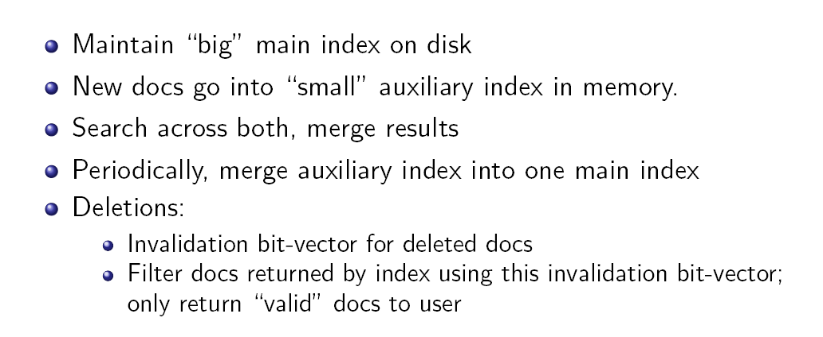
Dynamic Indexing
“simplest” approach

Slide 36
Large Scale Indexing

Slide 39
Partition the set of documents into “blocks”
construct index for each block separately
merge the indexes

