Slide 1
Clustering

Slide 2
Idea and Applications
Clustering is the process of grouping a set of physical or abstract objects into classes of similar objects.
  It is also called unsupervised learning.
  It is a common and important task that finds many applications.
Applications in Search engines:
  Structuring search results
  Suggesting related pages
  Automatic directory construction/update
  Finding near identical/duplicate pages
Improves recall
Increases diversity**
Allows disambiguation
Recovers missing details

Slide 3
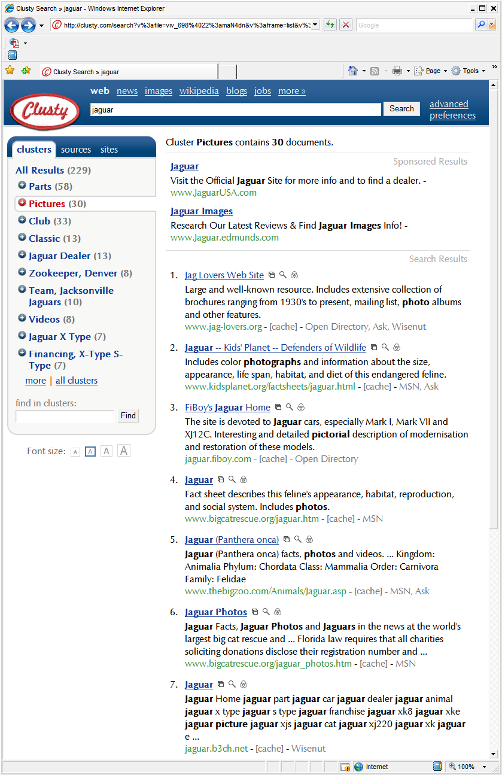



Slide 4
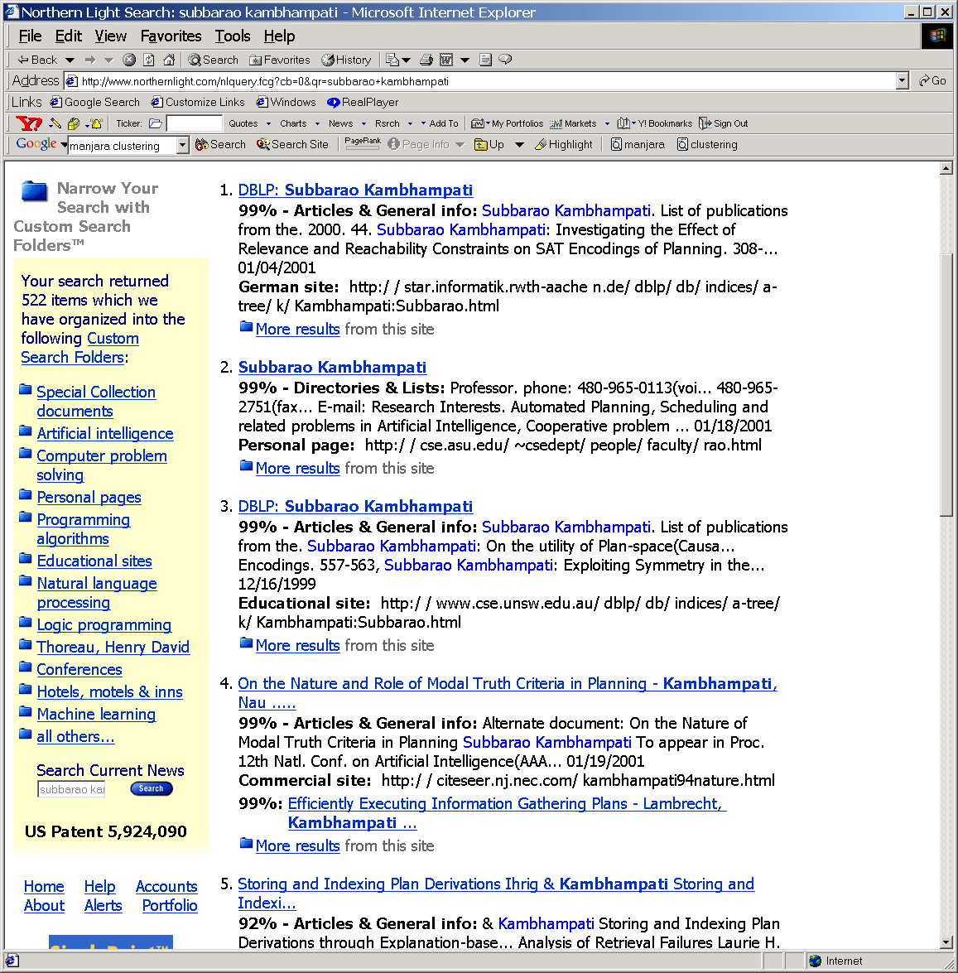
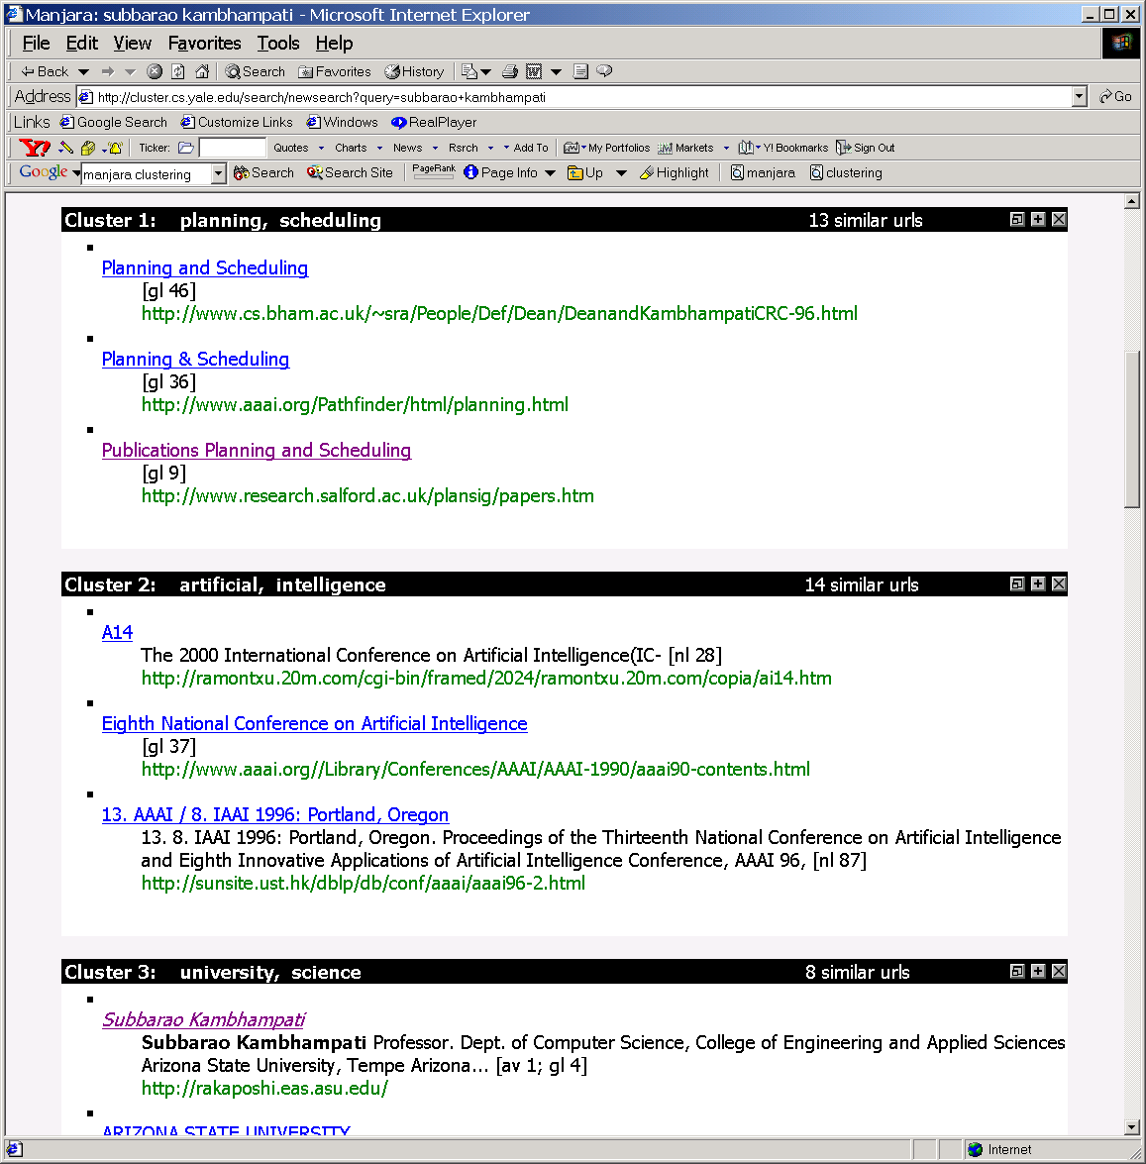
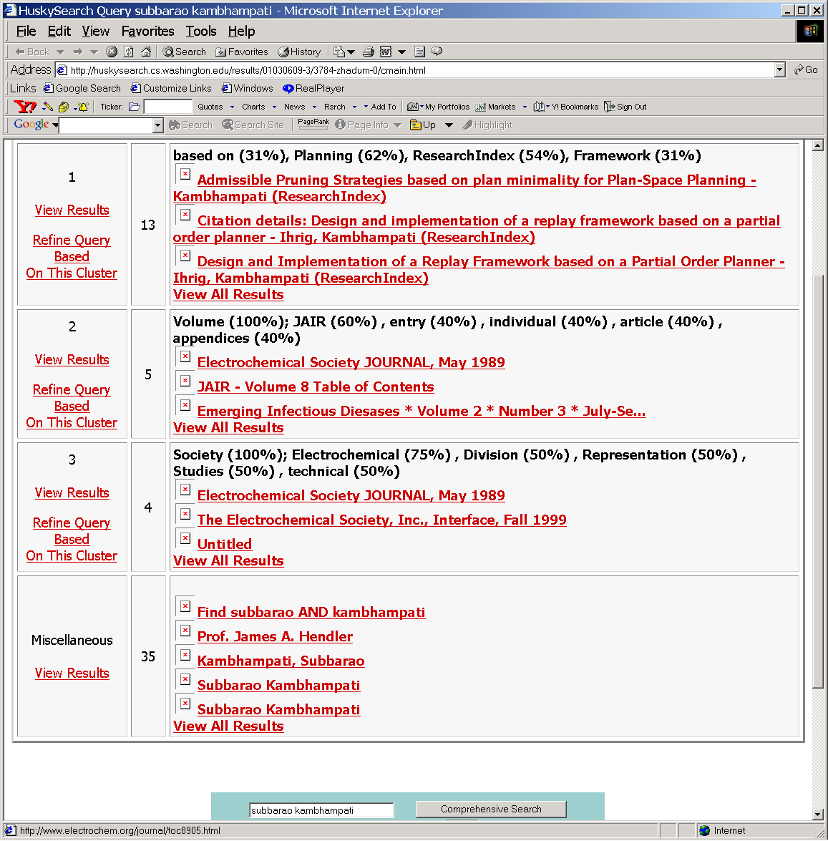

Slide 5
(Text Clustering)
When & From What
Clustering can be based on:
  URL source
    Put pages from the same server together
  Text Content
    -Polysemy (“bat”, “banks”)
    -Multiple aspects of a single topic
  Links
    -Look at the connected components in the link graph (A/H analysis can do it)
    -look at co-citation similarity (e.g. as in collab filtering)
Clustering can be done at:
  Indexing time
  At query time
    Applied to documents
    Applied to snippets

Slide 6
10/13
→Mid-term on Tu (10/18)
→Closed book and notes
→You are allowed one 8.5x11 sheet of hand written notes
→Calculators ok
Today’s agenda:
→ Text Clustering continued
(Not included in mid-term)

Slide 7
Clustering issues
--Hard vs. Soft clusters
--Distance measures
cosine or Jaccard or..
--Cluster quality:
Internal measures
--intra-cluster tightness
--inter-cluster separation
External measures
--How many points are
put in wrong clusters.
[From Mooney]

Slide 8
General issues in clustering
Inputs/Specs
  Are the clusters “hard” (each element in one cluster) or “Soft”
    Hard Clustering=> partitioning
    Soft Clustering=> subsets..
  Do we know how many clusters we are supposed to look for?
    Max # clusters?
    Max possibilities of clusterings?
What is a good cluster?
  Are the clusters “close-knit”?
  Do they have any connection to reality?
    Sometimes we try to figure out reality by clustering…
Importance of notion of distance
  Sensitivity to outliers?

Slide 9
Cluster Evaluation
  “Clusters can be evaluated with “internal” as well as “external” measures
    Internal measures are related to the inter/intra cluster distance
      A good clustering is one where
        (Intra-cluster distance) the sum of distances between objects in the same cluster are minimized,
        (Inter-cluster distance) while the distances between different clusters are maximized
        Objective to minimize: F(Intra,Inter)
    External measures are related to how representative are the current clusters to “true” classes. Measured in terms of purity, entropy or F-measure
      Note that in real world, you often don’t know what the true classes are. (This is why clustering is called unsupervised learning)

Slide 10
Inter/Intra Cluster Distances
Inter-cluster distance
Sum the (squared) distance between all pairs of clusters
Where distance between two clusters is defined as:
  distance between their centroids/medoids
  Distance between farthest pair of points (complete link)
  Distance between the closest pair of points belonging to the clusters (single link)
Intra-cluster distance/tightness
(Sum/Min/Max/Avg) the (absolute/squared) distance between
  All pairs of points in the cluster OR
  “diameter”—two farthest points
  Between the centroid /medoid and all points in the cluster
Letter grades and Single vs. Complete link
Red: Single-link
Black: complete-link

Slide 11
Cluster Evaluation
  “Clusters can be evaluated with “internal” as well as “external” measures
    Internal measures are related to the inter/intra cluster distance
      A good clustering is one where
        (Intra-cluster distance) the sum of distances between objects in the same cluster are minimized,
        (Inter-cluster distance) while the distances between different clusters are maximized
        Objective to minimize: F(Intra,Inter)
    External measures are related to how representative are the current clusters to “true” classes. Measured in terms of purity, entropy or F-measure

Slide 12
Cluster Purity
(given Gold Standard classes)
• •
• •
• •
• •
• •
• •
• •
• •
•
Cluster I
Cluster II
Cluster III
Pure size of a cluster = # elements from the majority class
Sum of pure sizes of clusters
--------------------------------------------------
Total number of elements across clusters
Purity of clustering:
Will it work if you allow
# of clusters to increase?
= (5 + 4 + 3)/ (6 + 6 + 5) = 12/17 = 0.71

Slide 13
Rand-Index: Precision/Recall based
How many couplings did you preserve/break?
Compare to Standard
Precision & Recall
The following table classifies all pairs of
entities (of which there are n choose 2) into
One of four classes
Is the cluster
putting non-class
items in?
Same
Same
Different
Different
Number of
Number of
Cluster in
Cluster in
Clusters in
Clusters in
points
points
clustering
clustering
clustering
clustering
Same class
Same class
in ground
TP
FN
in ground
truth
truth
Is the cluster
missing any in-class items?
Different
Different
classes in
FP
TN
classes in
ground truth
ground truth

Slide 14
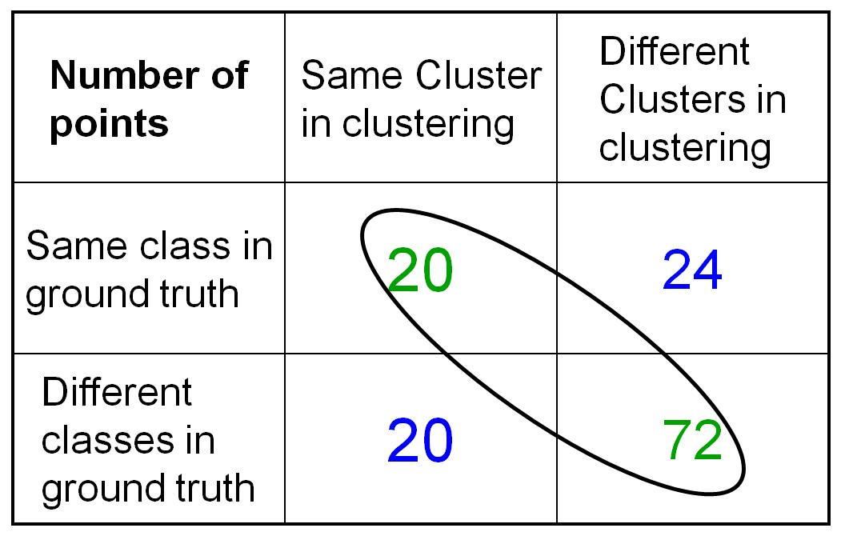
Rand-Index Example
• •
• •
• •
• •
• •
• •
• •
• •
•
Cluster I
Cluster II
Cluster III
RI= 20+72/(20+20+24+72) =0.68
Elementary combinatorics
TP+FP (total pairs in the same clusters)
= 6 C 2 + 6 C 2 + 5 C 2 = 40
To get TP
= 5 C 2 + 4 C 2 + 3 C 2 + 2 C 2 = 20
You can compute FN/TN simlarly

Slide 15
Unsupervised?
Clustering is normally seen as an instance of unsupervised learning algorithm
  So how can you have external measures of cluster validity?
  The truth is that you have a continuum between unsupervised vs. supervised
    Answer: Think of “no teacher being there” vs. “lazy teacher” who checks your work once in a while.
    Examples:
      Fully unsupervised (no teacher)
      Teacher tells you how many clusters are there
      Teacher tells you that certain pairs of points will fall or will not fill in the same cluster
      Teacher may occasionally evaluate the goodness of your clusters (external measures of validity)

Slide 16
How hard is clustering?
One idea is to consider all possible clusterings, and pick the one that has best inter and intra cluster distance properties
Suppose we are given n points, and would like to cluster them into k-clusters
  How many possible clusterings?
Too hard to do it brute force or optimally
Solution: Iterative optimization algorithms
  Start with a clustering, iteratively improve it (eg. K-means)

Slide 17
Classical clustering methods
Partitioning methods
  k-Means (and EM), k-Medoids
Hierarchical methods
  agglomerative, divisive, BIRCH
Model-based clustering methods

Slide 18




Properties of Vector Similarity as a distance measure for text clusterings
Similarity between a doc and the centroid is equal to
avg similarity between that doc and every other doc
Average similarity between all pairs of documents is equal
to the square of centroid’s magnitude.

Slide 19
K-means
Works when we know k, the number of clusters we want to find
Idea:
  Randomly pick k points as the “centroids” of the k clusters
  Loop:
    For each point, put the point in the cluster to whose centroid it is closest
    Recompute the cluster centroids
    Repeat loop (until there is no change in clusters between two consecutive iterations.)
Iterative improvement of the objective function:
Sum of the squared distance from each point to the centroid of its cluster
(Notice that since K is fixed, maximizing tightness also maximizes inter-cluster
distance)

Slide 20
K Means Example
(K=2)
Pick seeds
Reassign clusters
Compute centroids
Reasssign clusters
x
x
x
Compute centroids
x
x
x
Reassign clusters
Converged!
[From Mooney]

Slide 21
What is K-Means Optimizing?
Define goodness measure of cluster k as sum of squared distances from cluster centroid:
  G_{k} = Σ_{i} (d_{i} – c_{k})² (sum over all d_{i} in cluster k)
G = Σ_{k} G_{k}
Reassignment monotonically decreases G since each vector is assigned to the closest centroid.
  Is it global optimum? No.. because each node independently decides whether or not to shift clusters; sometimes there may be a better clustering but you need a set of nodes to simultaneously shift clusters to reach that.. (Mass Democrats moving en block to AZ example).
What cluster shapes will have the lowest sum of squared distances to the centroid?
  Is it global optimum? No.. because each node independently decides whether or not to shift clusters; sometimes there may be a better clustering but you need a set of nodes to simultaneously shift clusters to reach that.. (MA Democrats moving en block to AZ example).
Spheres…
But what if the real data doesn’t have spherical clusters?
(We will still find them!)

Slide 22
K-means Example
For simplicity, 1-dimension objects and k=2.
  Numerical difference is used as the distance
Objects: 1, 2, 5, 6,7
K-means:
  Randomly select 5 and 6 as centroids;
  => Two clusters {1,2,5} and {6,7}; meanC1=8/3, meanC2=6.5
  => {1,2}, {5,6,7}; meanC1=1.5, meanC2=6
  => no change.
  Aggregate dissimilarity
    (sum of squares of distanceeach point of each cluster from its cluster center--(intra-cluster distance)
  = 0.5²+ 0.5²+ 1²+ 0²+1² = 2.5
|1-1.5|²

Slide 23
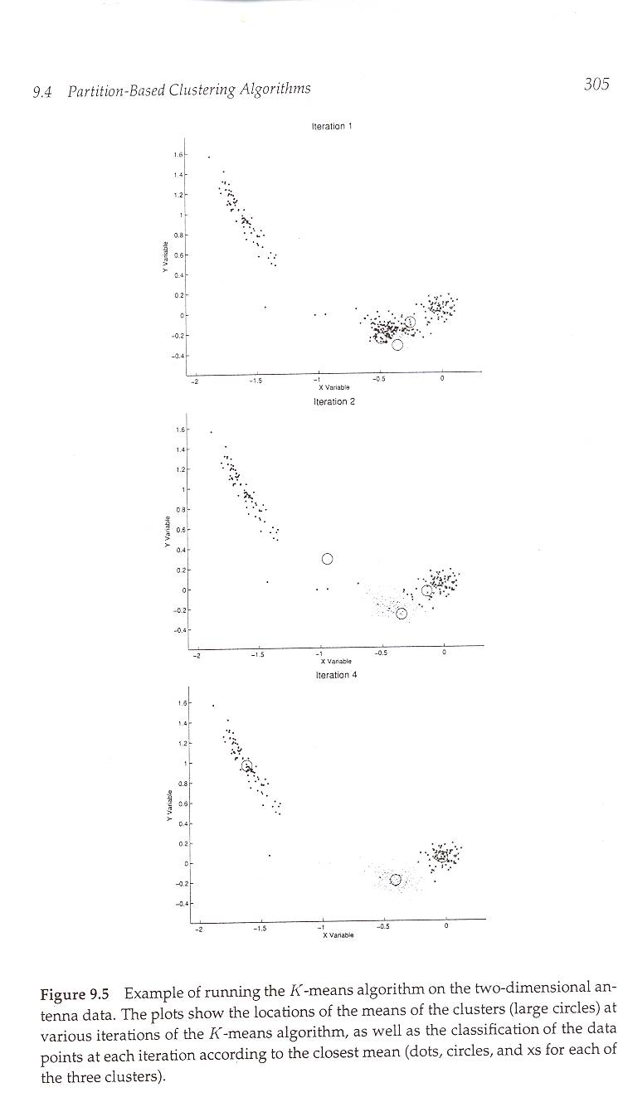
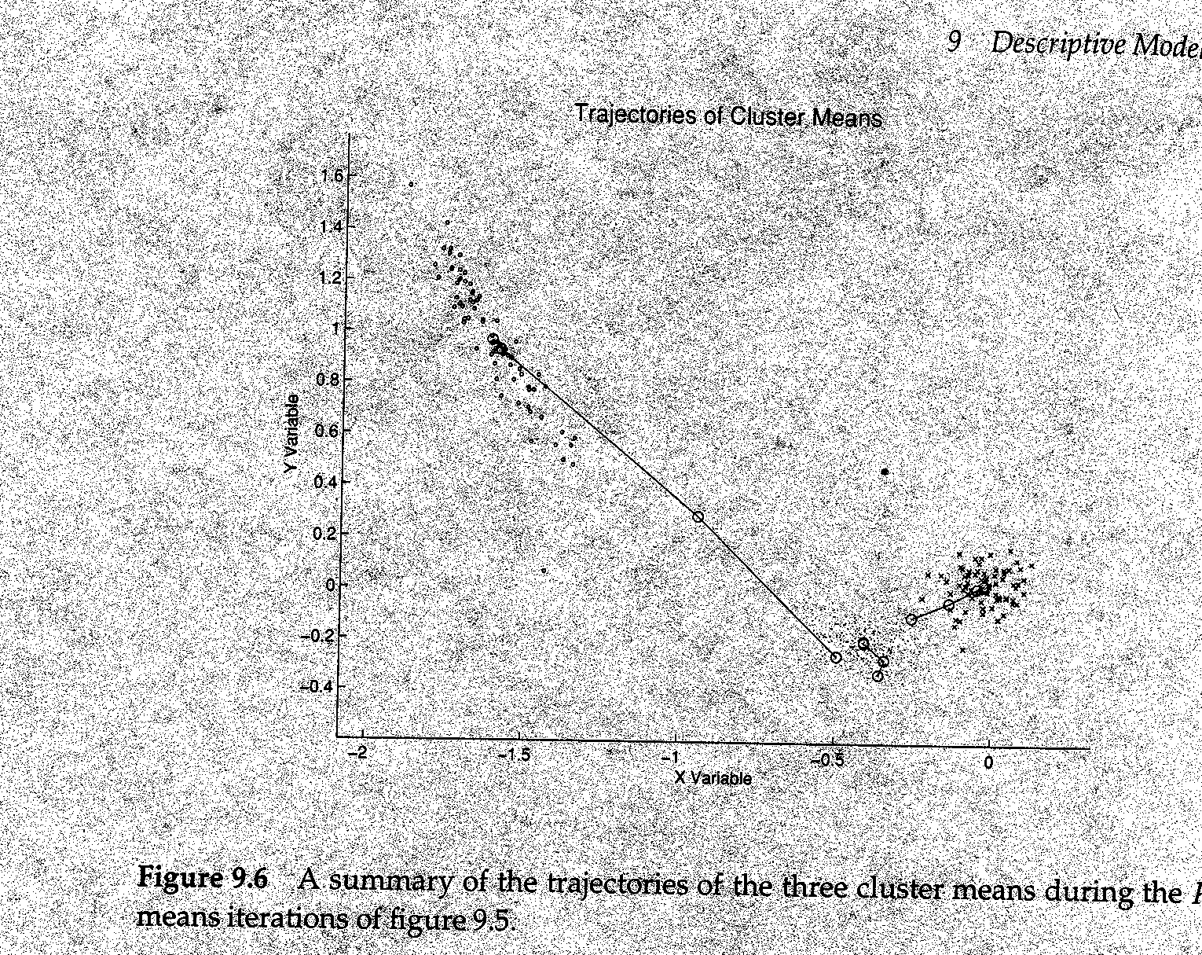
Example of K-means in operation
[From Hand et. Al.]

Slide 24
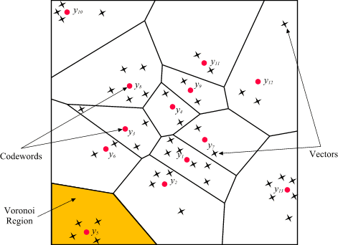
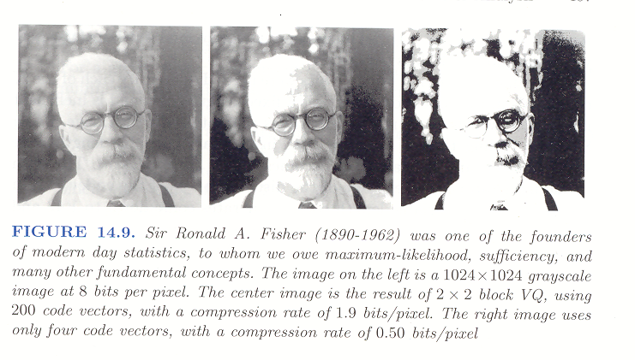
Vector Quantization:
K-means as Compression

Slide 25
10/20

Slide 26
Variations on K-means
Recompute the centroid after every (or few) changes (rather than after all the points are re-assigned)
  Improves convergence speed
Starting centroids (seeds) change which local minima we converge to, as well as the rate of convergence
  Use heuristics to pick good seeds
    Can use another cheap clustering over random sample
  Run K-means M times and pick the best clustering that results
    Bisecting K-means takes this idea further…
Lowest aggregate
Dissimilarity
(intra-cluster
distance)

Slide 27
Problems with K-means
Why not the minimum value?
Need to know k in advance
  Could try out several k?
    Cluster tightness increases with increasing K.
      Look for a kink in the tightness vs. K curve
Tends to go to local minima that are sensitive to the starting centroids
  Try out multiple starting points
Disjoint and exhaustive
  Doesn’t have a notion of “outliers”
    Outlier problem can be handled by K-medoid or neighborhood-based algorithms
Assumes clusters are spherical in vector space
  Sensitive to coordinate changes, weighting etc.

Slide 28
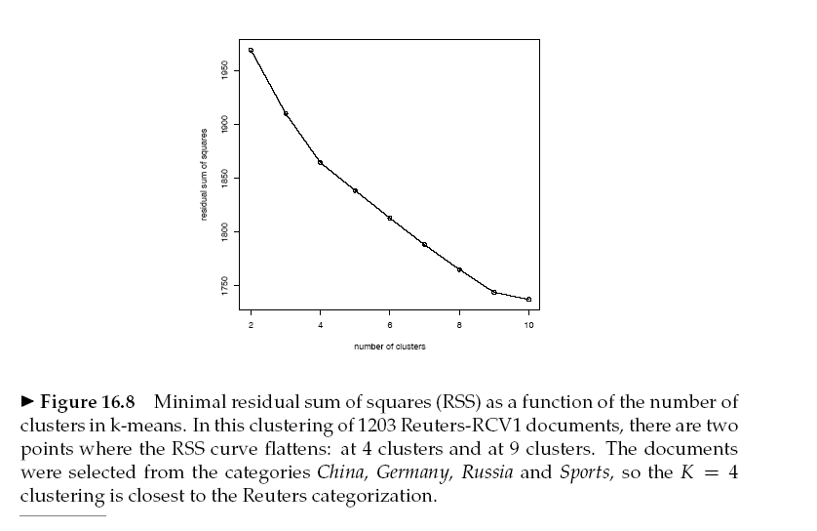
Looking for knees in the sum of intra-cluster dissimilarity
The problem is that
Comparing G values
across different
clustering sizes (k)
is apple/organge
comparison
→Once k is allowed
to change we need
to also consider
inter-cluster distance
that is not captured by G

Slide 29
Penalize lots of clusters
For each cluster, we have a Cost C.
Thus for a clustering with K clusters, the Total Cost is KC.
Define the Value of a clustering to be =
  Total Benefit - Total Cost.
Find the clustering of highest value, over all choices of K.
  Total benefit increases with increasing K. But can stop when it doesn’t increase by “much”. The Cost term enforces this.

Slide 30

Problems with K-means
Need to know k in advance
  Could try out several k?
    Cluster tightness increases with increasing K.
      Look for a kink in the tightness vs. K curve
Tends to go to local minima that are sensitive to the starting centroids
  Try out multiple starting points
Disjoint and exhaustive
  Doesn’t have a notion of “outliers”
    Outlier problem can be handled by K-medoid or neighborhood-based algorithms
Assumes clusters are spherical in vector space
  Sensitive to coordinate changes, weighting etc.
Example showing
sensitivity to seeds
In the above, if you start
with B and E as centroids
you converge to {A,B,C}
and {D,E,F}
If you start with D and F
you converge to
{A,B,D,E} {C,F}

Slide 31
Time Complexity
Assume computing distance between two instances is O(m) where m is the dimensionality of the vectors.
Reassigning clusters: O(kn) distance computations, or O(knm).
Computing centroids: Each instance vector gets added once to some centroid: O(nm).
Assume these two steps are each done once for I iterations: O(Iknm).
Linear in all relevant factors, assuming a fixed number of iterations,
  more efficient than O(n²) HAC (to come next)

Slide 32
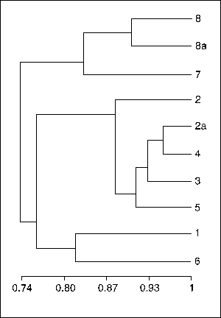
Hierarchical Clustering Techniques
Generate a nested (multi-resolution) sequence of clusters
Two types of algorithms
  Divisive
    Start with one cluster and recursively subdivide
    Bisecting K-means is an example!
  Agglomerative (HAC)
    Start with data points as single point clusters, and recursively merge the closest clusters
“Dendogram”

Slide 33
Bisecting K-means
Hybrid method 1
Can pick the largest
Cluster or the cluster
With lowest average
similarity
For I=1 to k-1 do{
  Pick a leaf cluster C to split
  For J=1 to ITER do{
    Use K-means to split C into two sub-clusters, C₁ and C₂
    Choose the best of the above splits and make it permanent}
  }
Divisive hierarchical clustering method
uses K-means

Slide 34
Hierarchical Clustering Techniques
Generate a nested (multi-resolution) sequence of clusters
Two types of algorithms
  Divisive
    Start with one cluster and recursively subdivide
    Bisecting K-means is an example!
  Agglomerative (HAC)
    Start with data points as single point clusters, and recursively merge the closest clusters
“Dendogram”

Slide 35
Hierarchical Agglomerative Clustering Example
{Put every point in a cluster by itself.
For I=1 to N-1 do{
let C₁ and C₂ be the most mergeable pair of clusters
    →(defined as the two closest clusters)
Create C_{1,2} as parent of C₁ and C₂}
Example: For simplicity, we still use 1-dimensional objects.
  Numerical difference is used as the distance
Objects: 1, 2, 5, 6,7
agglomerative clustering:
  find two closest objects and merge;
  => {1,2}, so we have now {1.5,5, 6,7};
  => {1,2}, {5,6}, so {1.5, 5.5,7};
  => {1,2}, {{5,6},7}.
Qn: What should be the distance between two clusters (or a cluster and a point)
  Single-link (closest two points); multi-link (farthest two points)…
1
2
5
6
7

Slide 36
Single Link Example

Slide 37
Complete Link Example

Slide 38
Impact of cluster distance measures
“Single-Link”
(inter-cluster distance=
distance between closest pair of points)
“Complete-Link”
(inter-cluster distance=
distance between farthest pair of points)
[From Mooney]

Slide 39
Group-average Similarity based clustering
Instead of single or complete link, we can consider cluster distance in terms of average distance of all pairs of points from each cluster
Problem: n*m similarity computations
Thankfully, this is much easier with cosine similarity… (but only with cosine similarity)

Slide 40
Group-average Similarity based clustering
Instead of single or complete link, we can consider cluster distance in terms of average distance of all pairs of points from each cluster
Problem: n*m similarity computations
Thankfully, this is much easier with cosine similarity!
Average similarity between all pairs of documents is equal
to the square of centroid’s magnitude.

Slide 41
Properties of HAC
Creates a complete binary tree (“Dendogram”) of clusters
Various ways to determine mergeability
  “Single-link”—distance between closest neighbors
  “Complete-link”—distance between farthest neighbors
  “Group-average”—average distance between all pairs of neighbors
  “Centroid distance”—distance between centroids is the most common measure
Deterministic (modulo tie-breaking)
Runs in O(N²) time

Slide 42
Bisecting K-means
(example of Divisive Hierarchical)
Can pick the largest
Cluster or the cluster
With lowest average
similarity
For I=1 to k-1 do{
  Pick a leaf cluster C to split
  For J=1 to ITER do{ /*Look for the best split */
    Use K-means to split C into two sub-clusters, C₁ and C₂
    Choose the best of the above splits and make it permanent}
  }
Divisive hierarchical clustering method
uses K-means

Slide 43
Buckshot Algorithm
Hybrid method 2
Cut where
You have k
clusters
Combines HAC and K-Means clustering.
First randomly take a sample of instances of size √n
Run group-average HAC on this sample, which takes only O(n) time.
Use the results of HAC as initial seeds for K-means.
Overall algorithm is O(n) and avoids problems of bad seed selection.
You can use this either to find the best seeds
for K-means given K, or also decide a
reasonable K. For the latter, you can decide
the level of cluster tightness/similarity you
want in each cluster (see x axis in the fig above)

Slide 44
Text Clustering Status
HAC and K-Means have been applied to text in a straightforward way.
Typically use normalized, TF/IDF-weighted vectors and cosine similarity.
High dimensionality
  Most vectors in high-D spaces will be orthogonal
  Do LSI analysis first, project data into the most important m-dimensions, and then do clustering
    E.g. Manjara
Optimize computations for sparse vectors.
Applications:
  During retrieval, add other documents in the same cluster as the initial retrieved documents to improve recall.
  Clustering of results of retrieval to present more organized results to the user (à la Northernlight folders).
  Automated production of hierarchical taxonomies of documents for browsing purposes (à la Yahoo & DMOZ).

Slide 45
An idea for getting cluster descriptions
Just as search results need snippets, clusters also need descriptors
One idea is to look for most frequently occurring terms in the cluster
A better idea is to consider most frequently occurring terms that are least common across clusters.
  Each cluster is a set of document bags
  Cluster doc is just the union of these bags
  Find tf/idf over these cluster bags

Slide 46
Didn’t cover after this..

Slide 47
Approaches for Outlier Problem
Remove the outliers up-front (in a pre-processing step)
  “Neighborhood” methods
    “An outlier is one that has less than δ points within ε distance” (δ, ε pre-specified thresholds)
    Need efficient data structures for keeping track of neighborhood
      R-trees
Use K-Medoid algorithm instead of a K-Means algorithm
  Median is less sensitive to outliners than mean; but it is costlier to compute than Mean..

Slide 48
Variations on K-means (contd)
Outlier problem
  Use K-Medoids
    Costly!
Non-hard clusters
  Use soft K-means {basically, EM}
    Let the membership of each data point in a cluster be proportional to its distance from that cluster center
    Membership weight of elt e in cluster C is set to
      Exp(-b dist(e; center(C))
        Normalize the weight vector
      Normal K-means takes the max of weights and assigns it to that cluster
        The cluster center re-computation step is based on the membership
      We can instead let the cluster center computation be based on the all points, weighted by their membership weight

Slide 49
K-Means & Expectation Maximization
Added after class discussion; optional
A “model-based” clustering scenario
The data points were generated from k Gaussians N(m_{i},v_{i}) with mean m_{i} and variance v_{i}
In this case, clearly the right clustering involves estimating the m_{i} and v_{i} from the data points
We can use the following iterative idea:
  Initialize: guess estimates of m_{i} and v_{i} for all k gaussians
  Loop
    (E step): Compute the probability P_{ij} that i^{th} point is generated by j^{th} cluster (which is simply the value of normal distribution N(m_{j},v_{j}) at the point d_{i} ). {Note that after this step, each point will have k probabilities associated with its membership in each of the k clusters)
    (M step): Revise the estimates of the mean and variance of each of the clusters taking into account the expected membership of each of the points in each of the clusters
    Repeat
It can be proven that the procedure above converges to the true means and variances of the original k Gaussians (Thus recovering the parameters of the generative model)
The procedure is a special case of a general schema for probabilistic algorithm schema called “Expectation Maximization”
It is easy to see that
K-means is a “hard-assignment”
Form of EM procedure
For recovering the
Model parameters

Slide 50
Semi-supervised variations of K-means
Often we know partial knowledge about the clusters
  [MODEL] We know the Model that generated the clusters
    (e.g. the data was generated by a mixture of Gaussians)
    Clustering here involves just estimating the parameters of the model (e.g. mean and variance of the gaussians, for example)
  [FEATURES/DISTANCE] We know the “right” similarity metric and/or feature space to describe the points (such that the normal distance norms in that space correspond to real similarity assessments). Almost all approaches assume this.
  [LOCAL CONSTRAINTS] We may know that the text docs are in two clusters—one related to finance and the other to CS.
    Moreover, we may know that certain specific docs are CS and certain others are finance
    Easy to modify K-Means to respect the local constraints (constraints violation can lead to either invalidation of the cluster or just penalize it)

Slide 51
Which of these are the best for text?
Bisecting K-means and K-means seem to do better than Agglomerative Clustering techniques for Text document data [Steinbach et al]
  “Better” is defined in terms of cluster quality
    Quality measures:
      Internal: Overall Similarity
      External: Check how good the clusters are w.r.t. user defined notions of clusters

Slide 52
Challenges/Other Ideas
High dimensionality
  Most vectors in high-D spaces will be orthogonal
  Do LSI analysis first, project data into the most important m-dimensions, and then do clustering
    E.g. Manjara
Phrase-analysis (a better distance and so a better clustering)
  Sharing of phrases may be more indicative of similarity than sharing of words
    (For full WEB, phrasal analysis was too costly, so we went with vector similarity. But for top 100 results of a query, it is possible to do phrasal analysis)
    Suffix-tree analysis
    Shingle analysis
Using link-structure in clustering
  A/H analysis based idea of connected components
  Co-citation analysis
    Sort of the idea used in Amazon’s collaborative filtering
Scalability
  More important for “global” clustering
  Can’t do more than one pass; limited memory
  See the paper
    Scalable techniques for clustering the web
    Locality sensitive hashing is used to make similar documents collide to same buckets

Slide 53
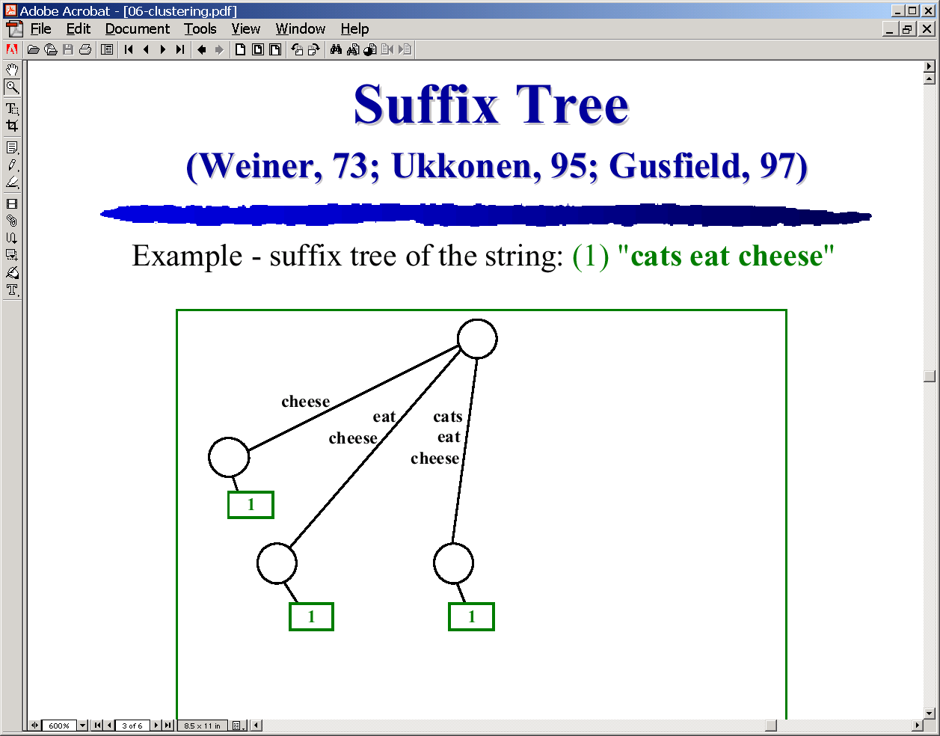
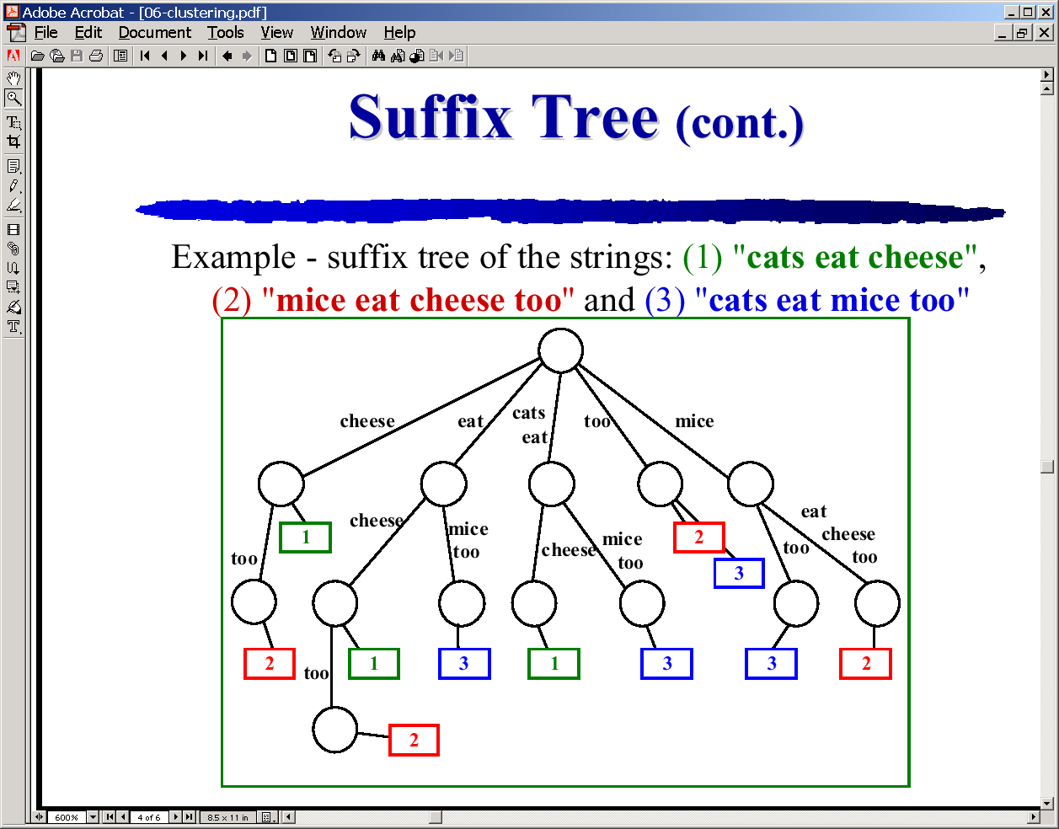
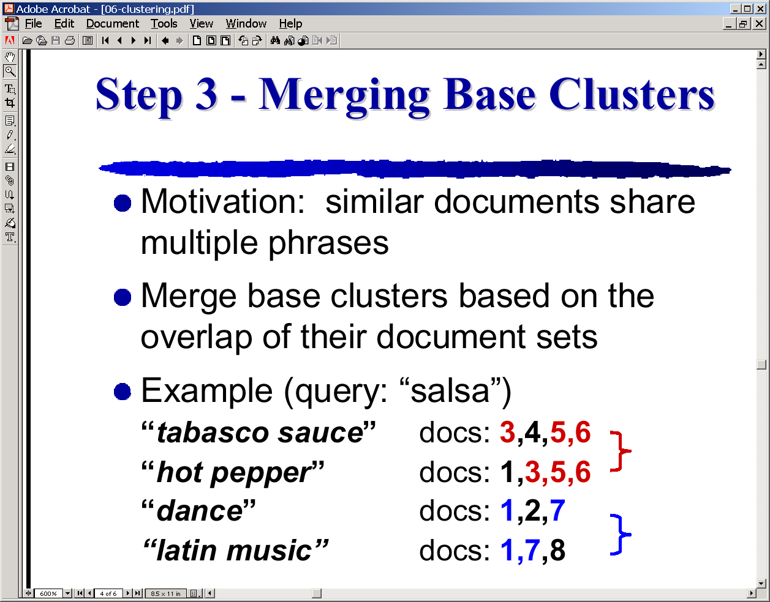
Phrase-analysis based similarity
(using suffix trees)

