Slide 1

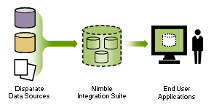

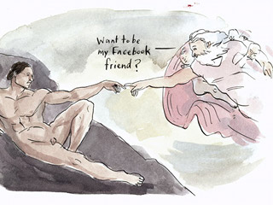

CSE 494/598
Information Retrieval, Mining and Integration on the Internet
Given two randomly chosen web-pages p₁ and p₂, what is the
Probability that you can click your way from p₁ to p₂?
<1%?, <10%?, >30%?. >50%?, ~100%? (answer at the end)
Spring2010

Slide 2
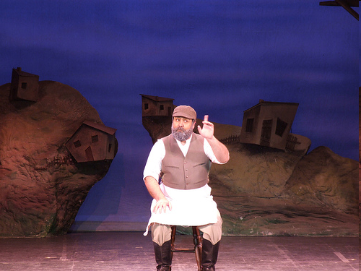
If you can have a Super-Human
Web-Secretary
what would we have him/her/it do for you?

Slide 3
What is the Holy Grail
If we can have a “super-human” Web-Secretary, what would we have him/her/it do for us?
  Read all the web & remember what information is where
  Be able to reason about connections between information
  Read my mind and answer questions (or better yet) satisfy my needs, even before I articulate them
How close is this dream to reality?
Are we being too easy on our search
engines?

Slide 4
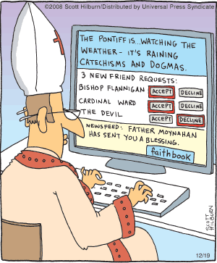
Course Outcomes
After this course, you should be able to answer:
  How search engines work and why are some better than others
  Can web be seen as a collection of (semi)structured data/knoweldge bases?
  Can useful patterns be mined from the pages/data of the web?
  Can we exploit the connectedness of the web pages?

Slide 5
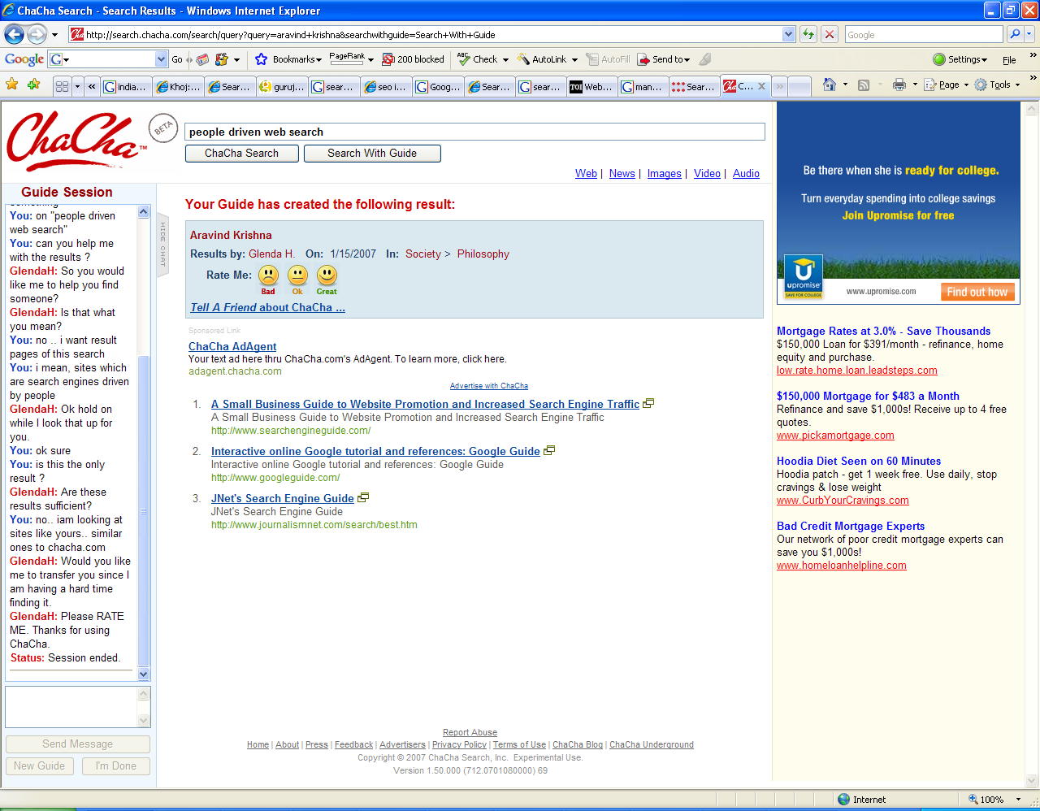
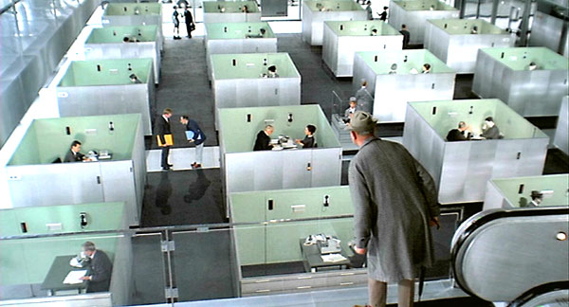

Slide 6
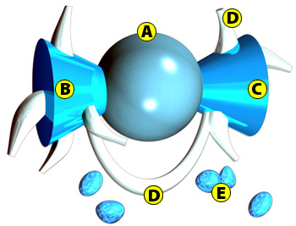
Web as a bow-tie
Given two randomly chosen web-pages p₁ and p₂, what is the
Probability that you can click your way from p₁ to p₂?
<1%?, <10%?, >30%?. >50%?, ~100%? (answer at the end)
19%
39%
21%
14%
7%
Probability that two pages are connected:
(.21+.39) * (.39 +.19) = .348
Reference: The Web as a Graph.
PODS 2000: 1-10
Ravi Kumar, Prabhakar Raghavan,
Sridhar Rajagopalan, D. Sivakumar,
Andrew Tomkins, Eli Upfal:

Slide 7
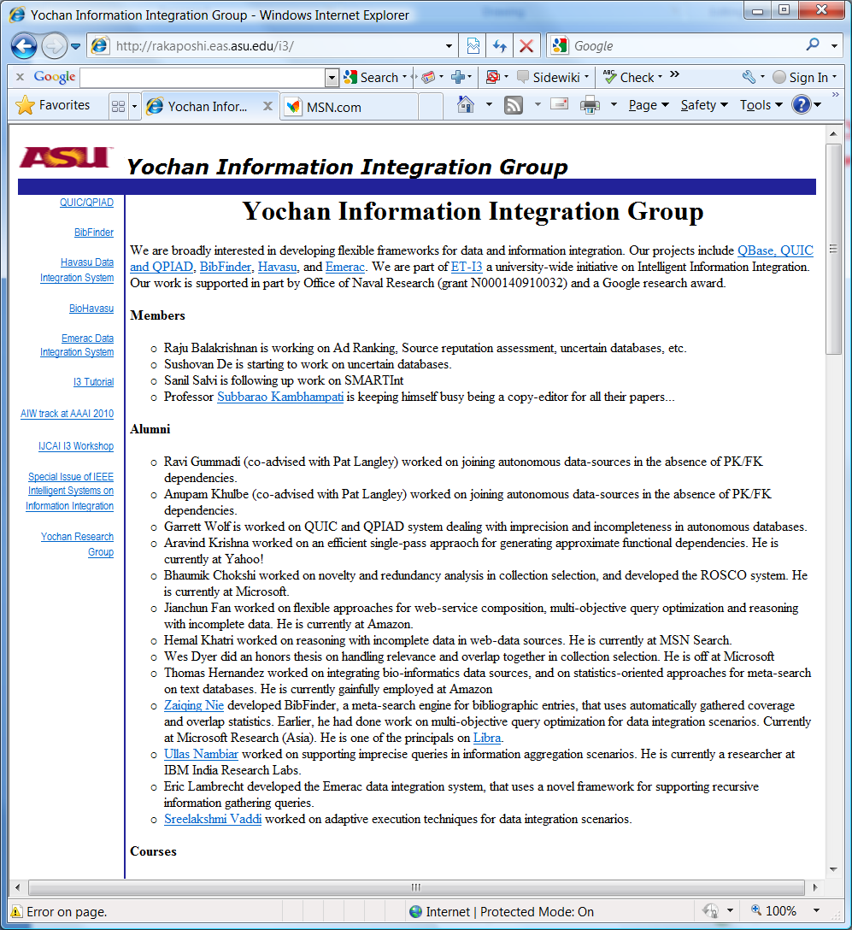
About Me
Mid-life Schizophrenia
  Plan-yochan: Planning, Scheduling, CSP, a bit of learning etc.
  Db-yochan: Information integration, retrieval, mining etc. rakaposhi.eas.asu.edu/i3
    Did a fair amount of publications, tutorials and workshop organization. Had students who did even better ☺
      Nie→Microsoft Research; Nambiar→IBM Research Labs
        Khatri,Chokshi→Bing..; Kalavagattu→Yahoo!
        Hernandez, Fan→Amazon

Slide 8
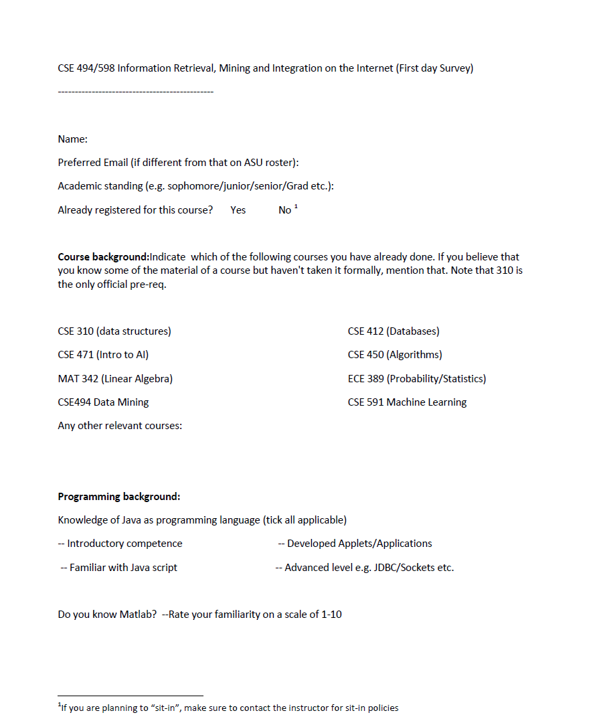
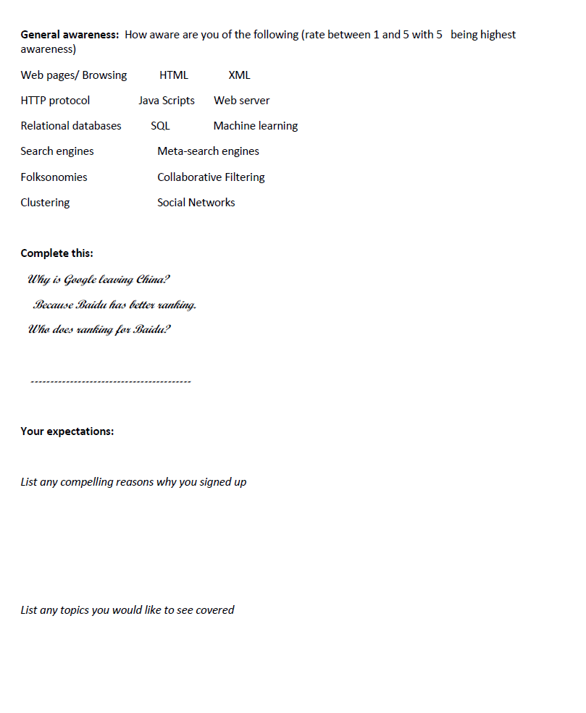

About You
Hu does! ☺
Fill and Return by the end of the class

Slide 9
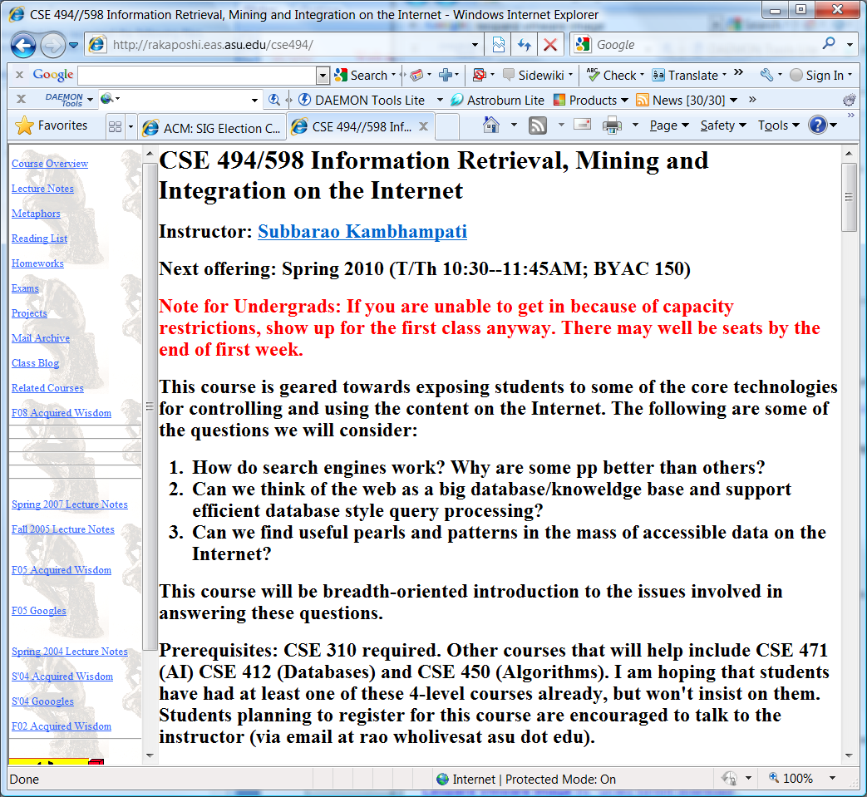
Contact Info
Instructor: Subbarao Kambhampati (Rao)
  Email: rao@asu.edu
  URL: rakaposhi.eas.asu.edu/rao.html
  Course URL: rakaposhi.eas.asu.edu/cse494
  Class: T/Th 10:30—11:45 (BYAC 150)
  Office hours: T/Th 2:45—3:45
TA: Sushovan De
  sushovan@asu.edu
  Office: BY 557AD
Webpage *NOT* on Blackboard

Slide 10
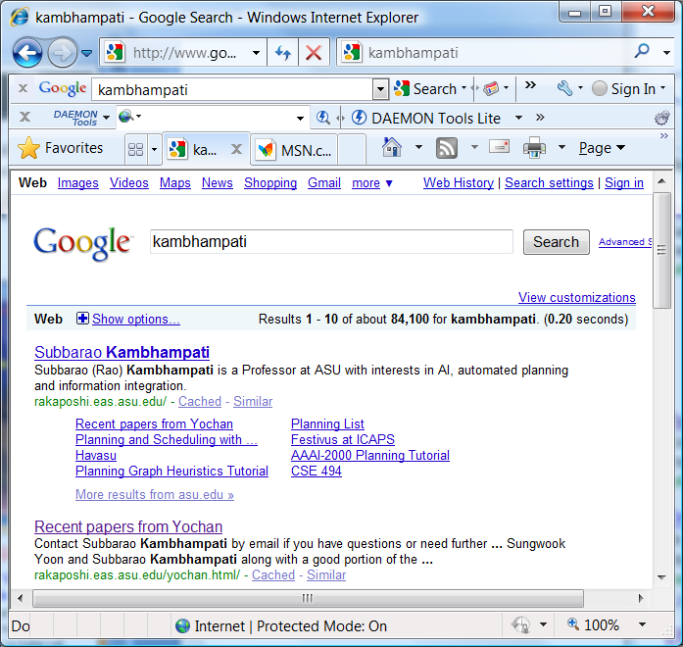

Slide 11
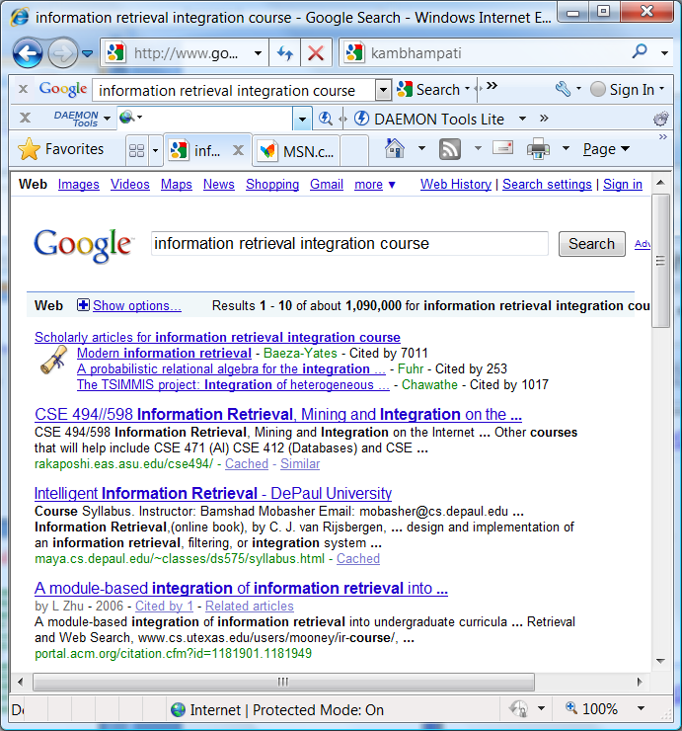

Slide 12
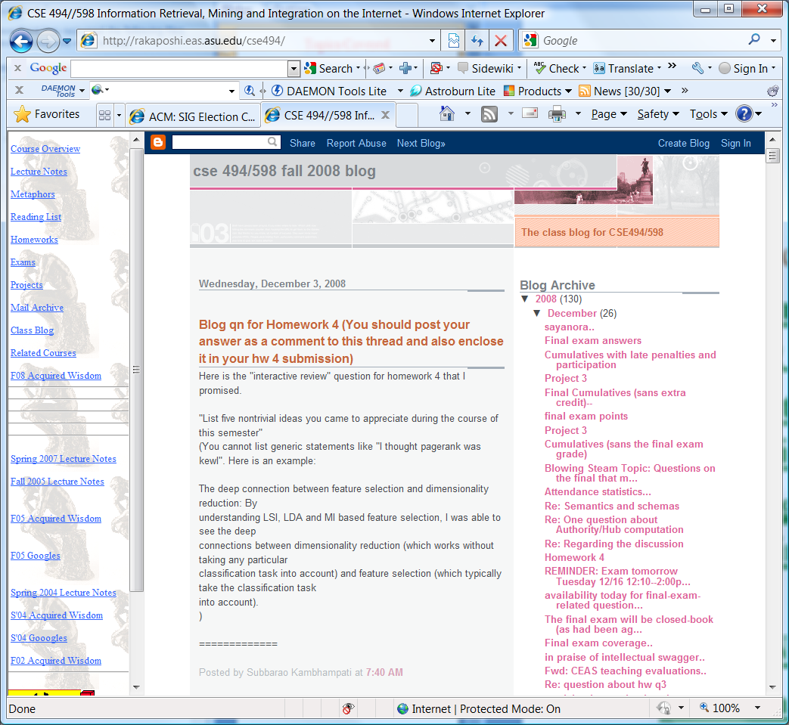
Main Topics
Approximately three halves plus a bit:
  Information retrieval
  Social Networks
  Information integration/Aggregation
  Information mining
  other topics as permitted by time

Slide 13
Topics Covered
Introduction (1)
Text retrieval; vectorspace ranking (3)
Correlation analysis & Latent Semantic Indexing (2)
Indexing; Crawling; Exploiting tags in web pages (2)
Social Network Analysis (2)
Link Analysis in Web Search (A/H; Pagerank) (3+)
Clustering (2)
Text Classification (1)
Filtering/Recommender Systems (2)
Why do we even care about databases in the context of web (1)
XML and handling semi-structured data + Semantic Web standards (3)
Information Extraction (2)
Information/data Integration (2+)
Discussion Classes: ~3+

Slide 14
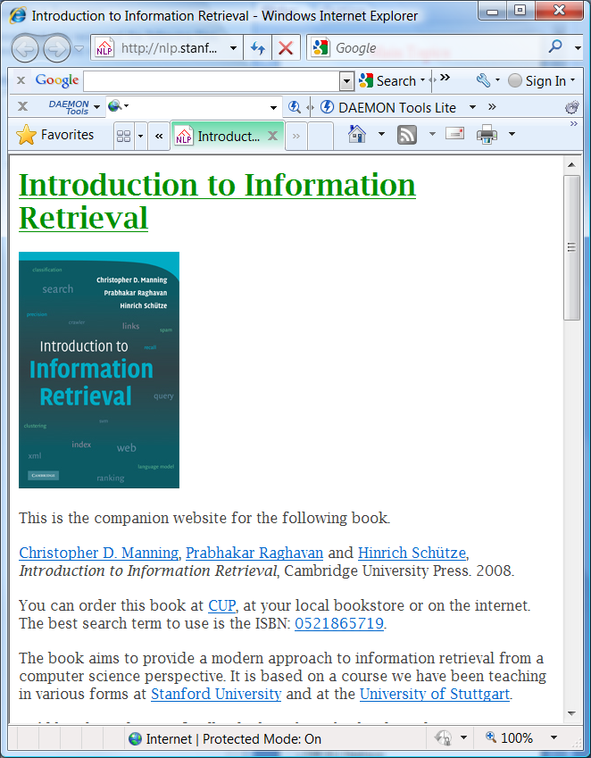
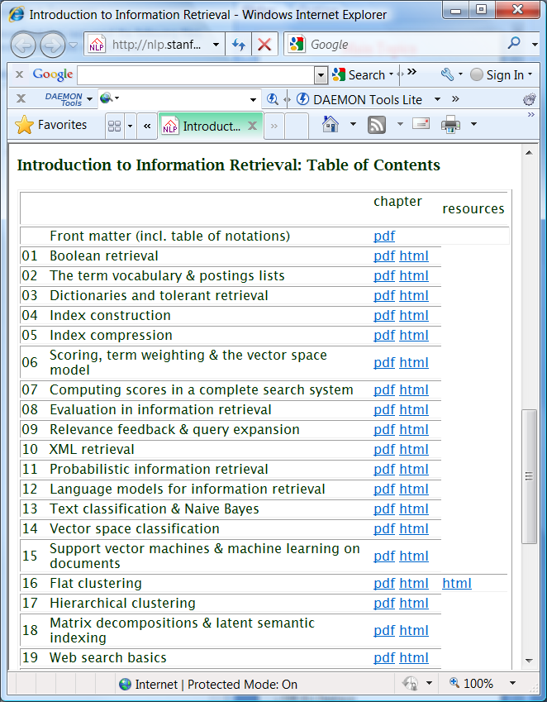
Books (or lack there of)
There are no required text books
  Primary source is a set of readings that I will provide (see “readings” button in the homepage)
    Relative importance of readings is signified by their level of indentation
A good companion book for the IR topics
  Intro to Information Retrieval by Manning/Raghavan/Schutze (available online)
    Modern Information Retrieval (Baeza-Yates et. Al)
Other references
  Modeling the Internet and the Web by Baldi, Frasconi and Smyth
  Mining the web (Soumen Chakrabarti)
  Data on the web (Abiteboul et al).
  A Semantic Web Primer (Antonieu & van Haarmalen)

Slide 15
Pre-reqs
Useful course background
  CSE 310 Data structures
    (Also 4xx course on Algorithms)
  CSE 412 Databases
  CSE 471 Intro to AI
+ some of that math you thought you would never use..
  MAT 342 Linear Algebra
    Matrices; Eigen values; Eigen Vectors; Singular value decomp
      Useful for information retrieval and link analysis (pagerank/Authorities-hubs)
  ECE 389 Probability and Statistics for Engg. Prob solving
    Discrete probabilities; Bayes rule, long tail, power laws etc.
      Useful for datamining stuff (e.g. naïve bayes classifier)
Homework
Ready…
You are primarily
responsible for
refreshing your
memory...

Slide 16
What this course is not (intended tobe)
[] there is a difference between training and education.
If computer science is a fundamental discipline, then university
education in this field should emphasize enduring fundamental
principles rather than transient current technology.
-Peter Wegner, Three Computing Cultures. 1970.
This course is not intended to
  Teach you how to be a web master
  Expose you to all the latest x-buzzwords in technology
    XML/XSL/XPOINTER/XPATH
      (okay, may be a little).
  Teach you web/javascript/java/jdbc etc. programming

Slide 17
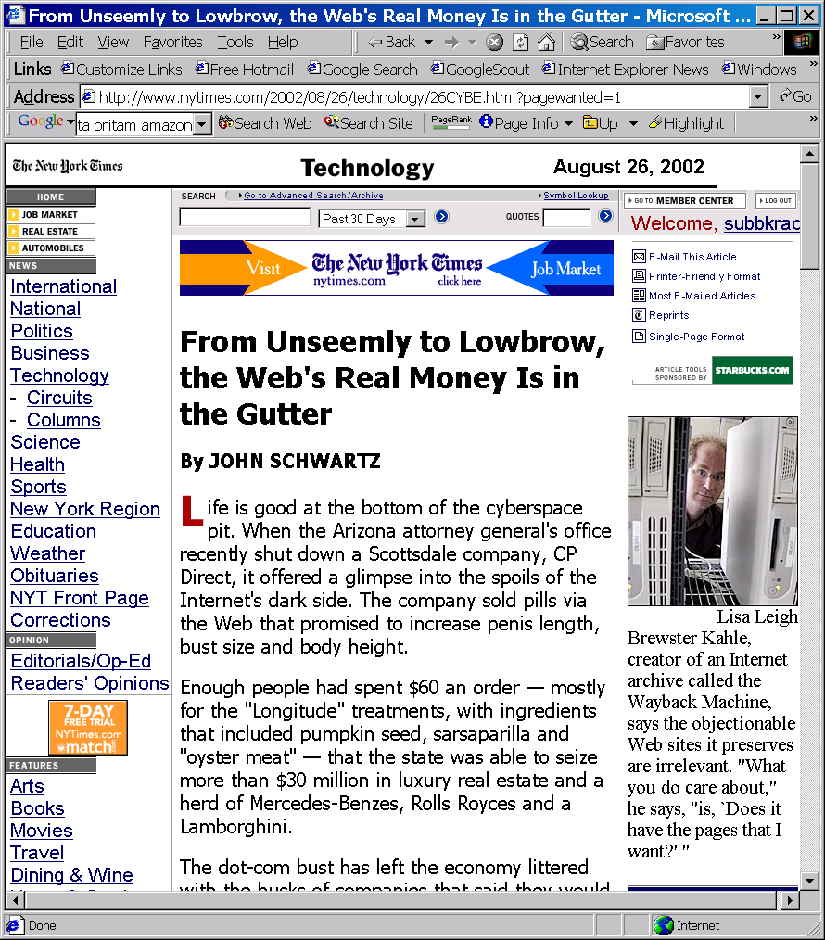
Neither is this course
allowed to teach you
how to really make
money on the web

Slide 18

Grading etc.
Subject to (minor)
Changes
  Projects/Homeworks (~45%)
  Midterm / final (~40%)
  Participation (~15%)
    Reading (papers, web - no single text)
    Class interaction (***VERY VERY IMPORTANT***)
      will be evaluated by attendance, attentiveness, and occasional quizzes
471 and 598 students are treated as separate clusters while awarding final letter grades
(no other differentiation)

Slide 19
Projects (tentative)
One project with 3 parts
  Extending and experimenting with a mini-search engine
    Project description available online (tentative)
        (if you did search engine implementations already and would rather do something else, talk to me)
Expected background
  Competence in JAVA programming
    (Gosling level is fine; Fledgling level probably not..).
    We will not be teaching you JAVA

Slide 20
Honor Code/Trawling the Web
Almost any question I can ask you is probably answered somewhere on the web!
  May even be on my own website
    Even if I disable access, Google caches!
…You are still required to do all course related work (homework, exams, projects etc) yourself
  Trawling the web in search of exact answers considered academic plagiarism
  If in doubt, please check with the instructor

Slide 21
Sociological issues
Attendance in the class is *very* important
  I take unexplained absences seriously
Active concentration in the class is *very* important
  Not the place for catching up on Sleep/State-press reading
Interaction/interactiveness is highly encouraged both in and outside the class
  There will be a class blog…

Slide 22

Occupational Hazards..
Caveat: Life on the bleeding edge
  494 midway between 4xx class & 591 seminars
    It is a “SEMI-STRUCTURED” class.
  No required text book (recommended books, papers)
  Need a sense of adventure
    ..and you are assumed to have it, considering that you signed up voluntarily
Being offered for the sixth time..and it seems to change every time..
  I modify slides until the last minute…
    To avoid falling asleep during lecture…
Silver Lining?

Slide 23
Life with a homepage..
I will not be giving any handouts
  All class related material will be accessible from the web-page
    Home works may be specified incrementally
      (one problem at a time)
  The slides used in the lecture will be available on the class page
    The slides will be “loosely” based on the ones I used in f08 (these are available on the homepage)
      However I reserve the right to modify them until the last minute (and sometimes beyond it).
    When printing slides avoid printing the hidden slides
Google "asu cse494"

Slide 24
Readings for next week
The chapter on Text Retrieval, available in the readings list
  (alternate/optional reading)
    Chapters 1,8,6,7 in Manning et al’s book

Slide 25
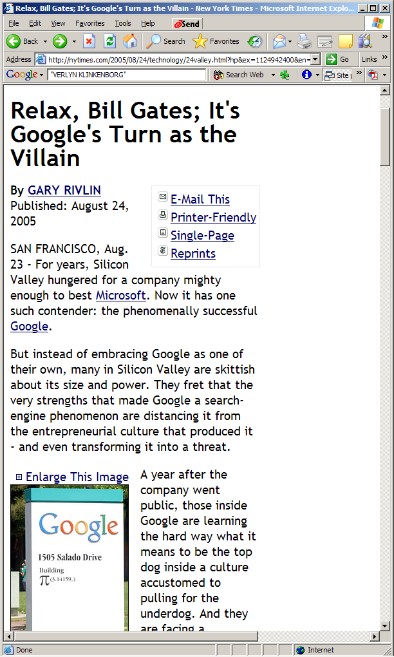
8/24

Slide 26
Course Overview
(take 2)

Slide 27
Web as a collection of information
Web viewed as a large collection of__________
  Text, Structured Data, Semi-structured data
  (connected) (dynamically changing) (user generated) content
  (multi-media/Updates/Transactions etc. ignored for now)
So what do we want to do with it?
  Search, directed browsing, aggregation, integration, pattern finding
How do we do it?
  Depends on your model (text/Structured/semi-structured)

Slide 28
Structure
A generic
web page
containing text
An employee
record
[SQL]
[English]
A movie
review
[XML]
How will search and querying on these three types of data differ?
Semi-Structured

Slide 29
Structure helps querying
Expressive queries
    Give me all pages that have key words “Get Rich Quick”
    Give me the social security numbers of all the employees who have stayed with the company for more than 5 years, and whose yearly salaries are three standard deviations away from the average salary
    Give me all mails from people from ASU written this year, which are relevant to “get rich quick”
keyword
SQL
XML

Slide 30
Does Web have Structured data?
Isn’t web all text?
  The invisible web
    Most web servers have back end database servers
    They dynamically convert (wrap) the structured data into readable english
      <India, New Delhi> => The capital of India is New Delhi.
      So, if we can “unwrap” the text, we have structured data!
        (un)wrappers, learning wrappers etc…
      Note also that such dynamic pages cannot be crawled...
  The Semi-structured web
    Most pages are at least “semi”-structured
    XML standard is expected to ease the presenatation/on-the-wire transfer of such pages. (BUT…..)

Slide 31
How to get Structure?
When the underlying data is already strctured, do unwrapping
  Web already has a lot of structured data!
  Invisible web…that disguises itself
..else extract structure
  Go from text to structured data (using quasi NLP techniques)
..or annotate metadata to add structure
  Semantic web idea..

Slide 32
1/21

Slide 33
Adapting old disciplines for Web-age
Information (text) retrieval
  Scale of the web
  Hyper text/ Link structure
  Authority/hub computations
Social Network Analysis
  Ease of tracking/centrally representing social networks
Databases
  Multiple databases
    Heterogeneous, access limited, partially overlapping
  Network (un)reliability
Datamining [Machine Learning/Statistics/Databases]
  Learning patterns from large scale data

Slide 34
Information Retrieval
Traditional Model
  Given
    a set of documents
    A query expressed as a set of keywords
  Return
    A ranked set of documents most relevant to the query
  Evaluation:
    Precision: Fraction of returned documents that are relevant
    Recall: Fraction of relevant documents that are returned
    Efficiency
Web-induced headaches
  Scale (billions of documents)
  Hypertext (inter-document connections)
& simplifications
  Easier to please “lay” users
Consequently
  Ranking that takes link structure into account
    Authority/Hub
  Indexing and Retrieval algorithms that are ultra fast

Slide 35
Social Networks
Web-induced headaches
  Scale (billions of entities)
  Implicit vs. Explicit links
    Hypertext (inter-entity connections easier to track)
    Interest-based links
& Simplifications
  Global view of social network possible…
Consequently
  Ranking that takes link structure into account
    Authority/Hub
  Recommendations (collaborative filtering; trust propagation)
Traditional Model
  Given
    a set of entities (humans)
    And their relations (network)
  Return
    Measures of centrality and importance
    Propagation of trust (Paths through networks)
  Many uses
    Spread of diseases
    Spread of rumours
    Popularity of people
    Friends circle of people

Slide 36
Information Integration
Database Style Retrieval
Traditional Model (relational)
  Given:
    A single relational database
      Schema
      Instances
    A relational (sql) query
  Return:
    All tuples satisfying the query
Evaluation
  Soundness/Completeness
  efficiency
Web-induced headaches
    Many databases
      With differing Schemas
    all are partially complete
    overlapping
    heterogeneous schemas
    access limitations
    Network (un)reliability
Consequently
    Newer models of DB
    Newer notions of completeness
    Newer approaches for query planning

Slide 37
Further headaches brought on by
Semi-structured retrieval
If everyone puts their pages in XML
  Introducing similarity based retrieval into traditional databases
  Standardizing on shared ontologies...

Slide 38
Learning Patterns (Web/DB mining)
Traditional classification learning (supervised)
  Given
    a set of structured instances of a pattern (concept)
  Induce the description of the pattern
Evaluation:
  Accuracy of classification on the test data
  (efficiency of learning)
Mining headaches
  Training data is not obvious
  Training data is massive
  Training instances are noisy and incomplete
Consequently
  Primary emphasis on fast classification
    Even at the expense of accuracy
  80% of the work is “data cleaning”

Slide 39
Finding“Sweet Spots” in computer-mediated cooperative work
Big Idea 1
It is possible to get by with techniques blythely ignorant of semantics, when you have humans in the loop
  All you need is to find the right sweet spot, where the computer plays a pre-processing role and presents “potential solutions”
  …and the human very gratefully does the in-depth analysis on those few potential solutions
Examples:
  The incredible success of “Bag of Words” model!
    Bag of letters would be a disaster ;-)
    Bag of sentences and/or NLP would be good
      ..but only to your discriminating and irascible searchers ;-)

Slide 40
Collaborative Computing
AKA Brain Cycle Stealing
AKA Computizing Eyeballs
Big Idea 2
A lot of exciting research related to web currently involves “co-opting” the masses to help with large-scale tasks
  It is like “cycle stealing”—except we are stealing “human brain cycles” (the most idle of the computers if there is ever one ;-)
    Remember the mice in the Hitch Hikers Guide to the Galaxy? (..who were running a mass-scale experiment on the humans to figure out the question..)
  Collaborative knowledge compilation (wikipedia!)
  Collaborative Curation
  Collaborative tagging
  Paid collaboration/contracting
Many big open issues
  How do you pose the problem such that it can be solved using collaborative computing?
  How do you “incentivize” people into letting you steal their brain cycles?
    Pay them! (Amazon mturk.com )
    Make it fun (ESP game)

Slide 41

Tapping into the Collective Unconscious
Big Idea 3
Another thread of exciting research is driven by the realization that WEB is not random at all!
  It is written by humans
  …so analyzing its structure and content allows us to tap into the collective unconscious ..
    Meaning can emerge from syntactic notions such as “co-occurrences” and “connectedness”
Examples:
  Analyzing term co-occurrences in the web-scale corpora to capture semantic information (today’s paper)
  Analyzing the link-structure of the web graph to discover communities
    DoD and NSA are very much into this as a way of breaking terrorist cells
  Analyzing the transaction patterns of customers (collaborative filtering)

Slide 42
Future of the Net
Domination of Mobile Devices (cellphone, etc)
Link-Spamming (Arms race to bias SE ranking)
Local Search, Digital Earth
Image & Video search
Social news (Digg / Twitter)
Crowd Sourcing
What else?

