Slide 1
→Viewing the Coure in terms of IR, DB, Soc Net, ML adapted to web →Start of IR
Office Hours: 1-2pm T/Th
8/23

Slide 2
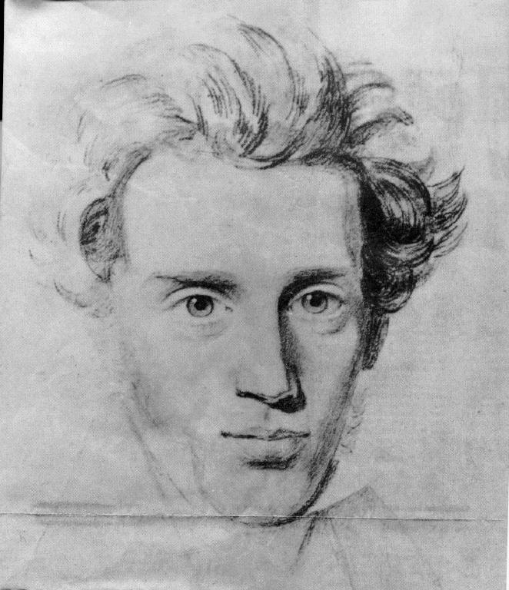
Course Overview (take 2)
Life can only be understood backwards; but it must be lived forwards. --Soren Kierkegaard

Slide 3
Web as a collection of information
Web viewed as a large collection of__________
Text, Structured Data, Semi-structured data
(connected) (dynamically changing) (user generated) content
(multi-media/Updates/Transactions etc. ignored for now)
So what do we want to do with it?
Search, directed browsing, aggregation, integration, pattern finding
How do we do it?
Depends on your model (text/Structured/semi-structured)

Slide 4
Structure
A generic
web page
containing text
An employee
record
[SQL]
[English]
A movie
review
[XML]
How will search and querying on these three types of data differ?
Semi-Structured

Slide 5
Structure helps querying
Expressive queries
Give me all pages that have key words “Get Rich Quick”
Give me the social security numbers of all the employees who have stayed with the company for more than 5 years, and whose yearly salaries are three standard deviations away from the average salary
Give me all mails from people from ASU written this year, which are relevant to “get rich quick”
keyword
SQL
XML

Slide 6
Does Web have Structured data?
Isn’t web all text?
The invisible web
Most web servers have back end database servers
They dynamically convert (wrap) the structured data into readable english
<India, New Delhi> => The capital of India is New Delhi.
So, if we can “unwrap” the text, we have structured data!
(un)wrappers, learning wrappers etc…
Note also that such dynamic pages cannot be crawled...
The Semi-structured web
Most pages are at least “semi”-structured
XML standard is expected to ease the presenatation/on-the-wire transfer of such pages. (BUT…..)

Slide 7
How to get Structure?
When the underlying data is already strctured, do unwrapping
Web already has a lot of structured data!
Invisible web…that disguises itself
..else extract structure
Go from text to structured data (using quasi NLP techniques)
..or annotate metadata to add structure
Semantic web idea..
Pandora employees adding features to music..
Structure is so important that
we are willing to pay people to
add structure or hope that people
will be disciplined enough to annotate
their pages with structure.
Magellan went around the world three times.
On one of those trips he died.
On which trip did he die?
Notes:
Pandora’s employees make the features…

Slide 8
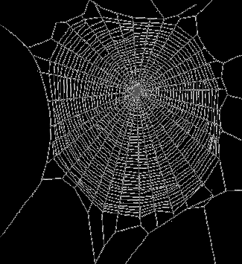
Adapting old disciplines for Web-age
Information (text) retrieval
Scale of the web
Hyper text/ Link structure
Authority/hub computations
Social Network Analysis
Ease of tracking/centrally representing social networks
Databases
Multiple databases
Heterogeneous, access limited, partially overlapping
Network (un)reliability
Datamining
[Machine Learning/Statistics/Databases]
Learning patterns from large scale data
IR
Social
Networks
Web
Databases
Datamining

Slide 9
Information Retrieval
Traditional Model
Given
a set of documents
A query expressed as a set of keywords
Return
A ranked set of documents most relevant to the query
Evaluation:
Precision: Fraction of returned documents that are relevant
Recall: Fraction of relevant documents that are returned
Efficiency
Web-induced headaches
Scale (billions of documents)
Hypertext (inter-document connections)
Bozo users
Decentralization (lack of quality guarantees)
Hard for users to figure out quality
Godfather & Eggplants
& simplifications
Easier to please “lay” users
Consequently
Emphasis of precision over recall
Focus on “trustworthiness” in addition to “relevance”
Indexing and Retrieval algorithms that are ultra fast
Notes:
Relevance is like correctness—a local property; while quality is like optimality—a global property

Slide 10
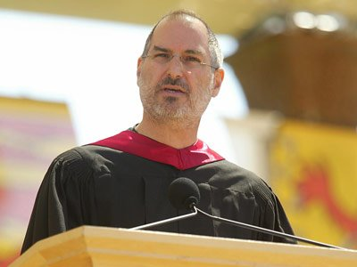
8/25
"You can't connect the dots looking forward;
you can only connect them looking backwards.
So you have to trust that the dots will somehow
connect in your future,"

Slide 11
Social Networks
Friends vs. Soulmates
Web-induced headaches
Scale (billions of entities)
Implicit vs. Explicit links
Hypertext (inter-entity connections easier to track)
Interest-based links
& Simplifications
Global view of social network possible…
Consequently
Ranking that takes link structure into account
Authority/Hub
Recommendations (collaborative filtering; trust propagation)
Traditional Model
Given
a set of entities (humans)
And their relations (network)
Return
Measures of centrality and importance
Propagation of trust (Paths through networks)
Many uses
Spread of diseases
Spread of rumours
Popularity of people
Friends circle of people

Slide 12
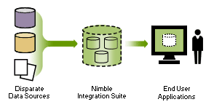
Information Integration Database Style Retrieval
Traditional Model (relational)
Given:
A single relational database
Schema
Instances
A relational (sql) query
Return:
All tuples satisfying the query
Evaluation
Soundness/Completeness
efficiency
Web-induced headaches
Many databases
With differing Schemas
all are partially complete
overlapping
heterogeneous schemas
access limitations
Network (un)reliability
Consequently
Newer models of DB
Newer notions of completeness
Newer approaches for query planning

Slide 13
Further headaches brought on by Semi-structured retrieval
If everyone puts their pages in XML
Introducing similarity based retrieval into traditional databases
Standardizing on shared ontologies...

Slide 14
Learning Patterns (from web and users)
Traditional classification learning (supervised)
Given
a set of structured instances of a pattern (concept)
Induce the description of the pattern
Evaluation:
Accuracy of classification on the test data
(efficiency of learning)
Mining headaches
Training data is not obvious
(relevance)
Training data is massive
But much of it unlabeled
Training instances are noisy and incomplete
Consequently
Primary emphasis on fast classification
Even at the expense of accuracy
Also on getting by with a little labeled data + a lot more unlabeled data [Dantzig Story]

Slide 15
Finding“Sweet Spots” in computer-mediated cooperative work
Big Idea 1
It is possible to get by with techniques blythely ignorant of semantics, when you have humans in the loop
All you need is to find the right sweet spot, where the computer plays a pre-processing role and presents “potential solutions”
…and the human very gratefully does the in-depth analysis on those few potential solutions
Examples:
The incredible success of “Bag of Words” model!
Bag of letters would be a disaster ;-)
Bag of sentences and/or NLP would be good
..but only to your discriminating and irascible searchers ;-)
Notes:
Don’t overthink the solution…. The surprising thing is not why they don’t work better, but why they work at all?

Slide 16
Big Ideas and Cross Cutting Themes

Slide 17
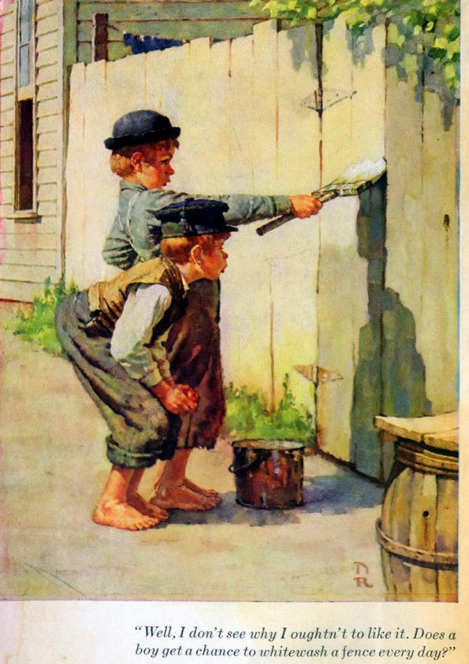
Collaborative Computing AKA Brain Cycle Stealing AKA Computizing Eyeballs
Big Idea 2
A lot of exciting research related to web currently involves “co-opting” the masses to help with large-scale tasks
It is like “cycle stealing”—except we are stealing “human brain cycles” (the most idle of the computers if there is ever one ;-)
Remember the mice in the Hitch Hikers Guide to the Galaxy? (..who were running a mass-scale experiment on the humans to figure out the question..)
Collaborative knowledge compilation (wikipedia!)
Collaborative Curation
Collaborative tagging
Paid collaboration/contracting
Many big open issues
How do you pose the problem such that it can be solved using collaborative computing?
How do you “incentivize” people into letting you steal their brain cycles?
Pay them! (Amazon mturk.com )
Make it fun (ESP game)

Slide 18
Tapping into the Collective Unconscious
Big Idea 3
Another thread of exciting research is driven by the realization that WEB is not random at all!
It is written by humans
…so analyzing its structure and content allows us to tap into the collective unconscious ..
Meaning can emerge from syntactic notions such as “co-occurrences” and “connectedness”
Examples:
Analyzing term co-occurrences in the web-scale corpora to capture semantic information (gmail)
Statistical machine translation with massive corpora
Analyzing the link-structure of the web graph to discover communities
DoD and NSA are very much into this as a way of breaking terrorist cells
Analyzing the transaction patterns of customers (collaborative filtering)

Slide 19
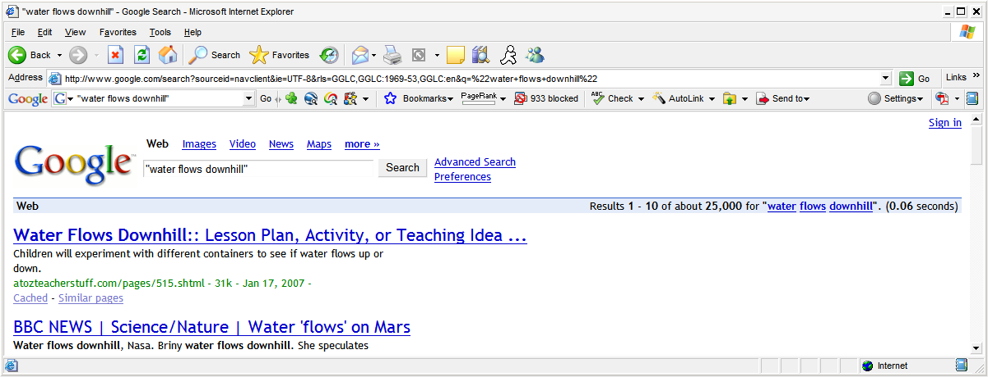
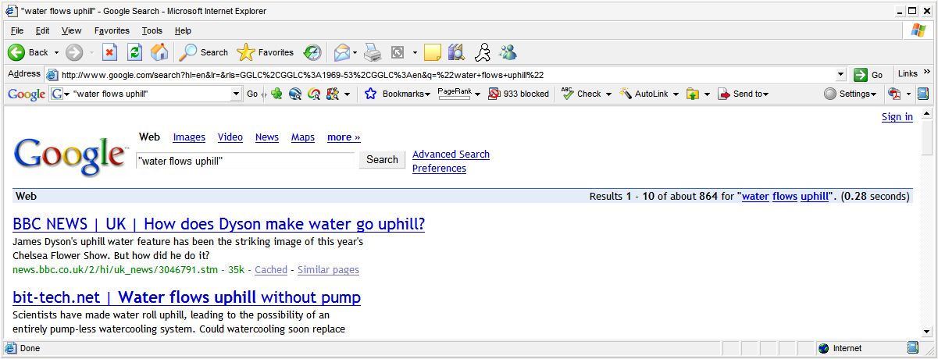
2007

Slide 20
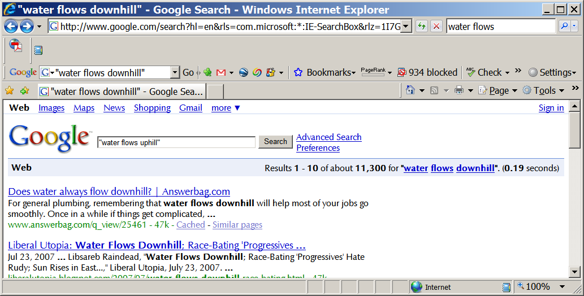
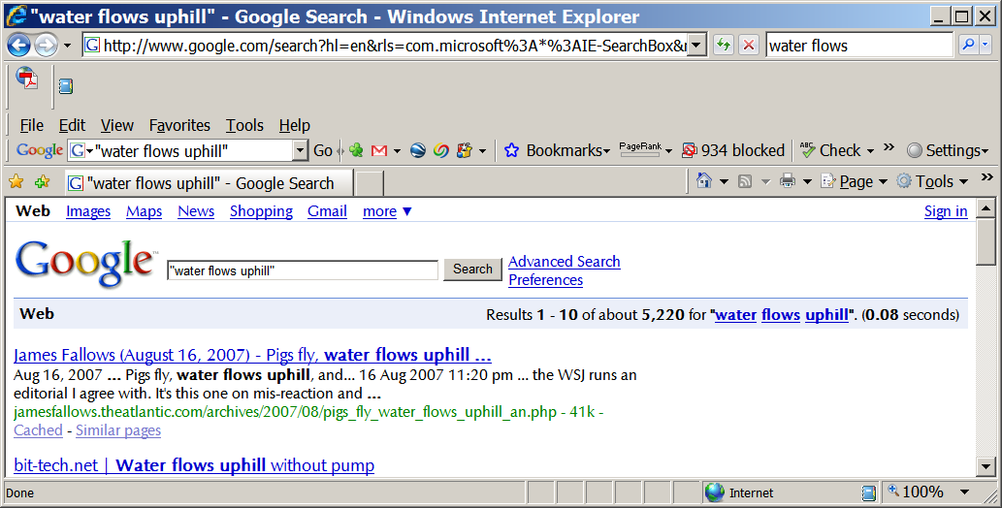
2008
Water’s getting
aggressive

Slide 21
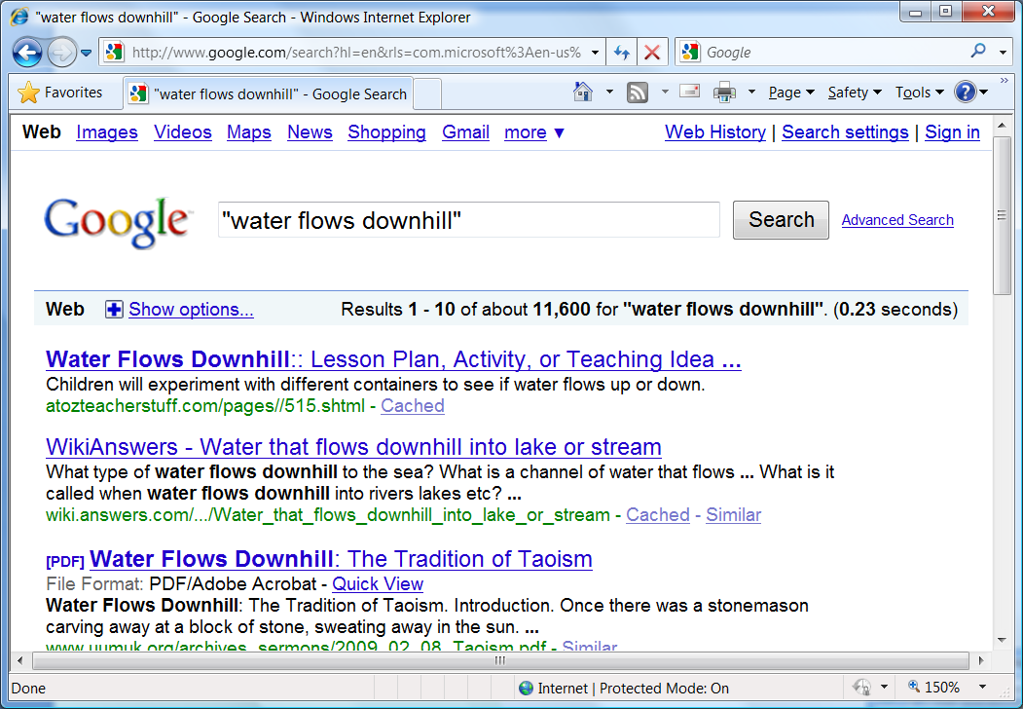
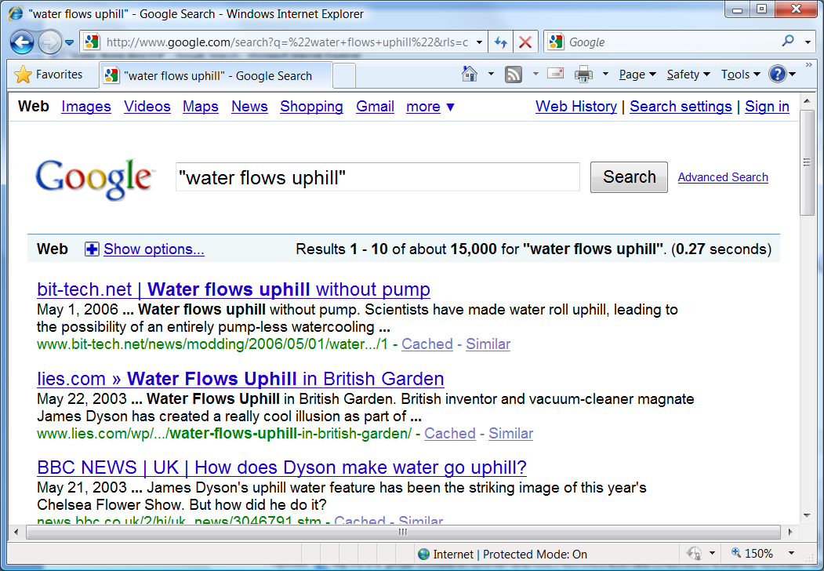
2010

Slide 22
It’s a Jungle out there (adversarial Web & Arms Race)
Big Idea 4
Web is authority-free zone!
Anyone can put up any information and get indexed..
Everyone is trying to trip you up… (snopes.com)
Need to keep “adversarial” aspect constantly in view
Adversarial IR (focus on Trust in addition to Relevance)
Adversarial mining (the class is being changed even as you are learning)
Classic example: Spam mail
Notes:
Mother may be making those sites too..

Slide 23
2011

