Slide 1
ASU 101 (Fall 2010)
Subbarao Kambhampati

Slide 2
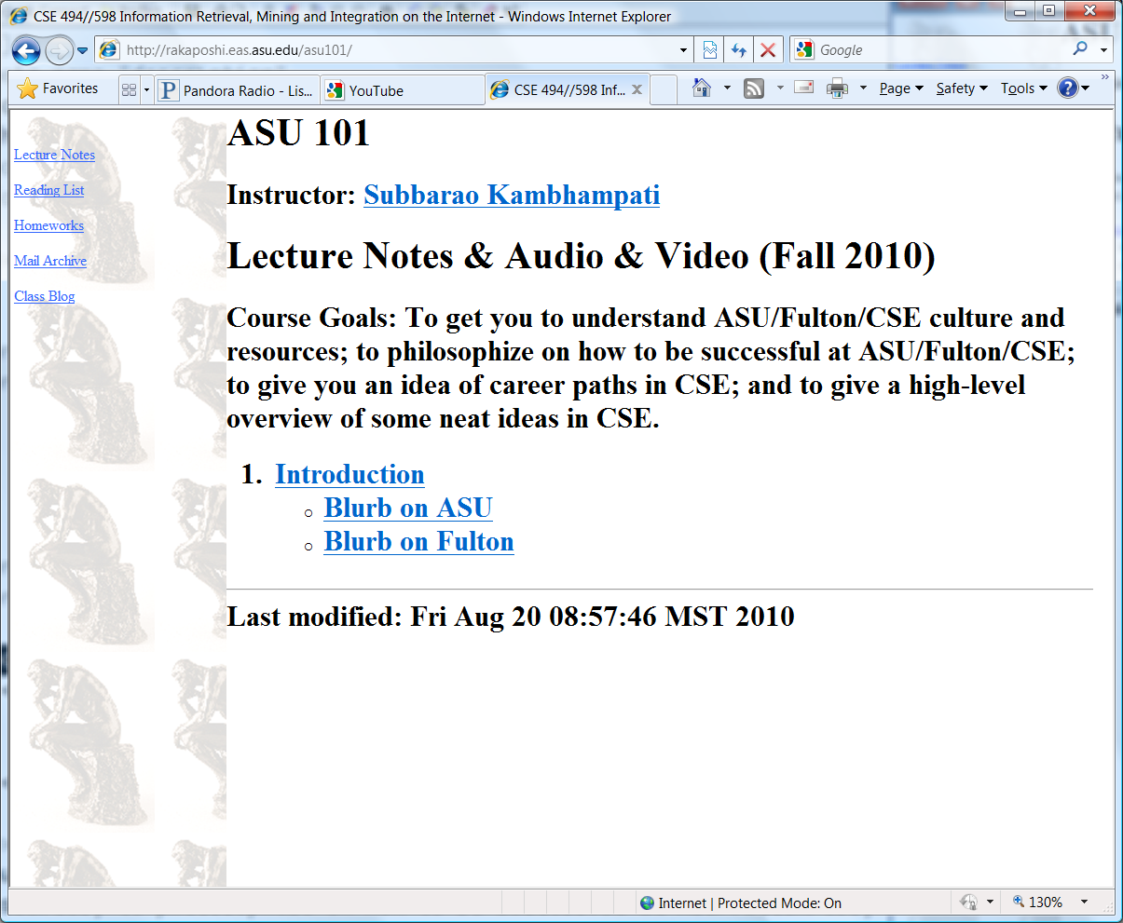
ASU 101
Instructor: Rao (Subbarao Kambhampati)
Meets once a week for 10 weeks (50min each)
Class home page:
http://rakaposhi.eas.asu.edu/asu101

Slide 3
ASU 101 Course Goals
Familiarize you with ASU, Fulton and CSE
Some philosophy about how to be successful at ASU/Fulton/CSE
Both home-spun (by yours truly), and from the horses’ mouth (by students who did UG here)
Overview and advice on career paths in CSE
Some overview lectures on Great Ideas in Computer Science
Will be biased (by the instructors’ own interests ;-)

Slide 4
“Grading”?
Not a formal course
You have to work hard to get a bad grade
You can get one by:
Not showing up for the class
Not participating
Not answering any blog questions

Slide 5
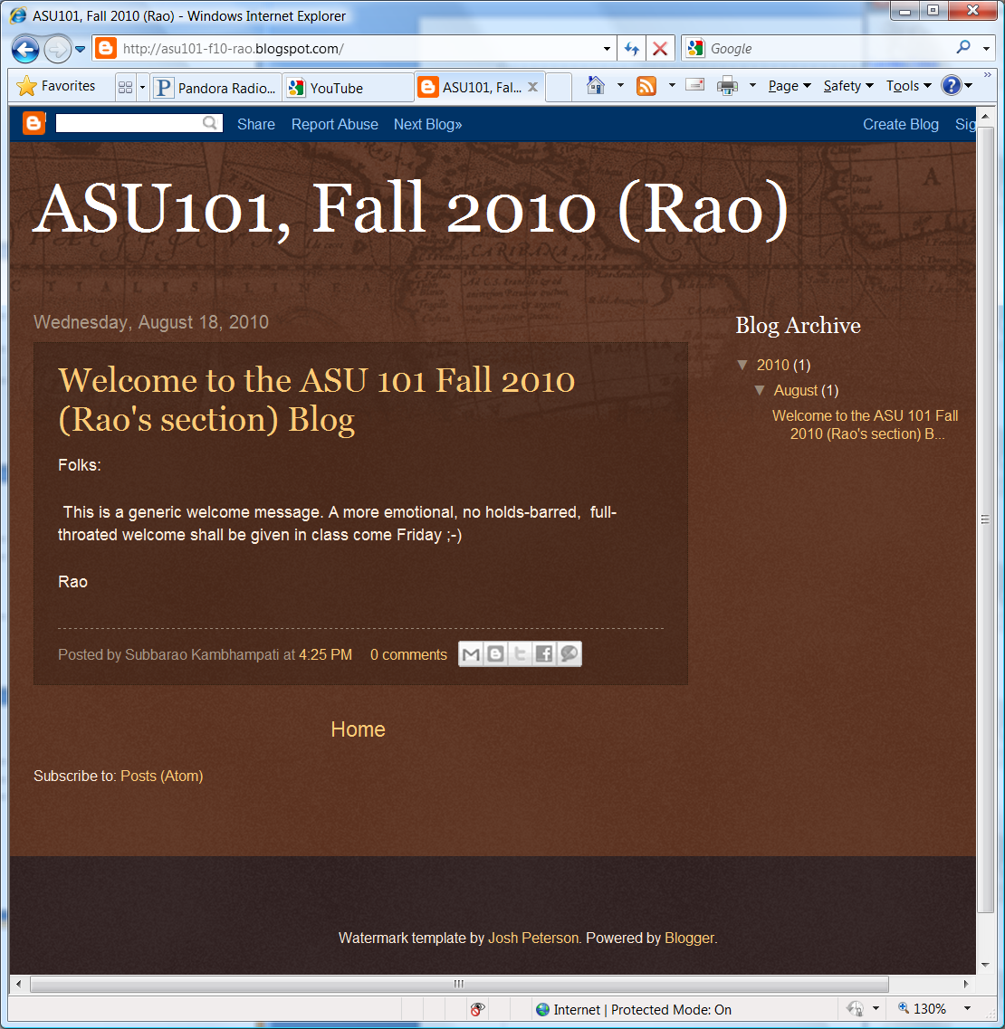
Blog?
There is a class blog
Each of you got invitations to join the blog (check your email!)
Some of you have already accepted the invitations
You can (and will) post as well as comment on blog

Slide 6
Today’s Agenda
Introductions
Each of you
Introduce yourself (your name)
Why did you choose CSE major? Any specific areas of CSE that are of particular interest to you?
Say something interesting about yourself
{You will enter this also as your first blog post}
Unexpected Pop-Quiz and Idiosyncratic overview of ASU/Fulton/CSE

Slide 7
Unexpected Pop-Quiz

Slide 8
Why is ASU an NAU?

Slide 9
Why are all ASU 101 sections capped at 19 students?

Slide 10
What are the research areas of your instructor?

Slide 11
What Engineering Discipline gets most mentions in NY Times Science News?

Slide 12
What is i^{i} ?

Slide 13
How many pairwise comparisons do I need to do to check if a sequence of n-numbers is sorted?

Slide 14
What major CS theorem did someone claimed to have proved recently?

