Slide 1
Open only for Humans; Droids and Robots should go for CSE 462 next door ;-)
CSE 471/598
Intro to AI

Slide 2
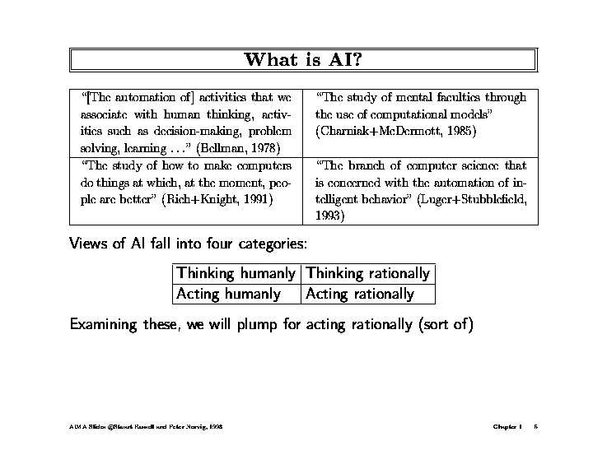
Although we will see that all four views have
motivations..

Slide 3
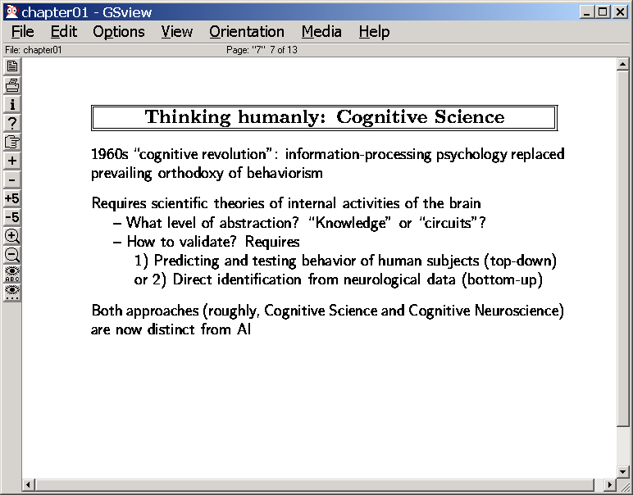
Do we want a machine that beats humans in chess or a machine that thinks like humans
while beating humans in chess?
→DeepBlue supposedly DOESN’T think like humans..
(But what if the machine is trying to “tutor” humans about how to do things?)
(Bi-directional flow between thinking humanly and thinking rationally)

Slide 5
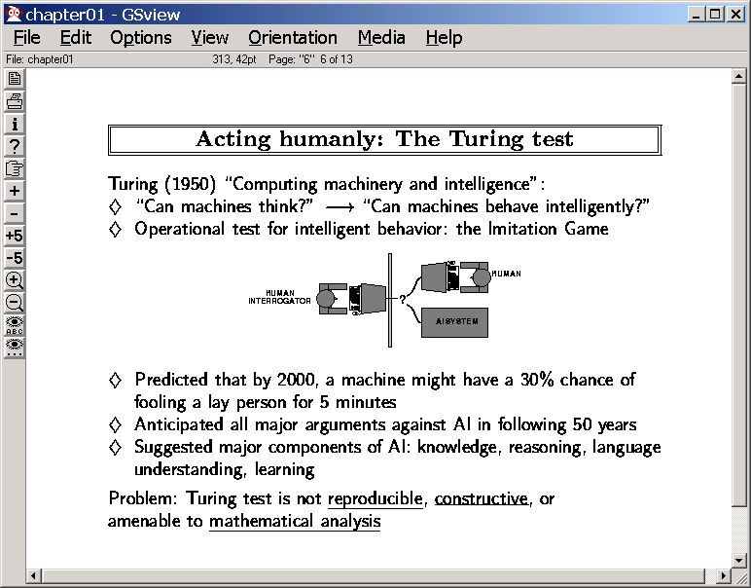
What if we are writing intelligent
agents that interact with humans?
→The COG project
→The Robotic care givers
Mechanical flight became possible only when people decided to stop
emulating birds…

Slide 6
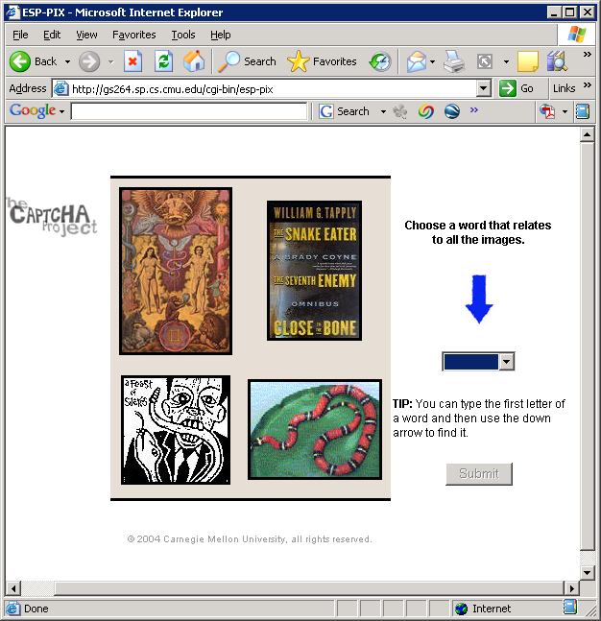
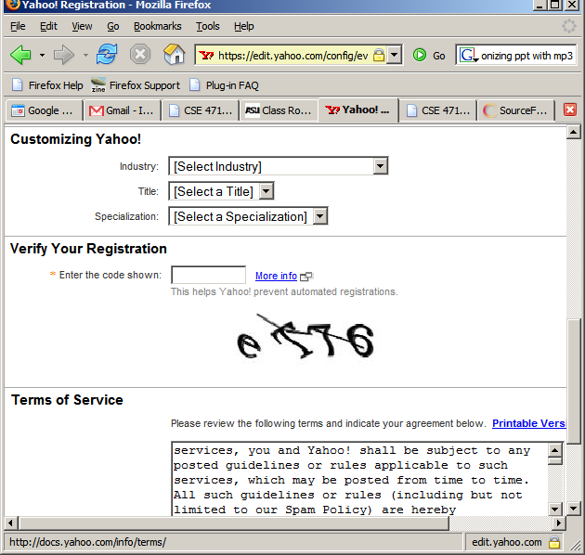
What AI can do is as important as what it can’t yet do..
Captcha project

Slide 7
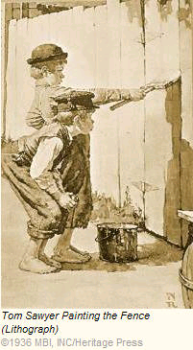
Arms race to defeat Captchas… (using unwitting masses)
digression
Start opening an email account at Yahoo..
Clip the captcha test
Show it to a human trying to get into another site
Usually a site that has pretty pictures of the persons of apposite* sex
Transfer their answer to the Yahoo
Much more interesting idea: ESP Game
Note: Apposite—not opposite. This course is nothing if not open minded ☺

Slide 9
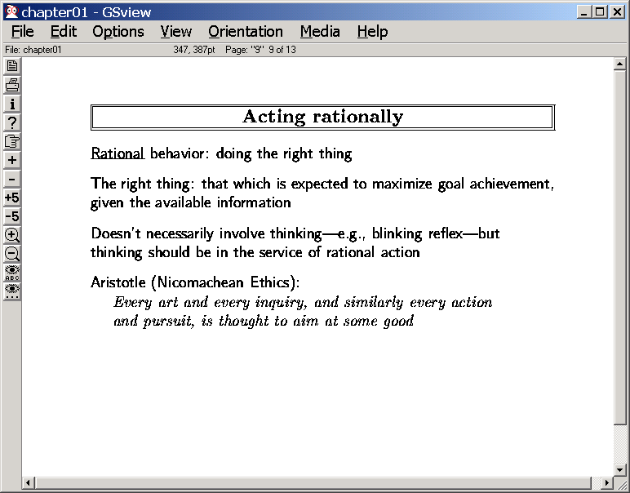
It can be argued that all the faculties needed to pass turing test are also needed to act rationally
to improve success ratio…

Slide 10
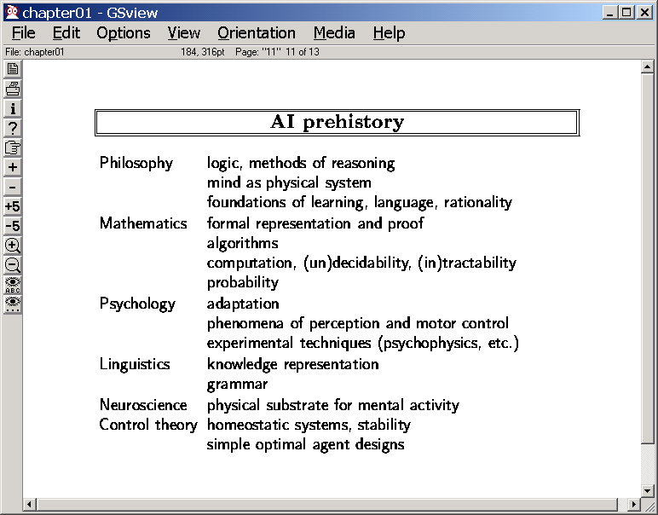

Slide 12
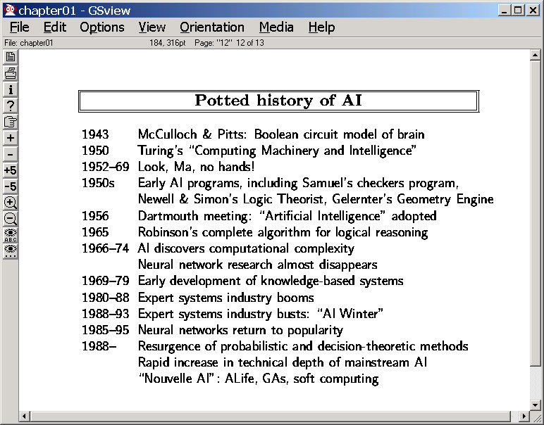

Slide 13
Discuss on
Class Blog
Playing an (entertaining) game of Soccer
Solving NYT crossword puzzles at close to expert level
Navigating in deep space
Learning patterns in databases (datamining…)
Supporting supply-chain management decisions at fortune-500 companies
Learning common sense from the web
Navigating desert roads
Navigating urban roads
Bluffing humans in Poker..

Slide 14
Architectures for Intelligent Agents
Wherein we discuss why do we need representation, reasoning and learning

Slide 15
Environment
What action next?
The $$$$$$ Question
Notes:
Intelligent agency involves controlling the evolution of external environments in desirable ways. Planning provides a way in which the agent can maximize its chances of effecting this control. Informally, a plan can be seen as a course of actions that the agent decides upon based on its overall goals, information about the current state of the environment, and the dynamics of its evolution.
The complexity of plan synthesis depends on a variety of properties of the environment and the agent. Perhaps the simplest case of planning occurs when the environment is static, (in that it changes only in response to the agents actions), observable and the agent’s actions have deterministic effects on the state of the environment.
Plan synthesis under these conditions has come to be known as the classical planning problem.
Classical planning problem is thus specified by describing the initial state of the world, the desired goal state, and a set of deterministic actions. The objective is to find a sequence of these actions, which when executed from the initial state leads the agent to the goal state.
Despite its limitations, classical planning problem is still computationally hard, and has received a significant amount of attention. Work on classical planning has historically helped our understanding of planning under non-classical assumptions.

Slide 16
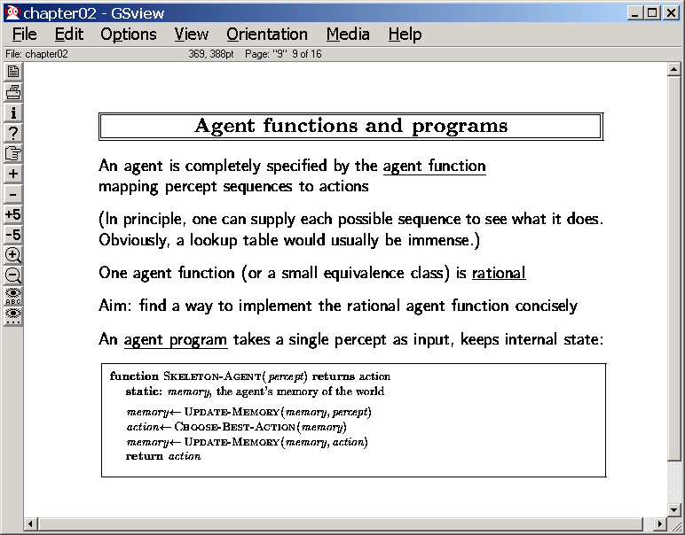

Slide 17
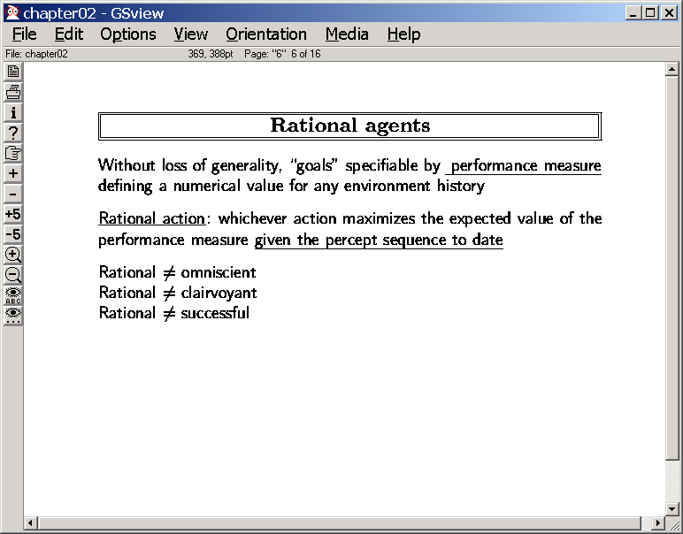
and prior knowledge
Rational != Intentionally avoiding sensing
“history” = {s0,s1,s2……sn….}
Performance = f(history)
Expected Performance= E(f(history))

Slide 18
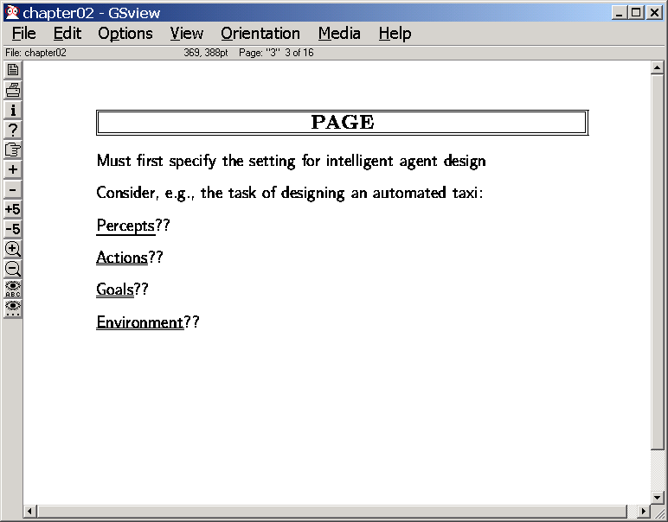

Slide 19
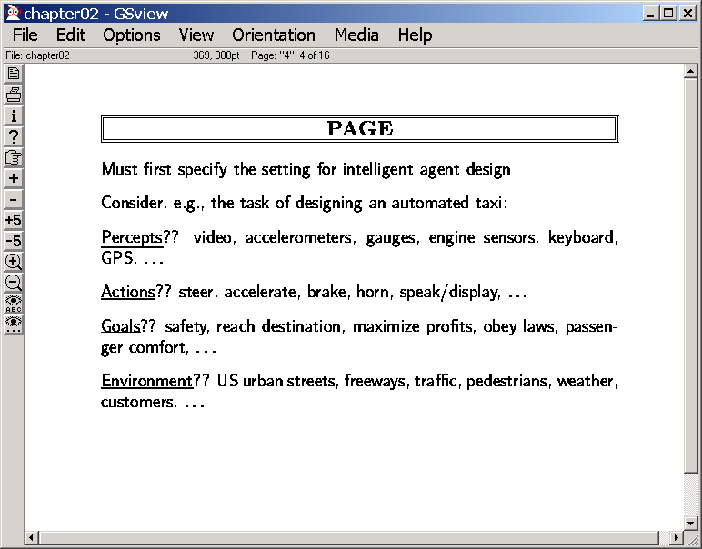

Slide 20
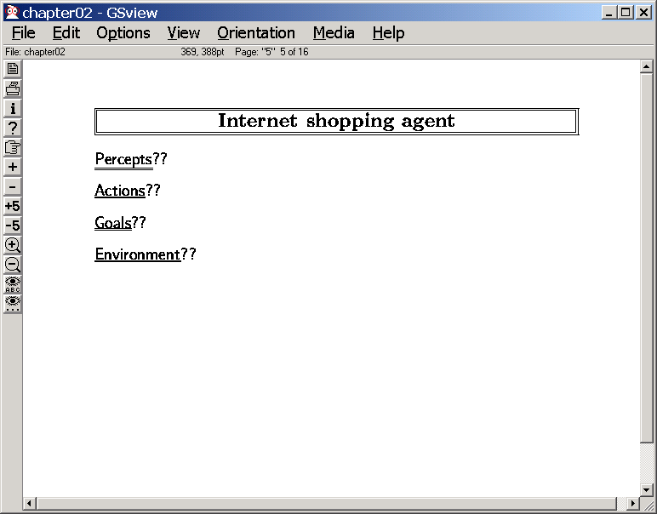
Partial contents of sources as found by Get
Get,Post,Buy,..
Cheapest price on specific goods
Internet, congestion, traffic, multiple sources
Qn: How do these affect the complexity of the problem the
rational agent faces?
→Lack of percepts makes things harder
→Lack of actions makes things harder…
→Complex goals make things harder
→How about the environment?

Slide 21
(Static vs. Dynamic)
Environment
(Observable vs.
Partially Observable)
(perfect vs.
Imperfect)
perception
(Full vs.
Partial satisfaction)
(Instantaneous vs.
Durative)
Goals
action
(Deterministic vs.
Stochastic)
What action next?
The $$$$$$ Question
Notes:
Intelligent agency involves controlling the evolution of external environments in desirable ways. Planning provides a way in which the agent can maximize its chances of effecting this control. Informally, a plan can be seen as a course of actions that the agent decides upon based on its overall goals, information about the current state of the environment, and the dynamics of its evolution.
The complexity of plan synthesis depends on a variety of properties of the environment and the agent. Perhaps the simplest case of planning occurs when the environment is static, (in that it changes only in response to the agents actions), observable and the agent’s actions have deterministic effects on the state of the environment.
Plan synthesis under these conditions has come to be known as the classical planning problem.
Classical planning problem is thus specified by describing the initial state of the world, the desired goal state, and a set of deterministic actions. The objective is to find a sequence of these actions, which when executed from the initial state leads the agent to the goal state.
Despite its limitations, classical planning problem is still computationally hard, and has received a significant amount of attention. Work on classical planning has historically helped our understanding of planning under non-classical assumptions.

Slide 22
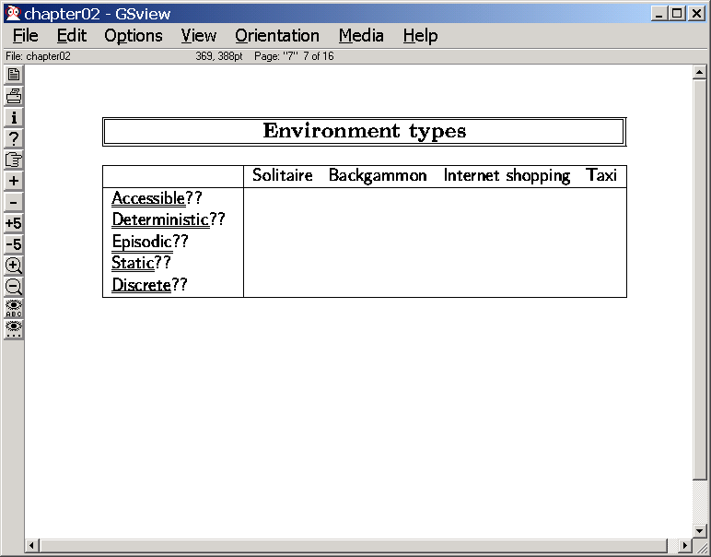
Yes
Yes
No
Yes
Yes
#1
No
No
No
No
No
>1
#Agents
Accessible: The agent can “sense” its environment
best: Fully accessible worst: inaccessible typical: Partially accessible
Deterministic: The actions have predictable effects
best: deterministic worst: non-deterministic typical: Stochastic
Static: The world evolves only because of agents’ actions
best: static worst: dynamic typical: quasi-static
Episodic: The performance of the agent is determined episodically
best: episodic worst: non-episodic
Discrete: The environment evolves through a discrete set of states
best: discrete worst: continuous typical: hybrid
Agents: # of agents in the environment; are they competing or cooperating?

Slide 23
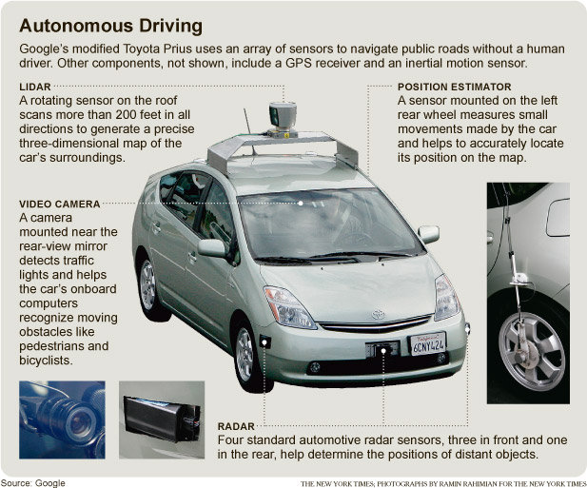

Slide 24
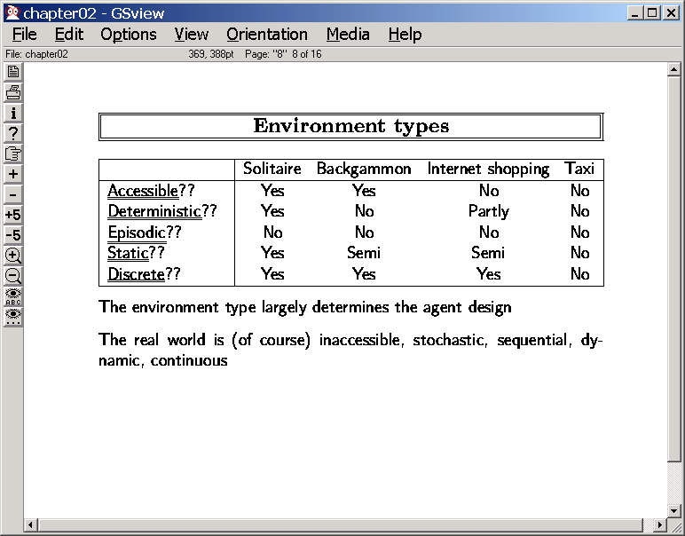
☹
Ways to handle:
→Assume that the environment is more benign than it really is
(and hope to recover from the inevitable failures…)
Assume determinism when it is stochastic;
Assume static even though it is dynamic;
→Bite the bullet and model the complexity

Slide 25
Additional ideas/points covered Impromptu
The point that complexity of behavior is a product of both the agent and the environment
Simon’s Ant in the sciences of the artificial
The importance of modeling the other agents in the environment
The point that one reason why our brains are so large, evolutionarily speaking, may be that we needed them to outwit not other animals but our own enemies
The issue of cost of deliberation and modeling
It is not necessary that an agent that minutely models the intentions of other agents in the environment will always win…
The issue of bias in learning
Often the evidence is consistent with many many hypotheses. A small agent, to survive, has to use strong biases in learning.
Gavagai example and the whole-object hypothesis.

Slide 26
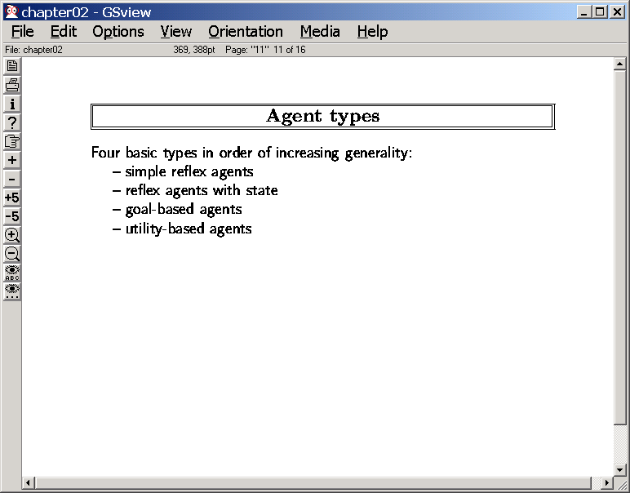
(Model-based reflex agents)
How do we write agent programs for these?

Slide 27
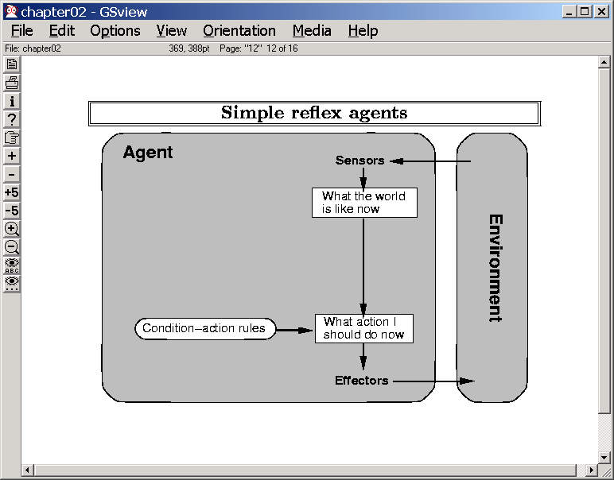
Even basic survival needs
state information..
This one already assumes that the “sensors→features” mapping has been done!

Slide 28
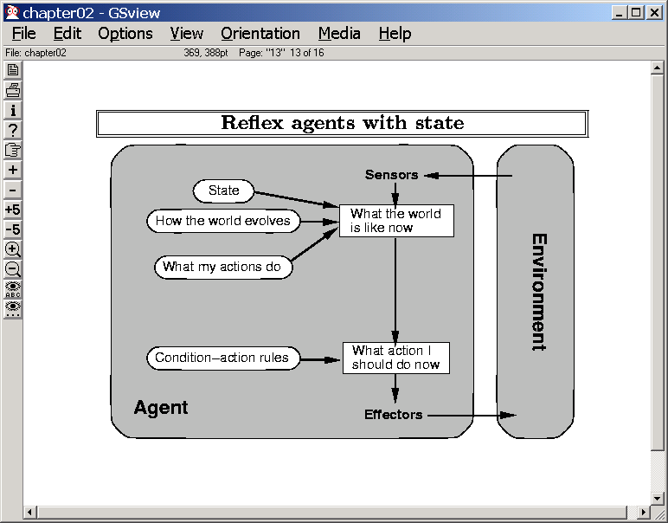
(aka Model-based Reflex Agents)
State
Estimation
EXPLICIT MODELS OF THE ENVIRONMENT
--Blackbox models
--Factored models
→Logical models
→Probabilistic models

Slide 29
A Robot localizing itself using particle filters

Slide 30
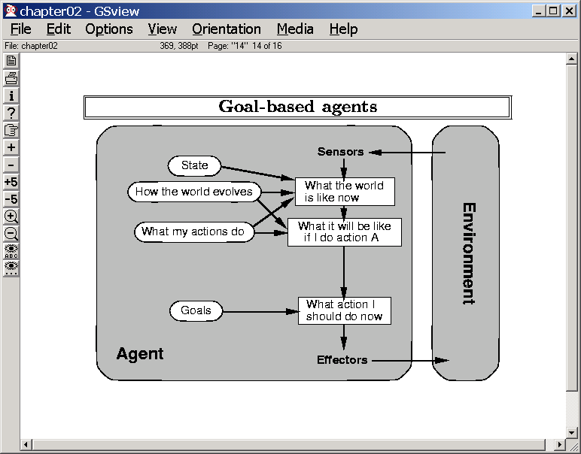
State
Estimation
Search/
Planning
It is not always obvious what action to do now given a set of goals
You woke up in the morning. You want to attend a class. What should your action be?
→ Search (Find a path from the current state to goal state; execute the first op)
→Planning (does the same for structured—non-blackbox state models)

Slide 31
Representation Mechanisms:
Logic (propositional; first order)
Probabilistic logic
Learning
the models
Search
Blind, Informed
Planning
Inference
Logical resolution
Bayesian inference
How the course topics stack up…

Slide 32
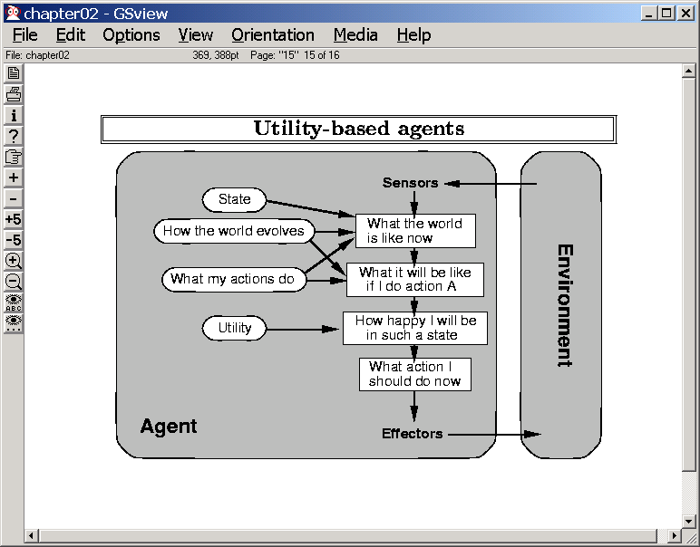
..certain inalienable rights—life, liberty and pursuit of
?Money
?Daytime TV
?Happiness (utility)
--Decision Theoretic Planning
--Sequential Decision Problems

Slide 33
Discounting
The decision-theoretic agent often needs to assess the utility of sequences of states (also called behaviors).
One technical problem is “How do keep the utility of an infinite sequence finite?
A closely related real problem is how do we combine the utility of a future state with that of a current state (how does 15$ tomorrow compare with 5000$ when you retire?)
The way both are handled is to have a discount factor r (0<r<1) and multiply the utility of n^{th} state by r^{n}
r⁰ U(s_{o})+ r¹ U(s₁)+…….+ r^{n} U(s_{n})+
Guaranteed to converge since power series converge for 0<r<n
r is set by the individual agents based on how they think future rewards stack up to the current ones
An agent that expects to live longer may consider a larger r than one that expects to live shorter…

Slide 34
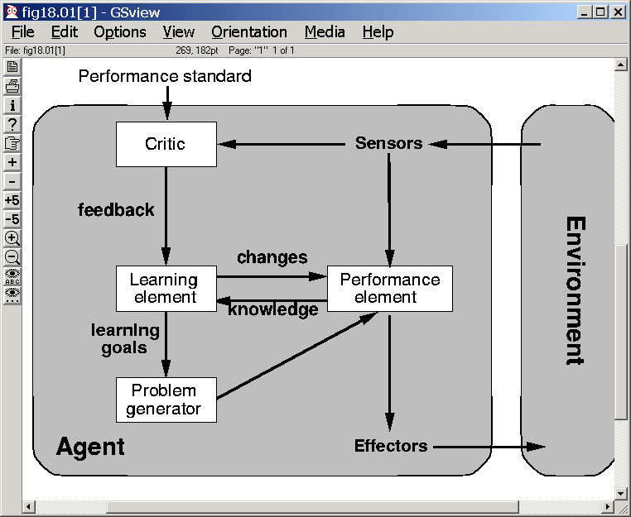
Learning
Dimensions:
What can be learned?
--Any of the boxes representing
the agent’s knowledge
--action description, effect probabilities,
causal relations in the world (and the
probabilities of causation), utility models
(sort of through credit assignment), sensor
data interpretation models
What feedback is available?
--Supervised, unsupervised,
“reinforcement” learning
--Credit assignment problem
What prior knowledge is available?
-- “Tabularasa” (agent’s head is a blank
slate) or pre-existing knowledge

