Slide 1
Search Engines

Slide 2
How to Compare two text files?
Do a “diff” or a “checksum”
Will only tell you if they are identical not if they are similar
Compare their “ingredients”
How to compare sets (or bags)
Ratio of cardinality of intersection to the cardinality of union
Can generalize intersection and union to bags..
Intersection is computed as the minimum number of items of the same kind in each bag; union is computed as the maximum number of items of the same kind in each bag
Bag1: {3 apples; 4 bananas} Bag2: {2 apples; 6 bananas; 4 mangos}
Intersection {2 apples; 4 bananas}
Union: {3 apples; 6 bananas; 4 mangos}
What are the ingredients of a file?
Letters; words; shingles (phrases)
Comparing over letters—most files will look similar
Comparing over shingles—more appropriate for duplicate detection
Comparing over words—pretty widely used to get a rough sense of similarity

Slide 3
Measuring Performance
1.0 precision ~ Soundness ~ nothing but the truth
1.0 recall ~ Completeness ~ whole truth
Analogy: Swearing-in witnesses in courts
“whole truth and nothing but the truth”
Actual relevant docs
Precision
Proportion of selected items that are correct
Recall
Proportion of target items that were selected
Precision-Recall curve
Shows tradeoff
tn
fp
tp
fn
System returned these
Precision
Document similarity checking by
“checksums” has high precision
but low recall;
Document similarity checking by “bag
Of letters” has low precision but
High recall
Recall
tp→true positives; tn→true negatives
fp→false positives; fn→false negatives

Slide 4
Bag of Words Comparison
Tom hit this ball and kicked that ball.
Tom(1) hit(1) this (1) that(1) ball(2) and(1) kicked(1)
Tom was hit by that ball.
Tom(1) was(1) hit(1) by (1) ball(1) that(1)
Intersection: Tom(1) that(1) ball(1) hit(1) Cardinality: 4
Union: Tom(1) hit(1) this(1) ball(2) and(1) kicked(1) by(1) that(1) was(1) Cardinality: 10
Similarity: 4/10 = 40%

Slide 5
Viewing Bags as “vectors”
(Linear Algebra)
A bag can be viewed as a vector in the n-dimensional space of words
The similarity between two bags can be measured as the cosine of the angle between the vectors
(2computer + 5 data)
“data”
Cosine of this angle is similarity
(5 computer + 1 data)
“Computer”
Cosine ( angle between v1 & v2)
= dot product of v1 and v2
(size of v1)* (size of v2)
= [2*5+5*1]/ sqrt(5^2+1^2)*sqrt(2^2+5^2) = 0.55

Slide 6
N-grams as a way of doing “Spelling Correction”
A k-gram is the sequence of k contiguous characters in the string
Kambhampati
^ka; kam; amb; mbh; bha; ham; amp; mpa; pat; ati;ti$
Now if you type “Kambhapatti”
^ka;kam;amb;mbh;bha;hap;apa;pat;att;tti;ti$
Bag similarity can be computed…

Slide 7
Idea for Search
Query is a set/bag/vector of words
The documents in the corpus are all set/bag/vector of words
Compare the query to the documents and see which document is most similar. Return the top 10
Issues: How to do similarity computation efficiently?
Answer: Inverted Index

Slide 8
Inverted Files
POS
1
10
20
30
36
FILE
A file is a list of words by position
First entry is the word in position 1 (first word)
Entry 4562 is the word in position 4562 (4562nd word)
Last entry is the last word
An inverted file is a list of positions by word!
a (1, 4, 40)
entry (11, 20, 31)
file (2, 38)
list (5, 41)
position (9, 16, 26)
positions (44)
word (14, 19, 24, 29, 35, 45)
words (7)
4562 (21, 27)
INVERTED FILE

Slide 9
Inverted Files for Multiple Documents
Can also store
precomputed “tf”
LEXICON
“jezebel” occurs
6 times in document 34,
3 times in document 44,
4 times in document 56 . . .
DOCID OCCUR POS 1 POS 2 . . .
…
OCCURENCE INDEX
. . .
Positional information is useful for (a) proximity queries and
(b) snippet construction

Slide 10
Inverted index needs to be dynamically maintained..

Slide 11
Should all words be considered equally important?
Consider three computer-related documents
The esoteric program for the computer
The fortran program for the computer
Esoteric program
Which if the last two documents is more similar to the first one? Will bag-of-words or vector similarity find it?
Need to weight words by their “distinctiveness”
Idea: Inverse document frequency
log( #documents in the corpus/#docs containing that word)

Slide 12
Does the fact that Pages are Hyper-linked affect retrieval?
Anchor Text
What other pages say about you…
So the “content” of a page is what is on the page + what others pointing to that page say about that page…

Slide 13
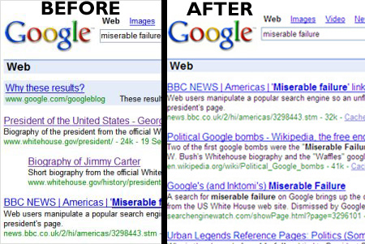
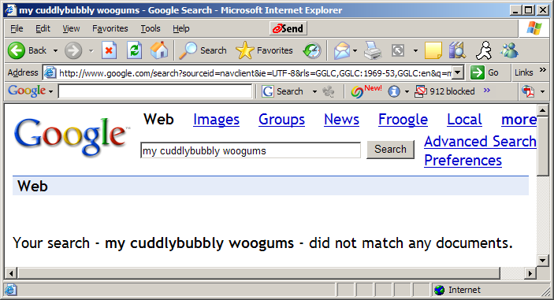
Google Bombs: The other side of Anchor Text
You can “tar” someone’s page just by linking to them with some damning anchor text
If the anchor text is unique enough, then even a few pages linking with that keyword will make sure the page comes up high
E.g. link your SO’s page with
“my cuddlybubbly woogums”
“Shmoopie” unfortunately is already taken by Seinfeld
For more common-place keywords (such as “unelectable” or “my sweet heart”) you need a lot more links
Which, in the case of the later, may defeat the purpose
Anchor text is a way of “changing” a page! (and it is given higher importance than the page contents)

Slide 14
What is the biggest competitive asset of Google?

Slide 15
Are all documents containing the query words equally important?
Reasonable assumption if you are searching over books in the library
What about searching over web pages?
Rao can put the phrase “white house” in his web page. Should his web page be the top hit for the query “white house”?

Slide 16
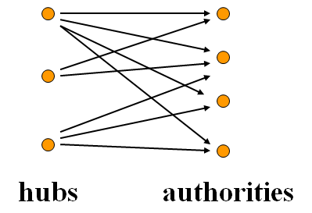
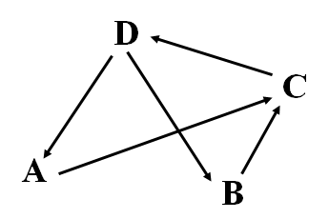
How do you judge importance?
Think of social networks
Who is the most popular kid in the school?
The one with most friends?
The one with most popular friends?
(The Papov Joke..)
Think of Kings and Kingmakers
If NYTimes mentions your name, you become popular; NYTimes itself is popular because it mentions important things
Authorities and Hubs
Think of a random surfer following links on the page..
Start from a random page, and clicks her way from one page to another
The “importance” of a page is the probability of the random surfer landing on that page
If many pages point to this page, then there is a higher probability of landing on this page.
Both connected to the notion of Eigen Vectors

Slide 17
Computing PageRank (10)
Example: Suppose the Web graph is:
M =
D
C
A
B
A B C D
A B C D
A
B
C
D
0 0 0 ½
0 0 0 ½
1 0 0
0 0 1 0
A
B
C
D
0 0 1 0
0 0 1 0
0 0 0 1
1 1 0 0
A=

Slide 18
Computing PageRank
If the ranks converge, i.e., there is a rank vector R such that
R = M × R,
Can compute iteratively
R₀ = {1/n ; 1/n…..}
Loop
R_{i} ← M x R_{i-1}
end
R is the eigenvector of matrix M with eigenvalue being 1.

Slide 19
Markov Chains & Random Surfer Model
Markov Chains & Stationary distribution
Necessary conditions for existence of unique steady state distribution: Aperiodicity and Irreducibility
Aperiodicity→it is not a big cycle
Irreducibility: Each node can be reached from every other node with non-zero probability
Must not have sink nodes (which have no out links)
Because we can have several different steady state distributions based on which sink we get stuck in
If there are sink nodes, change them so that you can transition from them to every other node with low probability
Must not have disconnected components
Because we can have several different steady state distributions depending on which disconnected component we get stuck in
Sufficient to put a low probability link from every node to every other node (in addition to the normal weight links corresponding to actual hyperlinks)
This can be used as the “reset” distribution—the probability that the surfer gives up navigation and jumps to a new page
The parameters of random surfer model
c the probability that surfer follows a link on the page
The larger it is, the more the surfer sticks to what the page says
M the way link matrix is converted to markov chain
Can make the links have differing transition probability
E.g. query specific links have higher prob. Links in bold have higher prop etc
K the reset distribution of the surfer (great thing to tweak)
It is quite feasible to have m different reset distributions corresponding to m different populations of users (or m possible topic-oriented searches)
It is also possible to make the reset distribution depend on other things such as
trust of the page [TrustRank]
Recency of the page [Recency-sensitive rank]
M*= c(M+Z) + (1-c)K

