Slide 1
RAProp: Ranking Tweets by Exploiting the Tweet/User/Web Ecosystem and Inter-Tweet Agreement
Srijith Ravikumar
Master’s Thesis Defense
Committee Members
Dr. Subbarao Kambhampati (Chair)
Dr. Huan Liu
Dr. Hasan Davulcu

Slide 2

The most prominent micro-blogging service.
Twitter has over 140 million active users and generates over 340 million tweets daily and handles over 1.6 billion search queries per day.
Users access tweets by following other users and by using the search function.

Slide 3

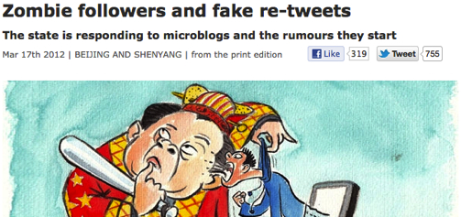


Need for Relevance and Trust in Search
Spread of False Facts in Twitter has become an everyday event
Re-Tweets and users can be bought.
Thereby solely relying on those for trustworthiness does not work.
Notes:
relevance only annoys users, trust misleads user
“We already established that relevance needs to be taken into account. Another aspect is trust..”

Slide 4
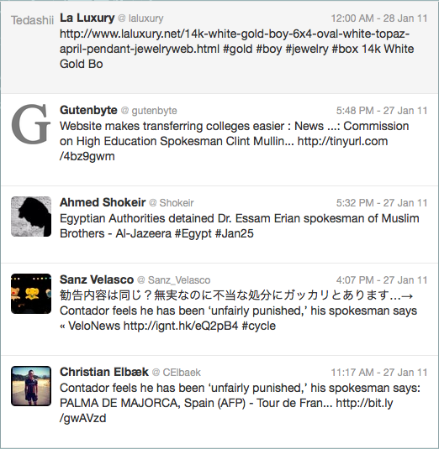
Twitter Search
Result for Query: “White House spokesman replaced”
Does not apply any relevance metrics.
Sorted by Reverse Chronological Order
Select the top retweeted single tweet as the top Tweet.
Contains spam and untrustworthy tweets.

Slide 5
Search on the surface web
Documents are large enough to contain most of the query terms
Document to Query similarity is measured using TF-IDF similarity
Due to the rich vocabulary, IDF is expected to suppress stop words.

Slide 6
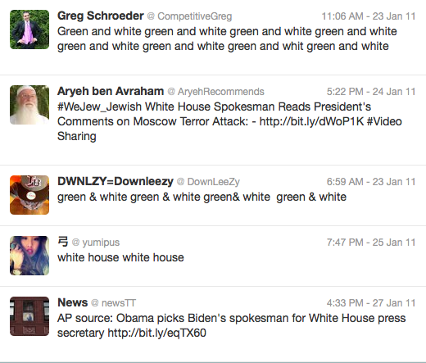
Applying TF-IDF Ranking in Twitter
High TF-IDF similarity may not correlate to higher Relevance
IDF of stop words may not be low
Does not penalize for not having any content other than query keyword.
Result for Query: “White House spokesman replaced”
User Popularity and trust becomes more of an issue than TF-IDF similarity

Slide 7
Measuring Relevance in Twitter
What may be a measure of Relevance in Twitter?
  Tweet similarity to Query.
  Tweet’s Popularity
  User Popularity and Trust
  Web Page linked in Tweet’s Trustworthiness

Slide 8
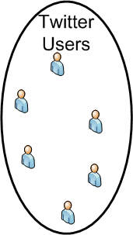
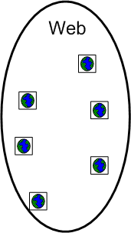
Twitter Eco-System
Query, Q
Tweeted By
Tweeted URL
Followers
Hyperlinks

Slide 9

Twitter Eco-System: Query
Query, Q
Tweet content also determines the Relevance to the query
Relevance
  TF-IDF Similarity Weighted by query term proximity
  w=0.2, d = sum of dist. between each query term, l = length of tweet

Slide 10
Twitter Eco-System: Tweets
A tweet that is popular may be more trustworthy
  # of Re-tweets
  # of Favorites
  # of Hashtags
  Presence of Emoticons, Question mark, Exclamations

Slide 11
Twitter Eco-System: Users
Tweets from popular and trustworthy users are more trustworthy
What user features determines popularity of a user?
  Profile Verified
  Creation Time
  # of Status
  Follower Count
  Friends Count
Followers

Slide 12
Twitter Eco-System: Web
A tweet that cites a credible web site as a source is more trustworthy
Web has solves measuring credibility of a web page
  Page Rank
Hyperlinks

Slide 13
Feature Score Leaner: Random Forest
These features are used to train a Random-Forest based learner to compute the Feature Score
Random Forest learner
  Ensemble Learning Method
  Creates multiple decision trees using bagging approach

Slide 14
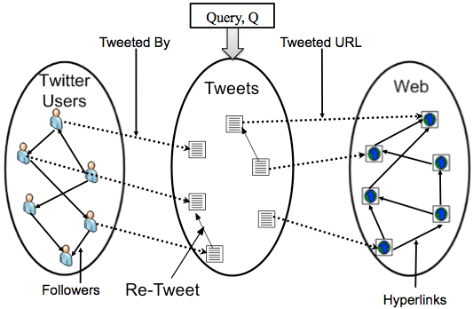
Feature Score
Random forest helps in learning a better classifier for tweets as Feature Score may not be linearly dependent on the features
The features were imputed so as not to penalize tweets with missing feature values

Slide 15
Feature Score: Training
Learner was trained on TREC Microblog 2011 Gold Standard
  IR competition on Ranking Microblogs
  Gold Standard was created by Crowd Sourcing a set of tweets and a query.
  Crowd need to mark if the tweet is relevant to that query (1) or not (0).
  Trained on 5% of the Gold standard.

Slide 16
Ranking using Feature Score
Feature Score does improve on Twitter Search for all values of K and in MAP

Slide 17
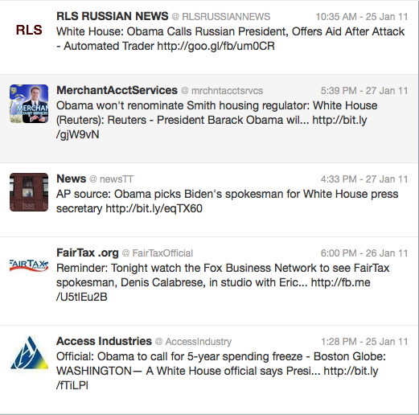
Ranking using Feature Score
Result for Query: “White House spokesman replaced”
Ranking seems to improve over Twitter and TF-IDF search
Tweets in the ranked list are from reputed source.
But they seem to be irrelevant to the query.
Even if the query terms are present the tweet from a popular User/Web may not be relevant to the query.

Slide 18
Agreement
In twitter, a query is mostly on the current breaking news.
There also should be a burst of tweets on that breaking news.
How do we tap into this wisdom of the crowd?
  Use the tweets to vote(endorsement) on a topic
  The tweets from the topic that has highest votes is likely to be more relevant to the query.
Notes:
What is the thing that lot of tweets are talking abt
If a lot of indipendant users agree on something then it should be popular
It means giving the smaller guy

Slide 19
Links in Twitter Space: Endorsement
On Twitter, Agreement may be seen as implicit endorsement
Retweet
Agreement
Re-Tweet: Explicit links between tweets
Agreement: Implicit links between tweets that contain the same fact

Slide 20
Similarity Computation
Compute agreement using Part of Speech weighted TF-IDF Similarity.
Due to the presence of non dictionary vocabulary, IDF is computed on the Result Set.
Sparsity of stop words in Twitter leads to IDF of stop words to be high.

Slide 21

Similarity Computation: PoS Tagging
Uses Part of Speech tagger to identify the weightage for each Part of Speech in TF-IDF Similarity.

Slide 22

Agreement Graph
Propagate the Feature Score across the Agreement graph
w_{ij} is agreement of T_{i} and T_{j ,} S(Q,T_{i}) is Feature Score of T_{i}
Tweets are ranked by the Propagated Feature Score
Can be seen as Feature Score considering endorsement

Slide 23
Agreement Propagation
Bad
Good
.45
1.5
.89
Good

Slide 24
1–ply Propagation
Unlike TrustRank/PageRank, Feature Score is propagated only 1-ply.
Implicit links makes trust non-transitive over agreement graph
A spam tweet that contains a part of the content of a trustworthy tweet may propagate the trust to the spam cluster

Slide 25

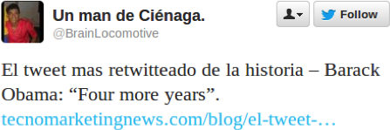
1–ply Propagation
.5
.6
T4
T1 and T2 are the trustworthy tweets
T4 and T5 are the untrustworthy tweets
T3 contains text from trustworthy and untrustworthy tweets
Multi-ply propagation leads to Feature Score propagation from T1,T2 to T4,T5 though T3
T1
T2
.3
T3
.3
T5

Slide 26
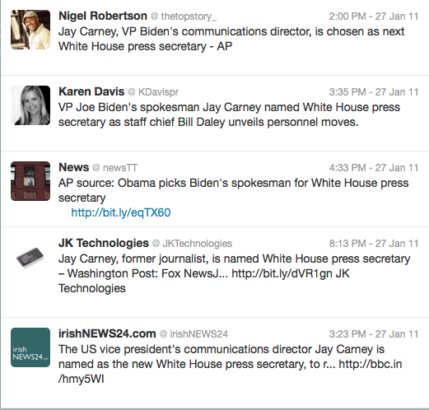
Ranking using RAProp
Result for Query: “White House spokesman replaced”
All the tweets seems to be relevant to the query
The top tweets seems to be more trustworthy.

Slide 27
Ranking using RAProp
RAProp does improve on Feature Score for all values of K and in MAP

Slide 28
Dataset
Conducted experiments on 16 million tweets TREC 2011 Microblog Dataset for the experiments
Gold Standard consists of a selected set of tweets for a query that were marked as {-1, 0, 1}: -1 for spam, 0 for irrelevant, 1 for relevant
Experiments were run over all the 49 queries in the gold standard

Slide 29
Picking Result Set
Result Set R_{Q} contains Top-N tweets for query Q
Use query expansion to get better tweets in the Result Set
  Pick an initial set of tweets, R’_{Q’} for query Q’
  Pick Top-5 nouns with highest TF-IDF Score
  Original query Q’ is expanded using the nouns to get expanded query Q
  RAProp runs on R_{Q}

Slide 30
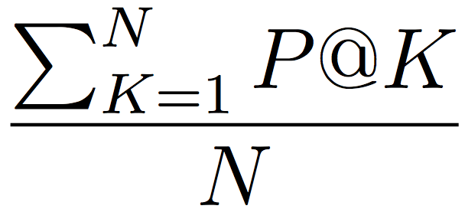
Experiment Setup: Precision
Compare the precision of RAProp against all baselines
  Precision at 5, 10, 20, 30:
  P@K = Number of relevant results in the top-K results
  K
  Mean Average Precision (MAP):
      MAP =
      MAP is sensitive to ordering of relevant tweets in the Result Set.

Slide 31
Experiment Setup: Models
Compare the performance of the RAProp against baselines while assuming
  Mediator Model
    Assume that we don’t have access to the entire twitter dataset
    Uses Twitter APIs to query and get results
    The tweets that contain one or more query keywords would be sorted in reverse chronological order.

Slide 32
Experiment Setup: Models
  Non-Mediator Model
    Assume to host the entire dataset
    Can select the Result Set using non-twitter selection algorithm
    Can index offline and run the query over this offline index
    RAProp select the results using basic TF-IDF similarity to the query.

Slide 33
Internal Baselines
Agreement (AG): Ranking tweet using agreement as voting. Tweets are ranked by the sum of its agreement with all other tweets
Feature Score (FS): Ranking tweets using Feature Score
User/Pagerank Propagate(UPP)
  User Trustworthiness Score was trained to predict the trustworthiness of a user between 0 to 4.
  PageRank defines the Web Trustworthiness Score
  The User and Web Trustworthiness Score is propagated over the agreement graph
  The propagated User and Web Trustworthiness Score is combined with the tweet features are used by a learning to rank method to rank the tweets for that query.

Slide 34
Internal Evaluation: Mediator
In the mediator model, the top-2000 tweets where picked from the simulated twitter for the expanded Query, Q.

Slide 35
Internal Evaluation: Mediator
25 % Improvement
RAProp is able to achieve higher Precision and MAP scores than other baselines in Mediator Model

Slide 36
Internal Evaluation: Non Mediator
In non-mediator model the Result Set is selected by the TF-IDF similarity of the tweet to the query.
The Top-N tweets with the highest TF-IDF similarity becomes the Result Set.

Slide 37
Internal Evaluation: Non Mediator
16% Improvement
RAProp is able to achieve higher Precision and MAP scores than other baselines in Non Mediator Model

Slide 38
1-ply vs. Multi-ply
Precision improves on 1-ply and significantly reduce on higher number of propagations

Slide 39
External Baselines
Twitter Search (TS): Simulated Twitter Search by Reverse Chronologically sorting tweets that contain one or more of the query keywords.
Current State of the Art(USC/ISI)[1]
  Uses a system(Indri) which is an LDA based relevance model that considers not only terms but also phrases to get relevance scores for the tweets.
  A Co-ordinate Assent Learning to Rank Algorithm uses the relevance score along with other tweet features(has url, has hashtag,is a reply) to rank the tweets.
[1] D. Metzler and C. Cai. Usc/isi at trec 2011: Microblog track. In Proceedings of the Text REtrieval Conference (TREC 2011), 2011

Slide 40
External Evaluation: Mediator
37% Improvement
RAProp is able to achieve higher Precision and MAP scores than Twitter Search as well as current state of the art in Mediator Model

Slide 41
External Evaluation: Non Mediator
17% Improvement
The TREC gold standard does not evaluate all possible relevant tweets, resulting in decreased precision for certain queries.

Slide 42
Conclusions
Introduced a Ranking method that is sensitive to Relevance and Trust
Uses the twitter three layer graph to find the Feature Score of a tweet.
Computed pair wise agreement using POS weighted TF-IDF Similarity.
Propagate the Feature Score over the agreement graph in order to improve relevance of the ranked results
Tweets are ranked by propagated Feature Score.

Slide 43
Conclusions
Detailed Experiments shows that RAProp performs better than both Internal and External Baselines both as a Mediator and Non Mediator Model.
Experiments also show that 1-ply propagation performs better than multi-ply propagation.
Timing analysis shows that RAProp takes less than a second to rank.

Slide 44




Conclusions
Introduced a Ranking method that is sensitive to Relevance and Trust
Uses the twitter three layer graph to find the Feature Score of a tweet.
Computed pair wise agreement using POS weighted TF-IDF Similarity.
Propagate the Feature Score over the agreement graph in order to improve relevance of the ranked results
Tweets are ranked by propagated Feature Score.
Detailed Experiments shows that RAProp performs better than both Internal and External Baselines both as a Mediator and Non Mediator Model.
Experiments also show that 1-ply propagation performs better than multi-ply propagation.
Timing analysis shows that RAProp takes less than a second to rank.

Slide 45
Queries
BBC World Service staff cuts
2022 FIFA soccer
Haiti Aristide return
Mexico drug war
NIST computer security
NSA
Pakistan diplomat arrest murder
phone hacking British politicians
Toyota Recall
Egyptian protesters attack museum
Kubica crash
Assange Nobel peace nomination
Oprah Winfrey half-sister
release of "The Rite"
Thorpe return in 2012 Olympics
release of "Known and Unknown"
White Stripes breakup
William and Kate fax save-the-date
Cuomo budget cuts
Taco Bell filling lawsuit
Emanuel residency court rulings
healthcare law unconstitutional
Amtrak train service
Super Bowl seats
TSA airport screening
US unemployment
reduce energy consumption
Detroit Auto Show
global warming and weather
Keith Olbermann new job
Special Olympics athletes
State of the Union and jobs
Dog Whisperer Cesar Millan's techniques
MSNBC Rachel Maddow
Sargent Shriver tributes
Moscow airport bombing
Giffords' recovery
protests in Jordan
Egyptian curfew
Beck attacks Piven
Obama birth certificate
Holland Iran envoy recall
Kucinich olive pit lawsuit
White House spokesman replaced
political campaigns and social media
Bottega Veneta
organic farming requirements
Egyptian evacuation
carbon monoxide law

Slide 46
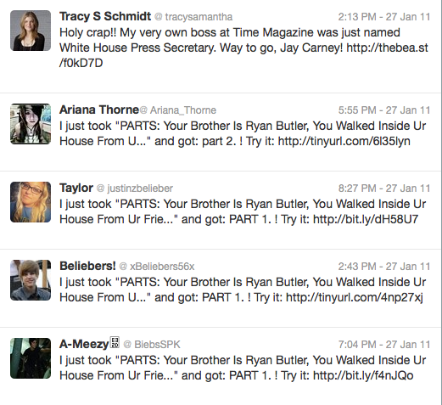
Ranking using Agreement
Most of the tweets seem to be auto generated tweets that gain high agreement due to the same content.
They seem to be from lesser trustworthy users

Slide 47
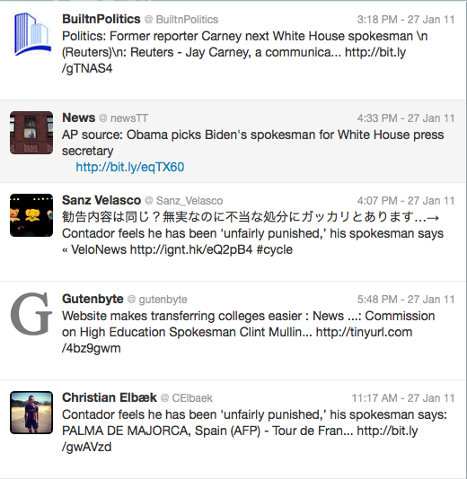
Ranking using USC/ISI Method
Result for Query: “White House spokesman replaced”
Does seem to perform better than TF-IDF
Still seem to have tweets that are lesser trustworthy and relevant.

Slide 48
Varying the Seed Set Size
TrustRank selects a small set of nodes to be the seed set and Feature Score is propagated from the seed set.
Compared the performance of RAProp by restricting the seed set size to values less than the Result Set size, N.

Slide 49
Varying Seed Set Size
It was expected that Precision value would flatten out before seed set size is N, in the experiments at 500.
Kept the seed set size equal to the Result Set size as:
  Accurately predicting the seed set size is not trivial
  Keeping seed set size at N does not incur any additional computational expense.

Slide 50
Varying the Seed Set Size
Precision improves until the seed set size grows to 500.

Slide 51
RAProp

Slide 52
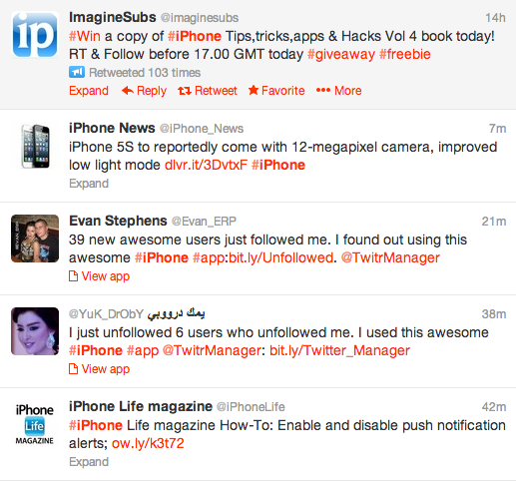
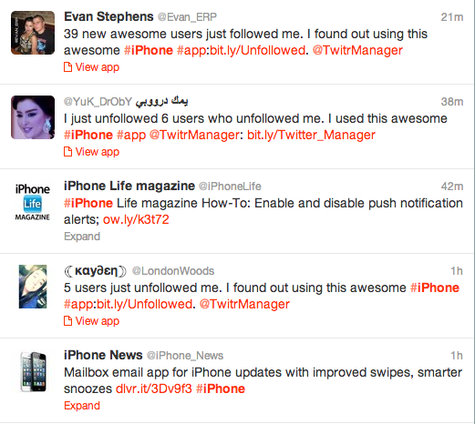
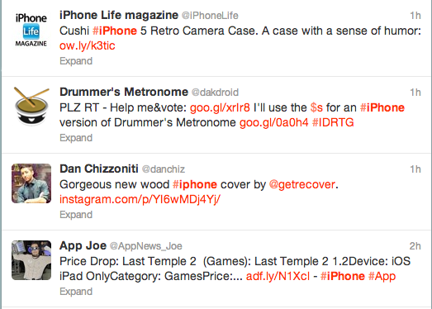
Twitter Search
Does not apply any relevance metrics.
Sorted by Reverse Chronological Order
Select the top re-tweeted single tweet as the top Tweet.
Contains spam and untrustworthy tweets.
Results for the Query: “#iphone”

Slide 53
Trust Rank: Trust computation on Webpages
Seed Set
1
    Use a threshold value and mark all pages below the trust threshold as spam
1
0
Propagate the Trust from good seeds to its neighbors over the hyperlinks

Slide 54
Finding Trust on Web: TrustRank
Basic principle: It is rare for a “good” page to point to a “bad” (spam) page
Have an oracle (human) identify the good pages and the spam pages in a seed set
Propagate trust through links

Slide 55
Applying Trust Rank to Twitter
How do we assign Reputation (trustworthiness score) to tweets in real-time?
What is the endorsement structure on which the Reputation scores are propagated?
How do we pick the seed set for propagation?

Slide 56

Reputation
How do we assign trustworthiness score?
  Human Evaluators?: Not if we need a real-time search
  Verified Users (Trusted Sources)?: Too sparse. Around 51k verified users.
  The Tweet Eco-System: Contains users, tweet content and web page links.

Slide 57
Ideal Ranking Algorithm
What all features should be an Ideal Ranking Algorithm be based on?
  User Popularity
  Tweet Popularity
  Tweet Relevance to the query
  Trustworthiness of URL present in the tweet.

Slide 58
Agreement through Similarity
Agreement between two tweets is defined as amount of similarity in their content.
  Re-tweets are not considered in the agreement computation
Relevance and Trust from Agreement
  A tweet which is agreed upon by a large number of other tweets is likely to be popular.
  Since agreement does not include re-tweets, trust is proportional to the number of users who independently agree on the content of a tweet.

Slide 59
Agenda
Measuring Feature Score
Measuring Agreement
Ranking
Experiments

Slide 60
Agenda
Measuring Feature Score
Measuring Agreement
Ranking
Experiments

Slide 61
Agenda
Measuring Feature Score
Measuring Agreement
Ranking
Experiments

Slide 62
Agenda
Measuring Feature Score
Measuring Agreement
Ranking
Experiments

