Slide 1
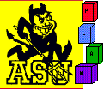




Topic-Sensitive SourceRank: Agreement Based Source Selection for the Multi-Topic Deep Web Integration
Manishkumar Jha
Raju Balakrishnan
Subbarao Kambhampati

Slide 2
Deep Web Integration Scenario
Millions of sources containing structured tuples
Autonomous Uncontrolled collection
Contains information spanning multiple topics
Mediator
Access is limited to query-forms
←query
←answer tuples
answer tuples→
query→
answer tuples→
answer tuples→
←query
←answer tuples
←query
query→
Web DB
Web DB
Web DB
Web DB
Web DB
Web DB
Web DB
Deep Web
Notes:
- deep web is composed of welter of web-accessible databases
searching over deep web has emerged as one of the biggest challenges in information management
what makes deep web so attractive is the existence of millions of sources containing structured tuples
these sources contain information spanning multiple topics
deep web has its own share of challenges too
access is limited to query-forms making information extraction and searching over deep web difficult

Slide 3
Source quality and SourceRank
Source quality
SourceRank
Deep-Web is
  Uncontrolled
  Uncurated
  Adversarial
Source quality is a major issue over deep-web
SourceRank^{[1]} provides a measure for assessing source quality based on source trustworthiness and result importance
^{[1]} SourceRank:Relevance and Trust Assessment for Deep Web Sources Based on Inter-Source Agreement, WWW, 2011
Notes:
deep web is adversarial
some deep web sources try to artificially boost their ranking for economic gain
for example: when searching for a book, some sources may advertise the book at unrealistically low prices to attract user attention.. When the user proceeds towards checkout, the book may either be out of stock or turn out to be another item with same title
autonomous and uncontrolled nature of deep web makes source quality critical for deep web too
sourcerank provides a measure for assessing source quality based on trustworthiness and result importance

Slide 4
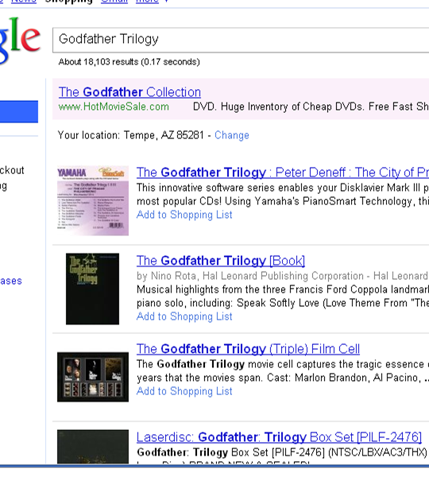
Why Another Ranking?
Rankings are oblivious to result Importance & Trustworthiness
Example Query: “Godfather Trilogy” on Google Base
Importance: Searching for titles matching with the query. None of the results are the classic Godfather
Trustworthiness (bait and switch)
The titles and cover image match exactly.
Prices are low. Amazing deal!
But when you proceed towards check out you realize that the product is a different one! (or when you open the mail package, if you are really unlucky)
Notes:
The most important problem in deep web search---in that matter any search---presenting relevant top-k results.
Why cant we reuse existing rankings?
Here is a search results for the query “Godfather Trilogy” in Google Product Search.
These results are ranked high due to keywords are contained in the title.
Then slide content.
…. Switch and Bait is frequently used.
4

Slide 5
SourceRank Computation
Assesses source quality based on trustworthiness and result importance
Introduces a domain-agnostic agreement-based technique for implicitly creating an endorsement structure between deep-web sources
Agreement of answer sets returned in response to same queries manifests as a form of implicit endorsement
Notes:
- brief overview of sourcerank

Slide 6
Method: Sampling based Agreement
where induces the smoothing links to account for the unseen samples. R₁, R₂ are the result sets of S₁, S₂ .
Agreement is computed using key word queries.
Partial titles of movies/books are used as queries.
Mean agreement over all the queries are used as the final agreement.
Link semantics from S_{i} to S_{j} with weight w: S_{i} acknowledges w fraction of tuples in S_{j}. Since weight is the fraction, links are unsymmetrical.
SourceRank defined as the Stationary Visit Probability on the Agreement Graph
Notes:
Sampling, Key word based, Send 200 movie/books title and computed the agreement on the returned answers.
The agreements are modeled as an agreement graph.
Weighted and Directed. Why unsymmatric.
Examples the two edges are merged.
6

Slide 7
Computing Agreement is Hard
Computing semantic agreement between two records is the record linkage problem, and is known to be hard.
Godfather, The: The Coppola Restoration | James Caan / Marlon Brando more | $9.99
Example “Godfather” tuples from two web sources. Note that titles and castings are denoted differently.
Marlon Brando, Al Pacino | 13.99 USD | The Godfather - The Coppola Restoration Giftset [Blu-ray]
Semantically same entities may be represented syntactically differently by two databases (non-common domains).
Notes:
1.Comparing Attribute values. Comparing Records. Comparing entire answer sets.
Soft-TFIDF is similar to the normal TFIDF, but counts the similar tokens in two vectors compared, instead of just exact matches in TFIDF. Secondary similarity is used which is jaro-winkler. Proved to be performing well for named entity matching.
2. Few things to be noted. No schema mapping assumed. Greedy matching is used. Attribute matches are weighted.
3. Third level is mapping between the result sets.
7

Slide 8
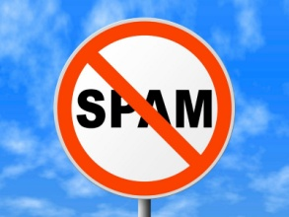
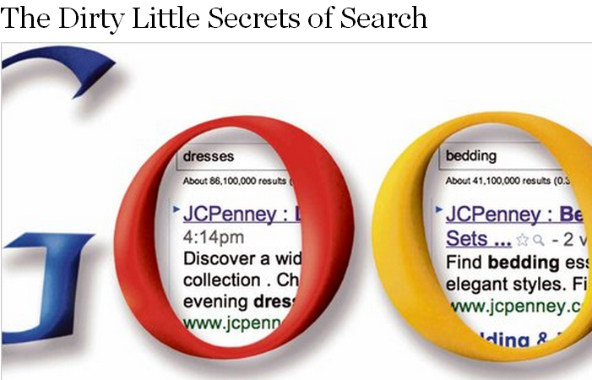
Detecting Source Collusion
The sources may copy data from each other, or make mirrors, boosting SourceRank of the group.
Observation 1: Even non-colluding sources in the same domain may contain same data.
e.g. Movie databases may contain all Hollywood movies.
Observation 2: Top-k answers of even non-colluding sources may be similar.
e.g. Answers to query “Godfather” may contain all the three movies in the Godfather trilogy.
Notes:
Like surface web---link spam---the sources may collude each other to improve their SourceRank. This was the news in NYTimes a week back on JCPenny boosting its ranks by paid links.
We compute and adjust for collusion while computing agreement.
8

Slide 9
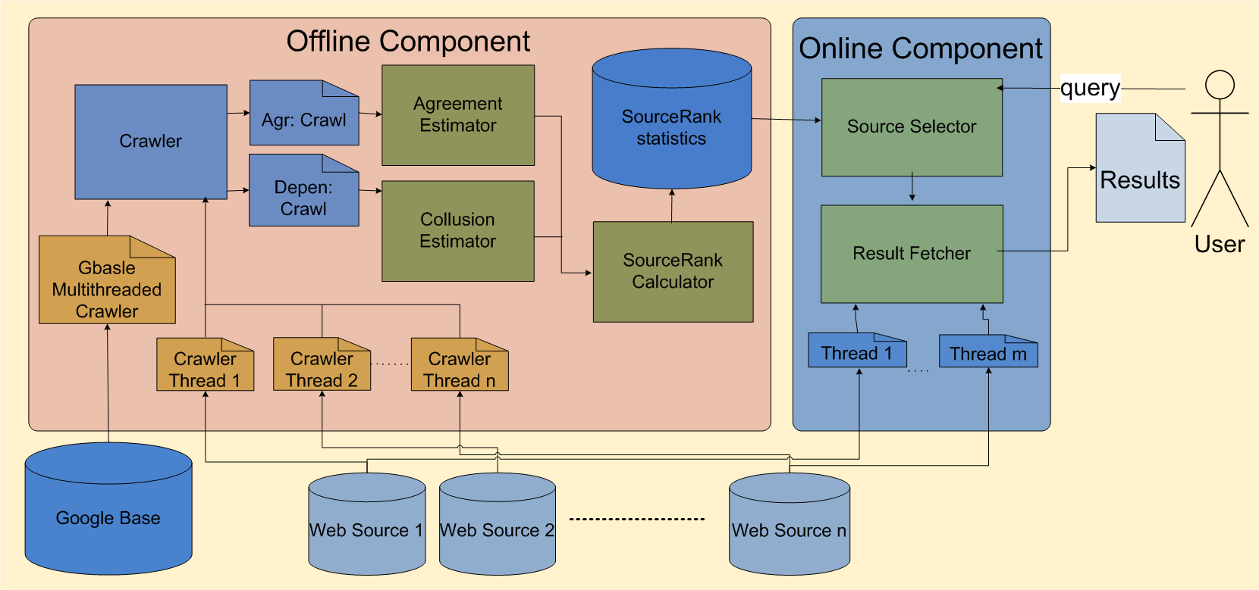
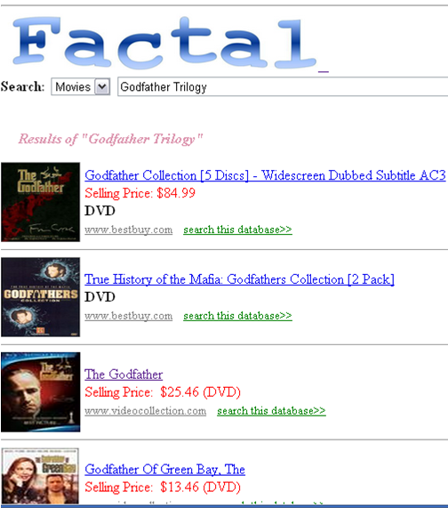
Factal: Search based on SourceRank
”I personally ran a handful of test queries this way and got
much better results [than Google Products] results using Factal” --- Anonymous WWW’11 Reviewer.
http://factal.eas.asu.edu
[WWW 2010 Best Poster; WWW 2011]
Notes:
1. Prototype System Implementation.
9

Slide 10
SourceRank is Query Independent
SourceRank computes a single measure of importance for each source, independent of the query…
  Large source that has high quality for one topic will also be considered to be high quality for topic B
Ideally, the importance of the source should depend on the query
  But, too many queries..
  ..and too costly to compute query specific quality at run time..

Slide 11
..But, Sources May Straddle Topics
Mediator
←answer tuples
←query
`
answer tuples→
query→
answer tuples→
answer tuples→
←query
←answer tuples
Movie
query→
←query
Web DB
Web DB
Web DB
Web DB
Web DB
Web DB
Web DB
Deep Web
Camera
Books
Music
Notes:
Updated view of deep web
topical representation of deep web

Slide 12

… And Source quality is topic-sensitive
Sources might have data corresponding to multiple topics. Importance may vary across topics
SourceRank will fail to capture this fact
Issues were noted for surface-web^{[2]}. But are much more critical for deep-web as sources are even more likely to cross topics
book
movie
^{[2]} Topic-sensitive PageRank, WWW, 2002
Notes:
Example: Barnes & Noble might be quite good as a book source but may not be as good a movie source TOPICS are latent variables--

Slide 13
SourceRank is Query Independent
SourceRank computes a single measure of importance for each source, independent of the query…
  Large source that has high quality for one topic will also be considered to be high quality for topic B
Ideally, the importance of the source should depend on the query
  But, too many queries..
  ..and too costly to compute query specific quality at run time..

Slide 14
This Paper: Topic sensitive-SourceRank
Compute multiple topic-sensitive SourceRanks
  Source quality is a vector in the topic space
  Query itself is a vector in the topic space
At query-time, using query-topic, combine these rankings into composite importance ranking
Challenges
  Computing topic-sensitive SourceRanks
  Identifying query-topic
  Combining topic-sensitive SourceRanks
Notes:
- instead of computing single importance ranking, we compute multiple rankings, each biased towards a topic

Slide 15
Agenda
SourceRank
Topic-sensitive SourceRank
Experimental setup
Results
Conclusion

Slide 16
Trust-based measure for multi-topic deep-web
Issues with SourceRank for multi-topic deep-web
  Single importance ranking
  Is query-agnostic
We propose Topic-sensitive SourceRank, TSR for effectively performing multi-topic selection sensitive to trustworthiness
TSR overcomes the drawbacks of SourceRank
Notes:
- limitations of sourcerank

Slide 17
Topic-sensitive SourceRank overview
Multiple importance rankings
  Each importance ranking biased towards a particular topic
At query-time, using query information, composite importance ranking is computed, biased towards the query
Notes:
Instead of creating a single importance ranking, multiple importance rankings are created

Slide 18
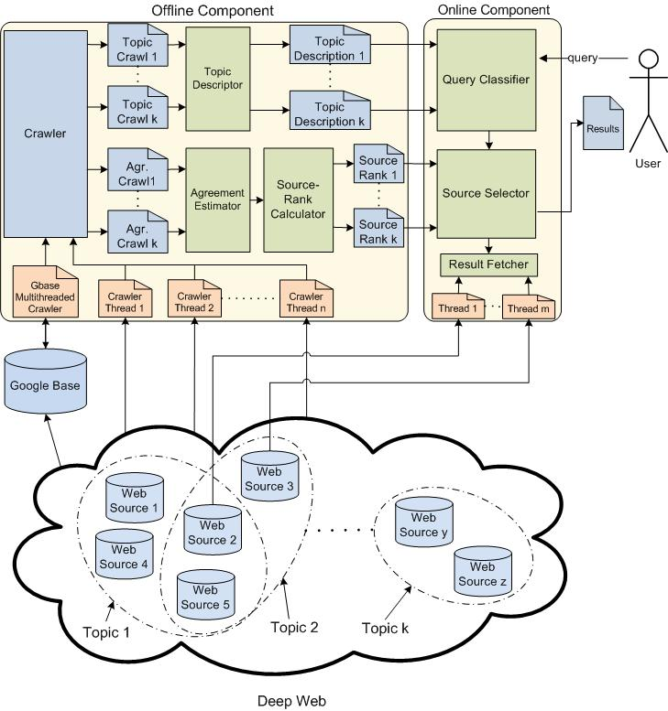
Notes:
system architecture
consists of two parts: offline and online computations
offline component computes topic-specific sourceranks and the online component uses the query-information for combining the multiple sourceranks into a single query-topic sensitive sourcerank
components are explained in the coming slides

Slide 19
Challenges for TSR
Computing topic-specific importance rankings is not trivial
Inferring query information
  Identifying query-topic
  Computing composite importance ranking

Slide 20
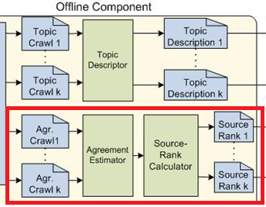
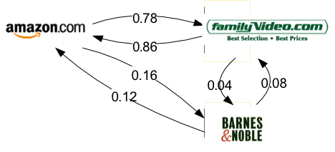
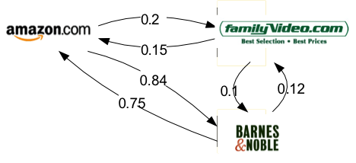
Computing topic-specific agreement
For a deep-web source, its
SourceRank score for topic
will depend on the answers
to queries of same topic
Topic-specific sampling queries will result in an endorsement structure biased towards the same topic
Topic Specific Source Ranks are stationary visit prob on the topic-specific agreement graphs
Movies
Books

Slide 21
Computing Topic-specific SourceRanks
Partial topic-specific sampling
queries are used for obtaining
source crawls
Biased agreement graphs are
computed using topic-specifc source crawls
Performing a weighted random walk on the biased agreement graphs would result in topic-specific SourceRanks, TSR’s
Notes:
We have solved our problem of computing topic-specific sourcerank, but in doing so we have introduced an unknown – topic specific sampling queries
how do we obtain topic-specific sampling queries
Answer: publicly available online directories

Slide 22
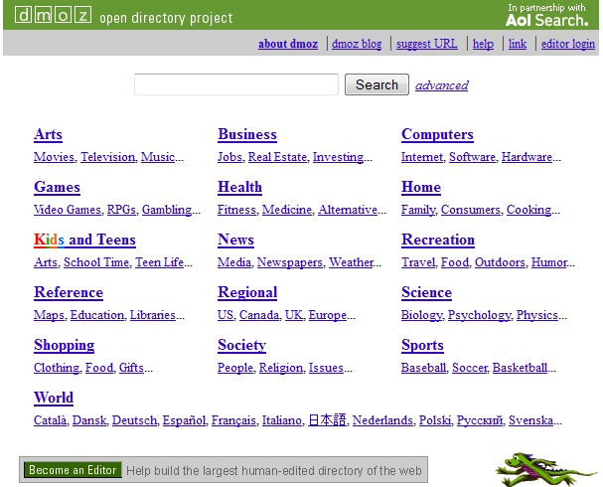
Topic-specific sampling queries
Publicly available online directories such as ODP, Yahoo Directory provide hand-constructed topic hierarchies
Directories are a good source for obtaining topic-specific sampling queries

Slide 23
Query Processing
Computing query-topic
Computing query-topic sensitive importance scores

Slide 24
Computing query-topic
Query-topic
  Likelihood of the query belonging to topics
  Soft classification problem
topic
Camera | Book | Movie | Music
0 | 0.3 | 0.6 | 0.1
query-topic
For Query=“godfather”
Notes:
For user query q and a set of topics c_{i} ε C, goal is to find fractional topic membership of q with each topic c_{i}

Slide 25
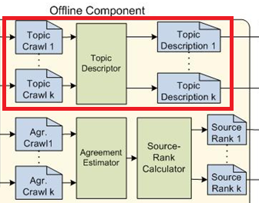
Computing query-topic – Training Data
Training data
  Description of topics
  Topic-specific source crawls
  act as topic descriptions
  Bag of words model
Notes:
Bag of words representation model is used for topic descriptions.
Note that we use complete sampling queries to eliminate noise from our training data

Slide 26
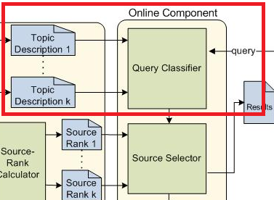
Computing query-topic – Classifier
Classifier
  Naïve Bayes Classifier (NBC)
  with parameters set
  to maximum likelihood
  estimates
  NBC uses topic-description to estimate topic probability conditioned on query q
  where q_{j} is the j^{th} term of query q

Slide 27
Computing query-topic sensitive importance scores
Topic-specific SourceRanks are linearly combined, weighted based on query-topic, to form a single composite importance ranking
  where TSR_{ki} is the topic-specific SourceRank score of source s_{k} for topic c_{i}

Slide 28
Notes:
putting it all together
a recap of how different components fit together in the system diagram

Slide 29
Agenda
SourceRank
Topic-sensitive SourceRank
Experimental setup
Results
Conclusion

Slide 30




Four-topic deep-web environment
Notes:
Experiments were conducted in a four-topic deep-web environment: camera, books, movies and music

Slide 31

Deep-web sources
Collected via Google Base
1440 sources: 276 camera, 556 book, 572 movie and 281 music sources
Notes:
Google Base was probed with 40 queries containing a mix of camera names, book, movie and music album titles

Slide 32




Sampling queries
Used 200 random titles or names for each topic
Notes:
Randomly selected cameras from pbase.com, book from New York Times best sellers, movies from ODP and music albums from Wikipedia’s top-100, 1986-2010

Slide 33
Test queries
Mix of queries from all four topics
Generated by randomly removing words from titles or names with 0.5 probability
Number of test queries varied for different topics to obtain the required (0.95) statistical significance

Slide 34
Baseline Methods
Used four baseline methods for comparison
  CORI (A standard Collection Selection approach)
  GoogleBase
    All Sources
    Only on the crawled sources
  USR: Undifferentiated Source Rank
    One rank per source, independent of query topic
  DSR: Domain Specific Source Rank
    Assumes oracular information on the topic of the source as well as query

Slide 35
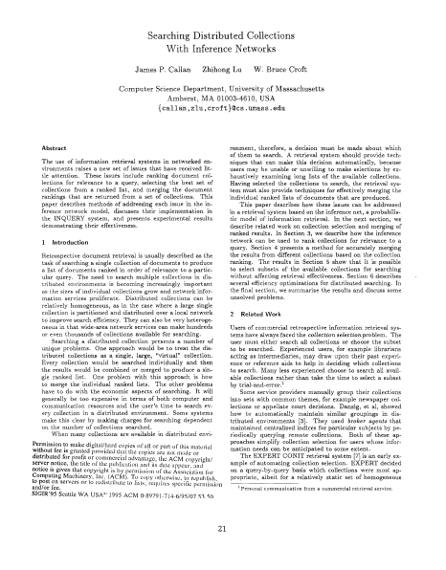
Baseline 1- CORI
Source statistics collected
using highest document
frequency terms
Source selection performed
using the same parameters
as found optimal in CORI
paper
Notes:
We compare our approach with four baseline source selection methods. Two query-similarity based and two agreement based source selection methods.
Query-similarity based measures

Slide 36
Baseline 2- Google Base
Two-versions of Google Base
  Gbase on dataset: Google Base search restricted to our crawled sources
  Gbase: Google Base search with no restrictions i.e. considers all sources in Google Base

Slide 37
Baseline 3- USR
Undifferentiated SourceRank, USR
  SourceRank extended to multi-topic deep-web
  Single agreement graph is computed using sampling queries
Notes:
USR of sources is computed based on a random walk on this graph

Slide 38
Baseline 4 - DSR
Oracular source selection, DSR
  Assumes a perfect classification of sources and user queries are available
  Creates agreement graphs and SourceRanks for a domain using just the in-domain sources
  For each test query, sources ranking high in the domain corresponding to the test query are used
Notes:
Assumes a perfect classification of sources and user queries are available i.e. each source and test query is manually labeled with its domain association
Comparison of TSR with DSR gives an idea of how well the automated topic classification of queries and sources of TSR is performing with respect to an oracular scenario.

Slide 39
Source selection
Agreement based selection models (TSR, USR and DSR) use a weighted combination of importance and relevance scores
  Example: TSR(0.1) represents 0.9xCORI + 0.1xTSR
For each query q, top-k sources are selected
Google Base is made to query only on these to top-k sources
Notes:
k=10 yielded optimal results

Slide 40
Tuple ranking and relevance evaluation
Google Base’s tuple ranking is used for ranking resulting tuples
Top-5 results returned were manually classified as relevant or irrelevant
Result classification was rule based
Notes:
Example- if the test query is “pirates caribbean chest” and original movie name is “Pirates of Caribbean and Dead Man’s Chest”, then if the result entity refers to the same movie (dvd, blue-ray etc.) then the result is classified as relevant and otherwise irrelevant
To avoid author bias, results from different source selection methods were merged in a single file so that the evaluator does not know which method each result came from while he does the classification

Slide 41
Agenda
SourceRank
Topic-sensitive SourceRank
Experiments
Results
Conclusion

Slide 42
Comparison of top-5 precision of TSR(0.1) and query similarity based methods: CORI and Google Base
TSR precision exceeds that of similarity-based measures by 85%
Notes:
As a note on the seemingly low precision values, these are mean relevance of the top-5 results. Many of the queries used have less than have
possible relevant answers (e.g. a book title query may have only paperback and hard cover for the book as relevant answers). But since we count the top-5 results always, the mean precision is bound to be low. For example, if a method returns one relevant answer on in top-5 for all queries, the top-5 precision value will be only 20%. We get better values since some queries have more than one relevant results in top-5 (e.g. Blu-Ray and DVD of a movie).

Slide 43
Comparison of topic-wise top-5 precision of TSR(0.1) and query similarity based methods: CORI and Google Base
TSR significantly out-performs all query-similarity based measures for all topics

Slide 44
Comparison of top-5 precision of TSR(0.1) and agreement based methods: USR(0.1) and USR(1.0)
TSR precision exceeds USR(0.1) by 18% and USR(1.0) by 40%

Slide 45
Comparison of topic-wise top-5 precision of TSR(0.1) and agreement based methods: USR(0.1) and USR(1.0)
For three out of the four topics, TSR(0.1) out-performs USR(0.1) and USR(1.0) with confidence levels 0.95 or more

Slide 46
Comparison of top-5 precision of TSR(0.1) and oracular DSR(0.1)
TSR(0.1) is able to match DSR(0.1)’s performance

Slide 47
Comparison of topic-wise top-5 precision of TSR(0.1) and oracular DSR(0.1)
TSR(0.1) matches DSR(0.1) performance across all topics indicating its effectiveness in identifying important sources across all topics
Notes:
A note on the DSR's performance for camera-topic. After investigating our deep-web environment for camera-topic, we found that the sourcerank for camera-topic was dominated by sources which answered less than 25% of sampling queries. This could be attributed to the fact that our source selection
technique led to selection of relatively more number of cross-topic sources than pure sources for camera topic. As a result, selecting top-ranked camera-topic sources infact led to a drop in performance.

Slide 48
Conclusion
Attempted multi-topic source selection sensitive to trustworthiness and importance for the deep-web
Introduced topic-sensitive SourceRank (TSR)
Our experiments on more than a thousand deep-web sources show that a TSR-based approach is highly effective in extending SourceRank to multi-topic deep-web

Slide 49
Conclusion contd.
TSR out-performs query-similarity based measures by around 85% in precision
TSR results in statistically significant precision improvements over other baseline agreement-based methods
Comparison with oracular DSR approach reveals effectiveness of TSR for topic-specific query and source classification and subsequent source selection

